Slide 1
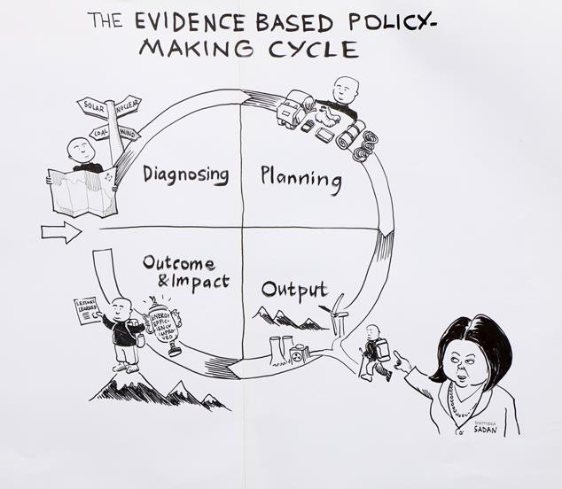
Evidence to Action 2019
Reflections on use of evidence by governments in Africa – building a conceptual framework
Dr Ian Goldman
11 July 2019

Slide 2
Draw from
Experience of developing and running NES in SA, and experience of peers in Twende Mbele prog
Performance culture survey in Benin, Uganda and SA undertaken by Twende Mbele (separate presentation on this by Cara Waller)
Introducing research project - Evidence in Practice: Documenting and Sharing Lessons of Evidence-informed Policy Making and Implementation in Africa – 8 African case studies, book coming out next year ‘Policy Making in Africa: Reflections on Using Evidence’ – panel on it on Friday

Slide 3
What is EBPM/EIDM
‘Evidence-based policy making (EBPM) is a process that assists policy makers to make better decisions and achieve better outcomes. It is concerned with using existing evidence more effectively, commissioning new research and evaluation to fill gaps in the evidence base, and assisting the integration of sound evidence with decision makers’ knowledge, skills, experience, expertise and judgement.’ (Davies, 2011 p2).

Slide 4
But what is the context
(Twende Mbele research, 328 respondents: SA- 104, Benin – 149, Uganda – 75
Orange is over 40% of respondents)
Barrier | % of responses saying always/often
 | SA | Benin | Uganda
Resistance by management to transparent decision-making | 27.9 | 35.6 | 33.3
Little respect for the use of evidence | 27.9 | 30.9 | 34.7
Difficult to discuss performance objectively because of the hierarchy | 38.5 | 40.3 | 42.7
Senior managers fear admitting mistakes or problems | 54.8 | 49.0 | 46.7
Senior managers consider M&E as a means to control staff | 44.2 | 43.0 | 37.3
Problems not seen as an opportunity for learning and improvement | 40.4 | 45.0 | 46.7
Problèmes non traités comme une opportunité d'apprendre
Problems not seen as an opportunity for learning and improvement
Source: Goldman et al, Performance M&E Culture in South Africa, Benin and Uganda

Slide 5
How do governments use evidence - comprehensive or bounded rationality
Factor | Comprehensive rationality | Bounded rationality
Policy makers’ aims | Clear sense of policy-maker preferences, | Aims unclear
Generation and underst-anding of information | Gather and understand all relevant information | Limited information
Make choices | Make choices based on that information | Unclear choices
Evidence from Perf Culture Survey for Benin, Uganda and South Africa
No evidence
27-44% of managers say information required to understand not available. Around 60% say information system integrates information needed by managers, while 70% say learning is documented and used to improve future results
Around 70% of managers report changes made to improve results, with around 62% saying evaluation recommendations are used to make changes in policies.
Source: Goldman et al, Performance M&E Culture in South Africa, Benin and Uganda

Slide 6
What is the context in Benin, Uganda and SA
Comparative statistics from performance culture survey (will be chapter in the book)

Slide 7
What can we see on supply of evidence in Benin, Uganda and SA
SA/Benin/Uganda countries developed national evaluation systems, others being supported by Twende Mbele and WACIE in W Africa
Data – surveys (CSOs), panel surveys eg Uganda and SA, linking up with SDGs, 6 monthly Cabinet retreats in Uganda build on performance information
In terms of building on existing evidence
Some work on systematic reviews, partic in Health, Uganda - Makerere
Tested out models for synthesis and rapid response using synthesis – Uganda - Makerere, DPME,
Capacity development:
Various countries training eg CLEAR DETPA, Harmattan School in W Africa, universities, ACE on SRs/rapid response
collaborative curriculum project of Twende Mbele

Slide 8
What can we see on demand side
Cabinet using evidence – eg Uganda, Benin, South Africa
Uganda good example of using M&E evidence, some cases in SA
Promoting an evaluative culture:
senior decision-makers eg Twende Mbele in Uganda/Benin, DPME in SA (300+), Vaka Yiko in Ghana (200+)
APNODE/CLEAR/Twende Mbele/AFIDEP – training legislatures in many countries
Sharing of experience with other African governments, notably through Twende Mbele African M&E partnership, with Latin America eg Mexico, Colombia

Slide 9
What about use of M&E evidence?
High proportion (around 70%) across the three countries indicated learning is documented and used to improve future results, similar proportion indicated changes are implemented.
Around 61% of respondents felt M&E evidence was always/often being used (58,4% in Benin, 63,5% in SA and 64% in Uganda).
Reverse is 40,1% in Benin, 49,3% in Uganda and 52,4% in South Africa indicated they never/rarely use evidence .
Evaluation evidence rarely used through programme cycle (8-15% of respondents), majority of use when evaluations are completed (32-47%). This potentially misses out on learning during the evaluation process itself.
Source: Goldman et al, Performance M&E Culture in South Africa, Benin and Uganda

Slide 10
Encouraging use Green is over 50%
Which of the following are proactively used to communicate information to stakeholders outside of the department? | % of respondents saying yes in
 | SA | Benin | Uganda
Evaluation reports shared publicly with external stakeholders | 58 | 63 | 61
Website to share evaluation reports | 45 | 53 | 49
Policy briefs published | 39 | 41 | 36
Newspaper articles published to inform stakeholders | 28 | 34 | 33
Academic journals | 28 | 2 | 13
More work needed with think tanks as key interlocutors for the public

Slide 11
Encouraging use through improvement plans
Components | Benin | Uganda | South Africa
Nos with improvement plans | None formally. But follow up study on use of evaluation findings provided information for improvement plan for 9 evaluations. | No improvement plans. However, recommend-ations sent to respective implementing agencies with targets to follow up uptake after 12 months | 21
Nos where high degree of implementation (%) | 6 /9 (67%). In follow up observe significant changes from implementation of findings | Follow up shows between 10-30 % of evaluation recommendations have been taken up | 9/16 have implemented >25% of recommendations, in 2 improvement plans incorporated into another evaluation.
Source: The emergence of government evaluation systems in Africa: The case of Benin, Uganda and South Africa

Slide 12
Understanding the causal mechanisms so we can design processes better
Rationale for the research project ‘Evidence in Practice: Documenting and Sharing Lessons of Evidence-informed Policy Making and Implementation in Africa’

Slide 13
Barriers and facilitators to use of research n refers to number of studies
Top 5 barriers to use of evidence | Top 5 facilitators of evidence use
Availability and access to research/ improved dissemination (n = 63) | Availability and access to research/ improved dissemination (n = 65)
Clarity/relevance/reliability of research findings (n = 54) | Collaboration (n = 49)
Timing/opportunity (n = 42) | Clarity/relevance/reliability of research findings (n = 46)
Policymaker research skills (n = 26) | Relationship with policymakers (n = 39)
Costs (n = 25) | Relationship with researchers/ info staff (n = 37)
Source: Oliver et al. BMC Health Services Research 2014, 14:2 http://www.biomedcentral.com/1472-6963/14/2

Slide 14
Analytical framework for the book
CONTEXT
External dimension: Macro-context; intra- relationships with state/non-state agents
Internal dimension: culture; organizational capacity; management; and core resources
Individual / organisational / systems change
EVIDENCE USE
DEVELOPMENT IMPACT
Evidence generation
Use intervention
Change
mechanism
Demand for evidence
- Instititutuonalised in system eg NEP)
Motivation to use evidence
Individual / organisational/ system behaviour change
Policy performance and impact
Type of evidence
Quality/ rigour
Other eg timeliness
Capacity-building
awareness raising
comms
Champions/mentors
Org change
M1— Awareness
M2—Agree
M3—Access
M4—Interact/trust
M5—Ability
M6—Institutionalising / formalising
Capability to use evidence
Wider Systems change
Instrumental
Conceptual
Symbolic
Process use
Opportunity to use evidence
Constant feedback between each step on the framework
Notes:
Underlying nature that each interlink.
-- make the feedback arrow more dynamic
-- make the long line going across.
-- shift the box.
-- couple of additional examples.

Slide 15
Example – SA National evaluation system
CONTEXT
External dimension: Macro-context; intra- relationships with state/non-state agents
Internal dimension: culture; organizational capacity; management; and core resources
Individual / organisational / systems change
EVIDENCE USE
DEVELOPMENT IMPACT
Evidence generation
Use intervention
Change
mechanism
Demand for evidence
- Instititutuonalised in system eg NEP)
Motivation to use evidence
Individual / organisational/ system behaviour change
Policy performance and impact
National
Provincial
Dept evals
Rapid?
Other?
Systems for credibility
Depts request
Part-fund
Steercoms
Credible
Workshop
Public
Imp Plans
DG course
M1— Awareness
M2—Agree
M3—Access
M4—Interact/trust
M5—Ability
M6—Institutionalising / formalising
Capability to use evidence
Wider Systems change
Instrumental
Conceptual
Symbolic
Process use
Opportunity to use evidence
Constant feedback between each step on the framework
Notes:
Underlying nature that each interlink.
-- make the feedback arrow more dynamic
-- make the long line going across.
-- shift the box.
-- couple of additional examples.

Slide 16
8 case studies – we will hear from 3 tomorrow
Ghana – civil society evidence in water and sanitation sector (tomorrow)
Uganda – evaluation of public procurement systems
Uganda – centre for rapid synthesis at Makerere University
Kenya – citizen engagement in development of Wildlife Conservation and Management Act
West Africa – use of research evidence in tobacco taxation for ECOWAS (tomorrow)
Benin – evaluation in the evolution of agricultural sector policy (tomorrow)
SA – use of evidence by Dept of Basic Education
SA – use of evidence in violence against women and children sector
Next year I’ll be able to tell you the results

Slide 17
Thank You
Dr Ian Goldman
Advisor: Evaluation and Evidence Systems
CLEAR Anglophone Africa
Ian.goldman@wits.ac.za @iangoldmansa
Further sources:
The emergence of government evaluation systems in Africa: The case of Benin, Uganda and South Africa https://aejonline.org/index.php/aej/article/view/253
Evaluation² – Evaluating the national evaluation system in South Africa: What has been achieved in the first 5 years? (forthcoming in African Evaluation Journal)
Book: Policy Making in Africa: Reflections on Using Evidence (Routledge, early 2020)

