Slide 1
Programming Fundamentals Session 1: Data Types
Jonas Willemsen – 17th Jan 2025
jonas.willemsen@nhs.net

Slide 2
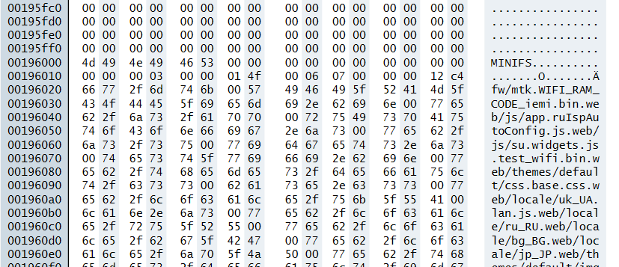
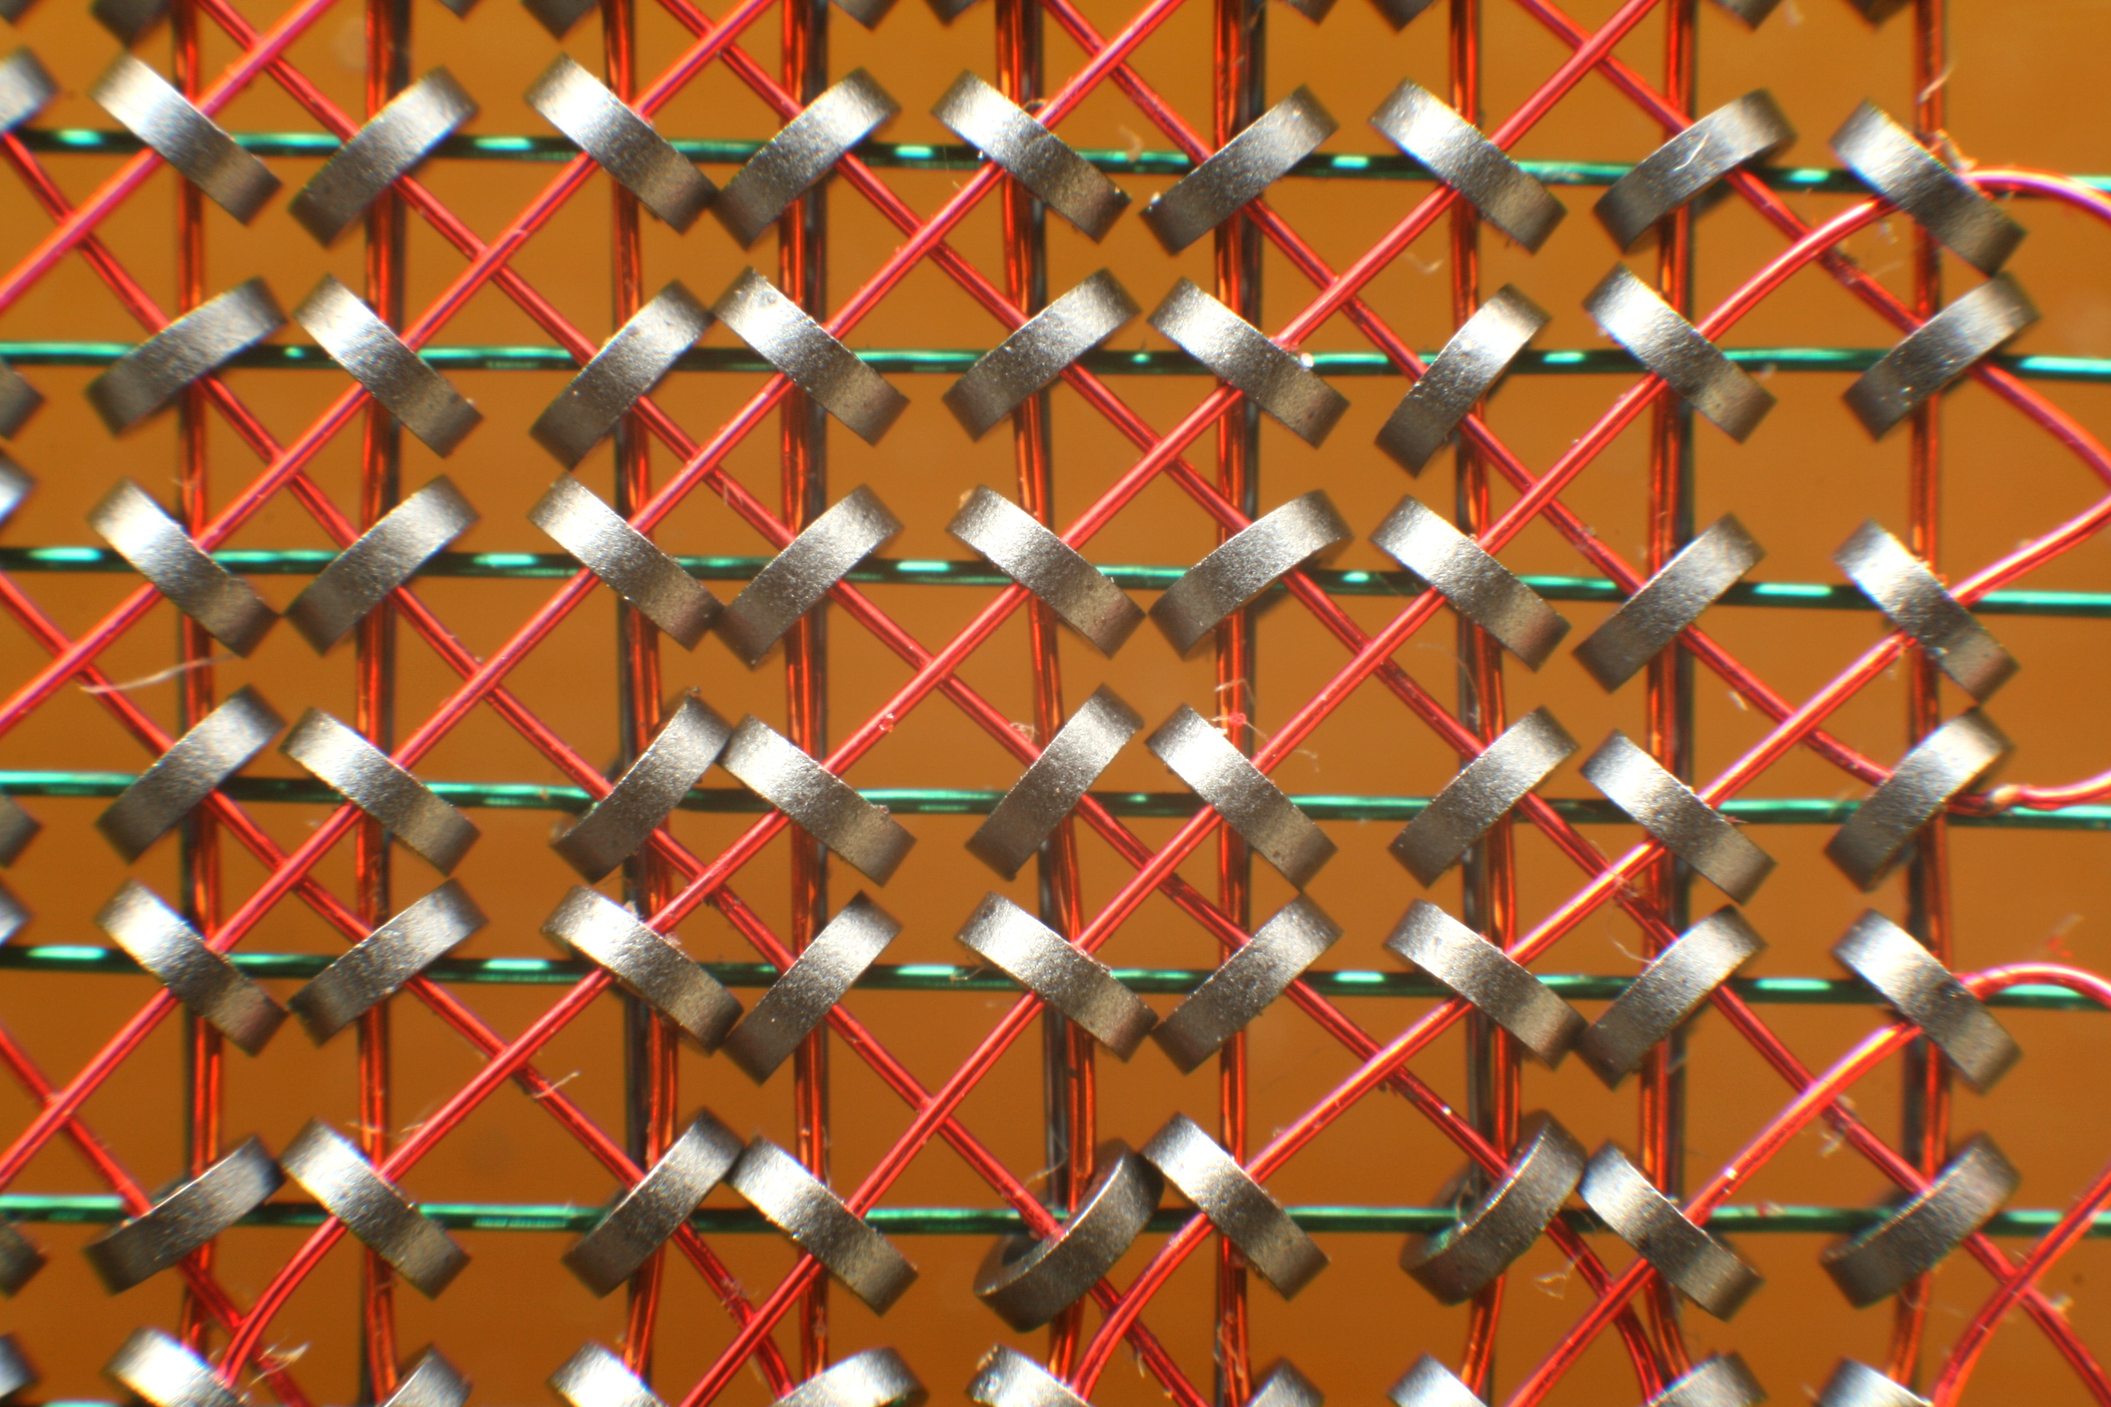
What are data types and why do we need them?
All* computers store data in binary (1s and 0s) – example shown on the right, represented as hexadecimal
Variables add a level of convenience and abstraction by letting us name specific buckets to put data in, and data types give structure to these buckets.
In the early days of computing data was stored as raw binary
The need for specific data types came from the emergence of structured programming from the 1950s onward
Languages like FORTRAN and COBOL introduced the segregation of numeric datatypes and character types
Object-oriented languages like C++ and Java further expanded on this with user-defined data types
Specifying the type of data allows the machine to allocate an appropriate amount of memory to it (was very important in the early days of computing, but still relevant)
Allows us to prevent errors; setting the expectation on the exact type of data that a specific variable will contain.
*: experimental ternary computers and quantum computing are firmly out of scope of this presentation
Raw data in hex format (ASCII representation on right)
Core rope memory (Konstantin Lanzet, Wikimedia Commons)

Slide 3
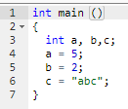
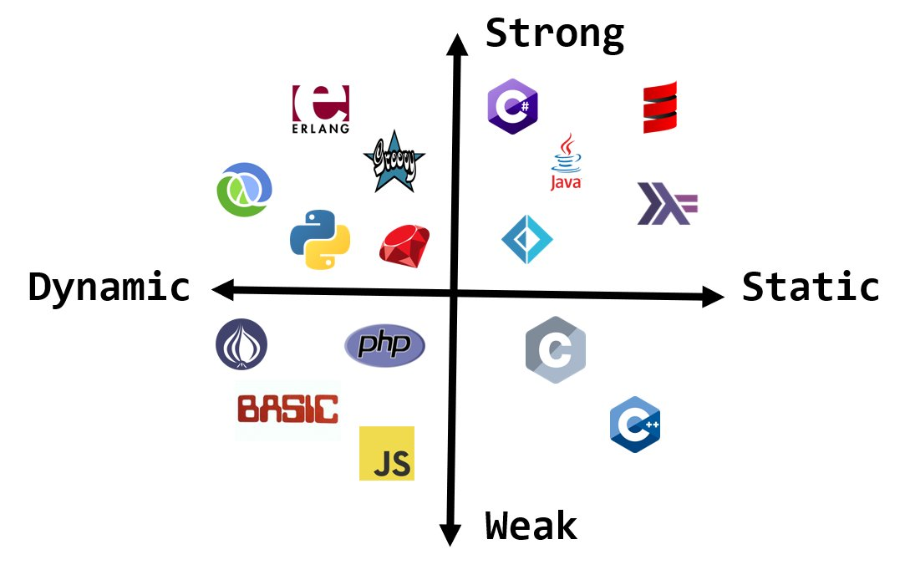


A quick note on type systems
Programming languages have different philosophies. They are often referred as being “strong” or “weak” and “static” or “dynamic”
Types of type checking
Statically-typed languages (C++, Rust)
The programmer has to specify the data type for a variable or object in the code itself and they are checked at compile time
Benefits: safety (catches errors early), possibly more performant
Downsides: more tedious and less flexible
Strongly but dynamically-typed languages (e.g. Python)
Python features dynamic typing. There is no need to explicitly declare variables as being a specific data type, and it does allow limited implicit conversions, but not as extensively as e.g. JavaScript.
Weakly-typed languages (e.g. Javascript)
Allows extensive type coercion; mixing-and-matching of datatypes freely e.g. 5+”2”=“52”
C++. This code generates a type error; we tried to assign a string value to an int
https://remotescout24.com/en/blog/806-typed-vs-untyped-programming-languages
JavaScript. This is valid JS code and ends with z being a string with the content “52”
Further reading: https://en.wikipedia.org/wiki/Type_system

Slide 4
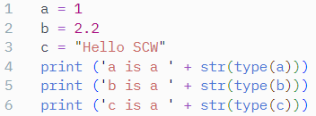

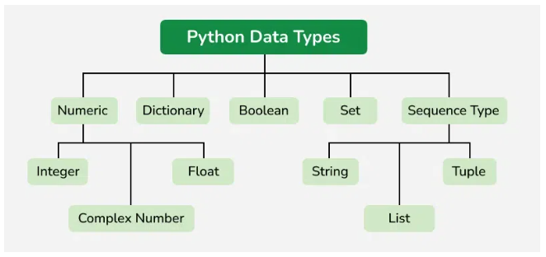
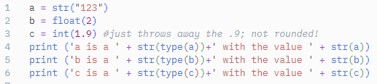

Data types in Python
When you set a variable to a value, Python automatically assigns an appropriate data type:
Alternatively, you can manually specify a datatype using a constructor function like int() or str():
Python has a fairly short list of datatypes (see right)
Important caveat; these are the defaults, and there are packages that supply further types e.g. arrays in numPy or Pandas dataframes.
Also, Python is an object-oriented language and variables are technically just names for objects with classes corresponding to the primitive data type…
From geeksforgeeks.org/python-data-types
Further reading: https://www.w3schools.com/python/python_datatypes.asp

Slide 5
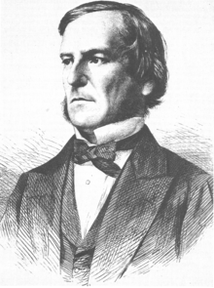
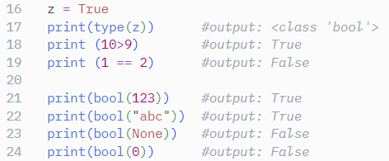
Booleans
Like most programming languages, python has a bool datatype. A Boolean can only be True or False, and is returned when evaluating an expression.
Booleans will become highly relevant when we talk about conditionals and program flow.
George Boole (1815-1864)
Further reading: https://www.w3schools.com/python/python_booleans.asp

Slide 6
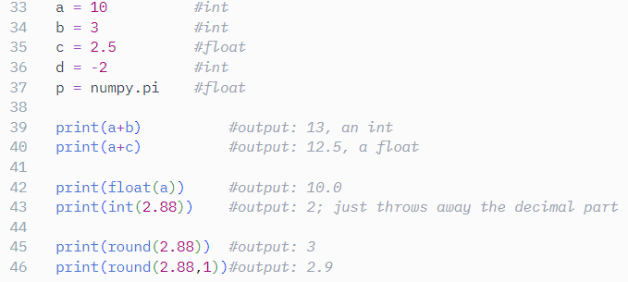
Numeric types
Python has two basic numeric datatypes; this sets it apart from, for example, C++ with its int, short, long, double, long double, signed and unsigned…
int
Whole numbers (can be negative). Can be extremely large.
float
Floating-point numbers i.e. decimals. Technically a double-precision float.
Further reading: https://www.w3schools.com/python/python_numbers.asp

Slide 7
Data structures
str(ing)
an ordered sequence of UTF-8 characters
a=“Hello World”
list
an ordered sequence of objects
b=[1, 2.3, “a”]
tuple
like a list, but can’t be changed once it is created
c=(1, 2.3, “a”)
dict
dictionary; key-value pairs
d={“org_code”:”0DF”, “name”: “SCW CSU”, “year”: 2013}
Remember that everything is 0-indexed in Python. The first element in a list is 0, not 1.
Further reading: https://docs.python.org/3/tutorial/datastructures.htm

Slide 8
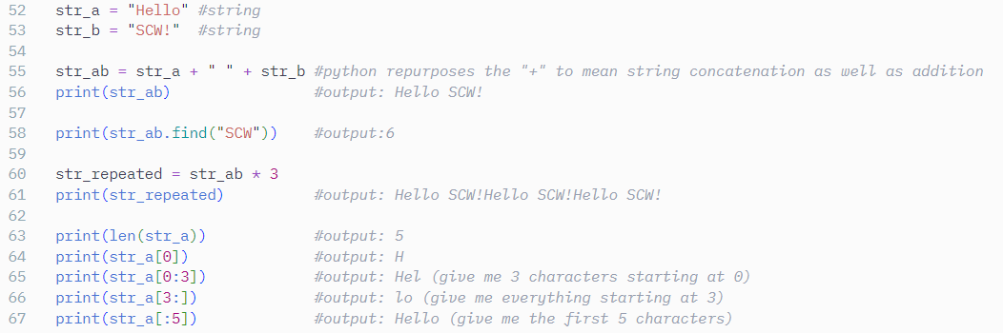
Strings
Strings are sequences of Unicode characters.
There is lots of syntax for slicing, indexing, concatenation etc; some of this is shared between strings, lists and tuples.
Example string manipulations:
Further reading: https://www.w3schools.com/python/python_strings.asp

Slide 9
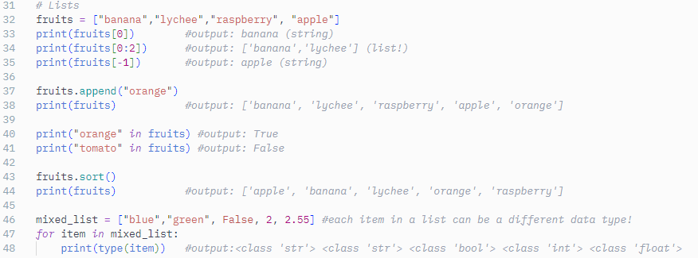
Lists
Lists are one-dimensional sequences of data
[value1, value2, value3,…]
There is lots of syntax for slicing, indexing, concatenation etc; much of this is shared between strings, lists and tuples.
Items in lists can be ints, floats, strings, etc
Further reading: https://www.w3schools.com/python/python_lists.asp

Slide 10
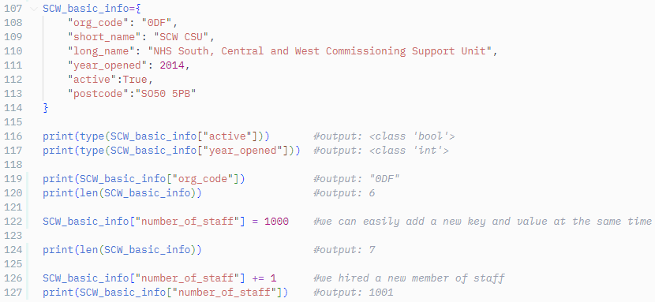
Dictionaries
dicts are key-value pairs
{“key1”: “value1”, “key2”: “value2}
Both the key and the value can be any* data type
*: keys can be any hashable type, so lists and dictionaries are not permitted as keys
Further reading: https://www.w3schools.com/python/python_dictionaries.asp

Slide 11
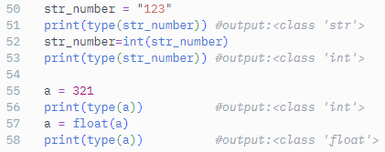
Manipulating data types
Conversion (casting) between different types is very intuitive in Python.
There is a set of type constructor functions int(), str(), float(),… that can be used to convert from one data type to another, as long as it “fits”.
These functions will throw an error if you try to do something nonsensical.
Further reading: https://www.w3schools.com/python/python_casting.asp

Slide 12
Thank you
Source script: on GitHub
Further reading:
https://docs.python.org/3/tutorial/datastructures.html
https://docs.python.org/3/library/stdtypes.html
https://www.geeksforgeeks.org/python-data-types/
https://www.w3schools.com/python/python_datatypes.asp

