Slide 1
Being a Data Scientist in Healthcare
Inspiring the Future: Pathways into Healthcare
england.datascience@nhs.net
Notes:
Standard title slide

Slide 2


What does NHS England do?
Maintains Digital Infrastructure in England
Custodians Healthcare Data for all Patients
Utilize Data to Improve Healthcare

Slide 3
“Using maths, statistics and computer science to build services to extract insights.”
Being a Data Scientist

Slide 4
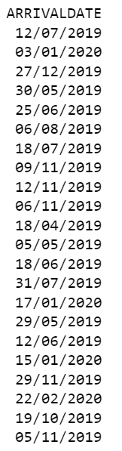

Example of work
You are given dates of patients that arrive at A&E at a hospital
Task: How many patients arrive in winter?
Data Source: https://digital.nhs.uk/services/artificial-data

Slide 5
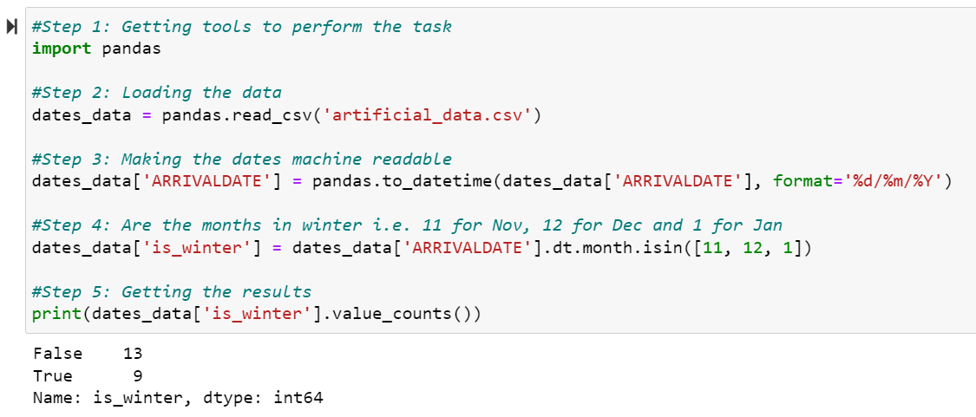
Using Python
Notes:
Plain slide with subhead and bullets

Slide 6
How to become a data scientist
Taken from the Job Specification

Slide 7
Qualifications & Career Pathways
Mathematical Route
Early Careers Pathways
Educated to degree level, (such as Statistics, Mathematics, Physics or Computer Science)
Internship | Length: 1 to 24 months Experience: A deep drive into a single project Pay: Band 2, £12.92/hr
Vocational Route
Graduate Scheme | Length: 24 months Experience: A rotation of different projects and teams Pay: Band 5, £16.40/hr
Degree level equivalent specialist experience, backed up by additional and continual professional development and/or academic study at a higher level.
Information are for illustrative purposes and may not reflect current career opportunities in NHS England. Pay based on AfC 2026/27.

Slide 8
Skills
Innovation
Communicating analysis for impact
Professional standards & quality
Suggest novel uses of existing data and technology.
Explain the analytical evidence resulting from own analysis
Support other data scientists and share own knowledge & expertise

Slide 9
End slide
Notes:
Connect with us

