Slide 1
Learnings from implementing machine learning models on NHS Federated Data Platform for predicting operational pressures escalation levels.
Kenneth (Kin) Quan
RPySOC 2025
datascience@nhs.net

Slide 2
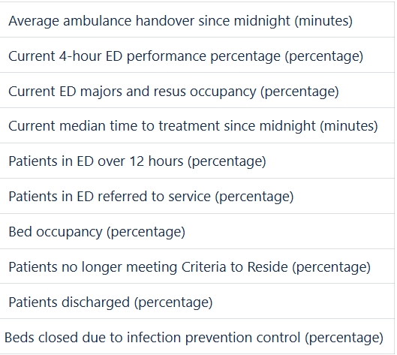
Operational Pressures Escalation Levels (OPEL)
The OPEL framework is a set of actionable metrics used by operational staff to measure and respond to acute pressure
Forecasting OPEL metrics would allow providers to make proactive decisions
Building and deploying these forecasts on a nationally-available platform will provide instant accessibility to all stakeholders
A sample of the features that is used to calculate the OPEL metric
Notes:
“…instant access to national and local (trust, system, region) stakeholders

Slide 3
NHS Federated Data Platform (FDP)
The NHS Federated Data Platform is a live data service that provides:
Cloud-based Data Warehouse & Infrastructure
Allows access to a single cut of data in a single place
Analytical Capabilities
Creating the predictive analytics from the data

Slide 4
Why do we need to look at the platform?
There is a business interest to analyse the following in any platform:
Adapting to the team workflow, for example Agile working
Identify enablers and pain points within the platform
Onboarding and upskilling of colleagues on the platform

Slide 5
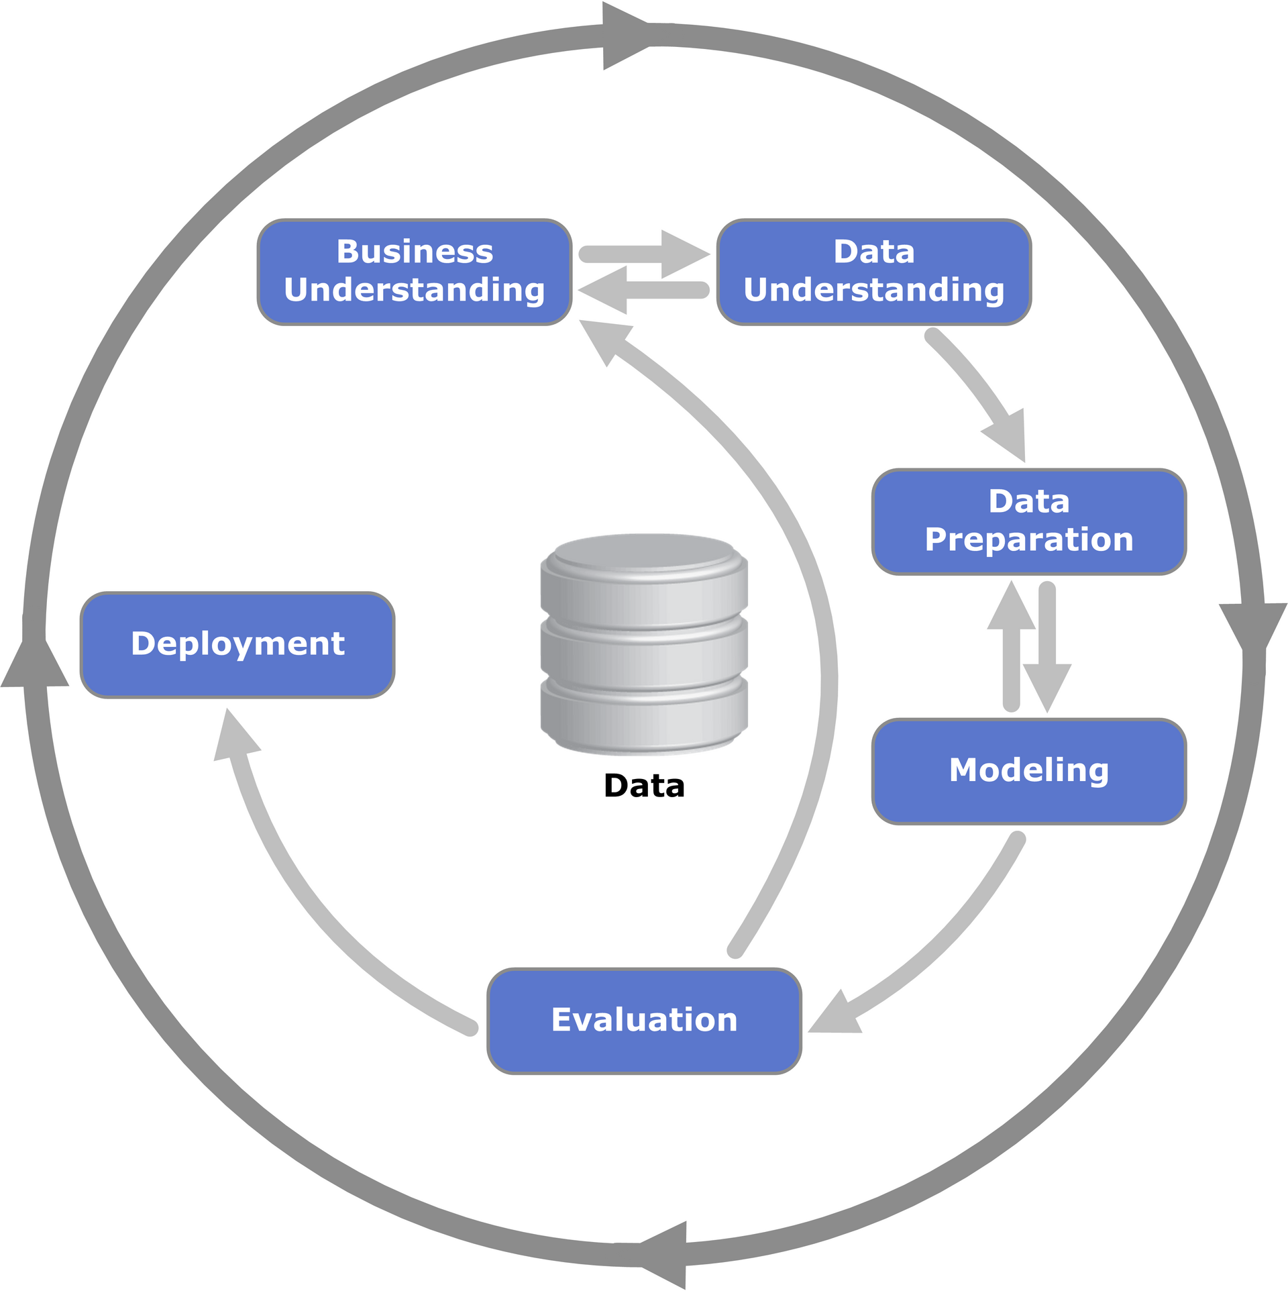
Principles, Build Strategy & Requirements
Aim for a code first, reproducible analytical pipeline (RAP)
Working in CRISP-DM
So, we need an Integrated Development Environment that can:
Prototype in Python
Evaluate in Python
Version Control the Python
Taken from Wikipedia

Slide 6
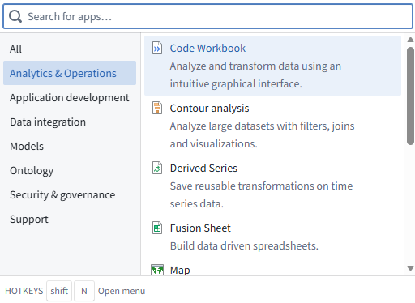
FDP – Scoping the Tools
FDP provides a wide range of apps for analytics – ranging from AI to Dashboarding
It is the onus on us to choose the correct tools and refine them for our purpose

Slide 7

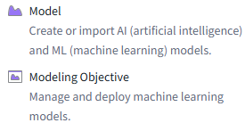
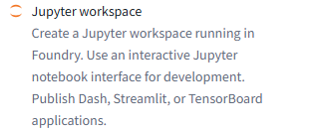

Workflow
Useful in the near future:

Slide 8
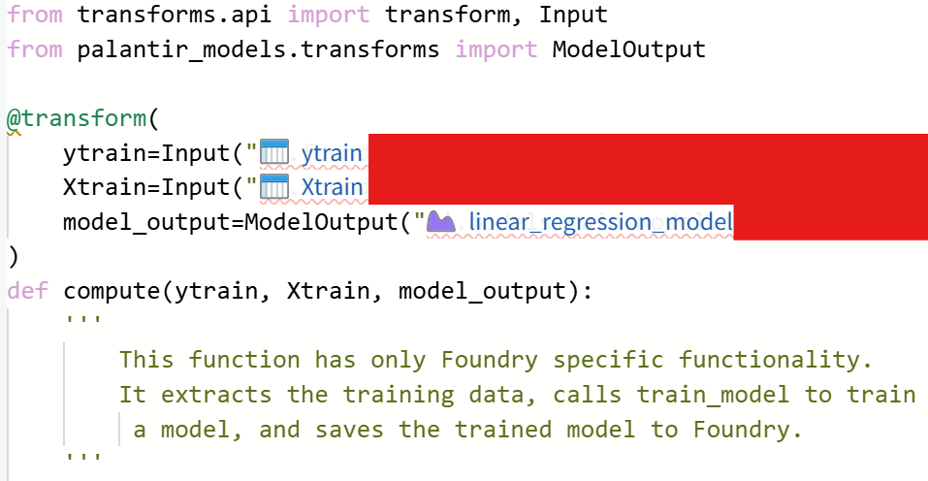
FDP – Code Repositories
We need to adapt and learn key features into our code such as:
Key Libraries
Decorators
Data Loading
Model Outputs
Code has been adapted and redacted for presentational proposes

Slide 9
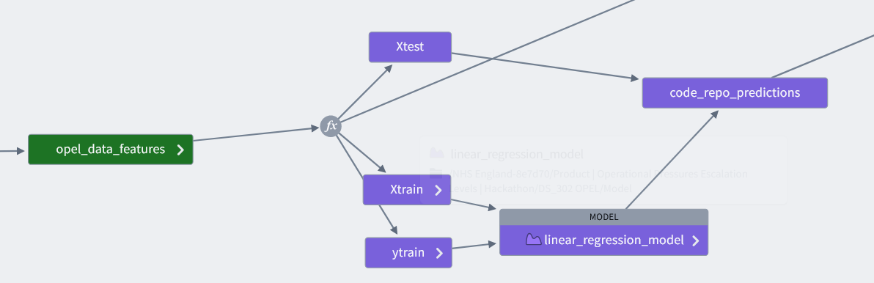
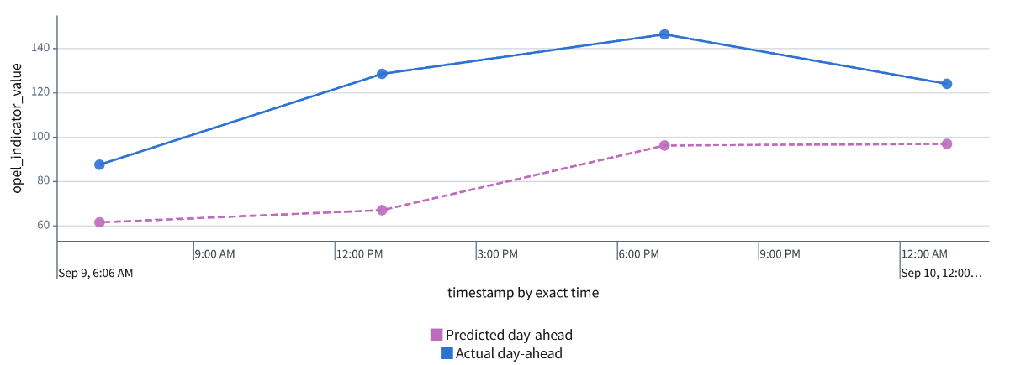
Prototype
Demonstration Data Only

Slide 10
Adaptation
We need to provide solutions to restrictions on FDP:
No connectivity with GitHub – Plan to have a milestone snapshot of the open-source code
Vendor locking – From the code and files, delineate what is system agonistic or system specific

Slide 11
Learnings
Adapting to the team workflow
Choosing the correct IDE for production
Identify enablers and pain points
Having templates for code development and ringfence time and resources to overcome vendor locking
Onboarding and upskilling of colleagues
Having a lighthouse and community of practice

Slide 12










Data Science & Applied AI Team at NHSE
Predictive Analytics
Artificial Intelligence and Machine Learning
NLP and LLMs
Artificial/Synthetic Data
Research and Emerging Tech
Reproducible Analytical Pipelines
Methodological Review
Data Linkage
Data Wrangling
datascience@nhs.net https://nhsengland.github.io/datascience/
Notes:
RAP
Data Viz
Artificial Data
Peer analysis
Cohort analysis
Machine Learning
Natural Language Processing
Data Linkage
Methodological Review
Data Wrangling

