Slide 1
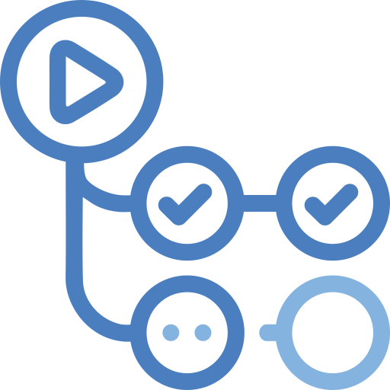




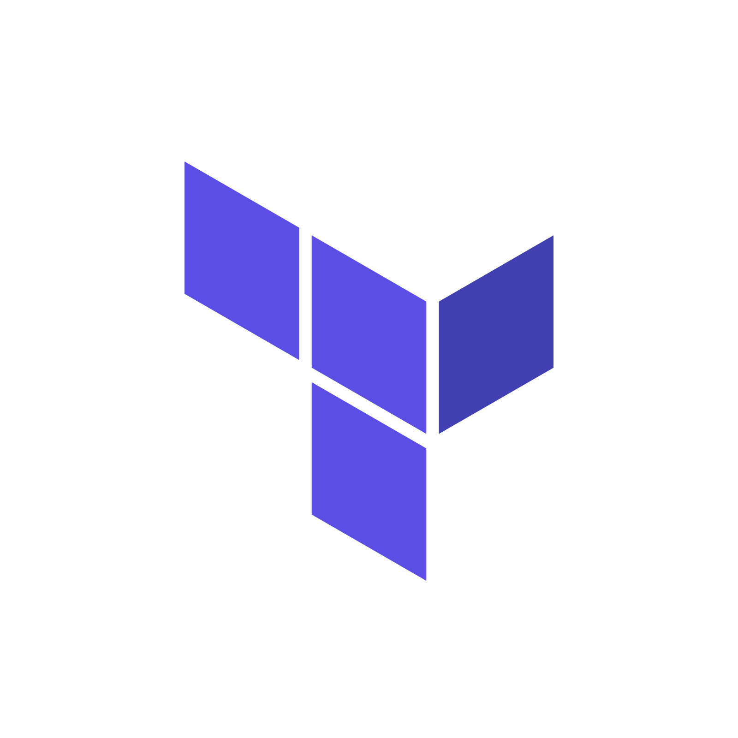







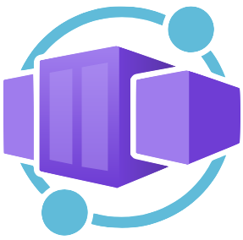






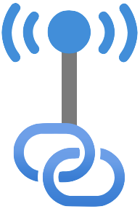








GitHub Actions
Continuous Integration
GitHub Container
Registry
Developer
GitHub Repository
Azure DevOps (Managed Agent Pool)
Continuous Deployment
Hub Azure Subscription For Shared Resources
Terraform
Per Environment Azure Subscription
Container App Env.
Network Security Group
User
Web Application
Firewall Policies
Front Door Profile
Container App
Managed
Identity
Postgres Database
Backup Vault
Application Logs
& Metrics
Managed
Identity
Developer Solution
Access
Entra ID
MFA Auth.
Azure Virtual
Desktop
Private DNS
Resolver
Azure Monitor Private
Link Scope
Peering
Private Link
All Egress
Traffic
Subnet
Azure Firewall
Managed DevOps
Pool
Virtual Network
Virtual Network
Infra Key Vault
App Key Vault
Public DNS
Private DNS
Storage Account
(Terraform State)
Application
Insights
(Per Env.)
Log Analytics
Workspace
(Per Env.)
Public Access Disabled
Public Access Disabled

Slide 2

GitHub Actions
Continuous Integration
GitHub Container
Registry
Developer
GitHub Repository
Azure DevOps (Managed Agent Pool)
Continuous Deployment
Hub Azure Subscription For Shared Resources
Terraform
Per Environment Azure Subscription
Container App Env.
Network Security Group
User
Web Application
Firewall Policies
Front Door Profile
Container App
Managed
Identity
Postgres Database
Backup Vault
Application Logs
& Metrics
Managed
Identity
Developer Solution
Access
Entra ID
MFA Auth.
Azure Virtual
Desktop
Private DNS
Resolver
Azure Monitor Private
Link Scope
Peering
Private Link
All Egress
Traffic
Subnet
Azure Firewall
Managed DevOps
Pool
Virtual Network
Virtual Network
Infra Key Vault
App Key Vault
Public DNS
Private DNS
Storage Account
(Terraform State)
Application
Insights
(Per Env.)
Log Analytics
Workspace
(Per Env.)
Public Access Disabled
Public Access Disabled

