Slide 1
Layoffs and newsroom productivity
Nick Hagar
Computational Journalism Lab

Slide 2
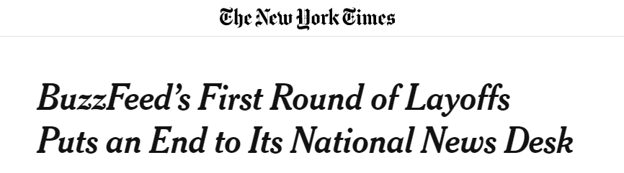

Slide 3
Motivation – layoffs

Slide 4
Motivation – news production

Slide 5
Expectations

Slide 6
Expectations
Aggregate story output will drop

Slide 7
Expectations
Aggregate story output will drop
Individual story output (stories/journalist) will increase

Slide 8
Expectations
Aggregate story output will drop
Individual story output (stories/journalist) will increase
More layoffs on desk will amplify aggregate effects

Slide 9
Data
~39k BuzzFeed News stories from Internet Archive
Stories scraped via retrieved links, text cleaned, filtered via pub date
Layoff lists
~150 names

Slide 10
Methods

Slide 11
Methods
Regression discontinuity design

Slide 12
Methods
Regression discontinuity design
Layoff information

Slide 13
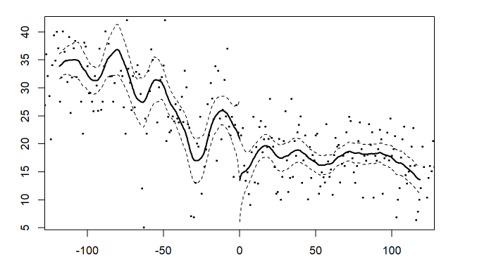
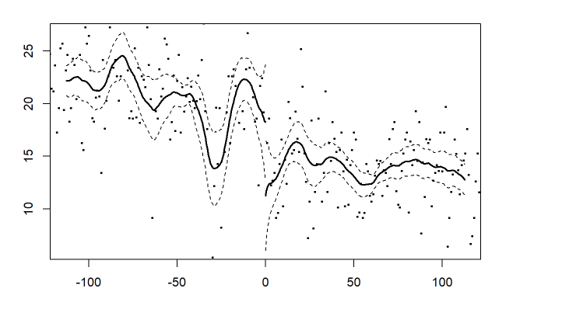
Initial results
Story count
Byline count

Slide 14
Next steps

Slide 15
Next steps
Fancier RDD cutoff

Slide 16
Next steps
Fancier RDD cutoff
Section layoff analysis

Slide 17
Next steps
Fancier RDD cutoff
Section layoff analysis
Section output analysis

Slide 18
Next steps
Fancier RDD cutoff
Section layoff analysis
Section output analysis
Story text analysis

