Slide 2
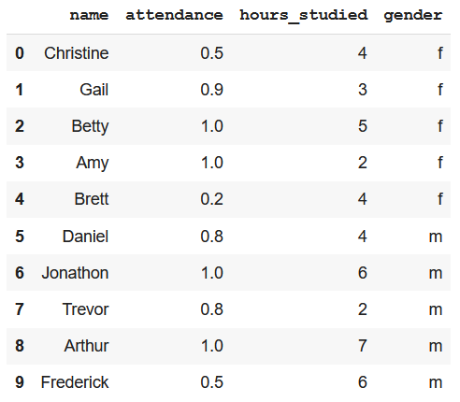

Slide 3
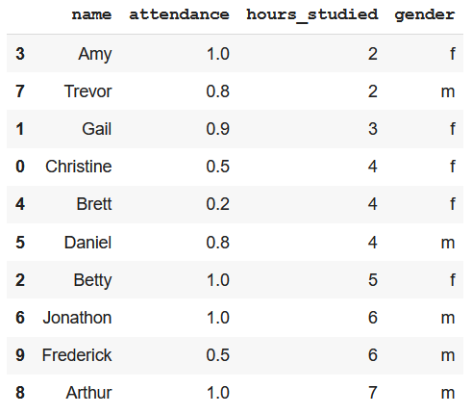

Slide 4
0 | 1 | 2 | 3
positions
labels
0
1
2
3
4
5
6
7
8
9
positions
labels

