Slide 1



Distributed XGBoost Performance with PySpark and AWS
Nicholas Hopewell

Slide 2
Table of contents
Data used
System I used
System and steps visualized
Performance trials
Determining instance type
Hyperthreading trials as nodes as added and data is increased
Distributed trials with fixed data size
Distributed parameter tuning
Parameters vs. training time
Job time vs. objective metric
Model inference
Params vs objective
Making inferences through batch predictions
Conclusions
Challenges
Future work

Slide 3
visa data
Tested XGBoost with visa data from data.gov (2010-first 2 quarters of 2018)
Case_status: ‘Denied’, ‘Certified’
Example features: wage, whether their job was full time or not, state and city of work, whether they had support from employer, when they would start work

Slide 4
Components used
Storage: AWS S3 buckets used as file system
Primary clusters: Apache Spark clusters running on EMR
(3x m5.large EC2 instances) for lighter work
(4x m5.xlarge EC2 instances) for heavier work
Used this cluster for preprocessing and working with the data and to monitor loads through the masters web ui.
Task-specific clusters: multiple SageMaker instances ran on these EMR clusters to connect my separate notebooks
Ran with PySpark kernels
Using master node private ip
Ran several training jobs with using memory-optimized clusters (1,2,3 x m5.xl ) and (4,6,8 x m5.xl)
Ran several parameter tuning jobs using compute-optimized EC2 instance pairs (2 x c4.2xl)
* The cluster configuration chosen at each step was done so to best suit the job at hand. *

Slide 5






Visual of the steps I took / complete environment
3.
Deployed XGB model into production
(with SM)
Connected SageMaker instances to EMR talk to my Spark cluster
1.
Explored, cleaned and preprocessed visa data.
(Spark clusters with EMR)
2.
Trained and validated XGB model.
(with SM deploying multiple EC2 clusters and my Spark data imported from S3).
Ran performance tests.
4.
Made inferences/batch predictions
(on my test data in S3)

Slide 6
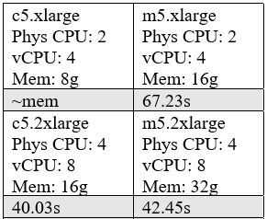
Determining the optimal instance type to train XGBoost with
Initially tried both compute-optimized instances with more cpu power but less memory and memory-optimized instances.
Memory is better for XGBoost. Why?
Parameters used – defaults for testing.

Slide 7
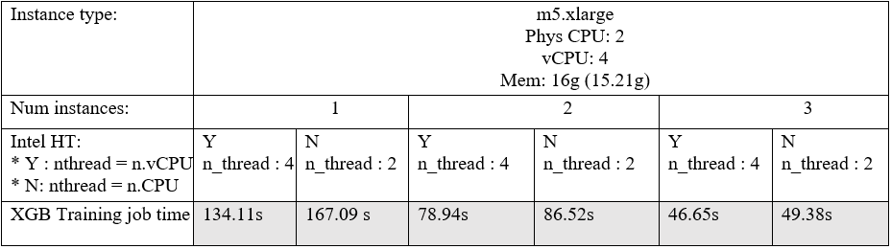
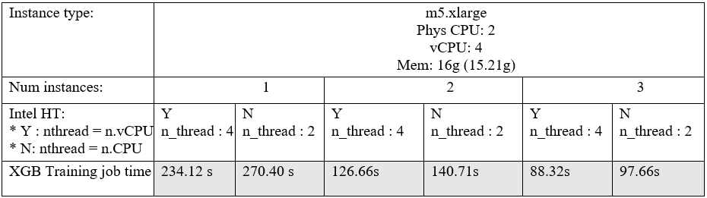
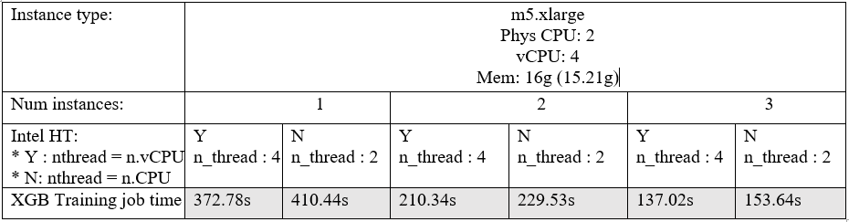
Adjusting size of training instances across stable environments
n_rows: 2,242,519 (x83 cols)
Spark df size in mem: 83.4MB
n_rows: 4,485,038 (x83 cols)
Spark df size in mem: 166.9MB
n_rows: 6,727,557 (x83 cols)
Spark df size in mem: 250.3 MB

Slide 8
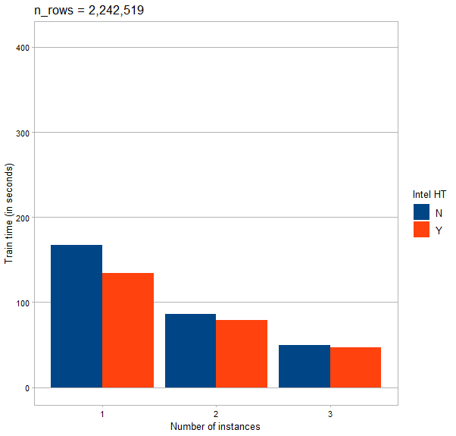
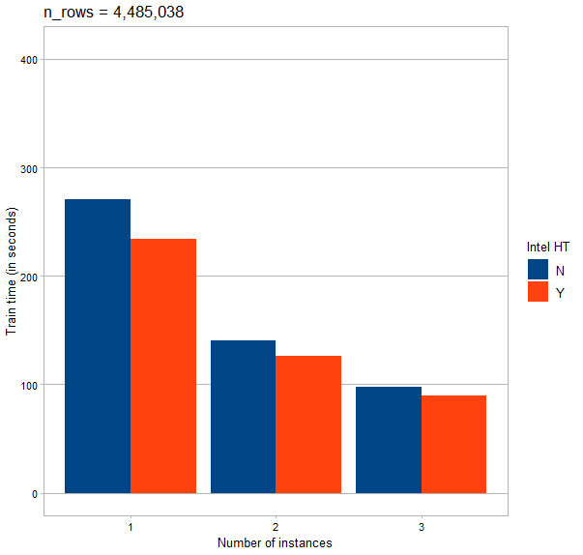
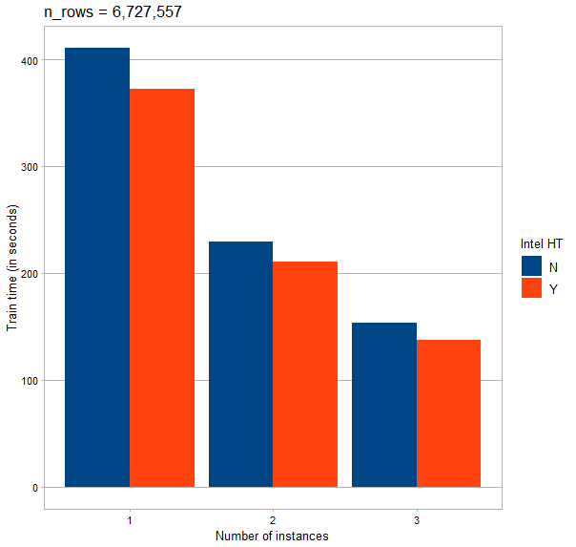
- Threads getting diminishing returns quicker than physical cpus as data grows on a single node
- But, as nodes are added, the diminishing returns aren’t exactly the same (greater for less data, better for more data).
depends on resources and data size.
There should be a point where nthread = number of physical CPUs is optimal according to the original author.

Slide 9
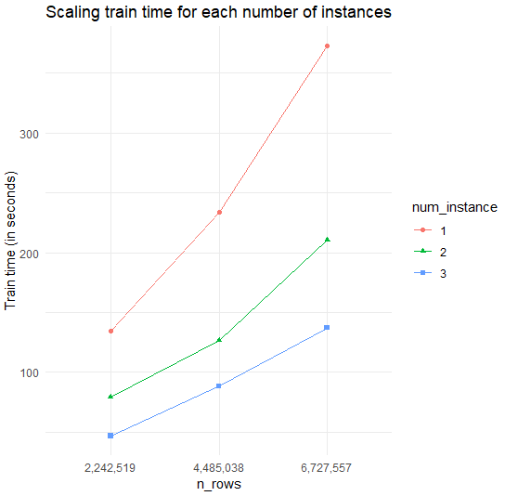
Scales well, especially with more memory. Expected linear.
Why? Original XGBoost optimized for one machine, amazons XGBoost optimized for distribution
With the out-of-core version, could keep adding data until it utilized disk scale (which would slow it down a lot).

Slide 10
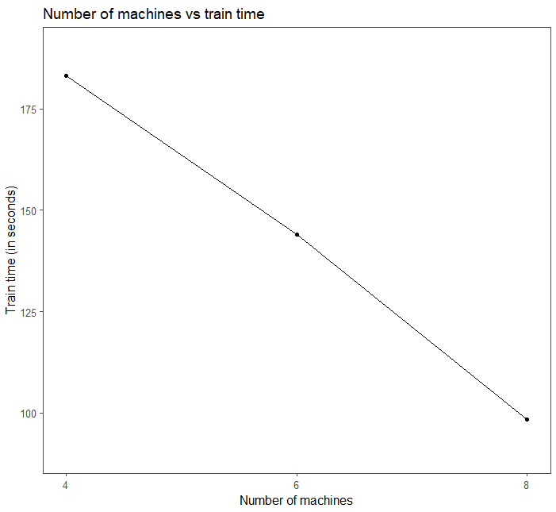
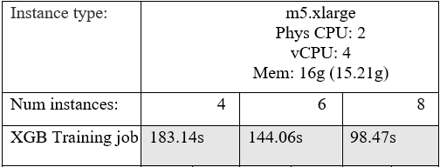
Fixing training size for distributed trials
n_rows = 11,212,595 (x83 cols)
Result are slightly super linear (from 4 to 6 to 8 nodes gives better than linear decay), scaling very well.

Slide 11
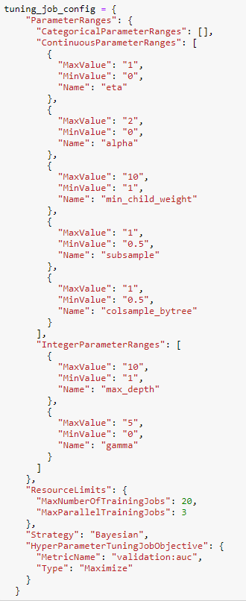
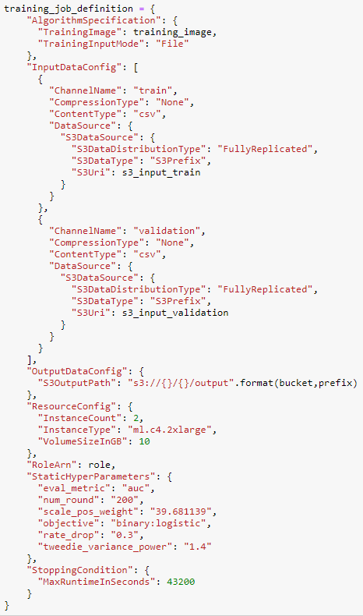
Parameter tuning
Each run was 20 fits with 200 boosting rounds
3 models built in parallel at a time to reduce overall time
Instances used: c4.2xlarge

Slide 12
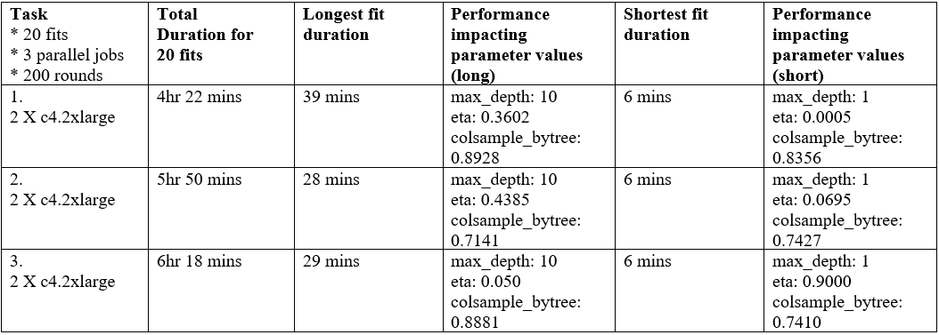
Hyperparameter tuning jobs

Slide 13
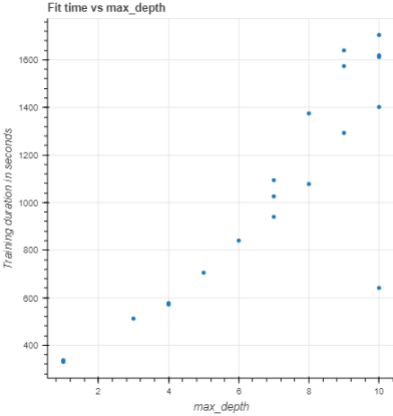
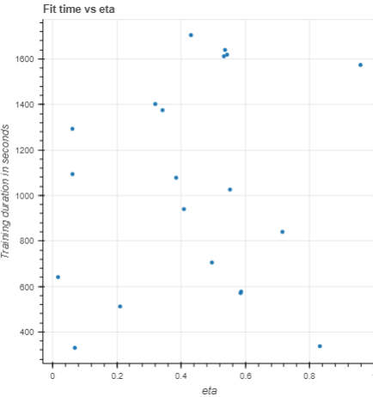
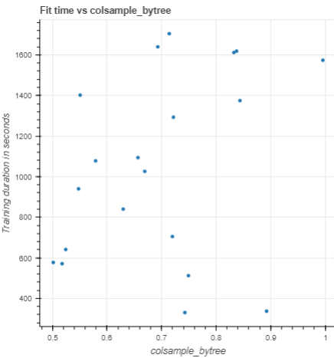
Parameter values vs. training time
max_depth dominating run time and masking effects other param values may have – need to do more runs.

Slide 14
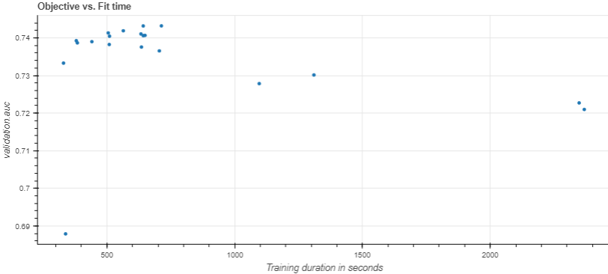
Hyperparameter tuning job results vs time
XGB models which took longer to train did worse, like max_depth learning noise of the training set.

Slide 15
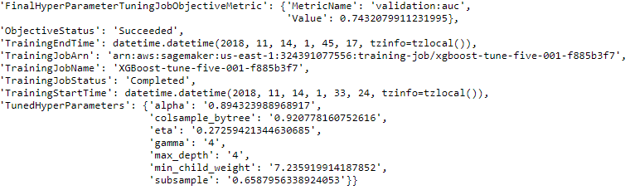
Best model - maximizing auc

Slide 16
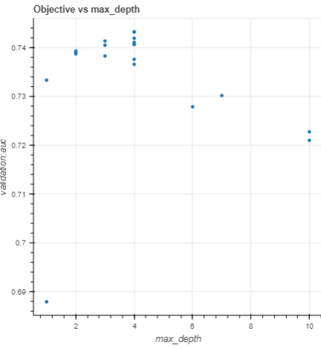
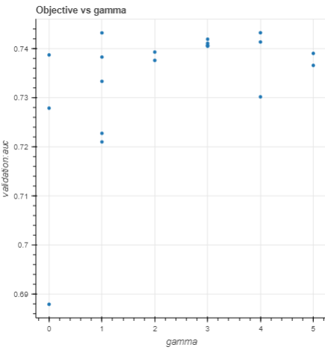
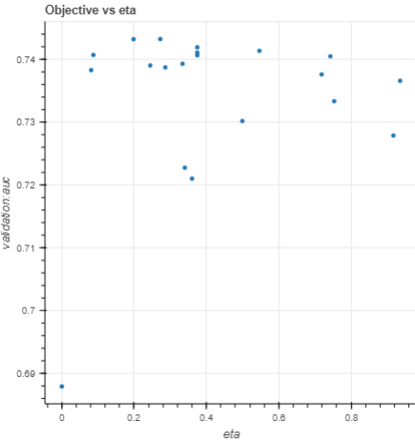
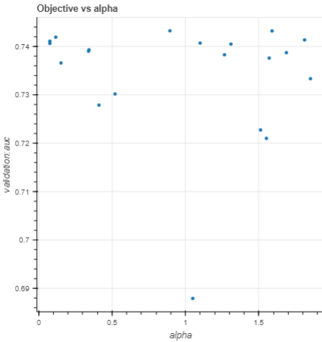
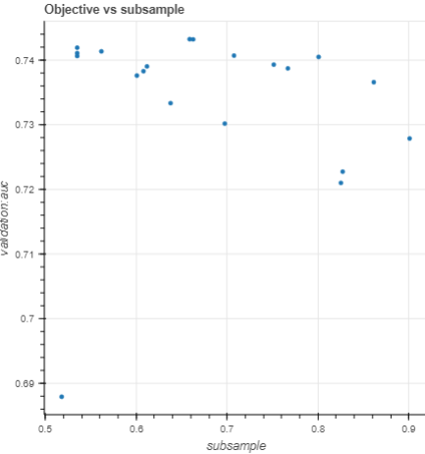
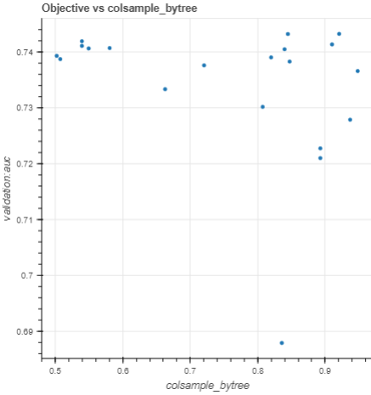
Notes:
Some relationships but it is hard to tell without doing more fits – 200 fits would be ideal instead of 20

Slide 17
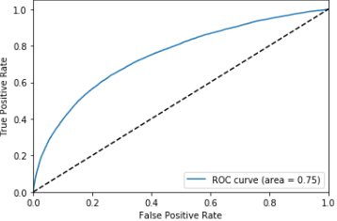

Deploying the best mode and invoking its end point to perform a batch prediction on my test set
‘Denied’ = rare class, given as class 1 a weight of ~39 to 1.
Sampling techniques were not used. Only weighting.
Ideally, the model should have strong specificity and a low fall out rate.
Why? Because the idea is to streamline the process such that visa applicants who are very likely to be approved (class 0) are done so automatically, whereas less certain cases are sent to human review.
True neg rate - (TN)/(TN+FP)*100 = 98.79%
False posi rate - (FP)/(FP+TN)*100 = 1.21%
Want a model with a false positive rate of as close to 0 as possible.
AUC on validation and test sets are the same.
A lot more time needed on preprocessing to clean cmatrix.
Idea for this project wasn’t to get a strong predictive model and I did not compare it to a baseline.

Slide 18
Conclusion
Scales very well - didn’t test out of core computation.
Some key factors which prevent it from being sped-up past a certain point.
I believe I saw super linear distributed results because XGBoost pushes the resources of each individual machine and the cumulative benefits resulted in that relationship and because this version is optimized for distribution.

Slide 19
Challenges
Getting the setup to actually work – reconnecting instances I was working on to my EMR cluster whenever I changed something or had to resize something. Notebooks weren’t on my computer – it was on its own instance.
Getting the low-level library to submit my jobs correctly and how I wanted them to be done.
Preprocessing the data to even train with. Had requirements that took me days to even figure out.
Interacting with the file system in order to create and manage the directories each job expected to be present and where the data was expected to be. Just how the library loads from and writes data to S3 was very strange.
Understanding each piece of PySpark, SparkSQL, and SageMakerSpark code
Understanding the Java errors from Py4J.
Using my root account to create a new AWS role to give myself the power to even let SageMaker run my different jobs. I needed permissions for different things like submitting jobs, querying job results, configuring and creating endpoints, storing and invoking models.

Slide 20
Future work
Something I wanted to try but didn’t have time to: determine how much the out of memory version of the algorithm slows down training when not enough memory is available.
Compare it to Sparks GBM / other tree boosting algorithms.
Try sampling techniques
I did a lot of missing value imputation which I think hurt XGBoost because of how well it handles decision-making when x is spare. I think I might have reinforced noise and relationships inherent to the dominant class.

Slide 21
Additional interesting information on following slides
In case someone is interested (not part of presentation).

Slide 22
Key caveats and assumptions of XGBoost
Handles missing data without the need of imputation, user must supply a value for missing data and pass it as a parameter so XGBoost can learn a path to take when meeting this value.
Wont stop splitting when negative loss encountered, keeps splitting until max_depth and prunes backwards until no positive gain. (GBM would simply miss better splits to come later).
Cannot directly deal with categorical variables – needs to be handled with one-hot encoding. Although this results in a sparse input space, XGBoost implements a novel sparsity-aware algorithm which learns based on choosing default directions in sparse environments (reducing run time greatly).
Memory bound not computation bound (acts to reduce performance when you need to switch to its out-of-memory state).

Slide 23
Overview of XGBoost + why it is particularly powerful in a scalable ML environment
Programmed to scale to large quantities of data efficiently.
Implements parallel processing much faster than traditional GBM (explained later) by reducing sorting time (most time-consuming part of tree learning) by pre-sorting once and storing index pointers.
Doesn’t only split with an exact greedy algorithm – combines many performance-enhancing splitting techniques.
Learns default sparsity patters.
Memory optimization - most memory construction is done in the first pass, and no dynamic memory is allocated over the process. Allows out of core processing on disk if memory is not enough.
Has an out of memory version when data is too large for memory

Slide 24
What most impacts XGBoost performance?
Writing files onto disk if training data does not fit into memory (out-of-memory).
Parameters (max_depth, eta, colsample_bytree – subsampling columns)
Number of iterations (and how that relates to eta) – tree boosting is typically a slower learning process with more iterations the slower the learning rate is
Might need to reduce some of these parameters to increase performance
Can see their impact on run-time with parameter tuning trials later

Slide 25
Isn’t Boosting a sequential process? How are boosted models parallelized?

Slide 26
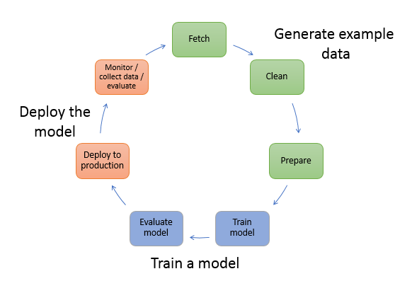
Typical ML life cycle
Different demands at each stage, especially when data is large
Different configurations optimal for each task
Configuring cluster to optimize the performance of one task may hinder or be overkill for another task.
Especially important if you need to do GPU training

Slide 27
What is AWS SageMaker?
Specifically designed for large-scale parallel machine-learning. Offers a complete encapsulated end-to-end distributed environment when coupled with Spark and EMR.
Provides scalable notebook instances (which I ran on my cluster).
Allows the building of a machine learning teams (giving ml roles and job permissions manually).
* Can either be very straight forward to use (using a console for most tasks – suitable for business people), or more complicated (using the low level SageMaker library). I used the SageMaker library and the PySpark SageMaker library which gives a lot more control. *

Slide 28
Strength of the setup
Normally run with Python.
Why use SageMaker with PySpark and EMR? Or SparkML?
1) More suitable for working with large amounts of data (the obvious reason).
2) Decouples exploration and processing from the model training process. Basically, you can do the transformations and loading in your EMR cluster and then send out the data for modelling using a separate dynamic clusters optimized for your needs. Each stage of the process is distributed in the most efficient way as long as you do your research first.
3) In the case that you need to utilize GPUs for training, it would not be optimal to work with your EMR cluster on GPUs only for this reason.
4) Allows an accessible way to deploying models into production as an artifact for later use. Spark ML has nothing equivalent to this feature.
5) Additionally, what I notices using Spark ML in the big data course -you must load data into a Spark Dataframe to make predictions on it after transformation. With this system, you can just invoke the endpoint directly which is stored away in S3. Makes batch predictions very efficient.

