Slide 1
Week 10
Keel Bone Chicken Project
08/10/26

Slide 2
This Week
Weekly Progress
Web Logger Updates
Logger complete
PCB Updates
Working on placement file updates
Documentation Updates
GitHub Documentation Created
GitHub Files Transferred
Ownership Transferred
Paper Updates
Paper Acceptance Date Changed
Next Week
Plans for next week
Overall Thoughts

Slide 3
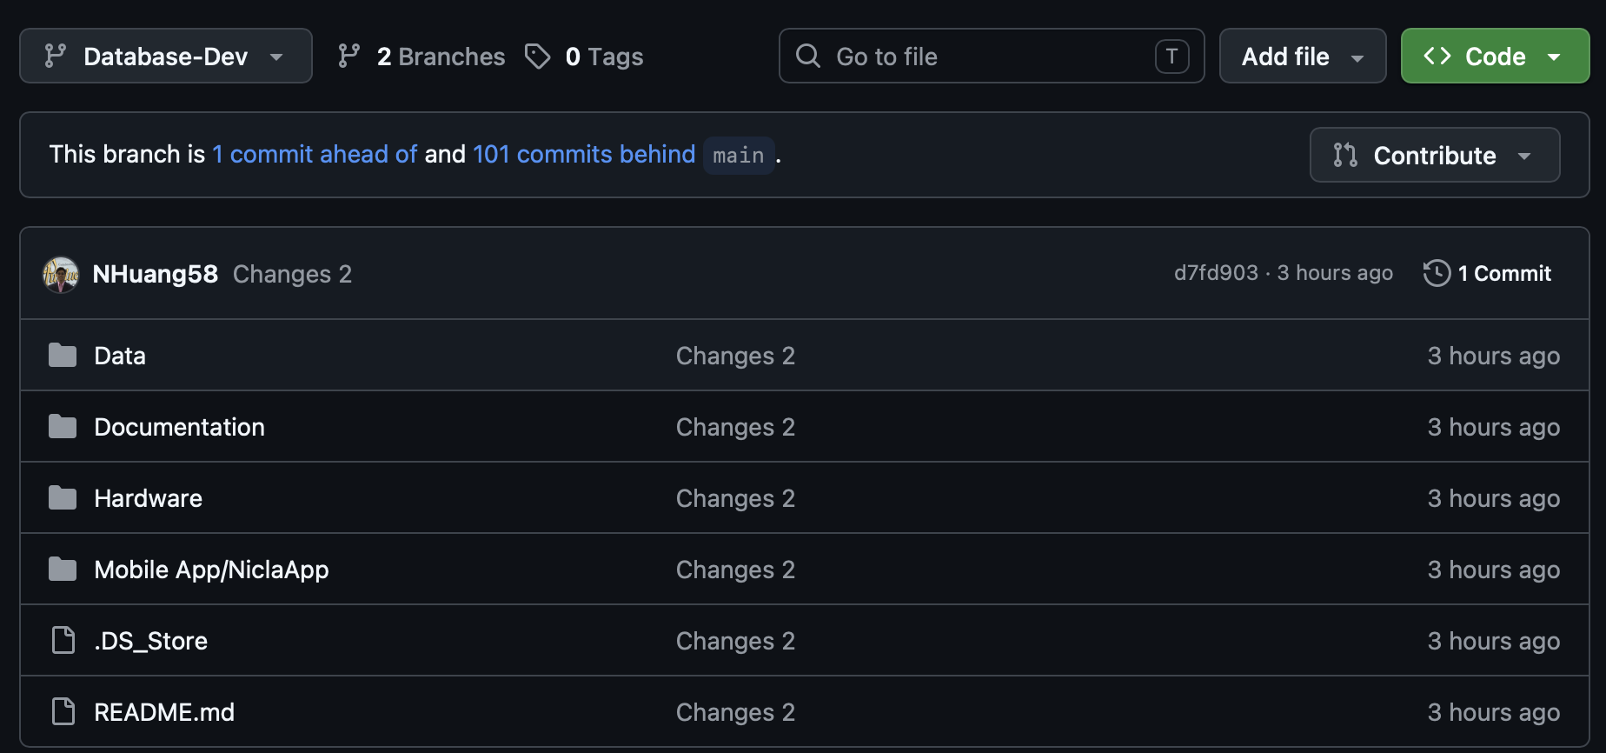
Web Logger Updates
Logger Complete
All features in Web Logger
Logger in separate branch of GitHub
Changed database to SQLite3 database
Everything functional

Slide 4
PCB Updates
Working on placement file updates
Noticed discrepancy with component placements and drill file
Contacted DL-Engineering; in the process of fixing
Will have to go to procurement office for new quote + purchasing

Slide 5
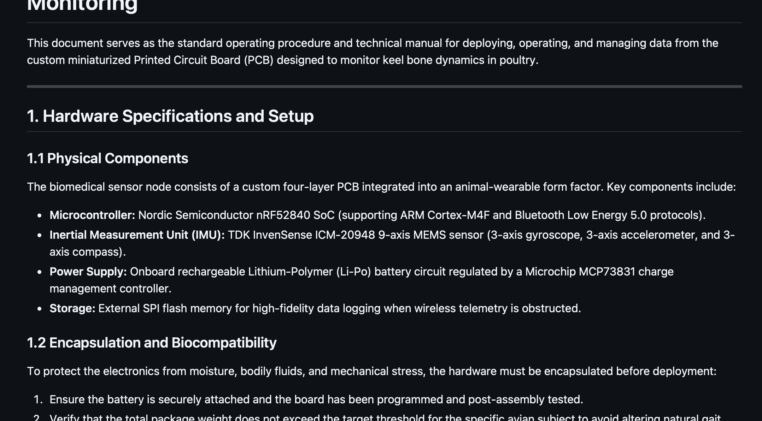
Documentation Updates
GitHub Documentation Created
GitHub Documentation Created to maintain consistency moving forward
Mostly in .MD files

Slide 6
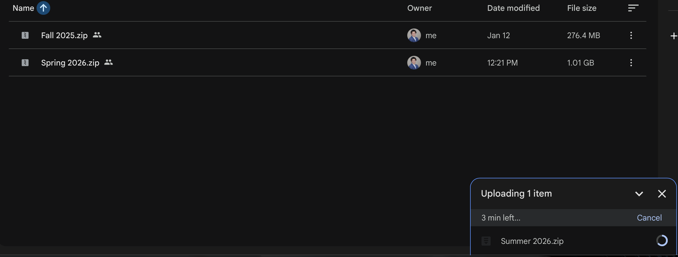
Documentation Updates
GitHub Files Transferred
Files Transferred over into Google Drive:
https://drive.google.com/drive/folders/1Ul3LAQrhO1t5J_EVqvNEP-hPAe9nVNyN

Slide 7
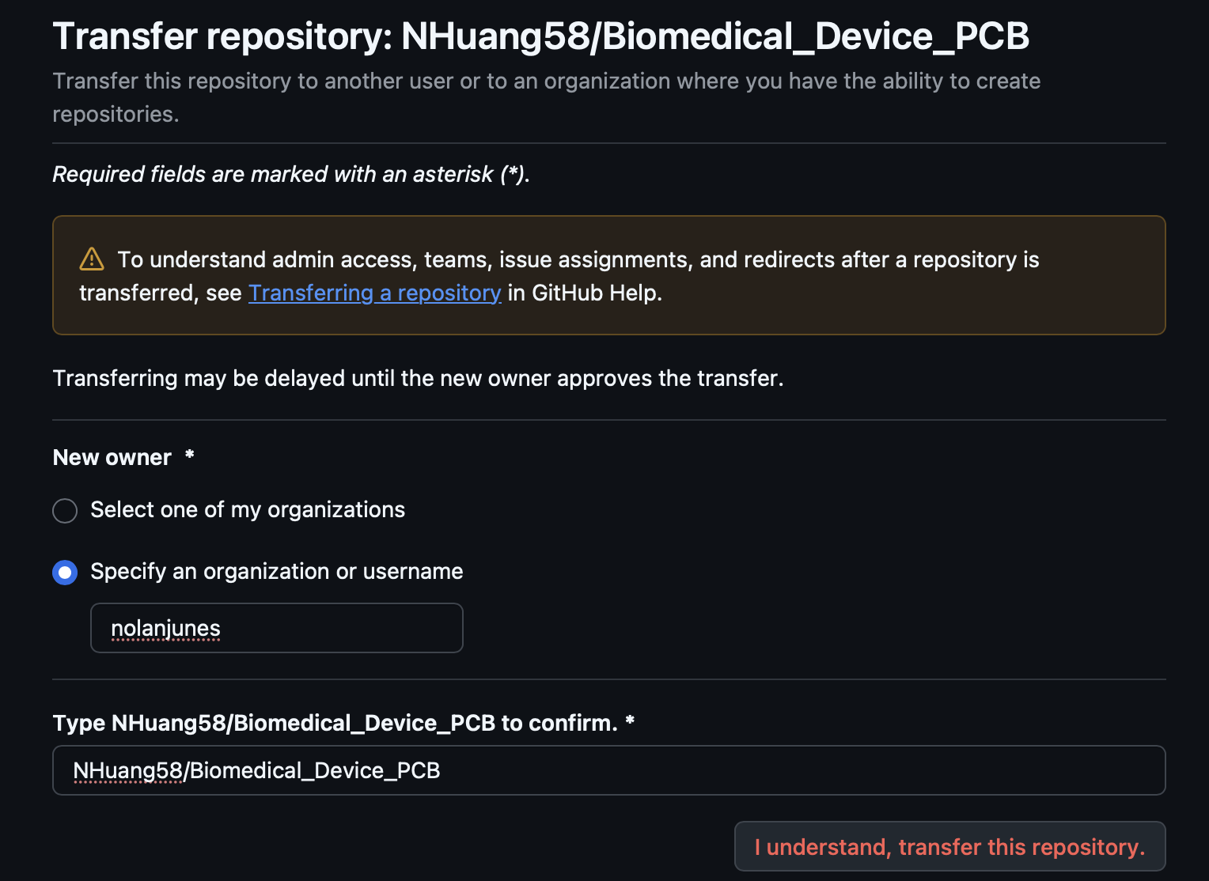
Documentation Updates
Ownership Transferred
Transferred ownership of repository over to Nolan
Should take a few days

Slide 8
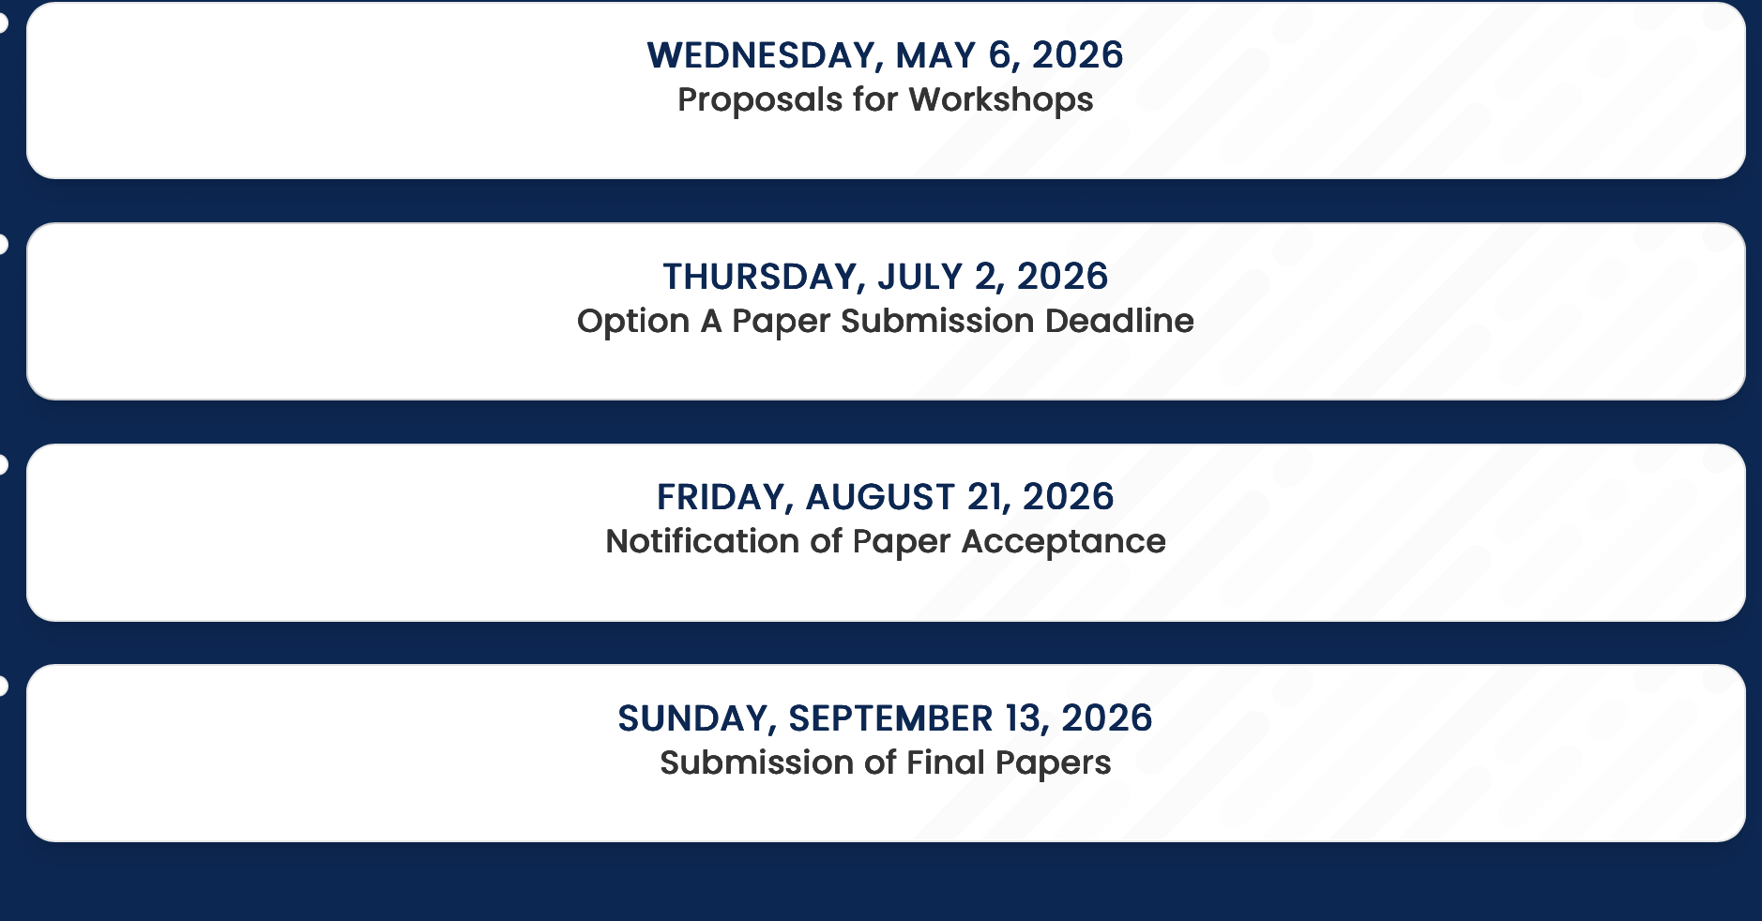
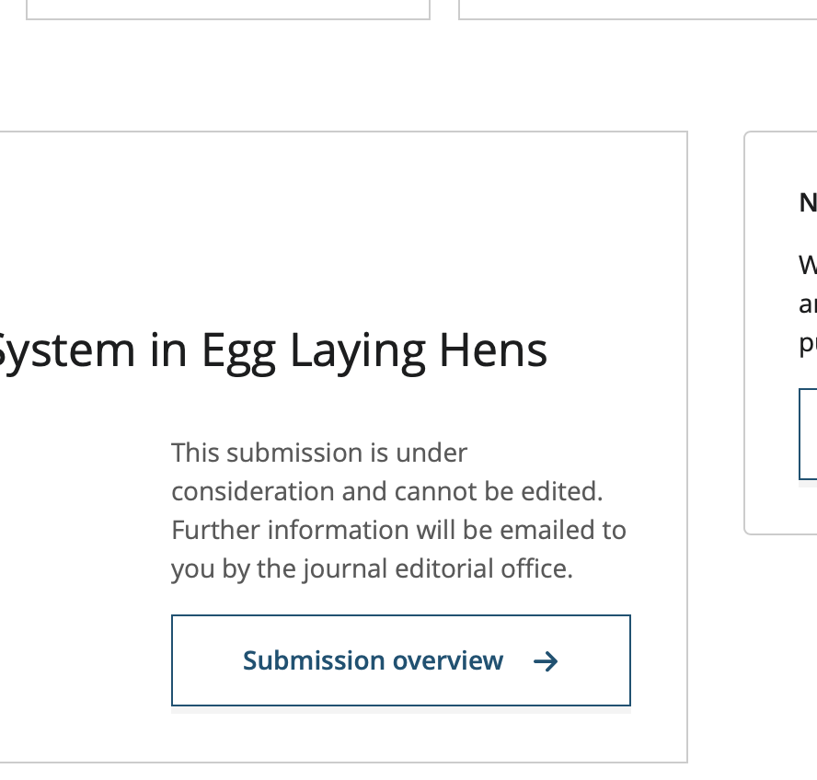
Paper Updates
Paper Acceptance Date Changed
Now notification of Acceptance will be on 8/21
No updates on author portal

Slide 9
Next Week
Plans for next week
Get PCB fully ordered and ensure payment goes through
Wrap up documentation for next developer

Slide 10
Next Week
Thoughts
Very useful interdisciplinary project where I was able to practice a lot of skills
Firmware Development
PCB Design
Sensor Testing
Communication with other parties
Lot of potential for the project; can’t wait to see where it goes

Slide 11
Thank You
Purdue Polytechnic Institute

