Slide 1
Week 5
Keel Bone Chicken Project
06/15/26

Slide 2
This Week
Weekly Progress
Database Updates
MongoDB Development Continues
IDE Setup
PCB Updates
Hardware Changes
Sensor Testing Updates
More information about testing equipment

Slide 3
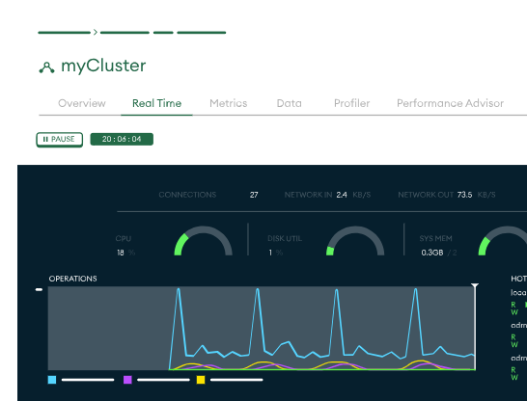
Database Updates
MongoDB Development Work Continues
Verified data from collection:
Seems to be fine but a slight issue with sampling
Cluster Data and usage is acceptable
Graph below shows data capacity

Slide 4
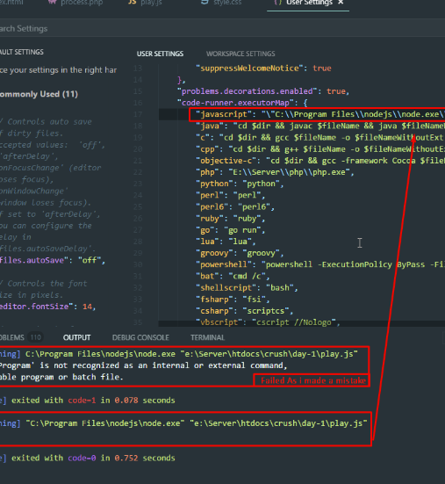
Database Updates
IDE Setup
IDE and code setup now properly mapped to MongoDB backend
.ENV files match up with the results from the code
Nicla Payloads should go directly to the backend

Slide 5
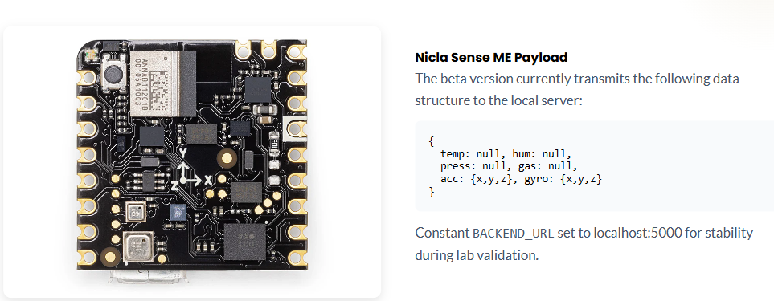
PCB Updates
Hardware Changes
Initial design rejected because of improper Gerber files
New hardware implemented before final design

Slide 6
Sensor Testing Updates
More information about testing equipment
Current Lab Equipment:
50% - Basic Force
Prof. Wu's Equipment
95% - High Precision
Current lab force testing is insufficient for precise in-out calibration. Prof. Wenzhuo Wu's lab provides the specialized equipment needed for high-resolution force sensor validation.
Contacted professor Wu, still waiting on a response

Slide 7
Next Week
Plan for next week
Make gerber file and drill file revisions to PCBs for re-ordering
Continue work on Database Development
~3-4 more weeks to fully refine database
Look into hybrid option with infrequent backups (Would use same database model)
See if that option is feasible or a waste of resources
Meet with Professor Wu about sensor testing

Slide 8
Thank You
Purdue Polytechnic Institute

