Slide 1
Week 14
Keel Bone Chicken Project
04/17/26

Slide 2
This Week
Weekly Progress
PCB Updates
New sizing for PCB discovered
Sensor Updates
Strain & force gauges received
Begin process of calibration on breadboard
Data Logger Updates
Agriculture issues resolved
Device protocol changed
Powercast Updates
NDA resolutions
Paper Updates
Paper criteria for Conference met
Next Week

Slide 3
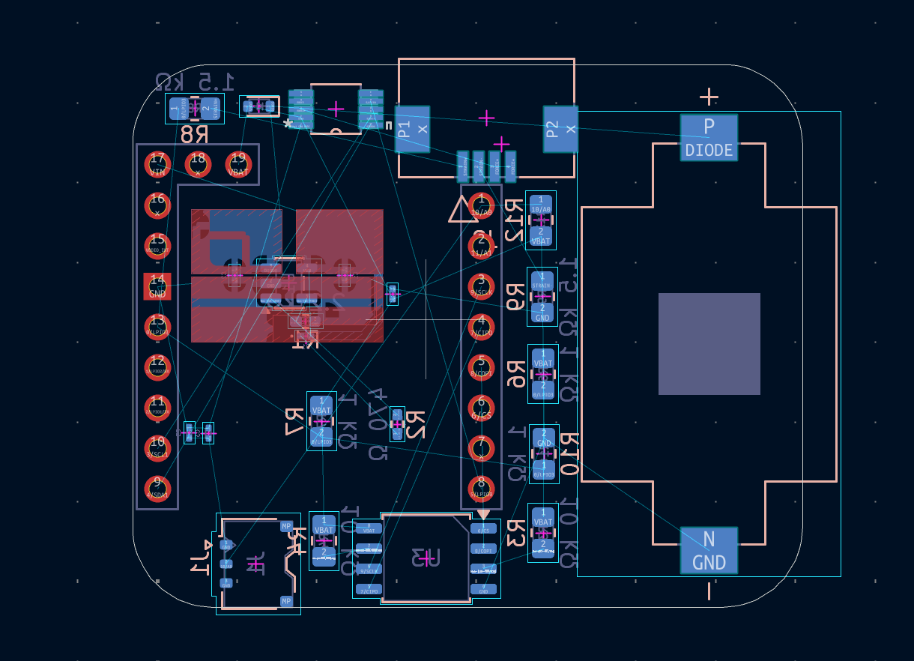
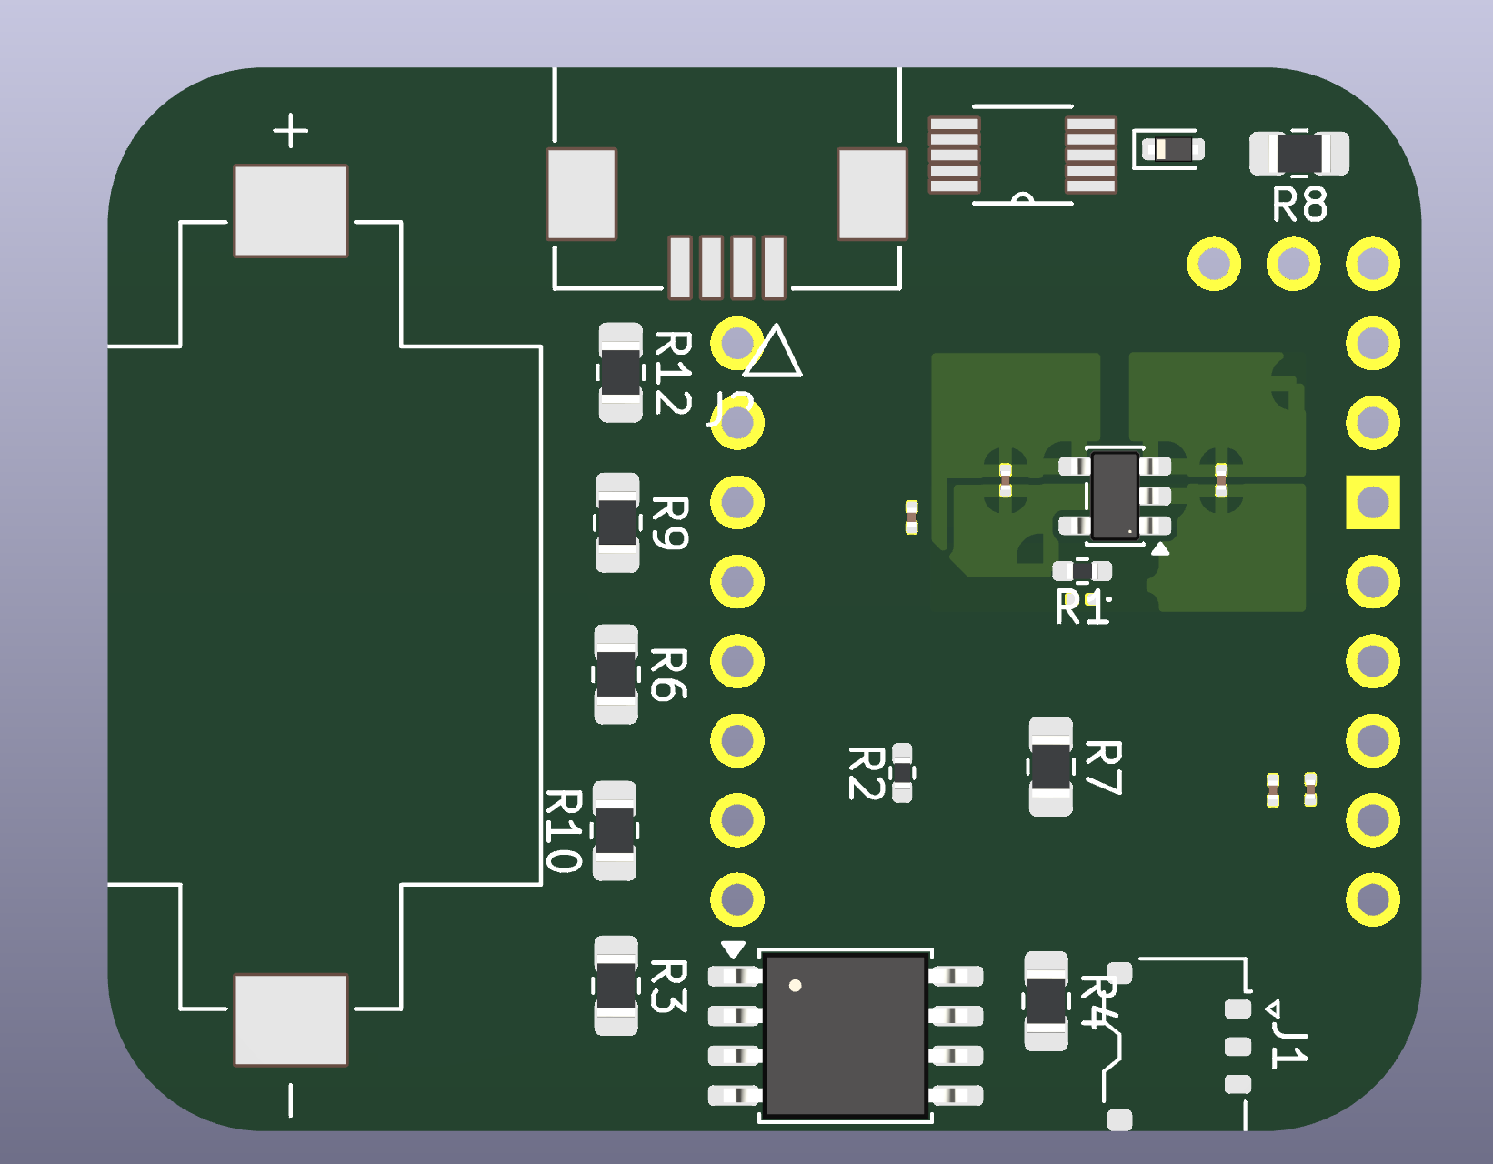
PCB Updates
New sizing for PCB discovered
Remeasured backpack:
Exterior: 37 mm x 44 mm x 16.5 mm
Interior: 42 mm x 34 mm x 14 mm
Changed sizing on second PCB variation:
Lost a bit of area

Slide 4
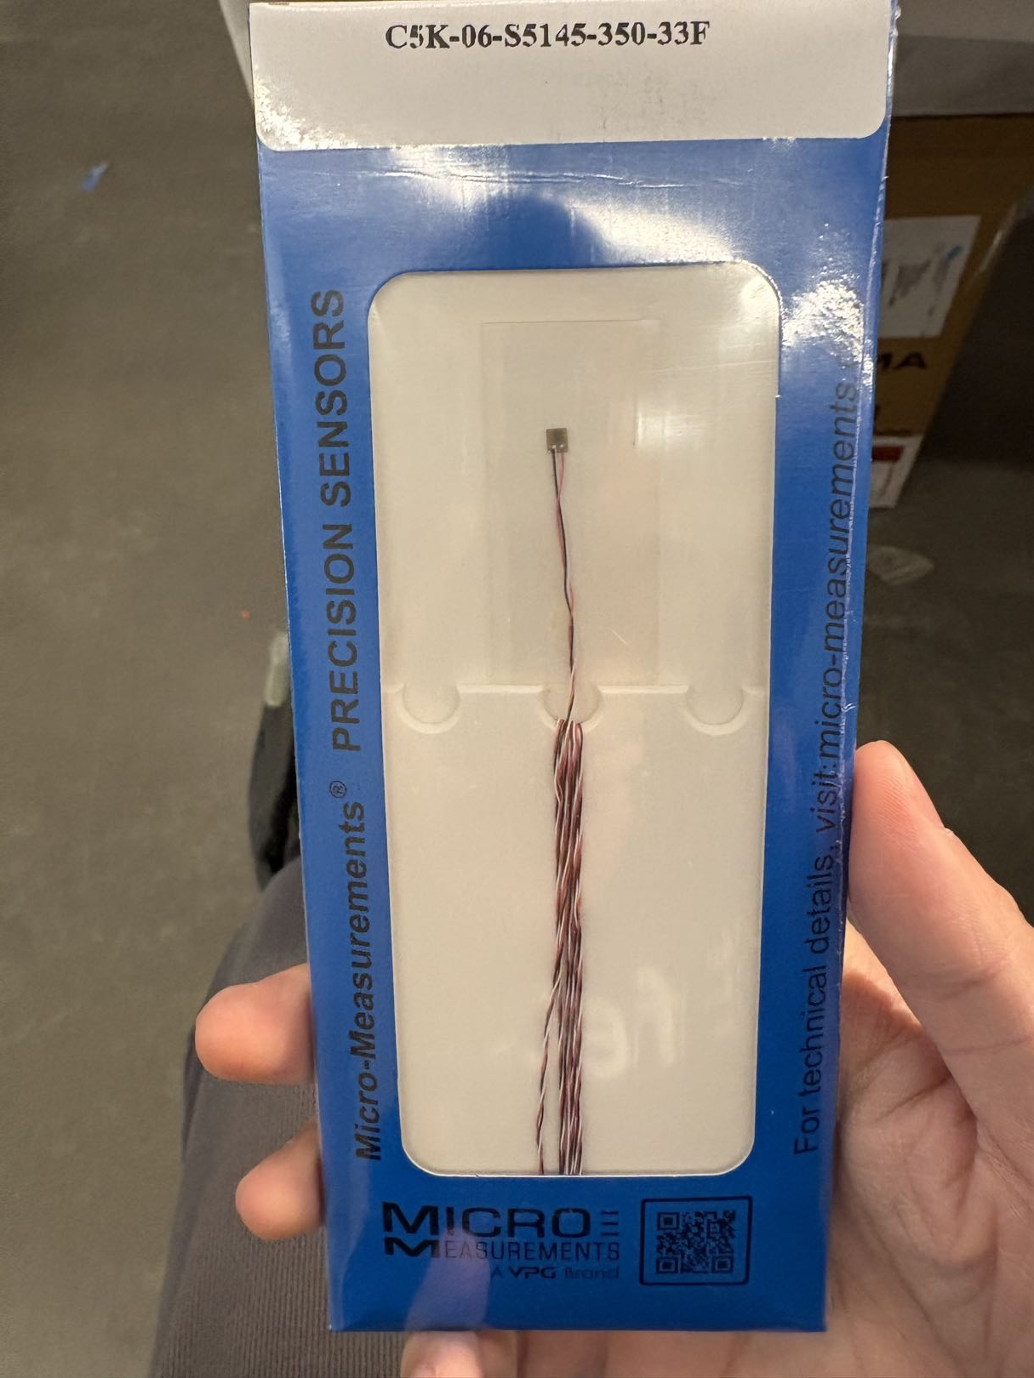
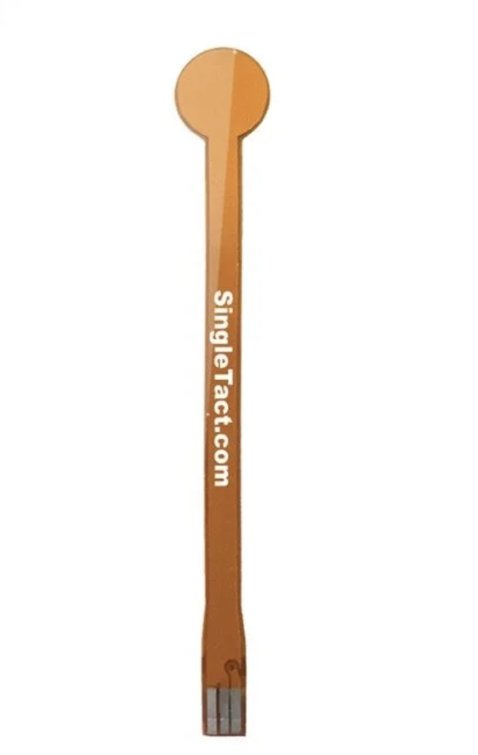
Sensor Updates
Strain & Force Gauges Received
Checked shipment areas for sensors
Both strain and force have arrived

Slide 5
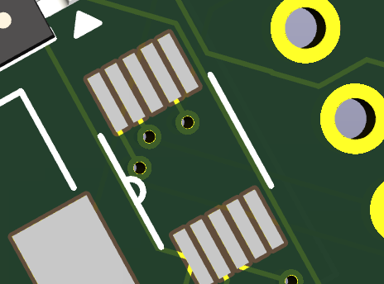
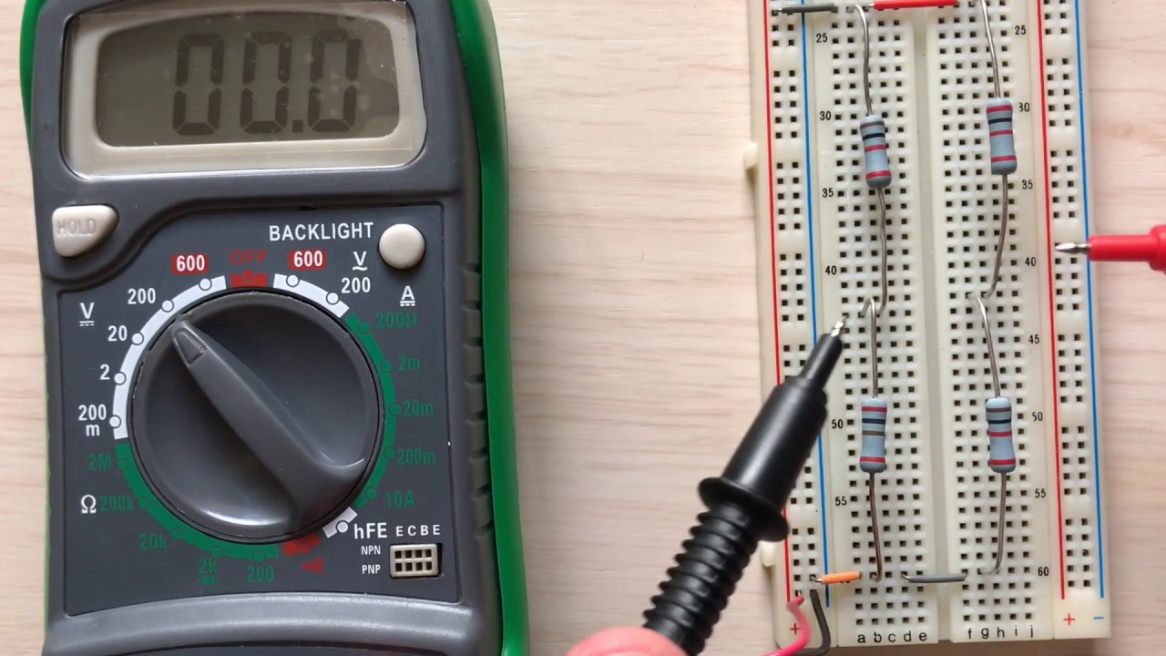
Sensor Updates
Begin process of calibration on breadboard
Wheatstone bridge to calibrate strain gauge
~3% tolerance, hopefully can be hit
Test charge amplifier on PCB to calibrate force gauge

Slide 6
Data Logger Updates
Agriculture Issues Resolved
Agriculture was using broken devices for some of the testing, got that resolved
Needed a better fix for the excess power that might have been draining
Set maximum records to an even higher constraint (More data storage)
Newest version released 4/16

Slide 7
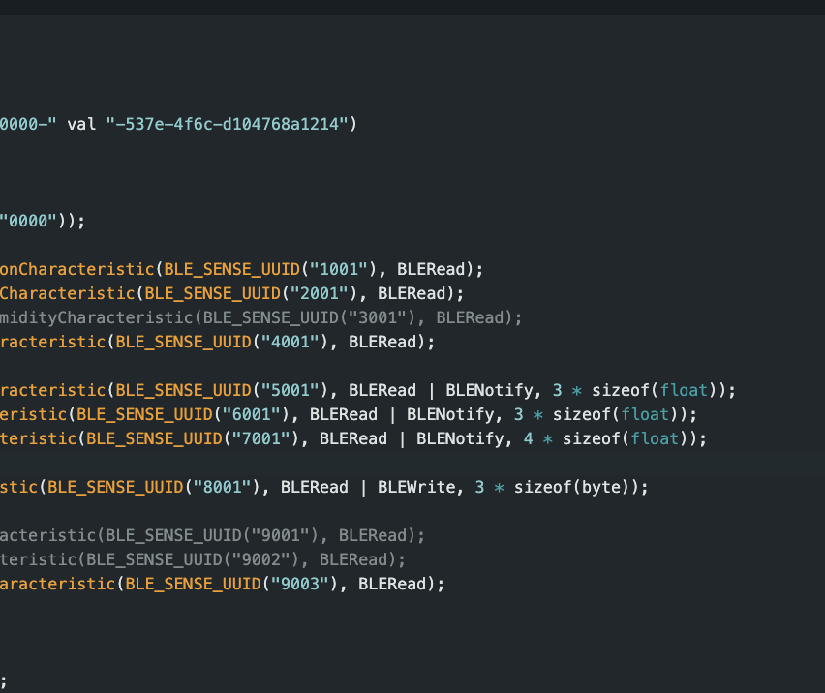
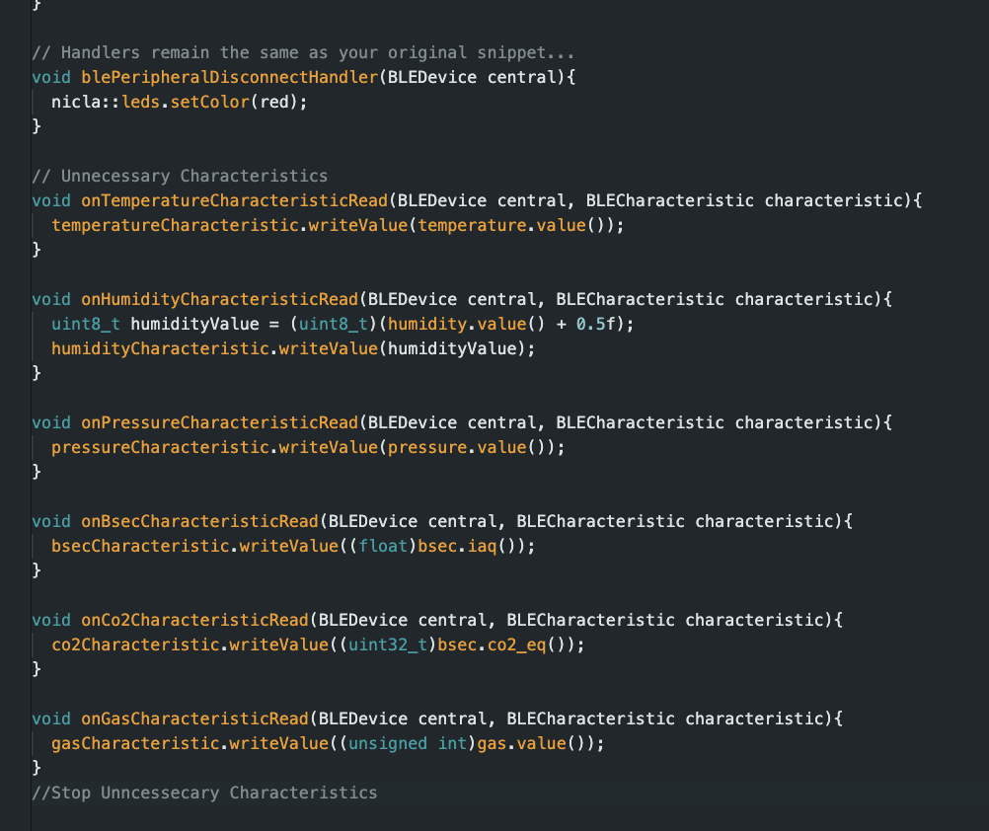
Data Logger Updates
Device Protocol Changes
Turned off unnecessary parts of the device if not going to be used
Can be easily changed or modified

Slide 8
Powercast Updates
NDA resolutions
Asked Dan Harrist for a version of the NDA to be sent to Professor Nawrocki
NDA should be arriving to purdue email soon
Also asked for clarification on P2110B and P1110B
Purdue legal department has version of NDA and should be in the process of signing
Should be able to work with PC110 manually
Can switch to P1110 (Slightly larger module) if needed

Slide 9
Paper Updates
Paper criteria for Conference met
IEEE Sensors 2026 Submission B Guidelines:
Paper Length: Maximum 3 pages including figures, tables & references or maximum 4 pages are allowed if the 4th page is only reference (Page maximum very strict)
Paper Size: US Letter (8.5" x 11") or A4 (210mm X 297mm)
Fonts: Embed ALL fonts in your PDF file. Avoid the use of Type 3 fonts.
File Format: Adobe PDF (.pdf)
Allowed File Size: 5.0MB
Do NOT page number your paper
Do NOT apply security settings to your PDF file.
As part of the submission, you will be asked explicitly to briefly describe the novelty of your paper within 1,000 characters.

Slide 10
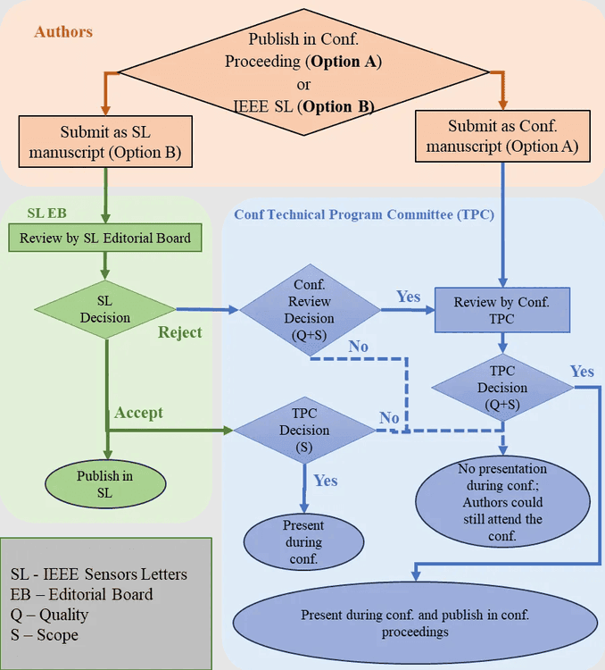
Paper Updates
Paper criteria for Conference met
Submission Requirements
Main manuscript
Graphical Abstract Image
*Conflict of Interest
Cover Letter
Tracked Changes
Supplementary Material*
Image*
LaTeX supplementary file*
Previously Published – Statement*
Previously Published – Files*

Slide 11
Next Week
Next Week’s Plan
Finalize Paper (Professor Salas meeting)
Ask Omosalewa for a recording of the data as it is collected
Match up chicken results to chicken video
Edit the video so such results are shown while the chicken is moving
Do paper-based data analysis on data collected

Slide 12
Thank You
Purdue Polytechnic Institute

