Slide 1
Week 07
Keel Bone Chicken Project
10/10/25

Slide 2
This Week
Progress & Issues faced this week
Locally hosting BLE Data Logger
KiCad Schematic Changes
KiCad Layout Changes
Routing Issues on PCB

Slide 3
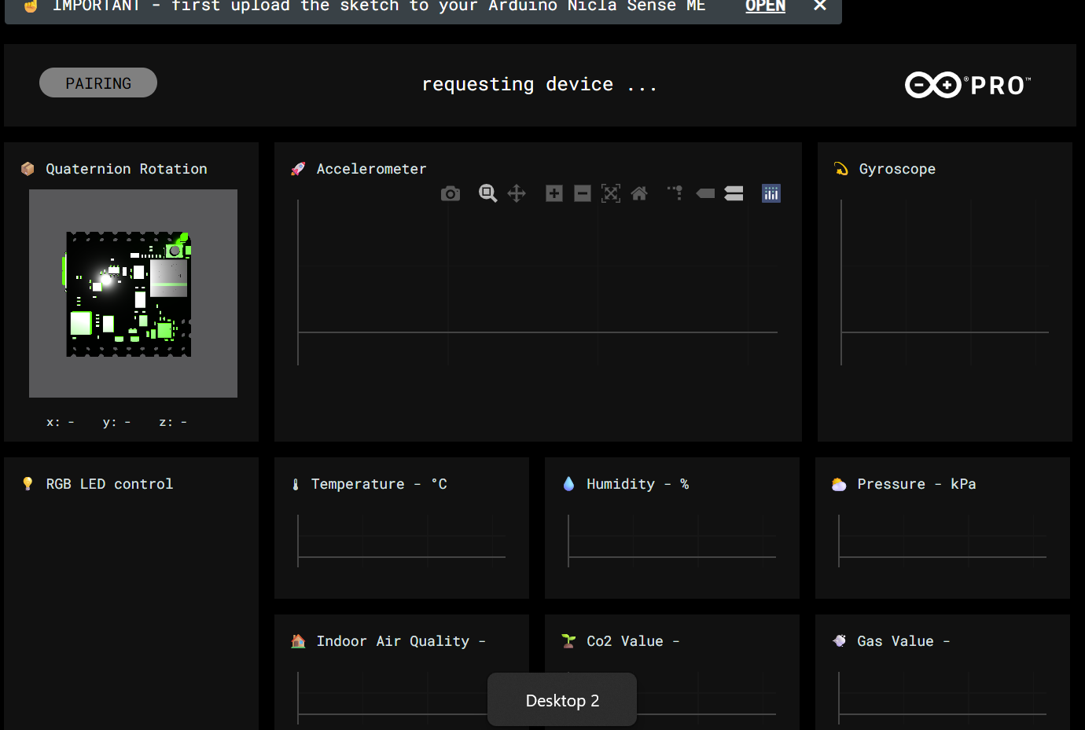
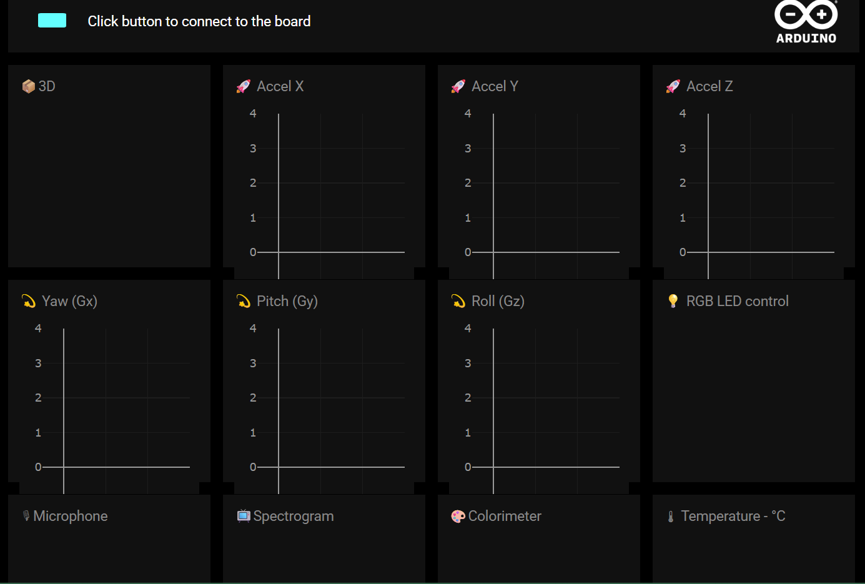
Locally hosting BLE Data Logger
Able to move from Arduino API to personal device
http://localhost:8000/BLESense-test-dashboard/
Used index.html and GTLFLoader.js to modify charts
Arduino BLE Dashboard
Locally Hosted

Slide 4
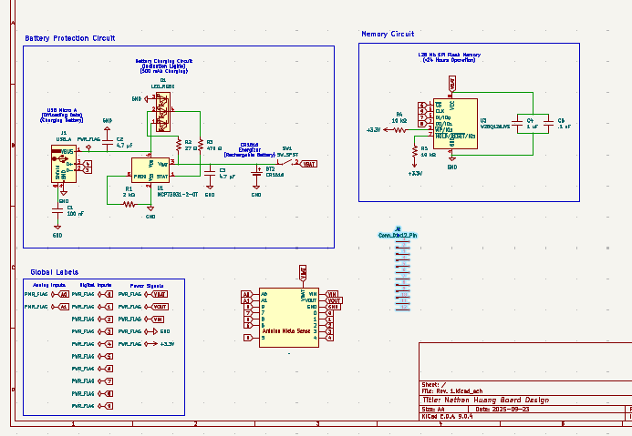
KiCad Schematic Changes
New Circuit Components
Battery Charging Circuit (LIR1616)
Ribbon Cable
Rechargeable Battery Holder
Protection Circuit

Slide 5
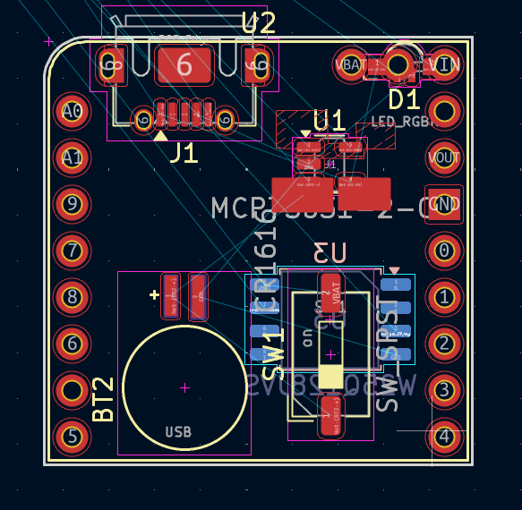
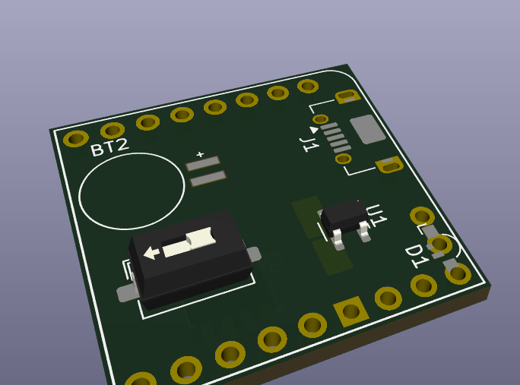
KiCad Layout Changes
Components added to layout, finalizing layout
USB Micro Connector
Battery Charging Circuit IC (MCP73831)
LIR1616 Holder
Potential Switch for Charging/Discharging?

Slide 6
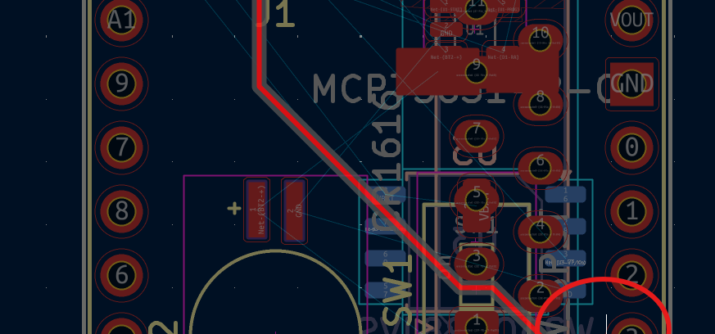
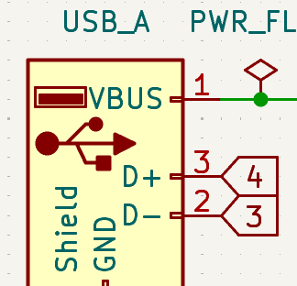
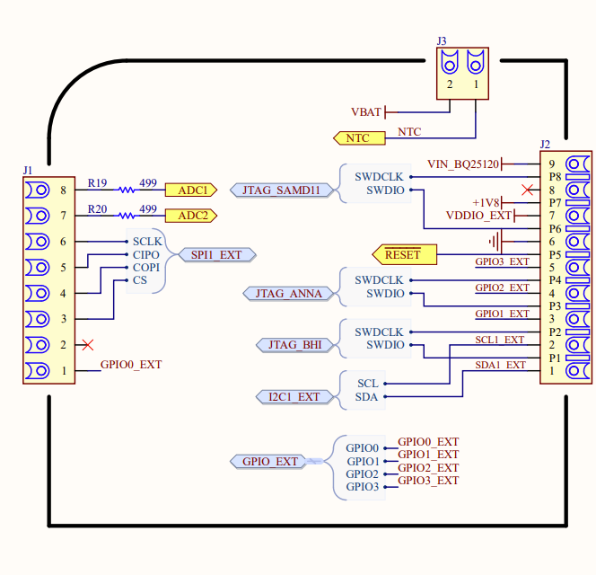
Routing Issues on PCB
Footprint not readily available online, cannot route PCB
https://forum.arduino.cc/t/nicla-sense-me-and-nicla-vision-footprints/1013892/2
https://github.com/Alarm-Siren/arduino-kicad-library
https://github.com/Alarm-Siren/arduino-kicad-library/blob/master/footprints/arduino-library.pretty/Arduino_Nicla_Vision_Socket.kicad_mod?

Slide 7
Next Week
Blockers & brief summary of next week’s work
Fix routing issue in order to get a fully working schematic (passes design and electrical rules check)
Order PCB (Lead time ~3 days?)
Test and verify PCB
Show Localhost BLE interface with Agriculture researchers → Show them how to use it

Slide 8
Thank You
Purdue Polytechnic Institute

