Slide 1
Week 4
Keel Bone Chicken Project
06/08/26

Slide 2
This Week
Weekly Progress
Data Collection Updates
Database Updates
Database Setup
Database Extraction
Database Beta Version
Sensor Testing Updates
Next Week

Slide 3
Data Collection Updates
Agriculture Updates on Farm
Device taken to farm
Undergraduate student allowed to test and collect data
Collected for around ~2 hours
Documentation for device given to Sara (Post-doc) and Undergraduate
Hopefully setup was successful
May be bugs
Sara requested I check the data collected

Slide 4
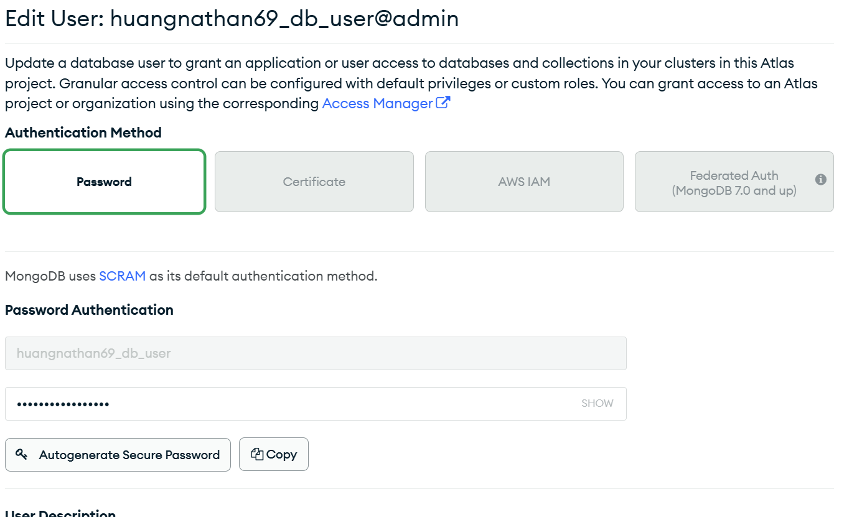
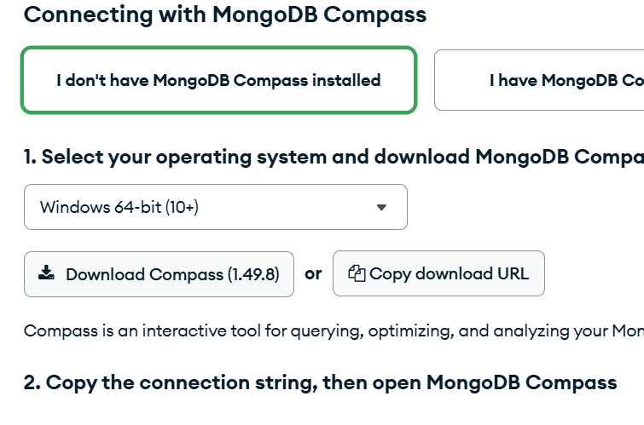
Database Updates
Database Setup
Connecting to MongoDB compass in the new cluster
Added secure user
User will be able to change databases
Others will only be able to read databases

Slide 5
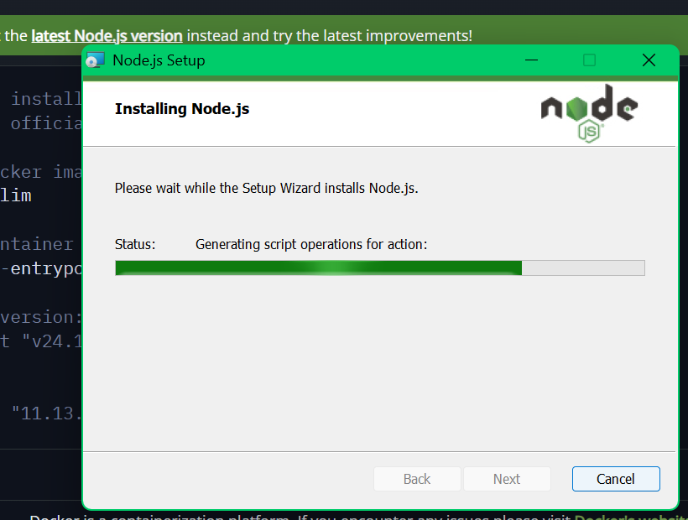
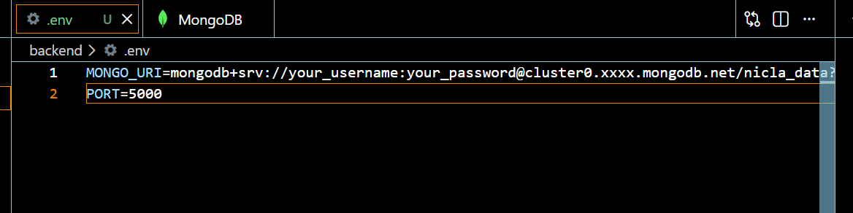
Database Updates
Copied Signing Key to Database
Set the signing key in Visual Studio Code
Copied into the .ENV file
Downloaded Node.js for development

Slide 6
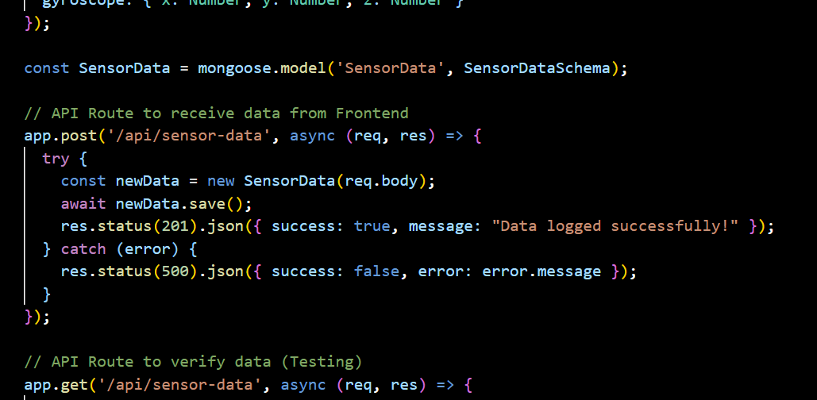
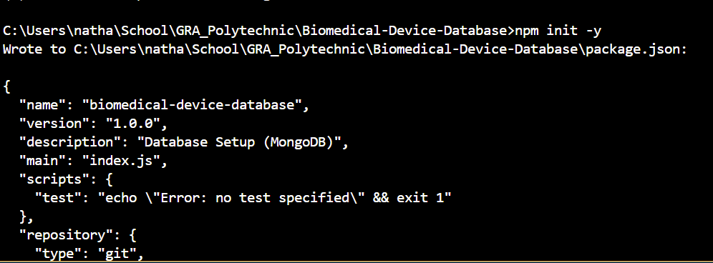
Database Updates
Database Extraction
Began calling attributes in the terminal to be transferred over
Database calls appear to be working
Have to write unit tests to confirm this

Slide 7
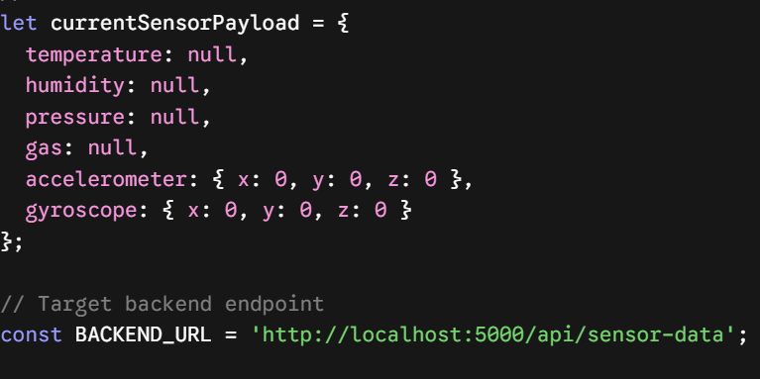
Database Updates
Database Beta Version
Will host a localhost version on server 5000
Set the backend_url to be constant for testing
Only applicable to my development environment

Slide 8
Sensor Testing Updates
Inquiries on force testing machine
Force in-out testing, not sufficient equipment at lab
More precise equipment at Prof. Wenzhuo Wu’s lab
Will contact him later this week about a visit

Slide 9
Next Week
Next Week’s Plan
Analyze data collected from web logger in the Agriculture trial
See if any bugs arose
Verify the entire length of data is being collected
Contact Professor Wu about the Force sensor testing unit
Contact DL-Engineering for boards

Slide 10
Thank You
Purdue Polytechnic Institute

