Slide 1
Week 12
Keel Bone Chicken Project
11/14/25

Slide 2
This Week
Progress this week
Revision 2 for Circuit Design
Remote Power Transmission with Battery
Improved Data Logging

Slide 3
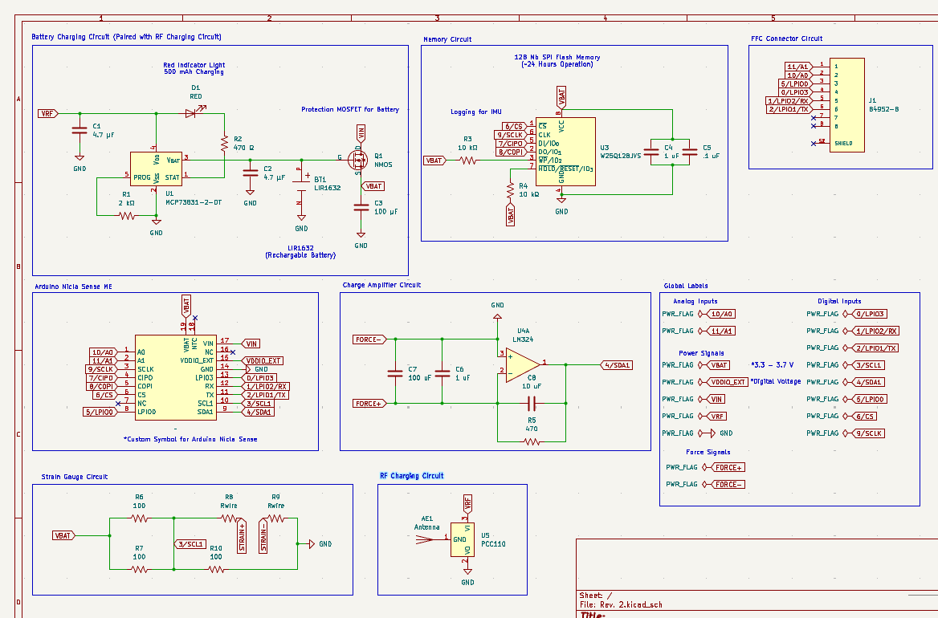
Revision 2 for Circuit Design
Introduction of RF harvesters onto board design
Multiple (10+) Transmitters on Floor boards for chickens equipped with PCBs

Slide 4
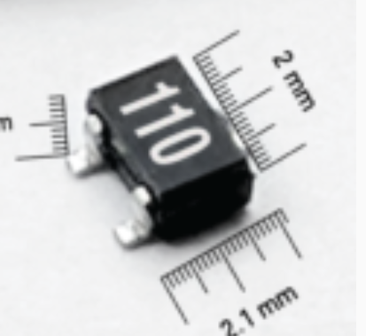
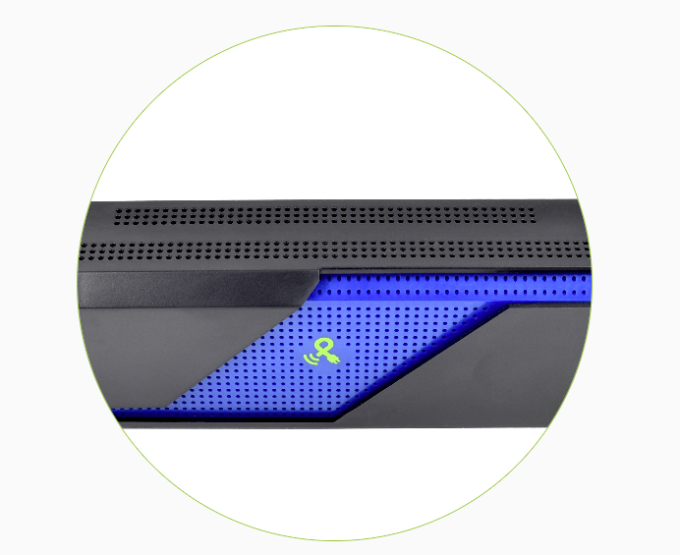
Remote Power Transmission with Battery
Power Harvester System
Power Transmitters Under Floorboards:
https://www.powercastco.com/products/rf-power/powerspot-transmitter
Power Transceivers on System:
https://www.powercastco.com/products/rf-power/pcc110

Slide 5
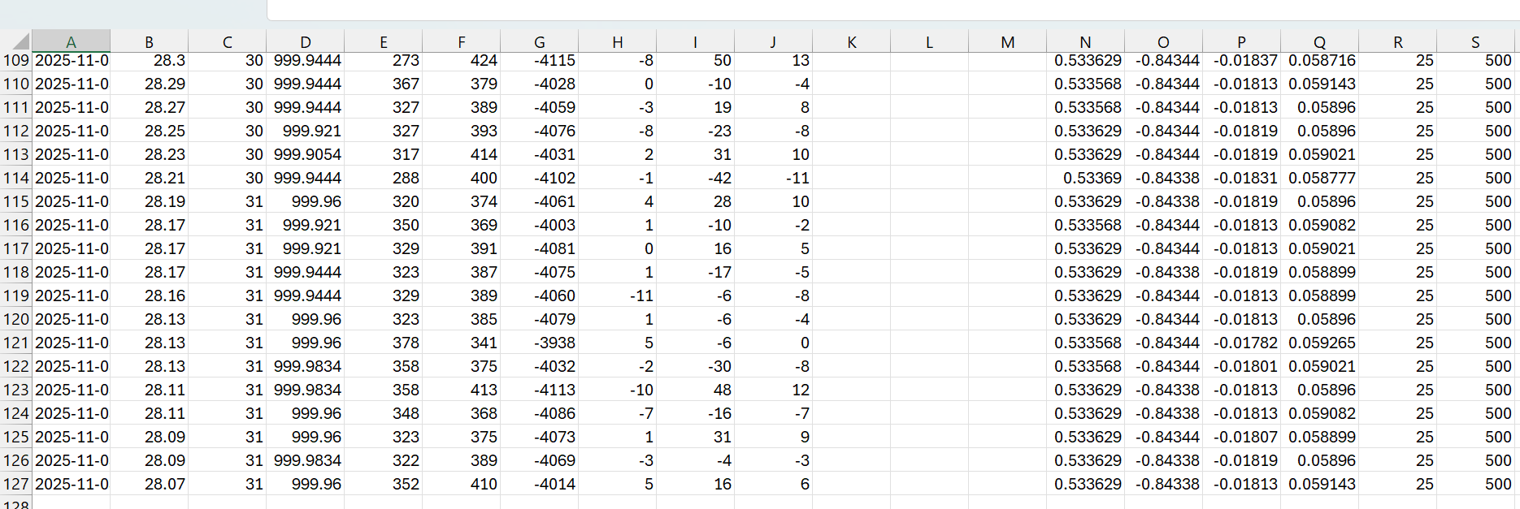
Improved Data Logging
Data logging now works for values > 60 seconds on the web interface

Slide 6
Next Week
Projection of next week’s work + Issues
Analysis of cost for successive RF Transmitters
Finalized BOM for PCB components
Analysis of Data collected from agriculture department
Video/README of walkthrough for data collection
Issues:

Slide 7
Thank You
Purdue Polytechnic Institute

