Slide 1
Week 12
Keel Bone Chicken Project
11/14/2025

Slide 2
This Week
This week’s progress
PCBA Setup for Ordering
BOM Generation
Final Routing
Ordering PCB

Slide 3
PCBA Setup for Ordering
Using JLCPCB as a vendor
Options:
JLCPCB
PCBWay
PCB Trace
All have ~24 hour lead time
Ship time varies
PCBA on JLCPCB Parts: https://jlcpcb.com/parts/in-stock-parts
Some parts may be unavailable, need to find alternatives

Slide 4
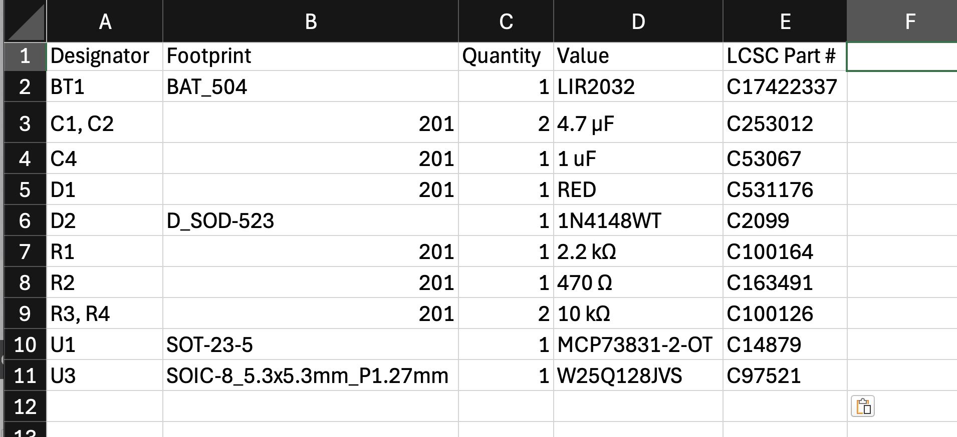
BOM Generation
~20 Components on BOM, listed below
BOM Created with JLC Extension in KiCAD:

Slide 5
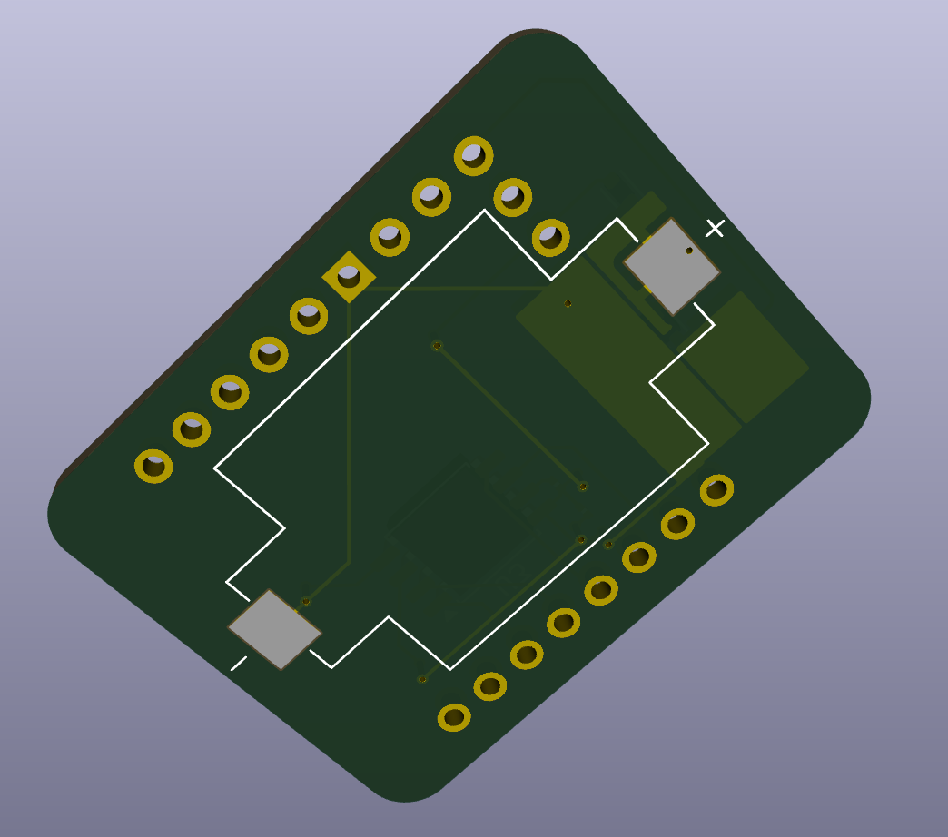
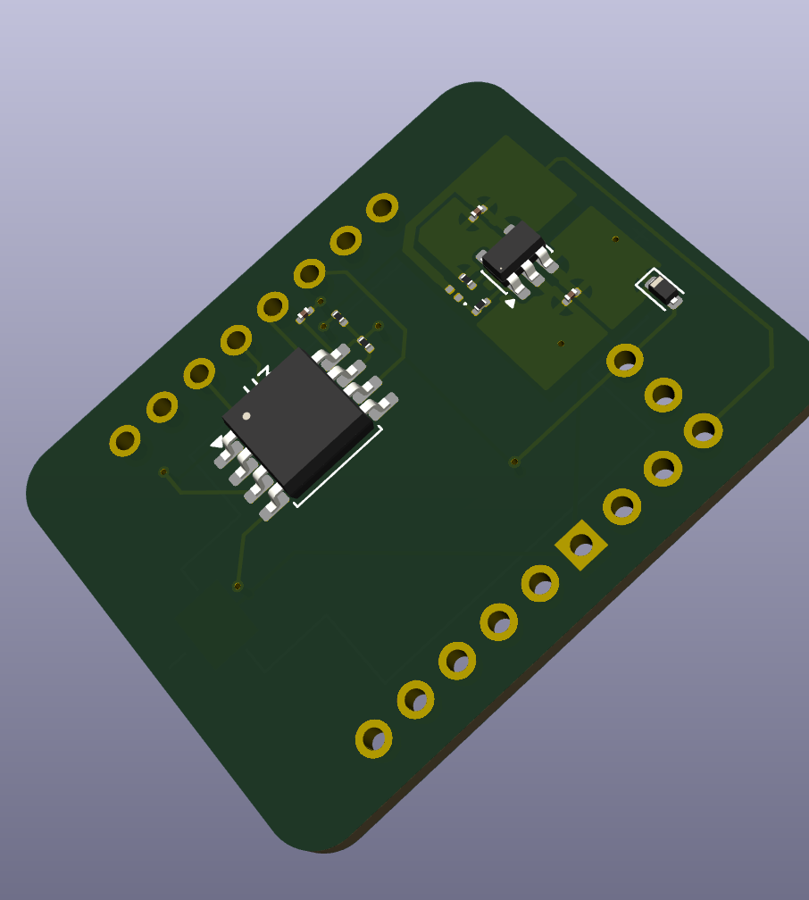
Final Routing
Several Design Choices/Sacrifices had to be made
Finished Rev. 1 Design

Slide 6
Ordering PCB
From JLCPCB’s website with .bom and .gerber files
[Insert]

Slide 7
Next Week
Blockers & Next Week’s Work
Hear back on Resistive vs. Capacitive Sensors
Test PCBs
Work on app store application for Nicla Sense while PCBs are being ordered

Slide 8
Thank You
Purdue Polytechnic Institute

