Slide 1
Week 4
Arduino Nicla Sense Statistics
9/19/2025

Slide 2
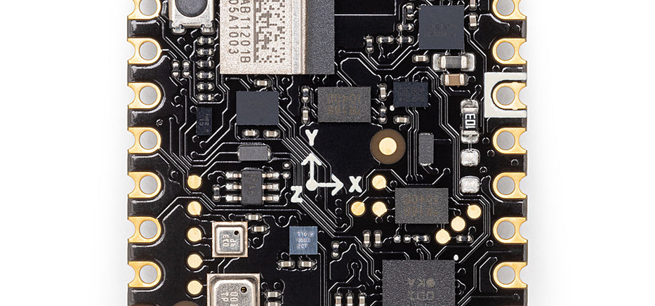
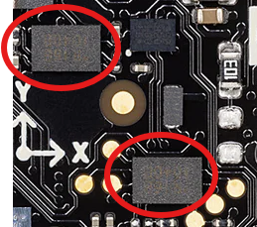
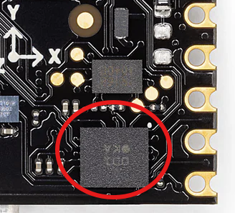
Arduino Nicla Sense ME
22,86 mm x 22,86 mm, ~ 2 g Weight
BHI260AP motion sensor system with integrated AI
BMM150 magnetometer
BMP390 pressure sensor
BME688 4-in-1 gas sensor with AI and integrated high-linearity, as well as high-accuracy pressure, humidity and temperature sensors.
Datasheet: https://docs.arduino.cc/resources/datasheets/ABX00050-datasheet.pdf

Slide 3
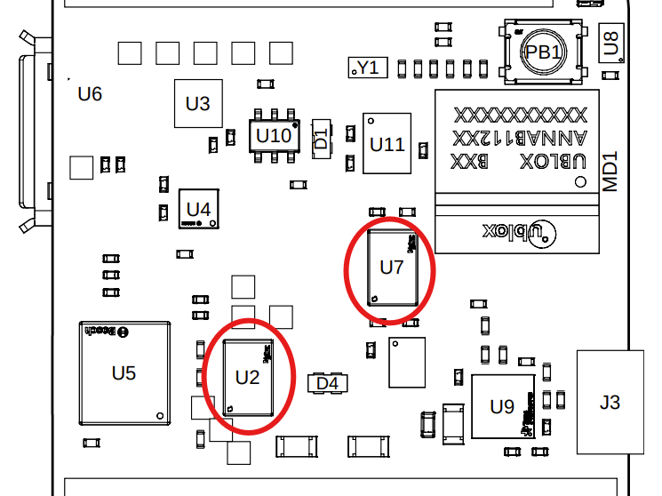
BHI260AP Flash Memory
On-board vs. Wireless Memory

Slide 4
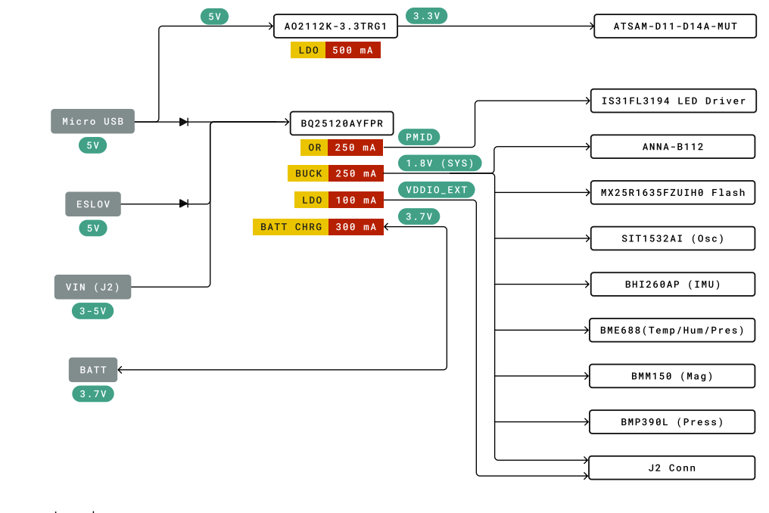
Power Consumption (General Statistics)
Page 13, Arduino Nicla Sense ME: https://docs.arduino.cc/resources/datasheets/ABX00050-datasheet.pdf

Slide 5
General Memory Considerations
Memory Type | Purpose / What It’s Good For | Capacity | Limitations
Internal Flash (512 KB) | Holds firmware, bootloader, other code + maybe small datasets; some OTA firmware space | 512 KB | Shared space; large code or ML models + libraries + BLE stack can use most of it; little room for large data storage
SRAM (64 KB) | Working memory: variables, stack, buffers | 64 KB | RAM is volatile, limited; can't hold large buffers; fragmentation or stack/heap overflow possible if too many libraries or high rate data handling
SPI Flash (2 MB) | Non-volatile data logging, raw sensor data, buffering during offline periods | 2 MB | Only ~2 MB → fills quickly at high sample rates; read/write speed slower; wear & write latency; power overhead when writing often
Sensor-dedicated QSPI 2 MB | For the BHI260AP internal needs: its own algorithms, calibration, possibly “execute-in-place” code in the sensor hub | 2 MB | Probably not fully accessible for user data; intended mostly for the sensor’s internal firmware / patches; constrained interfaces

Slide 6
Energy Consumption Comparisons
Flash Logging
Bluetooth Low Energy (BLE) Streaming
Total current: ~1.5–2.2 mA
IMU + hub baseline: ~1.2–1.9 mA
Flash write duty: +0.15–0.38 mA (page writes)
Data rate: 12 B/sample × 200 Hz = 2.4 kB/s (~8.6 MB/h)
2 MB SPI flash fills in ~14 min @ 200 Hz
6 h battery need: ≥100 mAh Li-Po (with margin)
~2–3× more energy-efficient
Best for: offline, low-power logging with later upload
Total current: ~4–6 mA
IMU + hub baseline: ~1.2–1.9 mA
Radio overhead: +3–4 mA (avg, 5–7 mA peaks)
Data rate: 2.4 kB/s (~19 kbps) over BLE
Unlimited logging time (requires receiver in range)
6 h battery need: ≥150–200 mAh Li-Po (with margin)
~2–3× less efficient than flash
Best for: real-time monitoring

Slide 7
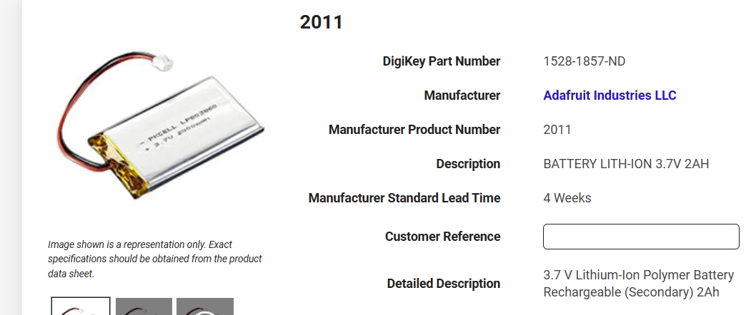
Battery Sizing
Flash logging: ~11 mAh for 6 h
→ Pick ≥100 mAh Li-Po (safe margin)
BLE streaming: ~30 mAh for 6 h
→ Pick ≥150–200 mAh Li-Po
In general: 100–150 mAh (flash) or 200–300 mAh (streaming)

Slide 8
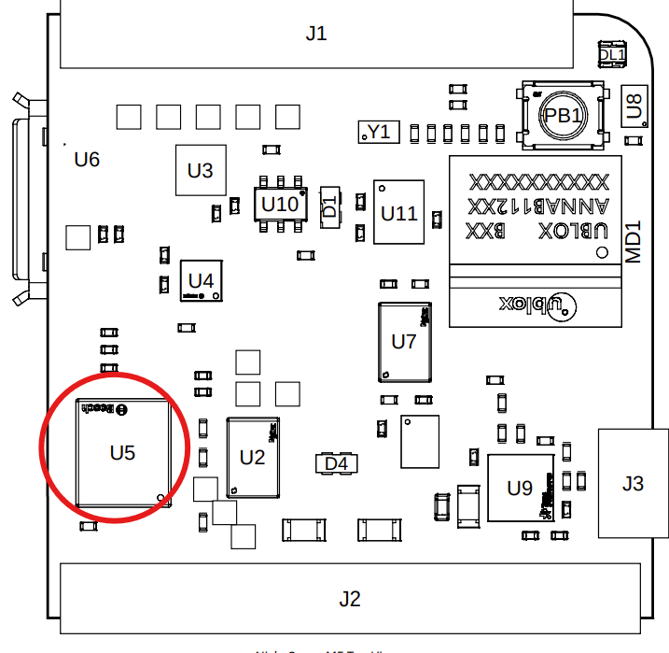
BHI260AP 6 axis IMU
Sampling Rate and Data Collection Calculations

Slide 9
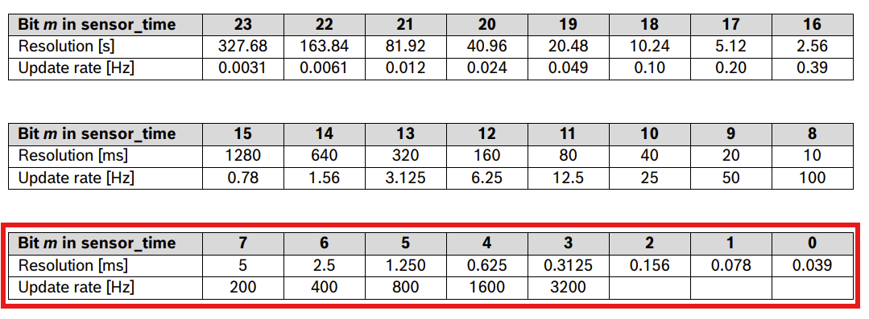
Sampling Rate
Data from BMI270 datasheet: https://www.bosch-sensortec.com/media/boschsensortec/downloads/datasheets/bst-bmi270-ds000.pdf

Slide 10
Sampling Rate Generalizations
On-board memory: 2 MB SPI Flash (limited for long logging)
Recommended: 200 Hz accel + gyro
Captures bumps, pecks, gait – no missed events
Data rate: 12 B/sample → ~2.4 kB/s → ~8.6 MB/hour
On-board flash fills in ~14 min at 200 Hz raw
Anything above the Nyquist of 100 Hz should capture the information well

Slide 11
Thank You
Purdue Polytechnic Institute

