Slide 1
Week 4
Keel Bone Chicken Project
02/06/26

Slide 2
This Week
Weekly Progress
Devices Prepared:
Devices all successfully flashed
Ready hand over to Agriculture department (Wednesday)
Website Updated:
Targeting time changed to 24 hours; live website changed to match
Sample Data Collected:
IMU Alarm data collected
Analysis of data
Purchase Reports:
Sensor form 12(s)
Transmitter Circuit
Creation of circuit and PCB

Slide 3
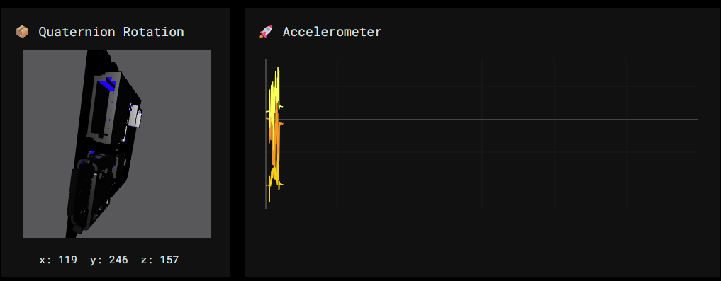
Devices Prepared
Devices all successfully flashed at varying rates
10 Hz
25 Hz
50 Hz
100 Hz
200 Hz

Slide 4
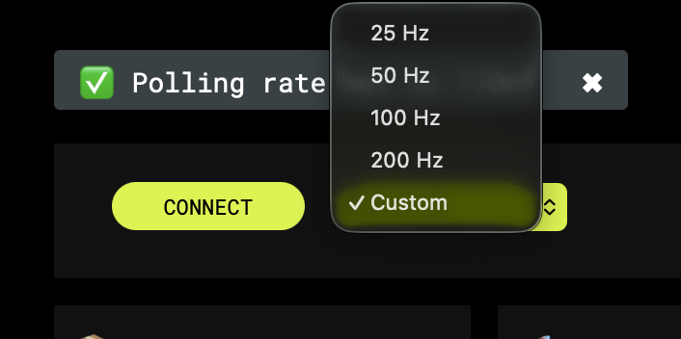
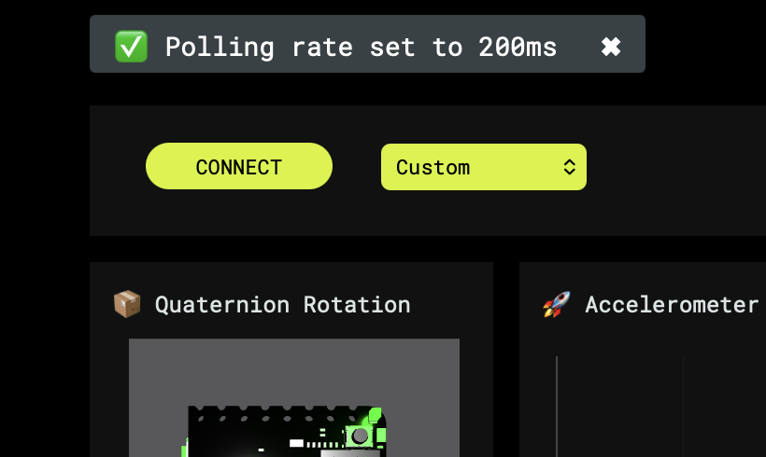
Devices Prepared
Ready hand over to Agriculture department (Wednesday)
Sampling Rate can now be adjusted before collecting data
In addition to changing sampling rate in firmware
Adds additional layer of verification
Easy and interactive for Agriculture department to use:
Notes:
Sabattical?
Leon Salas Weekly Meetings
Meeting Time

Slide 5
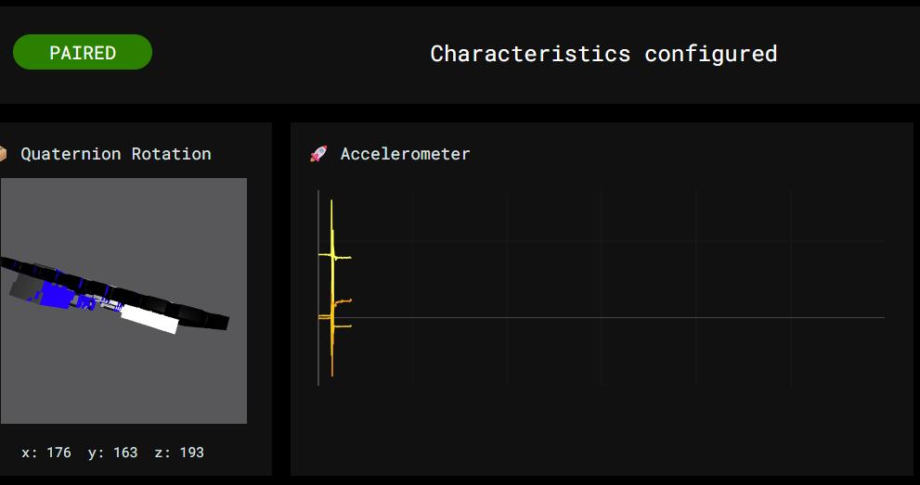
Website Updated
Targeting time changed to 24 hours; Live website changed to match
Verified through continuous 20-24 hour data collection period
No apparent adverse effects
Longer image spread:
Notes:
Sabattical?
Leon Salas Weekly Meetings
Meeting Time

Slide 6
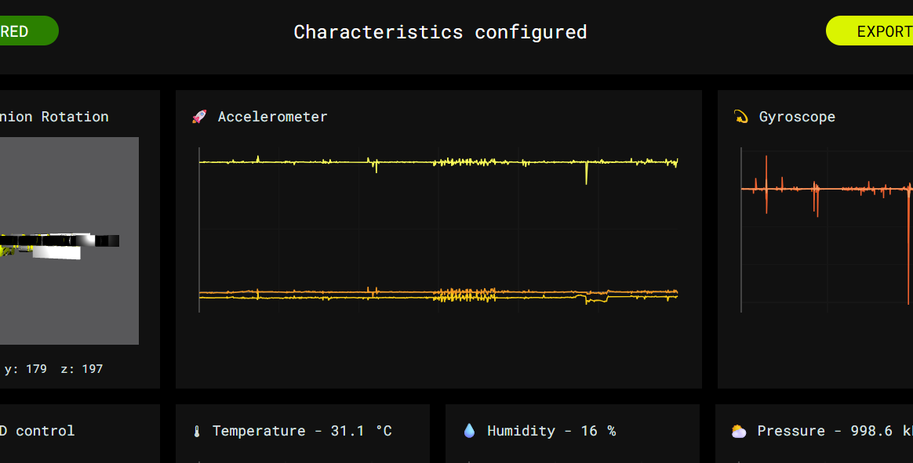
Sample Data Collected
IMU Alarm Data Collected
Slight perturbations from IMU visible from alarm vibrations
Test run and averaged over all 5 sampling rates
Notes:
Sabattical?
Leon Salas Weekly Meetings
Meeting Time

Slide 7
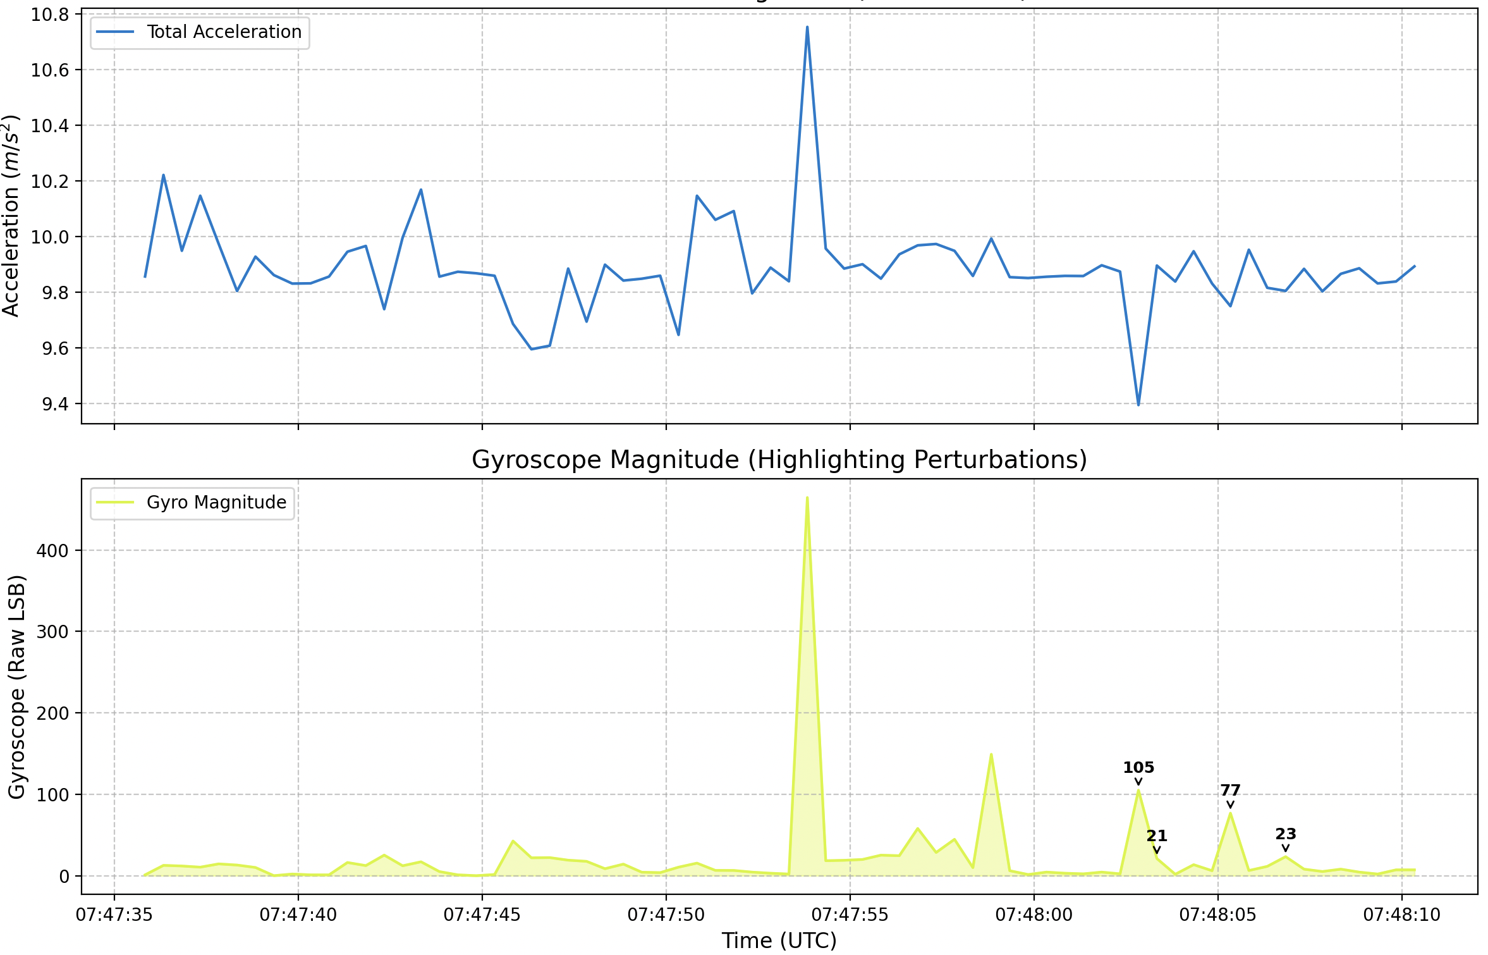
Sample Data Collected
Analysis of data
Python script to analyze if the small perturbations are correct
Seems initial vibration causes a major initial spike
9.8 -> 10.8 m/s^2
Conversion rate: 1g ~ 4096 LSB
Bit notation of the senso gets converted to raw acceleration
Notes:
Sabattical?
Leon Salas Weekly Meetings
Meeting Time

Slide 8
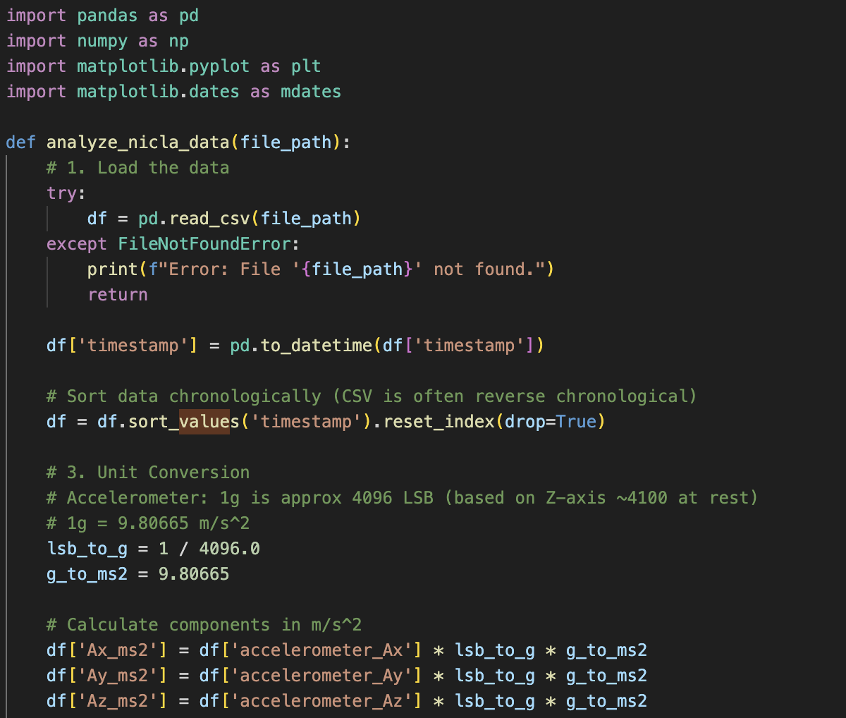
Sample Data Collected
Program used for data capture
Notes:
Sabattical?
Leon Salas Weekly Meetings
Meeting Time

Slide 9
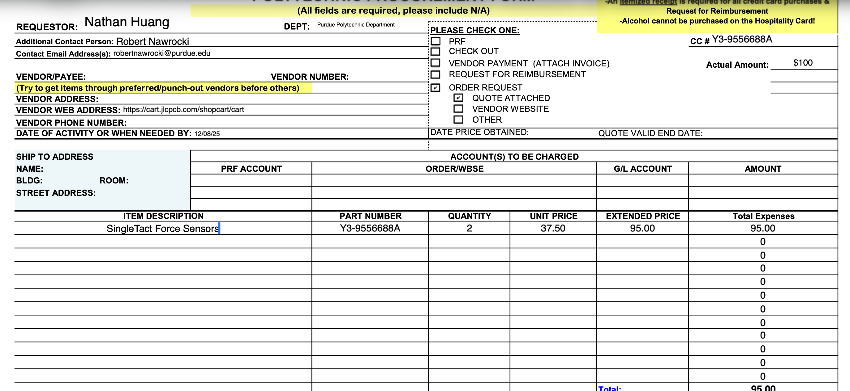
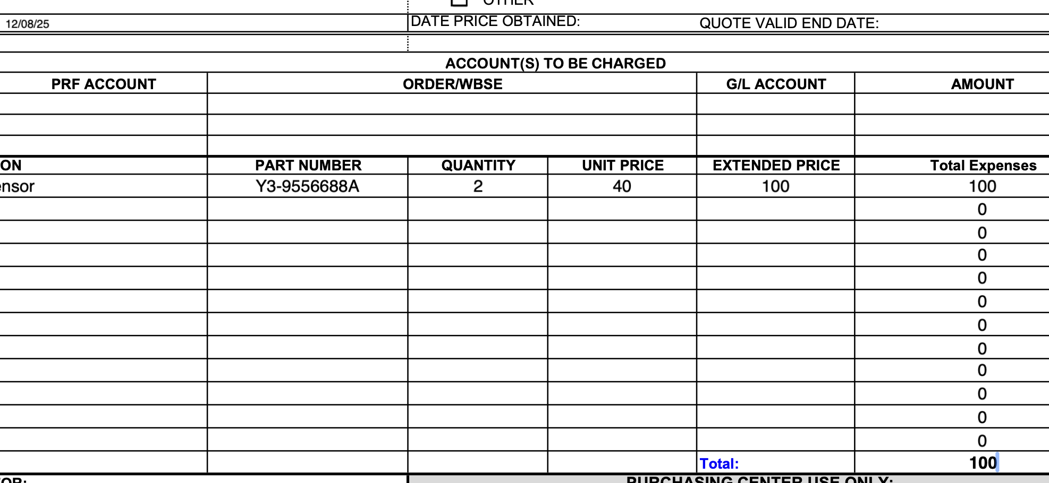
Purchase Reports
Sensor form 12(s)
Form 12 for strain gauge
Form 12 for force sensor
Notes:
Sabattical?
Leon Salas Weekly Meetings
Meeting Time

Slide 10
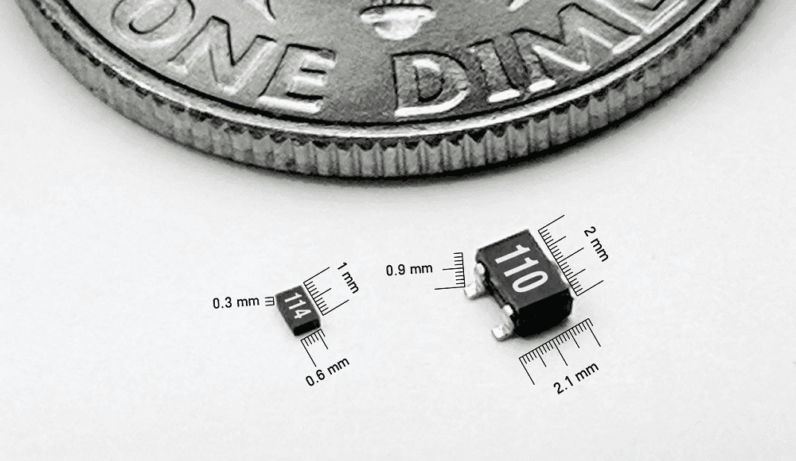
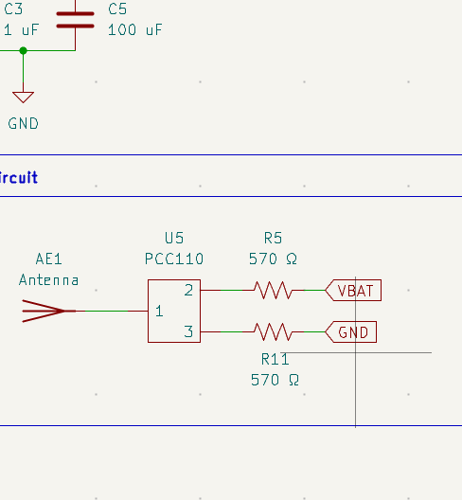
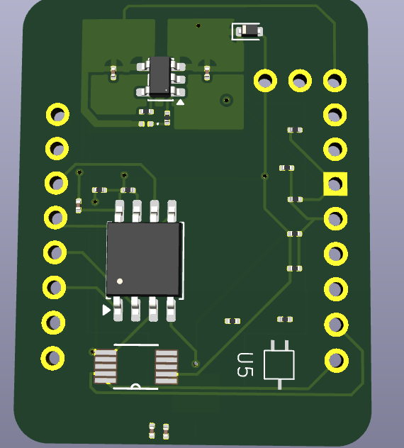
Transmitter Circuits
KiCAD Transmitter PCB and Circuits
Created custom footprint for PCC110
Changed footprints and circuit
Updated PCB location and wiring
Found suitable Antenna for PCC110 Harvester
Verified with Powercast support
PCC110 Sizing
PCC110 RFID Circuit
PCC110 RFID PCB
Notes:
Sabattical?
Leon Salas Weekly Meetings
Meeting Time

Slide 11
Next Week
Plans & Blockers
More Data Analysis of IMU
Obtain Powercast RFID -> DC Converters from Agriculture
Verify Powercast RFID circuits on breadboard
Research Papers:
IEEE
Transactions on Electronics Circuits and Systems
2 – 5 pages
1 – Long Journal
IoT Journal <-
Transactions on Industrial Electronics
Electronics DPI
Notes:
Sabattical?
Leon Salas Weekly Meetings
Meeting Time

Slide 12
Thank You
Purdue Polytechnic Institute

