Slide 1
Week 6
Keel Bone Chicken Project
06/29/26

Slide 2
This Week
Weekly Progress
Testing Updates
Arranging a time to meeting with Pedro
Firmware Changes
New Firmware flashed onto Arduino
Database Updates
Demo of Current Progress
Improvements Made (1)
Improvements Made (2)
Supply Updates
Initial Issue with Cabling
Proposed Solution
Purchased Solution
Pending Request in CIO
Next Week
Goals for next week

Slide 3
Testing Updates
Arranging a time to meeting with Pedro
As stated last week, Pedro Barbosa is a PhD candidate in Industrial Engineering (IE)
No further authorization is needed, he just needs to let me into the facility
Says the Piezoelectric testing of the system is feasible
Requested a detail diagram of the system
Still working on this
Likely we will meet after the 4th of July weekend (7/6)
Will keep updates

Slide 4
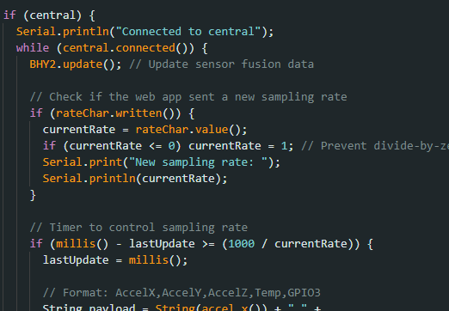
Firmware Changes
New Firmware flashed onto Arduino
Simple code to test all sensors connecting to database
Reduced all unnecessary links in code to reduce bugs

Slide 5
Database Changes
Demo of Current Progress
Video of Logging: https://www.youtube.com/watch?v=GDCnnC6DZ4

Slide 6
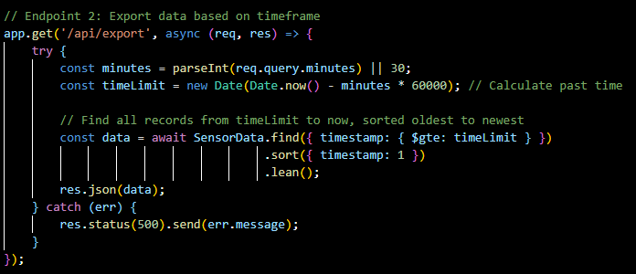
Database Changes
Improvements Made (1)
Logger time frame now only exports the needed data
Device UUID is now characterized so it is easy to identify
Previous Bugs: was calling database from all items
New Code seen below:

Slide 7
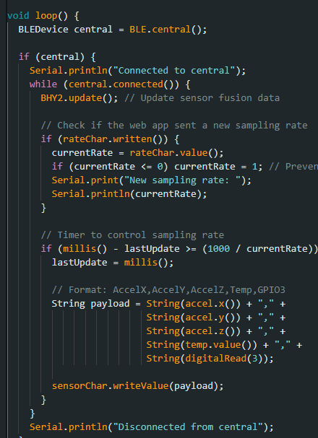
Database Changes
Improvements Made (1)
Backend Database Package has full integrity
All entries packaged and present
Built simple, light test app to verify

Slide 8
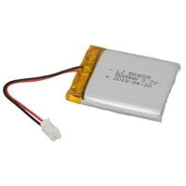
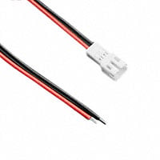
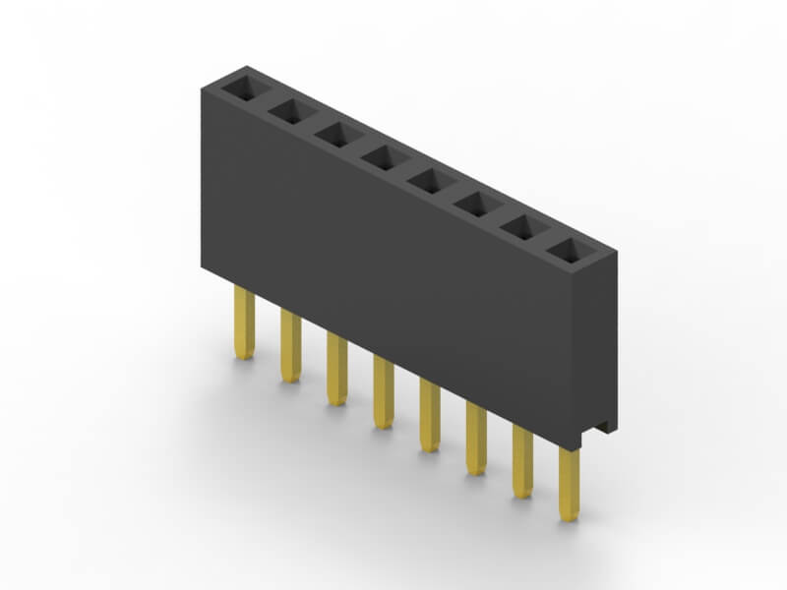
Supply Updates
Initial Issue with Cabling
As presented last week, the Battery is a JST PH 2 Pin Female Cable:
https://www.digikey.com/en/products/detail/jameco-electronics/LJ503035/25966108?s=N4IgTCBcDaIDIEsAKB7ABAVgAwGZcZAF0BfIA
The cable needs to connect a JST PH 2 Pin Male → Single Pin DuPont Casing
These do not commercially exist

Slide 9
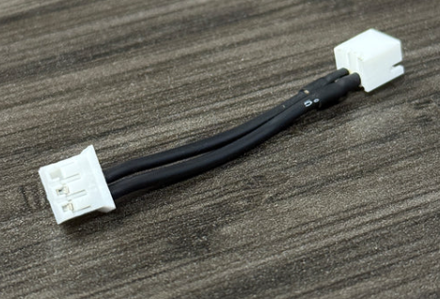
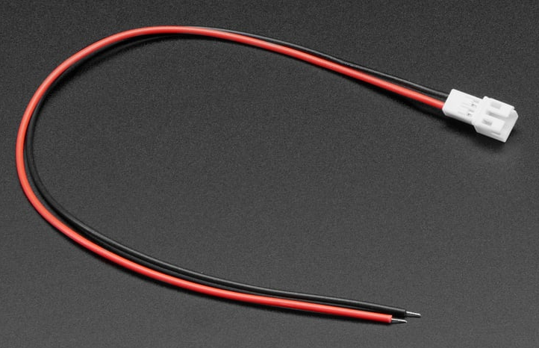
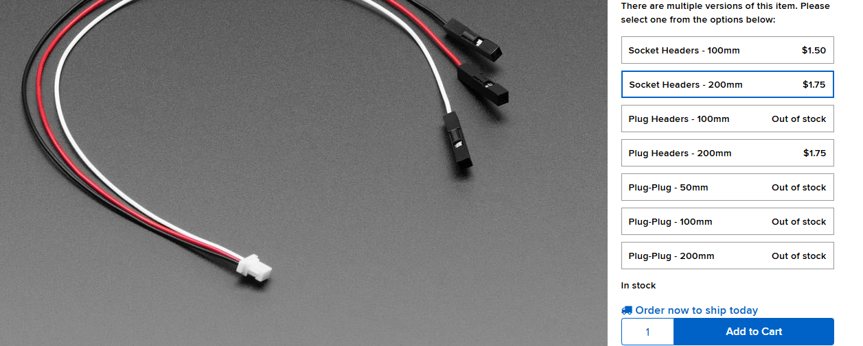
Supply Updates
Proposed Solution
A lot of these wires exist, but none fit the given specification
Seen below, one of these ends is always wrong or not specified with the correct header casing
One approach is to use the right picture and connect a 3-pin male header → 2 pin male header, as seen below, but we would lose a lot of signal integrity

Slide 10
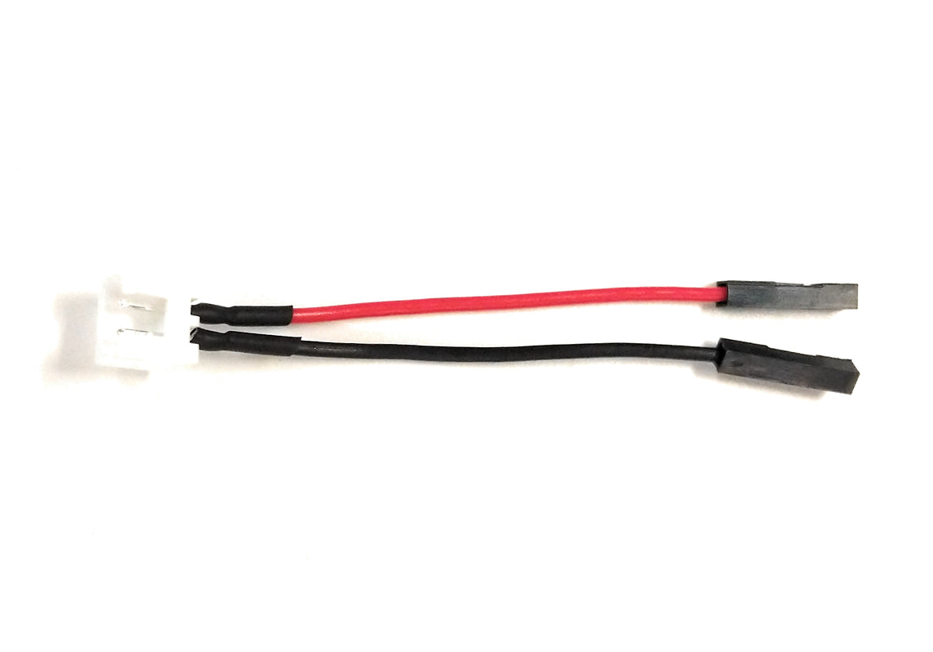
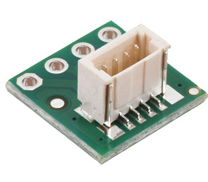
Supply Updates
Purchased Solution
What I think is the best solution is to use an alternative cable with no adverse effects
The GPIO header on most boards uses the same connector, so we can take advantage of that
A version of the DuPont header to GPIO 2 JST Pin Male Header exists, which is exactly what we need
We might run into signal integrity issues, but there will be no connectivity issues. This version is also short (as the Agriculture department requested)

Slide 11
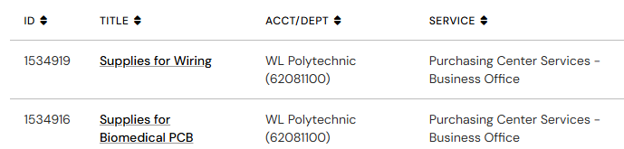
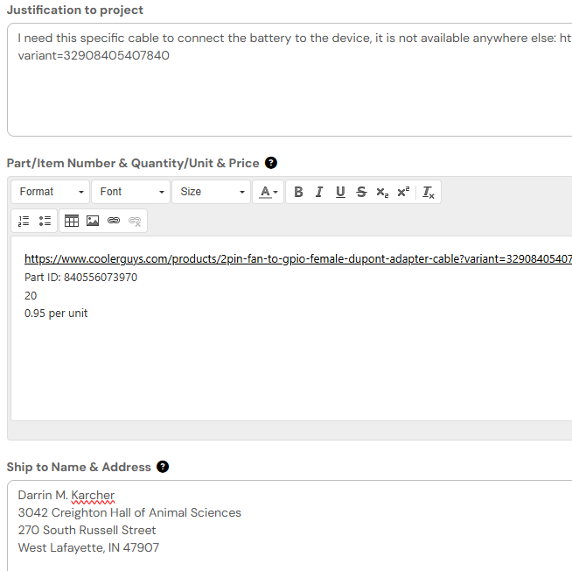
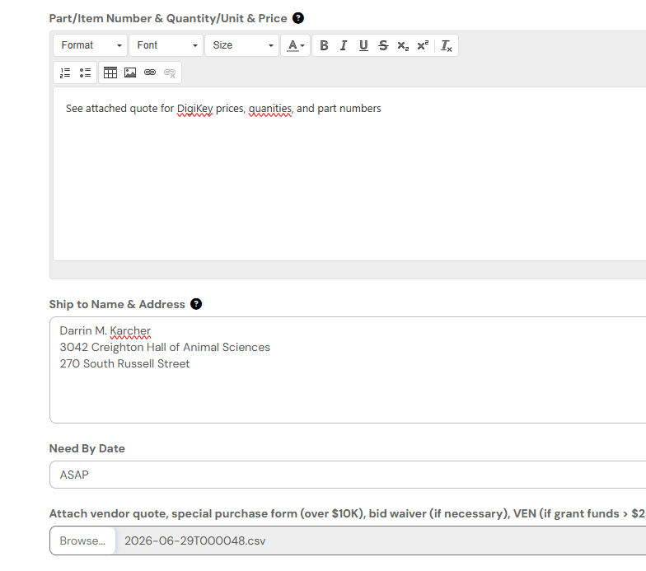
Supply Updates
Pending Request in CIO
Purchase Links
2 Pin Male JST to 2 Separate Female Headers (10)
2-PIN Male JST to 2 Wires (10)
Female Header to Female Header 5 cm (20)
Requested through Purdue CIO (2) Requests): Waiting on Approval

Slide 12
Next Week
Goals for next week
Finish System characterization and diagram for Pedro
Ensure shipment is approved and gets sent to Professor Karcher
Ideate changes for Nicla backpack

Slide 13
Thank You
Purdue Polytechnic Institute

