Slide 1
Week 6
Keel Bone Chicken Project
06/29/26

Slide 2
This Week
Weekly Progress
Database Updates
Local Hosting Enabled
Expanded Test Code from Last Week
Web Logger Updates
MongoDB UI now in use
Data Export Functional Fixes
Supply Updates
Shipment dates
Testing Updates
Characterization Sent
Next Week

Slide 3
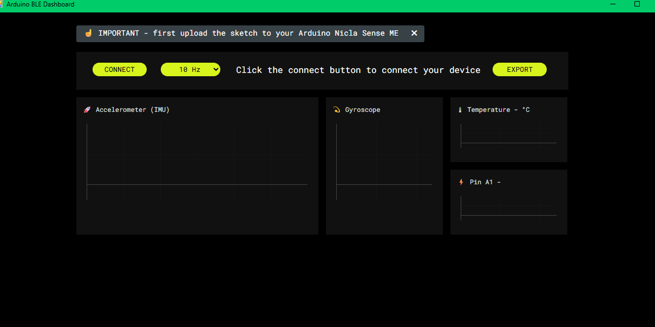
Database Updates
Local Hosting Enabled
MongoDB Key is now optional
Can be hosted on local machine (without use of web application)
Need to walk Agriculture department through the steps
Example of Mongo URI Key below:
Running as GUI application now

Slide 4
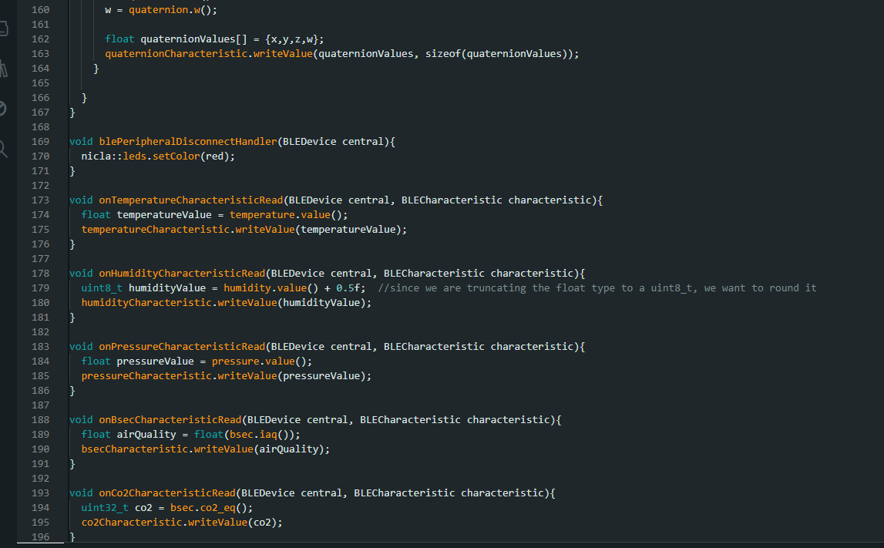
Database Updates
Expanded Test Code from Last Week
Expanded Simple Test Code from Last Week
Got working version of test code → working logger on localhost
Code seen below:

Slide 5
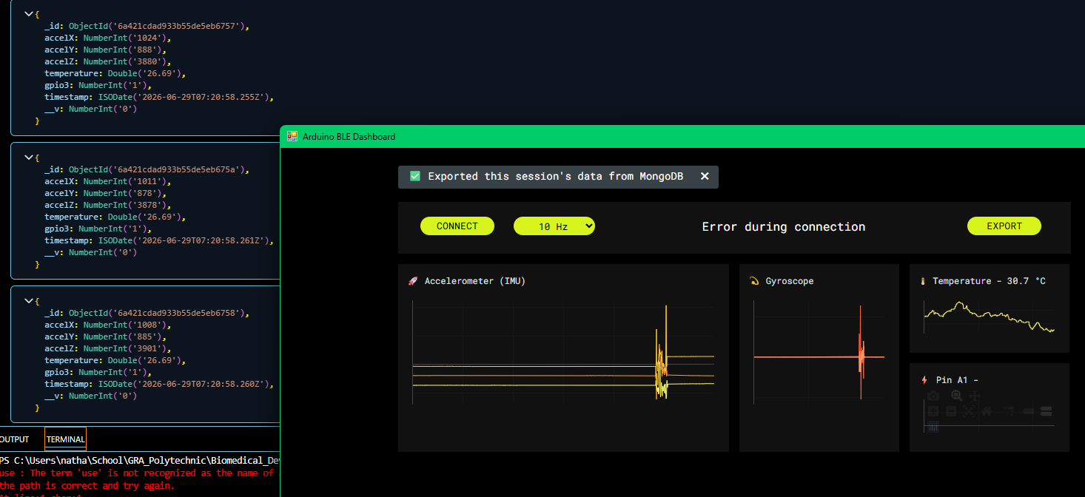
Web Logger Updates
MongoDB UI now in use
MongoDB UI in use (over MongoDB Altas)
Connection string is now: localhost:12701
Image of data being loaded seen below

Slide 6
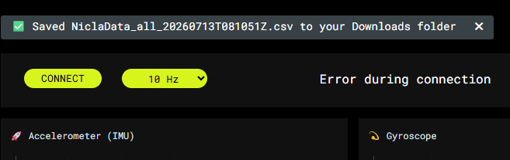

Web Logger Updates
Data Export Functional Fixes
Fixed functional issue where download would go to unexplored path
Fixed logger download time to sync up with real world time

Slide 7
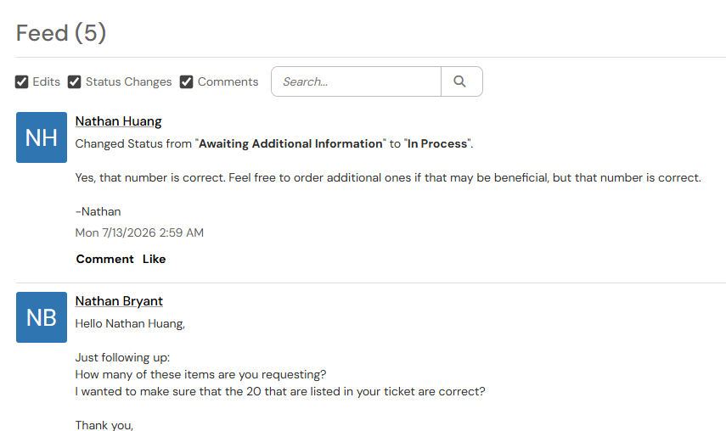
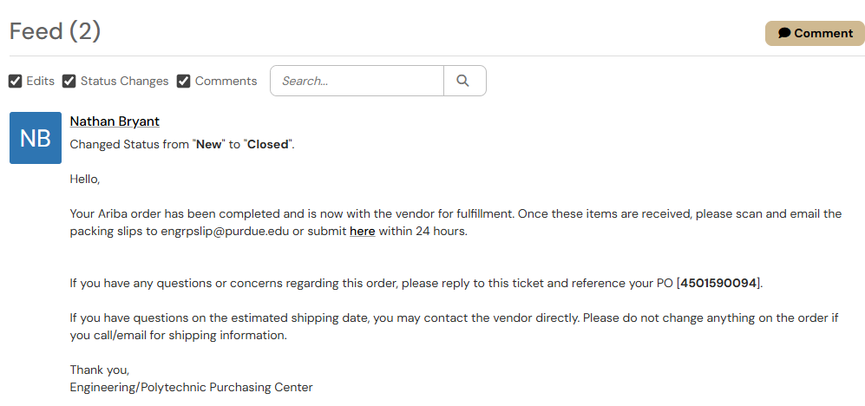
Supply Updates
Shipment Dates
First purchase request filled (PO 4501590095 UPS)
Shipment should have arrived last Friday, need to verify with Professor Karcher
Second pending (Verified that the number is correct)
This shipment should arrive by the end of the week given it goes through approvals quickly

Slide 8
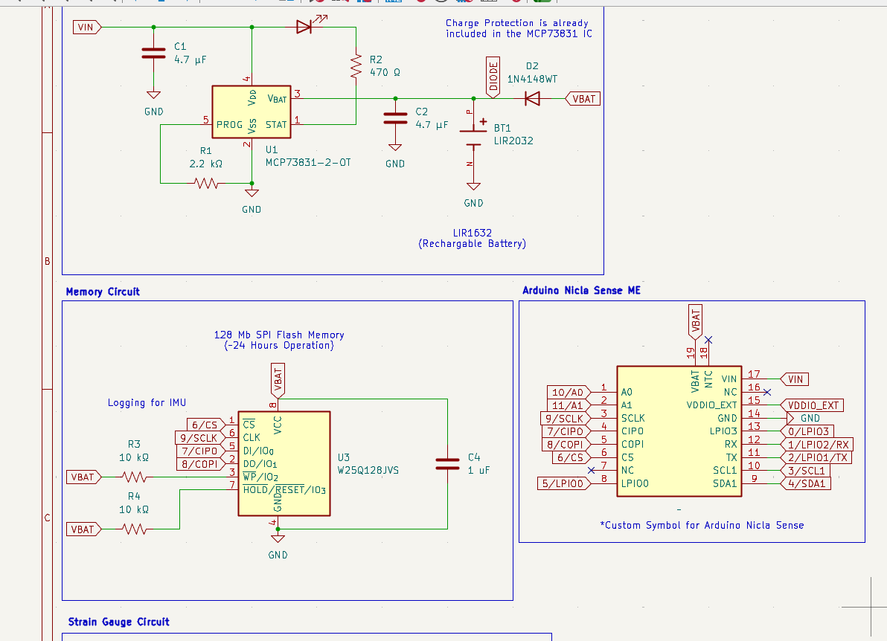
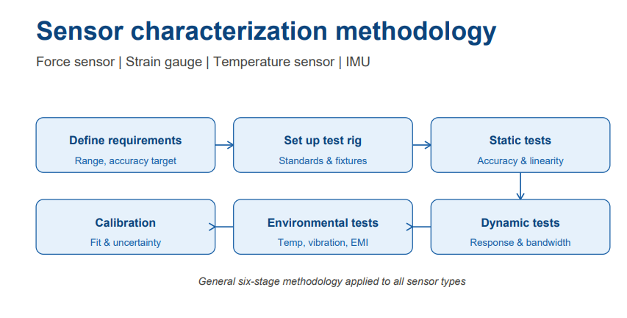
Testing Updates
Characterization Sent
Pedro requested characterization of the Sensors
Sent as rudimentary diagram (see below)
Also sent as PNG for easier system design view
After approval, should plan for Friday to test sensors

Slide 9
Next Week
Goals for next week
Check on shipment and hardware check with Professor Karcher/Omosalewa
Verify characterization method with Pedro
Continue work on database with application efforts

Slide 10
Thank You
Purdue Polytechnic Institute

