Slide 1
Week 7
Keel Bone Chicken Project
02/20/26

Slide 2
This Week
Weekly Progress
Furthered Data Analysis of IMU
New Study Conducted
Verification Successful
Research on RF to DC Converters
915 MHz Band Research Paper
DigiKey Parts Ordering
Parts List Curated – F Number Required (Procurement Office)
Agriculture Components
Sent electrical components needed for study to department

Slide 3
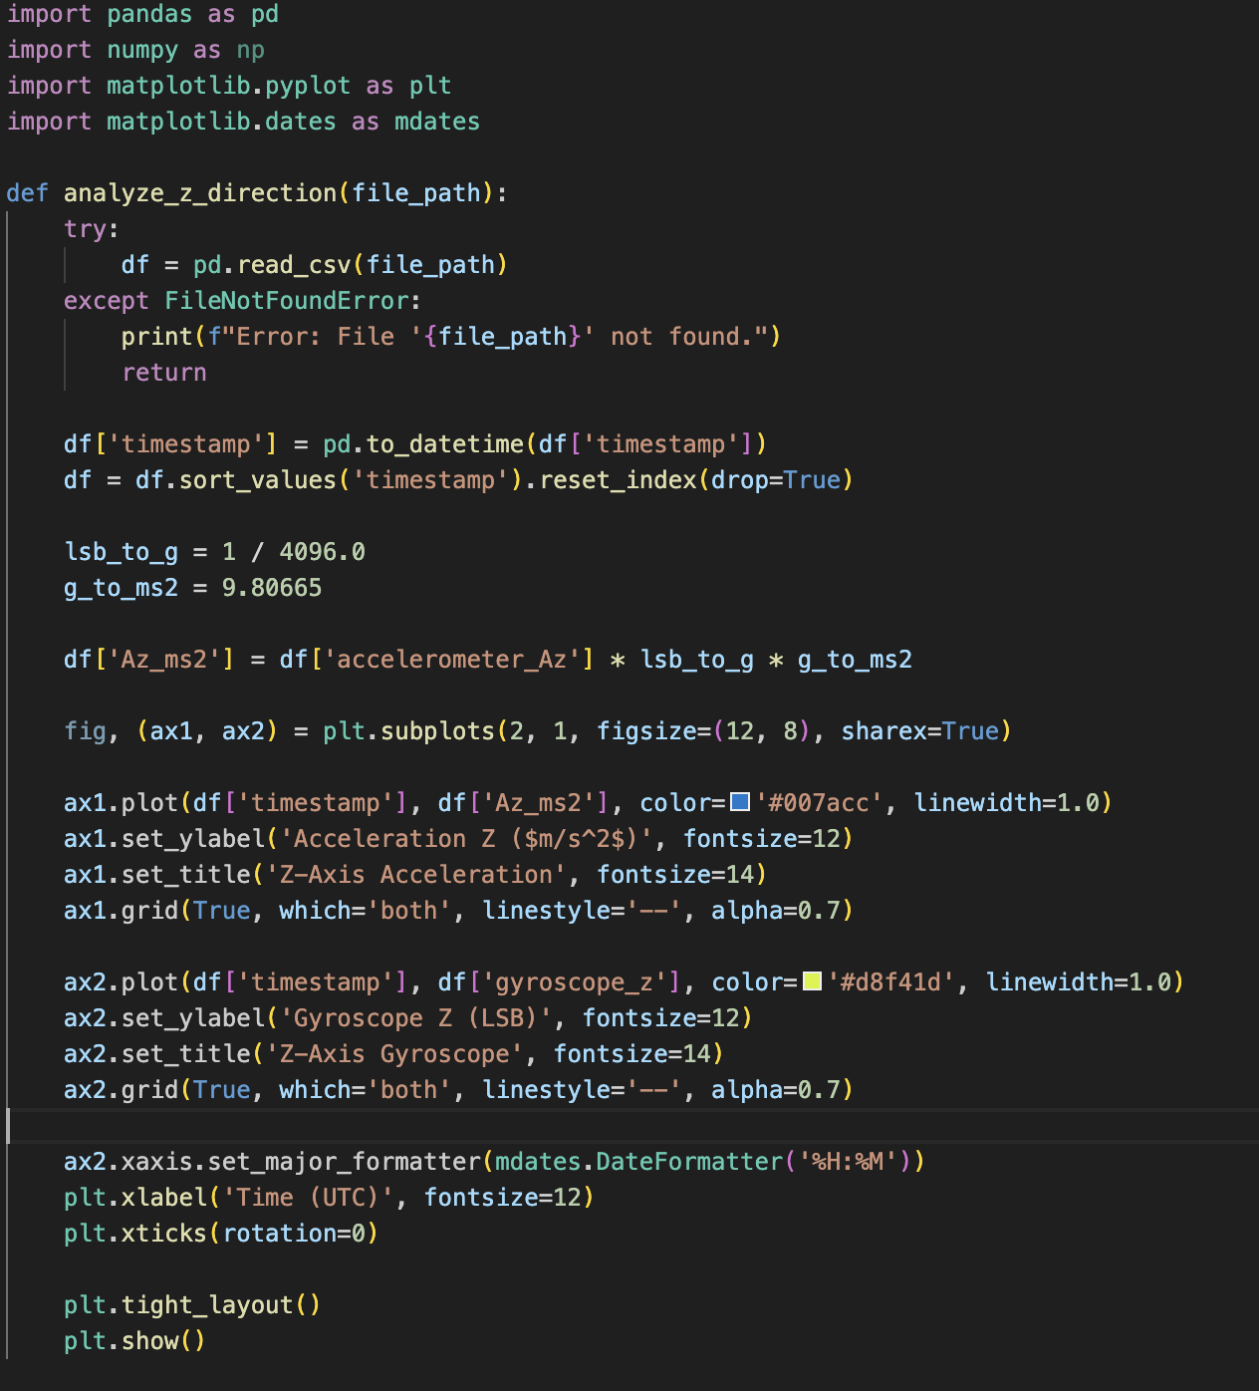
Furthered Data Analysis of IMU
New Study Conducted
Ran study for longer period of time ~60 minutes
Results were very similar (next slide)
Data analysis was done with the following Python script

Slide 4
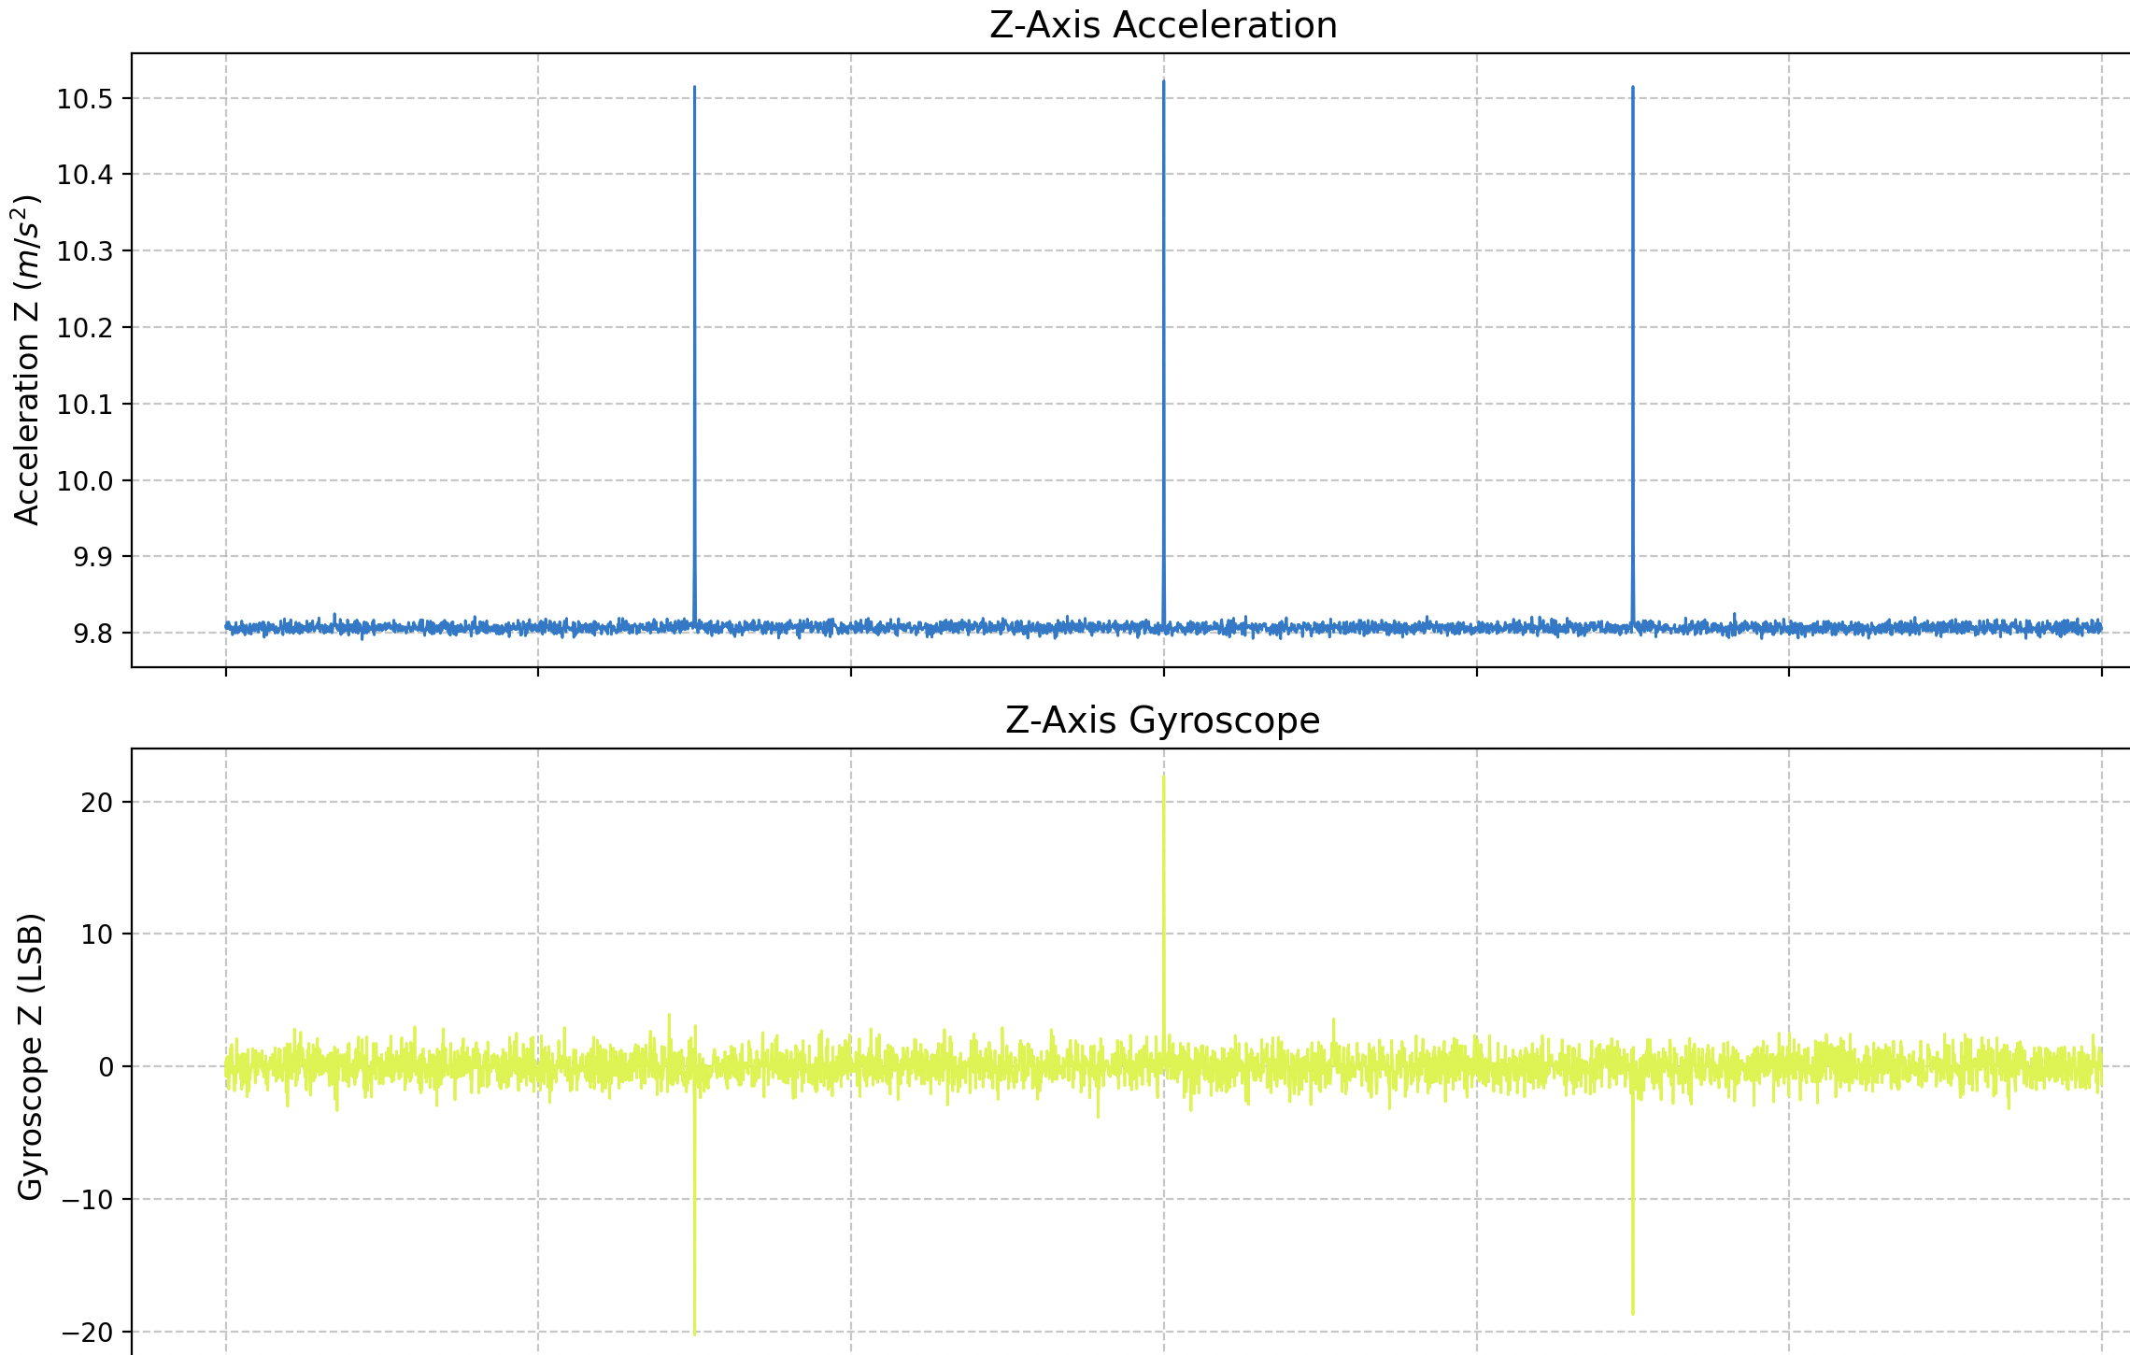
Furthered Data Analysis of IMU
Verification Successful
Results seemed to match the first study
9.8 m/s^2 acceleration amplified to around 10.5-10.8 m/s^2
Verified with magnitude and z-axis movement
Z-axis movement seemed to be the most substantial

Slide 5
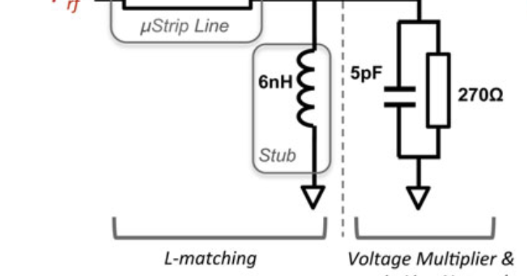
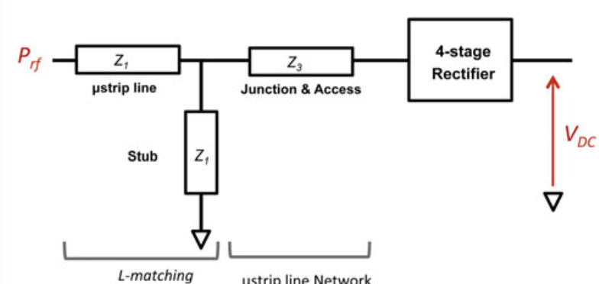
Research on RF to DC Converters
915 MHz Band Research Paper
Very little circuitry needed to run the RF to DC converter successfully
Still need to acquire circuit components (harder than anticipated)
Fundamental Theory is very strong
System and Circuit Diagrams to the right
Works cited on last slide

Slide 6
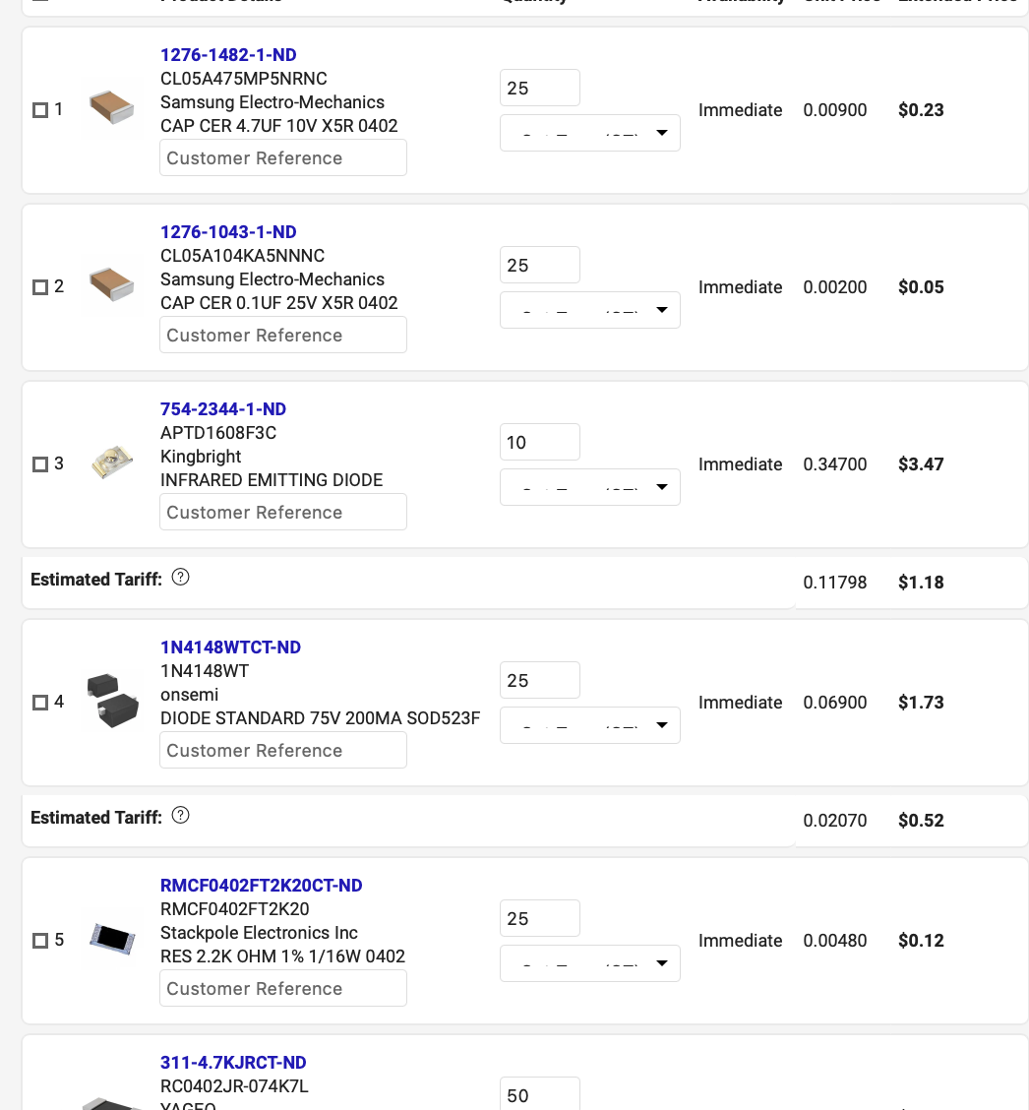
DigiKey Parts Ordering
Parts List Curated – F Number Required (Procurement Office)
F Number needed to subvert filling out of Form 12 repetitively
DigiKey and Mouser Orders can be filed and filled remotely
Cart for needed PCB components already setup:
https://www.digikey.com/short/p757fqdw
~$30 Total

Slide 7
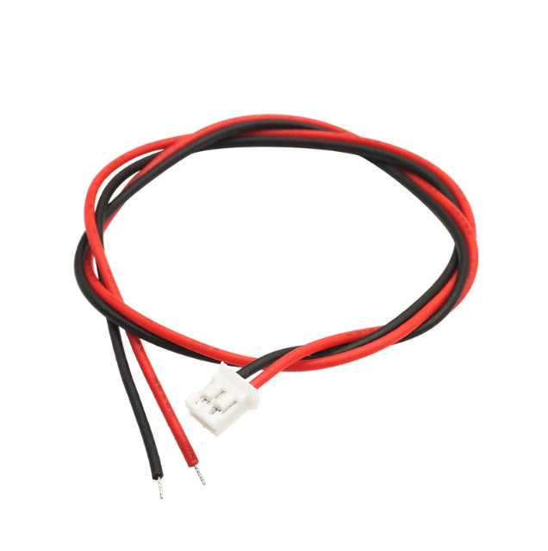
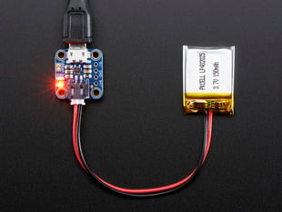
Agriculture Components
Sent electrical components needed for study to department
USB-A -> LiPo Charger
JST PH 2mm 2-Pin to Female Socket Cable - 200mm

Slide 8
Next Week
Plans & Blockers
Begin foundations of research paper (Overleaf)
Ensure that agriculture study has gone successfully and there are no blockers
Research American PCB vendors to order assembled PCB from
Unable to use Chinese vendors (PCBWay, JLCPCB) anymore
Notes:
Sabattical?
Leon Salas Weekly Meetings
Meeting Time

Slide 9
Works Cited
J. G. D. P. Pinto, H. J. C. P. Oliveira, and N. B. Carvalho, "RF energy harvesting and remote powering at 900MHz and 2.4GHz," in 2015 IEEE Wireless Power Transfer Conference (WPTC), Boulder, CO, USA, 2015, pp. 1-3.

Slide 10
Thank You
Purdue Polytechnic Institute

