Slide 1
Week 8
Keel Bone Chicken Project
02/23/26

Slide 2
This Week
Weekly Progress
PCB Updates
Handling of Physical PCBs
New Vendor & Vertical Dividers
New Layout for Revision 5
Placement of RFID Charging on Board
Selection of Thermometer
Placement on PCB
Purchasing Requests
Sensors
Cabling
Data Updates & Research
Time Zone Issue Resolved
Research into

Slide 3
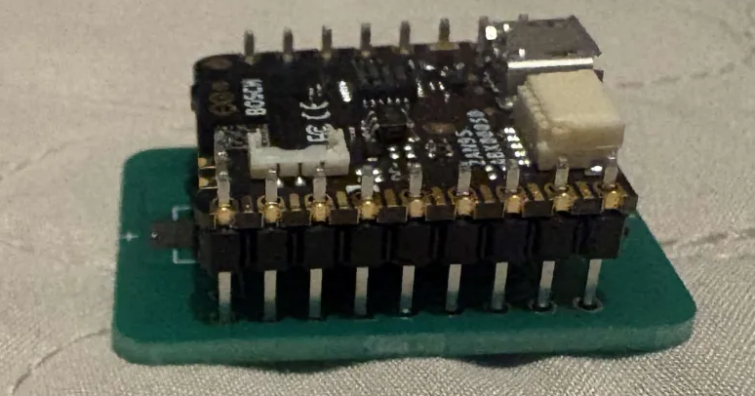
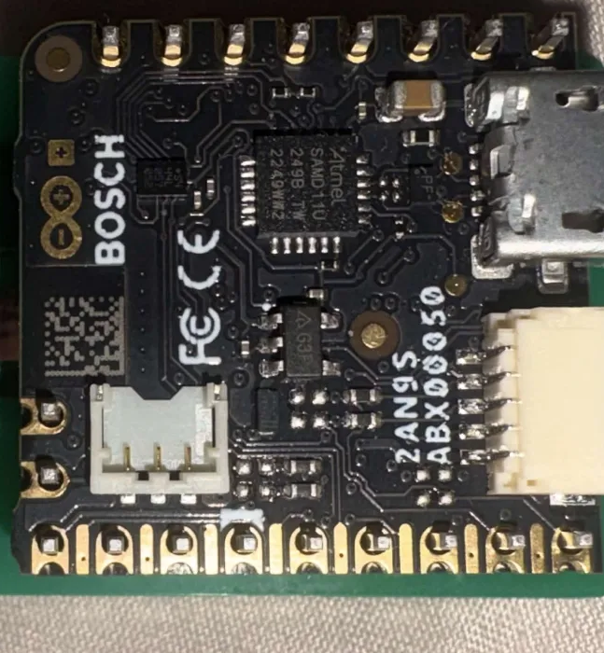
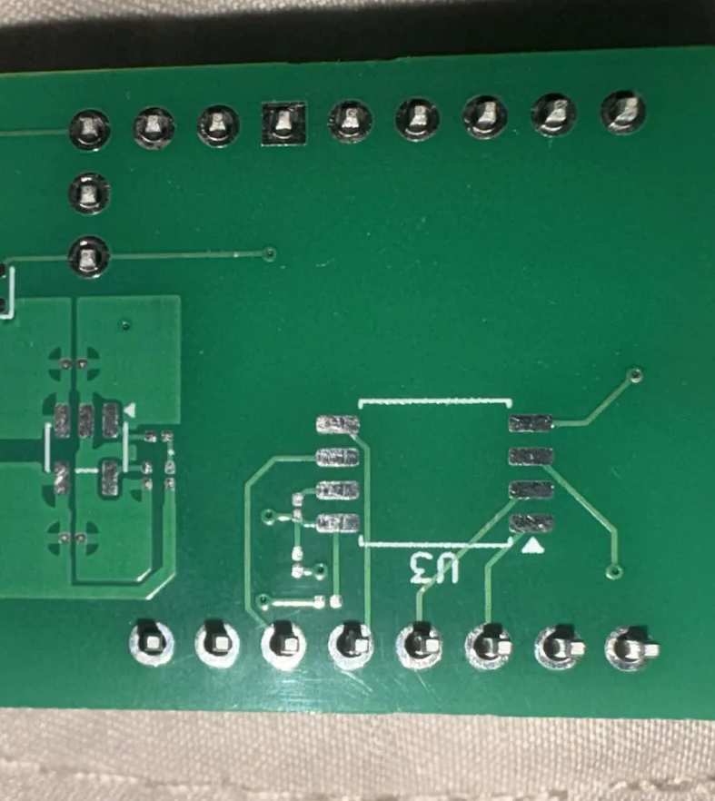
PCB Updates
Handling of Physical PCBs
PCBs have been partially soldered
Slight alignment errors that need to be analyzed
Final Approximate Volume:
29.20 mm x 29.20 mm x 11.50 mm = 9.80 cm^3

Slide 4
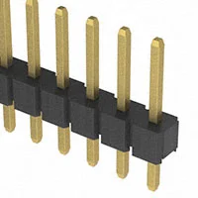
PCB Updates
New Vendor & Vertical Dividers
Black plastic insulating base stripped from existing pin headers and attached to PCB
Doubles the distance between the PCBs and allows for better heat dissipation
Leads to a very tight fit and little heat lost
New Vendor for PCBs: DL-Engineering, LLC
Indiana based company
Fast lead times
Interaction with engineers for validation
Based on Professor Berry’s input, have already reached out: https://dl-engineering.com/contact-us
Also considering 7PCB.com, based on Professor Salas’ input: https://www.7pcb.com

Slide 5
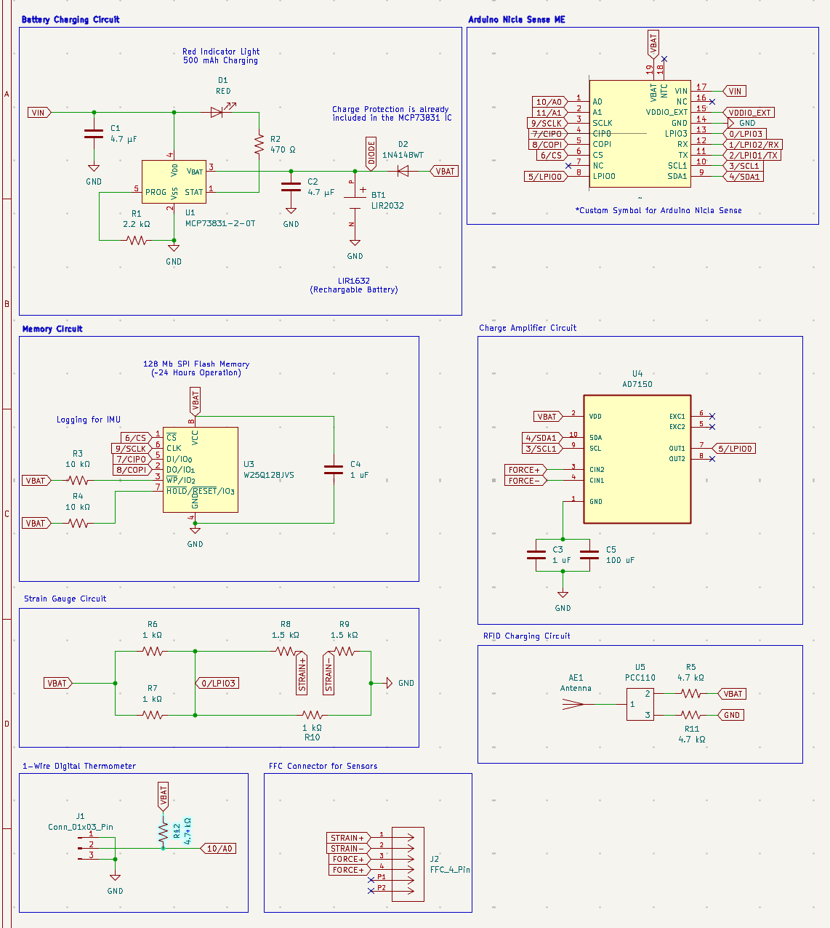
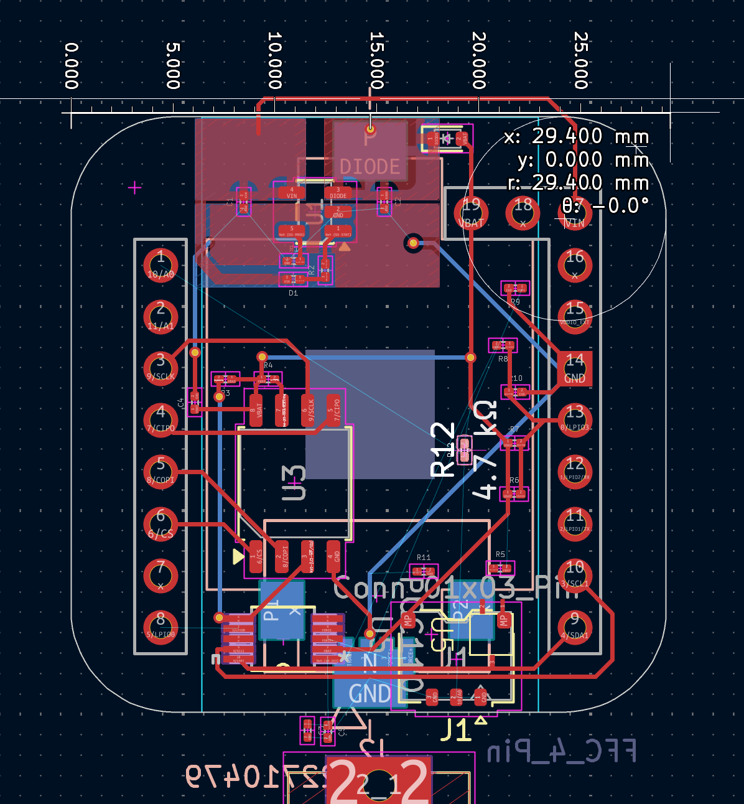
PCB Updates
New Layout for Revision 5
Size increased to 29.20 mm (~30 mm) square area
Sizing expanded to accommodate:
3 Pin JST (Thermistor), FFC Cable, Antenna
FFC located with 4 Pins for Charge and Strain
RFID Charging Managed with Minimal Circuitry

Slide 6
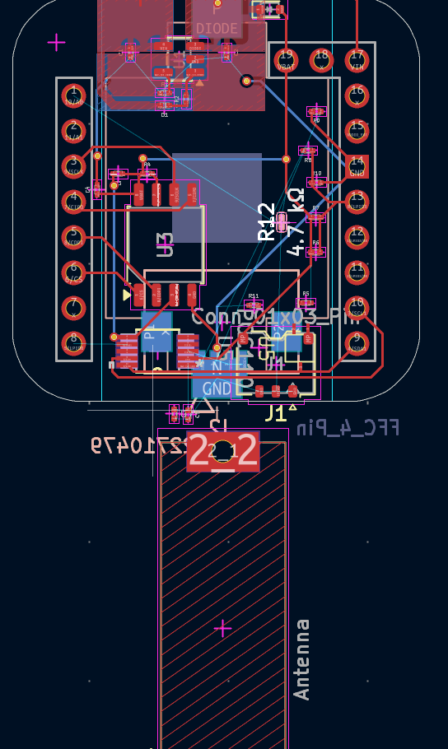
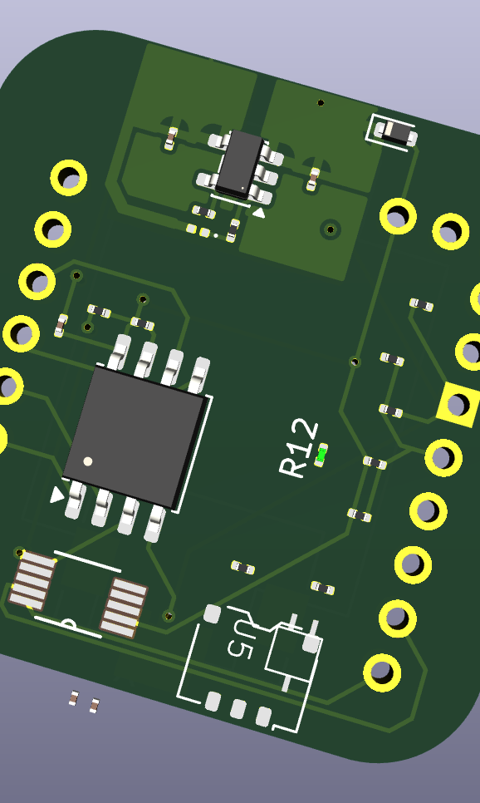
PCB Updates
Placement of RFID Charging on Board
Positioning of Antenna on Board
Antenna will hopefully pop OUT of the backpack to receive signal
~35 mm antenna (3.5 cm of extrusion)

Slide 7
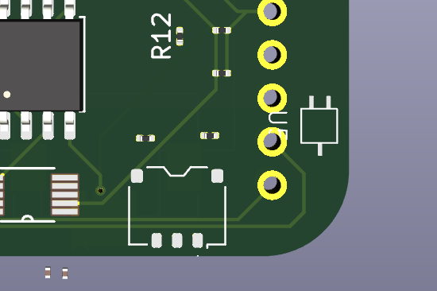
Selection of Thermometer
Placement on PCB
Placed at the edge for minimal interference
Three Pins:
Ground
Power
Signal (LPIO)

Slide 8
Purchasing Requests
Sensors
Thermometer: SNS-TMP-DS18B20-MAXIM
https://www.digikey.com/en/products/detail/olimex-ltd/SNS-TMP-DS18B20-MAXIM/21662296?gclsrc=aw.ds&gad_source=1&gad_campaignid=20232005509&gbraid=0AAAAADrbLliegx82J5vpe0y_dSkosqPHq&gclid=CjwKCAiAkvDMBhBMEiwAnUA9BWWfq8euNs4YlOp4R3yMrWfnmcKLHueiwK5gKe5NqGmmtLZWDIv-0xoCUsoQAvD_BwE
Force: C4A-XX-125SL-120-23P
https://www.digikey.com/en/supplier-centers/micro-measurements

Slide 9
Purchasing Requests
Cabling
JST Housings
https://www.adafruit.com/product/261?srsltid=AfmBOoqKFq32RkdNJbVjYIHT7c1LhXjM035h4cGkiIayPoPf2IxK2BJw
DuPont Housings:
https://www.digikey.com/en/products/filter/rectangular-connectors/rectangular-connector-housings/319
AWG Wire Housings:
https://www.digikey.com/en/products/detail/te-connectivity-amp-connectors/321026/299225
LiPo Battery Chargers:
*JST to DuPont Housings do not exist, the Agriculture department must make them (instruction will be provided)

Slide 10
Next Week
Plans & Blockers
Obtain data from agriculture and validate data
Begin first draft of paper
Notes:
Sabattical?
Leon Salas Weekly Meetings
Meeting Time

Slide 11
Thank You
Purdue Polytechnic Institute

