Slide 1
Week 13
Keel Bone Chicken Project
03/30/26

Slide 2
This Week
Weekly Progress
PCB Updates
Rev. 6 PCB created with optimal sizing for given backpack
Pin Header sizing
Non-essential components removed for Rev. 4
Powercast Updates
NDA issues with procurement of information
Paper Updates
Meeting with Professor Salas today

Slide 3
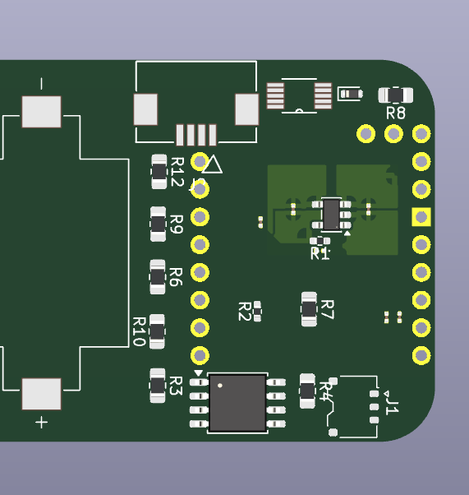
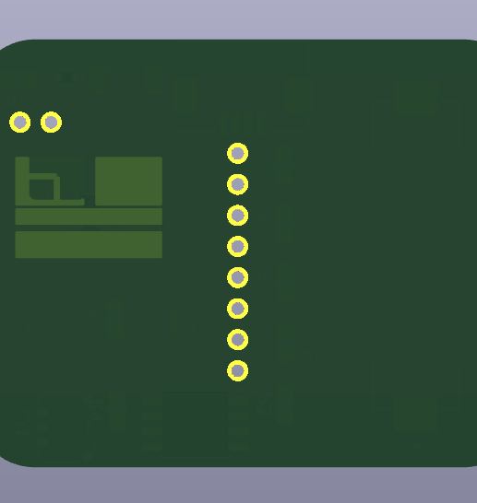
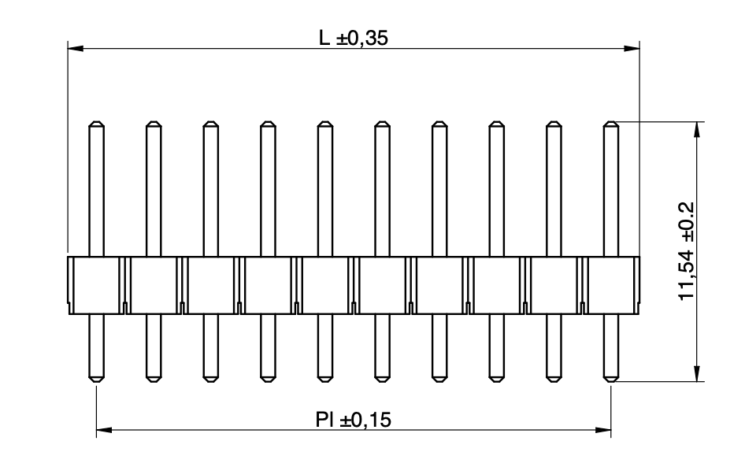
PCB Updates
Rev. 6 PCB created with optimal sizing for given backpack
Created to accommodate 35 x 45 x 17 mm size of backpack
All components fit on single side of board
Pin header sizing will not be an issue (~11.54 mm)

Slide 4
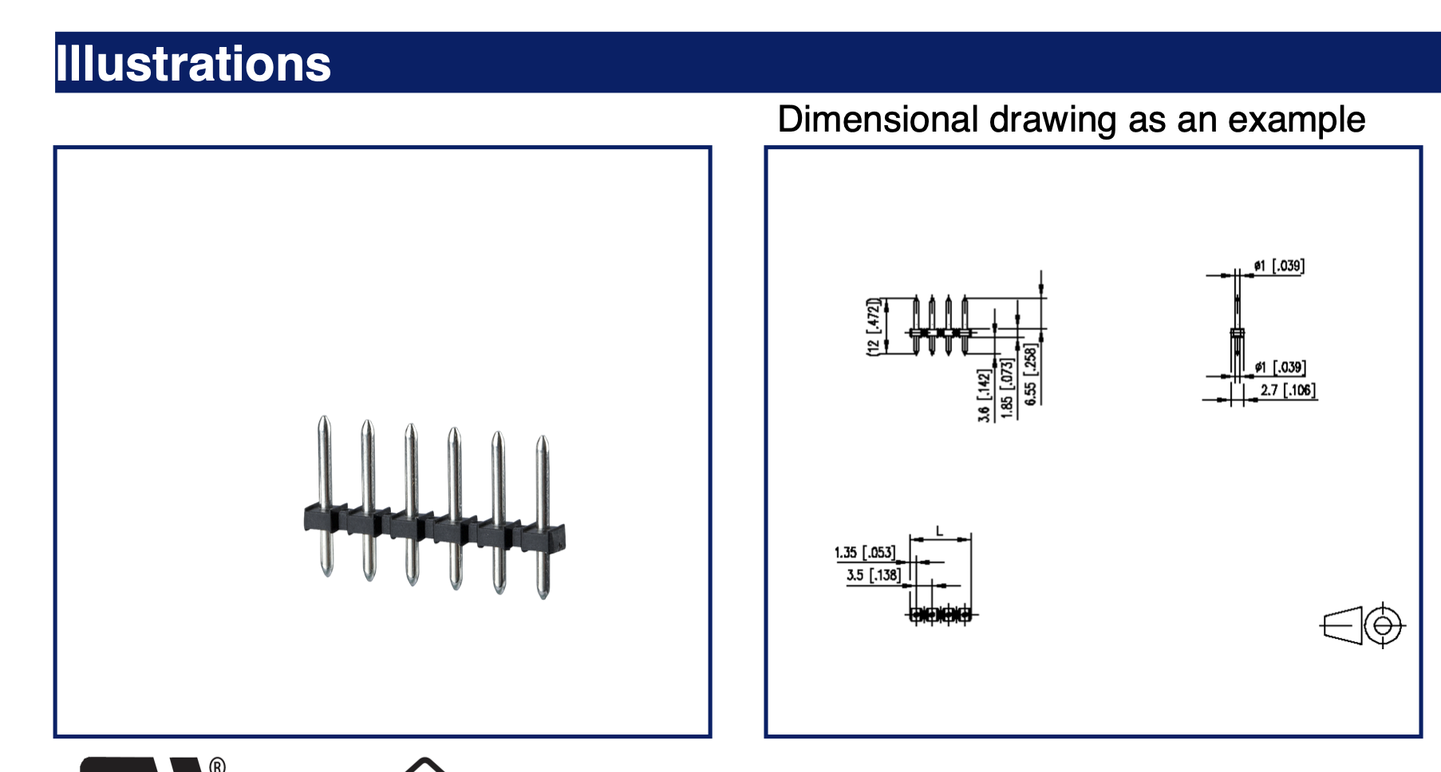
PCB Updates
Pin Header sizing is sufficient to require minimal modifications

Slide 5
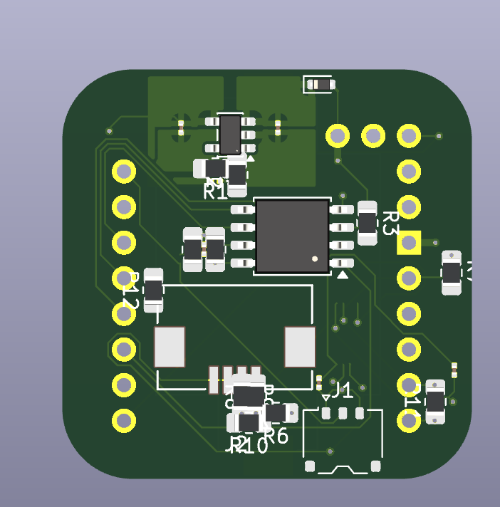
PCB Updates
Non-essential components removed for Rev. 5
Back to Rev. 5 of the PCB
Powercast Harvester removed
Temporary change, need to assess
Charge amplifier removed for irrelevance to paper

Slide 6
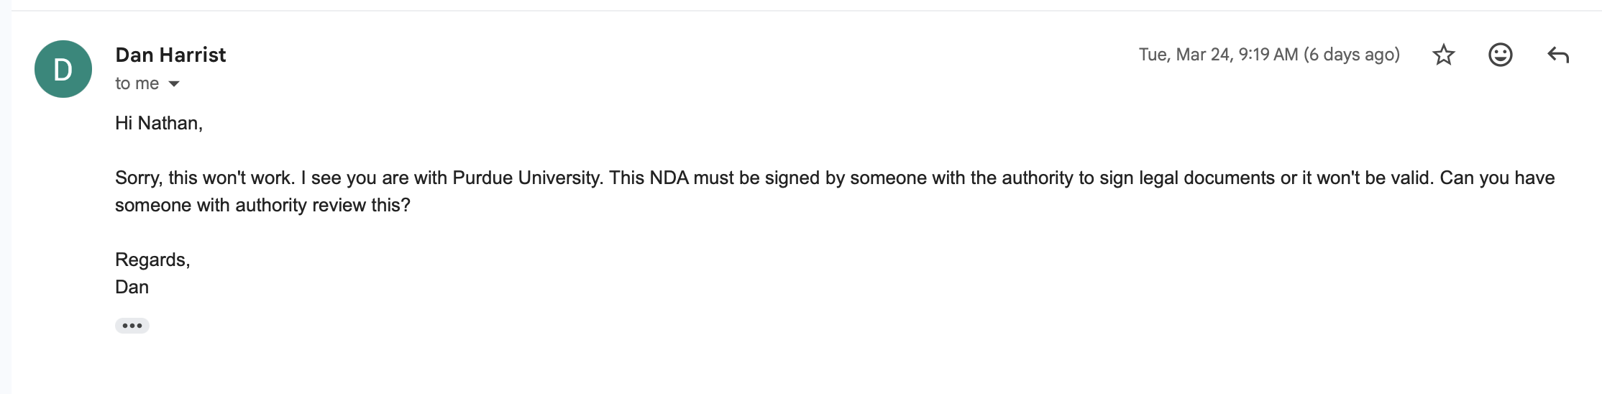
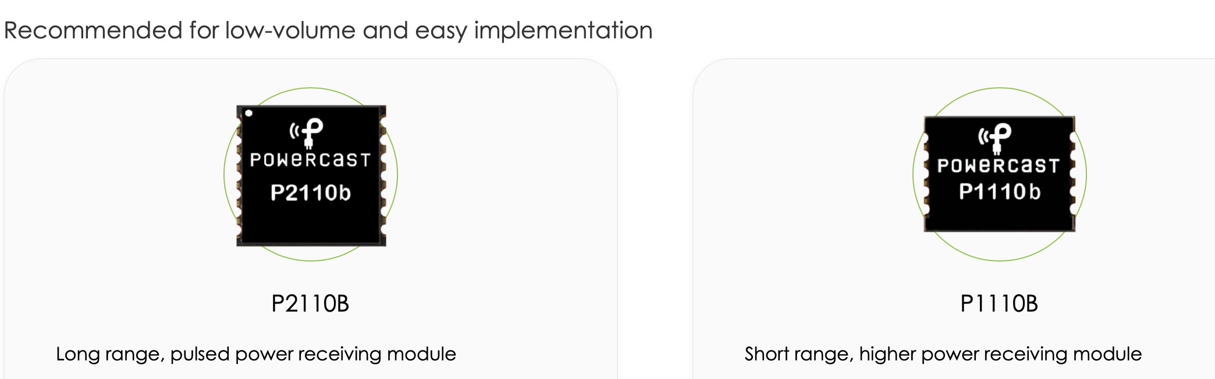
Powercast Updates
NDA issues with procurement of information
Powercast needs more NDA authority than anticipated
Other commercial products (2) worth looking into
P1110b
P2110b
Both short range pick and place modules

Slide 7
Paper Updates
Meeting with Professor Salas today
Paper review
Go over clarity and depth
Bring revisions for feedback

Slide 8
Thank You
Purdue Polytechnic Institute

