Slide 1
Week 05
Keel Bone Chicken Project
9/25/2025

Slide 2
Progress
Began Arduino Programming and PCB Design
Programming Arduino
GitHub Organization/Formulization
Schematic Creation
Circuit Board Creation

Slide 3
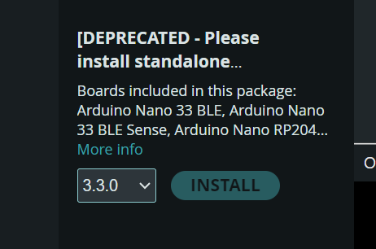
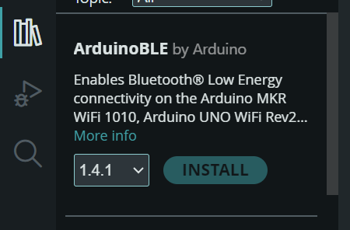
Libraries Needed
Several Libraries are needed to start the Arduino code
Install Deprecated version of Arduino Software
Install ArduinoBLE for Bluetooth communication
Install Arduino_BL2Y for communication to Arduino Nicla Sense ME

Slide 4
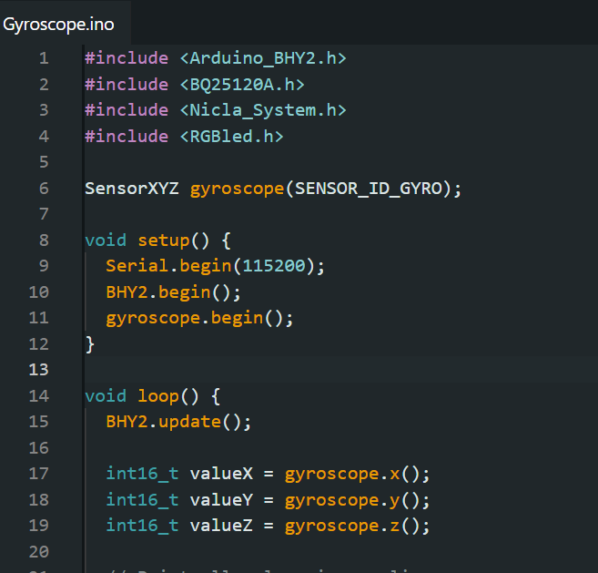
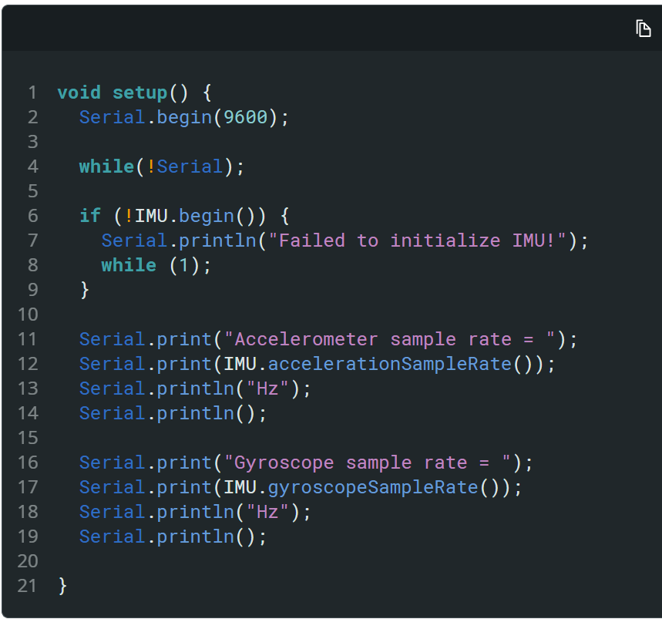
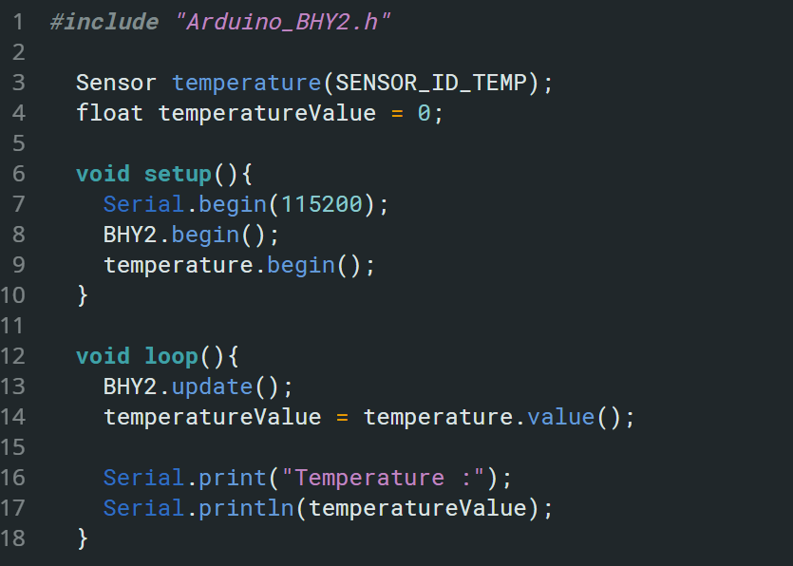
Tester code for Modules (Working)
Gyroscope IMU Temperature

Slide 5
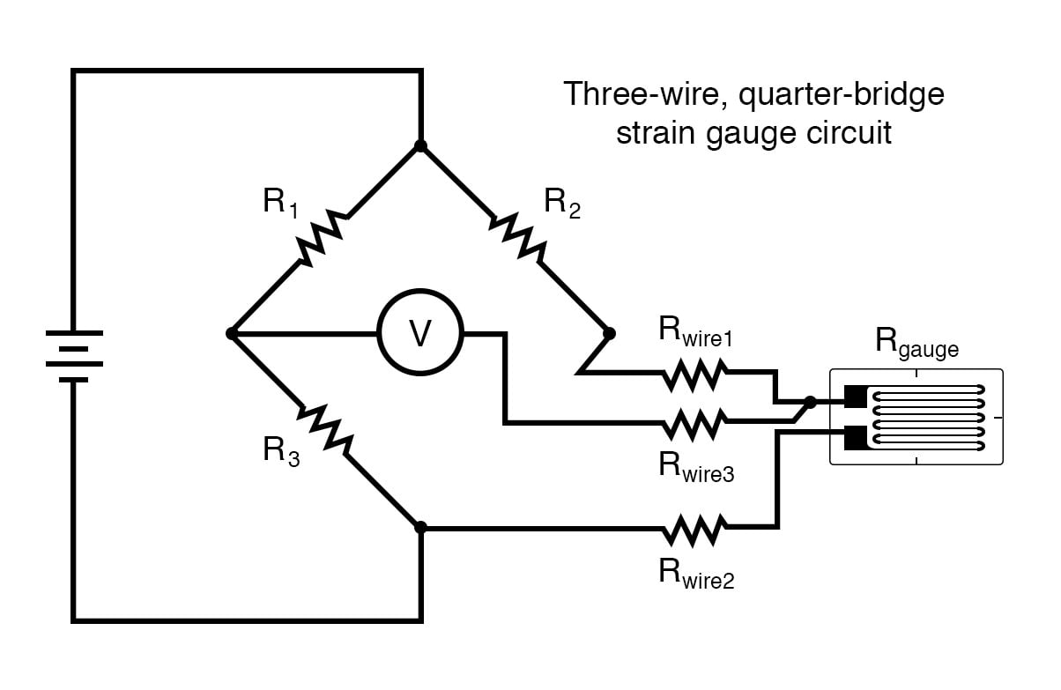
Strain Gauge
Needs to be created on the schematic

Slide 6
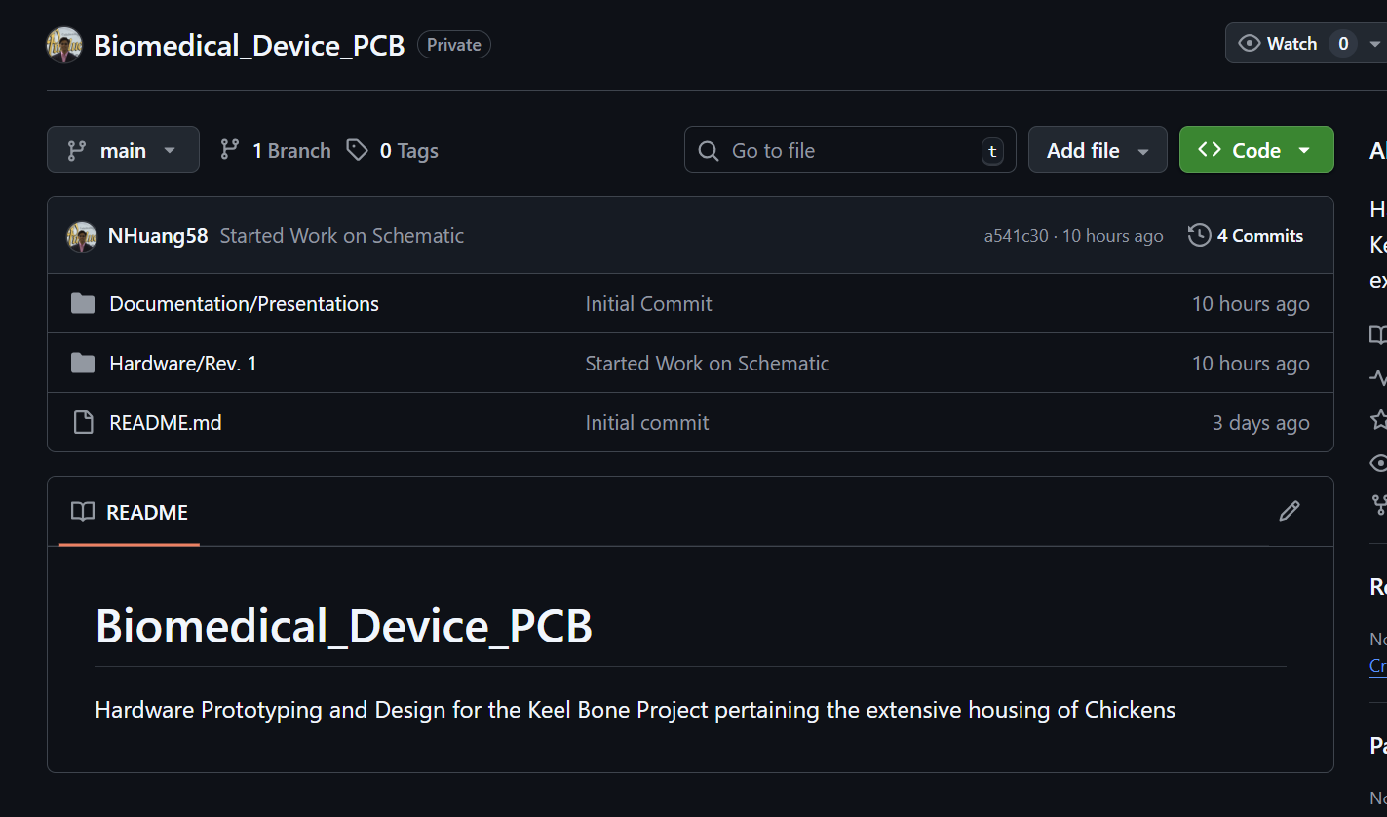
GitHub
Organization Metric for Next ~2 Semesters
https://github.com/NHuang58/Biomedical_Device_PCB.git

Slide 7
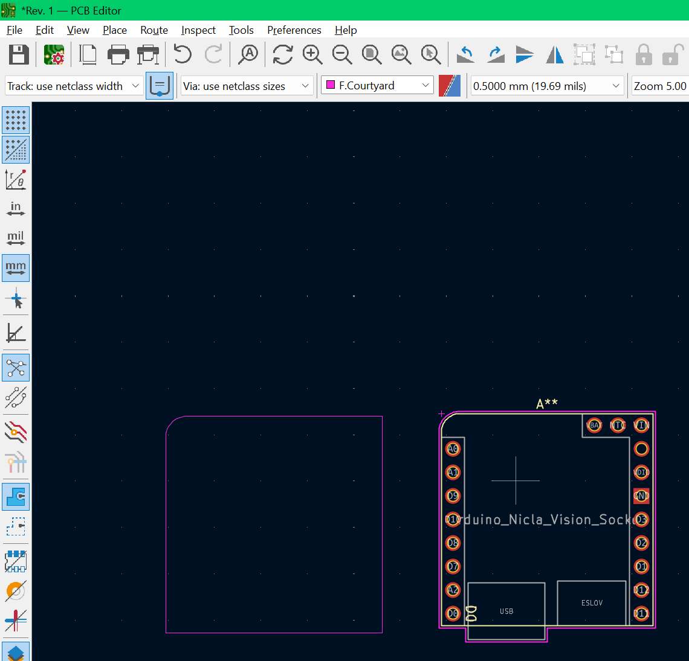
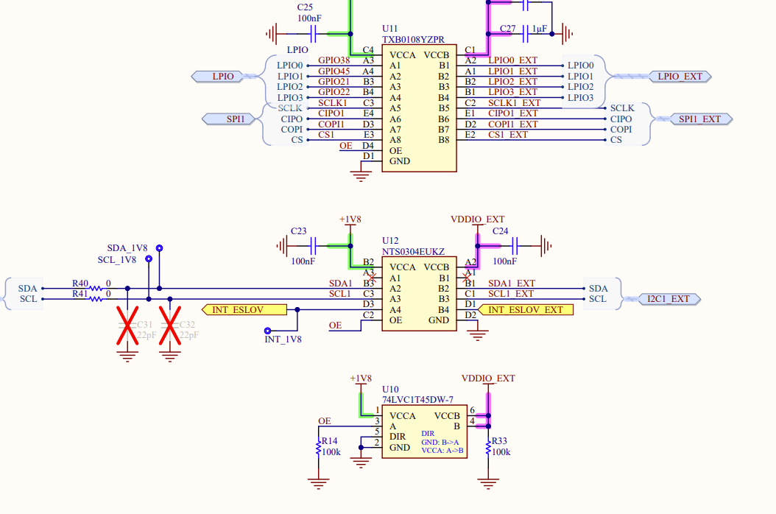
PCB & Schematic Creation
Started developing on KiCad: https://www.kicad.org/download/
Conventional Nicla Sense ME Schematics NOT available for download:
Schematics made available online however: https://docs.arduino.cc/resources/schematics/ABX00050-schematics.pdf
Needed to create own layout within PCB editor

Slide 8
Thank You
Purdue Polytechnic Institute

