Slide 1
Week 08
Keel Bone Chicken Project
10/17/2025

Slide 2
This Week
Progress & Issues faced this week
Design Changes
Data Logging
Schematic Edits

Slide 3
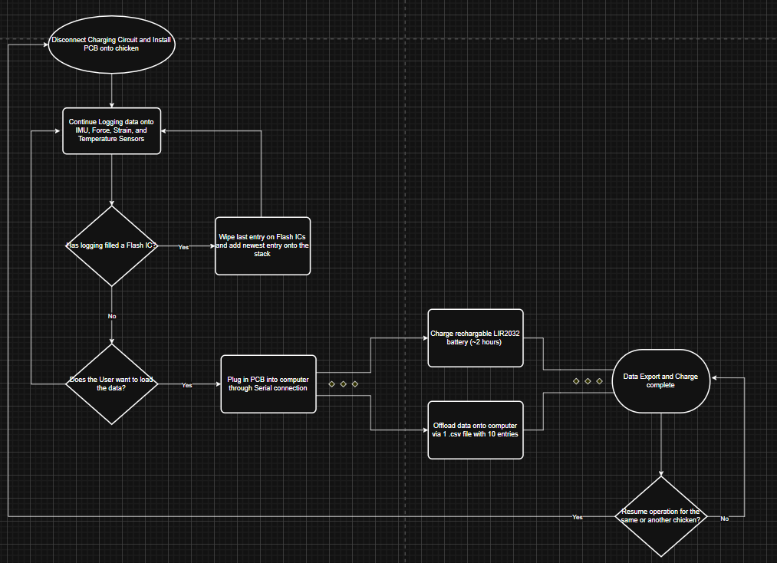
Design Changes
Exchanges with Agriculture Department will move to being Client Side
More emphasis on time (~10 – 25-hour operating range)
  Allow Agriculture research to see the entire egg laying process
  All sensors may be used; some sensors may be omitted.
Client-Service relationship with Agriculture, specifications given by them
Current Flowchart Design of Rev. 1 PCB:

Slide 4
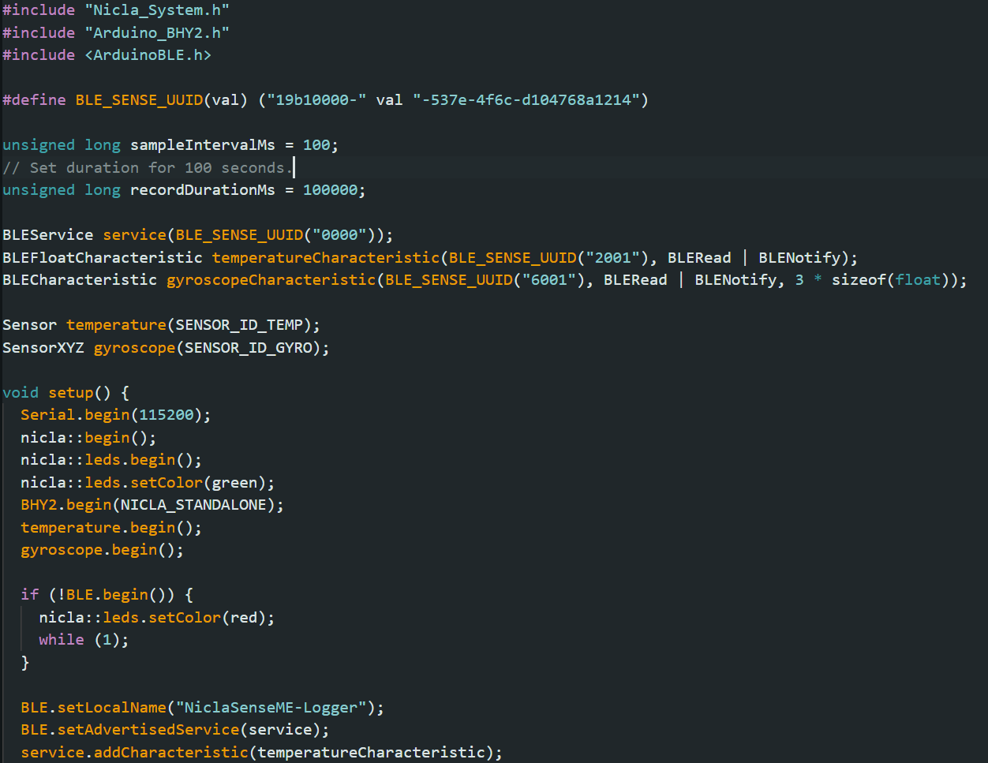
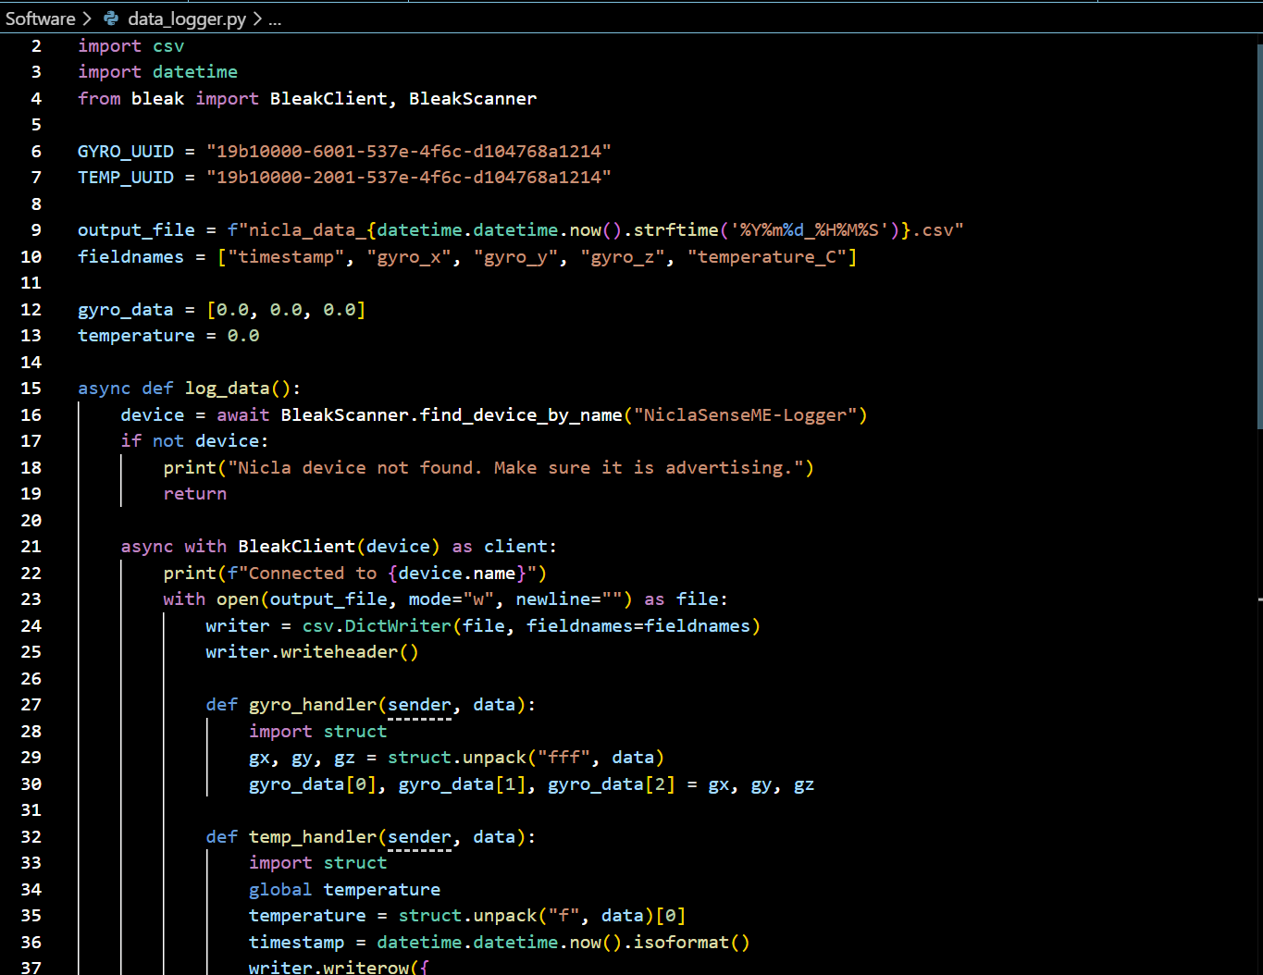
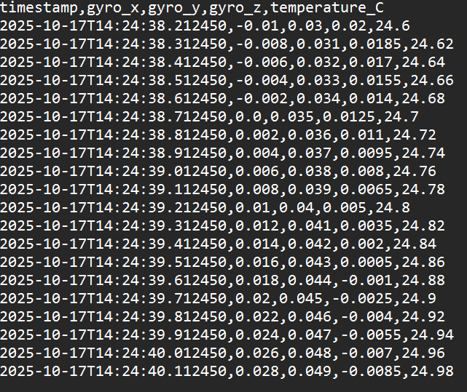
Data Logging
Values successfully logging over AsyncIO and Python
Run on Arduino IDE first
Able to log values over Python to generate a .csv over a time frame
Will update website to be able to download/generate .csv
Arduino Entrance Point
Python Backend
.CSV file generation

Slide 5
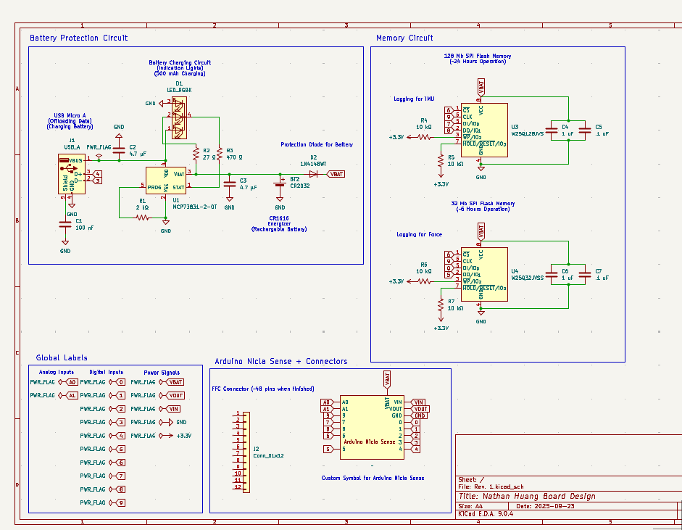
Schematic Edits
Mostly Finished Revision 1 of the Schematic for the Board
Summary:
  Two Memory Circuits
  1 Battery Charging Circuit
  24-48 Pin FFC Connector
Rev. 2 starts next week
  Hit constraints
  Potentially add new circuitry

Slide 6
Next Week
Blockers & Summary of next week’s work
Verify with Agriculture department that PCB meets their specifications
Select parts for PCB Assembly and start setting up the order
Get .csv loading/downloading working on the BLE web interface

Slide 7
Thank You
Purdue Polytechnic Institute

