Slide 1
Week 1
Keel Bone Chicken Project
05/18/26

Slide 2
This Week
Weekly Progress
PCB Updates
New symbol designed
New footprint designed
Power analysis done on P1110b
Summer Updates
Summer Calendar submitted and signed
Training Updates
Required Trainings Completed
Next Week

Slide 3
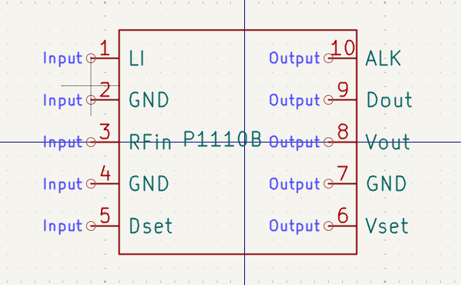
PCB Updates
New symbol designed
Designed to match P1110B
Grounds need to be separate
Might cause interference

Slide 4
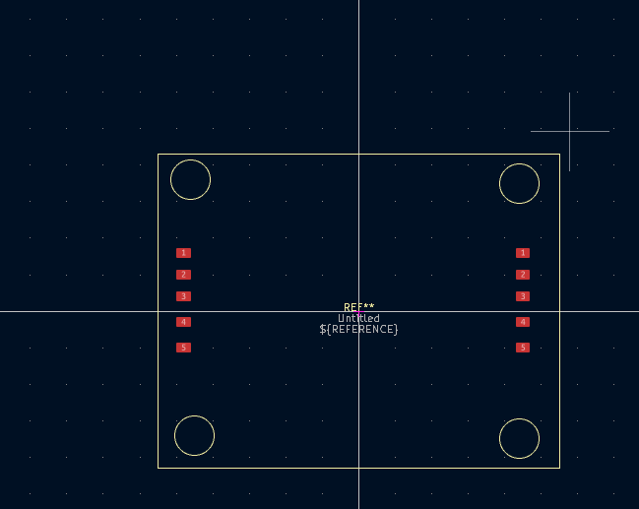
PCB Updates
New footprint designed
Designed to match P1110B
Powercast device will need to be elevated on board because it is an external product

Slide 5
PCB Updates
Power analysis
Peak Output Power: 210 mW (0.21 Watts) at maximum RF input.
Maximum Output Current: 100 mA.
Configurable Output Voltage: Up to 4.2V for Lithium-Ion or 3.3V for Alkaline.
Conversion Efficiency: Exceeds 70% efficiency when converting RF energy to DC power.

Slide 6
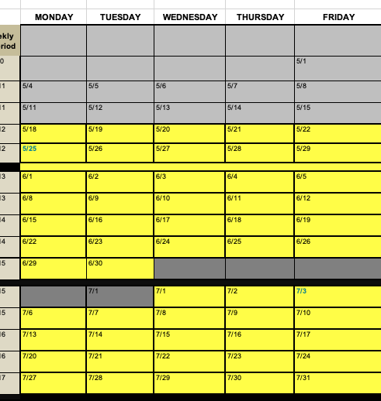
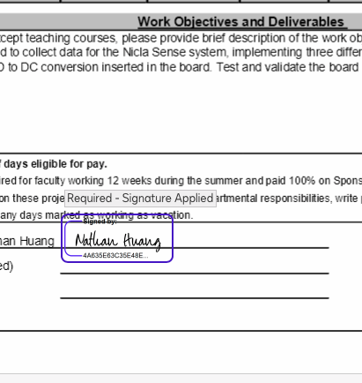
Summer Updates
Summer Calendar Submitted and Signed

Slide 7
Training Updates
Required Trainings Completed
Responsible Conduct of Research (RCR)
Ethics Training

Slide 8
Next Week
Next Week’s Plan
Look into AWS as potential data storage solution
S3 bucket is very cheap
Other options could open up
Before Sync-Up:
Getting demonstration to work
Showing Omosalewa how to program the firmware for the updated Nicla Sense code
Find a good time to meet with Omosalewa in-person moving forward

Slide 9
Thank You
Purdue Polytechnic Institute

