Slide 1
Week 2
Keel Bone Chicken Project
05/25/26

Slide 2
This Week
Weekly Progress
Data Collection Updates
New data logger frontend
Necessary firmware updates → avoid overheating
Corresponding backend updates
PCB Updates
Fundamental circuit diagram completed
Updated KiCAD full circuit
Zoomed in RFID section
Finished PCB component for use on new PCB
PCB component added to design
Database Updates
MongoDB database collection method started
Next Week

Slide 3
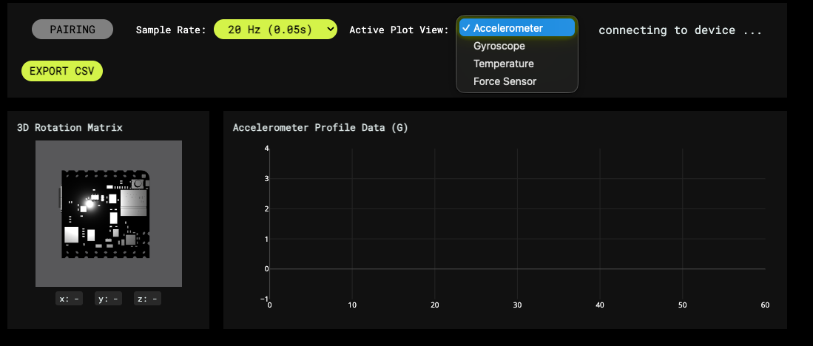
Data Collection Updates
New data logger frontend
Sensors will operate on a dropdown system to save cache memory
3D viewer still present to get an idea of the current positioning of the system
Critical parts of new design stated below:
Dropdown menu for sensor and sample rate
Only last 60 seconds present

Slide 4
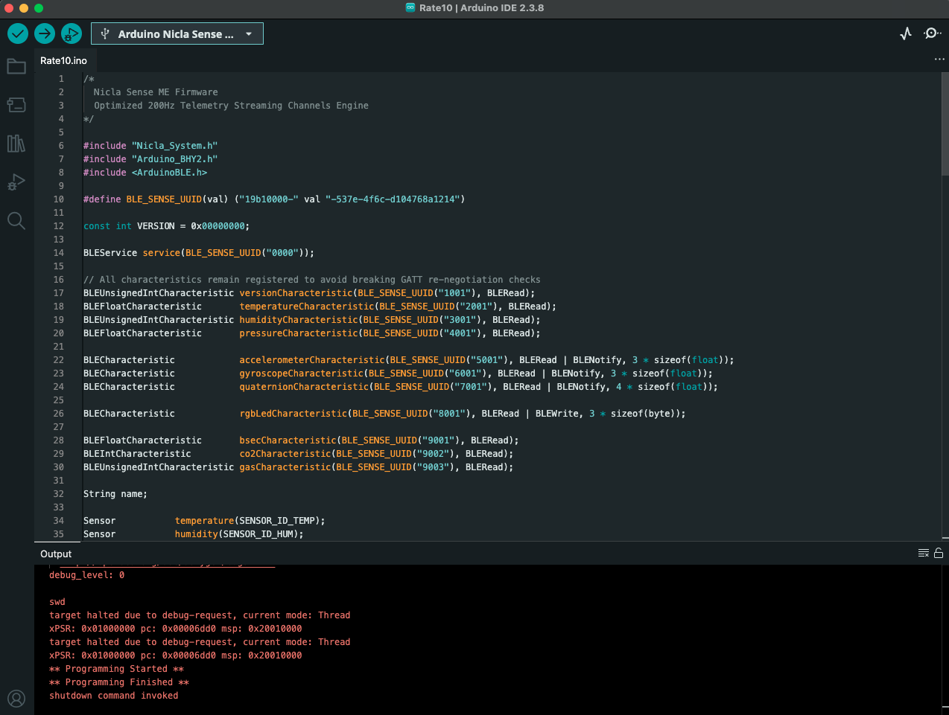
Data Collection Updates
Necessary firmware updates → avoid overheating
Unnecessary Sensors have been deactivated
Firmware NEEDS to be flashed every time a new software update is available:
Ensure the correct device is selected
Correct shutdown message will be stated

Slide 5
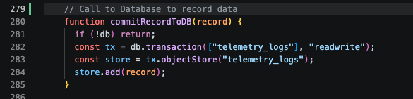
Collection
Corresponding backend updates
Backend again hosted at: https://nhuang58.github.io/Biomedical_Device_PCB/
Uses a InterDB Database to store data instead of relying on local storage on a user(s) device
Storage to the Database based on an API call within the code

Slide 6
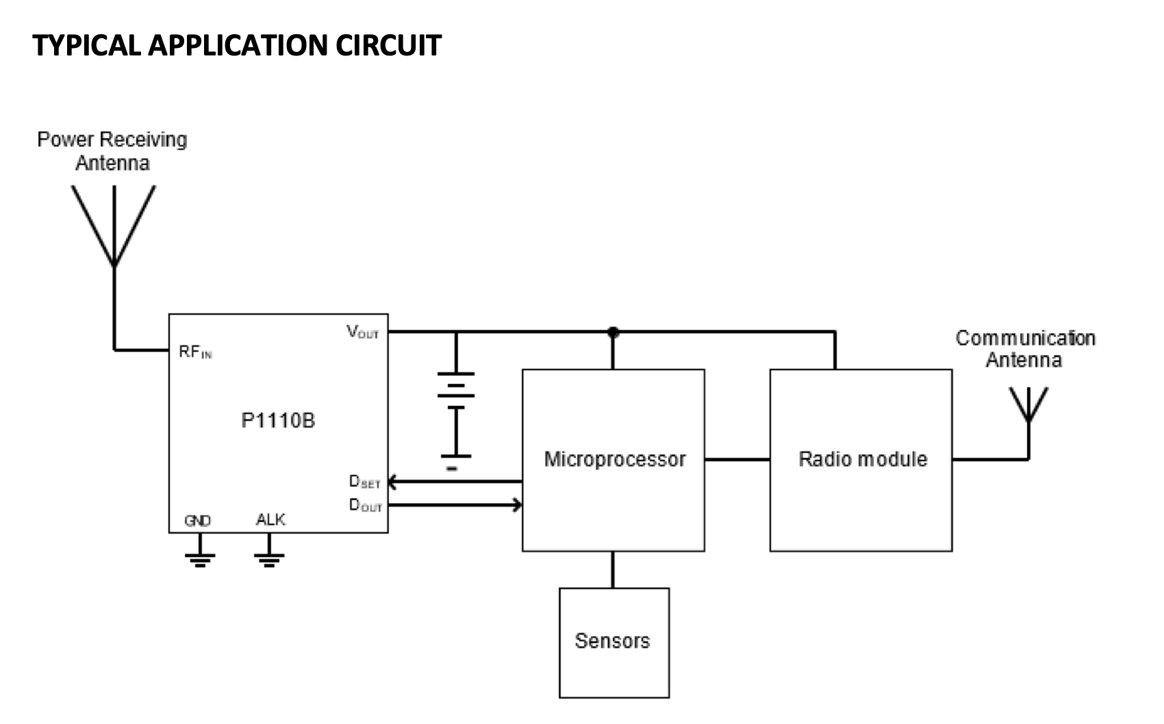
PCB Updates
Fundamental circuit diagram completed
Based on primitive circuit found in datasheet
Other circuit specifications needed to be outlined

Slide 7
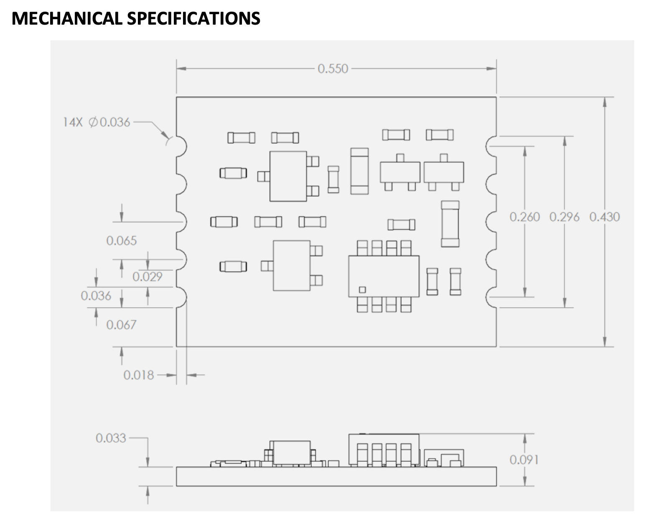
PCB Updates
Fundamental circuit diagram completed
Mechanical design specifications outlined:
Units in inches (hard to locate)
50 impedance antenna required (The antenna we have is sufficient)
0.550 x 0.430 x 0.033 in^3
13.97 x 10.92 x 2.31 mm^3
Sufficient space on board
See next slide

Slide 8
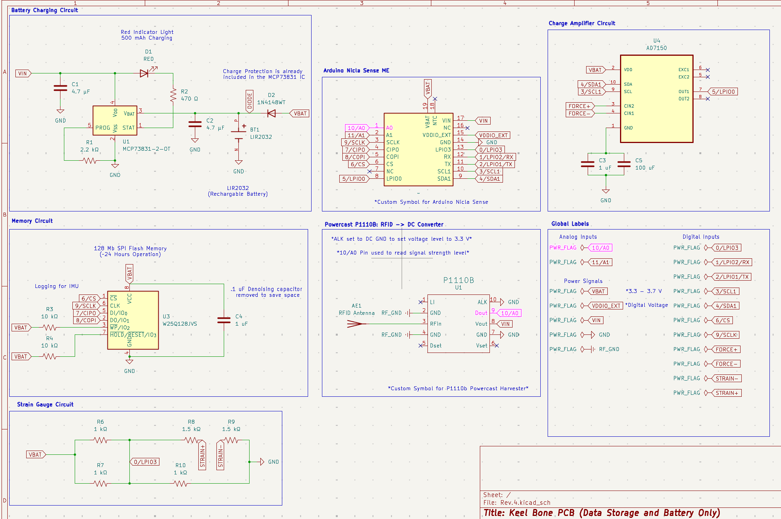
PCB Updates
Updated KiCAD full circuit

Slide 9
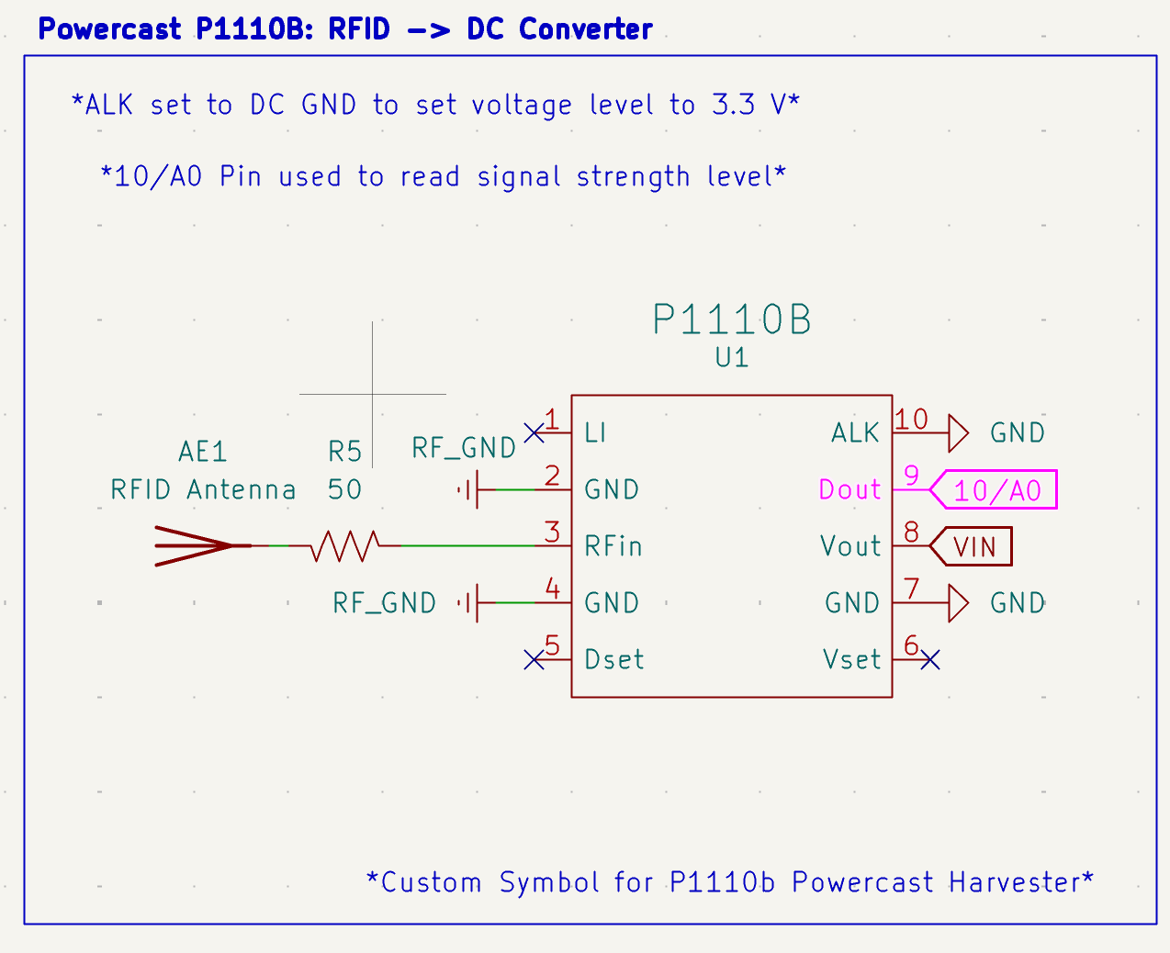
PCB Updates
Zoomed in RFID section
A0 analog input to read data in case of debugging
VIN connected to battery charger
3.3 V level

Slide 10
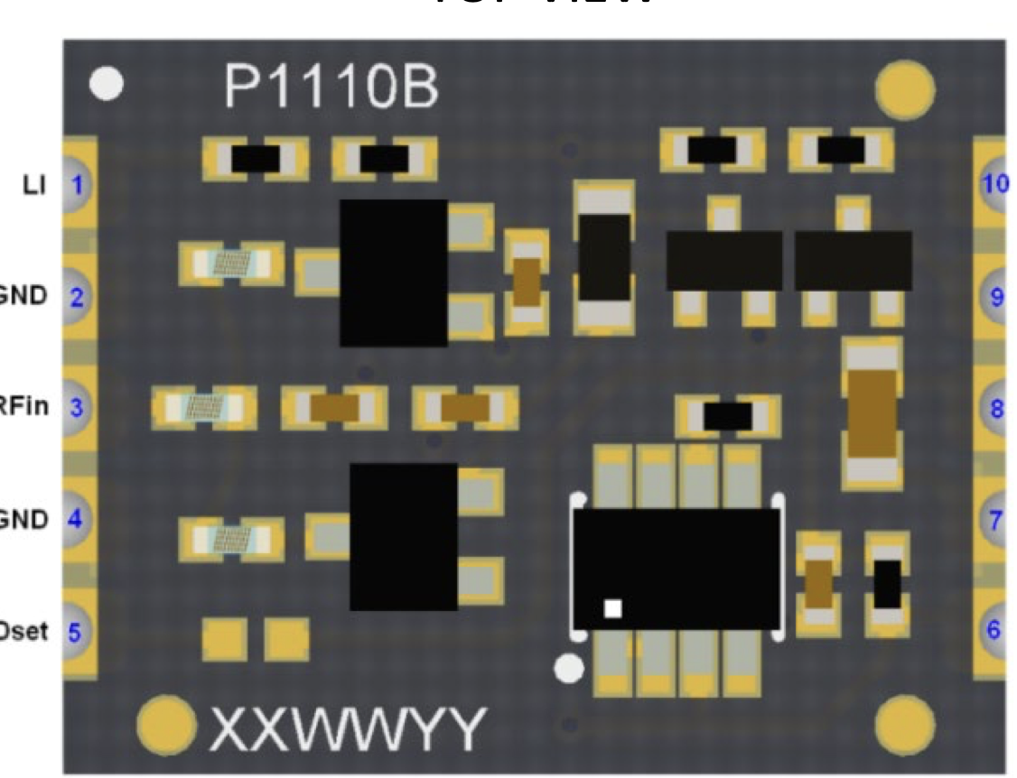
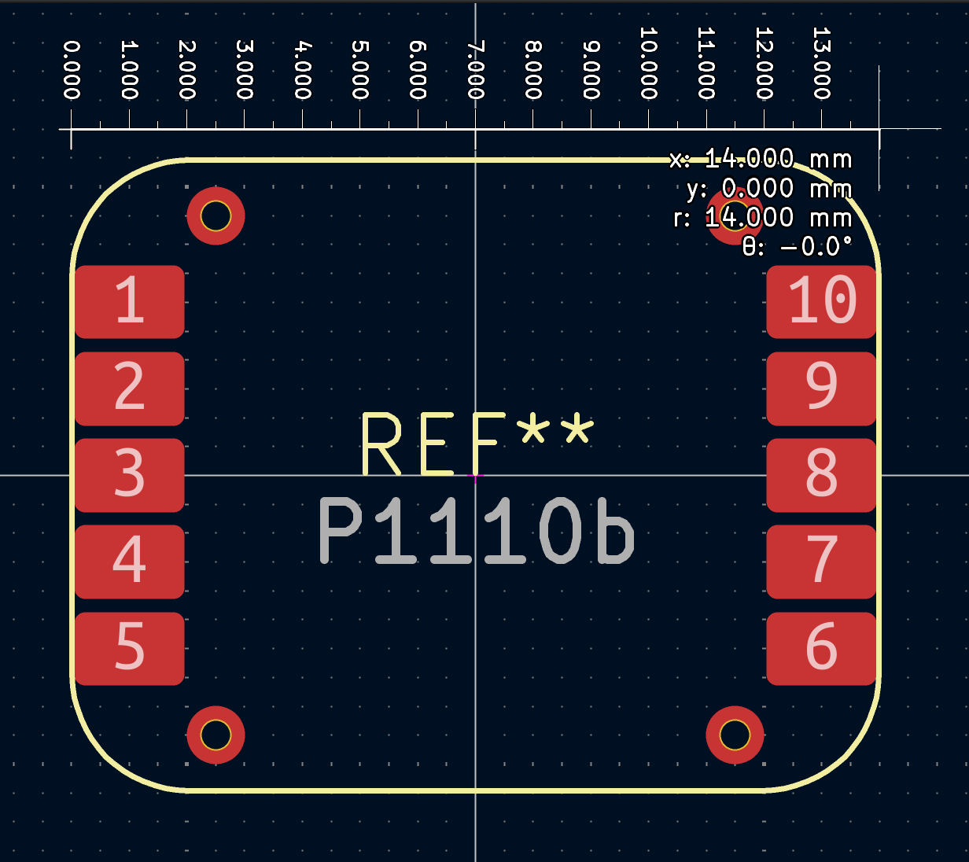
PCB Updates
Finished PCB component for use on new PCB
Allowed correct spacing for the P1110b mounting holes
1 mm diameter mounting hole:

Slide 11
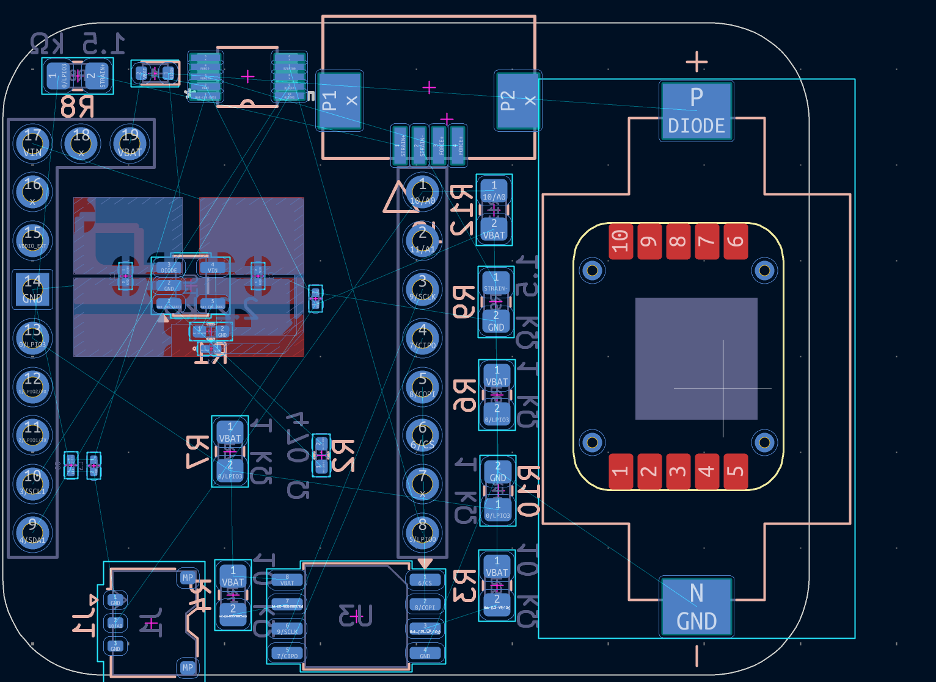
PCB Updates
PCB component added to design
Relative sizing on the back of the PCB seen for reference:
Not a large component by any regard

Slide 12

Database Updates
MongoDB database collection method started
Data collection method 3
Cloud Storage:
Operation: Data would be immediately backed up to the cloud or another service
Collection: A remote login would be needed to access data, nothing else
Potential Solution: MongoDB
Runs off AWS servers
Free for immediate use (No large-scale data)
Perfect for an intermediate cloud solution that is easy to maintain
Data can be pulled from the database without having to connect to a Nicla BLE device

Slide 13
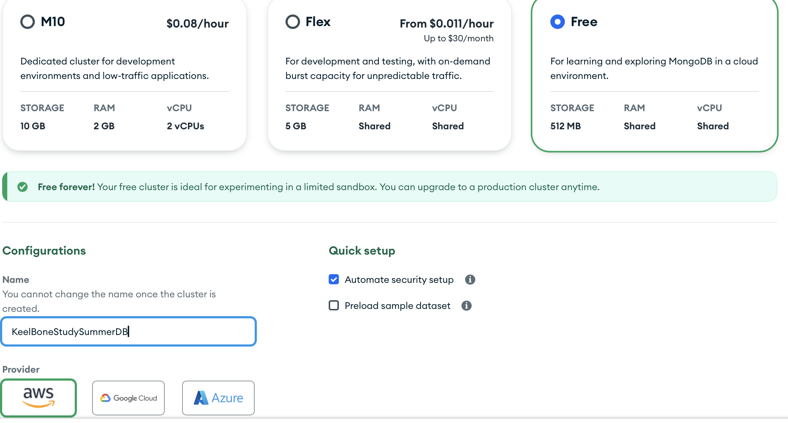
Database Updates
MongoDB database collection method started
Created Cluster (Keel_Bone_Study_Database) for collecting data through MongoDB servers
Free for now, up to 0.5 GB (.csv files on the order of 0.0001 Gb (0.02%)
Shouldn’t exceed the limits with the size of .csv files collected

Slide 14
Next Week
Next Week’s Plan
Implement MongoDB backend with current web application
No need for frontend, simplifies a lot of the work needed
Write documentation for operation of the device
Professor Karcher’s request for making sure the device is properly operated
Send a follow-up email to Professor Karcher for a specific date to meet
Showcase Agriculture department how to pull data from the database
Introduce MongoDB to Omosalewa and make sure the web application is as intuitive as possible

Slide 15
Thank You
Purdue Polytechnic Institute

