Slide 1
Week 9
Keel Bone Chicken Project
07/27/26

Slide 2
This Week
Weekly Progress
*Major Paper Updates
Revision 2 of Paper Complete
Agriculture Updates
Slight error with cables
Next Week

Slide 3
Major Paper Updates
Revision 2 of Paper Complete
Implemented all major edits to paper
Added PDF of Rebuttal to paper submission
Should hear back on August 9th whether paper is accepted

Slide 4
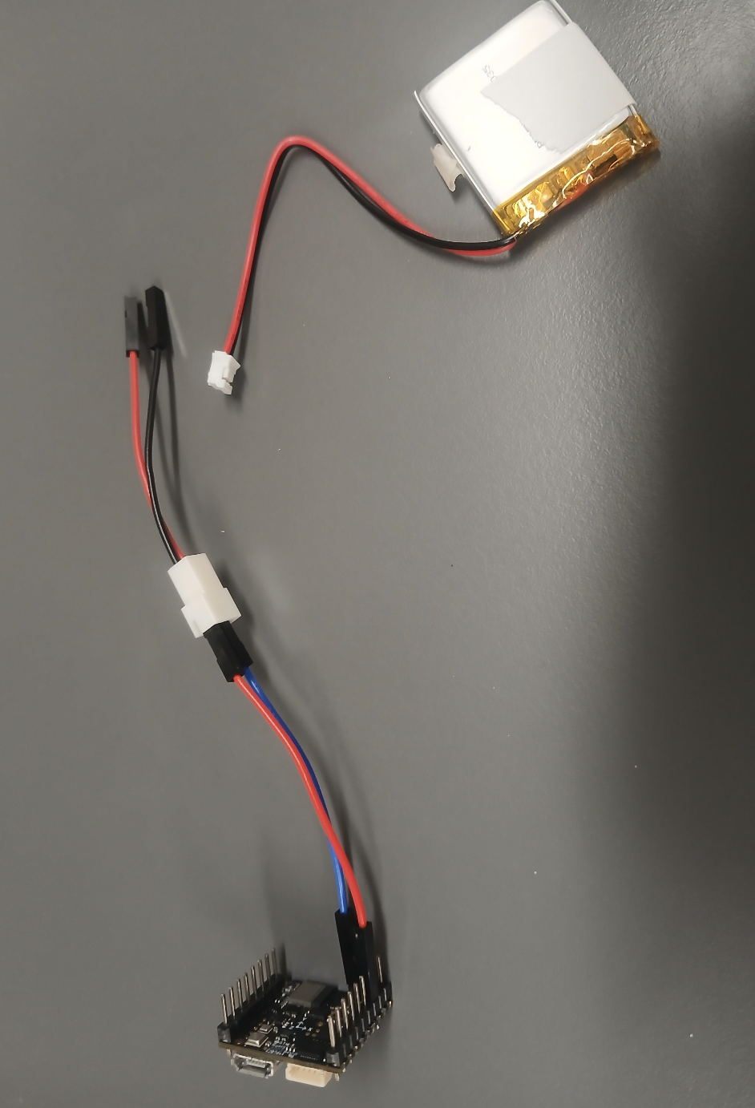
Agriculture Updates
Slight error with cables
Omosalewa tried connecting the headers the wrong way around
Need to connect dupont header to wires, JST housing to JST female in battery
This could be that the hardware is not compatible
Need to verify with Omosalewa.

Slide 5
Next Week
Next Week’s Plan
Meet in-person with Pedro for another sensor testing session
Finish and package web logger
App executable
Online version
Transfer of all Research Data

Slide 6
Thank You
Purdue Polytechnic Institute

