Slide 1
Week 8
Keel Bone Chicken Project
07/20/26

Slide 2
This Week
Weekly Progress
Paper Updates
Revisions to make
Sensor Updates
Wires work, but only momentarily
PCB Updates
Order number given
Next Week

Slide 3
Paper Updates
Revisions to make
Got revisions to make to the paper
Board said paper was almost there; just needed to make some changes
Wanted your opinion on whether this is feasible [Due July 28th at the latest]

Slide 4
Paper Updates
Revisions to make
Editors Comments:
Though the topic is interesting and relevant, the manuscript requires significant revision before it can be considered further. Circuit diagrams, PCB layouts, and bills of material are more adequate for a project report than for a paper in a scientific journal. We would rather expect more experimental results and particularly analysis of the acquired data. If you have done this in the meantime, please include it in the revised paper. Otherwise it might be more promising to resubmit it to the conference.

Slide 5
Paper Updates
Revisions to make
Comments to the Author:
Please revise and resubmit
The manuscript presents the development of a data collection device for monitoring hens.
Modifications:

Slide 6
Paper Updates
Revisions to make
Modifications:
The signal processing and data analytics aspects are relatively limited, with the results primarily presented through qualitative graphical observations
Let say the contribution is meant to be mainly lie in the electronic and hardware design rather than in data analysis, from an electronic system design perspective, several practical considerations are still insufficiently addressed. [Next Slide]

Slide 7
Paper Updates
Revisions to make
Modifications:
[Past Slide]
Scalability is a major concern. Commercial poultry farms typically contain a large number of hens, often in the hundreds or thousands. The manuscript does not describe and evaluate how the proposed system would perform when many devices are deployed and operating simultaneously, nor does it discuss potential issues related to wireless communication reliability, data transmission congestion, synchronization, or system management at scale.
Battery life is a critical factor for wearable monitoring devices. The manuscript lacks an investigation of power consumption, expected operating duration, charging frequency, and maintenance requirements.
The mechanical robustness of the device requires further consideration. The current prototype is attached to the hen's feathers with exposed wiring, but no evaluation is provided regarding attachment reliability under realistic farm conditions. Hens frequently move, interact, and may engage in aggressive behaviors, which could cause the device to loosen, detach, or sustain damage. Additional testing and discussion on the durability, safety, and long-term wearability of the device would strengthen the manuscript.
Overall, while the hardware prototype demonstrates initial feasibility, further investigation into scalability, power management, and mechanical robustness is necessary to establish its suitability for practical deployment in commercial poultry farming environments. Additionally, data analytics must be numerical, not qualitative.

Slide 8
Paper Updates
Revisions to make
Comments to the Author:
The manuscript entitled “Design of a Keel Bone Monitoring System in Egg Laying Hens” demonstrates preliminary hardware design, component selection, power optimization, and data analysis. The current version of this manuscript requires substantial revision before it can be considered for real-world applications. So, my recommendation is this article needs a compulsory major revision before publishing in this journal.

Slide 9
Paper Updates
Revisions to make
Authors are requested to analysis the sensitivity, and response time and stability for the long-term reliability of the sensor. Follow the article: https://doi.org/10.1109/LSENS.2025.3639618
While the hardware miniaturization and integration are commendable, the manuscript should more clearly articulate how this design advances beyond prior wireless monitoring devices.
The study emphasizes preliminary design and prototyping, yet lacks sufficient quantitative validation of sensor accuracy, reliability, and non‑interference with chicken behavior.
The manuscript should provide a stronger comparison with existing monitoring devices to highlight the novelty and advantages of the proposed system.

Slide 10
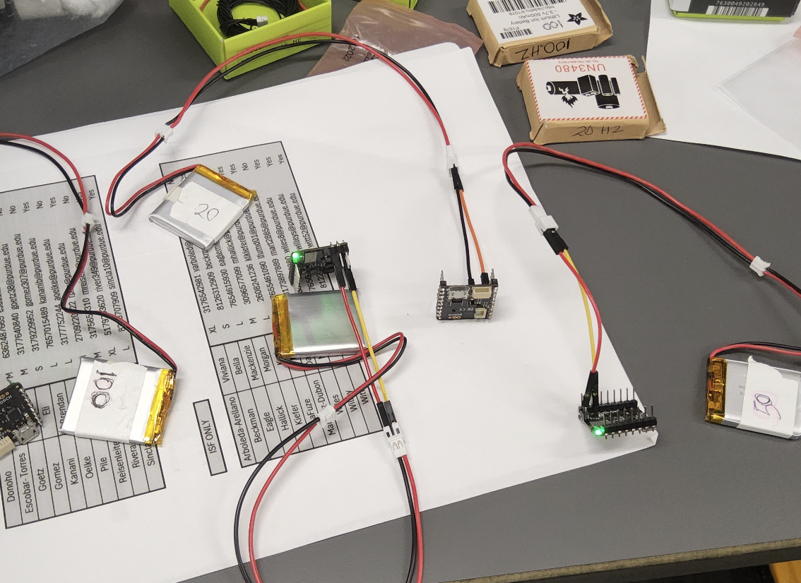
Sensor Updates
Wires work, but only momentarily
Wires purchased from specific vendor worked, but only for ~45 minutes
Good that wires work, but need to look into power output of cables (might have been a mismatch)

Slide 11
PCB Updates
Order Number Given
PCB Order number given from DL-Engineering
Should be arriving ~8/15
Week of 8/10
Order tracking: 840556073970

Slide 12
Next Week
Next Week’s Plan
Make all updates to paper, resubmit *Priority*
Continue sensor testing with Pedro
Meet with Omosalewa to figure out wire issue, and if new parts need to be ordered

Slide 13
Thank You
Purdue Polytechnic Institute

