Slide 1
Week 5
Keel Bone Chicken Project
06/22/26

Slide 2
This Week
Weekly Progress
Hardware Updates:
Agriculture Supplies
Testing Updates:
Access to Professor Wu’s lab
Database Updates:
Database Development still in Progress
PCB Updates:
New Routing done and waiting on validation from DL-Engineering
Next Week
Goals for next week

Slide 3
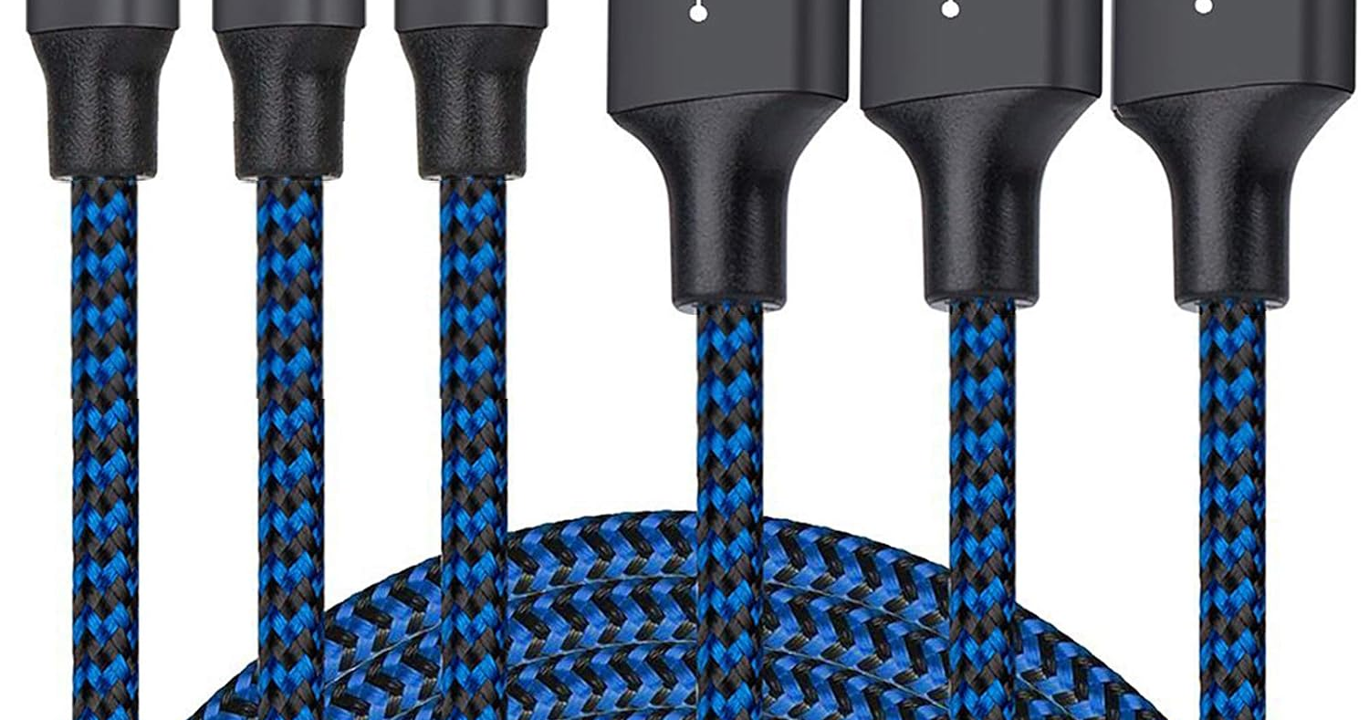
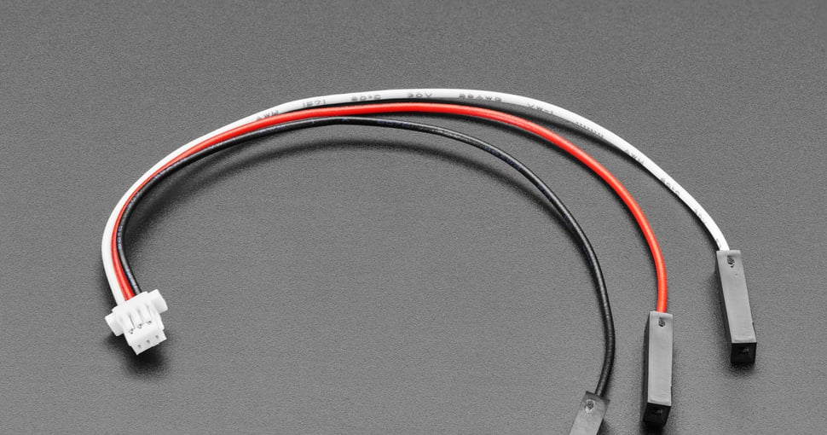
Hardware Supplies
Agriculture Supplies
Supplies requested from Agriculture department
4 Micro USB connectors
3 Connectors (JST to single female dupont)
3 Connectors:
4 Micro USB connectors:
Should we purchase them or allow the Agriculture department to purchase them?

Slide 4
Testing Updates
Access to Professor Wu’s lab
Pedro Barbosa (PhD candidate)
Able to let me in to allow me to do the testing
See if any further access or authorization is required
Testing specifically for piezoelectric devices

Slide 5
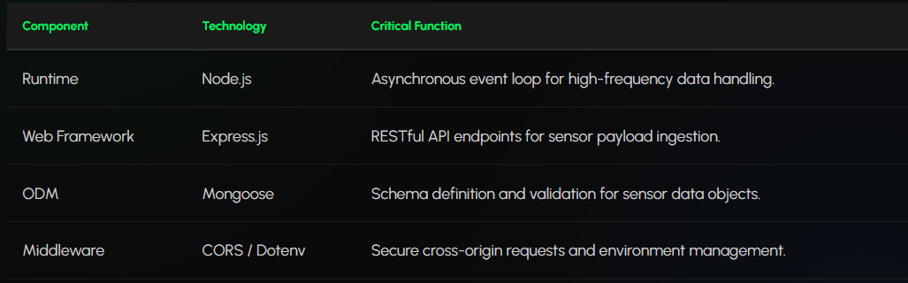
Database Updates
Database Development still in Progress
Testing backend requests
Finding a more convenient way to extract certain periods of data
Was initially custom (0-60 minutes)
Want to make intervals for easier exporting
10 min
60 min
3 hours
12 hours
Etc.
Find a good match which doesn’t overload the backend
Information about tech stack:

Slide 6
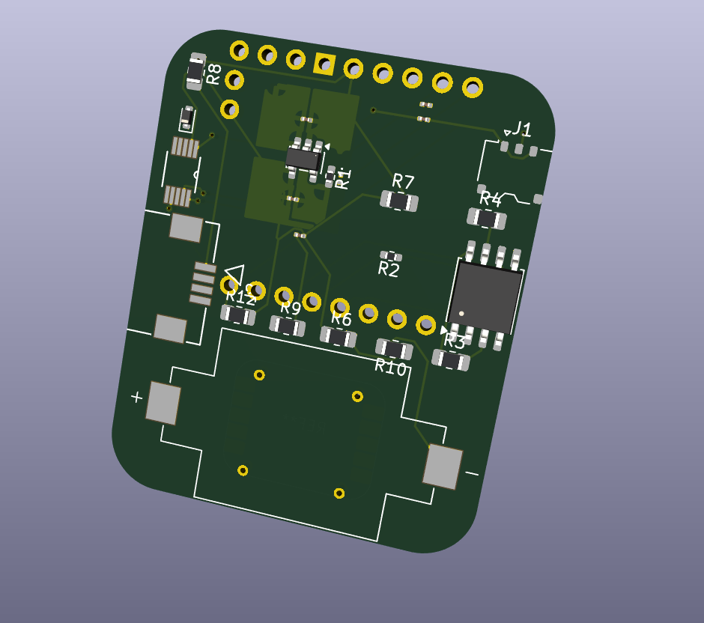
PCB Updates
New Routing done and waiting on validation from DL-Engineering
Finalized routing done and waiting on DL-Engineering
Need to validate with Powercast to ensure device will work on board
Seen below:

Slide 7
Next Week
Goals for next week
Coordinate with Pedro at Professor Wu’s lab
Continue Database Development Efforts
Make final changes to PCB
Test Force Sensor with PCB; tapping
Shorten cable if needed?

Slide 8
Thank You
Purdue Polytechnic Institute

