Slide 1
Week 13
Keel Bone Chicken Project
11/21/2025

Slide 2
This Week
This week’s progress
PCBA Setup for Ordering
BOM + PoS File Generation
Final Routing
Ordering PCB

Slide 3
PCBA Setup for Ordering
Using JLCPCB as a vendor
Options:
JLCPCB
PCBWay
PCB Trace
All have ~24 hour lead time + 3 day PCBA time
Ship time varies
PCBA on JLCPCB Parts: https://jlcpcb.com/parts/in-stock-parts
Some parts may be unavailable, need to find alternatives

Slide 4
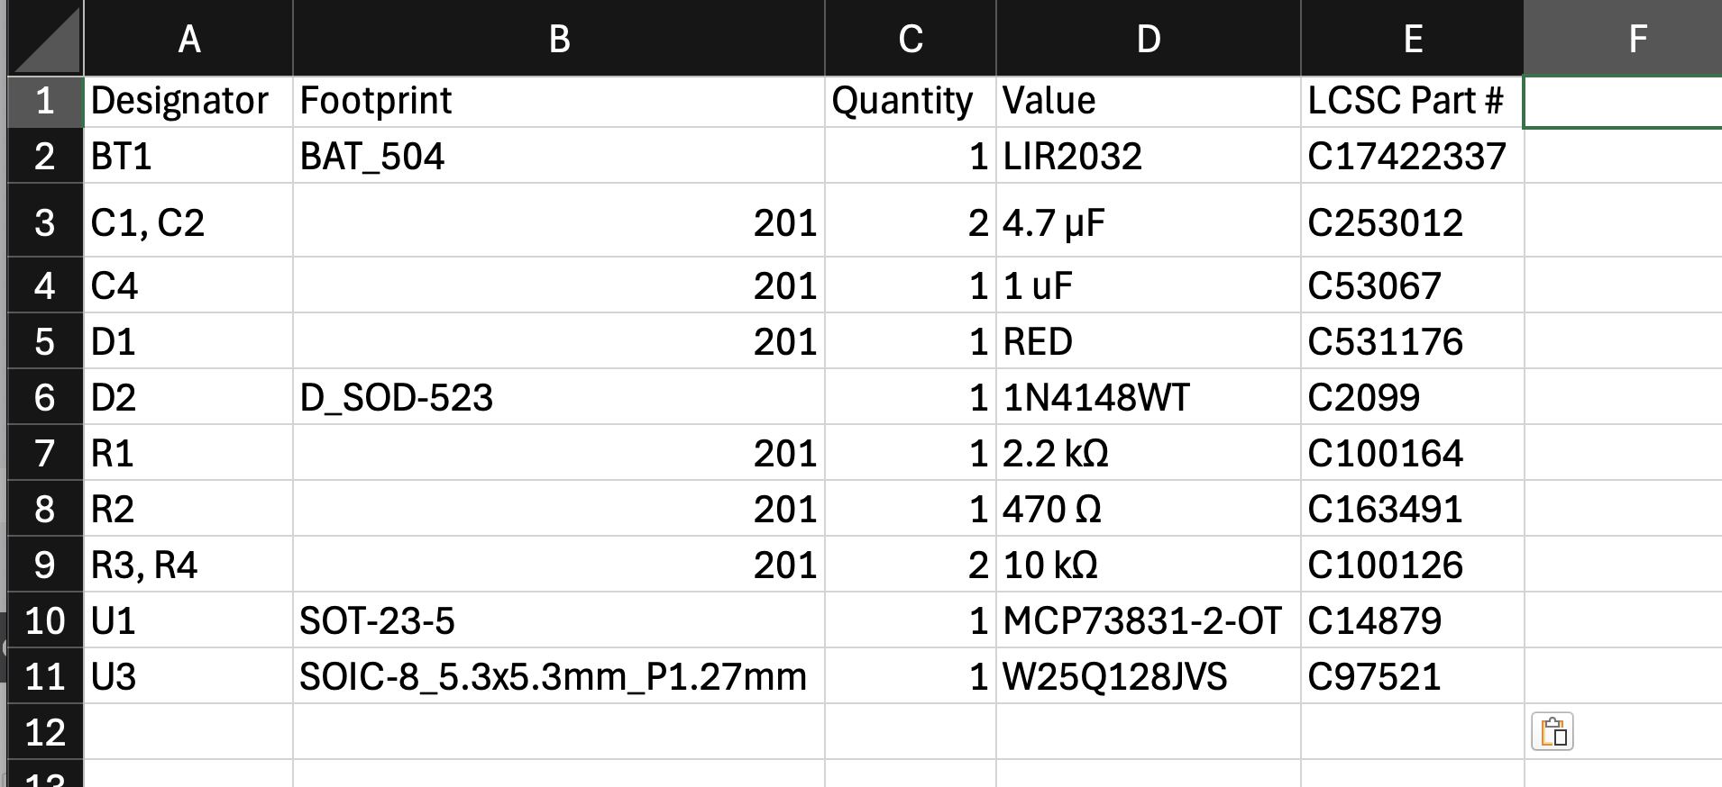
BOM Generation
~20 Components on BOM, listed below
BOM Created with JLC Extension in KiCAD:

Slide 5
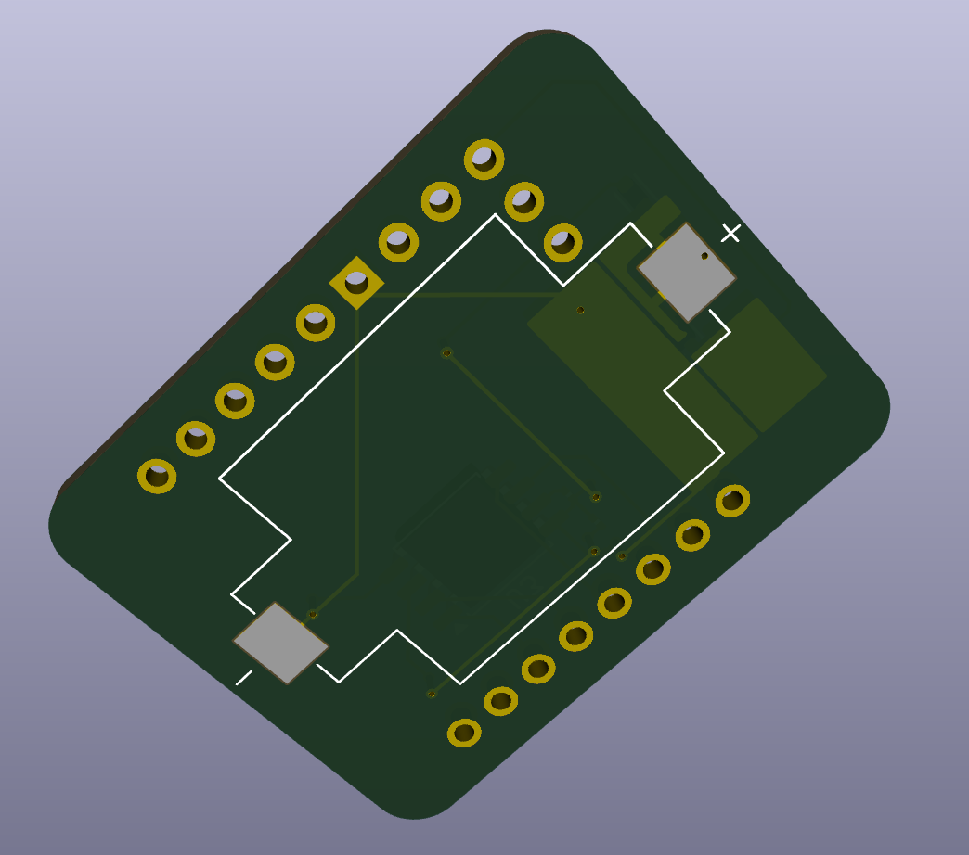
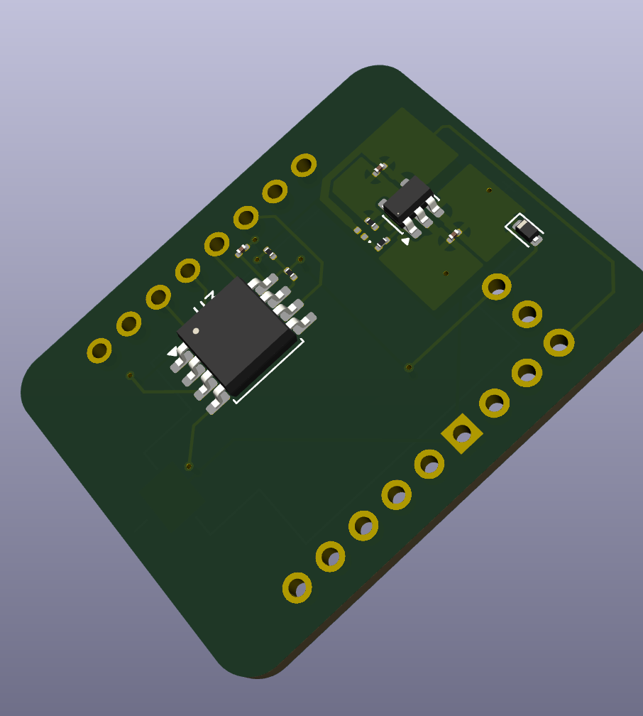
Final Routing
Several Different Design Choices
Finished Rev. 1 Design
Slightly larger frame for PCB than (insufficient area to increase price)
8 vias (1 may be cause of concern)

Slide 6
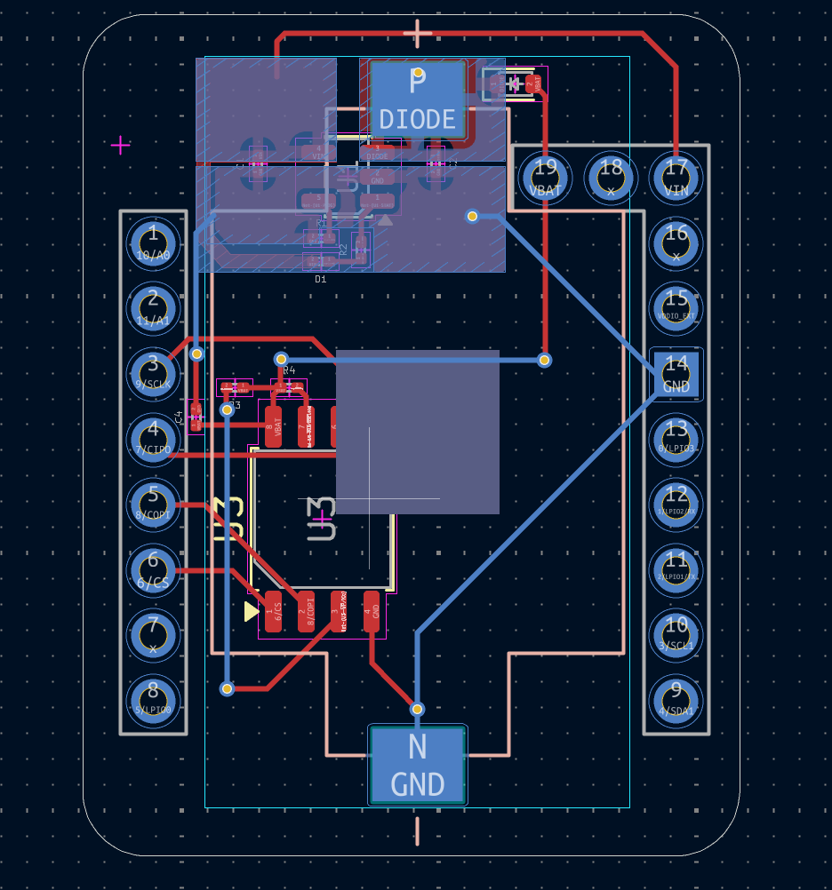
Final Routing
Traces on PCB Board
Location of vias and rest of board shown below
Would prefer review of 1+ other individuals

Slide 7
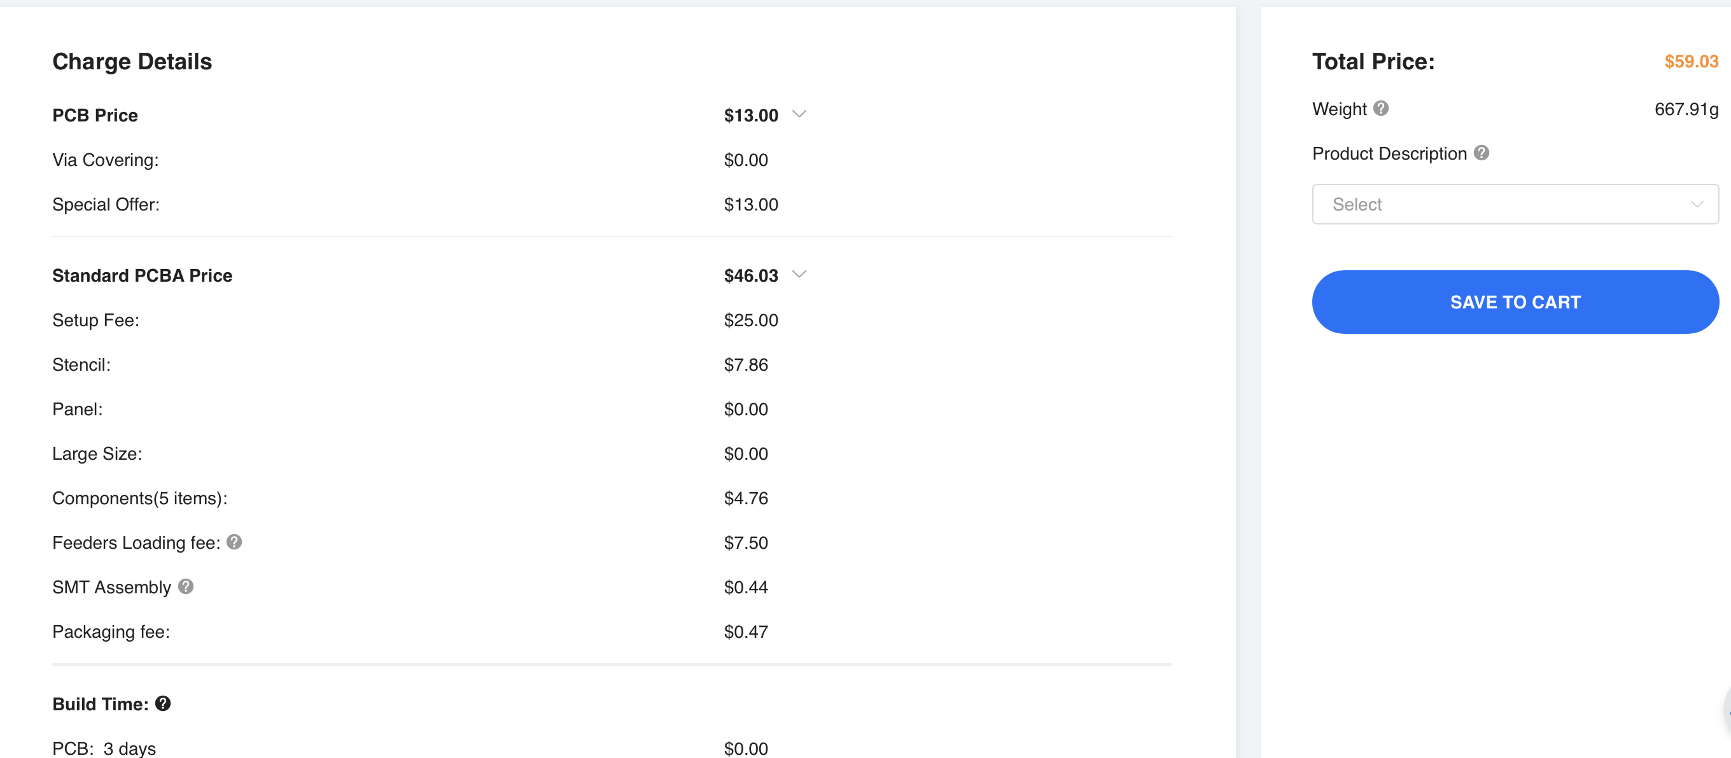
Ordering PCB
From JLCPCB’s website with .bom and .gerber and .pos files
Quote around $23 without assembly, $59 with assembly

Slide 8
Next Week
Blockers & Next Week’s Work
Hear back on Resistive vs. Capacitive Sensors
Order PCBs before break
Fill out form 12 from ordering office
Work on app store application
Developer app for monitoring Niclas + Sensors

Slide 9
Thank You
Purdue Polytechnic Institute

