Slide 1
Week 14
Keel Bone Chicken Project
11/24/2025

Slide 2
This Week
This week’s progress
Form 12 Ordering
Finished quote for PCB
Mobile App Development
Frontend Design Started
Backend Framework Started

Slide 3
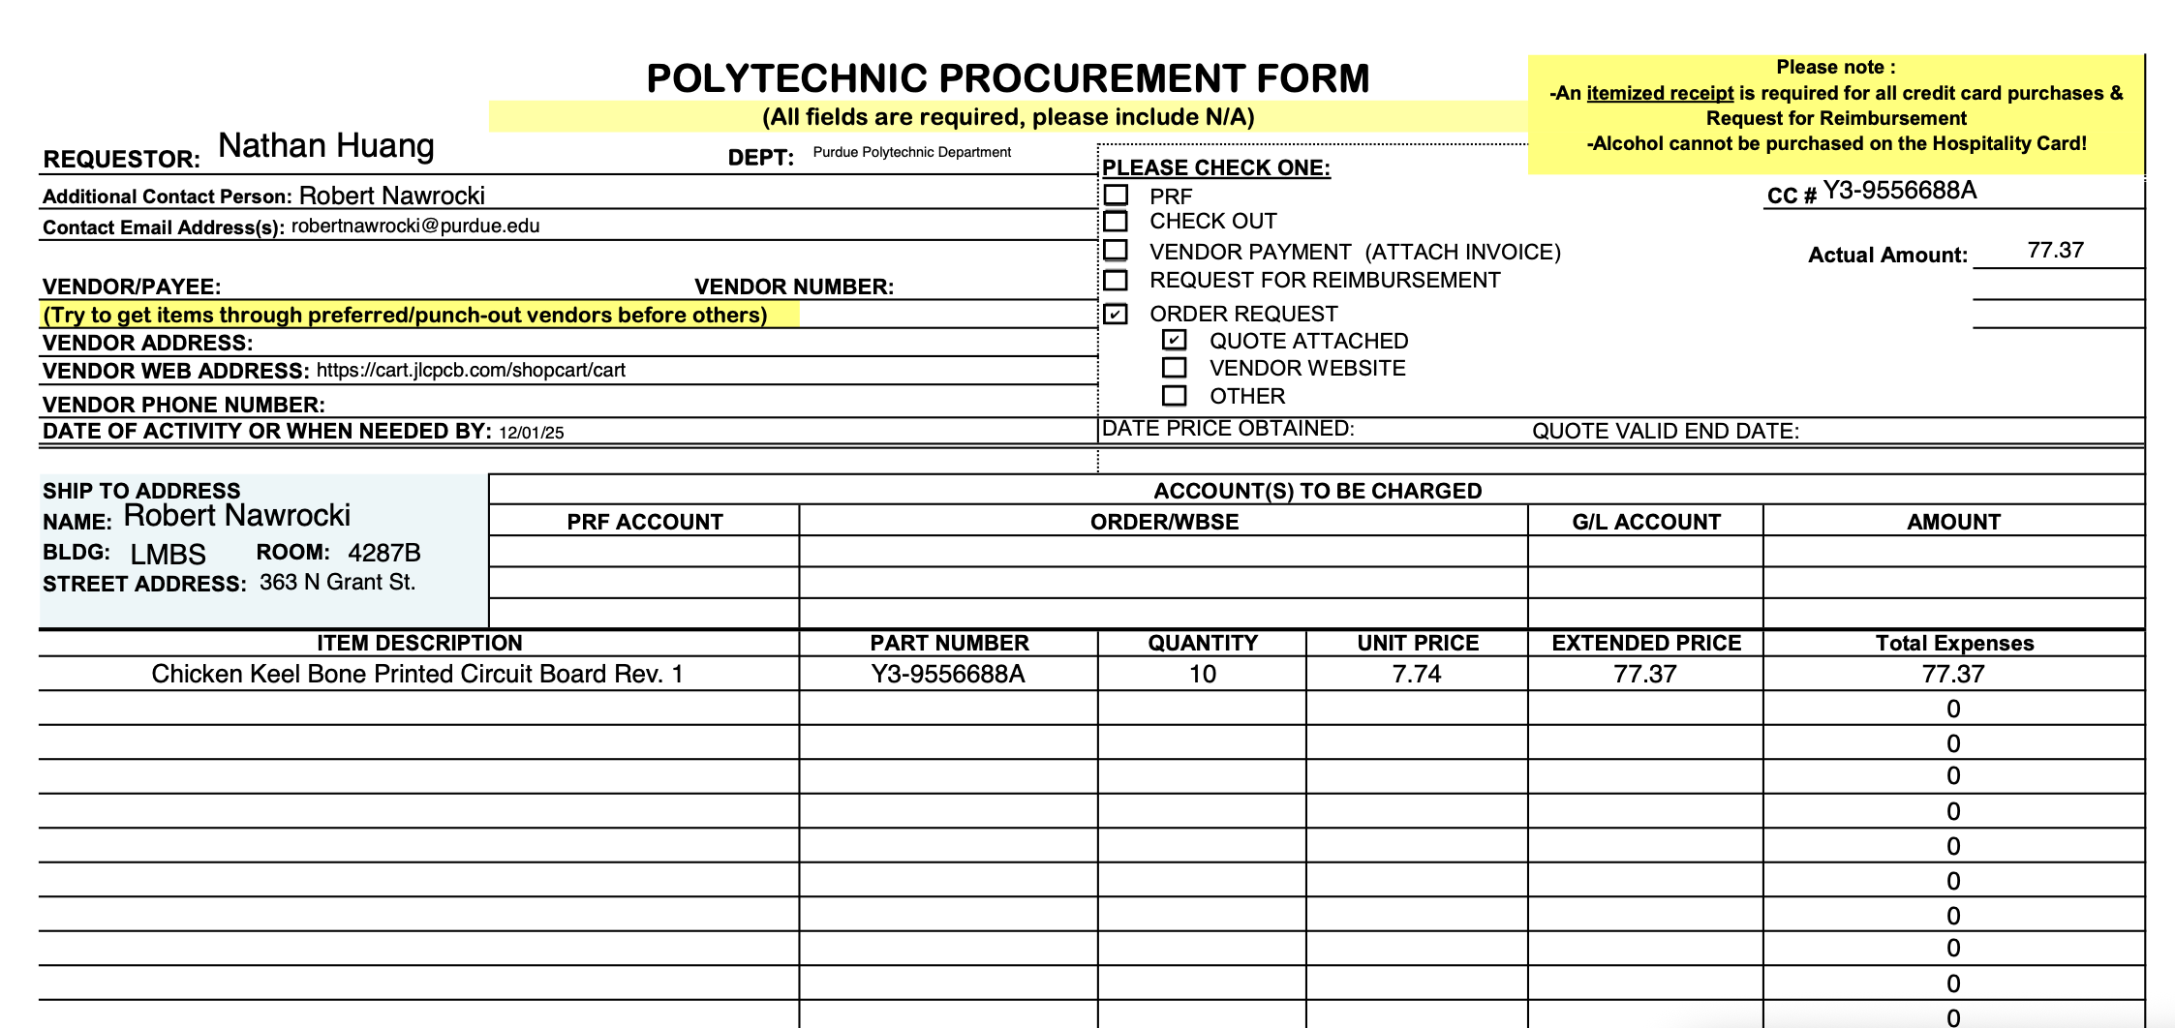
Form 12 Ordering
Form 12 complete and awaiting verification
Screenshot of form 12 attached below:

Slide 4
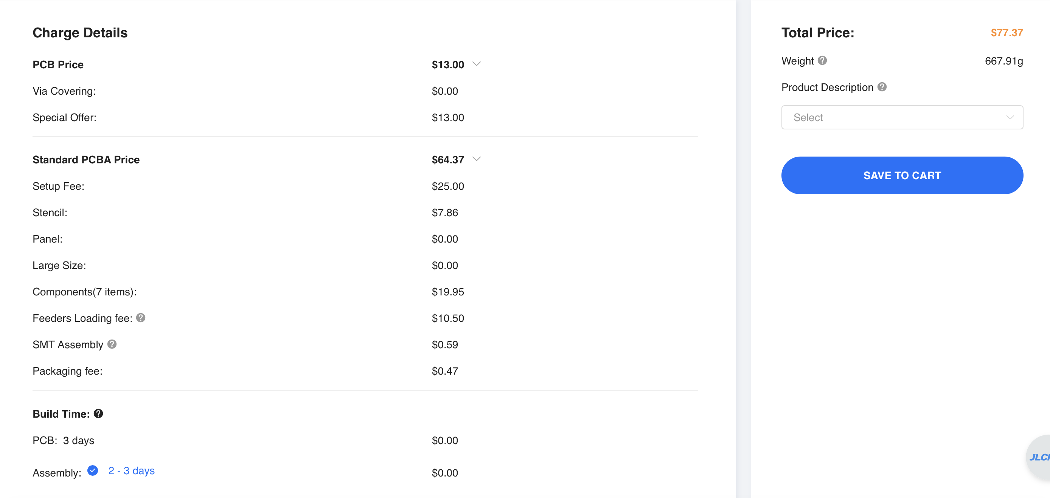
Finished Quote for PCB
PCBA can be ordered
Finalized quote seen below:
Weight estimate is incorrect (for all parts related to assembly)

Slide 5
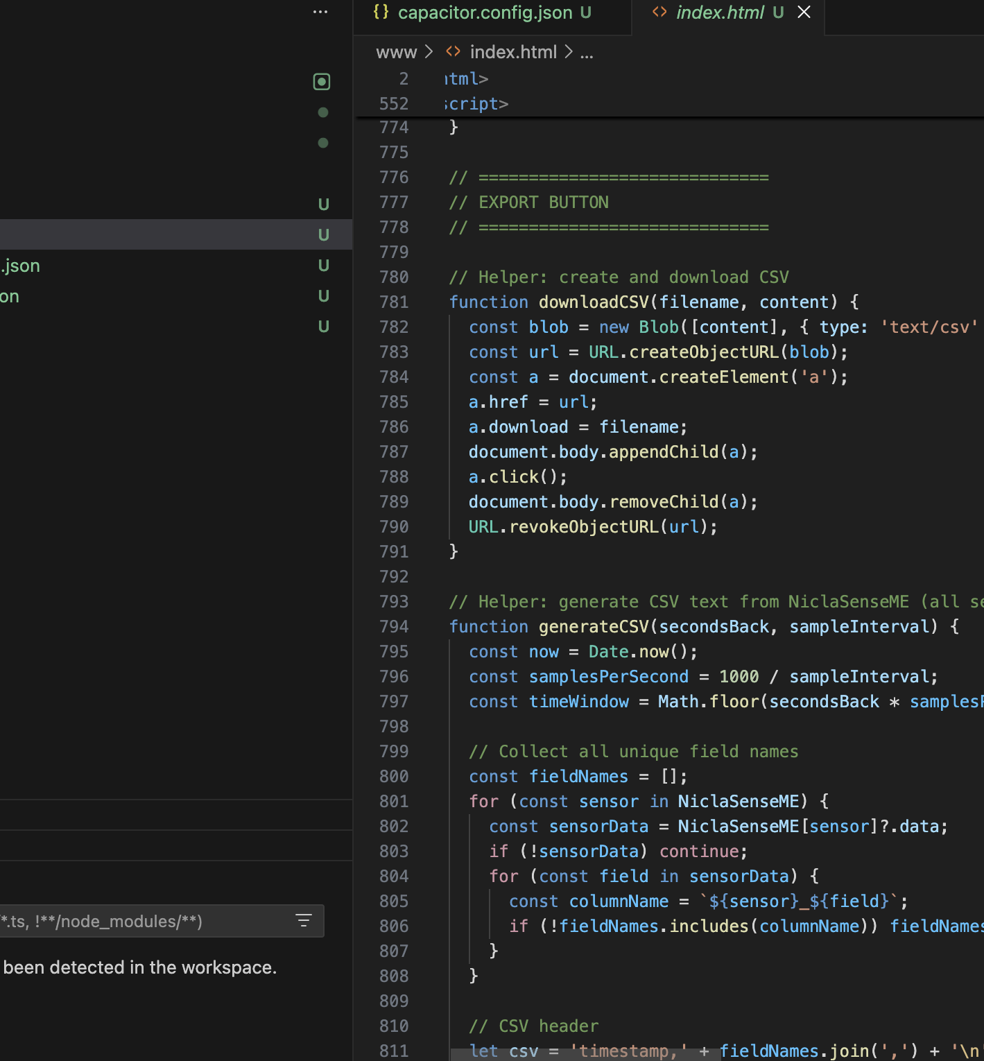
Mobile App Development
Frontend Design Started
Conversion from Web BLE -> Mobile more difficult than anticipated
Needed new dependencies: Xcode, CocoaPods, Capacitor
Will be able to finished by next week

Slide 6
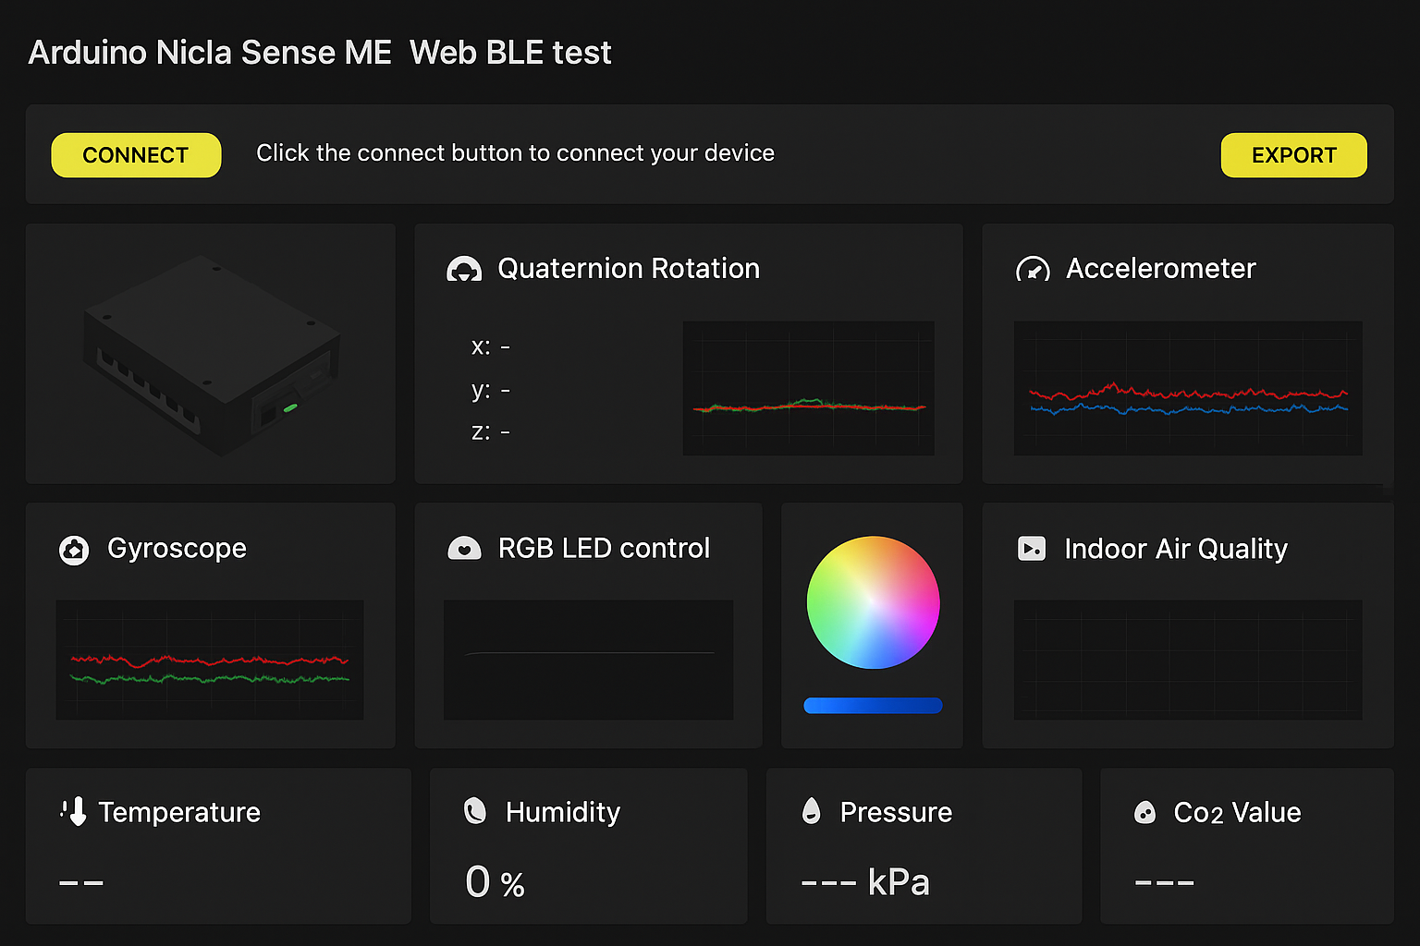
Mobile App Development
Backend Framework of App
Basic view of iPad app seen below
Basic functionality of the web version (with Bluetooth), with redundant feature removed
Need to ask Omosalewa if she believes additional features would benefit the app

Slide 7
Next Week
Blockers & Next Week’s Work
Finish Mobile App Development
Add Data Logging Functionality for
Blockers:
Dependency Issues with several iOS development environments
CocoaPods
NPM
Capacitor

Slide 8
Thank You
Purdue Polytechnic Institute

