Slide 1
Week 14
Keel Bone Chicken Project
12/05/2025

Slide 2
This Week
This week’s progress
Web App Development
Data logger works without need of constrained app
Case Study on Resistive vs. Capacitive Sensors
Rev. 2 PCB Started
Component placement on board

Slide 3
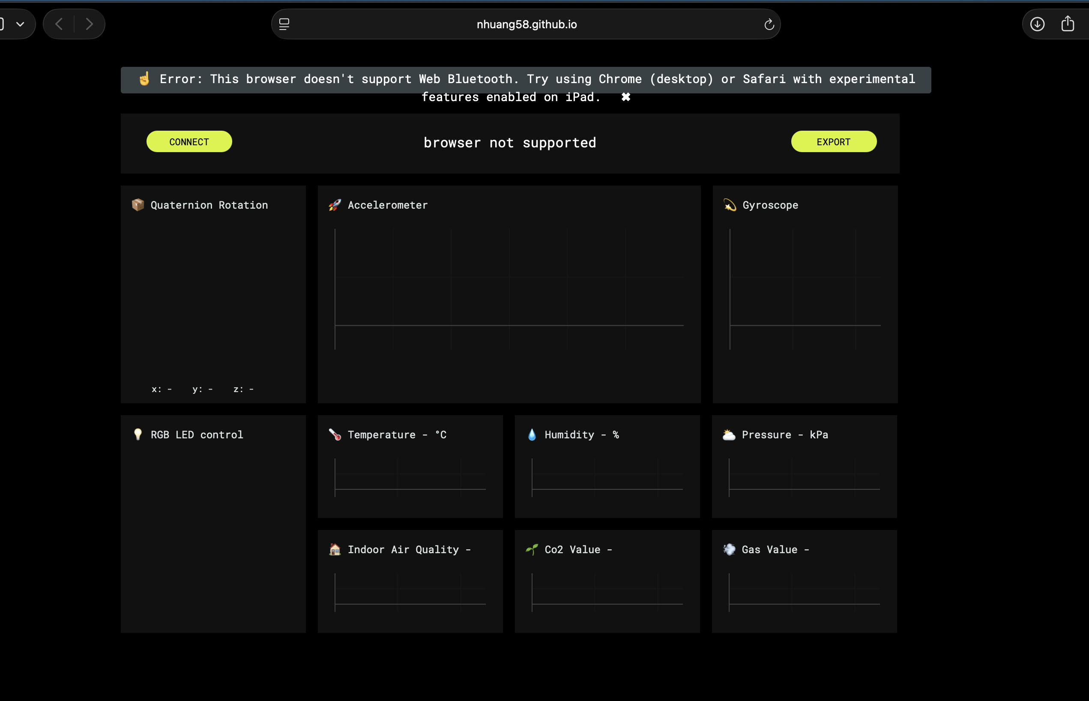
Web App Development
Data logger locally hosted
Website now live at:
https://nhuang58.github.io/Biomedical_Device_PCB/
Can be locally hosted, no need for a server
Data needs to be pulled when collection complete
Unsure if bandwidth will be an issue
Working on compatibility with hardware (iPads)
Determine if iPads are realistic to run with BLE, or another approach is needed
Live website: https://nhuang58.github.io/Biomedical_Device_PCB/

Slide 4
Case Study on Resistive vs. Capacitive Sensors
3 Main Sources for Research
Digi-Key Electronics
Mouser Electronics
Interlink Electronics (Contacted)

Slide 5
Case Study on Resistive vs. Capacitive Sensors
Digi-Key Electronics: 1-800-344-4539
Resistive vs. Capacitive Sensors
Strain Gauge – Resistive:
CEA-05-250-A350 ($18.00)
(.45 x .18 inches) Area
Force Gauge – Only Resistive Options:
Load Cell Device: Based on Pressure
Used in scales, weight, etc.
3917-GHB-10-ND ($5.86)
12 mm diameter (round area)
K-011-0400-80-NE2-K1-G1 ($130.87)
12 mm diameter (round area)

Slide 6
Case Study on Resistive vs. Capacitive Sensors
Mouser Electronics: 1-817-804-3888
Resistive vs. Capacitive Sensors
Unable to assist with applications due to viability concerns
Resistive Force Gauge:
https://www.mouser.com/c/sensors/force-sensors-load-cells/?operating%20force=20%20N&output%20type=Analog
Higher end product (~$90-110)
Load Cells are commonly used, almost entirely resistive
Not many options for capacitive sensors in Mouser’s arsenal
Resistive Strain Gauge:
Mouser PN: 485-4542 ($3.95 per unit)
Very cheap unit cost for resistive vs. capacitive units
However, only capacitive sensors are reliably capable at running at 3.3 V supply
https://www.mouser.com/c/sensors/force-sensors-load-cells/?operating%20supply%20voltage=3.3%20V&sensor%20type=Force%20Sensor
Middle end cost (~$30-50)

Slide 7
Case Study on Resistive vs. Capacitive Sensors
Final Sensor Selections (Force + Strain)
Force Sensor (Capacitive Sensor + Charge Amplifier)
Force Sensor: SingleTact Force Sensor
(https://5361756.fs1.hubspotusercontent-na1.net/hubfs/5361756/SingleTact%20Documents/SingleTact_Datasheet.pdf?
Charge Amplifier: AD7150
https://www.analog.com/en/products/ad7150.html?utm_source=chatgpt.com

Slide 8
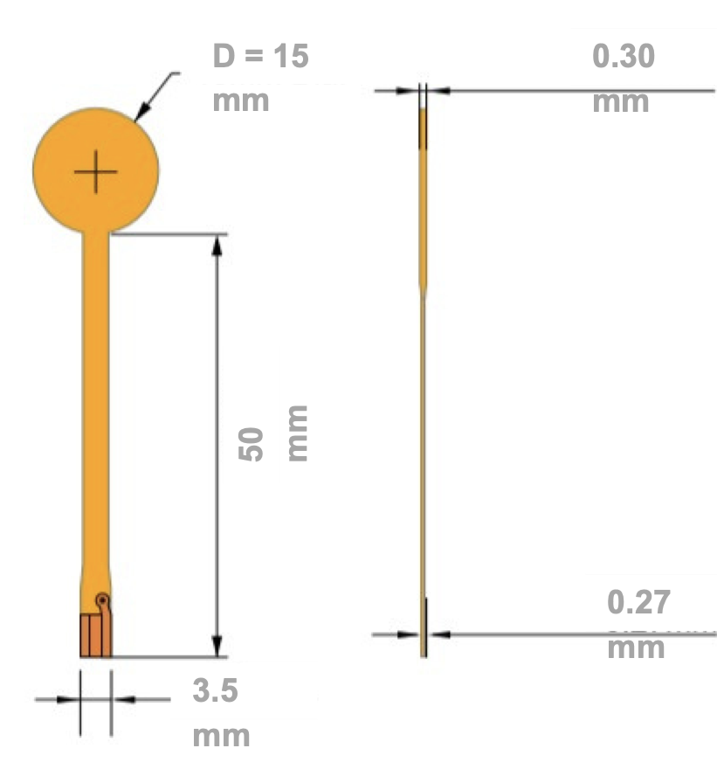
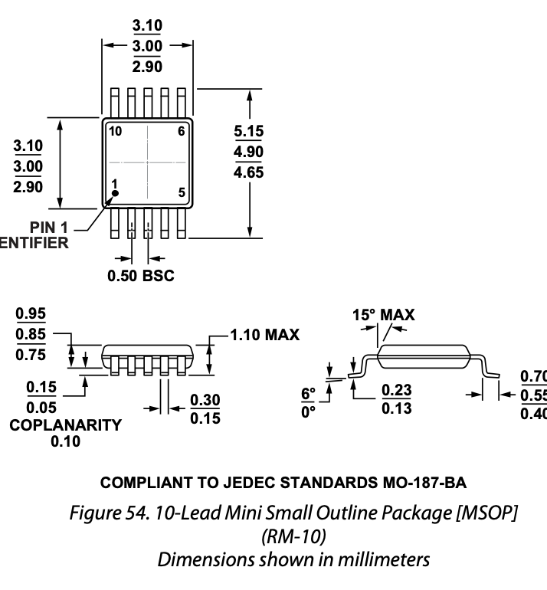
Case Study on Resistive vs. Capacitive Sensors
Relative Sizing of Force Sensor
Force Gauge
Charge Amplifier

Slide 9
Case Study on Resistive vs. Capacitive Sensors
Final Sensor Selections (Force + Strain)
Strain Sensor (Resistive Sensor + Wheatstone Bridge)
Resistive Sensor: C4A-06-125SLA-120-39P
https://mm.digikey.com/Volume0/opasdata/d220001/medias/docus/696/125SL.pdf
Charge Amplifier: INA333AIDGKT
https://www.digikey.com/en/products/detail/texas-instruments/INA333AIDGKT/1888785?

Slide 10
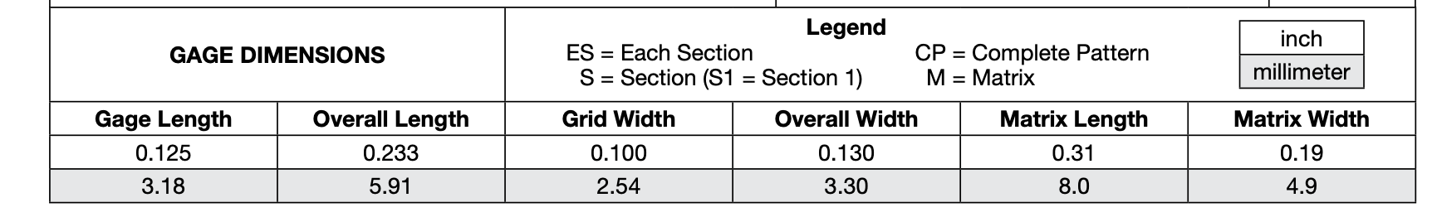
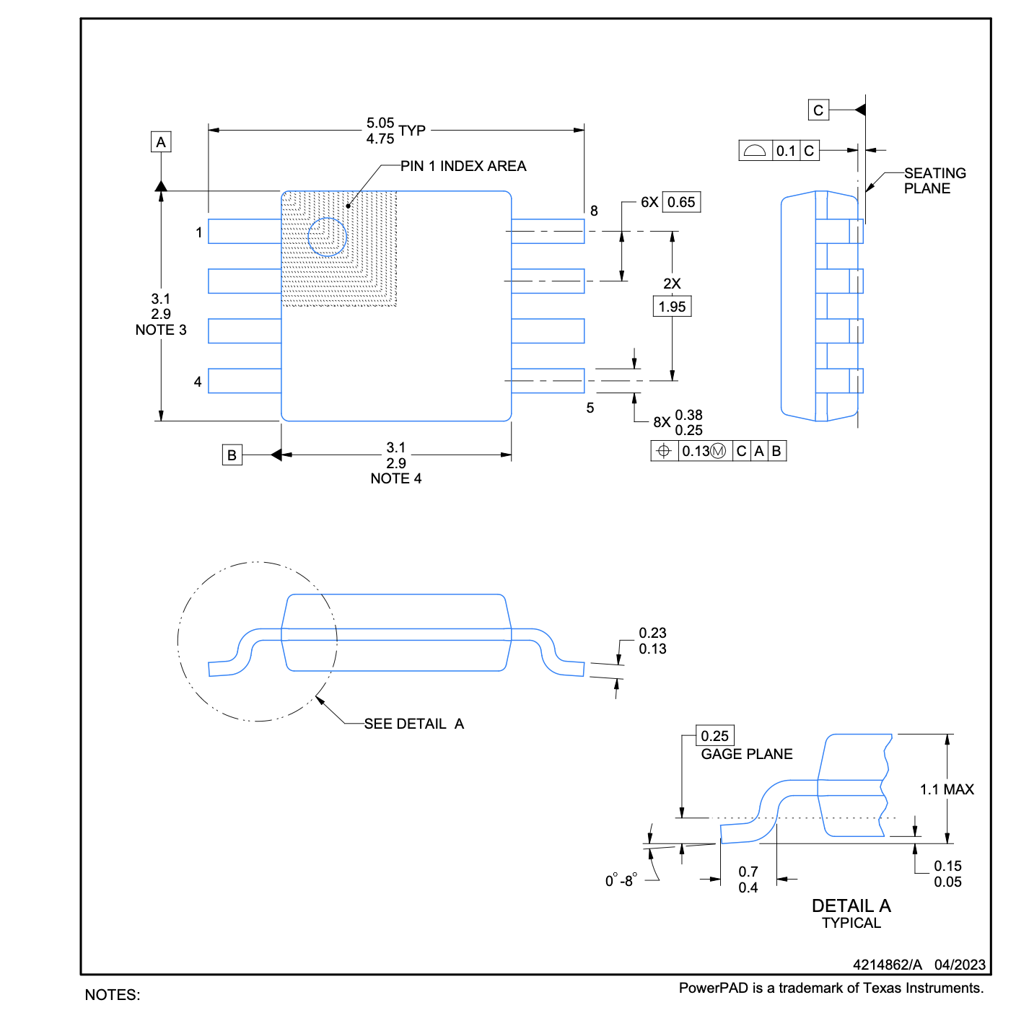
Case Study on Resistive vs. Capacitive Sensors
Relative Sizing of Strain Sensor
Strain Gauge
Charge Amplifier

Slide 11
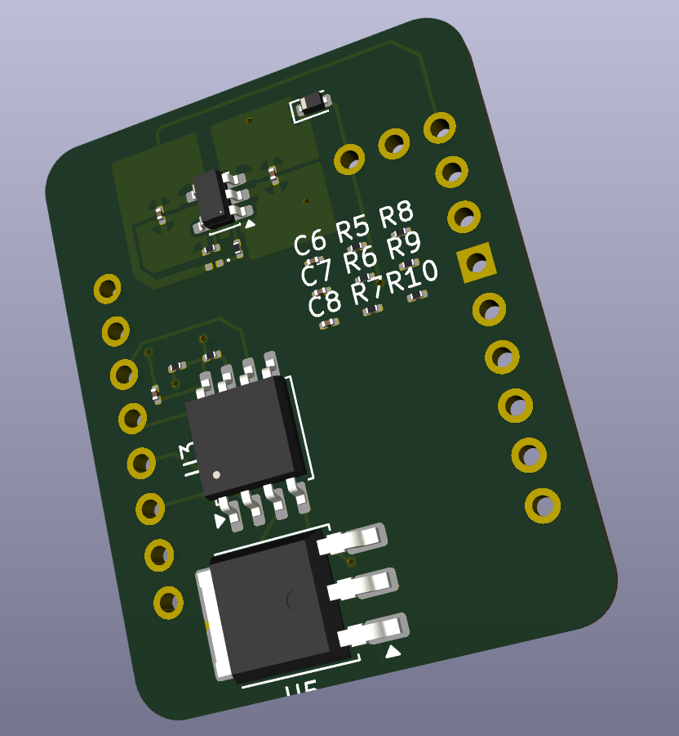
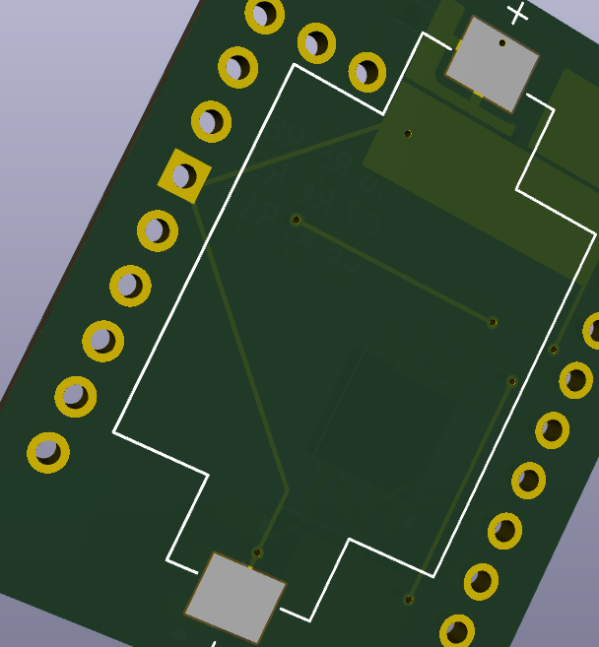
Rev. 3 PCB Started
Component Placement on Board
Need to resize the battery
Consider size constraints for PCB again

Slide 12
Next Week
Blockers & Next Week’s Work
Analyze what can be done with Hardware issues
Refine Rev. 2 of PCB
Send Sensors + Quotes of Sensors to Charles
Blockers:
Hardware restrictions given by Agriculture departments
Could a computer be used instead? It would simplify a lot
What other hardware can be purchased and used at the farm?

Slide 13
Thank You
Purdue Polytechnic Institute

