Slide 1
Week 15
Keel Bone Chicken Project
12/12/2025

Slide 2
This Week
This week’s progress
PCB Invoice
Selection of PCB Sensors
Based on Input from Mechanical Engineering
Finalized Sensor Selections with Diagrams
Finalized Part Selections with Footprints and Metrics
Creation of Data Logger Executable
Insights into Permanent Solutions for Data Logging Issue

Slide 3
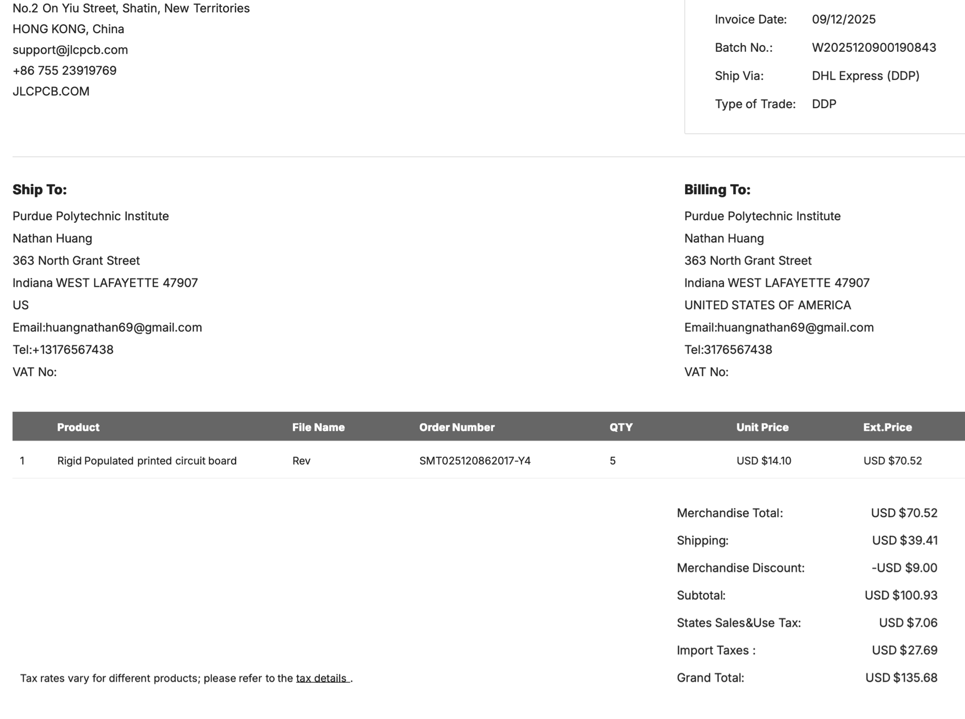
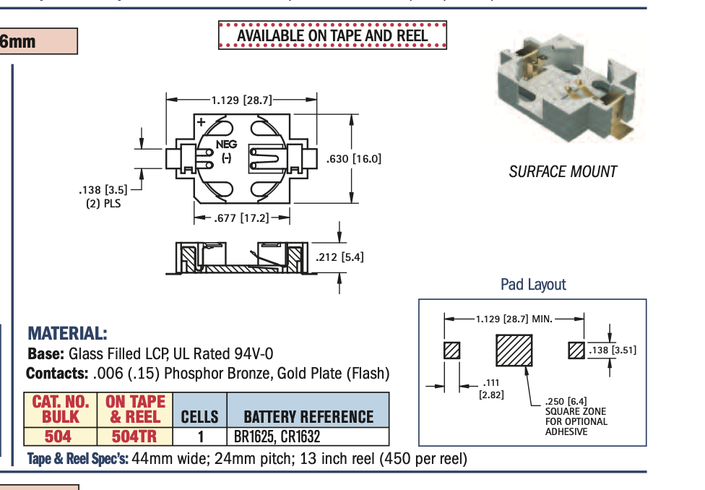
PCB Invoice
PCB Ordered from Procurement Office in POTR
Effective Shipment Date: 12/11/2025
Needed to purchase some equipment on the side (Not available on Vendor website
Battery Holder: https://www.digikey.com/en/products/detail/keystone-electronics/504/2745584?utm_campaign=buynow&utm_medium=aggregator&utm_source=snapeda
Need to Solder manually

Slide 4
Selection of PCB Sensors
Based on Input from Mechanical Engineering
Force Gauge:
1.4 m/s Impact Speed Maximum
1-2 MPa Contact Pressure on Bone
Down from ~10 MPa earlier
Strain Gauge:
~5-10% Strain due to Impact
1.42 kg approximated for Hen mass

Slide 5
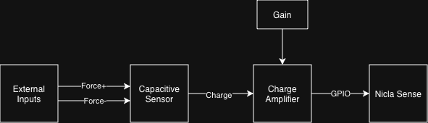
Selection of PCB Sensors
Finalized Sensor Selections with Diagrams
Force Sensor (Capacitive Sensor → Charge Amplifier)
Force Sensor: SingleTact Force Sensor:
https://5361756.fs1.hubspotusercontent-na1.net/hubfs/5361756/SingleTact%20Documents/SingleTact_Datasheet.pdf
Charge Amplifier: AD7150:
https://www.analog.com/en/products/ad7150.html
Figure 1: Diagram of Finalized Force Sensor

Slide 6
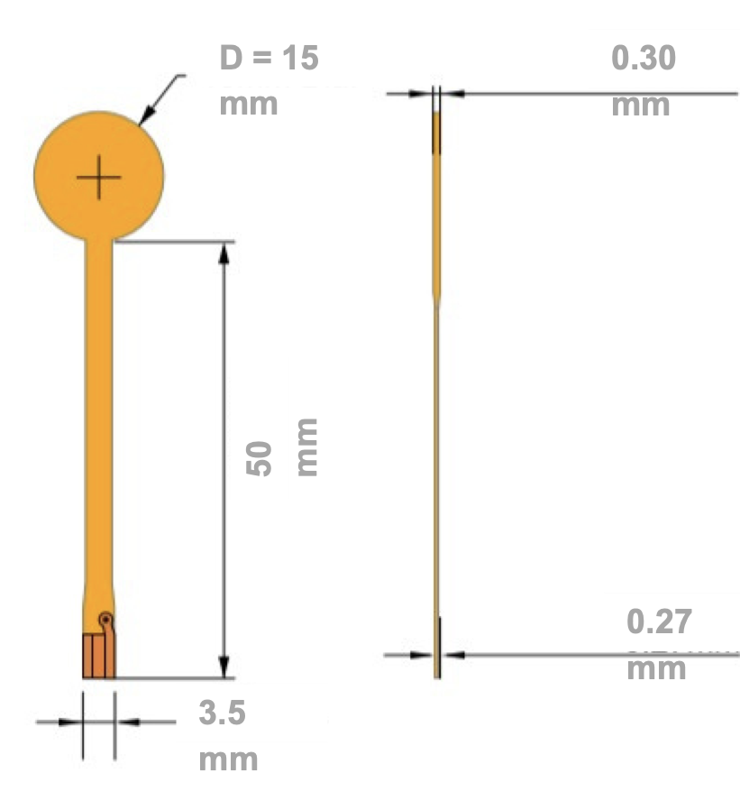
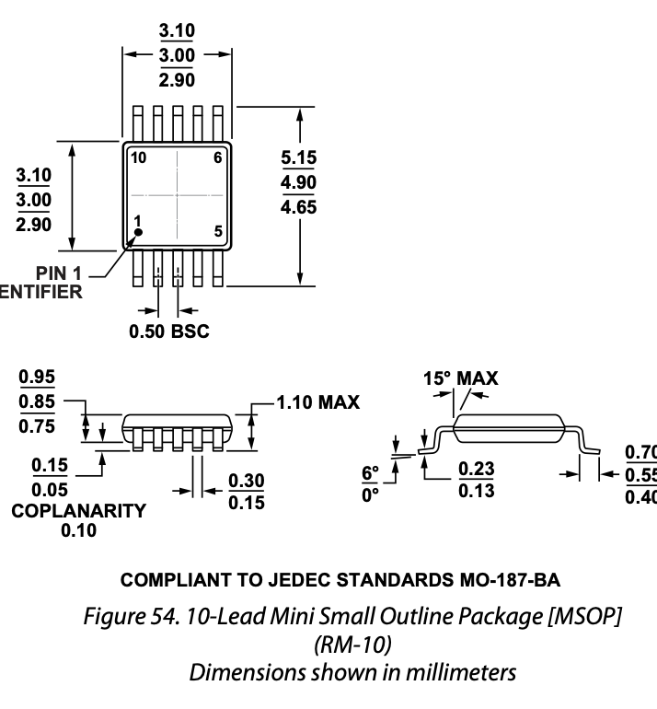
Selection of PCB Sensors
Finalized Part Selections with Footprints and Metrics
Outside region irrelevant
Force Gauge
Charge Amplifier

Slide 7
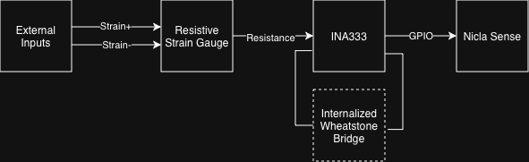
Selection of PCB Sensors
Finalized Sensor Selections with Diagrams
Strain Sensor (Resistive Sensor → Wheatstone Bridge)
Resistive Sensor: C4A-06-125SLA-120-39P
https://mm.digikey.com/Volume0/opasdata/d220001/medias/docus/696/125SL.pdf
Charge Amplifier: INA333AIDGKT
https://www.digikey.com/en/products/detail/texas-instruments/INA333AIDGKT/1888785?
Figure 2: Diagram of Finalized Strain Sensor

Slide 8
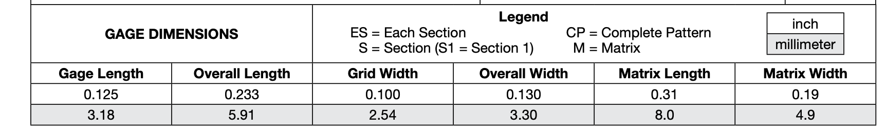
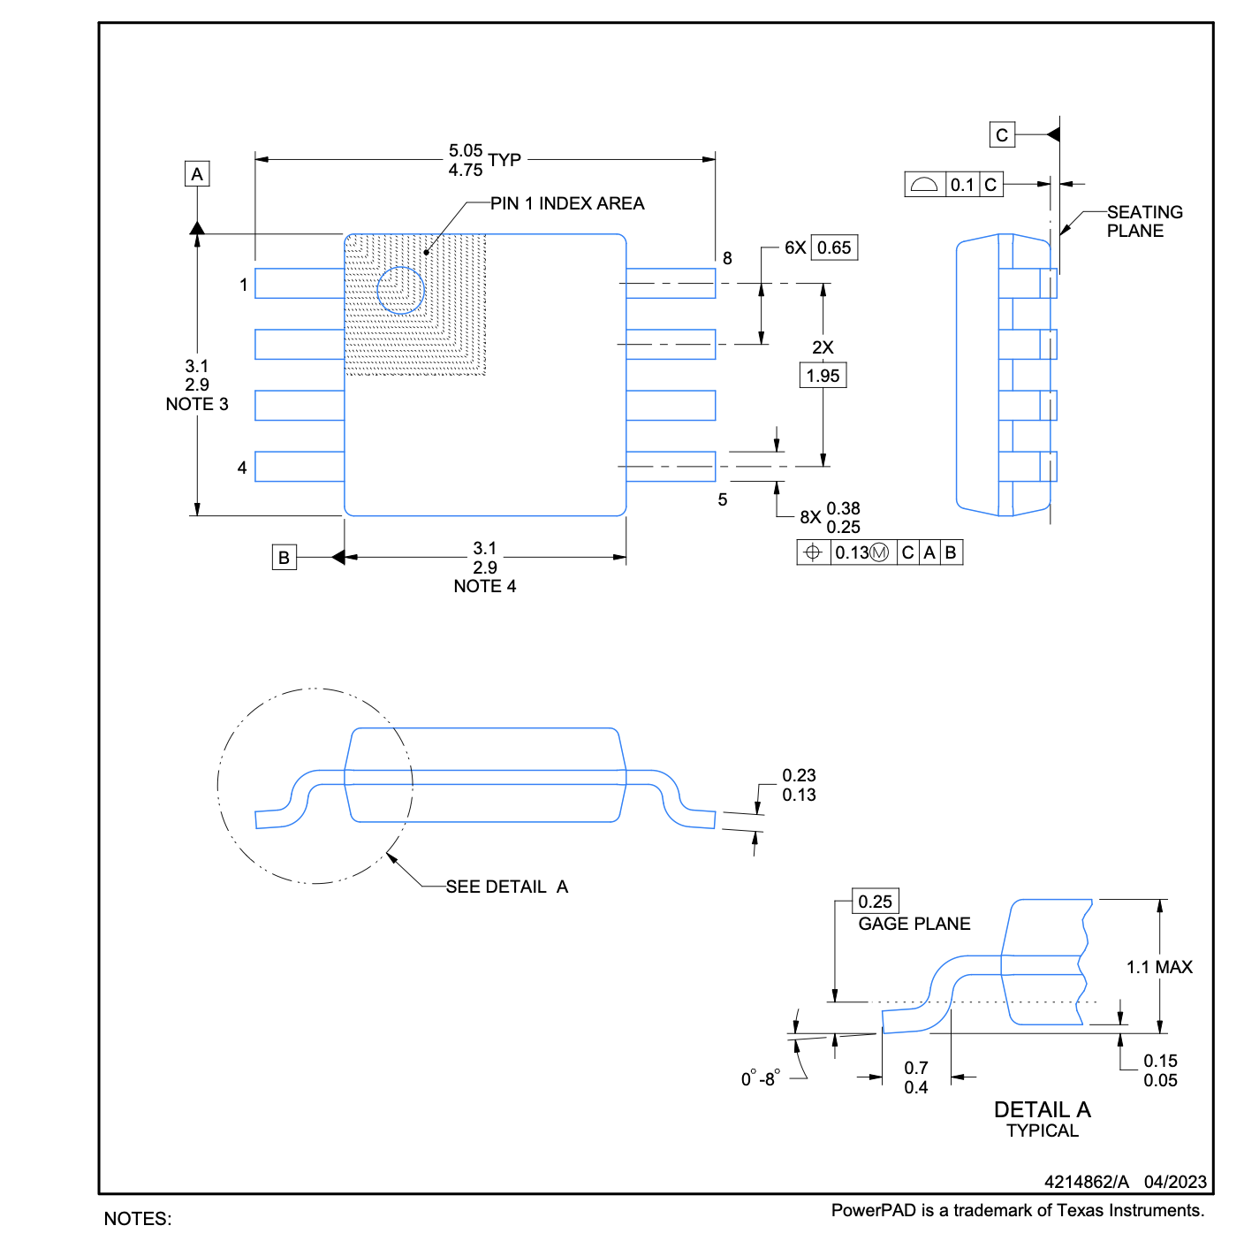
Selection of PCB Sensors
Finalized Part Selections with Footprints and Metrics
Strain Gauge
Charge Amplifier

Slide 9
Selection of PCB Sensors
Finalized Part Selections with Footprints and Metrics
Strain Gauge
Charge Amplifier

Slide 10
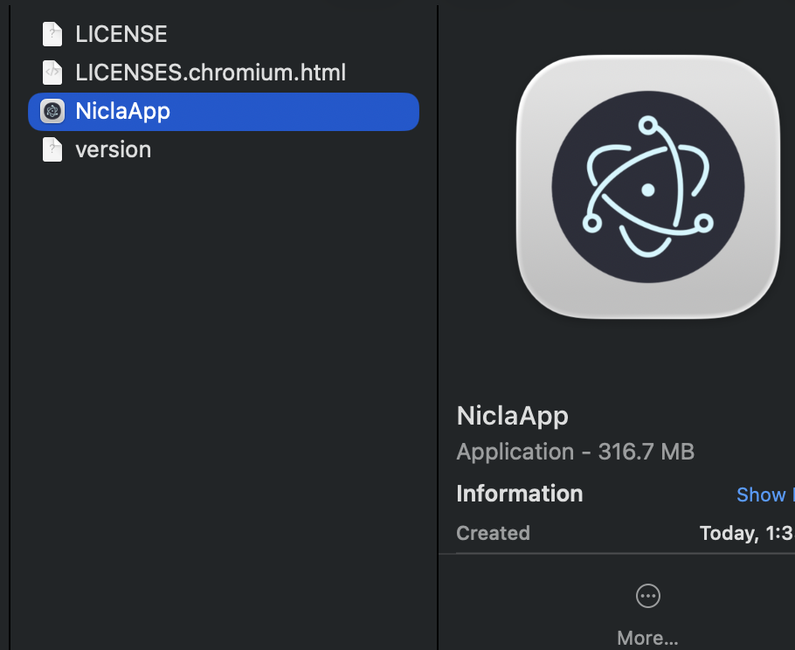
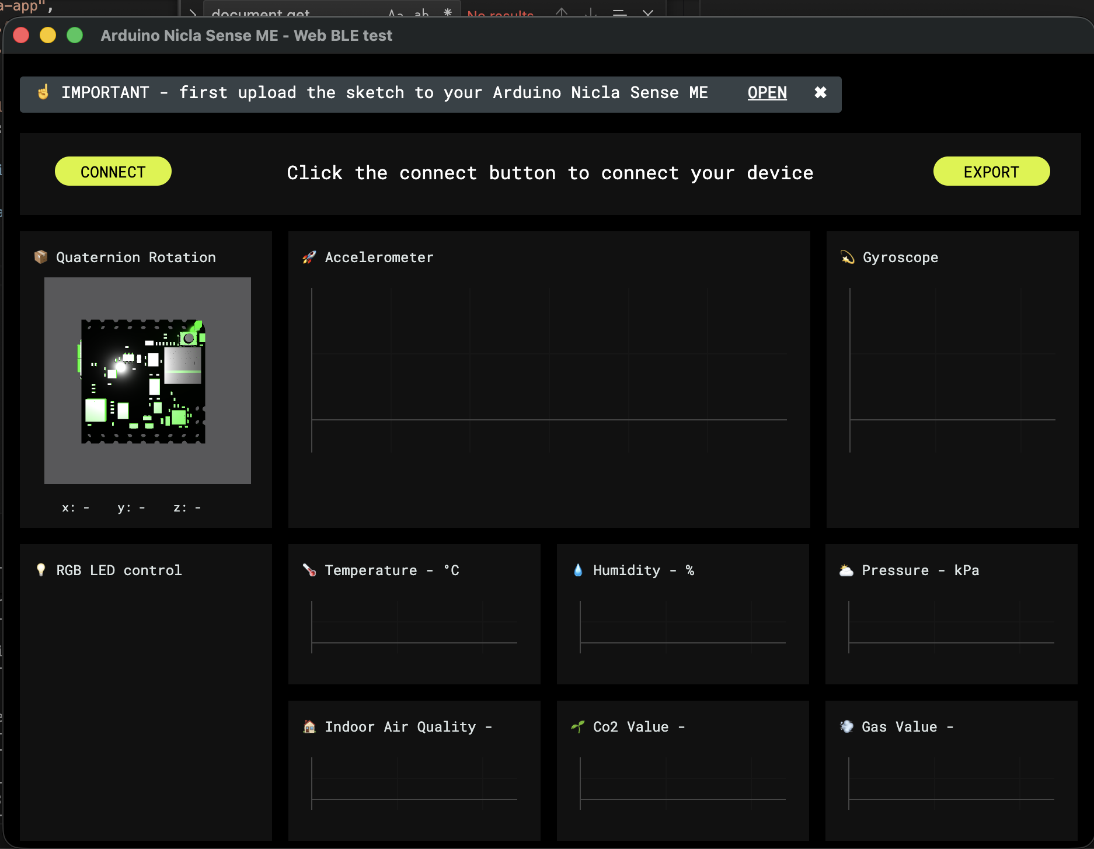
Creation of Data Logger Executable
Creation of Executable to Run on Mac/Windows
Issues with Data Logging need to be fixed with creation of remote executable
Tested Hosted Website Compatibility with Omosalewa last Friday

Slide 11
Creation of Data Logger Executable
Creation of Executable to Run on Mac/Windows
Unsure what options are available with PMDs with Agriculture department:
Android/iOS
Use of embedded iOS development in iOS/Android
React Native Frameworks
#1 (Expo Go), #2 (NativeBase/Base44)
Other Data Storage Options:
Cloud: GitHub (Subscription Required), AWS, Firebase
Local: Laptop/Server with SQLite for Database
Hybrid: Local Storage + (8 Hour Period x 3) Cloud Backups
Executable/App: Installable app logging data locally
Local iOS development as seen above

Slide 12
Next Week
Blockers & Next Week’s Work
Hand over PCB to Mechanical + Agriculture Department
Write up instructions for use
Figure out data storage problem with current executable
Blockers:
Shipment lead time for PCB

Slide 13
Thank You
Purdue Polytechnic Institute

