Slide 1
Week 16
Keel Bone Chicken Project
12/15/2025

Slide 2
This Week
This week’s progress
PCB Regeneration
Creation of Drill Files
Case Study on Data Options
(1) Local
(2) Cloud
(3) Hybrid
(4) React Framework
Rework of Wheatstone Bridge
Delivery of Device for Data Logging to the Agriculture Department

Slide 3
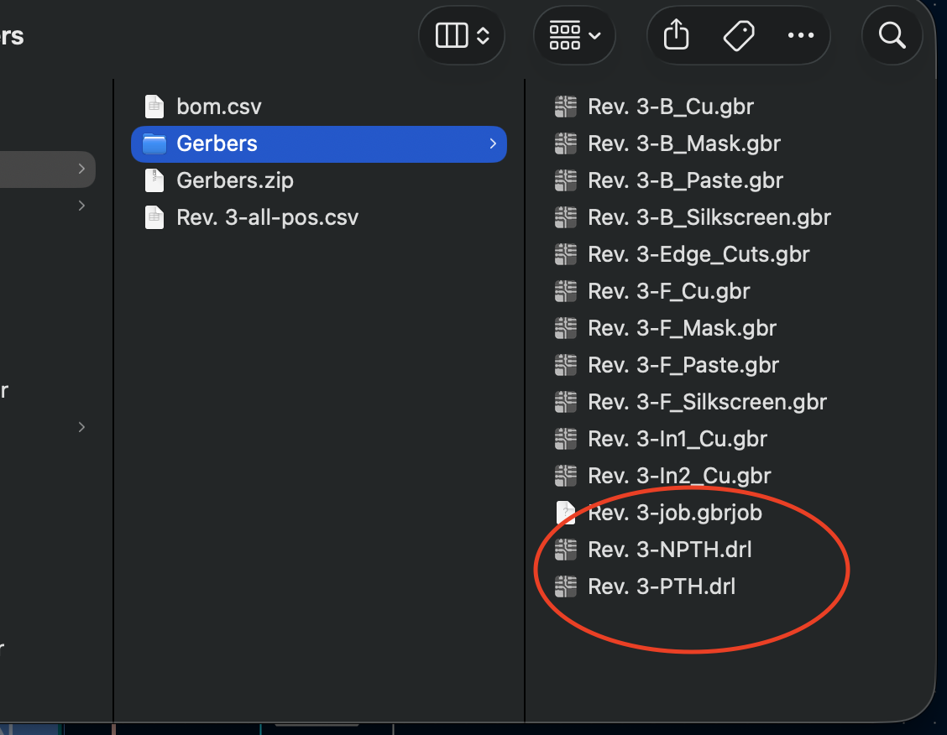
PCB Regeneration
Creation of Drill Files
Shipment Delayed
Contacted JLCPCB to Inquire about the shipment delay
Initially a problem with parts sourcing
Looked closer and it was an issue with drill file generation
Regenerated drill files
New Shipment before next week

Slide 4
Case Study on Data Options
Local Storage
Data stored will be stored on the device or on a laptop running an application
Highly reliable for offline environments and easily supports four-sensor data
Possibility to use external hardware to serve as a bridge between device and storage
Minimal cost, more difficult to develop

Slide 5
Case Study on Data Options
Hybrid Option
Local logging with periodic cloud sync (3 times x 8 hours / day).
Reduces bandwidth usage while providing remote accessibility and backup redundancy.
Cost: moderate—local hardware + limited cloud storage (No need for higher end web options)
Medium cost, medium difficulty to develop

Slide 6
Case Study on Data Options
Cloud Option
Data uploaded directly to GitHub, AWS, or Firebase.
Enables remote monitoring based on reliable server providers
Approximate costs:
GitHub: $4–$12/month for private repo tiers with higher storage
AWS S3: $0.023/GB per month for storage; additional data transfer charges
Firebase: $25–$100/month depending on read/write volume and database usage
Requires stable internet (Not a problem for the agriculture department)
Higher data uploads would cost more (Unsure if this would be a problem due to the nature of our data)
Higher cost, easy to develop

Slide 7
Case Study on Data Options
React Framework (For iOS/Android/PMD Platform)
Expo / Expo Go:
Easiest cross-platform development for Android/iOS; development environment already released to App Store/Google Play Store
Ideal for quickly testing BLE/USB
Free, no cloud development is necessarily needed
React Native:
More customization, better performance a mobile device to obtain data
Allows integrating native modules if the Nicla requires low-level hardware communication
Free; No Apple Development account needed for our application
Pure React (Web App):
Suitable for desktop browser dashboards
Free; More development time required since all web development occurs on our backend

Slide 8
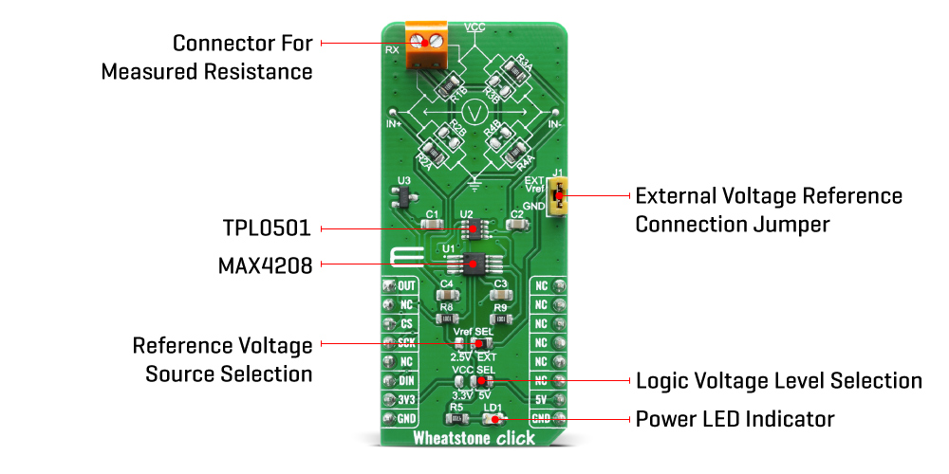
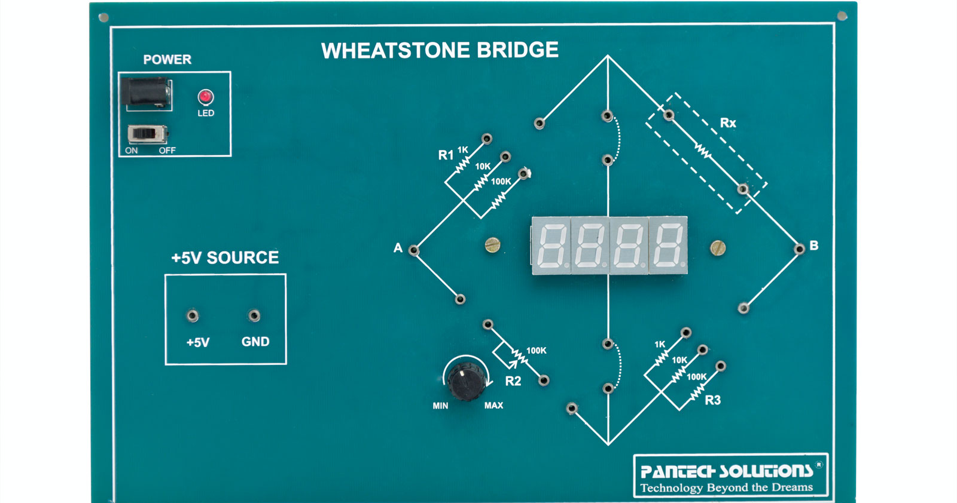
Rework of Wheatstone Bridge
SMD components would likely be preferable over a chip design
Used Professor Salas’ feedback
INA333 used better as an amplifier for Wheatstone bridges’ output
SMD components would likely form a better Wheatstone bridge

Slide 9
Delivery of Device for Data Logging to the Agriculture
Showed Executable App, got data working on remote device
Backpack maybe too small for the Battery + Device (Initial Concern)
Showed Agriculture Department that the remote app could be compiled
Data collection show take place 12/15 to obtain real data from chickens
Remote BLE, Battery, Website all work seamlessly

Slide 10
Next Week
Blockers & Next Week’s Work
Ensure PCB shipment arrives
Get started on data storage option chosen
Analyze Actual Chicken Data pulled from Agriculture Department
Finish Rev. 4 of PCB
Blockers:
Heavy traffic for JLCPCB around this season, need to ensure every component of the order is placed correctly

Slide 11
Thank You
Purdue Polytechnic Institute

