Slide 1
Week 1
Keel Bone Chicken Project
01/16/2026

Slide 2
This Week
This week’s progress
PCB Reordering
Purchase Request sent to Procurement Office
Initial Purchase Failed + New Purchase
PCB Design
Updates to Rev. 4 of PCB Design
Added Force + Strain Logging
Several Design Choices to Minimize Area
Data Analysis
Able to determine chicken movement from PCB
Need to change some firmware on the Nicla Sense
This Semester

Slide 3
PCB Reordering
Purchase Request sent to Procurement Office
Drill files regenerated and issue dealt with with JLCPCB support
Need to call procurement office to ensure the order successfully goes through
May be an issue with the resistors
2 mm (length) x 1 mm (height) sizing too small for regular PCBA
May need to switch to 4 mm (length) x 2 mm (height) for our PCB

Slide 4
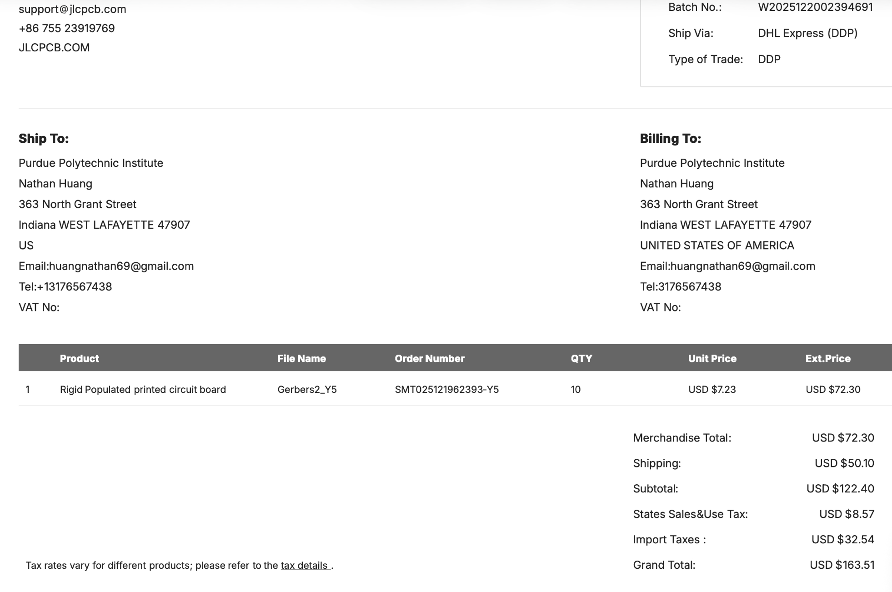
PCB Reordering
Initial Purchase Failed + New Purchase Successful
Order successfully went through
Card never charged, this time drill files are present and card will be charged

Slide 5
PCB Design
Updated Rev. 4 of PCB Design
Design Files + Footprints found and generated
Footprint of added hardware is smaller than anticipated, which is good
Minimal Issues with Routing this time around

Slide 6
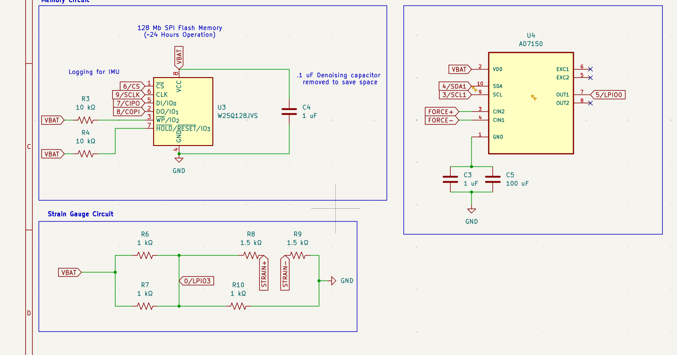
PCB Design
Added Force + Strain Logging
Sensor Circuitry can be seen in the Schematic below…
Added to PCB on the next slide

Slide 7
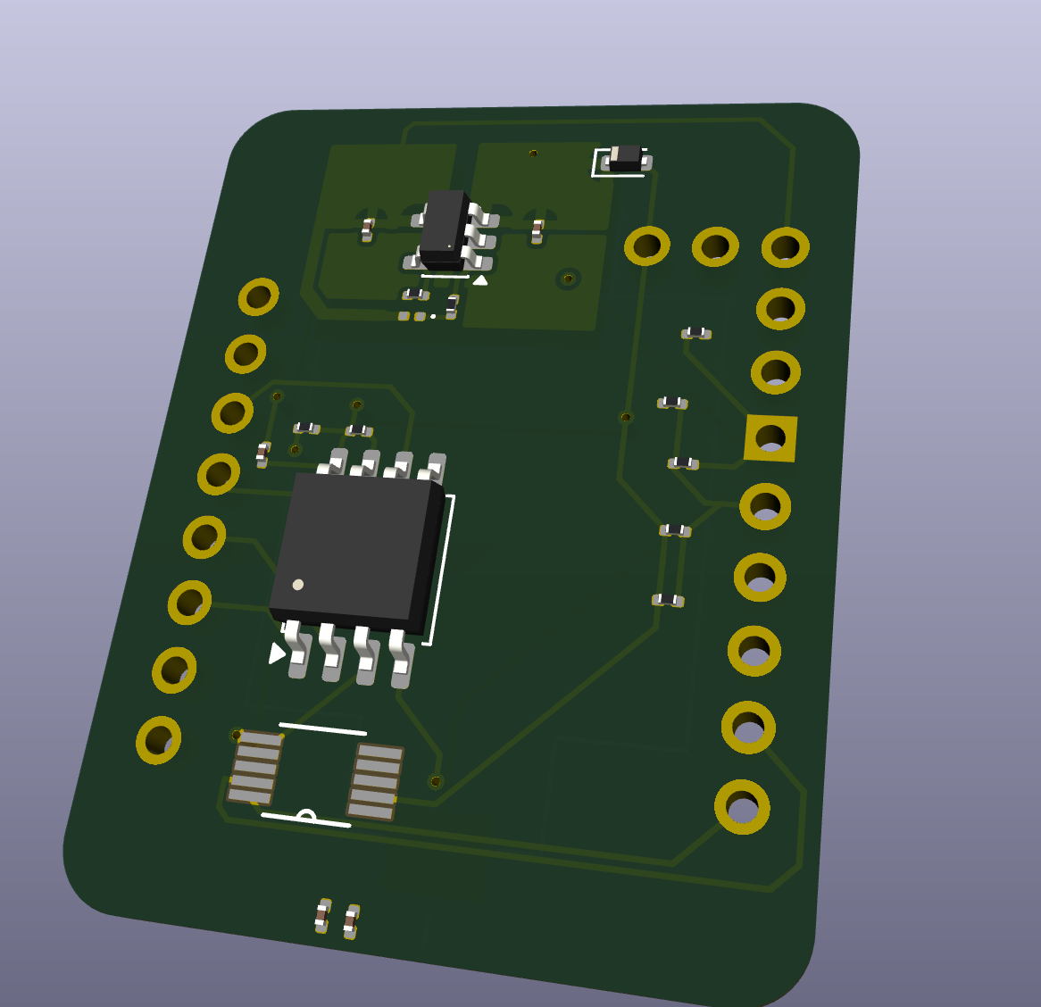
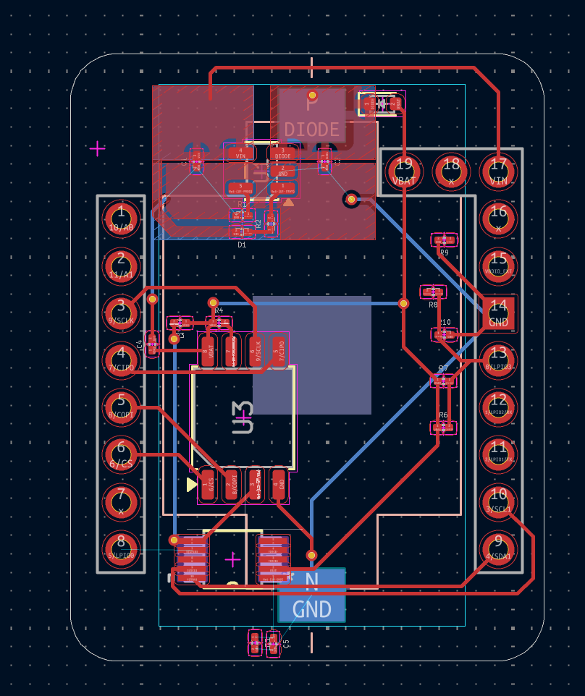
PCB Design
Several Design Choices to Minimize Area
Second Smallest Resistors Chosen due to Assembly Issues
Took precautions to minimize taken area
Space needed for Ribbon/Flat Flex Cables in the Future
Space needed for power dissipation in the future

Slide 8
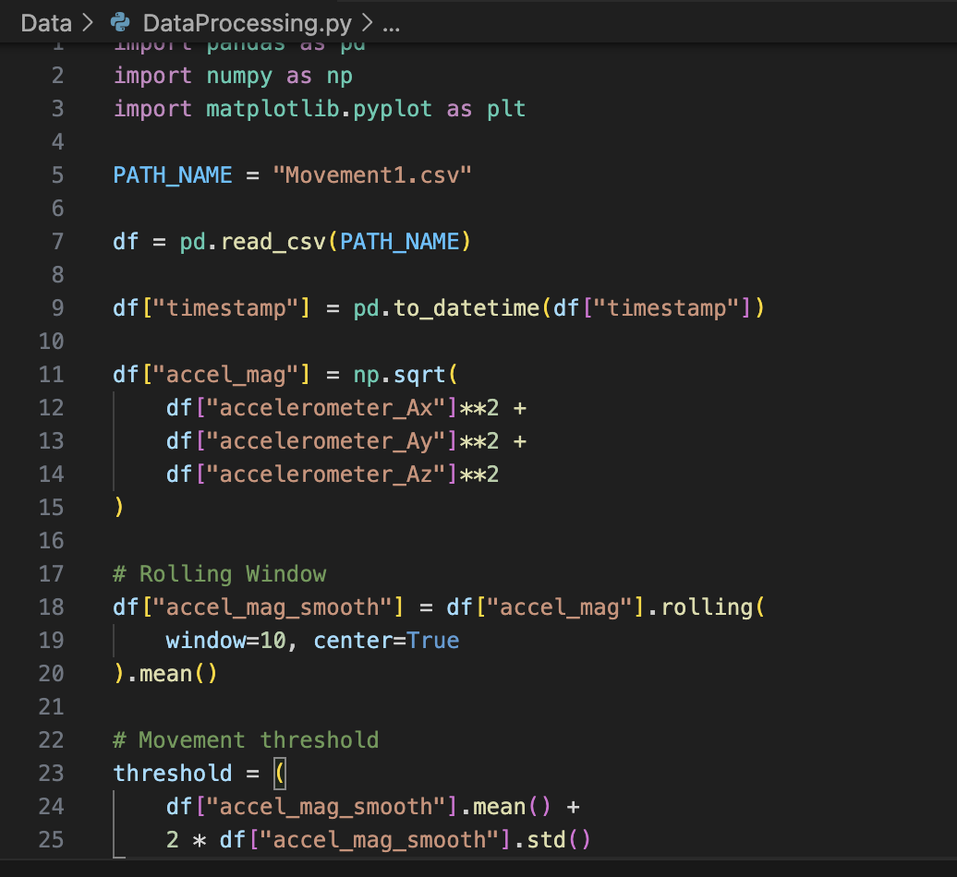
Data Analysis
Able to determine chicken movement from PCB
From the PCB, ~16 minutes 37 seconds of data was logged
I had originally set the maximum entries to 1000 -> 16:40
Missing 3 seconds of data is good, likely startup time
From the data, I was able to run the following data smoothing program:

Slide 9
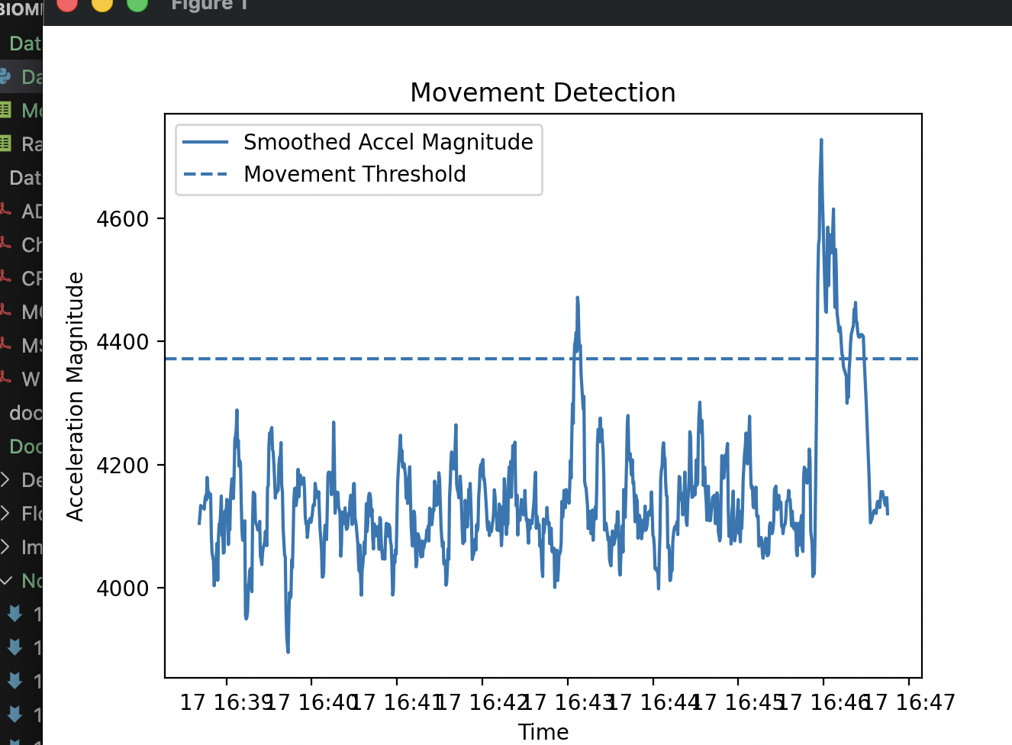
Data Analysis
Need to change some firmware on the Nicla Sense
IMU seems to turn off after extended periods of time on battery (20+ minutes)
Need to look into this issue and see how it can be avoided in the future
From data collection, I was able to obtain the following plot
Very visible when the chicken choose to move vs. fly

Slide 10
Next Week
Blockers & Next Week’s Work
Need to find the suitable battery replacement on the PCB
Work on Hybrid Approach for Data Collection
Fix Issue where Nicla IMU turned off unexpectedly after a prolonged time of data collection
Get Sample Data on Force Impacts (Small, Medium, Large Impacts)
Prepare the 2+ hour version of data test

Slide 11
This Semester
Outline Entire Semester Goals
Questions:
Notes:
Sabattical?
Leon Salas Weekly Meetings
Meeting Time

Slide 12
Thank You
Purdue Polytechnic Institute

