Slide 1
Week 2
Keel Bone Chicken Project
01/19/26

Slide 2
This Week
This week’s progress
Data Analysis
Measures of Impacts (Small, Medium, Large)
Power Management
Isolate Issues on Power Management within Board
Semester Plans
Agriculture Side (Phase 1)

Slide 3
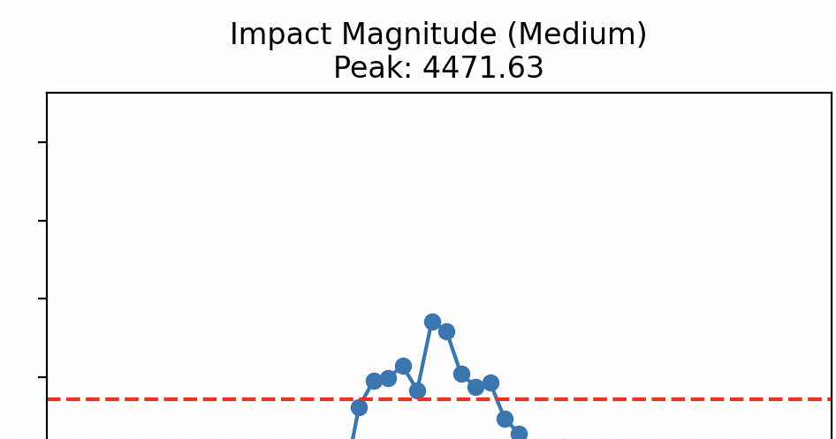
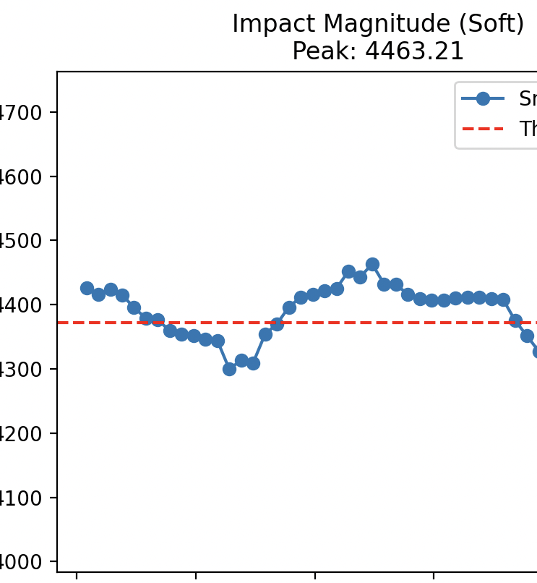
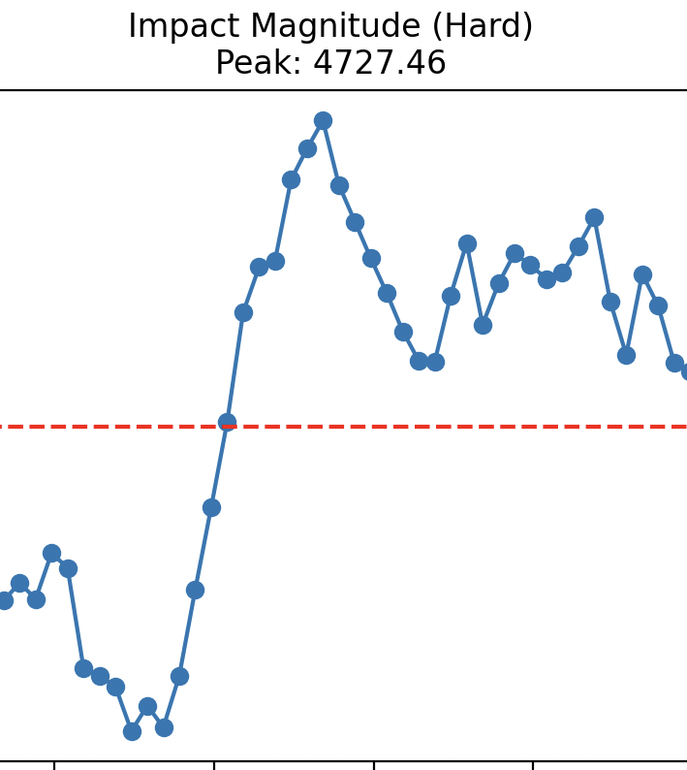
Data Analysis
Measures of Impacts (Small, Medium, Large)
Data averaged over 10 entries of Nicla Sense Data
10 entries attempted to be of the same magnitude

Slide 4
Power Management
Isolate Issues on Power Management with Board
PMIC Watchdog/Ship Mode: The BQ25120A Power Management IC may be entering "Ship Mode" or timing out.
Battery Undervoltage (BUVLO): Peak draws from BLE or sensors cause voltage sags that trigger the 3.0V safety cutoff.
NTC Thermal Protection: If using a 3-pin battery, the PMIC may be misreading temperature data as an overheat condition

Slide 5
This Semester
Outline Entire Semester Goals
Agriculture Department wants to complete Phase 1
Longer Data Collection
Emphasis on the Remote Charging System
Pilot Study
Notes:
Sabattical?
Leon Salas Weekly Meetings
Meeting Time

Slide 6
This Semester
Purdue Polytechnic
*Wait on Feedback from Agriculture and ME*
Refine the design/development of the system:
Battery
Board
Sensors
Collection of the Data from Chickens:
Refining the next version of the system
Refine the UI/UX – Agriculture people need help analyzing the data
Make it so they do not need our constant help with analyzing the data
Seeing what all the data looks like
Begin Thinking about Publication Manuscript: (Placeholder)
Go through different iterations of HW/SW, still want to be able to publish something
Want to get some kind of publishing from it
1st publication: System itself (all components, electrical parts, data)
2nd publication: Agriculture data + conclusion

Slide 7
Thank You
Purdue Polytechnic Institute

