Slide 1
Week 3
Keel Bone Chicken Project
01/30/26

Slide 2
This Week
Weekly Progress
Preparing Devices
Soldering Pin Headers onto all Devices
Changing Sampling Rates for Devices
Adjusting Data Collected
Changing Time Parameter
Adjustable Time Parameter
PCB Changes
PCB Prototyping + Size Changing
Parts Ordering

Slide 3
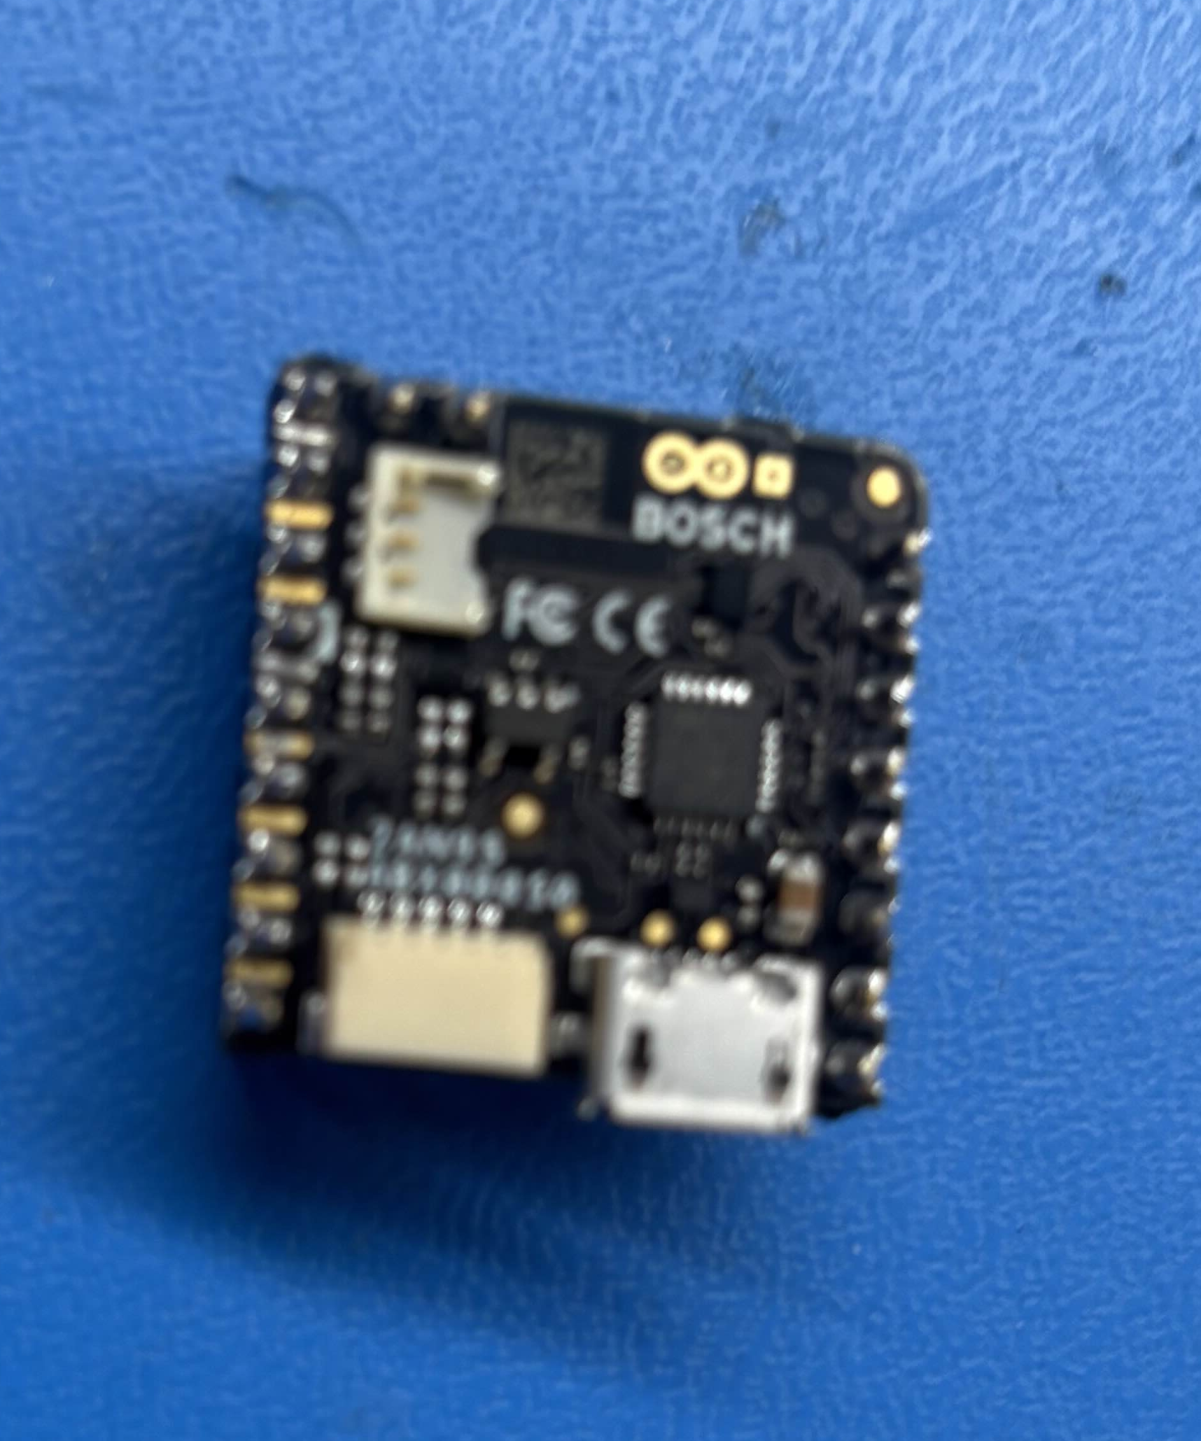
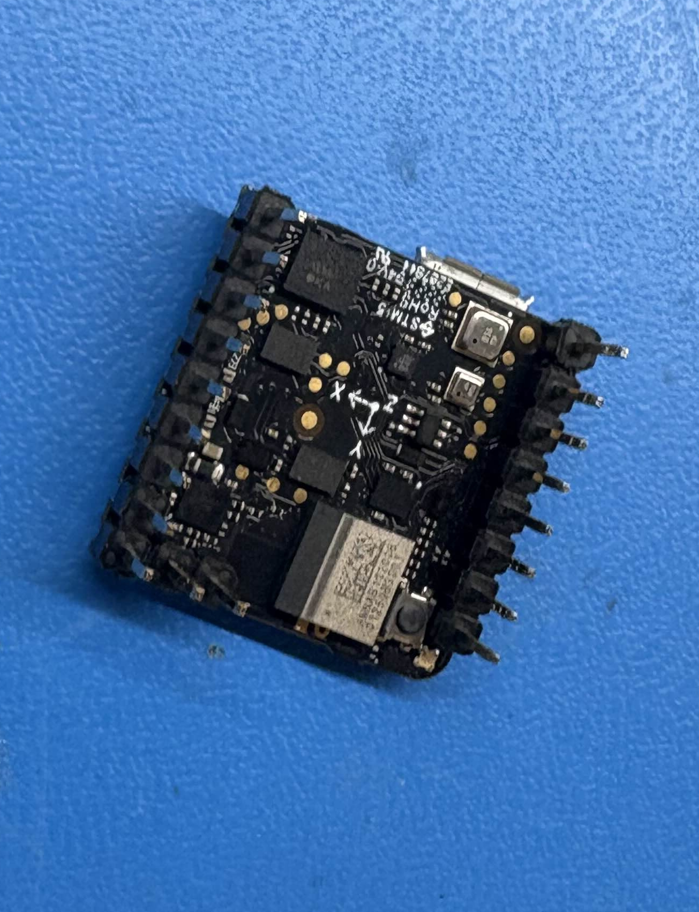
Preparing Devices
Soldering Pin Headers onto all Devices
After the combined meeting, distribution of devices has been determined:
6 – Agriculture for Testing
3 – Polytechnic for Development
1 – Shorted (Kept for Analysis)
Currently Soldering 5 more sets of pin headers onto each device
Notes:
Sabattical?
Leon Salas Weekly Meetings
Meeting Time

Slide 4
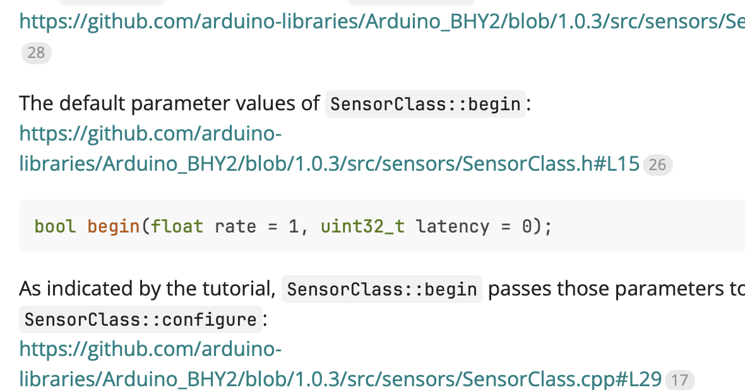
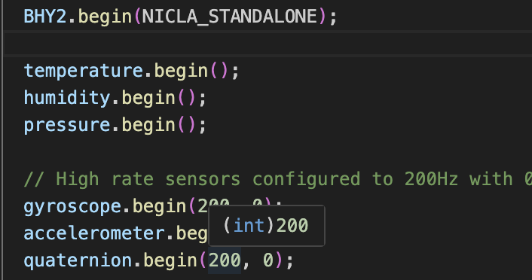
Preparing Devices
Changing Sampling Rates for Devices
After discussing with the Agriculture and Mechanical Engineering department, it might be useful to use different sampling rates:
Sampling rate can be changed in software, selecting:
500 Hz
200 Hz
100 Hz
50 Hz
25 Hz

Slide 5
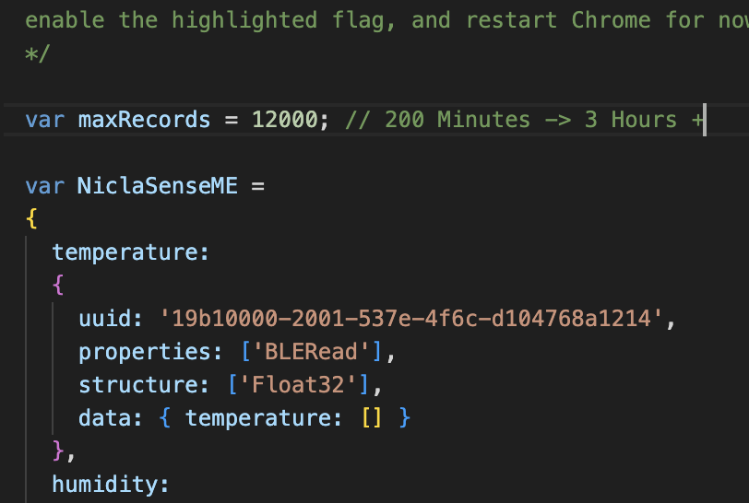
Adjusting Data Collected
Changing Time Parameter
Modified Maximum Entries from 1000 → 12000 (For 3 Hours)
Enough Time for Next Pilot Study
Will add user input to determine study time when finishing next version of code

Slide 6
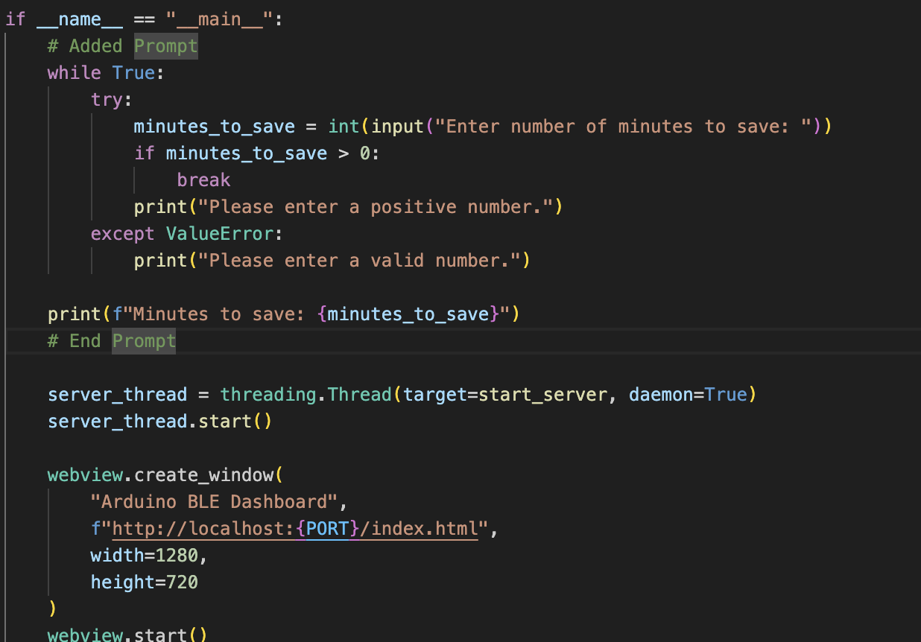
Adjusting Data Collected
Adjustable Time Parameter
User input to determine study time when finishing next version of code
Functionality kept for testing procedures
Could be replaced in future versions

Slide 7
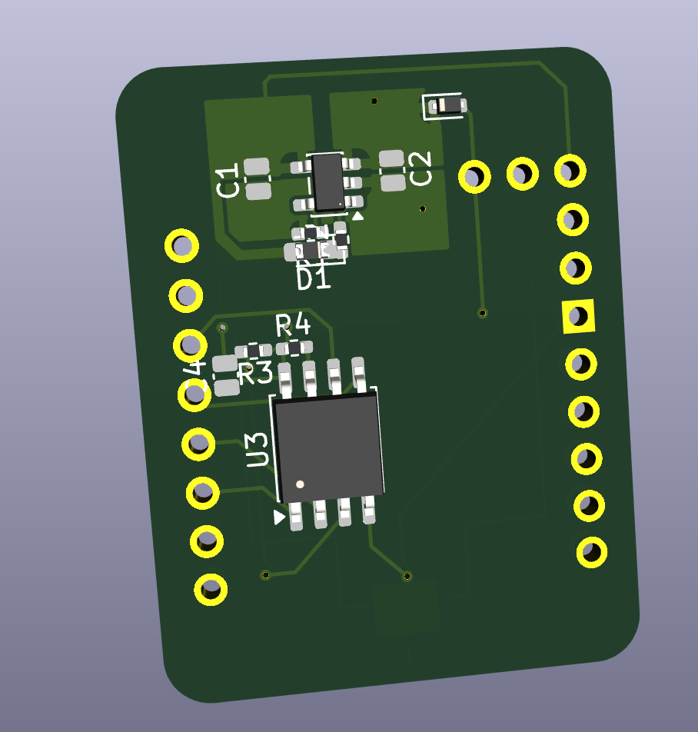
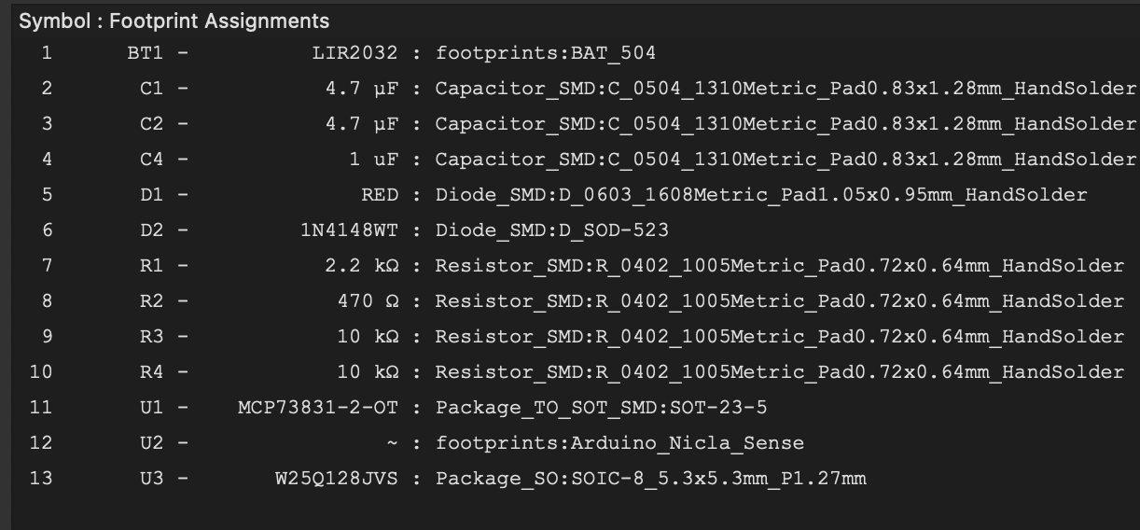
PCB Changes
PCB Prototyping + Size Changing
Components Resized to fit for Hand Soldering
Switched to 04x02 + 05x03 mm^2 Components for Hand Soldering
Size on board increased, but very insignificant in general

Slide 8
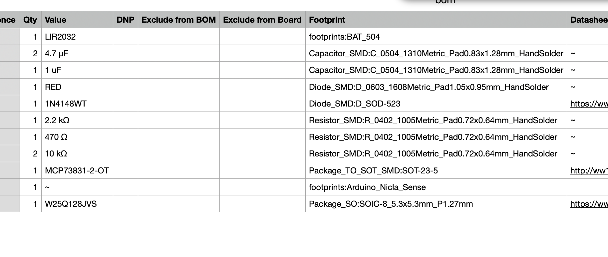
PCB Changes
PCB Ordering
~13 Components per board x 6 Boards
Attempting to purchase components from the same vendor (to reduce lead time)

Slide 9
Next Week
Plans & Blockers for Next Week
Test and finalized Rev. 3 PCB to Hand to Agriculture
Add User Input/GUI to Testing Environment
Obtain Powercast Transmitters from Agriculture Department
Verify Circuit from Powercast
Notes:
Sabattical?
Leon Salas Weekly Meetings
Meeting Time

Slide 10
Thank You
Purdue Polytechnic Institute

