Slide 1
ECCB 2026 · TUTORIAL 12 · SESSION 5
Presenting & Disseminating
Plant Pangenomes
The last mile: making a pangenome findable, viewable and reusable
Dr. Sebastian Beier
Forschungszentrum Jülich · IBG-4 (Bioinformatics)
Building on the ELIXIR E-PAN white paper for plant pan-genome standards
Notes:
Welcome to Session 5. Session 4 built and evaluated a pangenome; here we cover the last mile — presenting and sharing it so others can see it, find it, trust it and reuse it. The whole session follows the recommendations of the ELIXIR E-PAN white paper, the community standards effort I'm a co-author on.

Slide 2
FROM BUILDING TO SHARING
A pangenome on your disk helps no one
The dissemination gap
Our guide: the ELIXIR E-PAN white paper
A finished graph is only useful once others can access it
It must be FINDABLE (indexed, identified), VIEWABLE (a usable interface) and REUSABLE (standard formats + metadata)
Pangenomes are bigger and stranger than a single FASTA — sharing them needs its own conventions
Without shared standards, every group reinvents formats, names and viewers — and nothing interoperates
ELIXIR E-PAN = a community initiative for plant pan-genome standards
Synthesises lessons from barley, rice, tomato & Arabidopsis into actionable standards
Goal: unify the community and make resources FAIR — Findable, Accessible, Interoperable, Reusable
Covers naming, QC, data sharing, visualization & integration — the spine of this talk
Heuermann, Barros, Beier et al. (2026). White paper: standards for handling and analyzing plant pan-genomes. F1000Research 14:739 (CC-BY).
Notes:
The core problem: a graph sitting on your disk helps nobody. To be useful it must be findable, viewable and reusable — and pangenomes need their own conventions because they're far more complex than a single FASTA. Our guide throughout is the ELIXIR E-PAN white paper, a community standards effort across barley, rice, tomato and Arabidopsis, aimed squarely at making these resources FAIR.

Slide 3
ROADMAP
Three jobs of dissemination
1
2
3
Visualize
Share
Integrate
make the graph & its variation human-readable
release standard files with rich metadata, FAIR
plug it into the wider data ecosystem
viewers · idioms · figure craft
formats · names · repositories
portals · APIs · knowledge graphs
The aim: someone who has never met you can find your pangenome, open it in a browser, understand it, and build on it.
Notes:
Three jobs. Visualize — make the graph and its variation readable. Share — release standard files with rich metadata, the FAIR way. Integrate — plug it into the wider ecosystem of portals, APIs and knowledge graphs. The acid test: a stranger can find your pangenome, open it, understand it, and build on it.

Slide 4
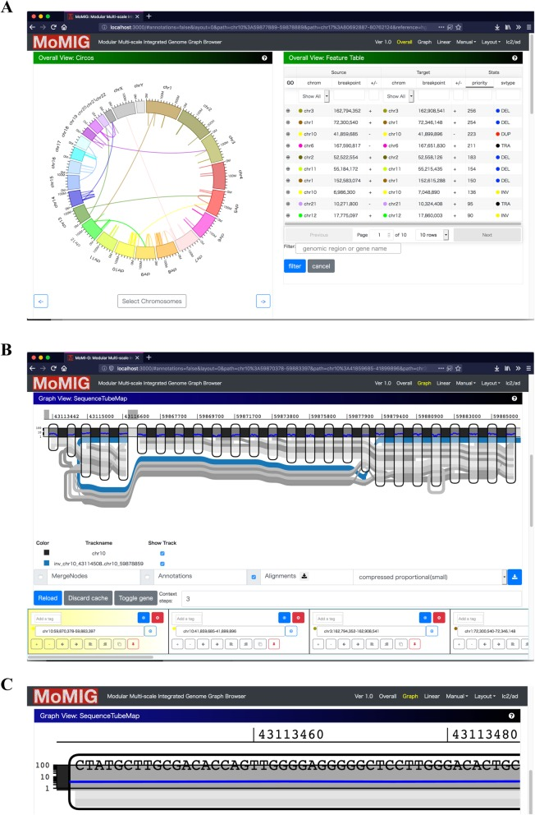
VISUALIZE
Why visualizing a pangenome is hard
A graph is non-linear — there is no single coordinate to plot against
They are huge: millions of nodes, dozens to hundreds of haplotypes
No single standard browser yet — tools specialise by scale and question
Different scales need different views:
Chromosome
Locus
Base
whole-graph overview
a gene & its variants
exact SNP / indel
A multi-scale graph browser (MoMI-G): chromosome → gene → nucleotide views. Yokoyama et al. (2019), BMC Bioinformatics 20:548 (CC-BY 4.0).

Slide 5
VISUALIZE
Visual idioms: match the view to the question
PAV heatmap
Core / shell / cloud
Growth curve
UpSet plot
pan
core
shell
cloud
core
who has which gene?
how is diversity partitioned?
open or closed pangenome?
which sets share features?
Schematic idioms. Choose the plot for the question you are answering — and label core/shell/cloud thresholds and sample size every time.
Notes:
A small visual vocabulary recurs across pangenome papers. A PAV heatmap answers 'who has which gene'. A core/shell/cloud bar shows how diversity is partitioned. A growth curve tells you whether the pangenome is open or closed. An UpSet plot shows which accessions share which features. The skill is matching the idiom to the question — and always labelling thresholds and sample size.

Slide 6
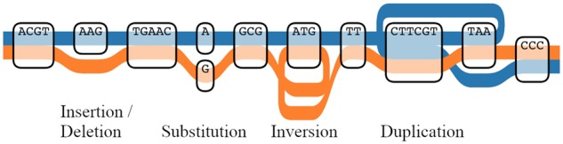
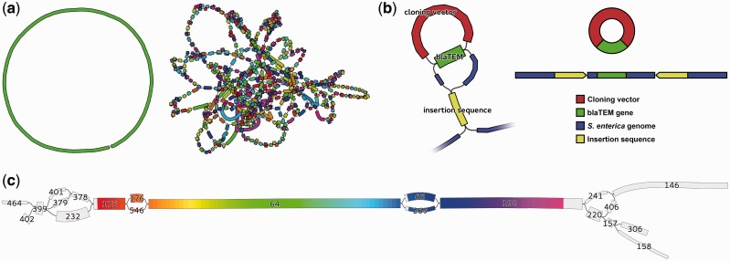
VISUALIZE
Tools to explore the graph
Make it intuitive — the sequence tube map
Interactive graph viewers
Each haplotype = a coloured line threading shared & variant segments
SNPs, indels, inversions & duplications become intuitive at a glance
Linear browsers (JBrowse2, IGV) show assemblies & variants side-by-side
Bandage / odgi — explore graph topology, search a gene, trace which genomes carry a node
Cytoscape, MoMI-G — network & multi-scale views
Built on toolkits: VG toolkit, PGGB, PanTools, wfmash
Tube map: Beyer et al. (2019), Bioinformatics 35:5318 (CC-BY 4.0). Bandage: Wick et al. (2015), Bioinformatics 31:3350 (CC-BY). Graph-tool list per the E-PAN white paper.
Notes:
For the graph itself, two families of tool. The sequence tube map makes a graph genome intuitive — each haplotype is a coloured line, and SNPs, indels, inversions and duplications jump out. For interaction, Bandage and odgi let you explore topology, search a gene, and see which genomes carry a node; Cytoscape and MoMI-G add network and multi-scale views. All sit on toolkits like the VG toolkit, PGGB, PanTools and wfmash — the set the E-PAN paper recommends.

Slide 7
SHARE
What to release — and in which format
Layer | Format | Holds
Assemblies | FASTA | sequences; headers = unique IDs (e.g. >chr01)
Annotation | GFF3 / GTF | gene/feature coordinates — Sequence-Ontology compliant
Variants | VCF / BCF | SNPs, indels & structural variants
Orthogroups | TSV | cluster ID + member genes
The graph | GFA | the pan-genome graph itself
Metadata | JSON-LD / RO-Crate | structured, machine-readable provenance
Golden rule: sequence IDs in the GFF3 first column must exactly match the FASTA headers — mismatched names are the No. 1 reason a shared pangenome is unusable.
E-PAN white paper §4.1. FASTA/GFF3/GTF/VCF/BCF/TSV/GFA are existing community formats; metadata in JSON-LD or RO-Crate. (BCF = binary VCF; GFA = Graphical Fragment Assembly.)
Notes:
Release each layer in its established format: FASTA for assemblies, GFF3 or GTF for annotation, VCF or BCF for variants, TSV for orthogroups, GFA for the graph itself, and JSON-LD or RO-Crate for metadata. The golden rule from the white paper: the sequence IDs in your GFF3 must match the FASTA headers exactly — name mismatches are the single most common reason a shared pangenome can't be used.

Slide 8
SHARE
Name things consistently; describe them richly
Naming conventions
Metadata standards
drOrySati.Nipponbare.RicePan.1.0
MIAPPE for phenotyping context; Sequence Ontology for feature types
Record: sequencing technology & coverage, assembly method, software versions
Provenance via BioSample IDs and NCBI Taxonomy ID
For the pangenome: version + build date + the full list of constituent genomes
species · variety/line · project · version
Assembly IDs: ≥ 4 dot-separated fields (species.variety.project.version)
Pan-genes get stable IDs, e.g. drOrySati.RicePan.pan00001
Adopt ToLID species prefixes; PanSN for sequence names in the graph
E-PAN white paper §2 & §4.3. MIAPPE = Minimum Information About a Plant Phenotyping Experiment; ToLID = Tree of Life identifier; PanSN = Pangenome Sequence Naming.
Notes:
Two halves of being reusable. Naming: assembly IDs with at least four dot-separated fields — species, variety, project, version — plus stable pan-gene IDs, ToLID species prefixes and PanSN for graph sequence names. Metadata: MIAPPE for phenotyping context, Sequence Ontology for feature types, and a record of sequencing technology, assembly method, software versions, BioSample and taxonomy IDs — and for the pangenome, its version, build date and the exact list of constituent genomes.

Slide 9
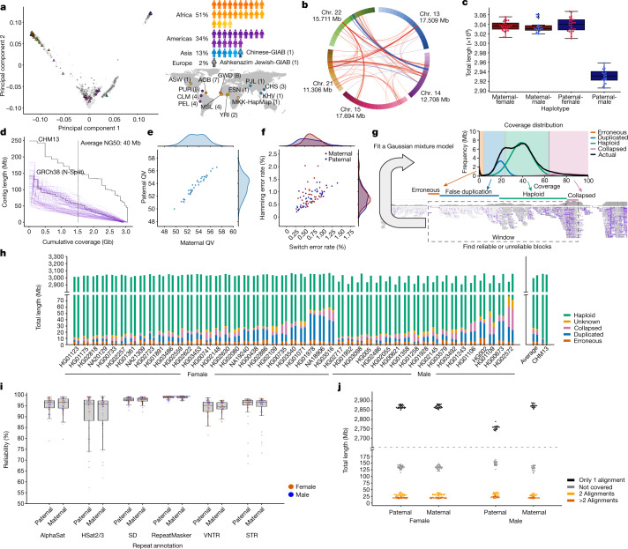
SHARE
Where it goes: repositories & persistent IDs
INSDC
A model release
raw reads & assemblies (ENA / NCBI / DDBJ)
Ensembl
gene annotations & browsers
CNCB-NGDC
mirror & archive (China Nat. Center for Bioinformation)
#
DOI (DataCite)
The Human Pangenome Reference Consortium: 47 assemblies, versioned & openly archived — a template plant projects can follow.
versioned datasets with persistent identifiers — e.g. Barley v2
E-PAN white paper §4.2. INSDC = International Nucleotide Sequence Database Collaboration. HPRC figure: Liao et al. (2023), Nature 617:312 (CC-BY 4.0).
Notes:
Deposit in the established public archives: INSDC for reads and assemblies, Ensembl for annotations, CNCB-NGDC as a mirror — and mint DOIs via DataCite so each dataset version is citable, like Barley v2. The Human Pangenome Reference Consortium is the model to copy: 47 assemblies, versioned and openly archived.

Slide 10
SHARE
The E-PAN sharing recipe — FAIR by construction
1 · Minimal compliant package
2 · RO-Crate archive (the full record)
FASTA (assemblies)
GFF3 (annotation)
VCF (variants)
core metadata
the complete GFA graph
Snakemake / Nextflow workflow files (provenance)
QC & validation reports
JSON-LD structured metadata
+
→ deposit in INSDC / Ensembl / CNCB-NGDC
→ DOI-versioned (Zenodo / DataCite)
FAIR by construction: Findable (DOI) · Accessible (public archives) · Interoperable (standard formats + ontologies) · Reusable (workflow + metadata).
E-PAN white paper §4.4 (recommended implementation). RO-Crate = Research Object Crate; a packaged, machine-readable bundle of data + metadata + provenance.
Notes:
The white paper's concrete recipe makes a release FAIR by construction. Submit a minimal compliant package — FASTA, GFF3, VCF and core metadata — to the public archives. Alongside it, attach a single RO-Crate archive holding the full GFA graph, the Snakemake or Nextflow workflow files, the validation reports and JSON-LD metadata, and give it a DOI on Zenodo. That delivers all four FAIR properties at once.

Slide 11
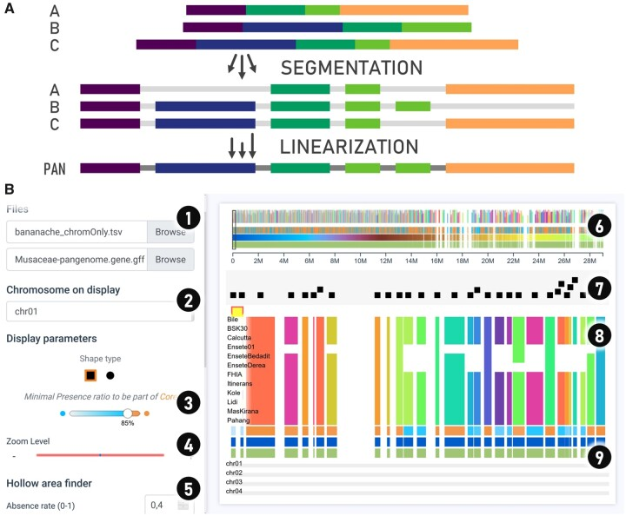
INTEGRATE
Browsers & portals — for the whole community
Pre-rendered web portals let breeders & biologists explore a pangenome with no command line
Panache — a browser for presence/absence variation across a linearized pangenome
Searchable tracks, PAV matrices and summary plots, ready to use
PanBARLEX (IPK) — a community barley pangenome portal exemplifying this approach
Panache: Durant et al. (2021), Bioinformatics 37:4556 (CC-BY). PanBARLEX: panbarlex.ipk-gatersleben.de (E-PAN white paper §5.1 & §8).
Notes:
Not everyone uses a command line. Pre-rendered web portals let breeders and biologists explore a pangenome directly. Panache is a browser for presence/absence variation across a linearized pangenome — searchable tracks, PAV matrices, summary plots. PanBARLEX, hosted at my institute IPK, is exactly this kind of community barley portal, and the white paper highlights it as an exemplar.

Slide 12
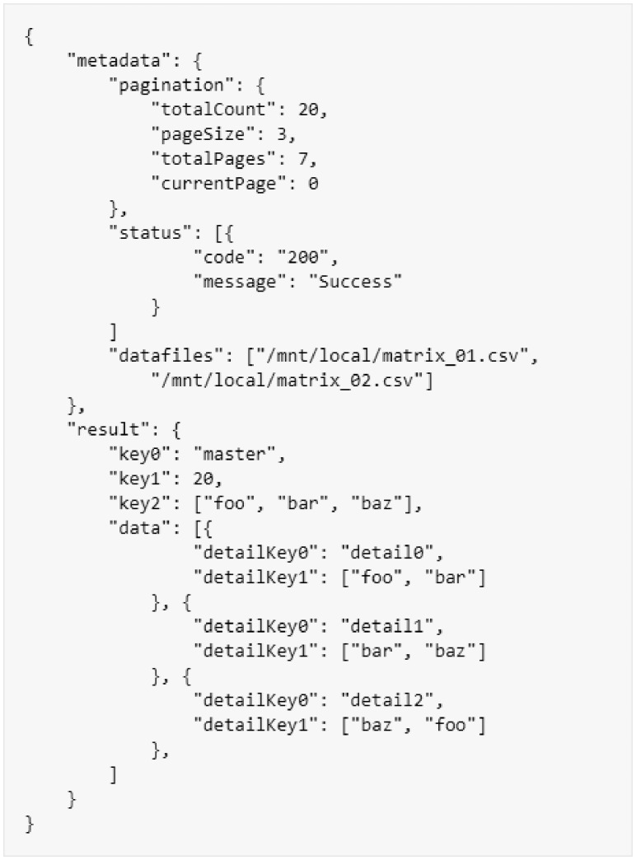
INTEGRATE
Programmatic reuse: APIs & interoperability
Machine-actionable access lets other databases & tools consume your pangenome automatically
BrAPI (Breeding API) — a community standard for breeding & genotype data exchange
Standardised JSON responses → the same query works across many databases
Graph queries (VG toolkit) expose variants & paths for downstream pipelines
Interoperability is what turns isolated resources into a connected ecosystem
API = Application Programming Interface. BrAPI: Selby et al. (2019), Bioinformatics 35:4147 (CC-BY). Standardised response: metadata + result + data records.
Notes:
Beyond a website, expose the data programmatically so other tools consume it automatically. BrAPI — the Breeding API — is the community standard for exchanging breeding and genotype data: a standardised JSON response means the same query works across many databases. Graph queries via the VG toolkit expose variants and paths to downstream pipelines. Interoperability is what turns isolated resources into a connected ecosystem.

Slide 13
INTEGRATE
From sequence to trait — and into knowledge graphs
Linking genotype to phenotype
Into the wider ecosystem
Detect structural variants (Sniffles2, SVIM) and PAV (Panaroo) across accessions
Test them against traits — graph-based GWAS finds SV/PAV associations a single reference misses
Tomato graph pangenome captured ~24 % more 'missing heritability'
Rice: hidden structural variants enabled new phenotype associations
Knowledge graphs (e.g. KnetMiner) fuse pangenome + association + omics + literature
Explore gene–trait–pathway links in context; support candidate-gene prioritization
Connects to Session 3 (knowledge graphs) and Session 1 (federated discovery)
The pangenome becomes a hub
E-PAN white paper §5.2 & case studies. GWAS = genome-wide association study; PAV = presence/absence variation; SV = structural variant.
Notes:
The ultimate point of sharing is reuse for biology. Detect structural variants and PAV across accessions and test them against traits — graph-based GWAS finds associations a single reference misses; the tomato pangenome recovered about 24% more missing heritability, and rice revealed hidden structural variants behind phenotypes. Then feed it into knowledge graphs like KnetMiner that fuse pangenome, association, omics and literature — exactly Dr. Bleker's Session 3, and discoverable through Dr. Pommier's federated portals from Session 1. The pangenome becomes a hub, not a dead-end file.

Slide 14
WRAP
A dissemination checklist
✓
Consistent names (E-PAN IDs, PanSN)
✓
Deposit minimal package in INSDC / Ensembl
✓
Standard formats (FASTA · GFF3 · VCF · GFA)
✓
Add an RO-Crate (GFA + workflow + reports)
✓
Rich metadata (MIAPPE · Sequence Ontology · BioSample)
✓
Version it and mint a DOI
✓
IDs that match across all files
✓
Provide a viewer/portal and link to knowledge graphs
If you can tick these, your pangenome is findable, viewable and reusable — the goal of the E-PAN standards.
Notes:
A practical checklist you can apply to any pangenome. On the left: consistent names, standard formats, rich metadata, matching IDs. On the right: deposit the minimal package, add an RO-Crate, version it with a DOI, and provide a viewer plus links to knowledge graphs. Tick all eight and your pangenome is findable, viewable and reusable — the whole goal of the E-PAN standards.

Slide 15
COMMUNITIES & NETWORKS
Join the global effort
IPPGN
ERGA
ELIXIR E-PAN
International Plant Pangenome Network
European Reference Genome Atlas
Plant pan-genome standards initiative
• Founded 2025, after the PAG conference (San Diego)
• ~38 researchers across 24 institutions — academia, tool developers & plant breeders
• Open knowledge-sharing and collective problem-solving on pangenome graphs
• Chaired at the Earlham Institute (R. Rusholme-Pilcher; co-founder A. Hall)
• Pan-European network: reference genomes for ~200,000 European species
• Pangenomes Working Group launched May 2026 (at the DAC meeting)
• Focus: pangenome standards & shared best practices
• Bottom-up and open — beginners and experts welcome
• The community effort behind this session’s white paper
• Standards for naming, QC, sharing, visualization & integration
• ELIXIR hackathons refine workflows & ontology terms
earlham.ac.uk — “Breaking silos” (2025)
erga-biodiversity.eu · ERGA News #36 (Mar 2026)
F1000Research 2026, 14:739
These networks welcome new members — open collaboration is how plant pangenomics moves faster. (ERGA fits this biodiversity-genomics context directly.)
Notes:
Dissemination is also social. Beyond standards, three communities are worth joining. IPPGN, the International Plant Pangenome Network, founded in 2025, brings together academics, tool developers and breeders to solve pangenome-graph problems in the open. ERGA, the European Reference Genome Atlas, is building reference genomes across European biodiversity and launched a Pangenomes Working Group in May 2026, focused on pangenome standards and best practices — bottom-up and open to all (contact secretariat@erga-biodiversity.org). And ELIXIR E-PAN is the standards initiative behind today's white paper. Getting involved is the fastest way to keep up and to make your own resources interoperate.

Slide 16
TAKEAWAYS
Summary & outlook
Dissemination is the last mile — a pangenome no one can see, find or reuse is wasted effort
Visualize with the right view for the question (tube maps, idioms, multi-scale browsers)
Share standard formats with rich metadata; deposit a minimal package + an RO-Crate, versioned with a DOI
Integrate via portals, APIs (BrAPI) and knowledge graphs — make the pangenome a hub
Follow community standards so resources interoperate and accelerate breeding & research
Community standards: Heuermann, Barros, Beier et al. — White paper: standards for handling and analyzing plant pan-genomes. F1000Research 2026, 14:739 (ELIXIR E-PAN).
Thank you — questions & discussion welcome
Notes:
To close the session and the tutorial. Dissemination is the last mile — visualize with the right view, share standard formats with rich metadata as a minimal package plus an RO-Crate under a DOI, and integrate via portals, APIs and knowledge graphs so the pangenome becomes a hub. Do it to community standards and everything interoperates. It's all set out in the E-PAN white paper. Thank you — happy to take questions.

