Slide 1
ECCB 2026 · TUTORIAL 12 · SESSION 4
Building & Evaluating
Plant Pangenomes
From many genome assemblies to one graph — and how we know it is good
Dr. Sebastian Beier
Forschungszentrum Jülich · IBG-4 (Bioinformatics)
Resources for plant sciences: data integration & interpretation tools
Notes:
Welcome to Session 4 — ~40 minutes on how plant pangenomes are built and, crucially, how we evaluate them. We run all the way from raw sequencing reads to a finished graph and its quality report, using the eggplant pangenome as a worked example. I'll spell out every abbreviation as we go.

Slide 2
ROADMAP
The pangenome workflow — and what this session covers
1
2
3
4
5
6
Sequence
Assemble
Annotate
Build graph
Evaluate
Use
reads from DNA
reads → genomes
find the genes
genomes → graph
is it any good?
variants & traits
This session (4): stages 1–5 — produce a pangenome graph and a trustworthy quality report.
Session 5: presenting & sharing pangenomes.
Notes:
Here's the whole pipeline and our roadmap. We sequence DNA, assemble reads into genomes, annotate the genes, build the graph that integrates all genomes, evaluate it at every step, and finally use it to find variants and link them to traits. Stages 1–5 are this session; sharing is Session 5.

Slide 3
CONCEPT
What is a pangenome?
Pangenome (Greek pan = all): the complete set of DNA sequence found across all individuals of a species — not just one reference individual.
Core genome — sequence present in (almost) every individual
Shell genome — present in some but not all (also called accessory)
Cloud genome — rare or private to one individual (also called dispensable)
Core + shell + cloud = the pangenome
CORE
in (almost) all
SHELL
CLOUD
These are conventions, not fixed categories — where the boundaries fall depends on how many individuals you sample (we return to this under 'saturation').
Notes:
Define the central term. A pangenome is the entire sequence space of a species. We partition it into core (everyone has it), shell or accessory (some have it), and cloud or dispensable (rare/private). The graph we build is literally a structure that holds all three layers at once.

Slide 4
MOTIVATION
Why one reference genome is not enough
The problem with a single linear reference
The pangenome answer
A reference describes one individual — sequence absent from it is invisible to every analysis
Plant genomes are large, repeat-rich and structurally diverse between accessions (varieties)
Reference bias: reads from divergent regions fail to map, so real variants are missed or miscalled
Presence/absence variation (PAV) — whole genes present in some accessions, absent in others
Represent the whole species — every accession's sequence is captured
Store shared sequence once; differences become alternative routes
Single-nucleotide changes through to large rearrangements live in one structure
Build it reference-free so no single genome is privileged — bias is minimised
Accession = a uniquely identified plant sample (a variety, landrace or wild collection) held in a genebank.
Notes:
The motivation. A single reference is one individual; everything not in it is invisible, and reference bias distorts mapping and variant calling. Presence/absence variation — entire genes missing from the reference — is common in plants. The pangenome captures the whole species instead.

Slide 5
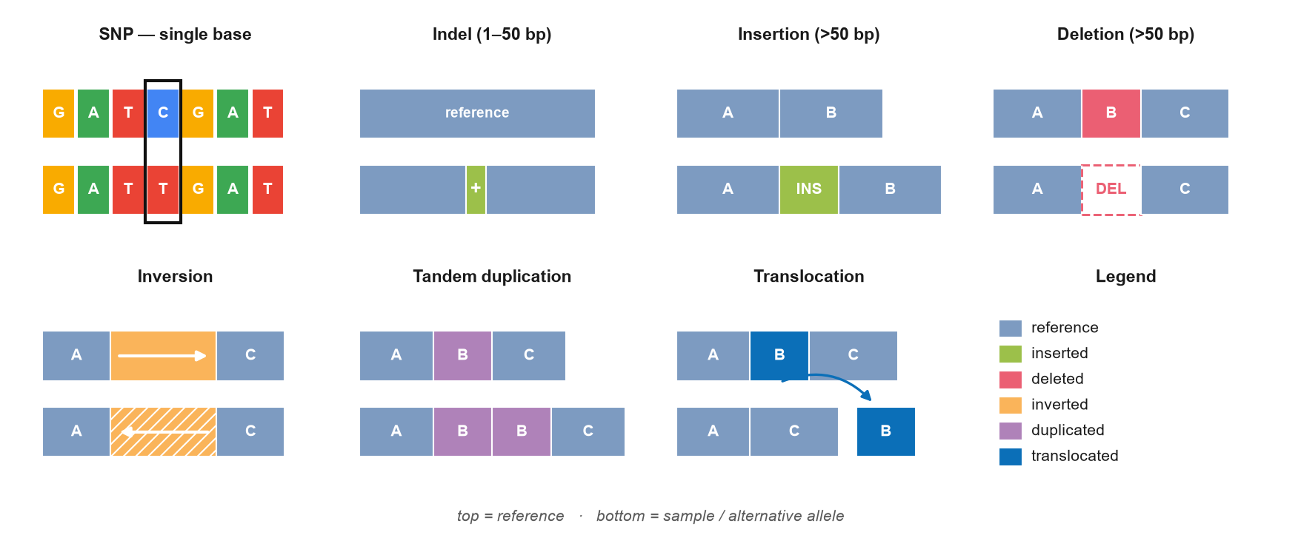
KEY TERMS
The vocabulary of genetic variation
SNP
indel
SV
CNV
PAV
single-nucleotide polymorphism — one base changed
insertion or deletion of 1–50 bp
structural variant — change > 50 bp
copy-number variation — repeated segments
presence/absence variation — present or gone
Notes:
Let's fix the vocabulary, because it recurs throughout. SNP — a single base swapped. indel — a short insertion or deletion. SV — any structural change over 50 bp. CNV — segments present in different copy numbers. PAV — sequence simply present or absent. bp means base pairs. The bigger the variant, the more functional impact it tends to carry.

Slide 6
CONCEPT
Two ways to represent a genome
Linear reference — one path
Pangenome graph — many paths
reference genome
n1
n2
n3
n5
n6
?
reads from a divergent / inserted region have nowhere to map → variant missed
n4
bubble = a variant
Anything not in the reference is lost
Reference bias in mapping & calling
Every genome is a path; nothing is dropped
Variants are alternative routes (bubbles)
Notes:
Side by side. A linear reference is a single path — reads from sequence it doesn't contain have nowhere to go, so variants are missed and mapping is biased. A graph offers many paths: each genome threads through, and where they differ you get a bubble. Nothing is thrown away.

Slide 7
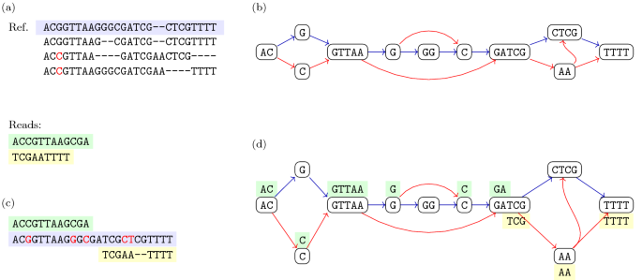
CONCEPT
From an alignment to a graph
Start from a multiple sequence alignment (MSA) — line the genomes up
Identical columns collapse into one shared node
Where genomes differ, the path branches into a bubble
Each genome becomes a labelled walk (path) through the nodes
Reads or new genomes can be threaded back through the same graph
MSA = multiple sequence alignment
(a) aligned sequences → (b) sequence graph → (c, d) reads mapped to the graph
Notes:
Mechanically: take a multiple sequence alignment, collapse the identical columns into shared nodes, and let the differences form bubbles. Panel (d) shows the real payoff — reads are mapped to the graph, not to one linear reference, which removes reference bias.

Slide 8
REPRESENTATION
Anatomy of a pangenome graph
Node — a piece of sequence shared by ≥ 1 genome
n1
n2
n3a
n4
n5
n3b
Edge — an allowed connection
Bubble — where paths diverge = a variant (SNP, indel or SV)
Path (walk) — how one genome threads the graph: Genome A = n1→n2→n3a→n4→n5 Genome B = n1→n2→n3b→n4→n5
Notes:
Four words you need. A node is a stretch of sequence. An edge is an allowed connection between nodes. A path — or walk — is how one genome threads through; here Genome A takes node n3a and Genome B takes n3b. The place where paths diverge and rejoin is a bubble, and a bubble is exactly a variant.

Slide 9
INPUTS · SEQUENCING
Step 1 — the raw material: sequencing technologies
Illumina
ONT — Oxford Nanopore
PacBio HiFi & Hi-C
short reads
long reads
long+accurate / 3-D
100–300 bp, very accurate (Q30+)
Great for polishing & SNP calling
Too short to span repeats
10 kb to > 100 kb reads
Spans repeats & structural variants
Higher raw error → needs polishing
HiFi: long and highly accurate
Hi-C: captures 3-D contacts
Orders contigs into chromosomes
Rule of thumb: read LENGTH resolves genome structure (repeats, SVs); read ACCURACY resolves single bases. Q = Phred quality = −10·log₁₀(error): Q30 = 0.1 % error.
Notes:
Building blocks. ONT — Oxford Nanopore Technologies — gives very long reads that span repeats and SVs, but with higher raw error. Illumina gives short, very accurate reads for polishing and SNP calling. PacBio HiFi is long AND accurate; Hi-C captures 3-D contacts to order contigs into chromosomes. Q is the Phred quality score: Q30 means one error in a thousand bases.

Slide 10
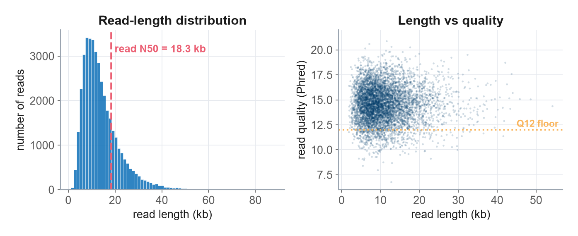
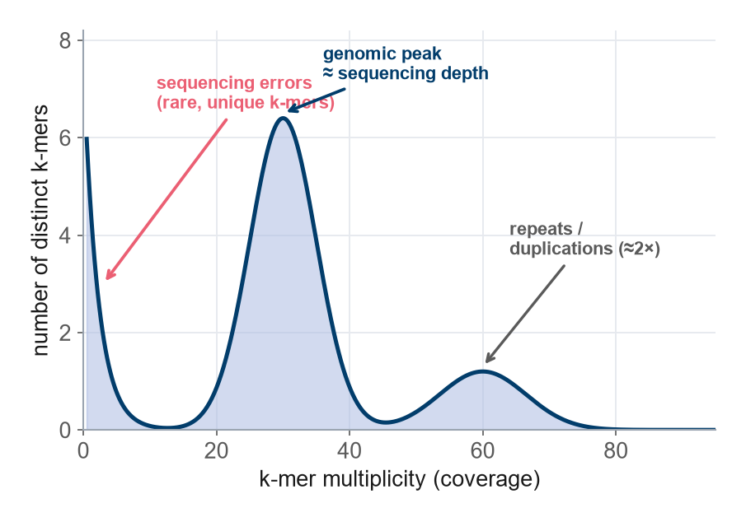
EVALUATING · SEQUENCING QUALITY
Know your reads before you assemble
NanoPlot: read-length distribution & quality (ONT)
k-mer spectrum: estimates depth, error & repeat content
Coverage (depth)
Read N50
Base quality
k-mer
total bases ÷ genome size — aim ≥ 30×
half of all bases sit in reads longer than this — aim ≥ 15 kb
median Phred Q ≥ 12–15 for ONT
a substring of length k; the spectrum reveals errors, depth & ploidy
Garbage in, garbage out: assembly cannot recover information that is missing from the reads. N50 is a length-weighted median; coverage/depth is how many times each base is read on average.
Notes:
Before assembling, QC the reads. NanoPlot shows the read-length distribution and quality for Oxford Nanopore data. The k-mer spectrum — a k-mer is just a substring of length k — tells you sequencing depth, error rate and repeat content from the read data alone. Targets: at least 30-fold coverage, read N50 above 15 kb, median quality Q12–15.

Slide 11
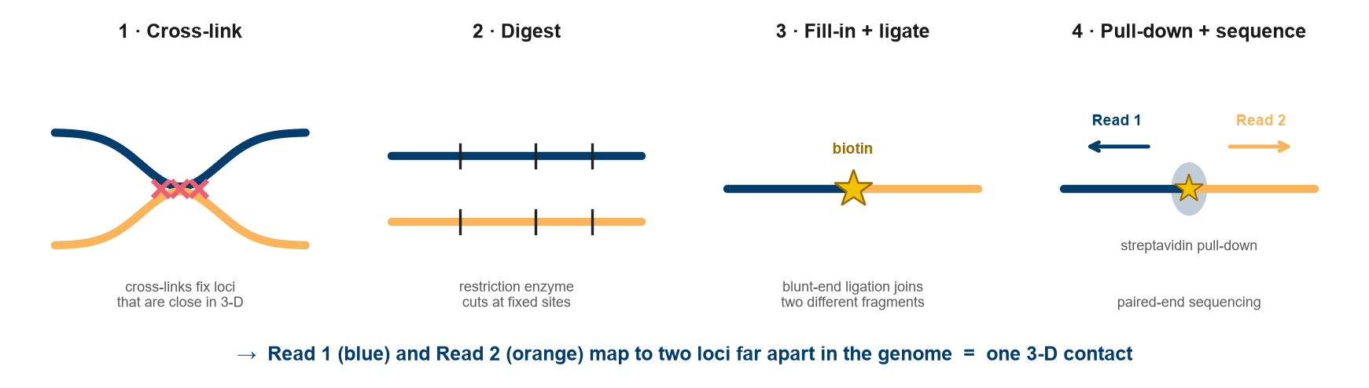
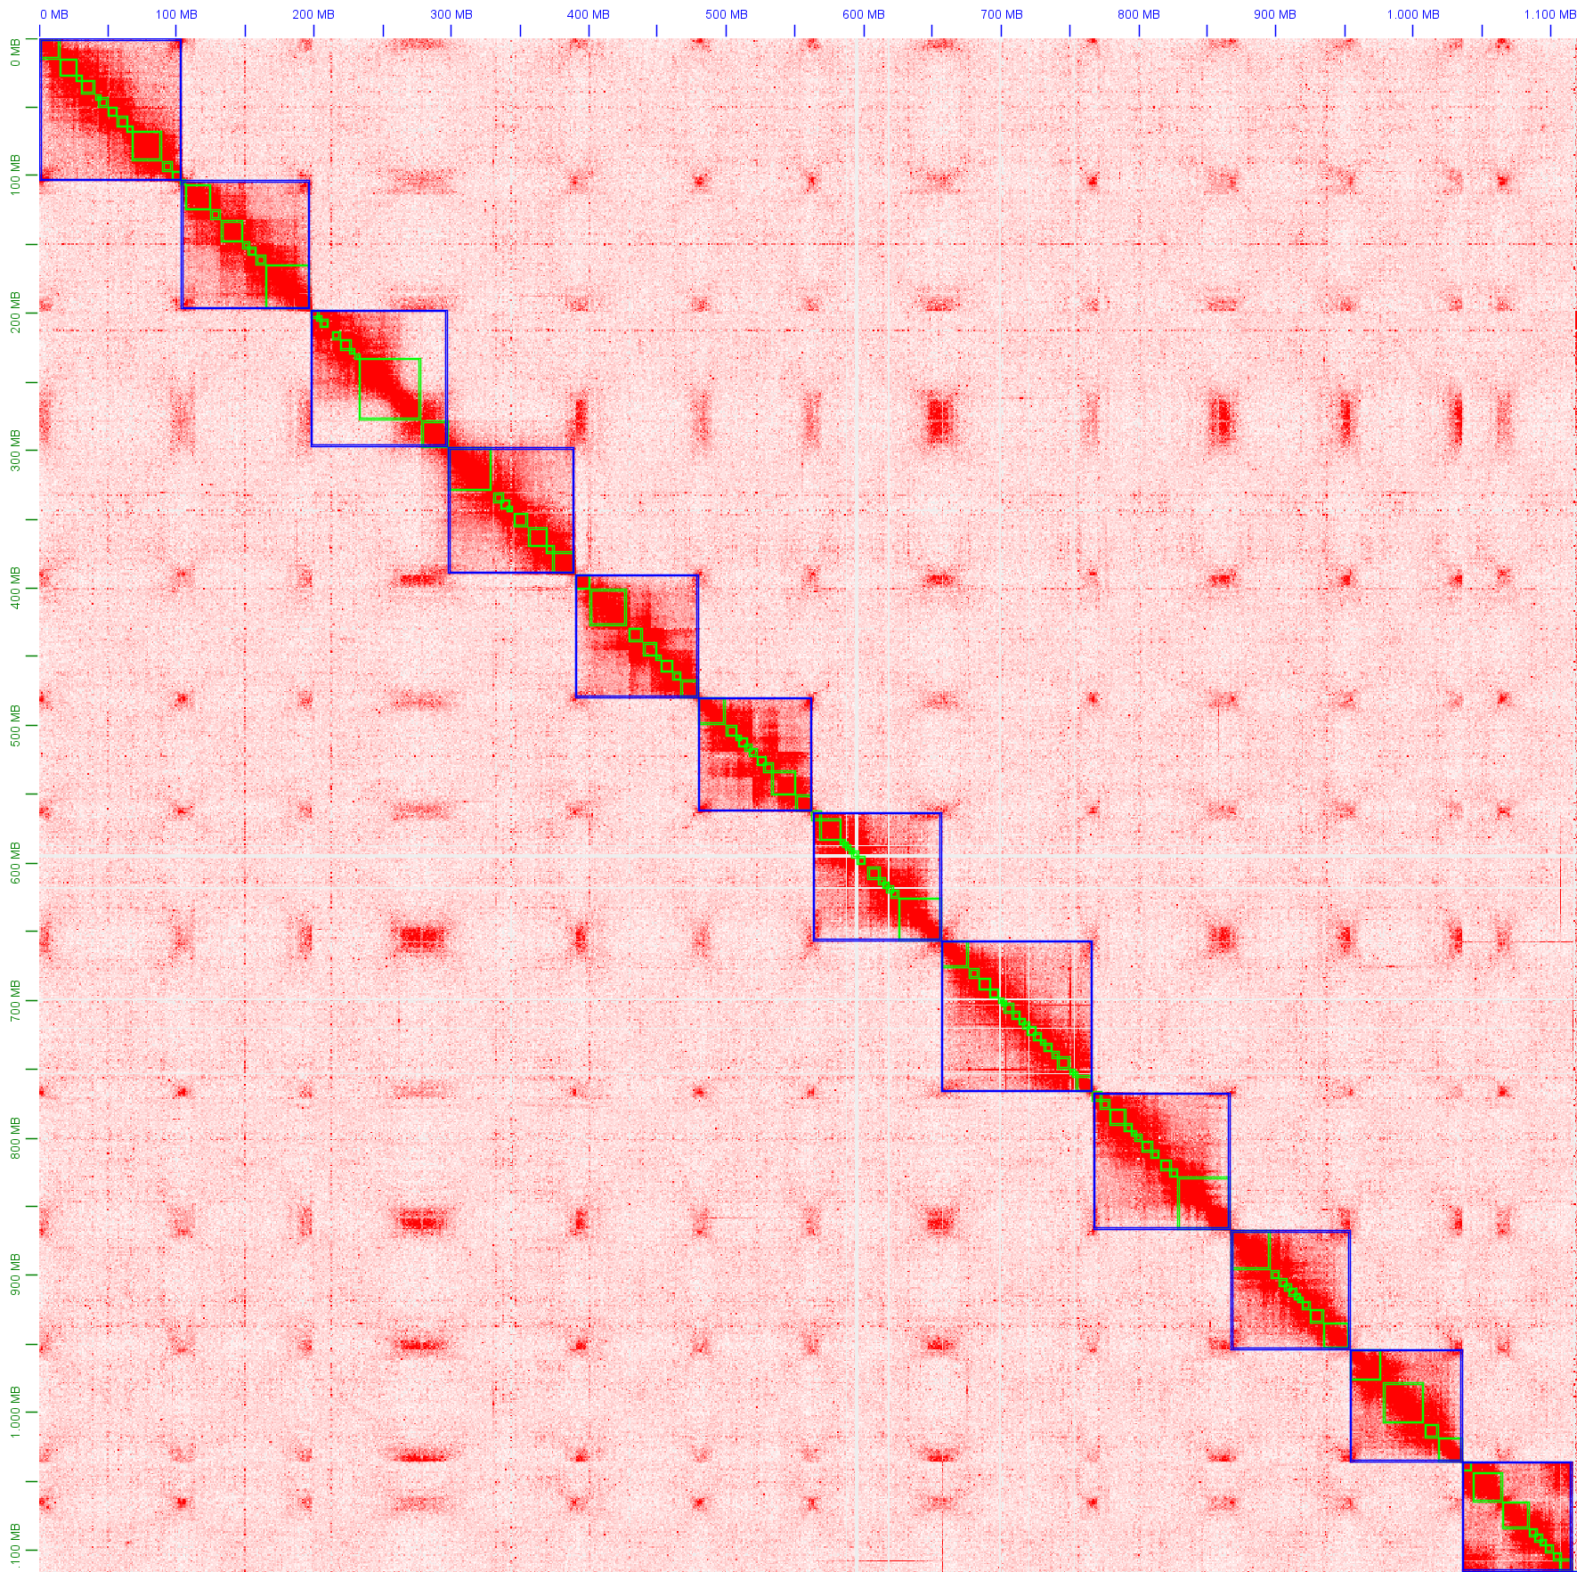
INPUTS · SCAFFOLDING
Hi-C: turning contigs into chromosomes
Hi-C (high-throughput chromosome conformation capture) records which DNA segments are physically close in 3-D
Segments on the same chromosome contact each other far more often than across chromosomes
That signal orders and orients contigs into chromosome-scale scaffolds
Contig = a continuous assembled sequence; scaffold = ordered contigs with gaps
Hi-C contact map: bright blocks = chromosomes
Notes:
Long reads give you contigs — continuous stretches — but not whole chromosomes. Hi-C, high-throughput chromosome conformation capture, cross-links DNA that is physically close in the nucleus, so a read pair tells you two loci are near each other. Since same-chromosome contacts dominate, this orders and orients contigs into chromosome-scale scaffolds — the bright blocks in the contact map are the chromosomes.

Slide 12
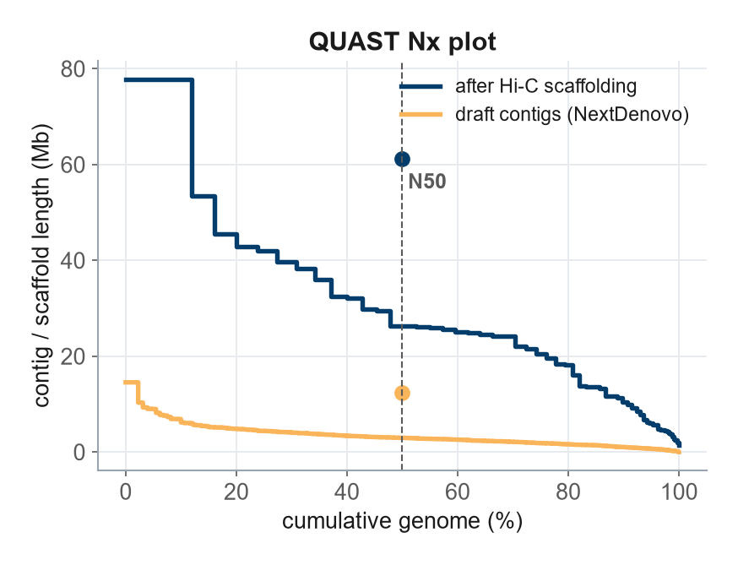
EVALUATING · ASSEMBLIES
Three questions to ask of any assembly
CONTIGUITY
QUAST
How fragmented?
N50 / L50, number of contigs, contig→chromosome ratio
COMPLETENESS
BUSCO, Merqury
Is anything missing?
expected genes found, k-mer completeness, size vs estimate
CORRECTNESS
Merqury, CRAQ
Is it accurate?
consensus quality value (QV), mis-joins, raw-read check
N50 = the contig/scaffold length such that 50 % of the genome lies in pieces this size or longer; L50 = how many pieces that takes. A big N50 alone is not enough — a long-but-wrong or long-but-incomplete assembly is still bad. (Wang & Wang 2023)
Notes:
Once assembled, ask three questions. Contiguity — how fragmented — measured by N50 and L50 in QUAST. Completeness — is anything missing — via BUSCO and Merqury. Correctness — is it accurate — via consensus quality value and misassembly detection. Read all three together: a big N50 on its own can hide a wrong or incomplete assembly.

Slide 13
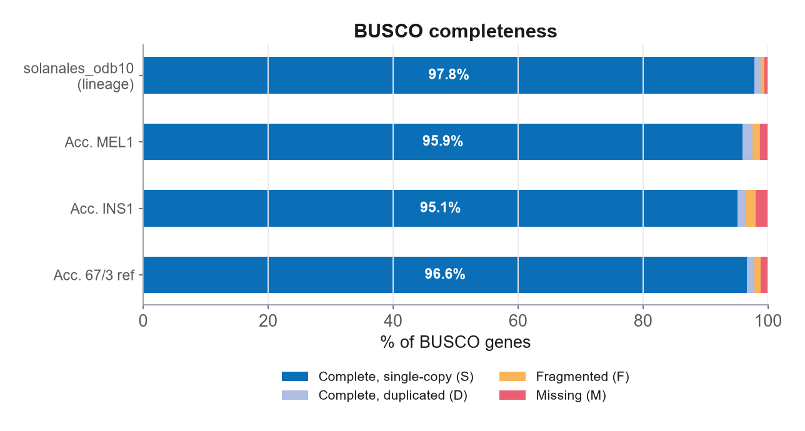
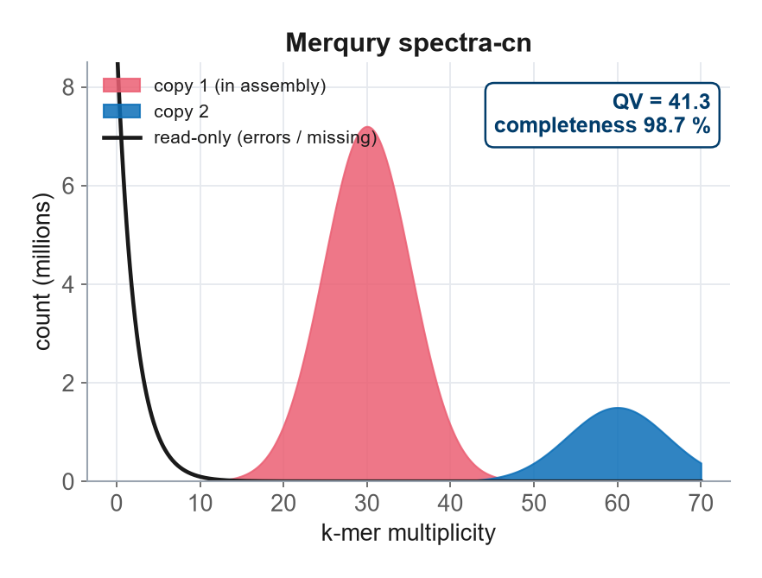
EVALUATING · ASSEMBLIES
Completeness & correctness, measured
BUSCO = Benchmarking Universal Single-Copy Orthologs.
Merqury / QV (QV = consensus quality value).
Looks for genes expected once in this lineage. High 'Complete' %, low 'Missing'/'Fragmented' = a complete assembly.
Compares read k-mers to the assembly. High QV = few base errors (QV 40 ≈ 1 error / 10,000 bp); peaks show single- vs multi-copy.
Notes:
Two concrete tools. BUSCO — Benchmarking Universal Single-Copy Orthologs — checks for genes that should appear exactly once in this lineage; you want a high Complete percentage. Merqury compares k-mers in the reads against the assembly to give a consensus quality value, QV; QV40 is about one error per ten thousand bases, and the spectrum peaks separate single-copy from duplicated sequence.

Slide 14
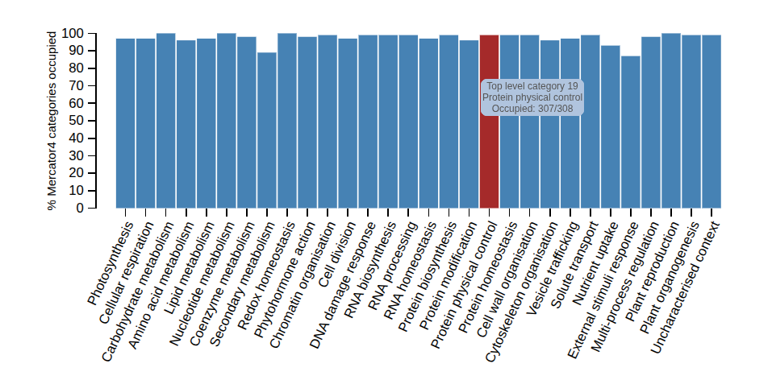
EVALUATING · ANNOTATION
Annotating the genomes: where are the genes?
Structural annotation — locate genes & exons (Helixer, BRAKER3); output in GFF3 format
Functional annotation — assign what each gene does (Mercator4, InterPro)
GFF3 = General Feature Format v3: coordinates of every feature on the genome
ORF = open reading frame — a stretch that can code for protein
QC the annotation too: BUSCO in protein mode, and coverage of expected functional categories
Mercator functional-category coverage: most categories near-fully occupied = a complete, well-annotated gene set. Annotations are later projected onto the graph so genes can be queried across all accessions.
Notes:
A graph of bare sequence isn't enough — we need genes. Structural annotation locates genes and exons and writes them in GFF3, the General Feature Format. Functional annotation says what each gene does. We QC the annotation with protein-mode BUSCO and by checking that expected functional categories are well covered, as in this Mercator plot.

Slide 15
BUILDING · METHODS
Three ways to build a pangenome graph
Tool | Resolution | Reference? | Best for
minigraph | structural (≥ 50 bp) | starts from one | Fast SV graph, many genomes
Minigraph-Cactus (MC) | base-level | reference-guided | Human-style, reference-anchored graphs
PGGB | base-level | reference-free | All-vs-all, unbiased — our choice
PGGB = PanGenome Graph Builder
Base-level resolution
Reference-free & symmetric: every genome enters an all-vs-all comparison, so no single genome is privileged and bias is minimised.
Captures single-nucleotide changes through to large structural variants in one graph; widely used for plant pangenomes.
Notes:
Three mainstream builders. minigraph is fast but only captures structural variants. Minigraph-Cactus — MC — is base-level but reference-guided, great for human. For unbiased plant work we use PGGB, the PanGenome Graph Builder: reference-free, all-vs-all, base-level. Everything that follows uses PGGB.

Slide 16
BUILDING · PGGB
Inside PGGB: four steps to a graph
1
2
3
4
wfmash
seqwish
smoothxg
gfaffix
all-vs-all alignment
alignments → graph
normalise & smooth
collapse redundancy
Finds homologous segments between every pair of genomes (uses wavefront alignment, WFA).
Induces a lossless sequence graph — no information is thrown away.
Local realignment with partial-order alignment (POA) tidies the graph.
Removes duplicated / redundant nodes for a compact graph.
Output: a graph in GFA format (Graphical Fragment Assembly) + a native .og file, plus odgi visualisations & statistics for QC.
Notes:
PGGB is four tools chained. wfmash aligns every genome against every other using wavefront alignment. seqwish turns those alignments into a lossless graph. smoothxg smooths it with partial-order alignment, POA. gfaffix collapses redundant nodes. The output is a GFA graph — Graphical Fragment Assembly — plus odgi files for QC.

Slide 17
BUILDING · CONVENTIONS
Naming sequences: the PanSN convention
GPE001970
#
1
#
chr2
sample
haplotype
contig / chromosome
PanSN = Pangenome Sequence Naming: sample # haplotype # contig
Haplotype = one of the chromosome copies (e.g. 1 or 2 in a diploid)
The shared scheme lets every tool track which path belongs to which genome through the graph
Notes:
A small but essential convention. Every input sequence is named sample-hash-haplotype-hash-contig — the PanSN scheme, Pangenome Sequence Naming. The sample is the accession, the haplotype is which chromosome copy, and the contig is the sequence name. This lets every downstream tool know which path through the graph belongs to which genome.

Slide 18
BUILDING · STRATEGY
Build per chromosome (communities)
Don't align a whole ~1.1 Gb genome at once (Gb = gigabase = 10⁹ bp)
Partition sequences into communities = chromosomes first (whole-genome alignment groups homologous sequence)
Build one graph per chromosome — independent runs
Runs in parallel: tractable, teachable, reproducible
Combine afterwards (odgi squeeze) for genome-wide statistics
all genomes → split by chromosome
chr1
chr2
chr3
chr4
chr5
chr6
chr7
chr8
chr9
chr10
chr11
chr12
The eggplant pangenome partitioned into 12 communities, one per chromosome.
→ 12 graphs, built in parallel
Notes:
A genome-wide all-vs-all alignment is intractable at 1 gigabase. So we partition into communities, which correspond to chromosomes, and build one graph per chromosome in parallel. Recombine afterwards with odgi squeeze. One caveat for later: per-chromosome graphs can't see translocations between chromosomes.

Slide 19
BUILDING · TUNING
Choosing parameters: a small sweep first
Estimate divergence first (mash dist) → set −p, the minimum % identity
Sweep segment length −s and minimum match −k on one chromosome
Judge each with odgi stats: graph length, node count, maximum node degree
Pick the balanced graph — avoid both over-collapse and over-fragmentation
minimum match −k →
k 19
k 23
k 47
tested
tested
tested
s 10k
segment −s
tested
✓ chosen
tested
s 20k
tested
tested
tested
Eggplant choice: −s 20000 −k 23 −p 93
s 30k
−p = minimum sequence identity (%) to call homology · −s = segment length (bp) · −k = minimum exact-match length (bp). Lower −p for more divergent, cross-species genome sets.
Notes:
Don't accept defaults blindly. Estimate divergence with mash to set the identity threshold −p, then sweep segment length −s and minimum match −k on a single chromosome — here a 3-by-3 grid — and judge each graph with odgi stats. Pick the balanced one. For eggplant that was s 20000, k 23, p 93.

Slide 20
BUILDING · HANDS-ON
Run PGGB on one chromosome
# 1 · one FASTA, all genomes, PanSN-named
# sample#hap#contig e.g. 67-3#1#chr2
$ samtools faidx all_chr2.fa
# 2 · build the graph for this chromosome
$ pggb -i all_chr2.fa \
-o chr2_graph/ \
-n 14 \ # number of haplotypes
-p 90 \ # min % identity (wfmash)
-s 10000 \ # segment length (bp)
-t 16 # CPU threads
-n
number of haplotypes going into the graph
-p
minimum % identity — lower it for divergent / cross-species sets
-s
segment length — bigger = simpler graph, fewer tiny bubbles
FASTA
plain-text sequence file; .fai index built by samtools faidx
Notes:
In practice it's one FASTA — a plain sequence file — with every genome, PanSN-named, indexed with samtools faidx. Then a single pggb command. The parameters that matter most are −n, the number of haplotypes; −p, the identity threshold; and −s, the segment length that controls graph granularity.

Slide 21
REPRESENTATION
Reading the graph: the GFA format
S n1 ACGT... # Segment = a node (sequence)
L n1 + n2 + 0M # Link = an edge between nodes
P 67-3 n1+,n2+,n3+,n5+ # Path = a genome's walk
P MEL1 n1+,n2+,n4+,n5+
GFA = Graphical Fragment Assembly
Plain text: one line per node, edge or path
S, L, P are the line types
+ / − give the strand (orientation)
Segment (S)
Link (L)
Path (P)
Bubble
a node = sequence
an edge = adjacency
a genome's walk
branch = a variant
Notes:
The graph is stored as GFA — Graphical Fragment Assembly — a plain-text format. S lines are segments, i.e. nodes; L lines are links, i.e. edges; P lines are paths, one per genome. The plus or minus marks strand. Where two P lines diverge you have a bubble, and a bubble is a variant.

Slide 22
REPRESENTATION
Variants for free: from bubbles to a VCF
the graph
VCF (Variant Call Format)
Every bubble → one variant record
SNPs through to large SVs in one pass
No separate caller, no single-reference bias
#CHROM POS REF ALT
chr2 812 A G
chr2 940 ATG A
chr2 1.2k <DEL> ...
a bubble
vg deconstruct
VCF = Variant Call Format: the standard table of variants (position, reference allele, alternative allele, genotypes)
vg = variation graph toolkit; vg deconstruct walks the graph and emits a VCF directly
Genotype new samples by mapping their reads with vg giraffe, then reading them against the same bubbles
Notes:
A big advantage: variants come for free. Because every bubble is a variant, the vg toolkit's deconstruct command walks the graph and writes a standard VCF — Variant Call Format — covering SNPs through to large SVs in one pass, with no separate caller and no reference bias. New samples are genotyped by mapping reads with vg giraffe against the same graph.

Slide 23
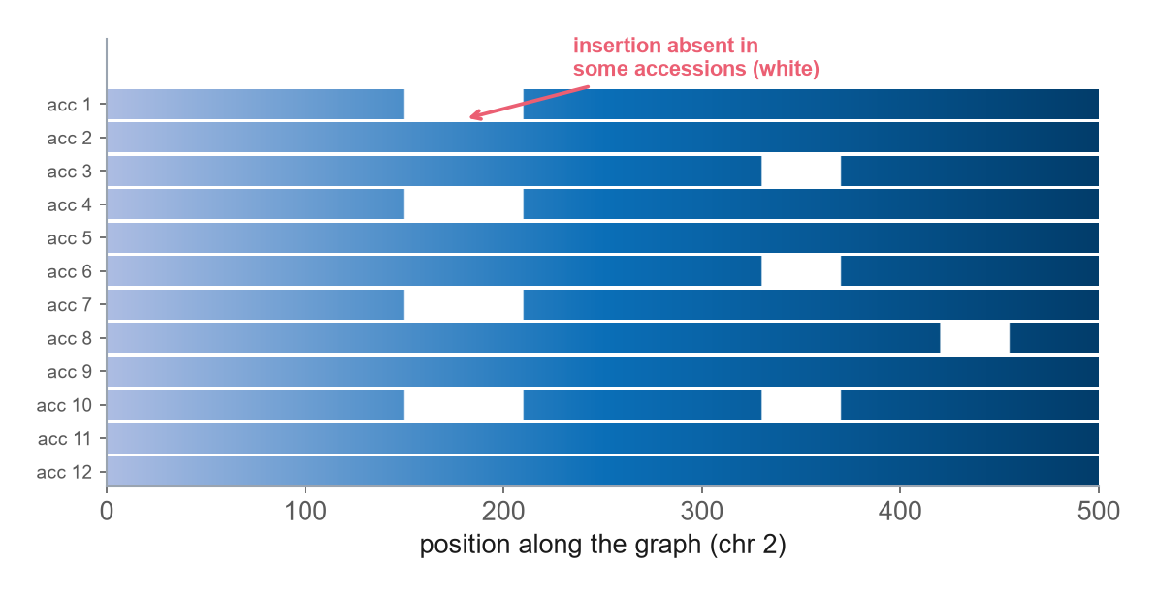
EVALUATING · VISUAL
Visualising the graph: odgi viz
odgi = Optimized Dynamic Genome/Graph Implementation — the graph toolkit
Each row = one genome's path along the chromosome
Coloured run = sequence present
White gap = sequence absent in that genome (presence/absence variation)
Gaps aligned across rows = a shared insertion / deletion (a real SV)
Every row spans the locus → all genomes embedded, nothing dropped
This single view turns the graph into biology — blocks present in some accessions but not others are exactly the variants we later test against traits.
Notes:
odgi — Optimized Dynamic Genome Implementation — is the toolkit for inspecting the graph. Its 1-D view shows one row per genome: colour means present, white means absent. White gaps are presence/absence variation; gaps that line up across rows are shared structural variants. If every row spans the locus, nothing was dropped.

Slide 24
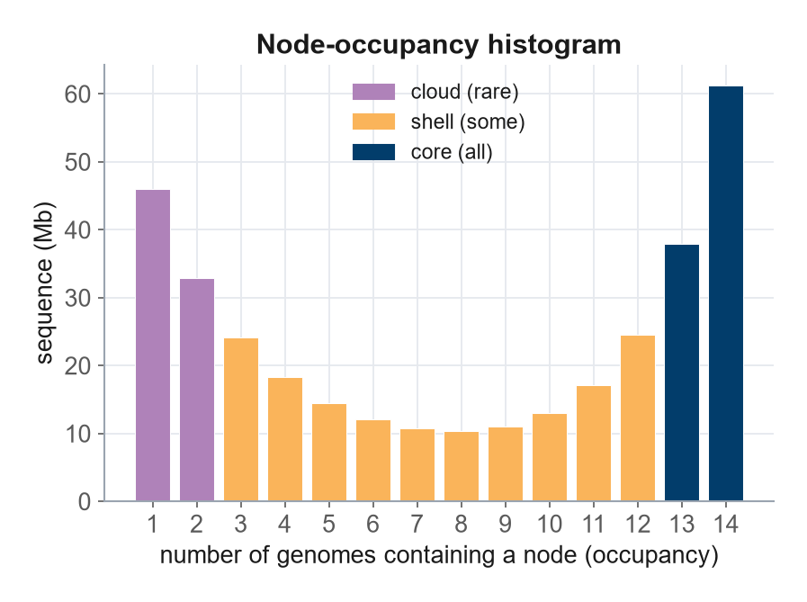
EVALUATING · DIVERSITY
Core, shell & cloud — read from the graph
Classify sequence by how many genomes carry each node (node occupancy)
Core = in (almost) all · Shell = in some · Cloud = rare / private
Node occupancy across paths = presence/absence variation, straight from the graph
Labels depend on sampling — more genomes shrink the core, grow the cloud
State your threshold (e.g. soft-core ≥ 90 %) and the number of genomes
panacus (pangenome counting tool) computes occupancy. The U-shape — much core (right) and much private (left) — is typical of an open plant pangenome.
Notes:
Core, shell and cloud are just node occupancy: how many genomes traverse each node. panacus — a pangenome counting tool — produces this histogram, and the classic U-shape shows lots of core on the right and lots of private sequence on the left. Remember the caveat: these labels depend on sample size, so always report the threshold and the number of genomes.

Slide 25
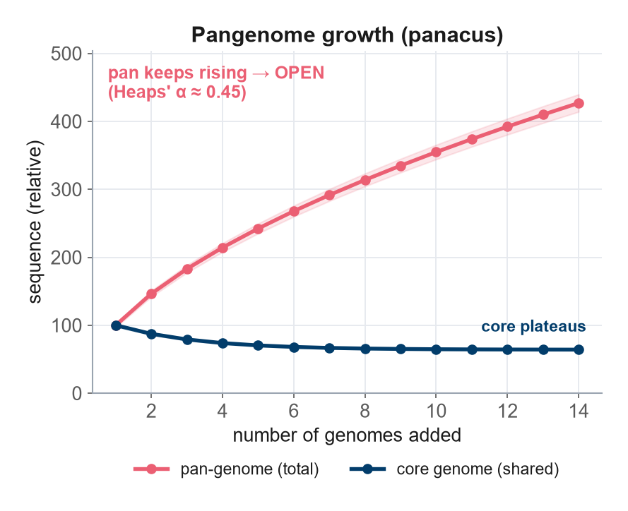
EVALUATING · SATURATION
Openness & saturation: enough genomes?
Add genomes one by one; fit Heaps' law to the accumulation curves
Pan curve still rising = OPEN pangenome (each genome adds new sequence)
Plateau = closed; the core curve falls then settles on the universal fraction
Saturation must hold before core / shell / cloud numbers are trustworthy
Rule of thumb: ~10–20 accessions (diploid), ~30–50 (polyploid)
Heaps' law describes how vocabulary (here, new sequence) grows with sample size. Diploid = two chromosome sets; polyploid = more than two. Saturation guidance: plant pan-genome white paper, F1000Research 2026 (14:739).
Notes:
Is your sample big enough? Build accumulation curves and fit Heaps' law. A pan curve that keeps rising means an open pangenome — more genomes still add sequence. The core curve falls and settles. You must be near saturation before core/shell/cloud fractions mean anything: roughly 10–20 diploid accessions, 30–50 for polyploids.

Slide 26
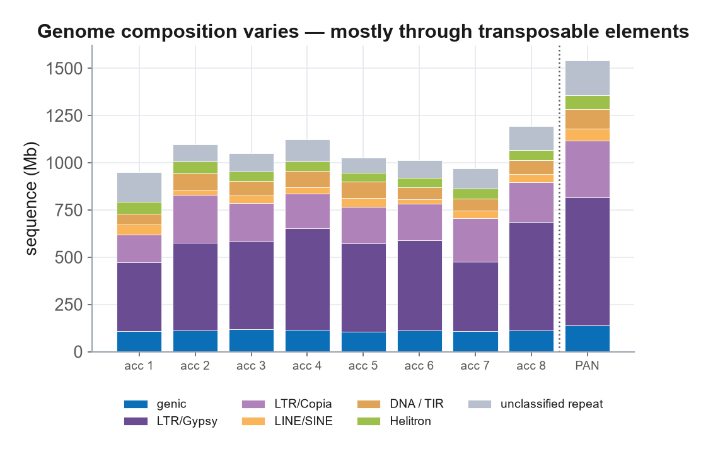
EVALUATING · BEYOND GENES
The variable majority: repeats & transposable elements
TE = transposable element: DNA that can move/copy itself; dominates plant genomes
TEs are the most variable fraction — they drive genome-size & SV diversity
Assess repeat resolution: LAI (LTR Assembly Index), TE libraries from EDTA
LTR = long terminal repeat, the commonest plant TE class
~40–50 % of graph-unique variants fall in repeats — QC these regions explicitly
EDTA = Extensive de-novo TE Annotator. Nested / tandem TEs inflate node duplication and false variants — repeat regions are where graphs most often go wrong.
Notes:
A pangenome is far more than its genes. Transposable elements — TEs, DNA that copies itself — are the biggest and most variable fraction in plants and drive genome-size and structural diversity. Measure repeat resolution with the LTR Assembly Index and annotate TEs with EDTA. Crucially, up to half of graph-unique variants sit in repeats, so QC those regions deliberately.

Slide 27
EVALUATING · BEYOND GENES
Regulatory & non-coding diversity
What varies (and is easy to miss)
How to capture it
Promoters & cis-regulatory elements (CREs) — sequence near genes that controls expression
Non-coding RNA (ncRNA): microRNA (miRNA), long non-coding RNA (lncRNA)
Methylation / chromatin state differs between haplotypes (epigenetics)
Gene-only pangenomes ignore all of this — PAV of genes ≠ PAV of regulation
RNA-seq across tissues/stress validates gene models & accessory features
Standardised feature IDs for TEs, repeats, ncRNA & regulatory motifs
Sequence-aware deep learning (e.g. Enformer, DNABERT) predicts regulatory effect
A TE landing in a promoter can change a trait without touching any coding sequence
CRE = cis-regulatory element · ncRNA = non-coding RNA · miRNA = microRNA · lncRNA = long non-coding RNA. RNA-seq = sequencing of expressed RNA.
Notes:
Function lives outside genes too. Promoters and cis-regulatory elements — CREs — control expression; non-coding RNAs like microRNA and long non-coding RNA vary across accessions; methylation differs between haplotypes. Gene-only pangenomes miss all of it. Capture it with RNA-seq, standardised feature IDs, and increasingly sequence-aware deep-learning models. A transposable element in a promoter can change a trait without altering a single codon.

Slide 28
EVALUATING · GRAPH QC
What makes a graph 'good'? A six-point checklist
Check | Good looks like | Tool
Every input represented | # paths = # genomes; coverage > 94 % | odgi paths
Graph complexity | node/edge counts & node length sane vs reference | odgi stats
Gene completeness | BUSCO on flattened graph ≈ the inputs | odgi flatten · BUSCO
Variant recall / precision | F1 vs a truth set ≈ 0.8–0.9 | vg deconstruct · Truvari
Read mapping | high % correct at minimum mapping quality (MQ) | vg giraffe
Growth / occupancy | saturating curve, sensible core fraction | panacus
F1 = harmonic mean of precision (are called variants real?) and recall (were real variants found?). Truvari = an SV benchmarking tool. MQ = mapping quality. A healthy graph passes all six.
Notes:
Six checks define a good graph. First and non-negotiable: number of paths equals number of input genomes, at high coverage — every genome recoverable. Then complexity, gene completeness via a flattened-graph BUSCO, variant accuracy as an F1 score against a truth set, read-mapping quality, and a saturating growth curve. F1 is the harmonic mean of precision and recall.

Slide 29
CASE STUDY
PG-SMA: a graph pangenome of eggplant
40
12
2.94 Gb
83,147
chromosome-scale assemblies
per-chromosome communities
total graph length
structural variants encoded
Reference-free, built with PGGB
Why the graph mattered
40 genomes across 3 species (cultivated eggplant + 2 wild relatives)
Best-practice parameter sweep: −s 20000 −k 23 −p 93
≈ 50 % core / ≈ 40 % dispensable genome composition
Pan-GWA: pangenome genome-wide association on 218 traits, 368 accessions
Captured 2.1 M SNPs vs 1.2 M from a single linear reference
Wild relatives carry alleles lost during domestication
GWA / GWAS = genome-wide association study (linking genotype to phenotype); Pan-GWA uses the pangenome's variants. Gaccione et al. (2025), Nature Communications 16:9919.
Notes:
A real example tying it together. PG-SMA: 40 chromosome-scale assemblies, 12 communities, a 2.94-gigabase graph encoding over 83,000 structural variants, built reference-free with PGGB after a proper parameter sweep. It yielded 2.1 million SNPs versus 1.2 million from a single reference, powering pangenome genome-wide association — Pan-GWA — across 218 traits.

Slide 30
CASE STUDY · PAYOFF
A trait the graph revealed: prickliness
Prickles protect the plant but complicate harvesting — most modern varieties are prickleless
Pan-GWA pinpointed the gene LOG3 (a cytokinin-biosynthesis gene) on chromosome 6
A single splice-site SNP switches prickly → prickleless
In a wild relative, the whole LOG3 gene was translocated from chr 6 to chr 1
That translocation is invisible to SNP analysis on a single reference — only the graph (with wild relatives) revealed it
Why a graph was essential
SNPs alone: found the splice-site change
Graph + SVs: found the gene-moving translocation
Wild relatives in the graph decoded the full architecture
Large SVs — not just SNPs — drive real phenotypes
LOG3 = LONELY GUY 3. Splice-site SNP = a single-base change that disrupts how a gene's RNA is assembled. Translocation = a segment moved to a different chromosome.
Notes:
Here's the concrete payoff. Pan-GWA found that prickliness is controlled by the gene LOG3 on chromosome 6, switched off by a single splice-site SNP. But in a wild relative the entire gene had been translocated to chromosome 1 — a structural variant completely invisible to SNP analysis on one reference. Only the graph, including wild relatives, revealed the full picture. Large SVs, not just SNPs, drive real traits.

Slide 31
BEST PRACTICE
Do it right — and make it reusable
Common pitfalls
Make it trustworthy & FAIR
Repeats / nested TEs → false duplications — QC repeat regions
Per-chromosome graphs miss inter-chromosomal translocations
Reference bias — reference-free reduces it, still check coverage
BUSCO dips on a graph — confirm with k-mer checks
Too few genomes → core/shell/cloud not yet saturated
Log every version & parameter (PGGB −p/−s/−n, odgi, panacus)
Wrap in a workflow manager (Snakemake / Nextflow) for provenance
Package GFA + GFF3 + VCF + metadata together (RO-Crate / JSON-LD)
Record constituent genomes, accessions and build date
Eggplant is just one example — the same QC fits any species
FAIR = Findable, Accessible, Interoperable, Reusable · RO-Crate = Research Object Crate · JSON-LD = JSON for Linking Data
Notes:
Two halves. The pitfalls: repeats causing false duplications, per-chromosome builds missing translocations, residual reference bias, BUSCO artefacts on graphs, and under-sampling. And the reproducibility discipline: log versions and parameters, use a workflow manager, and package everything FAIRly — Findable, Accessible, Interoperable, Reusable — with full metadata, e.g. as an RO-Crate.

Slide 32
REFERENCE
Abbreviations at a glance
SNP — single-nucleotide polymorphism
indel — insertion / deletion (1–50 bp)
SV — structural variant (> 50 bp)
PAV — presence/absence variation
CNV — copy-number variation
bp / Gb — base pairs / gigabase (10⁹ bp)
ONT — Oxford Nanopore Technologies
HiFi — high-fidelity (PacBio) reads
Hi-C — chromosome conformation capture
QV / Q — (consensus) quality value, Phred
N50 — length-weighted median contig size
BUSCO — Benchmarking Universal Single-Copy Orthologs
LAI / LTR — LTR Assembly Index / long terminal repeat
TE — transposable element
GFF3 — General Feature Format v3
PGGB — PanGenome Graph Builder
GFA — Graphical Fragment Assembly
PanSN — Pangenome Sequence Naming
odgi — Optimized Dynamic Genome Implementation
vg — variation graph toolkit
VCF — Variant Call Format
POA / WFA — partial-order / wavefront alignment
F1 — precision–recall harmonic mean
GWA(S) — genome-wide association study
ncRNA — non-coding RNA (miRNA, lncRNA)
CRE — cis-regulatory element
FAIR — Findable Accessible Interop. Reusable
Notes:
A reference slide you can leave up during questions — every abbreviation used in the session, expanded. Feel free to photograph it.

Slide 33
TAKEAWAYS
Summary
A pangenome captures a whole species; a graph stores it without reference bias
Quality is end-to-end: reads → assemblies → annotation → graph — evaluate every step
Build with PGGB per chromosome; read variants straight out as a VCF
Evaluate the graph: all inputs represented, saturation reached, repeats handled, variants accurate
Structural variants — not just SNPs — drive real plant traits (e.g. eggplant prickliness)
Log everything and package FAIRly so others can reuse it
Community standards: Heuermann, Barros, Beier et al. — White paper: standards for handling and analyzing plant pan-genomes. F1000Research 2026, 14:739.
Next — Session 5: presenting & disseminating pan-genome information
Notes:
To summarise: a graph pangenome captures the whole species without reference bias; quality is end-to-end from reads to graph; PGGB builds it per chromosome and hands you variants as a VCF; you then evaluate the graph on representation, saturation, repeats and variant accuracy; structural variants drive real traits; and you log and package everything FAIRly. All of this is codified in our white paper. Session 5 covers sharing. Questions?

