Slide 1

DBT on Field Demonstration
Directorate of Agriculture and Food Production
&
National Informatics Centre , Odisha

Slide 2
Schemes Involved
RKVY
NFSM
NFSM(OS)
State Plan

Slide 3
State Holder Associated
CDAO
ADO
BAO
VAW
OSSC
Registered Dealers
Registered Farmers

Slide 4

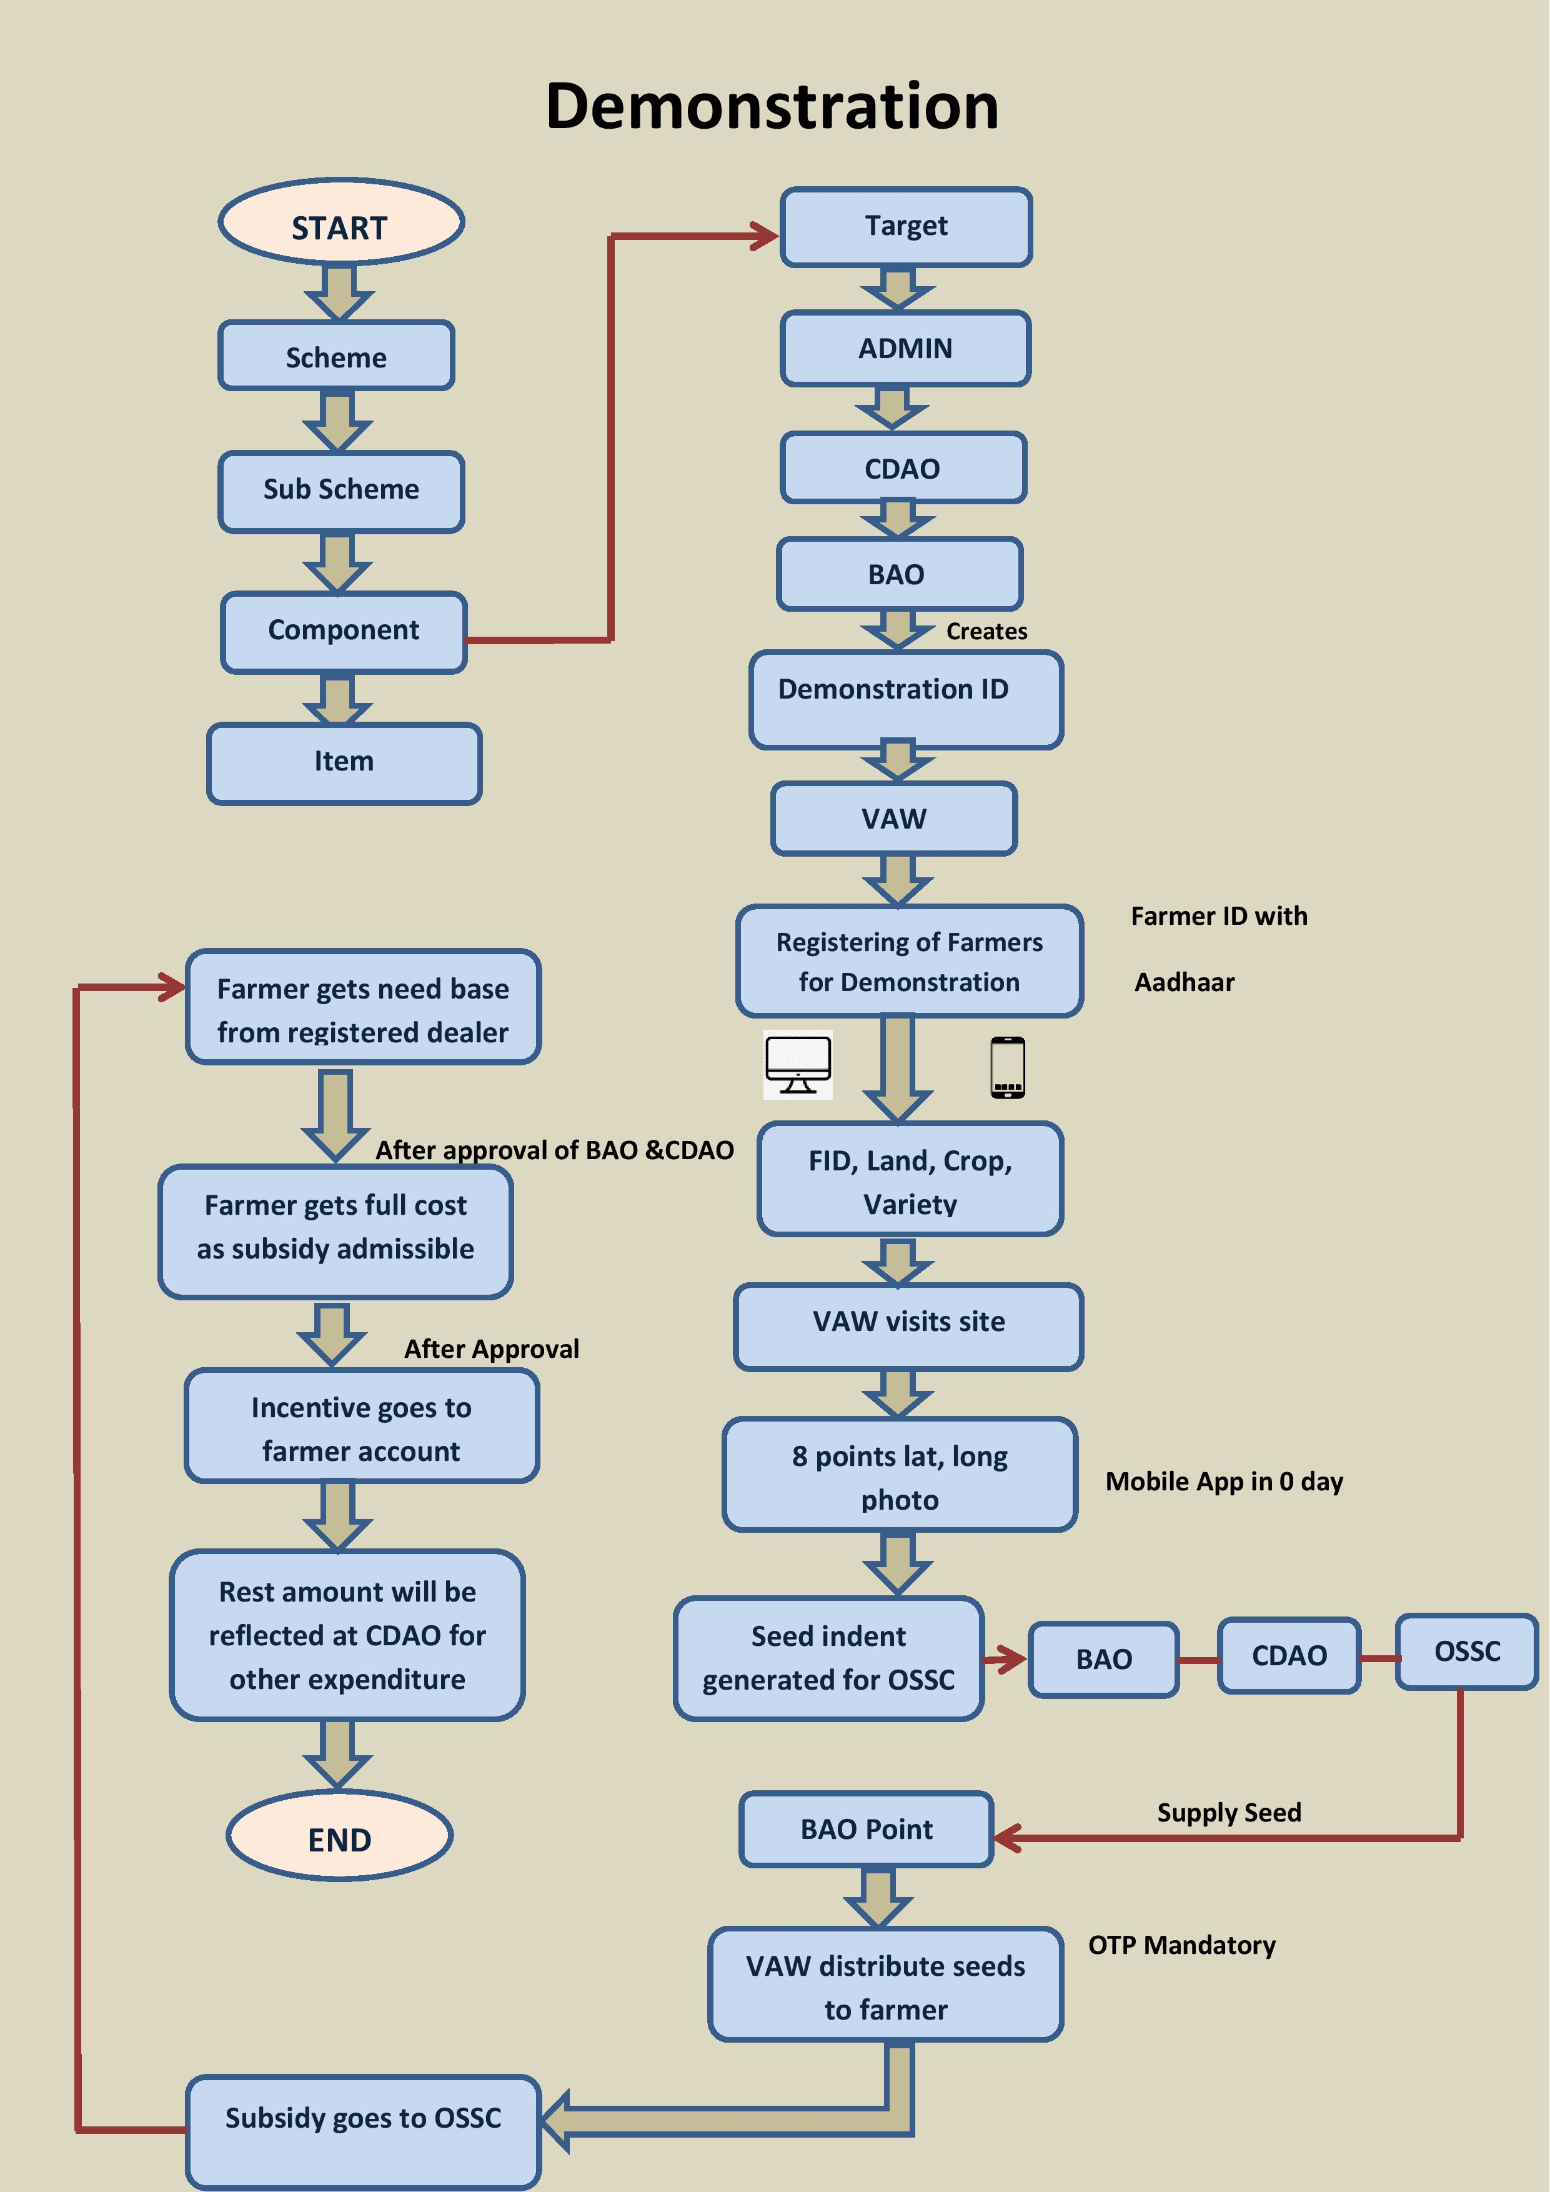
Work Flow

Slide 5
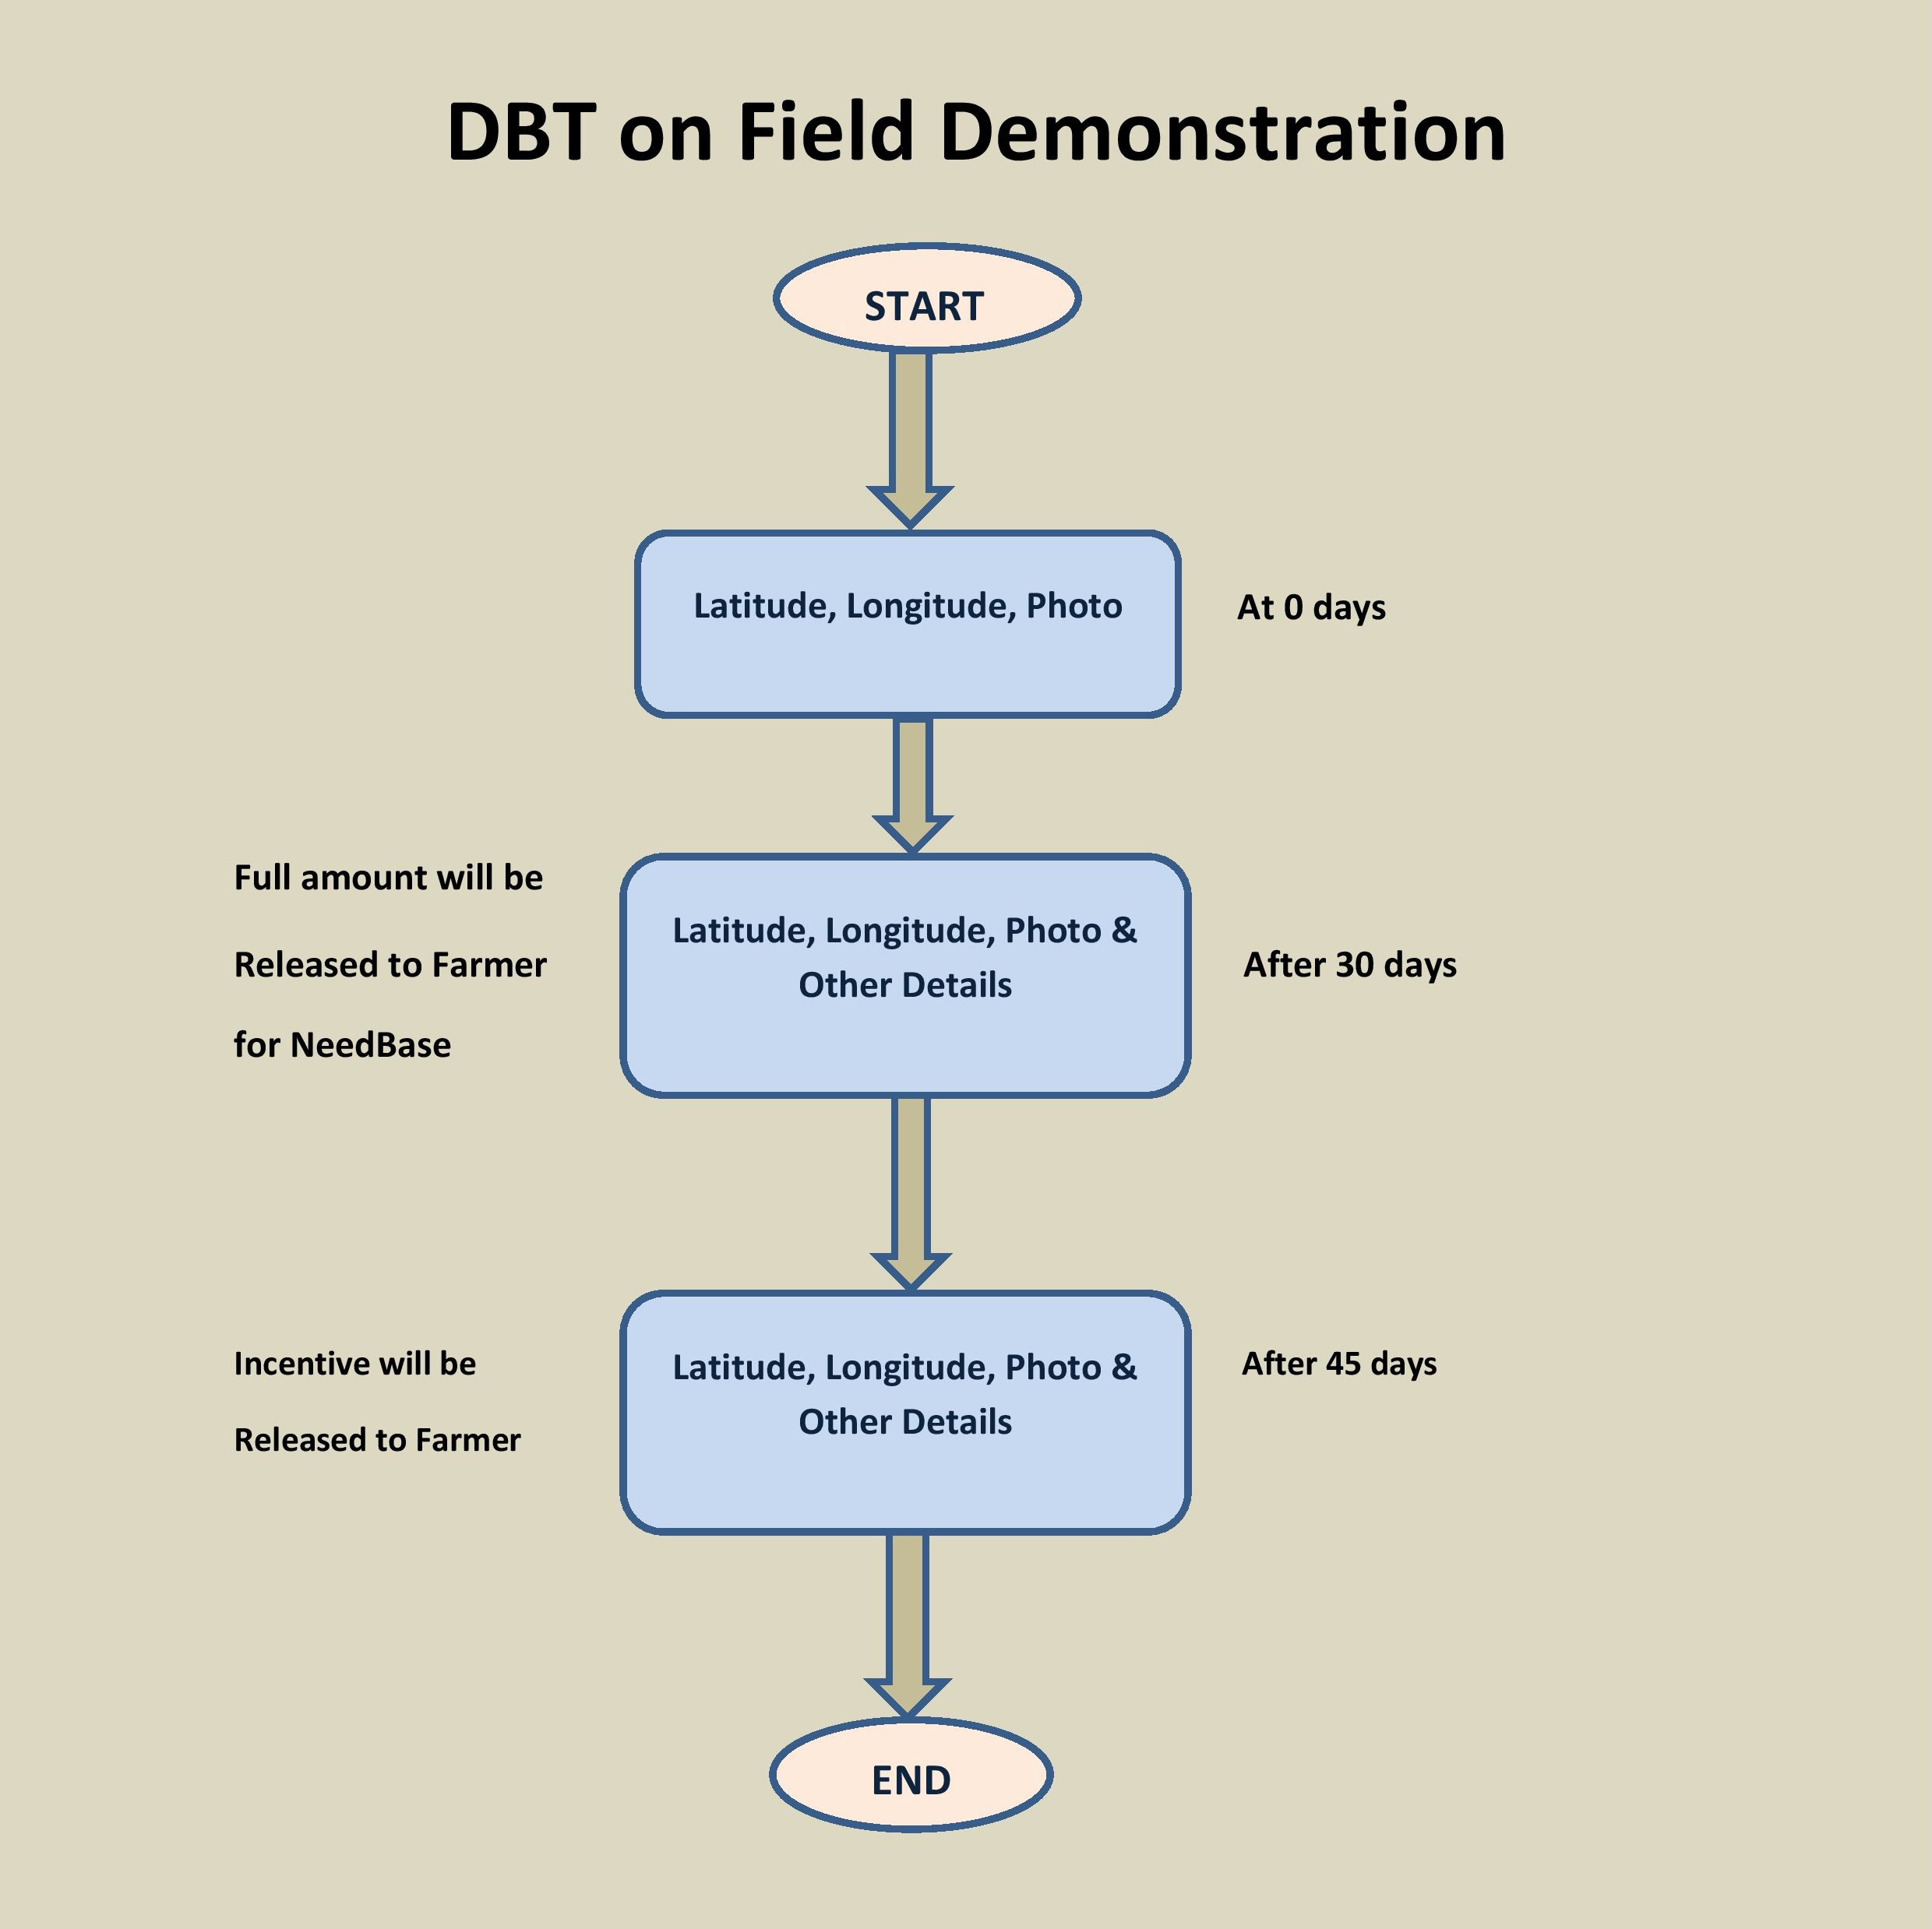

Mobile
Application

Slide 6
Thank You

