Slide 1
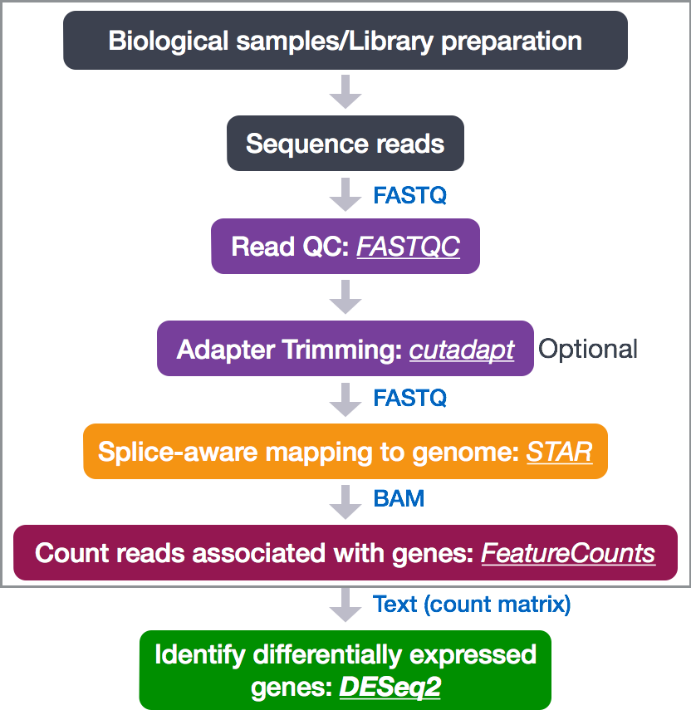

Slide 2
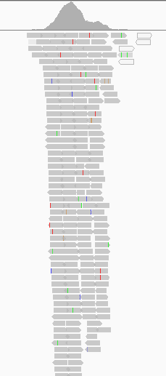
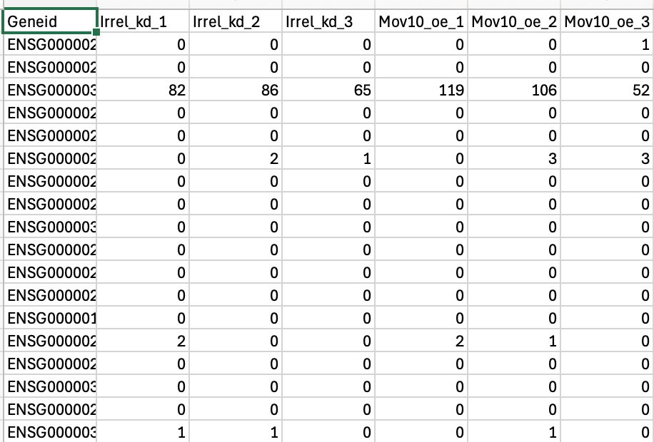
@SRR948304.5141 UNC14-SN744:253:D135LACXX:5:1101:4054:4287
AGGACTTTGGCTGTCCCCAACCGTACAGGTGGGTCTCTCCCTCATGGA
+
CCCFFFFFHHHHHGHIIJIJJJIEHGIJJCGGJAFHEIJDHGIFGGE<
@SRR948304.5160 UNC14-SN744:253:D135LACXX:5:1101:4625:4251
CCACGAAGTCAAGATCGCCGACAAGGCCTTCCTGATGAAGCAGAAGTT
+
BCCFFFFFHGHHHJJJJJJJIJGJJJJJJJJJJFIJJGIJJIJJJIGI
@SRR948304.5196 UNC14-SN744:253:D135LACXX:5:1101:5864:4425
GGAACGCCTACTGGTACTATCTGAACATGGACTACTCCTTCTTCCTGG
+
CCCFFFFFFHHHHJGHIIJJJJJJJJIJJJIJIIJJJJJJJJJJJJJI
@SRR948304.5200 UNC14-SN744:253:D135LACXX:5:1101:6109:4282
CAGGAAGAAGGAGTAGTCCATGTTCAGATAGTACCAGTAGGCGTTCCA
+
@@CFFBDDHHHBHIHIFGHHIGFFHHIJJJJFIIJIJGDFHIIFGGIF
@SRR948304.5215 UNC14-SN744:253:D135LACXX:5:1101:6464:4443
CCTTCTTCAACGACTACTACACCAAGTACTTCAAGTTCTGAGCGTCGT
+
@@@FFFFFHGDHFIEHGIJIFEHIHH?EFGGIGGG:BFGG4DFE)?D6
@SRR948304.5247 UNC14-SN744:253:D135LACXX:5:1101:8102:4331
CTACAGCTTCCGCAAGAACTACTACGAGATGGAGACCTACGCCAACTA
+
BB@FFFFFHHHHFIJIJJJIJIJIJJIGGGIIGGGIIJIJGIIGIII#
@SRR948304.5250 UNC14-SN744:253:D135LACXX:5:1101:8320:4324
CCTGGTTGAACTCGTAGATATTCTCGCGCAGAATGAACTTGTCCTCGG
+
CCCFFFFFHHHHHJHGHIJIJJJJJJJJJJJIIIJJIJJJJJJIJJJE
A few weeks ago, we were here, with a matrix of counts

Slide 3
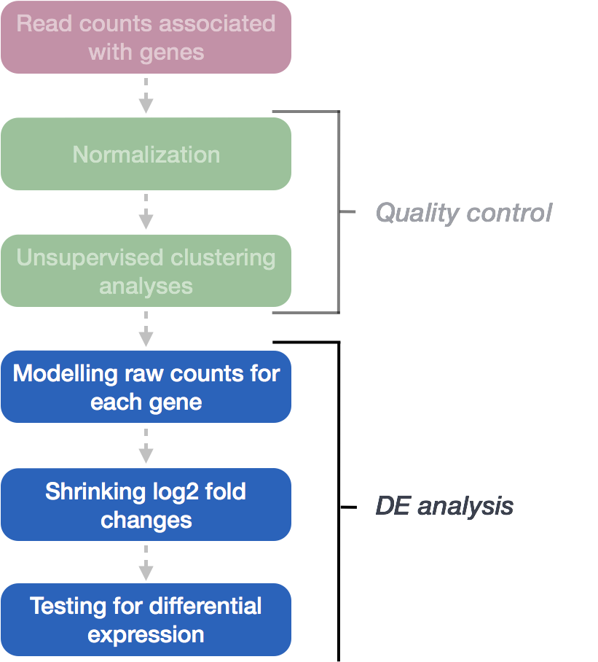
@SRR948304.5141 UNC14-SN744:253:D135LACXX:5:1101:4054:4287
AGGACTTTGGCTGTCCCCAACCGTACAGGTGGGTCTCTCCCTCATGGA
+
CCCFFFFFHHHHHGHIIJIJJJIEHGIJJCGGJAFHEIJDHGIFGGE<
@SRR948304.5160 UNC14-SN744:253:D135LACXX:5:1101:4625:4251
CCACGAAGTCAAGATCGCCGACAAGGCCTTCCTGATGAAGCAGAAGTT
+
BCCFFFFFHGHHHJJJJJJJIJGJJJJJJJJJJFIJJGIJJIJJJIGI
@SRR948304.5196 UNC14-SN744:253:D135LACXX:5:1101:5864:4425
GGAACGCCTACTGGTACTATCTGAACATGGACTACTCCTTCTTCCTGG
+
CCCFFFFFFHHHHJGHIIJJJJJJJJIJJJIJIIJJJJJJJJJJJJJI
@SRR948304.5200 UNC14-SN744:253:D135LACXX:5:1101:6109:4282
CAGGAAGAAGGAGTAGTCCATGTTCAGATAGTACCAGTAGGCGTTCCA
+
@@CFFBDDHHHBHIHIFGHHIGFFHHIJJJJFIIJIJGDFHIIFGGIF
@SRR948304.5215 UNC14-SN744:253:D135LACXX:5:1101:6464:4443
CCTTCTTCAACGACTACTACACCAAGTACTTCAAGTTCTGAGCGTCGT
+
@@@FFFFFHGDHFIEHGIJIFEHIHH?EFGGIGGG:BFGG4DFE)?D6
@SRR948304.5247 UNC14-SN744:253:D135LACXX:5:1101:8102:4331
CTACAGCTTCCGCAAGAACTACTACGAGATGGAGACCTACGCCAACTA
+
BB@FFFFFHHHHFIJIJJJIJIJIJJIGGGIIGGGIIJIJGIIGIII#
@SRR948304.5250 UNC14-SN744:253:D135LACXX:5:1101:8320:4324
CCTGGTTGAACTCGTAGATATTCTCGCGCAGAATGAACTTGTCCTCGG
+
CCCFFFFFHHHHHJHGHIJIJJJJJJJJJJJIIIJJIJJJJJJIJJJE

Slide 4
Now we have a bunch of DE genes
Ensgene | Symbol | baseMean | log2FoldChange | lfcSE | Pvalue | padj
ENSG00000000003 | TSPAN6 | 3556.8061460 | -0.441127573 | 0.05023113 | 2.718202e-19 | 1.974760e-17
ENSG00000000005 | TNMD | 26.5780991 | -0.001824407 | 0.19016980 | 9.839496e-01 | 9.916255e-01
ENSG00000000419 | DPM1 | 1647.8203572 | 0.357082308 | 0.07284209 | 2.710035e-07 | 2.804880e-06
ENSG00000000457 | SCYL3 | 525.1703268 | 0.201839039 | 0.08729909 | 1.202293e-02 | 3.882876e-02
ENSG00000000460 | FIRRM | 1157.7066145 | -0.365719321 | 0.06763055 | 1.773563e-08 | 2.288515e-07

Slide 5
So, we have a list of thousands of differentially expressed genes…
Visualizing and filtering to prioritize
Which genes are the most significant?
What about the expression of my favorite gene?

Slide 6
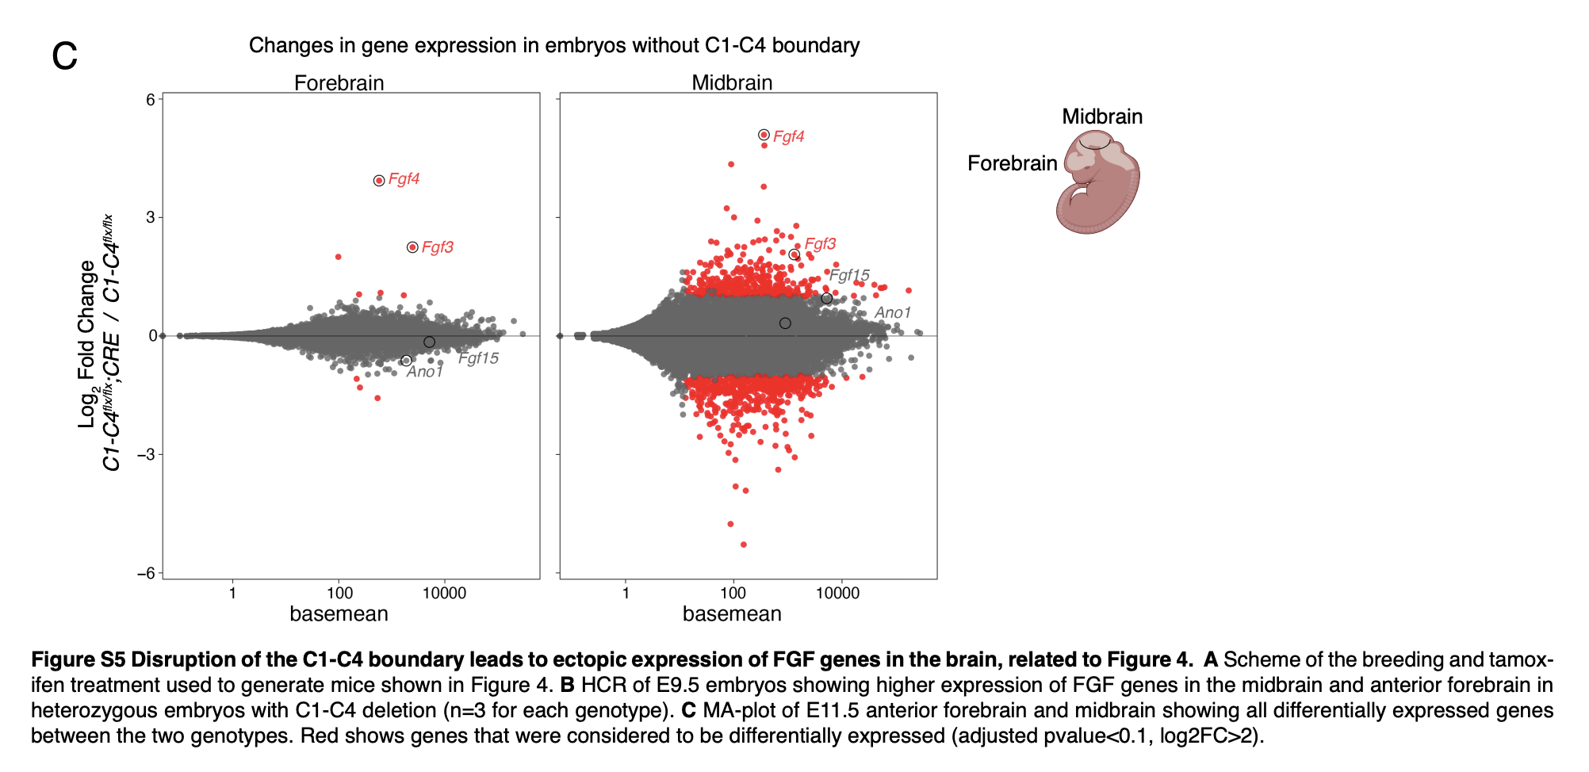
MA plots, for example
https://www.sciencedirect.com/science/article/pii/S1534580725000644

Slide 7
What about the rest of the genes?
What types of genes are common in my list of overexpressed genes?
Annotation with functional information
Overrepresentation Analysis (ORA)
Gene Set Enrichment Analysis

Slide 8
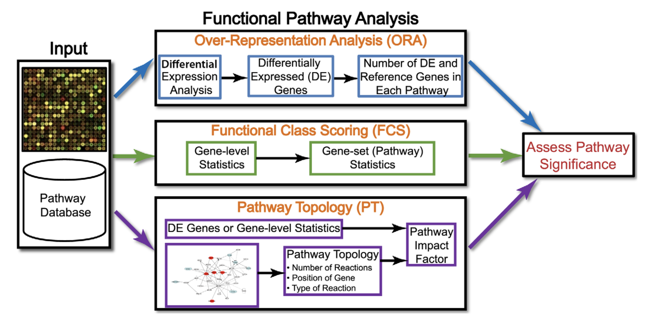
https://journals.plos.org/ploscompbiol/article?id=10.1371/journal.pcbi.1002375

Slide 9
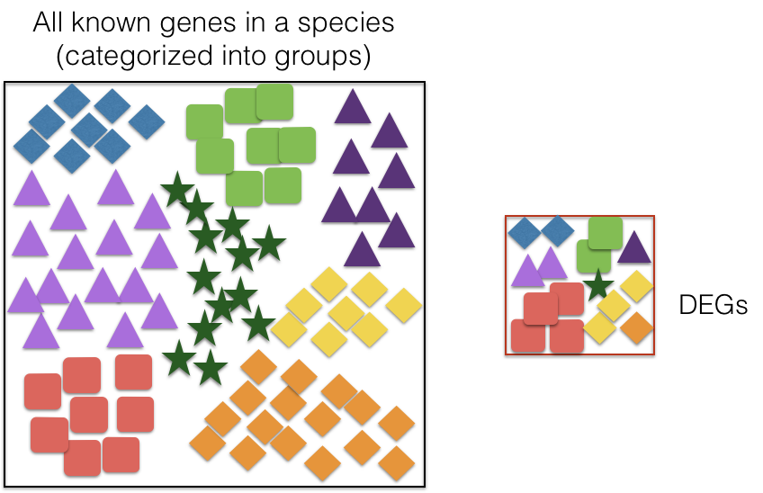
Overrepresentation Analysis
Over-representation analysis (ORA) is used to determine which a priori defined gene sets are more present (over-represented) in a subset of “interesting” (i.e. DE) genes than what would be expected by chance (Huang et al., 2009).
The “universe”
Are red squares overrepresented in the DEGs compared to the full set of genes?

Slide 10
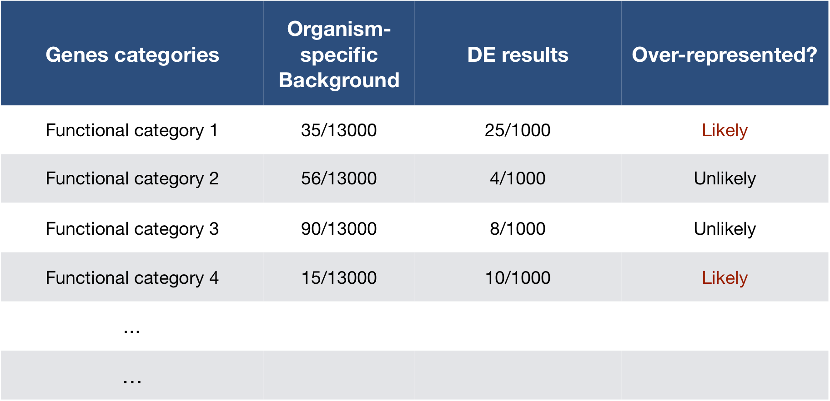

Slide 11

Hypergeometric Test
Describes the probability of 25 genes (k) being associated with "Functional category 1", for all genes in our gene list (n=1000), from a population of all of the genes in entire genome (N=13,000) which contains 35 genes (K) associated with "Functional category 1” -> get a P-value
https://systems.crump.ucla.edu/hypergeometric/index.php

Slide 12

GO Terms
Biological process: refers to the biological role involving the gene or gene product, and could include “transcription”, “apoptosis”.
Molecular function: represents the biochemical activity of the gene product, such activities could include “ligand”, “GTPase”, and “transporter”.
Cellular component: refers to the location in the cell of the gene product. Cellular components could include “nucleus”, “lysosome” etc.
https://geneontology.org/docs/guide-go-evidence-codes/
Example: https://amigo.geneontology.org/amigo/gene_product/UniProtKB:P31314
https://amigo.geneontology.org/amigo/dd_browse

Slide 13
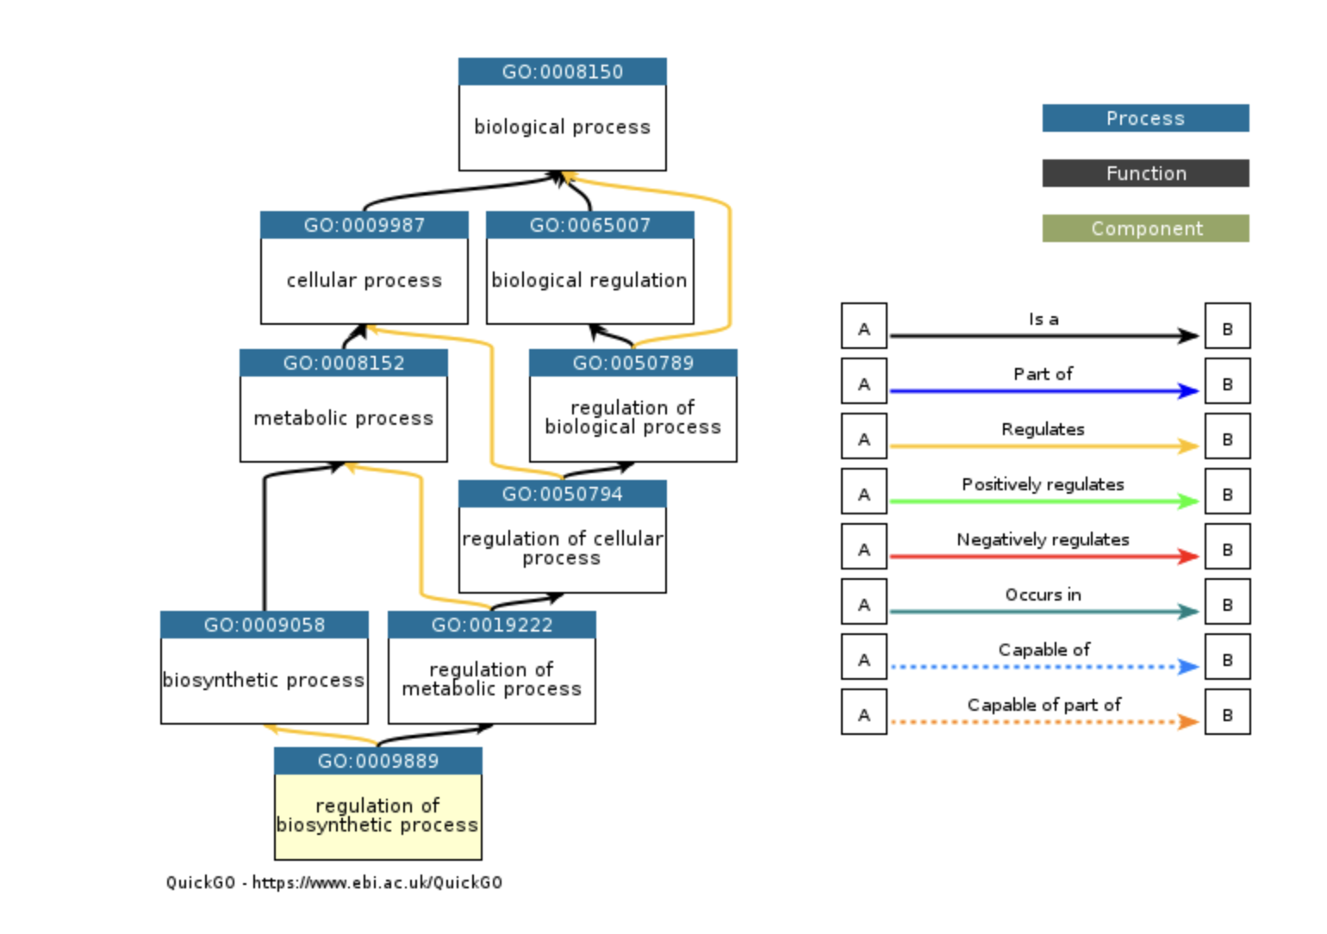
GO Terms are Hierarchical
https://amigo.geneontology.org/amigo/dd_browse

Slide 14
Caveats to ORA and other approaches
Ignores magnitude of differential expression within the group of DE genes
Independence of genes from one another? Pathways from one another?
Quality and availability of annotations
https://journals.plos.org/ploscompbiol/article?id=10.1371/journal.pcbi.1002375

Slide 15
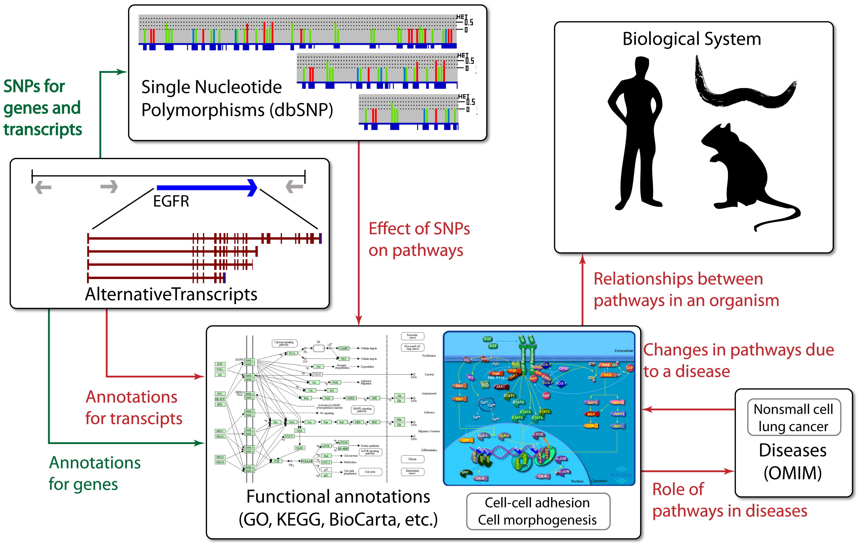
https://journals.plos.org/ploscompbiol/article?id=10.1371/journal.pcbi.1002375

Slide 16
Week 9: Day 1 – Gene Set Enrichment
The hypothesis behind functional class scoring (FCS) methods:
Large changes in individual genes can have significant effects on pathways (and will be detected via ORA methods)
Weaker but coordinated changes in sets of functionally related genes (i.e., pathways) can also have significant effects.
Thus, rather than setting an arbitrary threshold to identify ‘significant genes’, all genes are considered in the analysis.
Gene set enrichment analysis utilizes the gene-level statistics (log2 fold changes) for all genes to look to see whether gene sets for particular biological pathways are enriched among the large positive or negative fold changes.

Slide 17
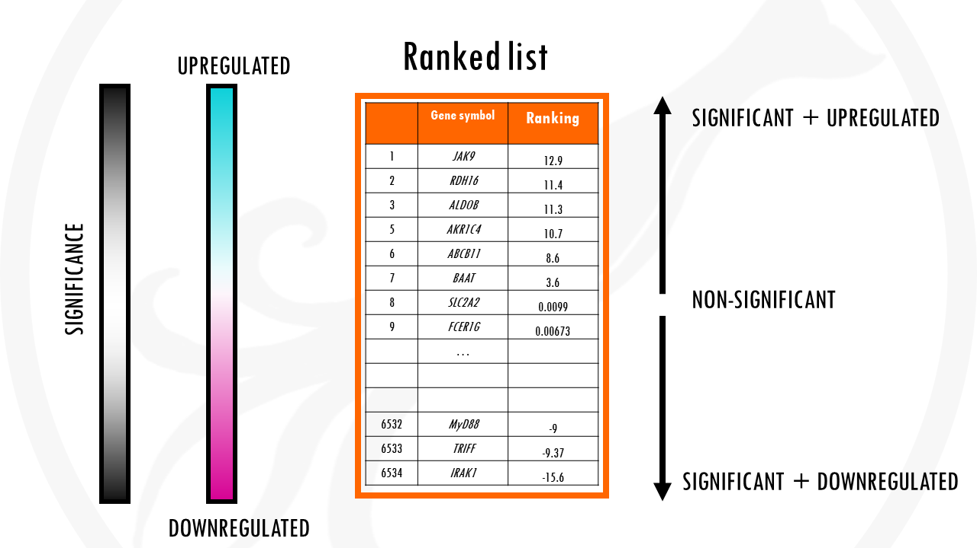
https://biostatsquid.com/gene-set-enrichment-analysis/

Slide 18
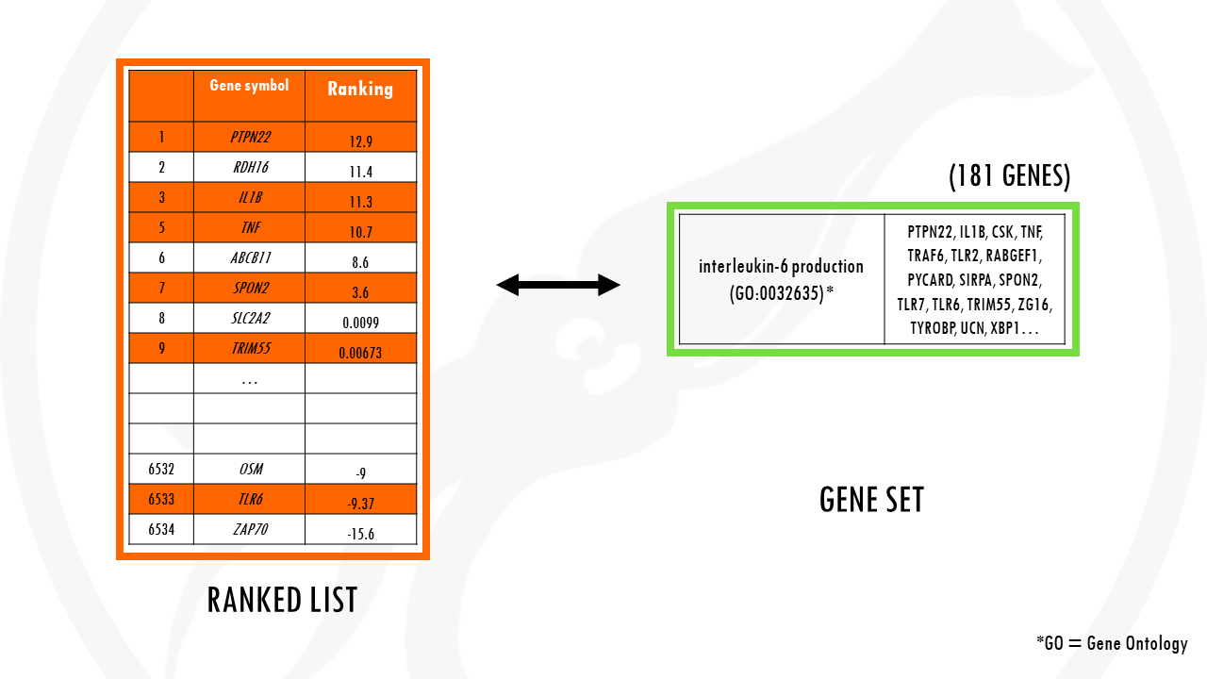
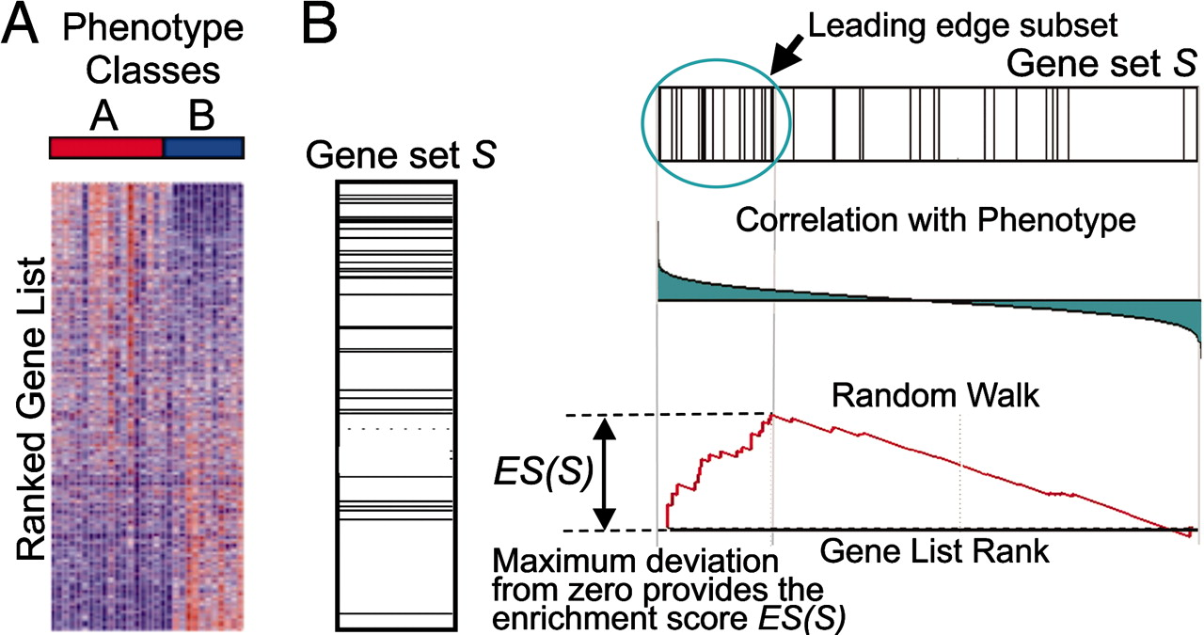
https://biostatsquid.com/gene-set-enrichment-analysis/

Slide 19
How does GSEA work?
Step 1: Calculation of enrichment score:
An enrichment score for a particular gene set is calculated by walking down the list of log2 fold changes and increasing the running-sum statistic every time a gene in the gene set is encountered and decreasing it when genes are not part of the gene set. The size of the increase/decrease is determined by magnitude of the log2 fold change. Larger (positive or negative) log2 fold changes will result in larger increases or decreases. The final enrichment score is where the running-sum statistic is the largest deviation from zero.
Step 2: Estimation of significance:
The significance of the enrichment score is determined using permutation testing, which performs rearrangements of the data points to determine the likelihood of generating an enrichment score as large as the enrichment score calculated from the observed data
Step 3: Adjust for multiple test correction
After all gene sets are tested, the enrichment scores are normalized for the size of the gene set, then the p-values are corrected for multiple testing.
The GSEA output will yield the core genes in the gene sets that most highly contribute to the enrichment score. The genes output are generally the genes at or before the running sum reaches its maximum value (eg. the most influential genes driving the differences between conditions for that gene set).

Slide 20
https://biostatsquid.com/gene-set-enrichment-analysis/

Slide 21
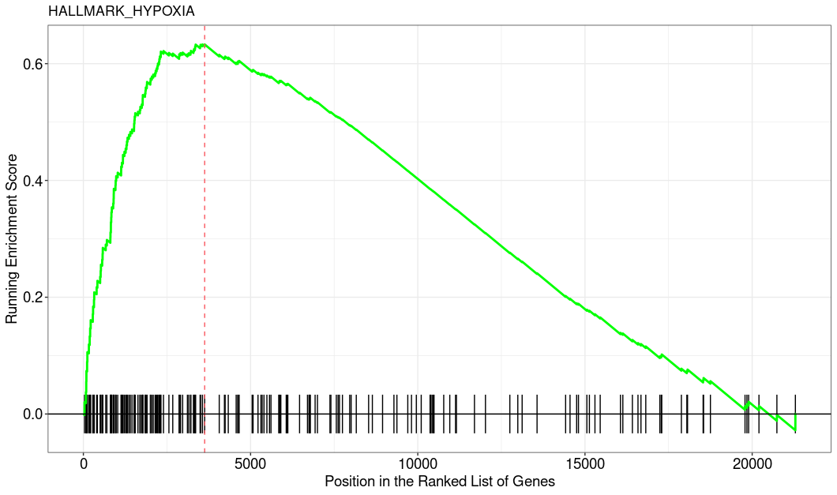

Slide 22
How does GSEA work?
Step 1: Calculation of enrichment score:
An enrichment score for a particular gene set is calculated by walking down the list of log2 fold changes and increasing the running-sum statistic every time a gene in the gene set is encountered and decreasing it when genes are not part of the gene set. The size of the increase/decrease is determined by magnitude of the log2 fold change. Larger (positive or negative) log2 fold changes will result in larger increases or decreases. The final enrichment score is where the running-sum statistic is the largest deviation from zero.
Step 2: Estimation of significance:
The significance of the enrichment score is determined using permutation testing, which performs rearrangements of the data points to determine the likelihood of generating an enrichment score as large as the enrichment score calculated from the observed data
Step 3: Adjust for multiple test correction
After all gene sets are tested, the enrichment scores are normalized for the size of the gene set, then the p-values are corrected for multiple testing.
The GSEA output will yield the core genes in the gene sets that most highly contribute to the enrichment score. The genes output are generally the genes at or before the running sum reaches its maximum value (eg. the most influential genes driving the differences between conditions for that gene set).

Slide 24
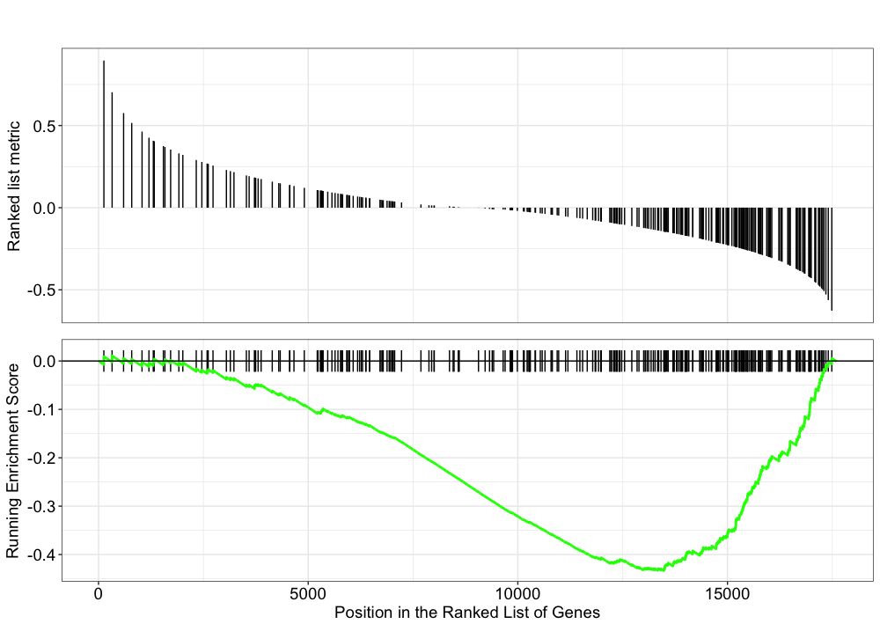

Slide 25
https://biostatsquid.com/gene-set-enrichment-analysis/

Slide 26
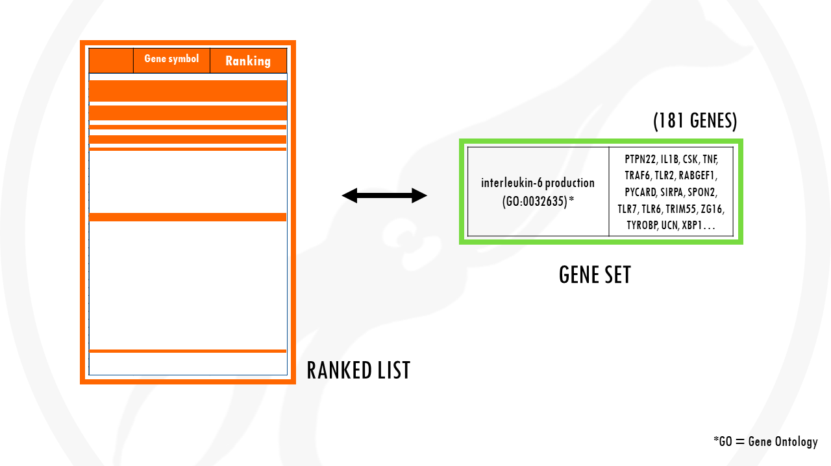
https://biostatsquid.com/gene-set-enrichment-analysis/

Slide 27
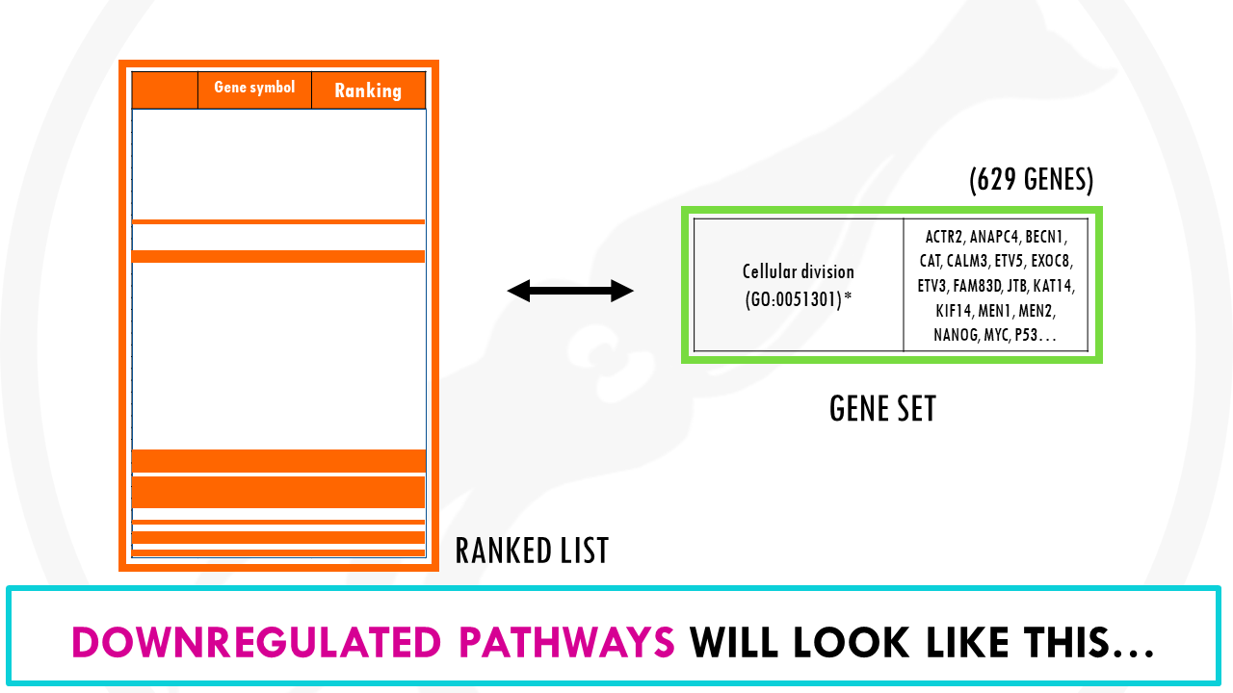
https://biostatsquid.com/gene-set-enrichment-analysis/

Slide 28
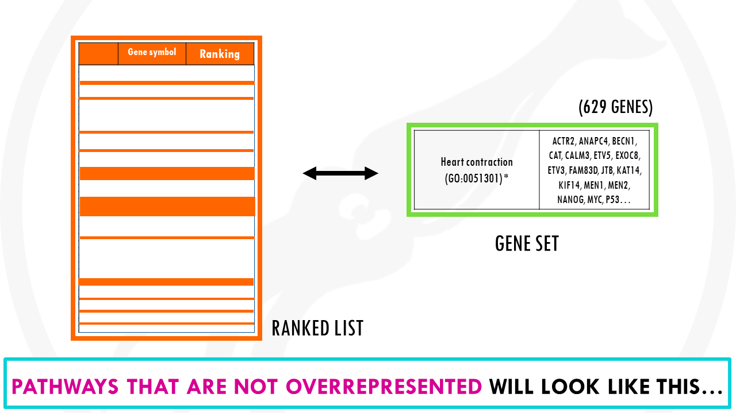
https://biostatsquid.com/gene-set-enrichment-analysis/

Slide 29
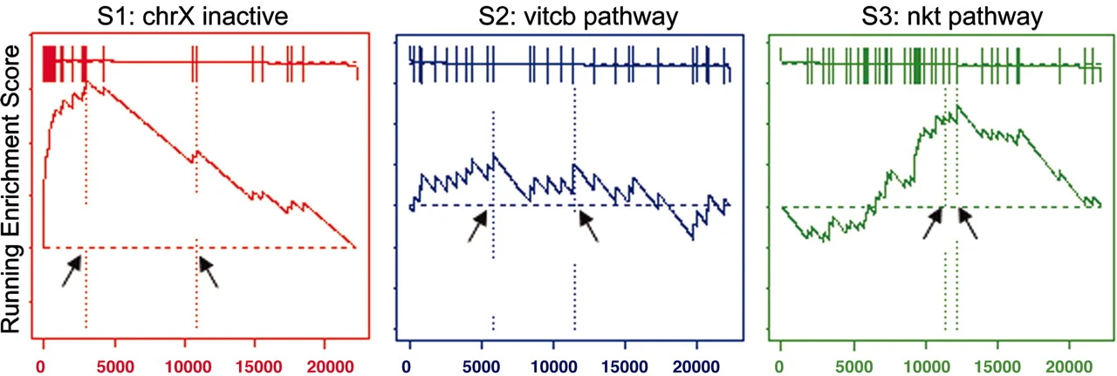
r. The distribution of three gene sets, from the C2 functional collection, in the list of genes in the male/female lymphoblastoid cell line example ranked by their correlation with gender: S1, a set of chromosome X inactivation genes; S2, a pathway describing vitamin c import into neurons; S3, related to chemokine receptors expressed by T helper cells. Shown are plots of the running sum for the three gene sets: S1 is significantly enriched in females as expected, S2 is randomly distributed and scores poorly, and S3 is not enriched at the top of the list but is nonrandom, so it scores well. Arrows show the location of the maximum enrichment score and the point where the correlation (signal-to-noise ratio) crosses zero.

Slide 30
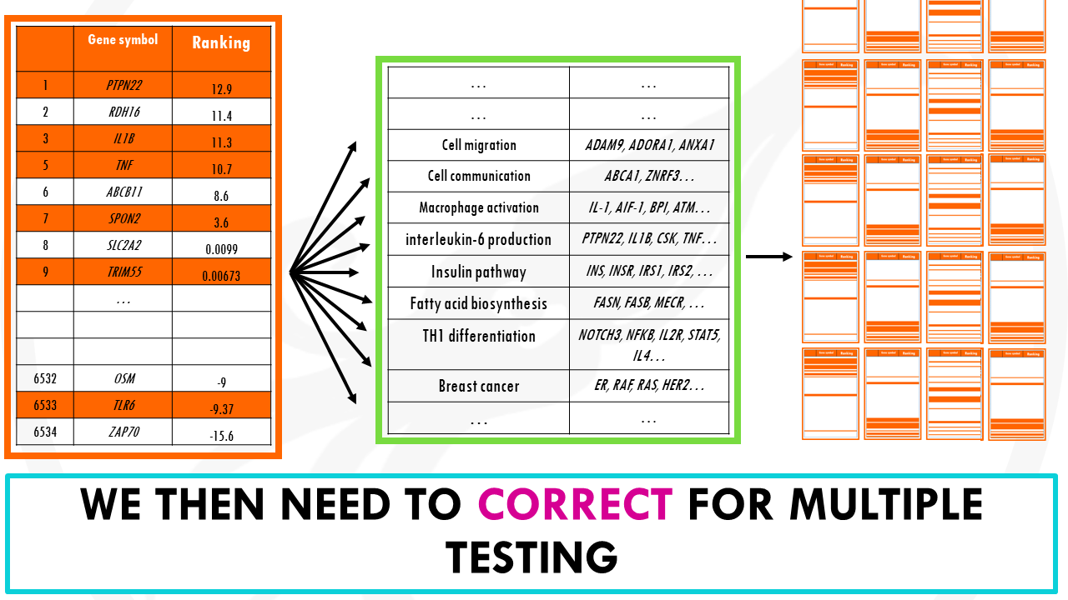

Slide 31
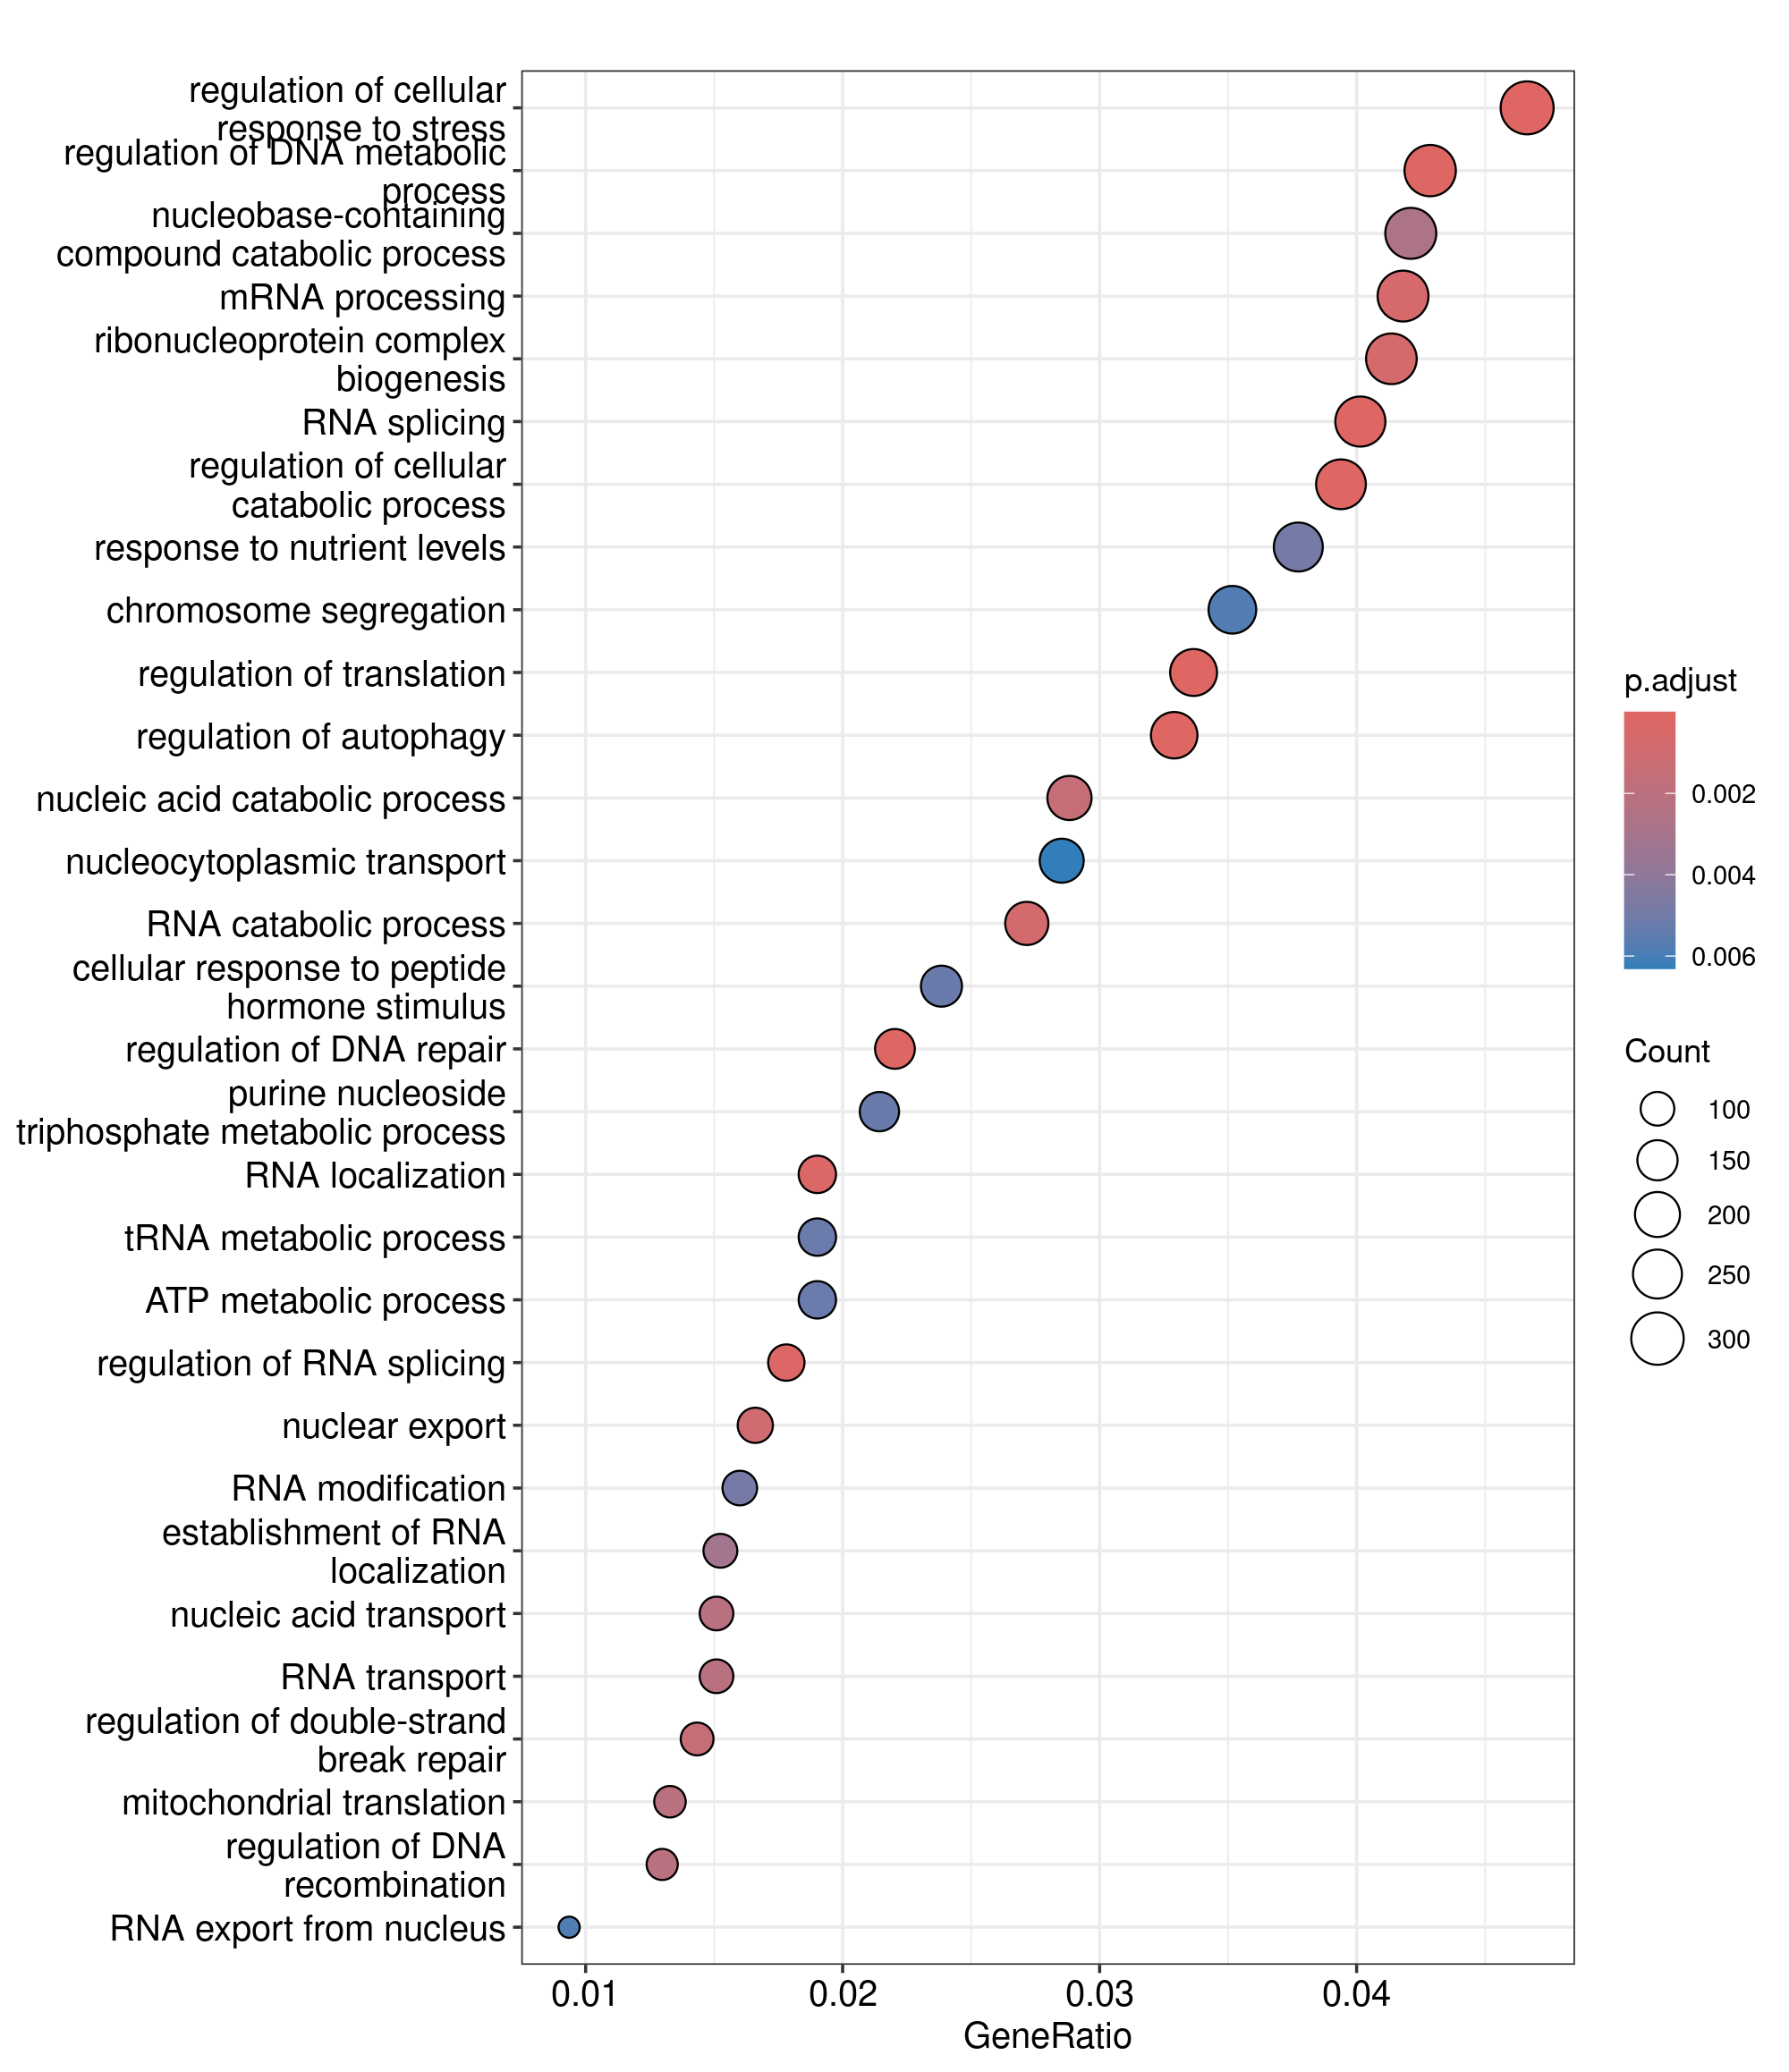
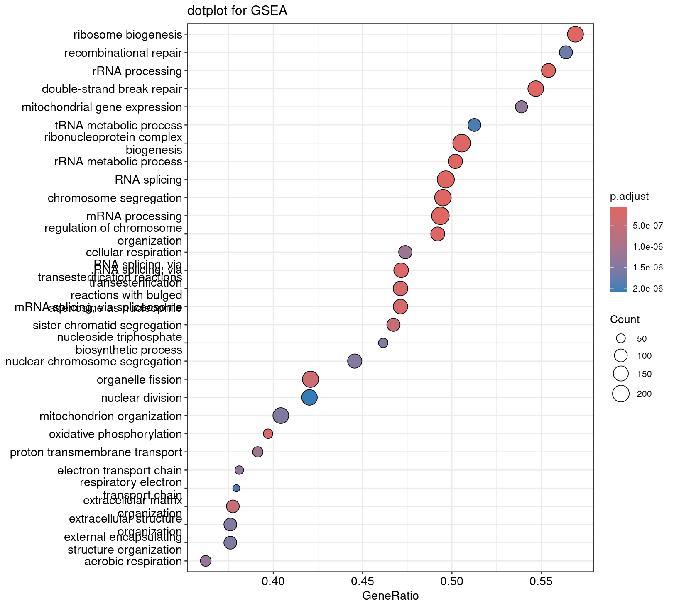

Slide 32
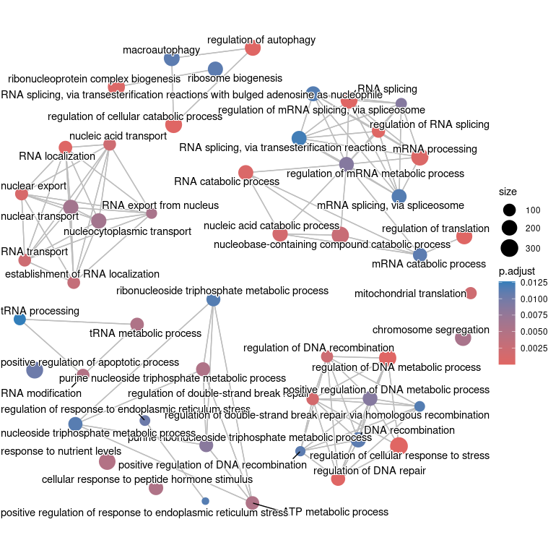
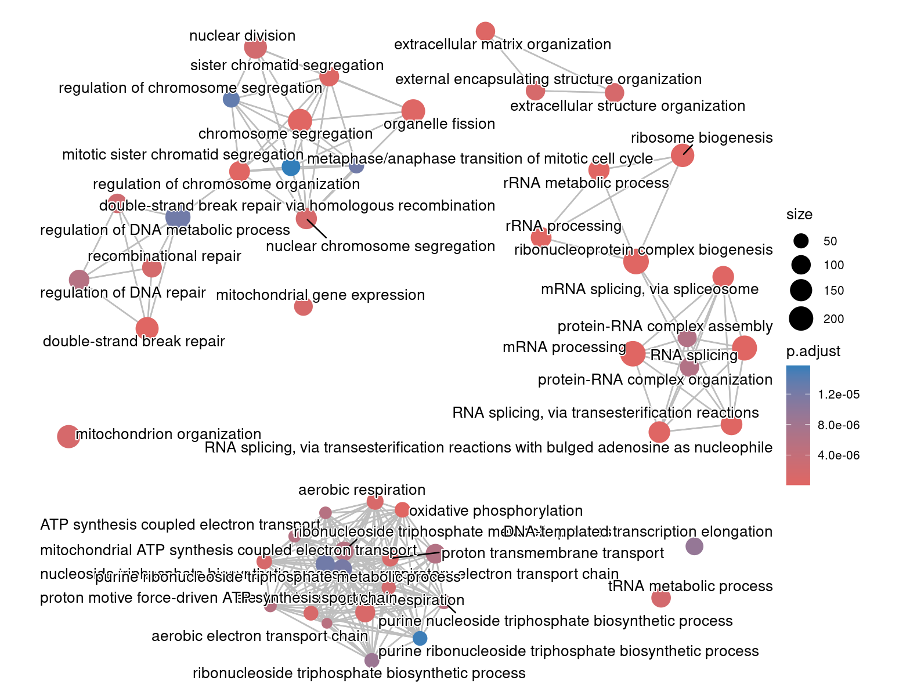
Emapplots

Slide 33
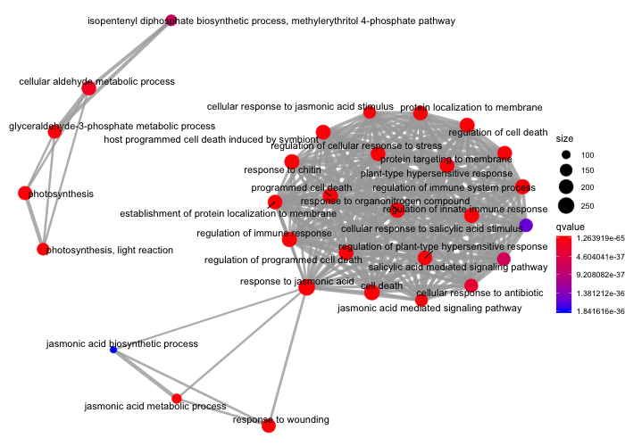
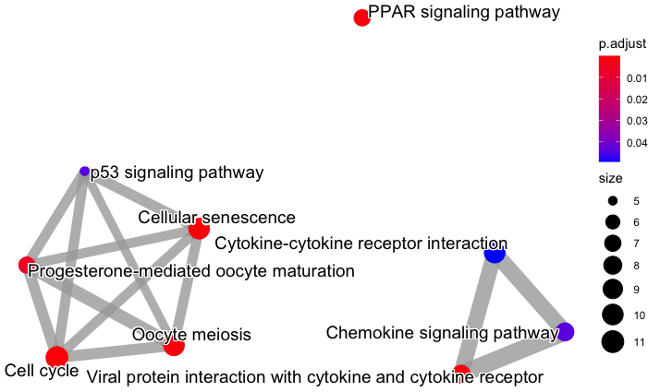
Really depends on the size of your data and plotting parameters

Slide 34
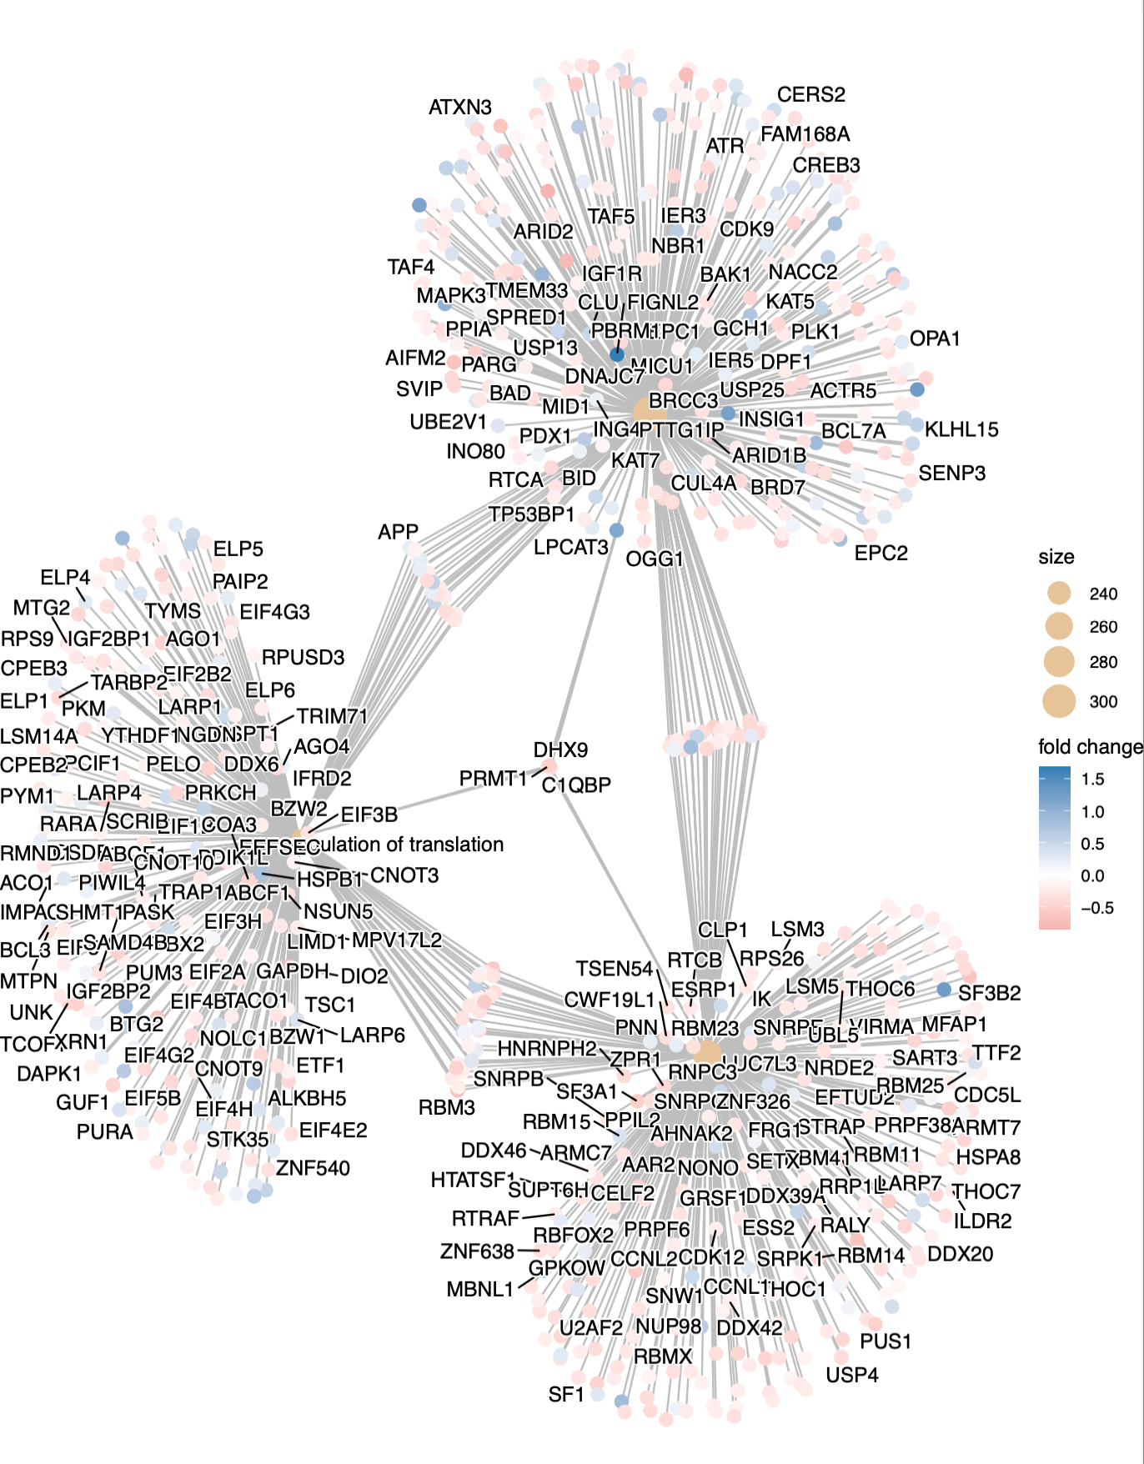
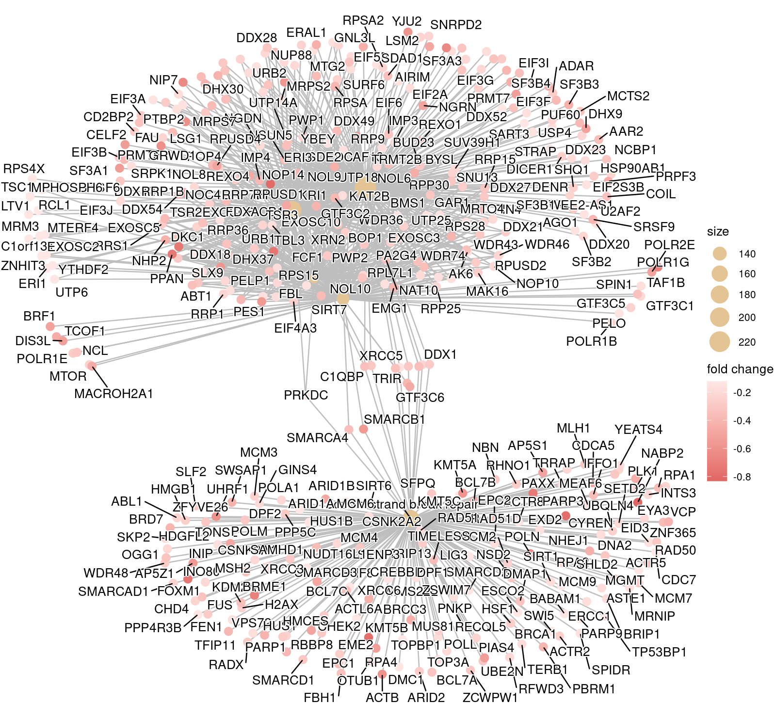
Cnetplots

Slide 35
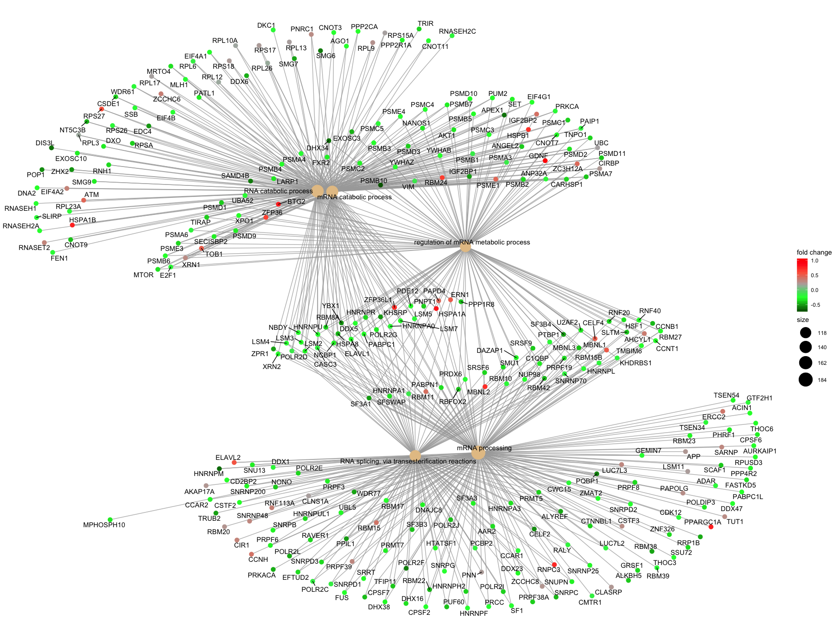
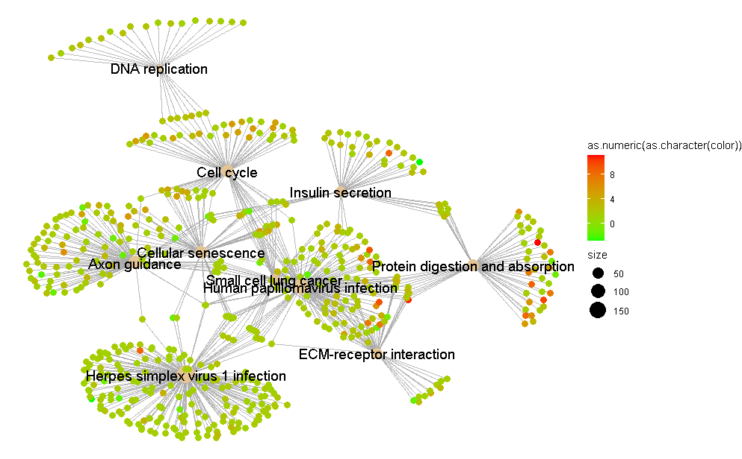
More useful cnetplots

