Slide 1
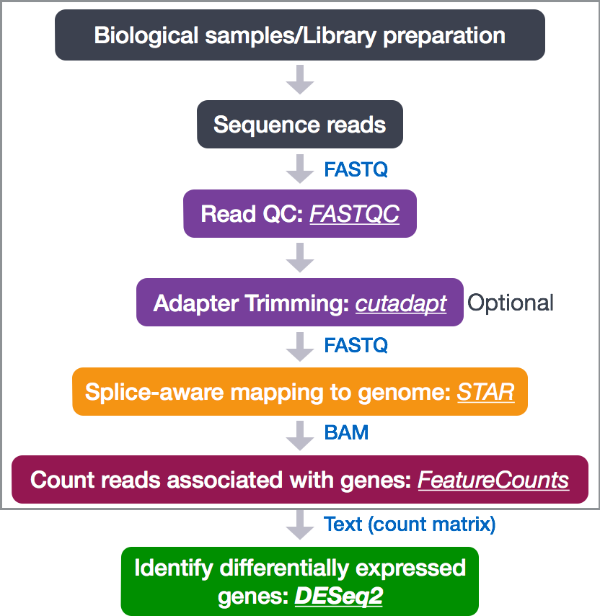

Slide 2
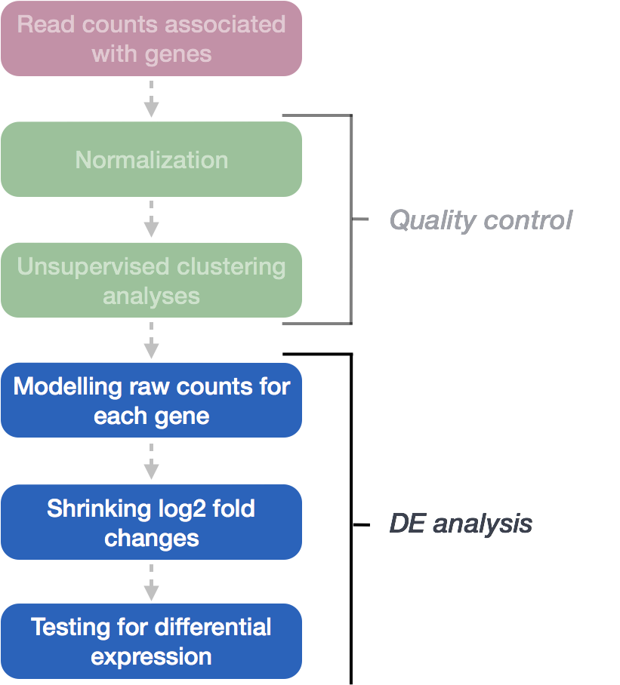

Slide 3
@SRR948304.5141 UNC14-SN744:253:D135LACXX:5:1101:4054:4287
AGGACTTTGGCTGTCCCCAACCGTACAGGTGGGTCTCTCCCTCATGGA
+
CCCFFFFFHHHHHGHIIJIJJJIEHGIJJCGGJAFHEIJDHGIFGGE<
@SRR948304.5160 UNC14-SN744:253:D135LACXX:5:1101:4625:4251
CCACGAAGTCAAGATCGCCGACAAGGCCTTCCTGATGAAGCAGAAGTT
+
BCCFFFFFHGHHHJJJJJJJIJGJJJJJJJJJJFIJJGIJJIJJJIGI
@SRR948304.5196 UNC14-SN744:253:D135LACXX:5:1101:5864:4425
GGAACGCCTACTGGTACTATCTGAACATGGACTACTCCTTCTTCCTGG
+
CCCFFFFFFHHHHJGHIIJJJJJJJJIJJJIJIIJJJJJJJJJJJJJI
@SRR948304.5200 UNC14-SN744:253:D135LACXX:5:1101:6109:4282
CAGGAAGAAGGAGTAGTCCATGTTCAGATAGTACCAGTAGGCGTTCCA
+
@@CFFBDDHHHBHIHIFGHHIGFFHHIJJJJFIIJIJGDFHIIFGGIF
@SRR948304.5215 UNC14-SN744:253:D135LACXX:5:1101:6464:4443
CCTTCTTCAACGACTACTACACCAAGTACTTCAAGTTCTGAGCGTCGT
+
@@@FFFFFHGDHFIEHGIJIFEHIHH?EFGGIGGG:BFGG4DFE)?D6
@SRR948304.5247 UNC14-SN744:253:D135LACXX:5:1101:8102:4331
CTACAGCTTCCGCAAGAACTACTACGAGATGGAGACCTACGCCAACTA
+
BB@FFFFFHHHHFIJIJJJIJIJIJJIGGGIIGGGIIJIJGIIGIII#
@SRR948304.5250 UNC14-SN744:253:D135LACXX:5:1101:8320:4324
CCTGGTTGAACTCGTAGATATTCTCGCGCAGAATGAACTTGTCCTCGG
+
CCCFFFFFHHHHHJHGHIJIJJJJJJJJJJJIIIJJIJJJJJJIJJJE

Slide 4
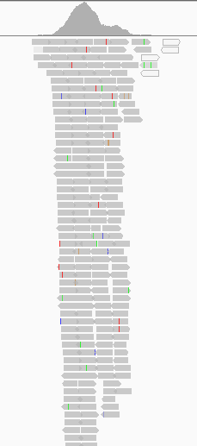
@SRR948304.5141 UNC14-SN744:253:D135LACXX:5:1101:4054:4287
AGGACTTTGGCTGTCCCCAACCGTACAGGTGGGTCTCTCCCTCATGGA
+
CCCFFFFFHHHHHGHIIJIJJJIEHGIJJCGGJAFHEIJDHGIFGGE<
@SRR948304.5160 UNC14-SN744:253:D135LACXX:5:1101:4625:4251
CCACGAAGTCAAGATCGCCGACAAGGCCTTCCTGATGAAGCAGAAGTT
+
BCCFFFFFHGHHHJJJJJJJIJGJJJJJJJJJJFIJJGIJJIJJJIGI
@SRR948304.5196 UNC14-SN744:253:D135LACXX:5:1101:5864:4425
GGAACGCCTACTGGTACTATCTGAACATGGACTACTCCTTCTTCCTGG
+
CCCFFFFFFHHHHJGHIIJJJJJJJJIJJJIJIIJJJJJJJJJJJJJI
@SRR948304.5200 UNC14-SN744:253:D135LACXX:5:1101:6109:4282
CAGGAAGAAGGAGTAGTCCATGTTCAGATAGTACCAGTAGGCGTTCCA
+
@@CFFBDDHHHBHIHIFGHHIGFFHHIJJJJFIIJIJGDFHIIFGGIF
@SRR948304.5215 UNC14-SN744:253:D135LACXX:5:1101:6464:4443
CCTTCTTCAACGACTACTACACCAAGTACTTCAAGTTCTGAGCGTCGT
+
@@@FFFFFHGDHFIEHGIJIFEHIHH?EFGGIGGG:BFGG4DFE)?D6
@SRR948304.5247 UNC14-SN744:253:D135LACXX:5:1101:8102:4331
CTACAGCTTCCGCAAGAACTACTACGAGATGGAGACCTACGCCAACTA
+
BB@FFFFFHHHHFIJIJJJIJIJIJJIGGGIIGGGIIJIJGIIGIII#
@SRR948304.5250 UNC14-SN744:253:D135LACXX:5:1101:8320:4324
CCTGGTTGAACTCGTAGATATTCTCGCGCAGAATGAACTTGTCCTCGG
+
CCCFFFFFHHHHHJHGHIJIJJJJJJJJJJJIIIJJIJJJJJJIJJJE

Slide 5
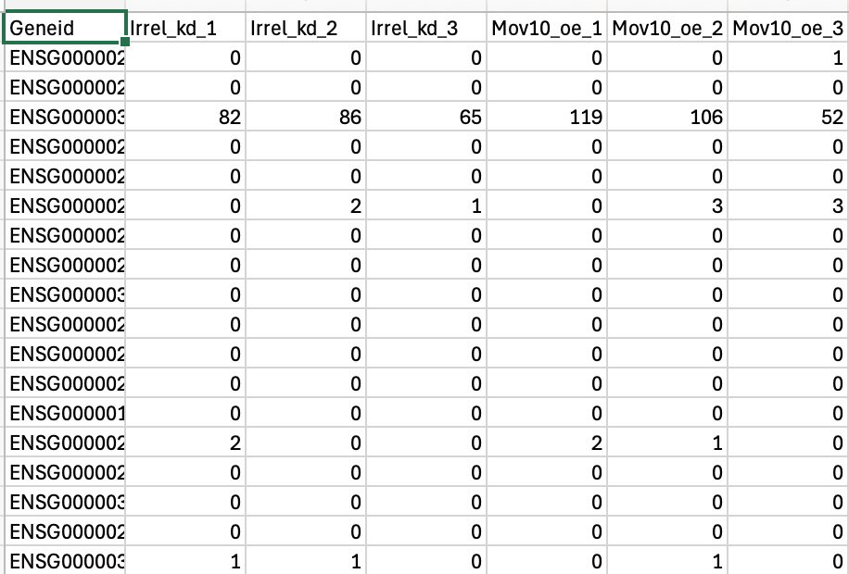
@SRR948304.5141 UNC14-SN744:253:D135LACXX:5:1101:4054:4287
AGGACTTTGGCTGTCCCCAACCGTACAGGTGGGTCTCTCCCTCATGGA
+
CCCFFFFFHHHHHGHIIJIJJJIEHGIJJCGGJAFHEIJDHGIFGGE<
@SRR948304.5160 UNC14-SN744:253:D135LACXX:5:1101:4625:4251
CCACGAAGTCAAGATCGCCGACAAGGCCTTCCTGATGAAGCAGAAGTT
+
BCCFFFFFHGHHHJJJJJJJIJGJJJJJJJJJJFIJJGIJJIJJJIGI
@SRR948304.5196 UNC14-SN744:253:D135LACXX:5:1101:5864:4425
GGAACGCCTACTGGTACTATCTGAACATGGACTACTCCTTCTTCCTGG
+
CCCFFFFFFHHHHJGHIIJJJJJJJJIJJJIJIIJJJJJJJJJJJJJI
@SRR948304.5200 UNC14-SN744:253:D135LACXX:5:1101:6109:4282
CAGGAAGAAGGAGTAGTCCATGTTCAGATAGTACCAGTAGGCGTTCCA
+
@@CFFBDDHHHBHIHIFGHHIGFFHHIJJJJFIIJIJGDFHIIFGGIF
@SRR948304.5215 UNC14-SN744:253:D135LACXX:5:1101:6464:4443
CCTTCTTCAACGACTACTACACCAAGTACTTCAAGTTCTGAGCGTCGT
+
@@@FFFFFHGDHFIEHGIJIFEHIHH?EFGGIGGG:BFGG4DFE)?D6
@SRR948304.5247 UNC14-SN744:253:D135LACXX:5:1101:8102:4331
CTACAGCTTCCGCAAGAACTACTACGAGATGGAGACCTACGCCAACTA
+
BB@FFFFFHHHHFIJIJJJIJIJIJJIGGGIIGGGIIJIJGIIGIII#
@SRR948304.5250 UNC14-SN744:253:D135LACXX:5:1101:8320:4324
CCTGGTTGAACTCGTAGATATTCTCGCGCAGAATGAACTTGTCCTCGG
+
CCCFFFFFHHHHHJHGHIJIJJJJJJJJJJJIIIJJIJJJJJJIJJJE

Slide 6
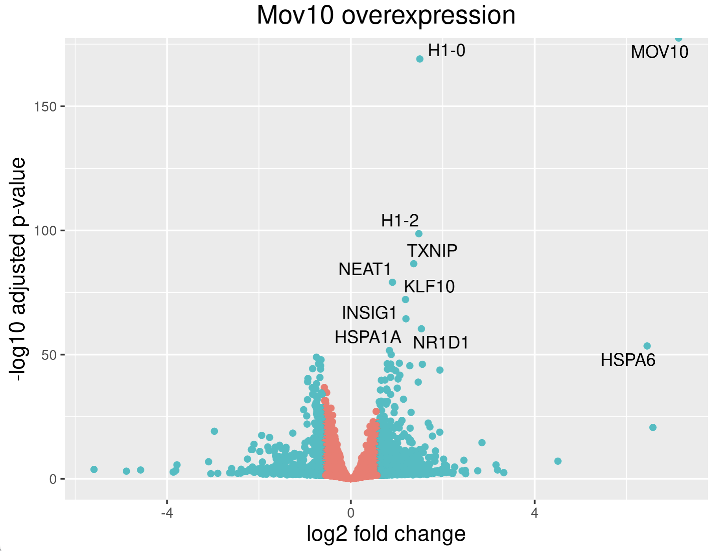
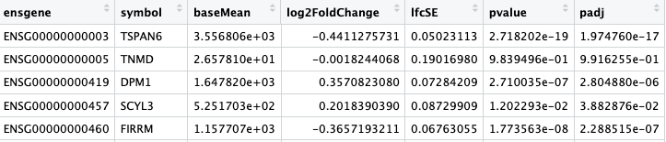
@SRR948304.5141 UNC14-SN744:253:D135LACXX:5:1101:4054:4287
AGGACTTTGGCTGTCCCCAACCGTACAGGTGGGTCTCTCCCTCATGGA
+
CCCFFFFFHHHHHGHIIJIJJJIEHGIJJCGGJAFHEIJDHGIFGGE<
@SRR948304.5160 UNC14-SN744:253:D135LACXX:5:1101:4625:4251
CCACGAAGTCAAGATCGCCGACAAGGCCTTCCTGATGAAGCAGAAGTT
+
BCCFFFFFHGHHHJJJJJJJIJGJJJJJJJJJJFIJJGIJJIJJJIGI
@SRR948304.5196 UNC14-SN744:253:D135LACXX:5:1101:5864:4425
GGAACGCCTACTGGTACTATCTGAACATGGACTACTCCTTCTTCCTGG
+
CCCFFFFFFHHHHJGHIIJJJJJJJJIJJJIJIIJJJJJJJJJJJJJI
@SRR948304.5200 UNC14-SN744:253:D135LACXX:5:1101:6109:4282
CAGGAAGAAGGAGTAGTCCATGTTCAGATAGTACCAGTAGGCGTTCCA
+
@@CFFBDDHHHBHIHIFGHHIGFFHHIJJJJFIIJIJGDFHIIFGGIF
@SRR948304.5215 UNC14-SN744:253:D135LACXX:5:1101:6464:4443
CCTTCTTCAACGACTACTACACCAAGTACTTCAAGTTCTGAGCGTCGT
+
@@@FFFFFHGDHFIEHGIJIFEHIHH?EFGGIGGG:BFGG4DFE)?D6
@SRR948304.5247 UNC14-SN744:253:D135LACXX:5:1101:8102:4331
CTACAGCTTCCGCAAGAACTACTACGAGATGGAGACCTACGCCAACTA
+
BB@FFFFFHHHHFIJIJJJIJIJIJJIGGGIIGGGIIJIJGIIGIII#
@SRR948304.5250 UNC14-SN744:253:D135LACXX:5:1101:8320:4324
CCTGGTTGAACTCGTAGATATTCTCGCGCAGAATGAACTTGTCCTCGG
+
CCCFFFFFHHHHHJHGHIJIJJJJJJJJJJJIIIJJIJJJJJJIJJJE

Slide 7
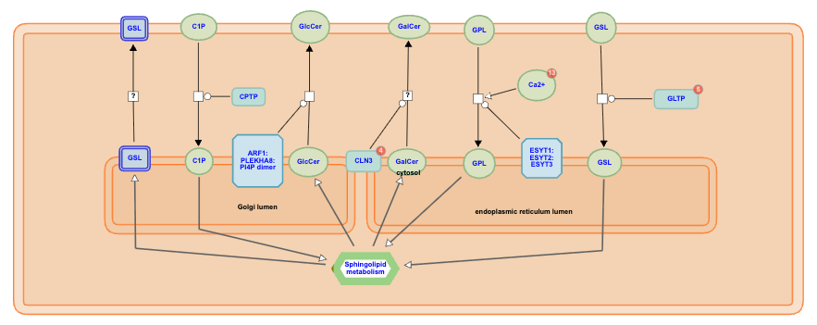
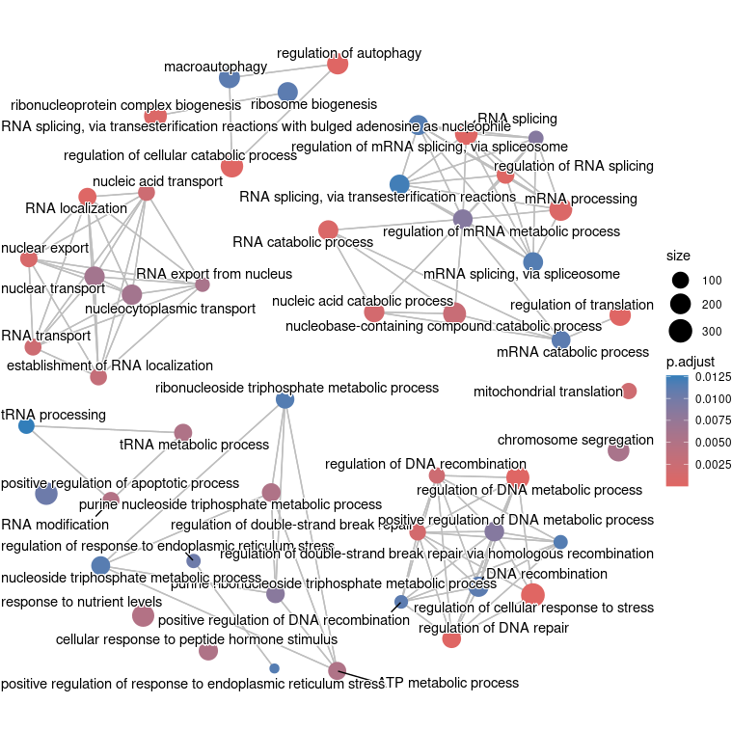
@SRR948304.5141 UNC14-SN744:253:D135LACXX:5:1101:4054:4287
AGGACTTTGGCTGTCCCCAACCGTACAGGTGGGTCTCTCCCTCATGGA
+
CCCFFFFFHHHHHGHIIJIJJJIEHGIJJCGGJAFHEIJDHGIFGGE<
@SRR948304.5160 UNC14-SN744:253:D135LACXX:5:1101:4625:4251
CCACGAAGTCAAGATCGCCGACAAGGCCTTCCTGATGAAGCAGAAGTT
+
BCCFFFFFHGHHHJJJJJJJIJGJJJJJJJJJJFIJJGIJJIJJJIGI
@SRR948304.5196 UNC14-SN744:253:D135LACXX:5:1101:5864:4425
GGAACGCCTACTGGTACTATCTGAACATGGACTACTCCTTCTTCCTGG
+
CCCFFFFFFHHHHJGHIIJJJJJJJJIJJJIJIIJJJJJJJJJJJJJI
@SRR948304.5200 UNC14-SN744:253:D135LACXX:5:1101:6109:4282
CAGGAAGAAGGAGTAGTCCATGTTCAGATAGTACCAGTAGGCGTTCCA
+
@@CFFBDDHHHBHIHIFGHHIGFFHHIJJJJFIIJIJGDFHIIFGGIF
@SRR948304.5215 UNC14-SN744:253:D135LACXX:5:1101:6464:4443
CCTTCTTCAACGACTACTACACCAAGTACTTCAAGTTCTGAGCGTCGT
+
@@@FFFFFHGDHFIEHGIJIFEHIHH?EFGGIGGG:BFGG4DFE)?D6
@SRR948304.5247 UNC14-SN744:253:D135LACXX:5:1101:8102:4331
CTACAGCTTCCGCAAGAACTACTACGAGATGGAGACCTACGCCAACTA
+
BB@FFFFFHHHHFIJIJJJIJIJIJJIGGGIIGGGIIJIJGIIGIII#
@SRR948304.5250 UNC14-SN744:253:D135LACXX:5:1101:8320:4324
CCTGGTTGAACTCGTAGATATTCTCGCGCAGAATGAACTTGTCCTCGG
+
CCCFFFFFHHHHHJHGHIJIJJJJJJJJJJJIIIJJIJJJJJJIJJJE

Slide 8
Quick Week-by-Week Summary!

Slide 9
Week 1
Introduction to Shell and the File System
Wildcards and Shortcuts
Working with Files
Searching in Files
Data Organization

Slide 10
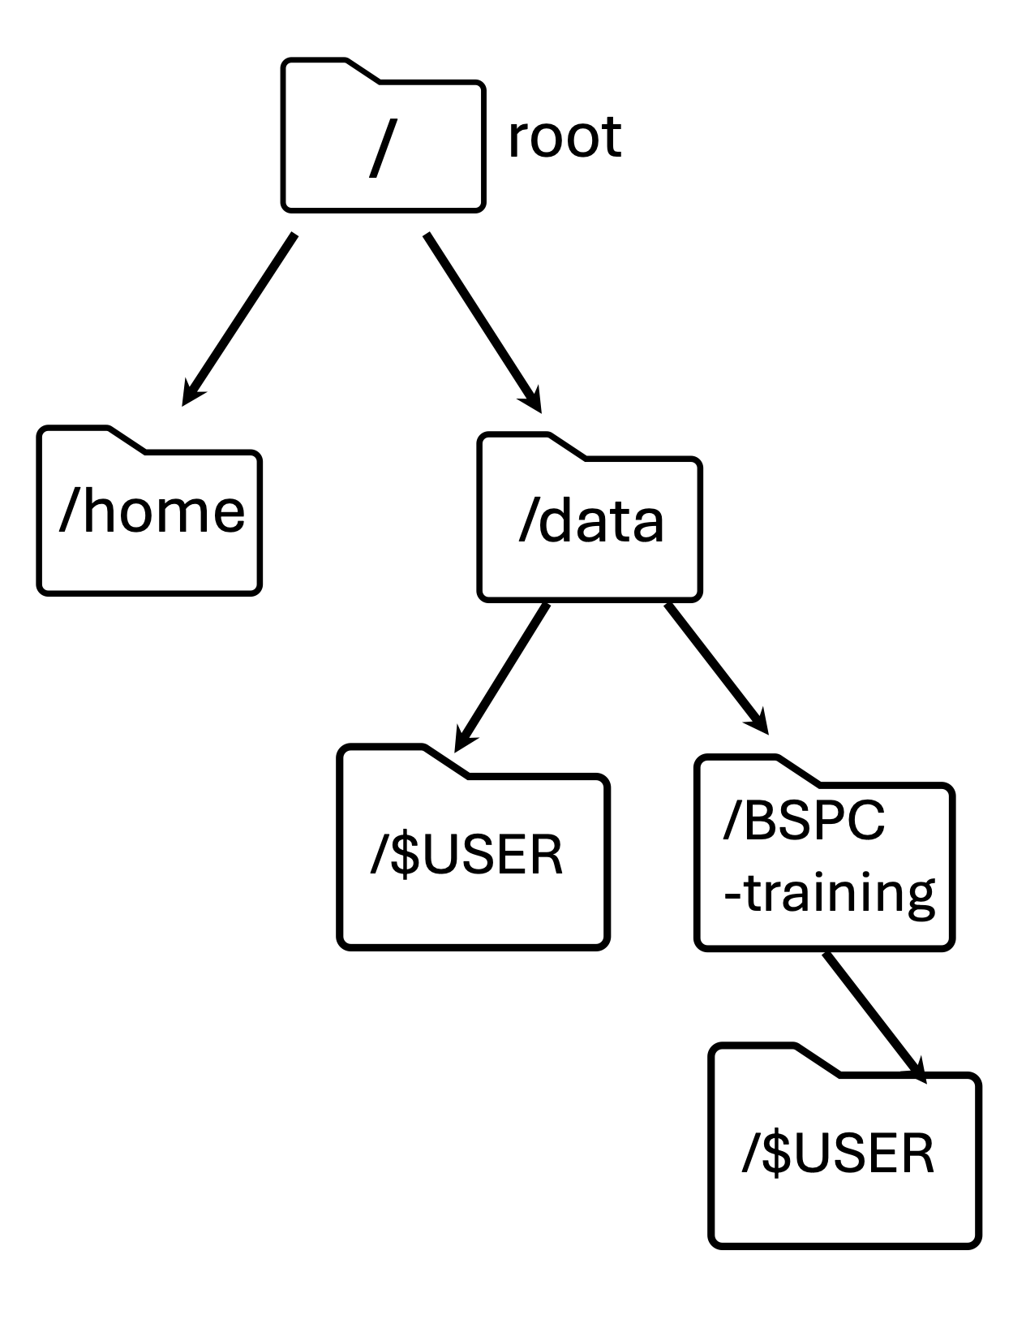
What commands could you use to navigate from THIS directory to THAT directory?
If you are editing a document in Vim – how do you save your current file AND exit at the same time?
grep -B 1 -A 2 NNNNNNNNNN Mov10_oe_2.subset.fq > bad_reads.txt
What are –B and –A? Will this overwrite anything already in bad_reads.txt?

Slide 11
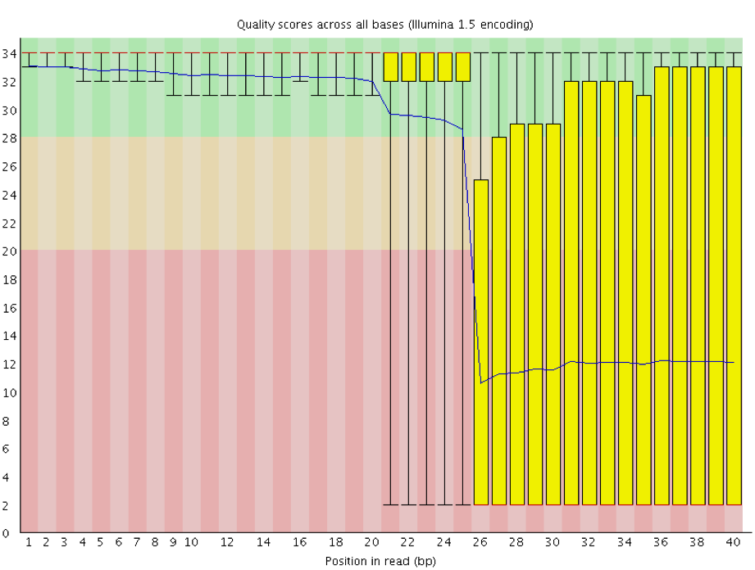
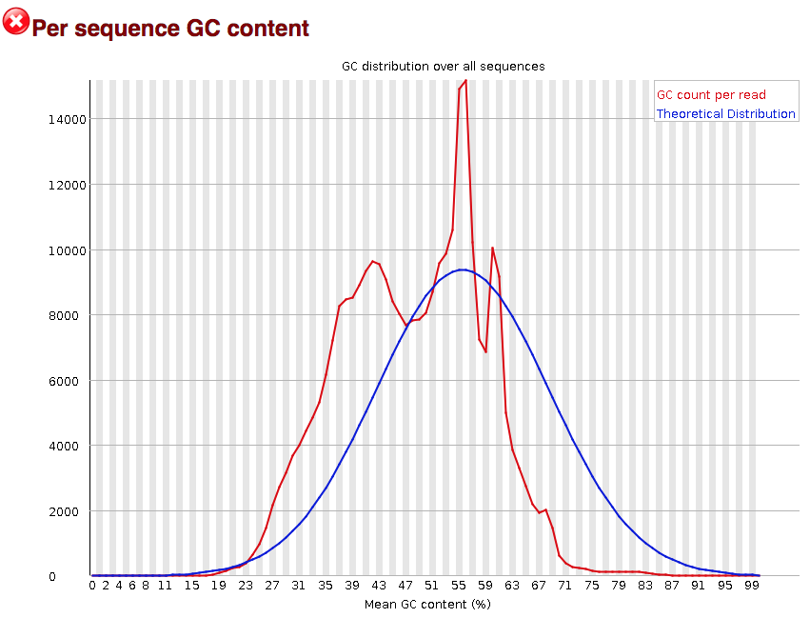
Week 2
Running FASTQC Interactively
Running FASTQC Using Job Submission
FASTQC Assessment

Slide 12
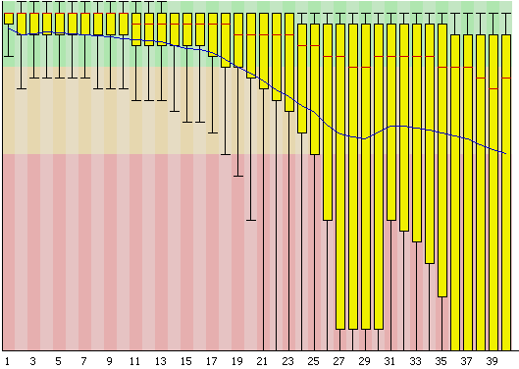
What does this command do and how would I specify 8G of memory for it?
sinteractive --cpus-per-task=4
--mem=8g
How should I label the axes of this plot? Is this a worrying pattern?
Uh oh – Biowulf can’t find the command `fastqc` even though I’m on an interactive node – what do I need to do??

Slide 13
Week 3
Reference Genomes and Genome Indices
Mapping with STAR and Viewing Results
MultiQC for organizing results
SAM/BAM format for mapping results

Slide 14
What ingredients do you need to create a genome index? What is a genome index used for?
What file format is this?
HWI-ST330:304:H045HADXX:2:2212:18192:97569 4 * 0 0 * * 0 CCAGATTTGCGATCTTCATTCCATACAGCATGGAGGAGAAGCCAGGGGCAGGGGTCCCATAGCTGGGCTTGAAGTCGTGGTTGTAAATCGTCCGCAGCCG =@@BDFFFF<FF8BEFE<FHGCFHE?@<++1:8:8CB13BBD;008(('70/';54?9=.7.;@?@==35>B@########################### NH:i:0 HI:i:0 AS:i:57 nM:i:3 uT:A:1
What are some parts of this data format?

Slide 15
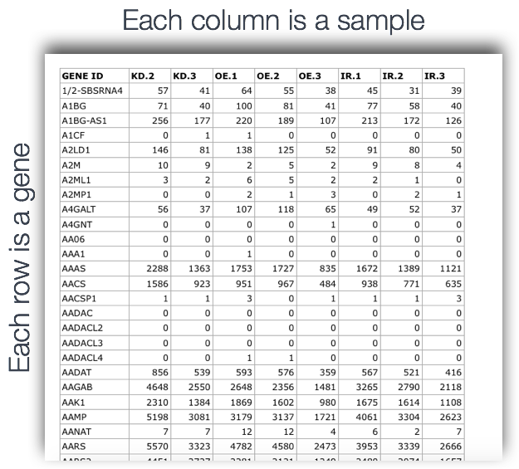
Week 4
Counting RNAseq Reads
Experimental Design

Slide 16
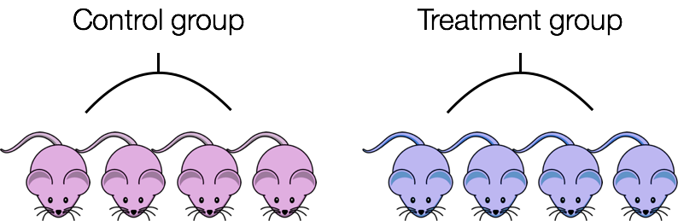
Week 4
What do we input to featureCounts?
Anyone remember what this did for us?
:%s/\/data\/Bspc-training\/shared\/rnaseq_jan2025\/results_for_counting\///g
How could we avoid confounding by sex (color)?

Slide 17
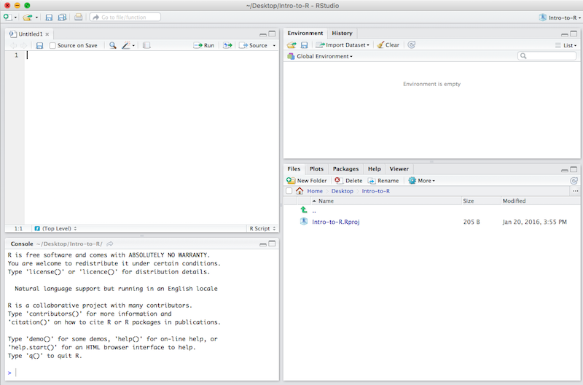
Week 5
Automating the RNAseq workflow
Intro to R and RStudio

Slide 18
Week 5
What does `fq=${1} ` do in our automation script?
Where does the value for SLURM_CPUS_PER_TASK come from?
What are some ways we can check if a TSV was successfully imported into Rstudio?

Slide 19
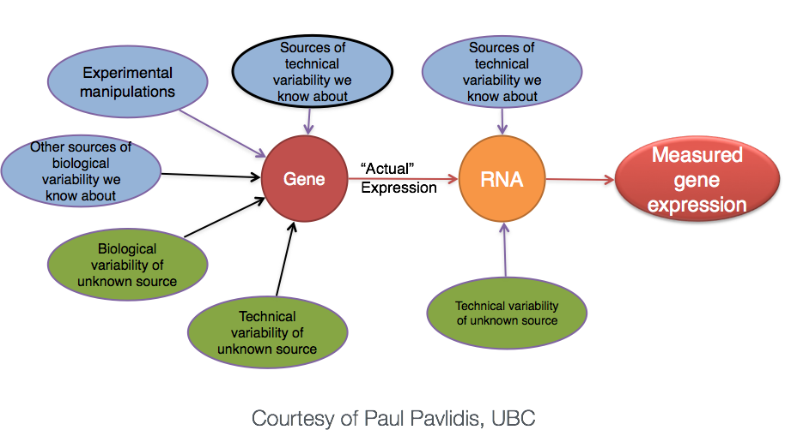
Week 6
Differential Gene Expression Overview and Setup
Count normalization
Quality Control of DE Analyses
DE Design Formulas

Slide 20
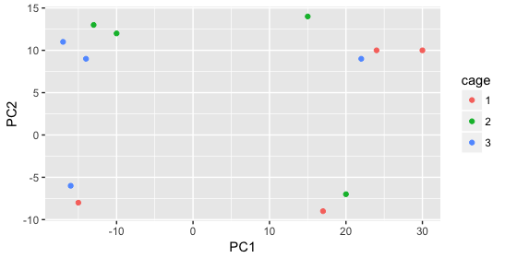
Week 6
Does it look like cage explains a lot of the variation in these two PCs?
dds <- DESeqDataSetFromMatrix(counts, meta, design formula = ~sampletype)
Why do we normalize our count data before DE analysis?

Slide 21
Week 7/8
Hypothesis Testing
Exploring Wald Test Results
Summarizing DE Results
Visualizing DE Results

Slide 22
Week 7/8
What statistical distribution does DESeq2 use to model RNA-Seq count data?
Fill in the blanks:
contrast_oe <- c("sampletype", mov10_oe , control )
What is the difference between `pval` and `padj` in our DESeq2 results?

Slide 23
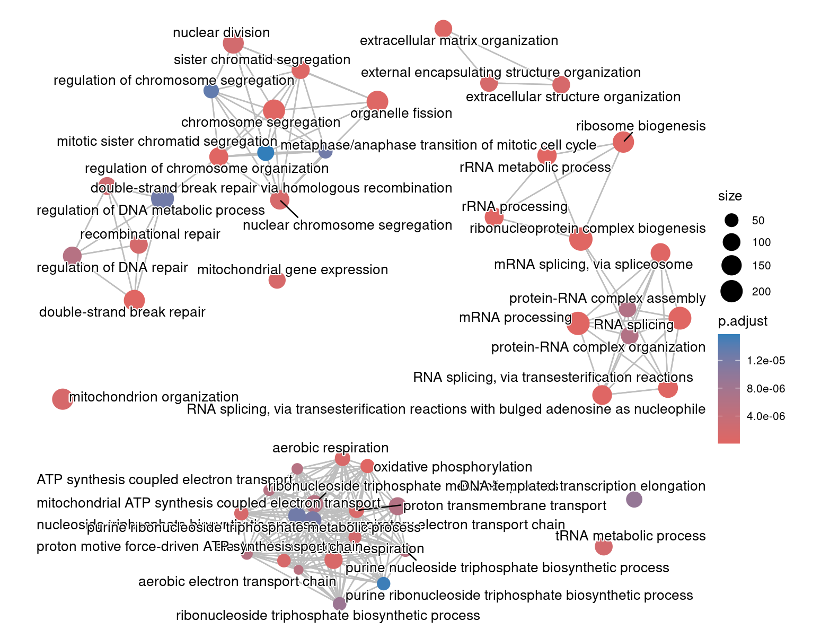
Week 8/9
Likelihood Ratio Testing Results
Annotation databases
Overrepresentation analysis
Functional class scoring

Slide 24
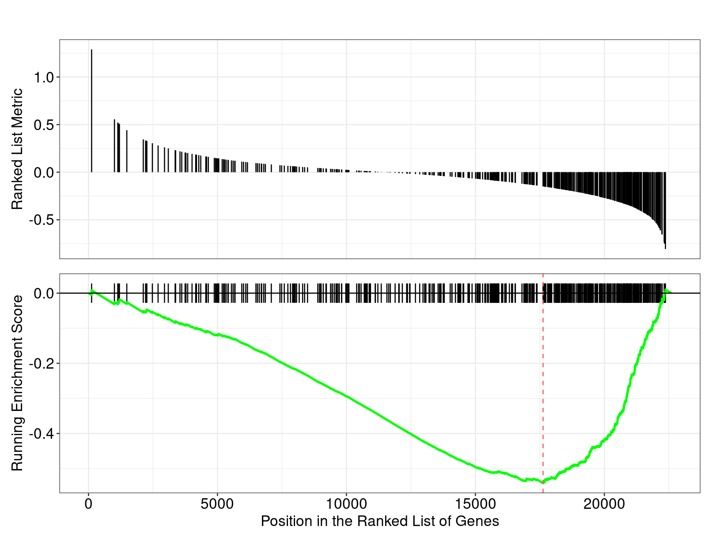
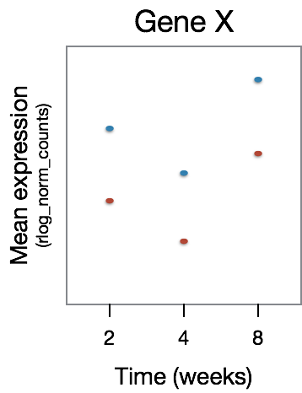
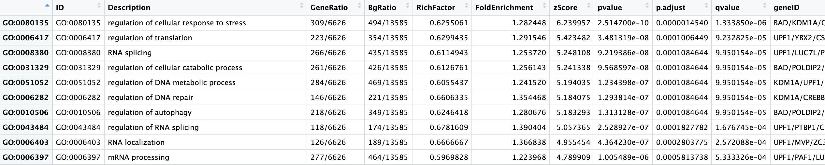

Slide 25
Last items
Please move your /data/Bspc-training/$USER directory to your main /data/$USER training folder.
Instructions to follow so we don’t accidentally overwrite anything!
Paths you are using in scripts will change
Course evaluation survey will go out this afternoon
Office hours: April 23rd 10am-12pm
Keep using course Slack channel – eventually move to general Help channel!

