Slide 1
Week 6
NICHD RNAseq Course, Spring 2025
March 4th, 2025

Slide 2
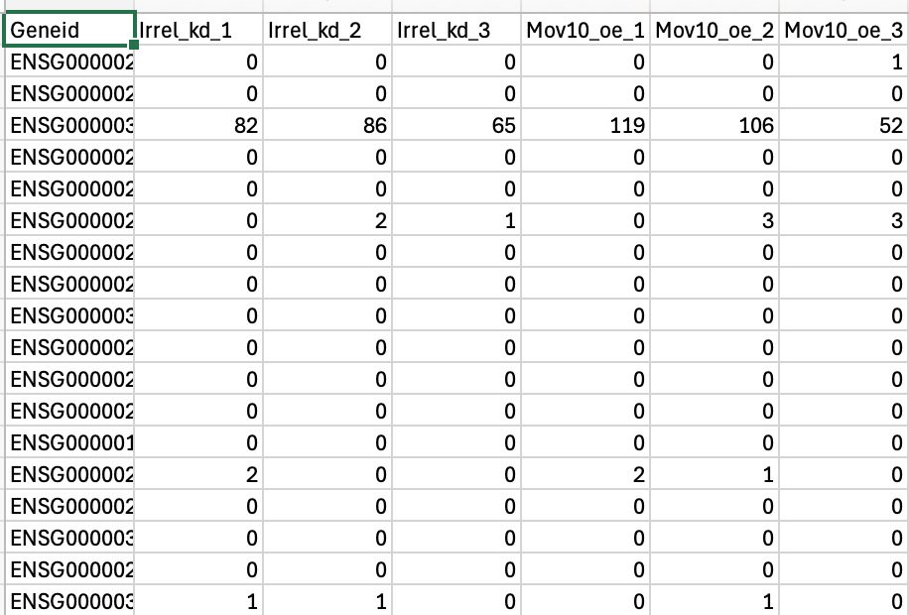
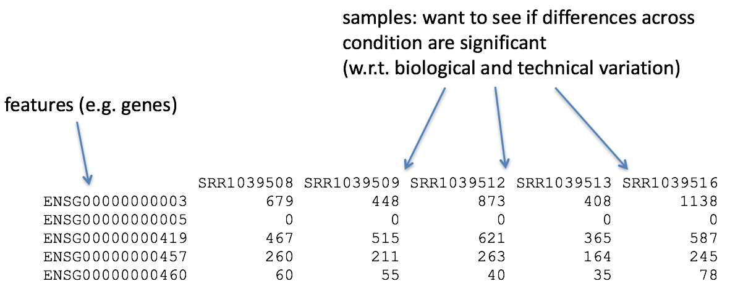
We are here!

Slide 3
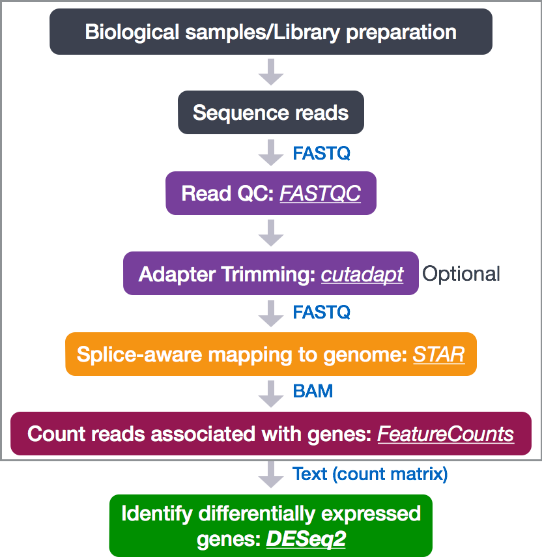

Slide 4
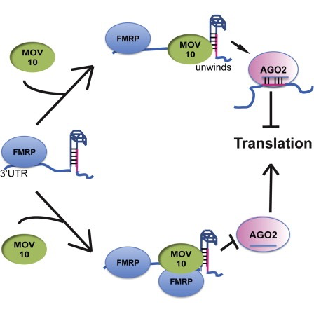
What is our example dataset testing?
The hypothesis the paper is testing is that FMRP and MOV10 associate and regulate the translation of a subset of RNAs.
https://nichd-bspc.github.io/intro-rnaseq-hpc/lessons/wk6_lesson01_dge_setup_overview.html
Notes:
The authors are investigating interactions between various genes involved in Fragile X syndrome, a disease in which there is aberrant production of the FMRP protein.
FMRP is “most commonly found in the brain, is essential for normal cognitive development and female reproductive function. Mutations of this gene can lead to fragile X syndrome, mental retardation, premature ovarian failure, autism, Parkinson’s disease, developmental delays and other cognitive deficits.” - from wikipedia
MOV10, is a putative RNA helicase that is also associated with FMRP in the context of the microRNA pathway.

Slide 5
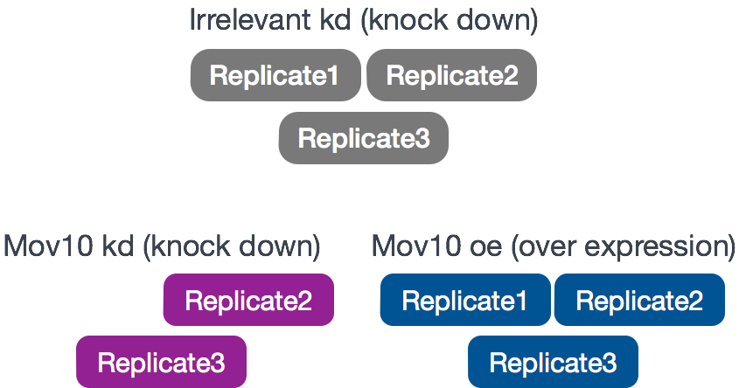
What is our example experimental design?
The RNA-Seq was performed on HEK293F cells that were either transfected with a MOV10 transgene, or siRNA to knock down Mov10 expression, or non-specific (irrelevant) siRNA.
https://nichd-bspc.github.io/intro-rnaseq-hpc/lessons/wk6_lesson01_dge_setup_overview.html

Slide 6
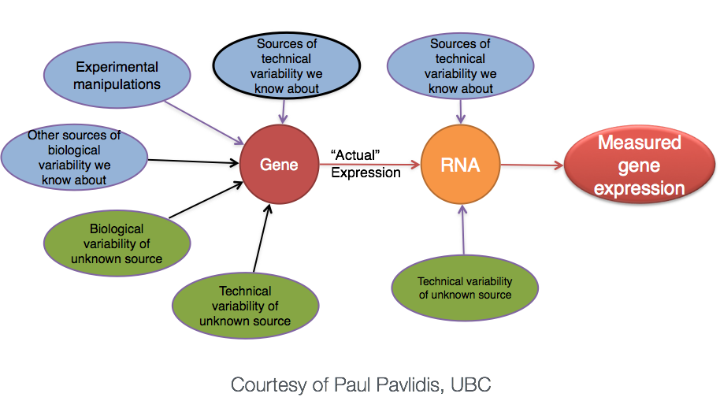
It is never just as simple as our design

Slide 7
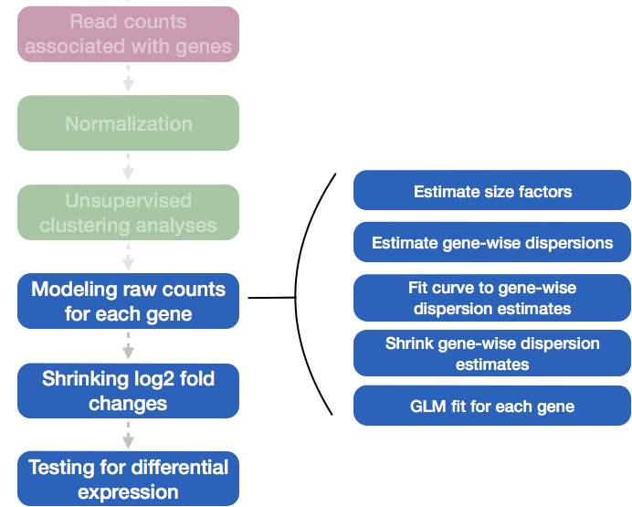
DESeq2 pipeline takes a lot of this into account
https://nichd-bspc.github.io/intro-rnaseq-hpc/lessons/wk6_lesson01_dge_setup_overview.html

Slide 8
Today:
Loading data into RStudio and DEseq2
Loading required packages for data viz and analysis
Understanding the underlying distribution of read counts
Normalization
If time: Sample-level QC with Principal components analysis

Slide 9
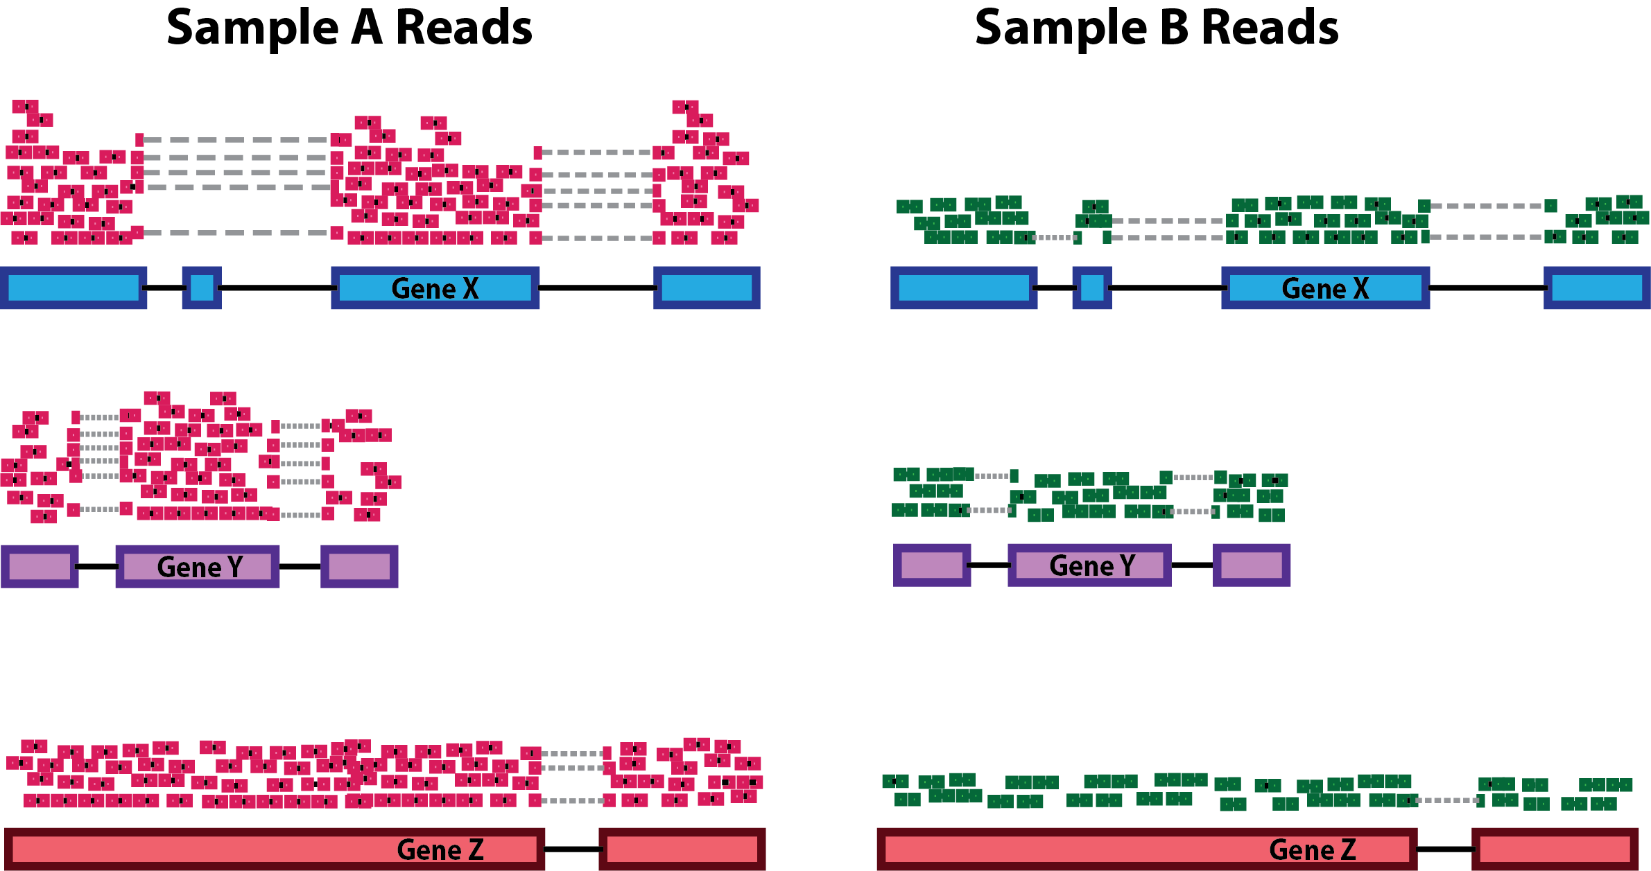
Normalization https://hbctraining.github.io/DGE_workshop_salmon/lessons/02_DGE_count_normalization.html
All genes in sample A appear to be 2x the expression of sample B
This only due to sample A being sequenced 2x deeper.
So we will need to normalize to depth

Slide 10
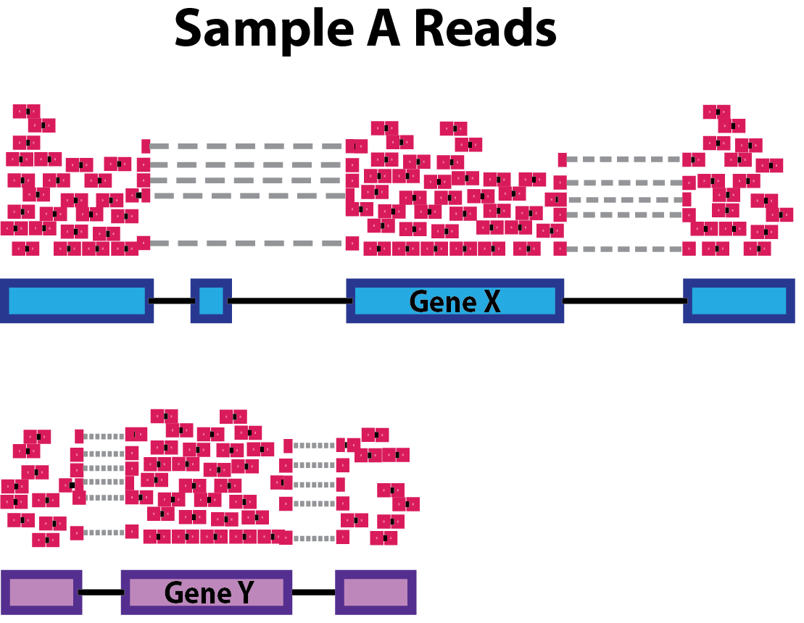
Normalization https://hbctraining.github.io/DGE_workshop_salmon/lessons/02_DGE_count_normalization.html
Within one sample, a single transcript of a long gene gives more reads than one transcript of a short gene. That’s because long transcripts get fragmented into many pieces, and we are counting pieces.
When comparing within a sample, we need to normalize by gene length.
When comparing across samples, we assume gene lengths do not change due to condition. So we do not need length normalization.

Slide 11
Normalization https://hbctraining.github.io/DGE_workshop_salmon/lessons/02_DGE_count_normalization.html
This bears repeating:
In typical DE analysis, counts are not normalized to gene length because we assume length does not change across our samples.

Slide 12
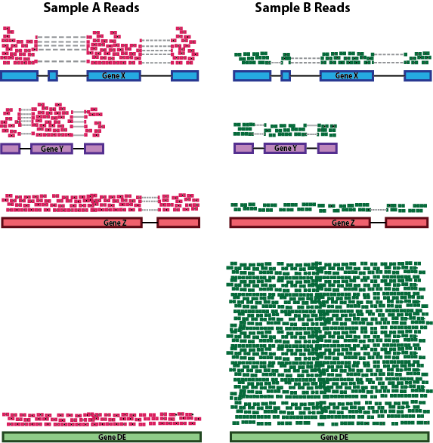
Normalization https://hbctraining.github.io/DGE_workshop_salmon/lessons/02_DGE_count_normalization.html
A sequencer’s flow cell has a finite number of reads.
One highly-expressed gene “soaks up” the reads in sample B, causing other genes to look lower than they are.
This difference in composition needs to be taken into account.

Slide 13
Side note: why is everything on a log scale?
RNA expression levels span 6 orders of magnitude (one transcript per cell to millions of transcripts in a cell) and distribution can be very skewed.
When expression increases, so does variance. This is a problem for statistical methods (heteroskedasticity)
Fold changes (the preferred method of quantifying differential expression) are not symmetric around 0, which is also a problem for statistical operations
Log-transformed data solves all of this

Slide 14
Replicates vs depth
For $2500, you get ~400M reads. How do you best allocate those reads?
Sequencing deeper:
catch low-expression genes
improve signal overall
More replicates:
improve statistical power
You can’t do both. Which strategy gives the most overall power (ability to detect truly differentially expressed genes)?

Slide 15
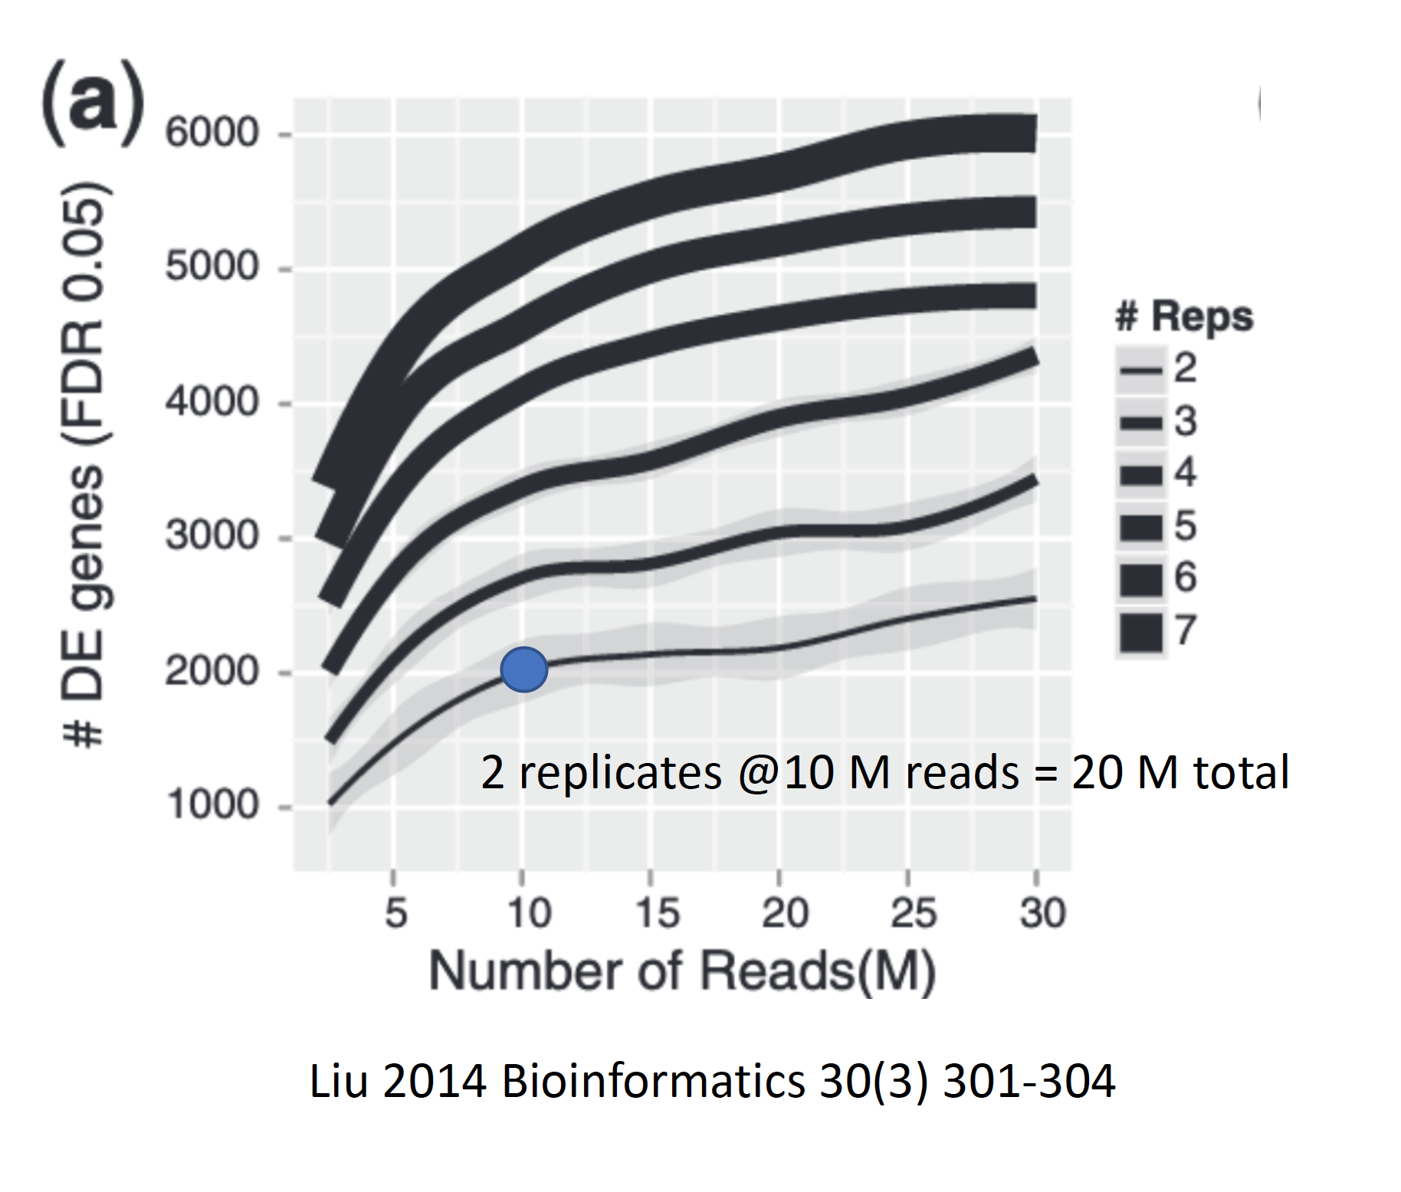
Always use more samples, not more depth

Slide 16
Always use more samples, not more depth
Add 10M reads by adding 5M for each of the 2 replicates

Slide 17
Always use more samples, not more depth
Add 10M reads by adding another 10M read sample

Slide 18
Always use more samples, not more depth
Another sample increases power by 700 DE genes.
More depth only increases by 50 DE genes.

Slide 19
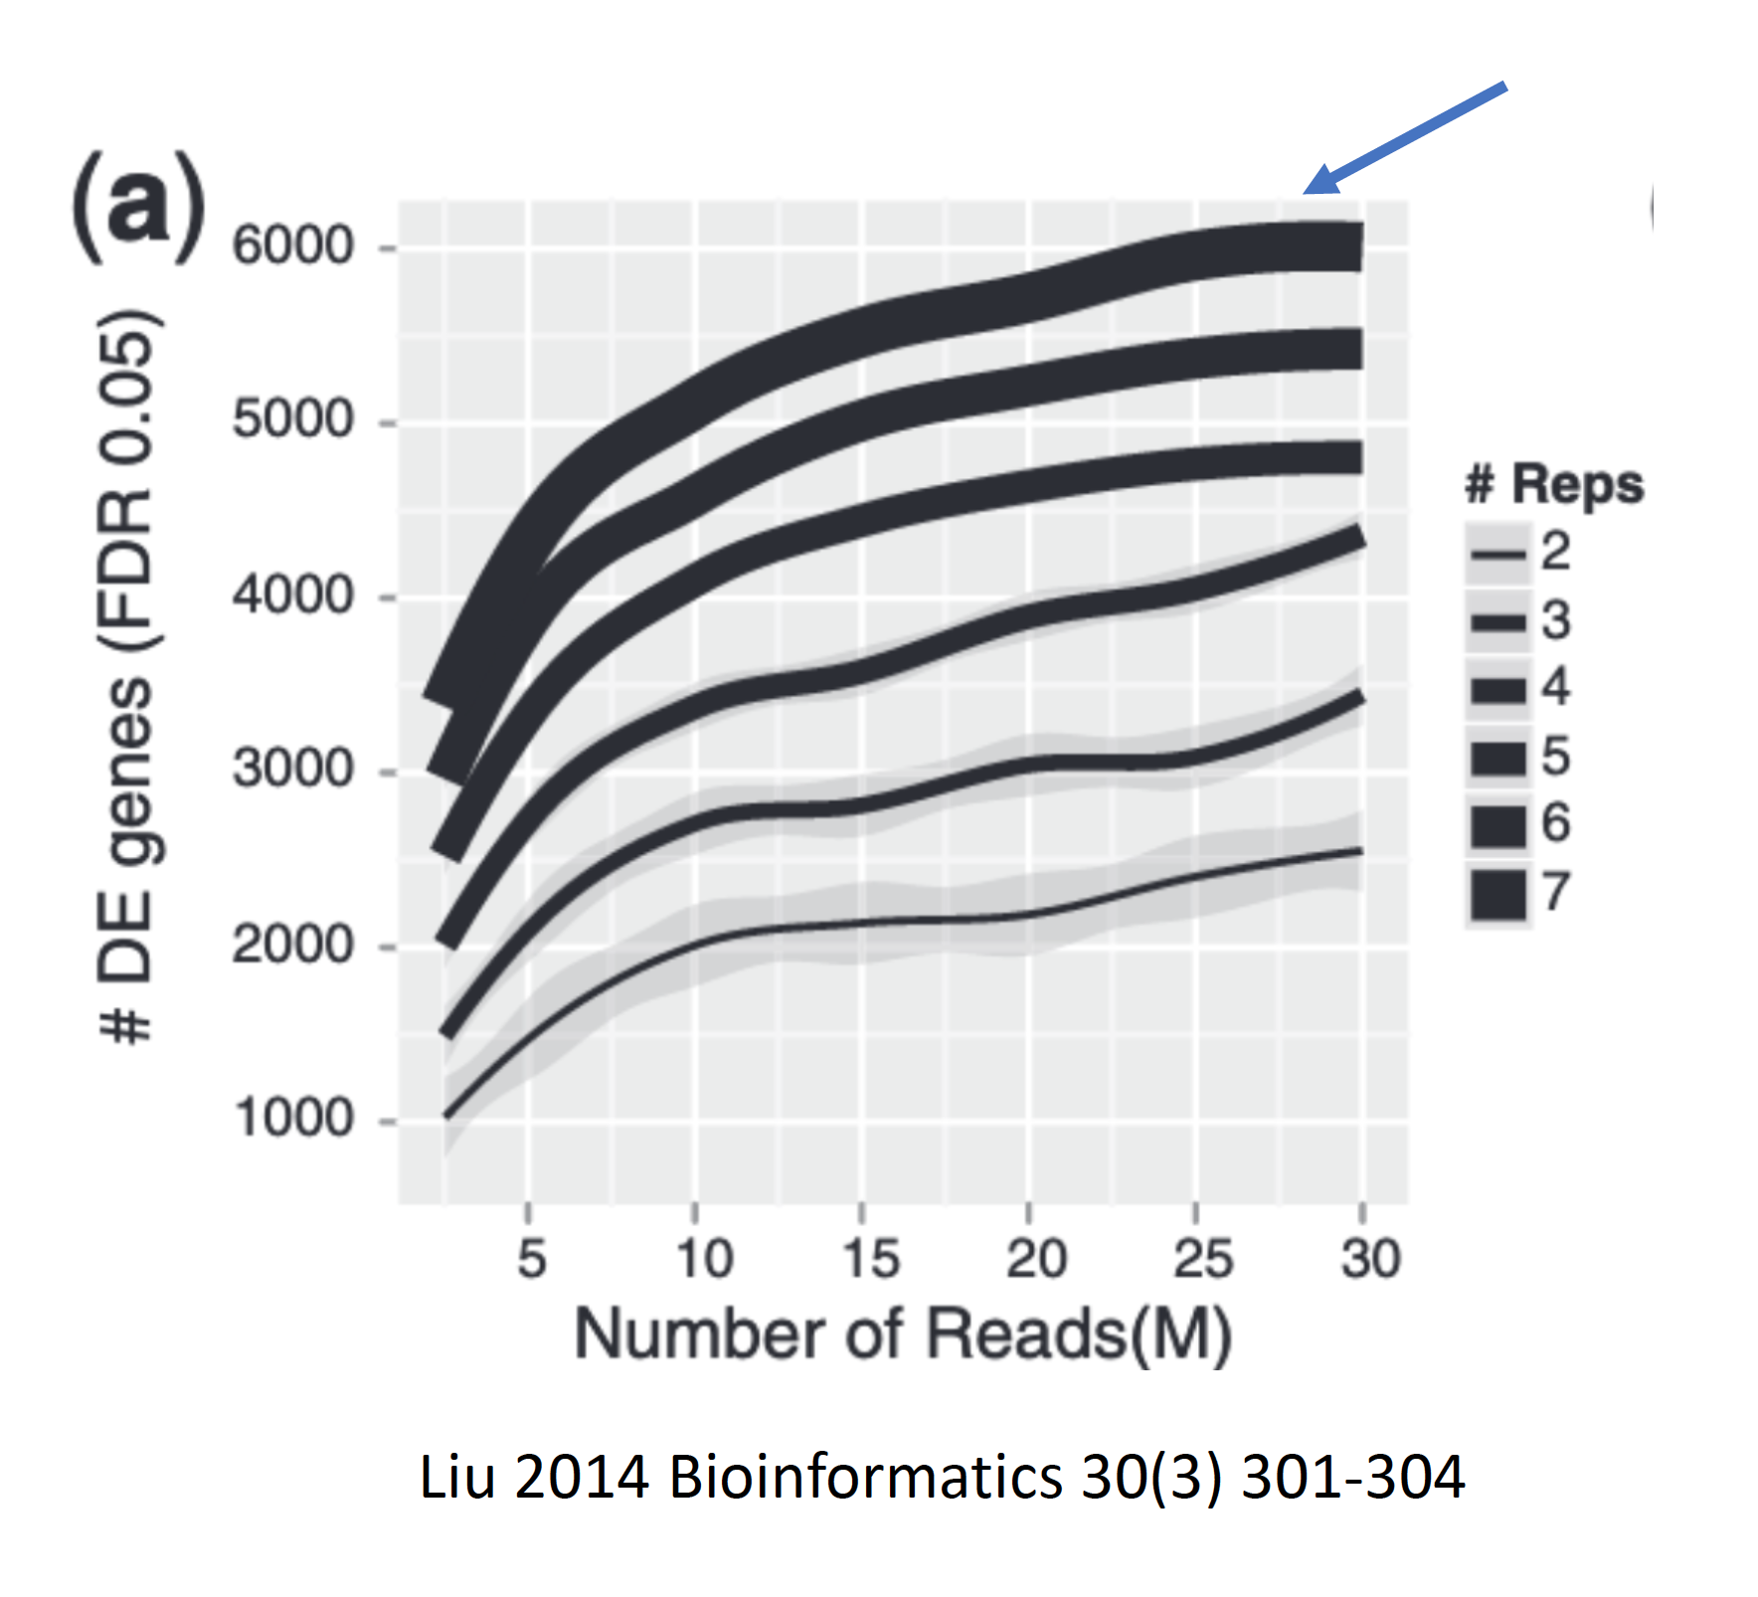
Always use more samples, not more depth
DE detection does not saturate!

Slide 20
Sample similarity (PCA plots)
Principal Components Analysis (PCA) is a dimension reduction technique used in machine learning and any time you need to summarize multi-dimensional data
No time for math today, will focus on visual aspect
PCA worked example: https://hbctraining.github.io/DGE_workshop_salmon/lessons/03_DGE_QC_analysis.html
StatQuest video: https://www.youtube.com/watch?v=_UVHneBUBW0

Slide 21
Two-condition PCA plot
Good separation of conditions
Which PC corresponds to the difference between our sample groups?
PC1:
PC2:

Slide 22
Two-condition PCA plot
Good separation of conditions
(here different, Borrelia temperatures)
PC1: temperature effect
PC2: ?

Slide 23
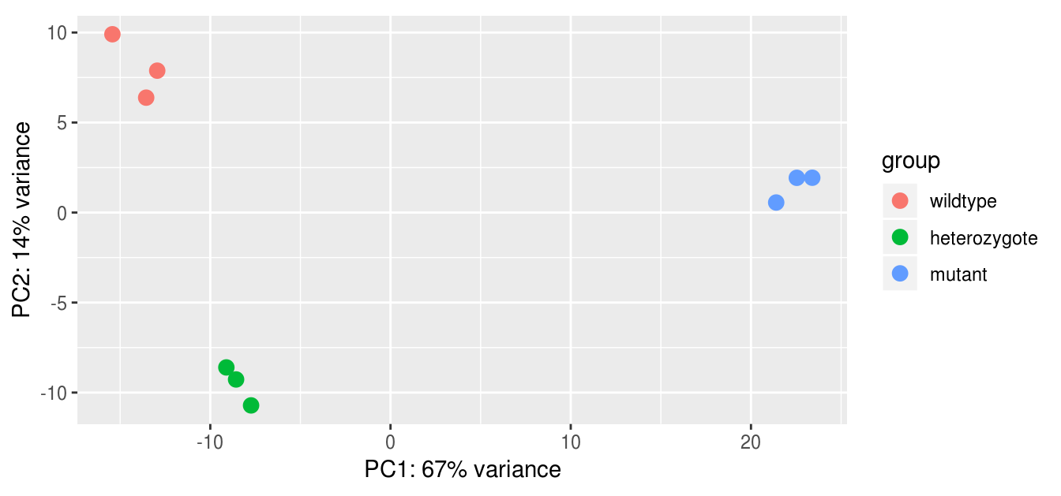
Three-condition PCA plot
We might hypothesize that the het is more similar to WT than it is to the mutant (PC1)
But it’s flipped when we look at PC2, likely due to different genes than those separating the mutant from WT
See StatQuest video for context and help thinking about this: https://www.youtube.com/watch?v=_UVHneBUBW0

Slide 24
Sometimes it gets crazy
Same plots, colored by different metadata (genotype or treatment)
Complicated experiment, hard to interpret PC1 and PC2

Slide 25
Replicates vs depth
For $2500, you get ~400M reads. How do you best allocate those reads?
Sequencing deeper:
catch low-expression genes
improve signal overall
More replicates:
improve statistical power
You can’t do both. Which strategy gives the most overall power (ability to detect truly differentially expressed genes)?

Slide 26
Always use more samples, not more depth

Slide 27
Always use more samples, not more depth
Add 10M reads by adding 5M for each of the 2 replicates

Slide 28
Always use more samples, not more depth
Add 10M reads by adding another 10M read sample

Slide 29
Always use more samples, not more depth
Another sample increases power by 700 DE genes.
More depth only increases by 50 DE genes.

Slide 30
Always use more samples, not more depth
DE detection does not saturate!

Slide 31
We are skipping how DESeq2 works

