Slide 1
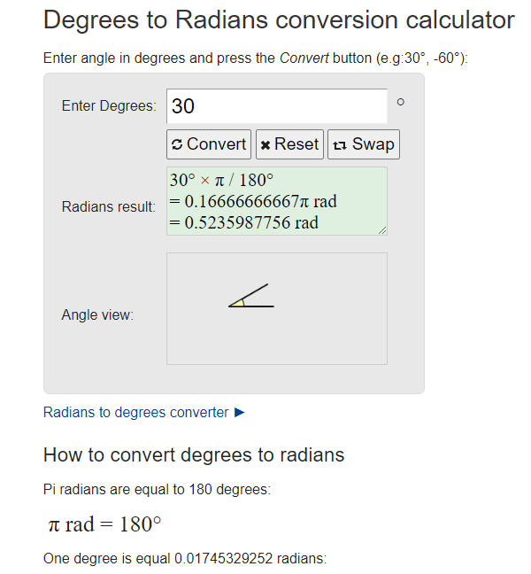
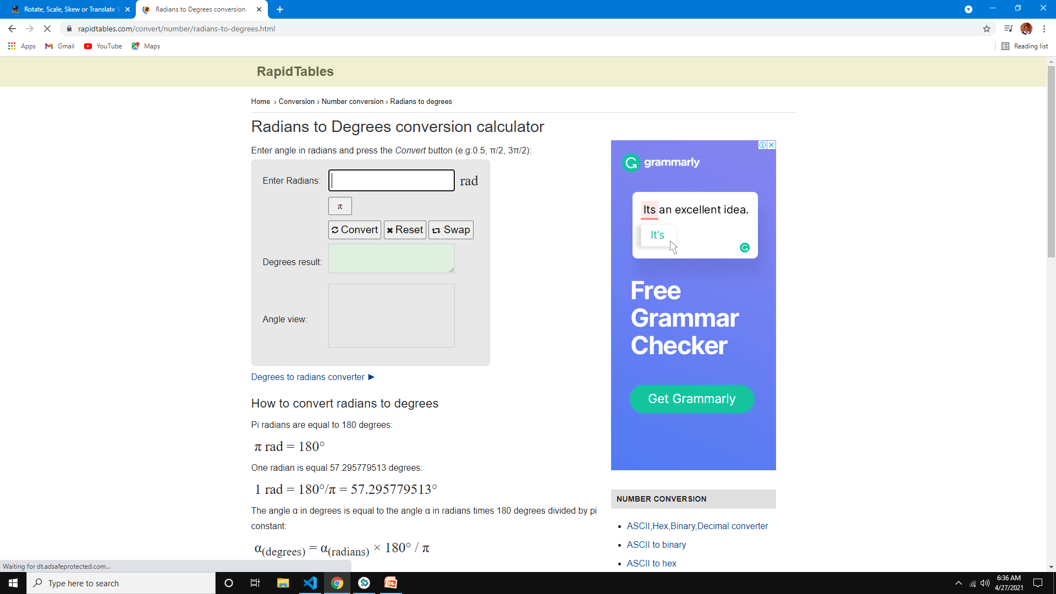

Slide 2
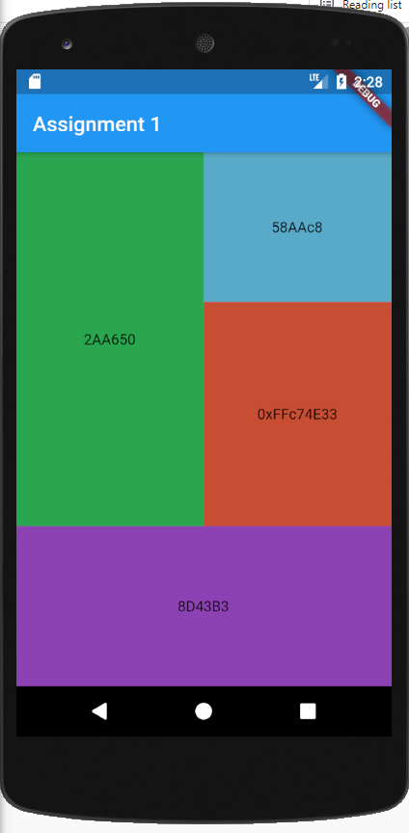
1 | 3
 | 4
2
Column
children flex 7
Row
children flex 5
flex 5
Column
children flex 2
flex 3
flex 3

Slide 3
Column
children flex 7
Row
children flex 5
flex 5
Column
children flex 2
flex 3
flex 3

Slide 4
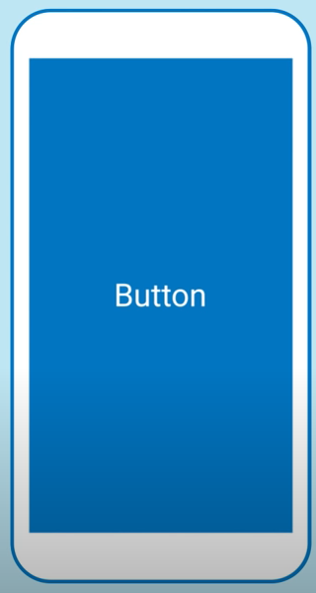
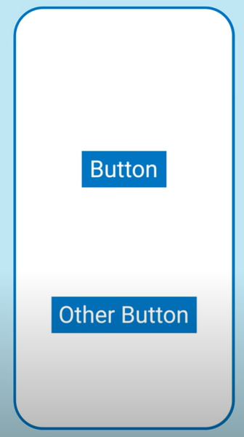

Slide 5
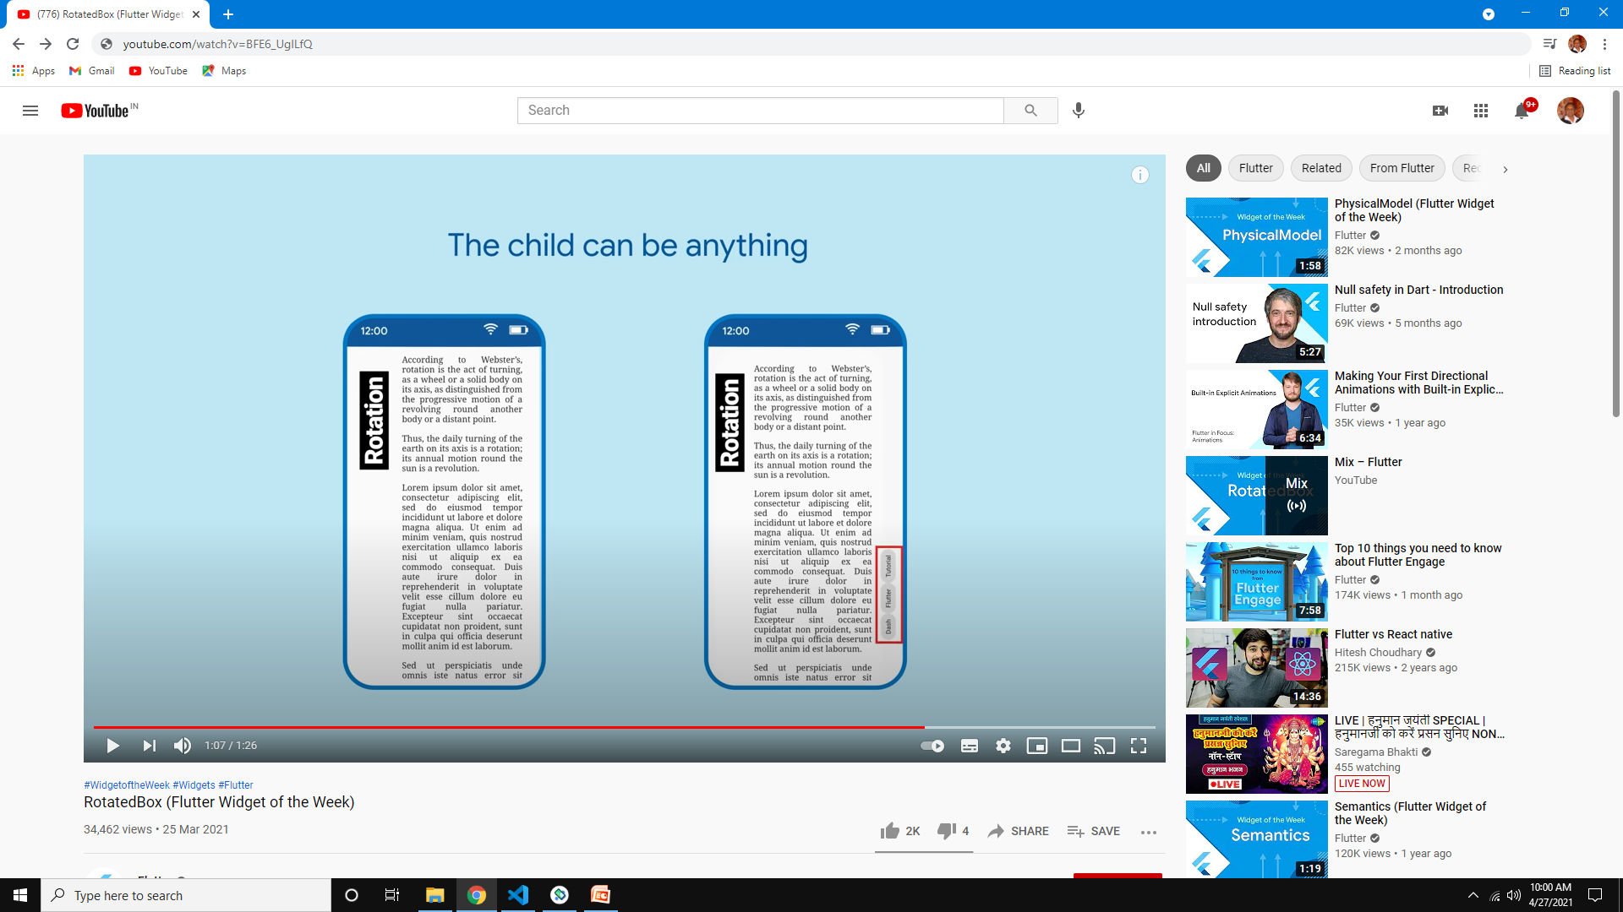

Slide 7
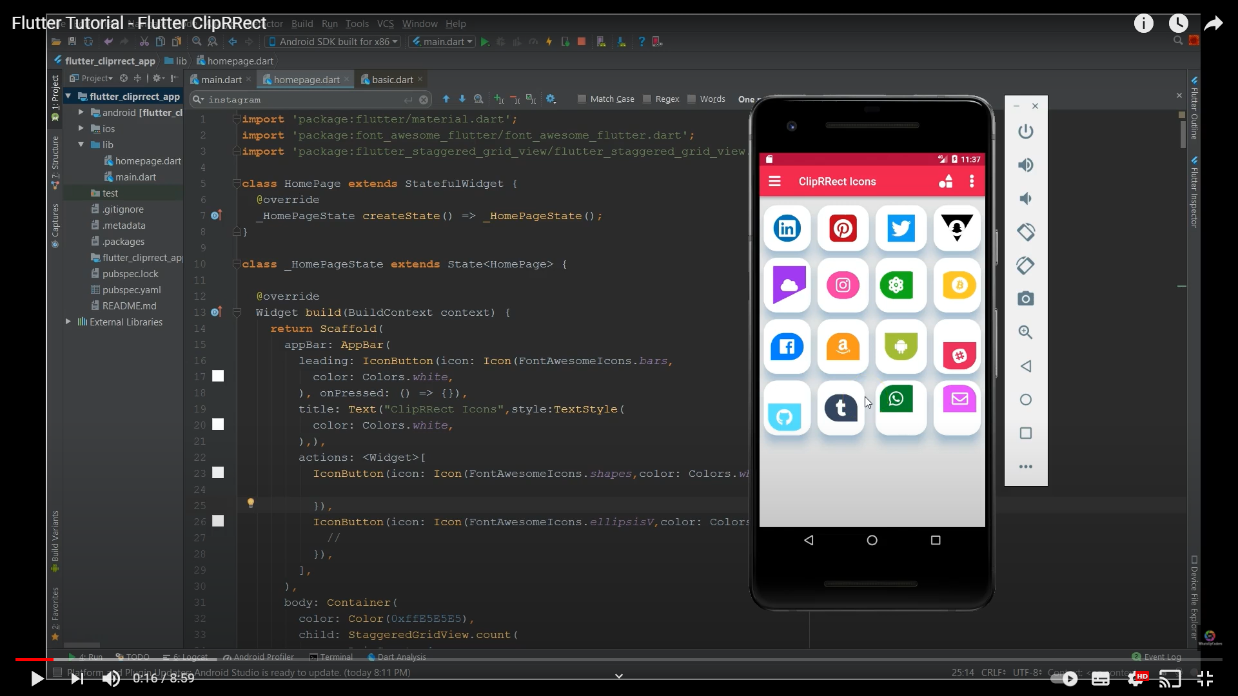
WhatsupCodes

Slide 12
Grouping of Similar Widgets
No child | Single Child | Multiple child
color | Container | Column, Row
image | Padding | Stack
 | SizedBox | ListView
 | Align | GridView
 | ClipRRect, ClipRect,ClipOval, ClipPath
 | Material
 | Center

Slide 13
Shortcuts
stl
stf
customClipper
m for MaterialApp
importM

Slide 14
Size, positioning, Shape
Width
Height
Heightfactor
widthFactor
Alignment
Center
Align
Stack
Padding
Margin
Shape
Scale
expanded

