Slide 1


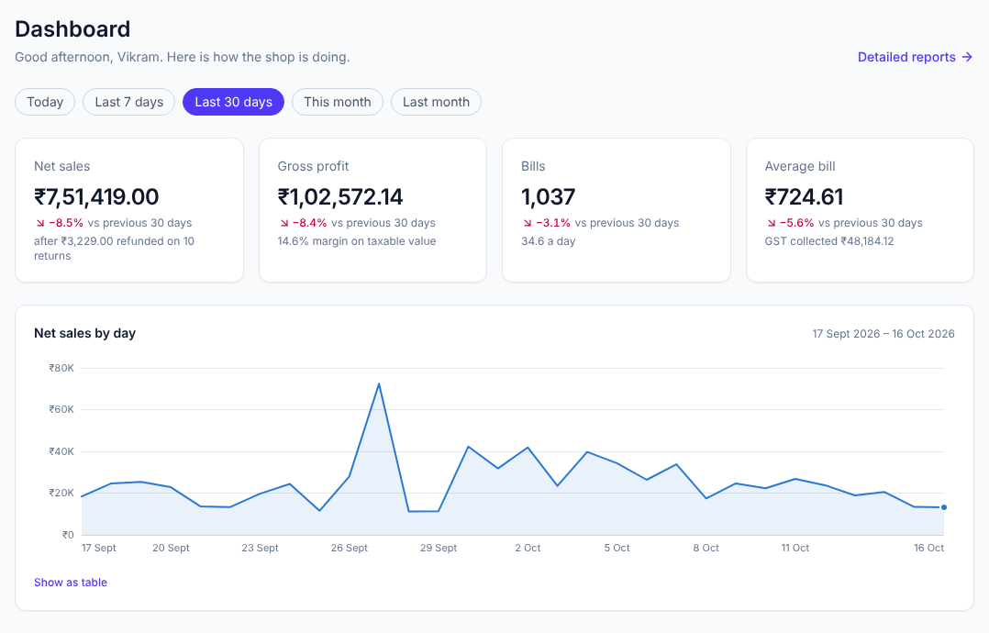
VISVESVARAYA TECHNOLOGICAL UNIVERSITY, BELAGAVI
Dr. T. THIMMAIAH INSTITUTE OF TECHNOLOGY, KGF
Department of Computer Science & Engineering (AI & ML)
COMMUNITY PROJECT · FIRST REVIEW
Digital Inventory & Sales Management System
Stock · Billing · GST · AI-assisted restocking
PRESENTED BY
Keerthana P
1GV25CI021
L Mohammed Fahad
1GV25CI023
UNDER THE GUIDANCE OF
Prof. APOORVA D
Assistant Professor, Dept. of CSE (AI & ML)
Mehfuza Khanum
1GV25CI026
Mohammed Saad
1GV25CI028
Notes:
Introduce the team, the guide and the project title: a web application that runs a retail store’s stock, purchases, billing and GST, with AI to help decide what to reorder.

Slide 2





Contents
FIRST REVIEW
01
02
03
04
05
Abstract
Introduction
Objectives
Literature Review
Methodology
The project at a glance
The problem and our answer
What the system must do
What others have built
How we are building it
Notes:
Five parts for this first review: abstract, introduction, objectives, literature review and methodology.

Slide 3






Abstract
01 · ABSTRACT
A web application that runs a retail store’s catalogue, stock, purchases, billing and reports in one place, following Indian GST rules, with AI that helps the owner decide what to reorder and when.
Catalogue & stock
Products, HSN codes and suppliers; every stock change kept in a ledger.
Fast billing
Barcode billing, discounts, cash, UPI or card, and a GST invoice PDF.
GST ready
CGST + SGST or IGST by place of supply; credit notes for returns.
Purchases
Purchase orders, part deliveries and average cost price.
3
user roles: admin, manager, cashier
Reports
Sales, profit, GST summary and stock value, as CSV or PDF.
AI assistance
Demand forecasts, restock plans the owner confirms, a Gemini assistant.
1 year
of realistic demo sales to test with
Notes:
One web app for the whole store. Six parts: catalogue and stock, billing, GST, purchases, reports and AI.

Slide 4




Introduction
02 · INTRODUCTION
In a small store today
With our system
Stock kept in paper registers and spreadsheets
Books drift from the shelf; reorders by guesswork
GST invoices and tax summaries made by hand
No quick view of sales or profit
One app for stock, purchases and billing
Every movement recorded; stock never goes negative
GST invoices, credit notes and GST summary built in
Dashboard, reports and AI restock tips
Built on the MERN stack in TypeScript: MongoDB, Express, React and Node.js
Notes:
Left: how many shops work today. Right: what the system changes. The stack is MongoDB, Express, React and Node.js.

Slide 5




Objectives
03 · OBJECTIVES
01
02
03
04
Digitise products and suppliers with HSN codes and GST rates
Keep stock exact with a ledger and all-or-nothing transactions
Bill quickly at the counter and print a GST invoice
Handle purchase orders, deliveries and customer returns
05
06
07
08
Show sales, profit and GST in a dashboard and reports
Forecast demand and prepare restock plans the owner confirms
Answer the owner’s questions in plain English with AI
Secure access for admin, manager and cashier roles
Notes:
Eight objectives: the first five run the shop day to day, the last three add AI and security.

Slide 6
Literature Review
04 · LITERATURE REVIEW
10 papers reviewed · 6 shown
Study | What it offers | What is missing
[1] Agboola et al., 2022 | Web inventory system for SMEs on MySQL, replacing spreadsheets | No GST billing, purchase orders or forecasting
[2] Lim et al., 2025 (EzStock) | Real-time stock for small businesses; 93.3% user satisfaction | No forecasting or AI restocking
[3] Phuthaikampanatpinya & Dechsupa, 2023 | Web point of sale for retail SMEs (PHP, MySQL) | No GST invoices or supplier orders
[4] Patil et al., 2022 | Account, GST and inventory ERP on cloud storage | No demand forecasting or assistant
[5] Nasseri et al., 2023 | Tree ensembles beat LSTM for retail demand prediction | Forecasting only; not linked to ordering
[6] Jiang et al., 2025 (SiriusBI) | LLM-powered business intelligence, 93% SQL accuracy | For analysts; not tied to stock or billing
Notes:
Existing systems cover stock or billing, but not GST billing, purchasing, forecasting and an assistant together. That gap is what this project fills.

Slide 7




Methodology
05 · METHODOLOGY
STEP 1
STEP 2
STEP 3
STEP 4
STEP 5
STEP 6
Study the problem
Gather requirements
Design
Build in steps
Test
Evaluate
Observe how small stores keep stock and bill today
Roles, GST rules, billing, stock, purchases, reports
Architecture, database, REST API and screens
Catalogue, stock, purchases, billing, returns, reports, AI
Automated tests and checks on every change
Demo year of sales, forecast accuracy, feedback
TOOLS
React
Node.js + Express
MongoDB
TypeScript
Google Gemini
GitHub Actions
Notes:
Six steps, from studying how shops work today to evaluating with a year of demo sales. The system is built module by module, each one tested before the next.

Slide 8
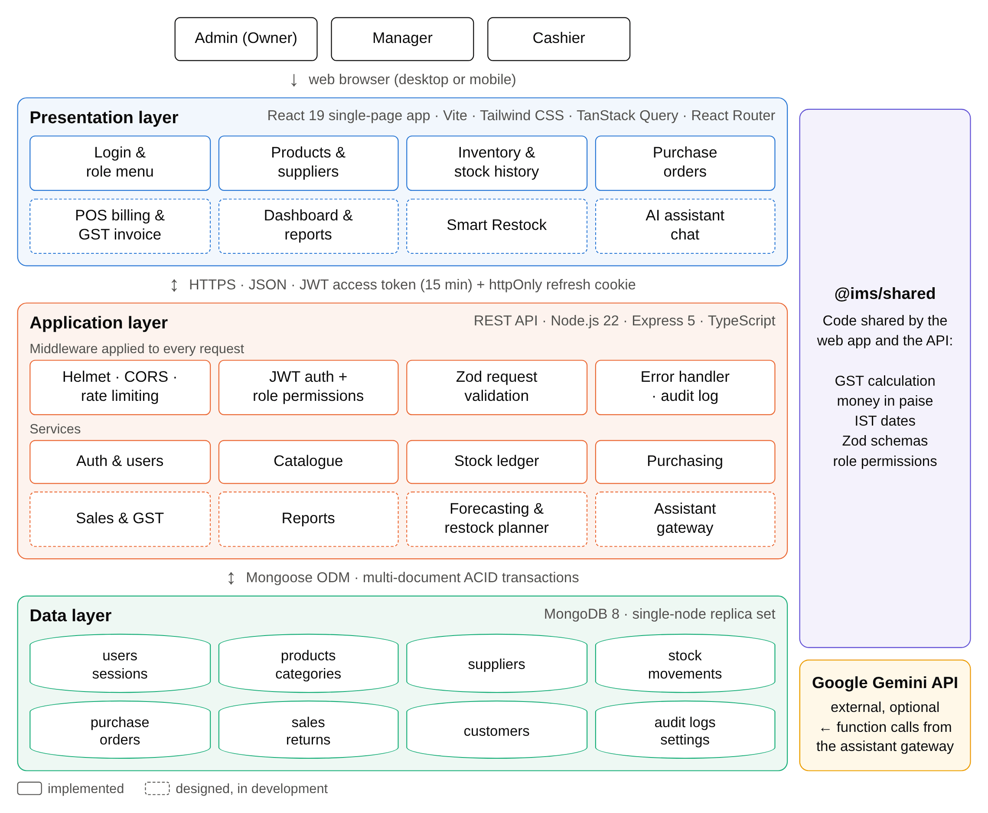




System Architecture
05 · METHODOLOGY
Presentation layer
React web app in the browser: one screen per module, for desktop or phone
Application layer
Express REST API: sign-in, role checks and validation on every request
Data layer
MongoDB replica set, so each sale or delivery saves all-or-nothing
Shared package
GST maths, money in paise and validation used by both sides
Notes:
Three tiers in one repository with a shared package. Google Gemini is optional and only used by the assistant.

Slide 9


AI Restocking Method
05 · METHODOLOGY
STAGE A
Forecast demand
STAGE B
Decide what to reorder
STAGE C
The owner decides
Daily sales of each product
Learns each product’s trend and weekly pattern
Plans for festivals like Diwali and Eid
Checks its accuracy against real sales
Expected sales until the supplier delivers
Keeps a safety buffer for busy days
Flags items that will run short
Suggests a quantity, with a reason
Items grouped by supplier into a draft plan
Owner edits quantities or removes items
Confirm creates one purchase order per supplier
Unconfirmed plans expire after 24 hours
Predicts what each item will sell
Order before it runs out, not after
AI can prepare a plan, never confirm it
Notes:
Forecast, decide, confirm. The forecasting runs inside the system with no external service; the owner always has the final say.

Slide 10

Thank You
Questions and suggestions are welcome
Keerthana P · L Mohammed Fahad · Mehfuza Khanum · Mohammed Saad
Guide: Prof. APOORVA D · Dept. of CSE (AI & ML), Dr. TTIT, KGF
Notes:
Thank the panel and invite questions.

