Slide 1

Omicron Twitter Sentiment Analysis.
TEAM ID : 4A
TEAM MEMBER1 B . Navya Charitha : 18pa1a0520
TEAM MEMBER2 A . Harshitha : 18pa1a0510
TEAM MEMBER3 J . Pratyusha : 18pa1a0560
TEAM MEMBER4 I . Nageswara Rao : 18pa1a0559
PROJECT GUIDE NAME : U.S.S.Padma Jyothi

Slide 2
Problem statement :
Now a day's social media became so popular that it has a significance impact on health care analysis and predictions. People share their precious views, opinion, experiences on social sites so that others can get benefit from these. Twitter is one of such platform where common people shares their reviews in short blogs. These reviews can be for anything like tweets on diseases and much more. There is a chance people may get infected by Omicron even if they have developed some natural immunity from previous COVID-19. Proposed system will contain the Natural language processing techniques are used to predict sentiment of health-related tweets which are related to Omicron.

Slide 3
Minimum H/w and S/w requirements :
Minimum Hardware requirements
Processor : I3 or I5
Hard Disk Capacity : 500GB
RAM : 4GB
Minimum Software requirements
Operating System : Windows XP/7/10
IDE: Anaconda
Dataset : Twitter Dataset

Slide 4
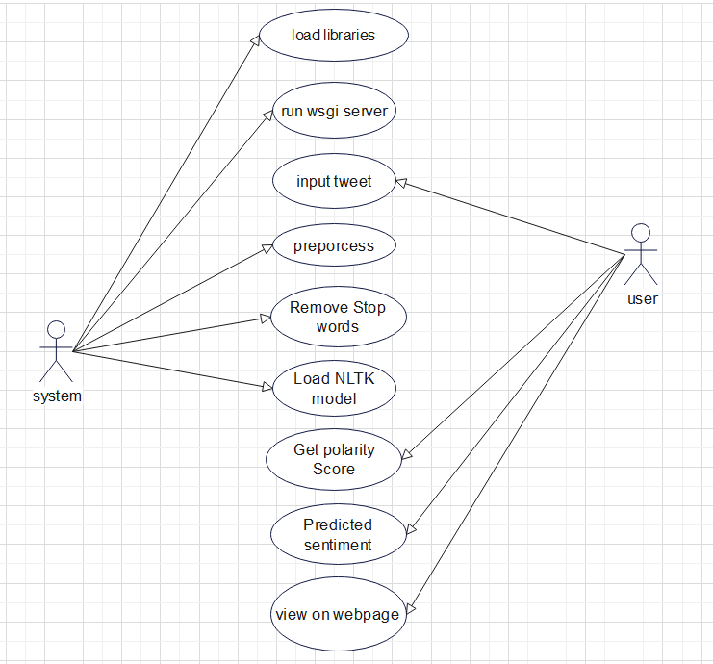
Design Diagrams (UML Diagram- Use Case diagram)

Slide 5
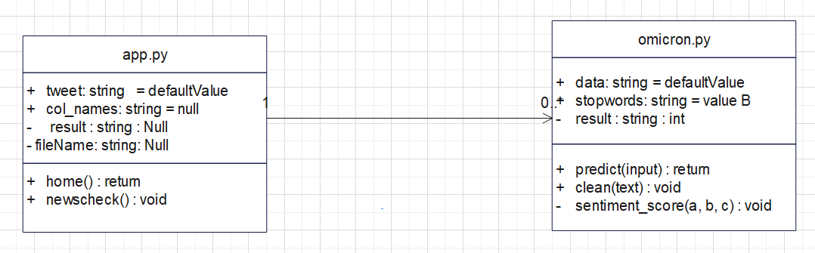
Design Diagrams (UML Diagram- Class diagram)

Slide 6
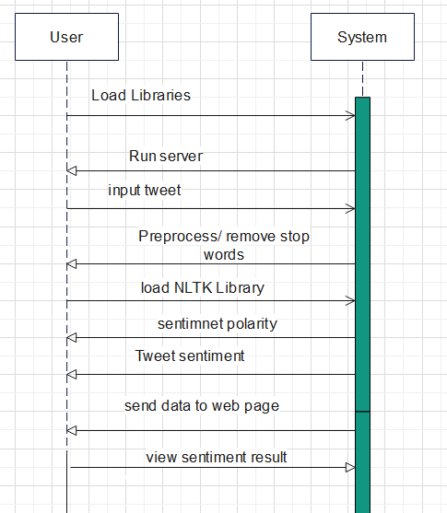
Design Diagrams (UML Diagram- Sequence diagram)

Slide 7
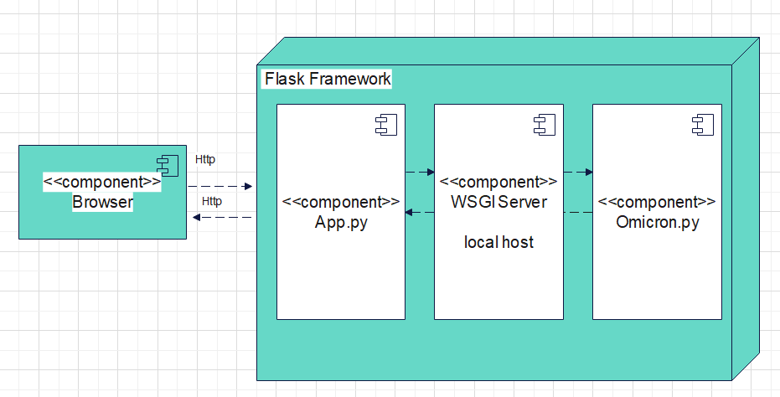
Design Diagrams (UML Diagram- Deployment diagram)

Slide 8
Module descriptions
User Module:
Using this module user enters health related omicron tweets and location of the tweet. User entered detail are stored in database ( mysql ) and sentiment is calculated as positive, negative, neutral and displayed to user and details are stored in database with tweet, username, location and sentiment .
Admin Module:
Based on the tweets and sentiments updated by users admin can view information in the form of graphs. Total count of tweets sentiments ( positive, negative, neutral ) in graphical representation.
Sentiment Analysis Module:
VADER Sentiment Analysis : VADER (Valence Aware Dictionary and sEntiment Reasoner) is a lexicon and rule-based sentiment analysis tool that is specifically attuned to sentiments expressed in social media. VADER uses a combination of A sentiment lexicon is a list of lexical features (e.g., words) which are generally labeled according to their semantic orientation as either positive or negative. VADER not only tells about the Positivity and Negativity score but also tells us about how positive or negative a sentiment is.

Slide 9
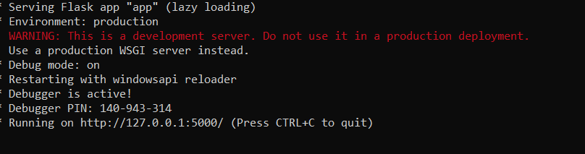
Implementation
Step 1: running WSGI server flask :

Slide 10
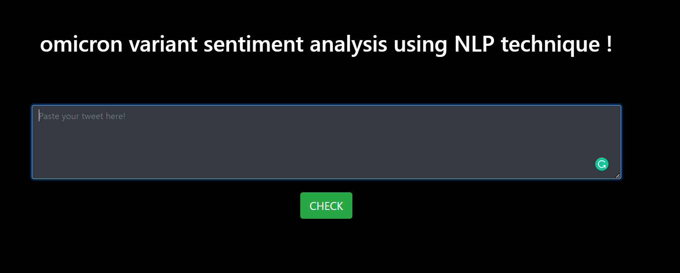
Step 2 : Main Screen

Slide 11
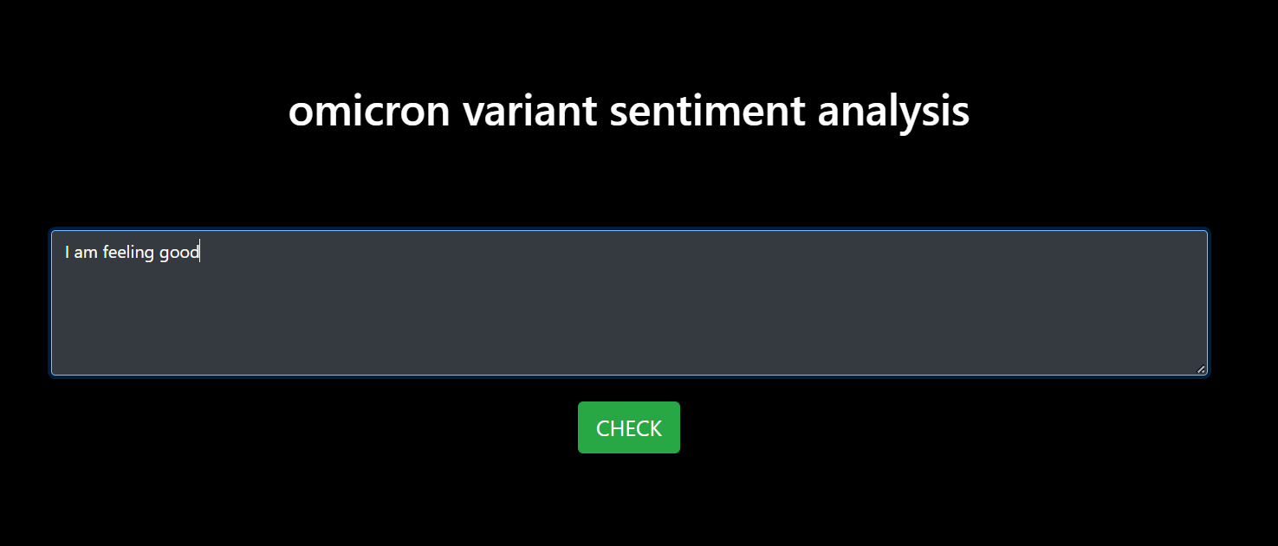
Step 3 : Enter the text

Slide 12
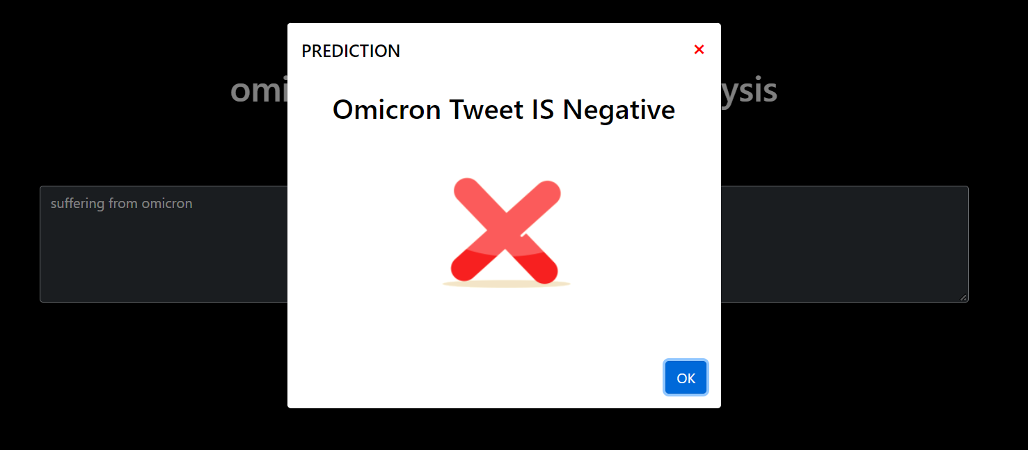
Step 4 : Output
Negative sentiment

Slide 13
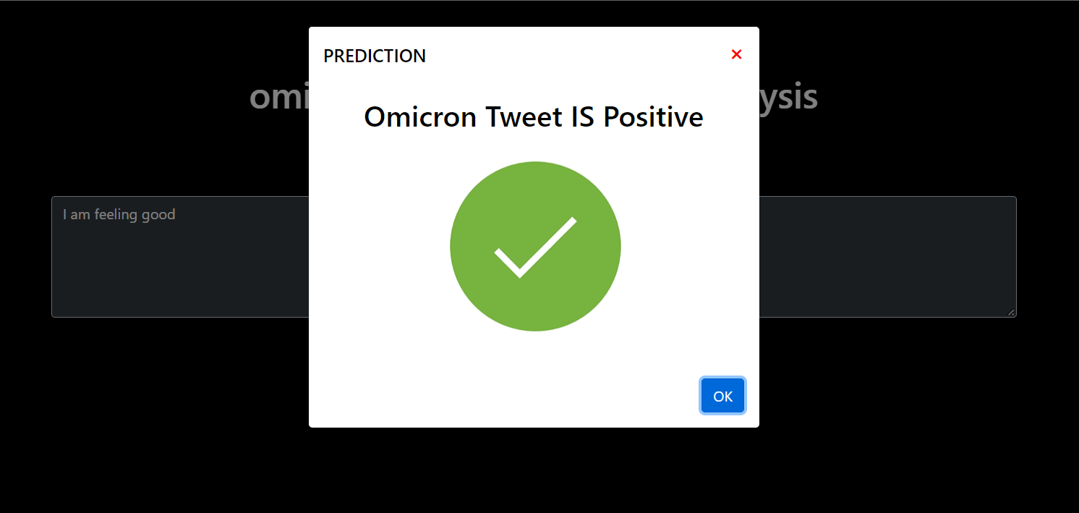
Positive Sentiment

Slide 14
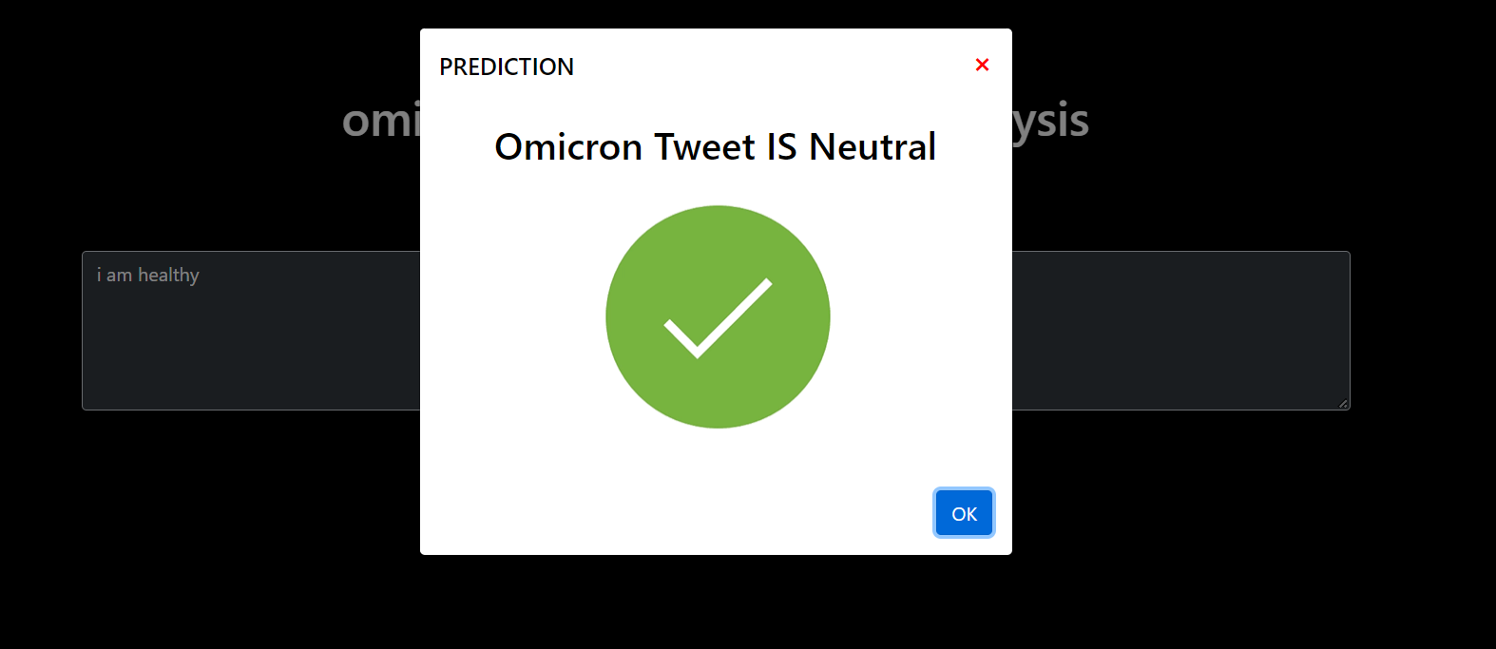
Neutral Sentiment

Slide 15
Testing
Testing is aimed at ensuring that the system was accurately an efficiently before live operation commands.
The main objective of testing is to uncover a host of errors, systematically and with minimum effort and time. Stating formally, we can say, testing is a process of executing a program with intent of finding an error.

Slide 16
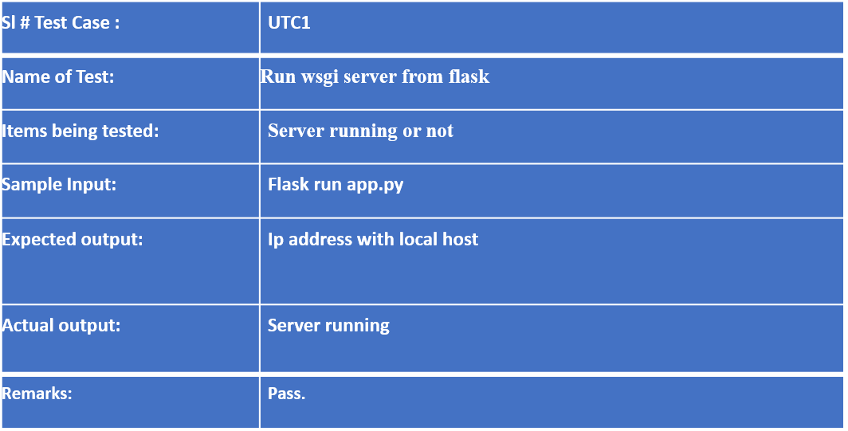
Test cases

Slide 17
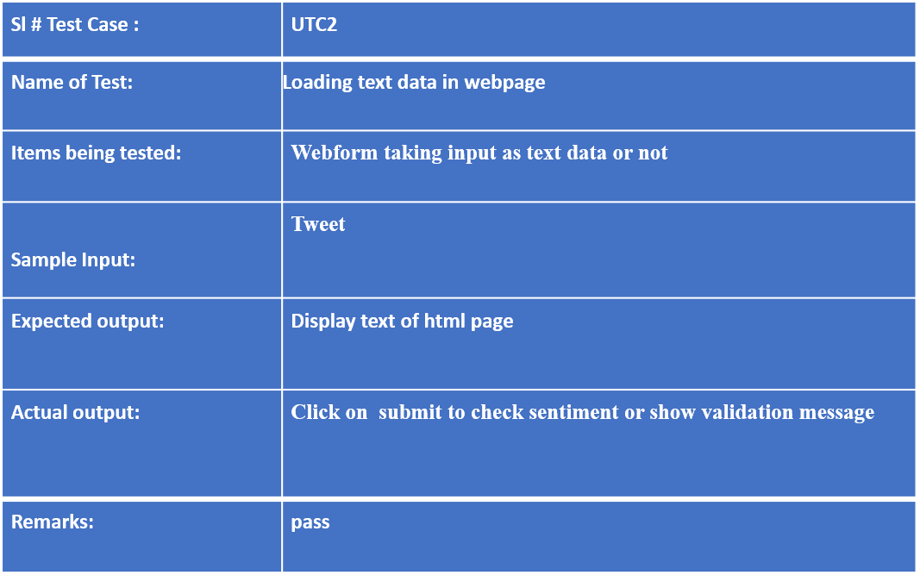

Slide 18
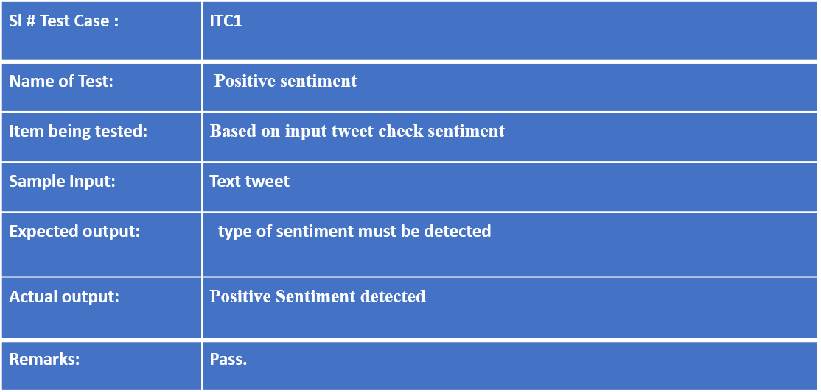

Slide 19
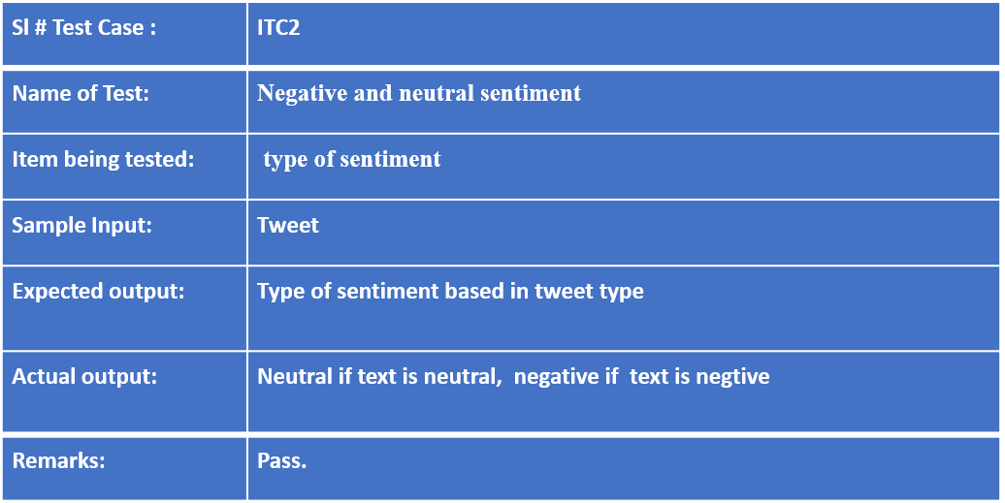

Slide 20
THANK YOU

