Slide 1
BOARD AND LODGE INMATE MONITORING SYSTEM
NIDHA POOZHIKAL
MES21MCA-2035
PRODUCT OWNER: NOWSHAD CV
Notes:
Be specific and direct in the title. Use the subtitle to give the specific context of the speech.
-The goal should be to capture the audience’s attention which can be done with a quote, a startling statistic, or fact. It is not necessary to include this attention getter on the slide.

Slide 2
TABLES OF CONTENT
Introduction
Modules
Module Descriptions
Data Flow Diagram
Developing Environment
User Story
Product Backlog
Project Plans
Notes:
Use the background points to post details that are not common knowledge, or that the audience will need to understand the context of the speech.
-Do not read these main points from the PowerPoint, instead elaborate on these points during the speech.

Slide 3
BOARD AND LODGE INMATE MONITORING SYSTEM
This project mainly targets lodges and hostels.
The management assures the safety and security of each customer.
It is very complex to manage data and information for each person.
There are many people to manage it and it takes a lot of time for them.
This project helps in keeping the track of workflow of the lodge and hostel.
This will reduce time delay and paper transactions and also reduce the workload of staff and as well as customers.
It is the computerization of a lodge or hostel.

Slide 4
BOARD AND LODGE INMATE MONITORING SYSTEM
The main objectives are,
To provide information instantly as and when it is required.
To make the Lodge information details more efficient and effective.
This system should maintain different data files so that the data can be retrieved easily and in an efficient manner.
The system should be very interactive.
It should ensure process integration to the desired extent, and various reports should be generated as the request.
This system should also ensure that there is no redundancy in the recorded data.

Slide 5
BOARD AND LODGE INMATE MONITORING SYSTEM
This project works and updates Customer Records, Employee Records, Lodge Records, Records of Tariff, Attendance Records, Room Records, Mess Records, Admission Processes, and Payment Processes.
The system automatically calculates Hostel Bills, Mess Bills, Other Bills, and Dues.
The data are stored in the database and the reports are generated according to the user request.
It keeps track of the number of customers in the room and the availability of rooms.
It helps the organization from the manual work from which it is very difficult to find the record of the customer and the mess bill of each customer.

Slide 6
MODULES
ADMIN | CUSTOMER
Add Customer | Profile
Add Room | login
Rooms Management | Room Add
Add Package | Book meals
Manage Package | View Access log
Manage Customer | View Bill
View User Access | Report

Slide 7
MODULE DESCRIPTIONS
ADMIN The Admin module is consisting of the task that of,
the Customer creation
addition of Room
Package availability management
view and change the customer status
The complete management of the application carried out by the Admin user.
This user will look after all the required changes by the subsequent other users.

Slide 8
MODULE DESCRIPTIONS
CUSTOMER
The login generated for customer end and functionalities carried over to the login is for
evaluating the confirmed booking
inspecting check in/out
requesting packages
the booking of meals
alerting for rooms
The customer module is focusing to meet all the requirements needed for their services and it is forwarding to the employee side.

Slide 9
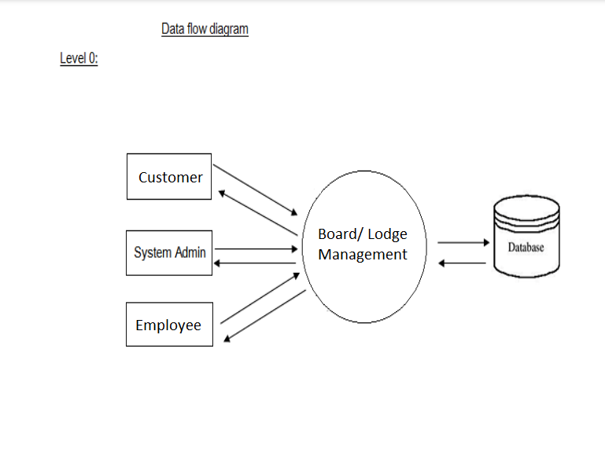
DATA FLOW DIAGRAM

Slide 10
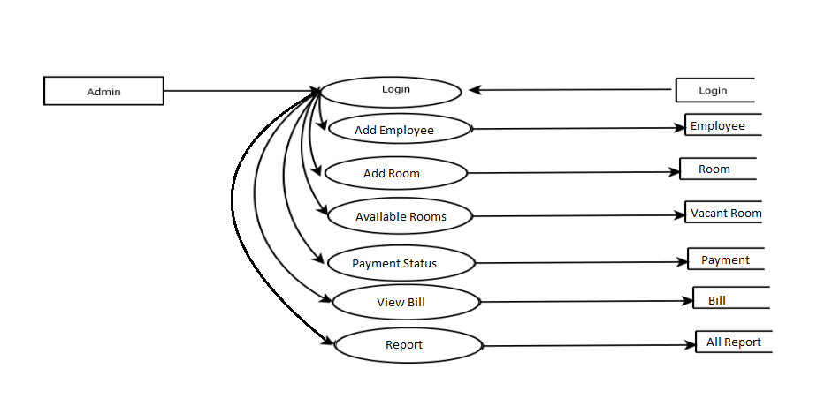
DATA FLOW DIAGRAM
Manager

Slide 11
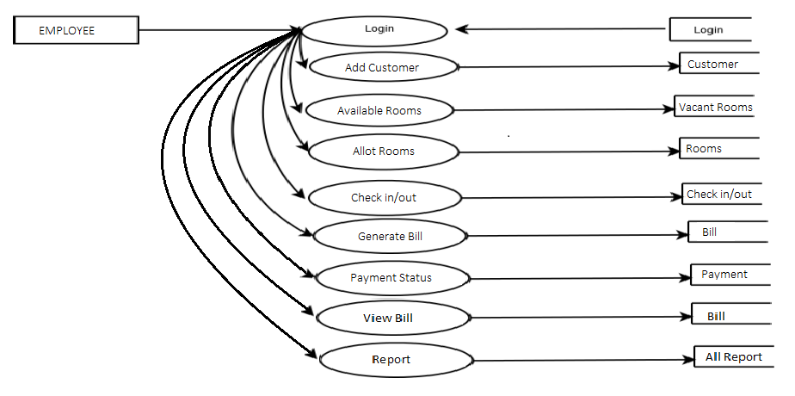
DATA FLOW DIAGRAM

Slide 12
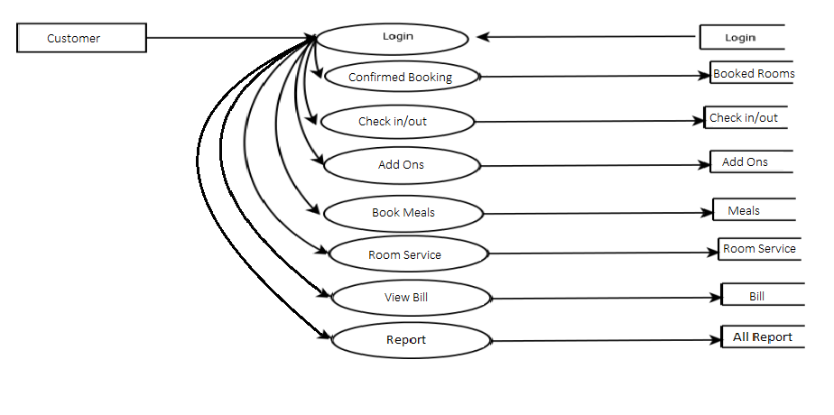
DATA FLOW DIAGRAM

Slide 13
DEVELOPING ENVIRONMENT
HARDWARE REQUIREMENTS
It is recommended that for optimal performance, the following minimum hardware is installed on the server on which the portal is hosted, as well as on clients that access the portal.
PROCESSOR : Intel core i3
MONITOR : LCD Display
RAM : Min 4 GB
HARD DISK : 100 GB

Slide 14
DEVELOPING ENVIRONMENT
SOFTWARE REQUIREMENTS
For the proposed system to work properly, it is necessary that following software are installed and running on the server / client.
FRONT END : HTML5,CSS,Javascript,Bootstrap
BACK END : PHP
Database: MySQL
Framework: Laravel
IDE : Visual Studio Code
TECHNOLOGY USED : Web
OPERATING SYSTEM : WINDOWS 7/8/10 for better performance
WEB BROWSER : Internet Explorer/Google Chrome/Firefox

Slide 15
PRODUCT BACKLOG
ID | NAME | PRIORITY <high/medium/law> | ESTIMATE (Hours) | STATUS <Planned/In progress/Completed>
1 | LOGIN GENERATION FOR USERS | High | 5 | COMPLETED
2 | CUSTOMER SELECTION OF ROOM | High | 5 | COMPLETED
3 | CRUD(Package Allocation, Room Selection, Check in/out, Book Meal) OPERATIONS | High | 20 | COMPLETED
4 | BILL GENERATION AND PAYMENT STATUS | High | 10 | COMPLETED
5 | REPORT | MEDIUM | 10 | COMPLETED

Slide 16
USER STORY
User Story ID | As a type of User | I want to <Perform some task> | So that i can <Achieve Some Goal>
1 | ADMIN | Login | login successful with correct username and password
2 | ADMIN | view and manage | Creation of room and customer
3 | ADMIN | View and Manage | Can view and Manage rooms, packages and bill
4 | ADMIN | Report | Customized different report
5 | ADMIN | Alter | Allot Rooms
6 | CUSTOMER | Login | login successful with correct username and password
7 | CUSTOMER | View | View confirmed booking and check in/out status
8 | CUSTOMER | Service appeal | Request room change, and package
9 | CUSTOMER | View Invoice | View invoice and forward to payment.

Slide 17
PROJECT PLAN
User Story ID | Task Name | Start Date | End Date | Days | Status
1 | Sprint 1 | 16/08/2022 | 19/08/2022 | 8 | Completed
6 |  | 20/08/2022 | 22/08/2022 |  | Completed
7 |  | 23/08/2022 | 27/08/2022 |  | Completed
2 | Sprint 2 | 13/09/2022 | 19/09/2022 | 15 | Completed
3 |  | 20/09/2022 | 27/09/2022 |  | Completed

Slide 18
PROJECT PLAN
User Story ID | Task Name | Start Date | End Date | Days | Status
4 | SPRINT 3 | 03/10/2022 | 08/10/2022 | 12 | Completed
9 |  | 09/10/2022 | 14/10/2022 |  | Completed
5 | SPRINT 4 | 28/10/2022 | 03/11/2022 | 15 | Completed
8 |  | 04/11/2022 | 11/11/2022 |  | Completed

Slide 19
SPRINT BACKLOG
Backlog item | Status And Completion Date | Original Estimation in Hours | Day 1 hrs | Day 2 hrs | Day 3 hrs | Day 4 hrs | Day 5 hrs | Day 6 hrs | Day 7 hrs | Day 8 hrs | Day 9 hrs | Day 10 hrs
SPRINT1
Table designing | 16/8/2022 | 2 | 1 | 1 | 0 | 0 | 0 | 0 | 0 | 0 | 0 | 0
Form designing | 22/8/2022 | 3 | 1 | 1 | 1 | 0 | 0 | 0 | 0 | 0 | 0 | 0
Coding | 27/8/2022 | 3 | 1 | 1 | 1 | 0 | 0 | 0 | 0 | 0 | 0 | 0
SPRINT 2
Data collection | 13/9/2022 | 7 | 1 | 1 | 1 | 1 | 1 | 1 | 1 | 0 | 0 | 0
Data processing | 29/9/2022 | 7 | 1 | 1 | 1 | 1 | 1 | 1 | 1 | 0 | 0 | 0

Slide 20
SPRINT BACKLOG
Backlog item | Status And Completion Date | Original Estimation in Hours | Day 1 hrs | Day 2 hrs | Day 3 hrs | Day 4 hrs | Day 5 hrs | Day 6 hrs | Day 7 hrs | Day 8 hrs | Day 9 hrs | Day 10 hrs
SPRINT3
Users Modules | 3/10/2022 | 7 | 1 | 1 | 1 | 1 | 1 | 1 | 1 | 0 | 0 | 0
User Registration | 20/10/2022 | 7 | 1 | 1 | 1 | 1 | 1 | 1 | 1 | 0 | 0 | 0
SPRINT 4
Package & Room Allocation | 8/11/2022 | 7 | 1 | 1 | 1 | 1 | 1 | 1 | 1 | 0 | 0 | 0
Testing | 11/11/2022 | 7 | 1 | 1 | 1 | 1 | 1 | 1 | 1 | 0 | 0 | 0
TOTAL |  | 50 | 9 | 9 | 8 | 6 | 6 | 6 | 6

Slide 21
THANKYOU

