Slide 1
AGU Poster figures

Slide 2
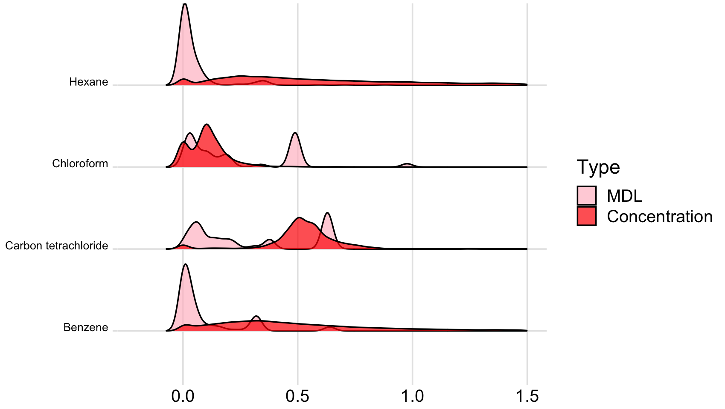
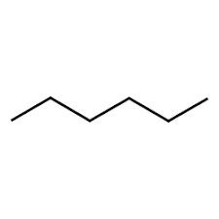
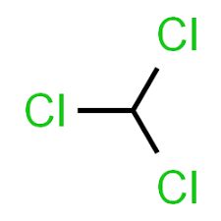
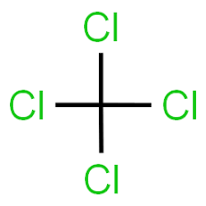

HAPS ridgeline plot
Density
Concentration (μg/m³)

Slide 3




Analysis Pipeline
Input
Data Processing
Modeling
Results
Exploratory Analysis
HAPs data
Select Chemicals
Preprocess
Validation metrics
Homogenize units
Amend records
Process non-detects
Add site metadata
Daily Averages
Model cross-validation
Parameter interpretation
Covariate data
Process @HAPs
Calculate @HAPs
Full model fit
Process @Pred. grid
Calculate @Pred. grid
Predictions
Prediction grid

Slide 4
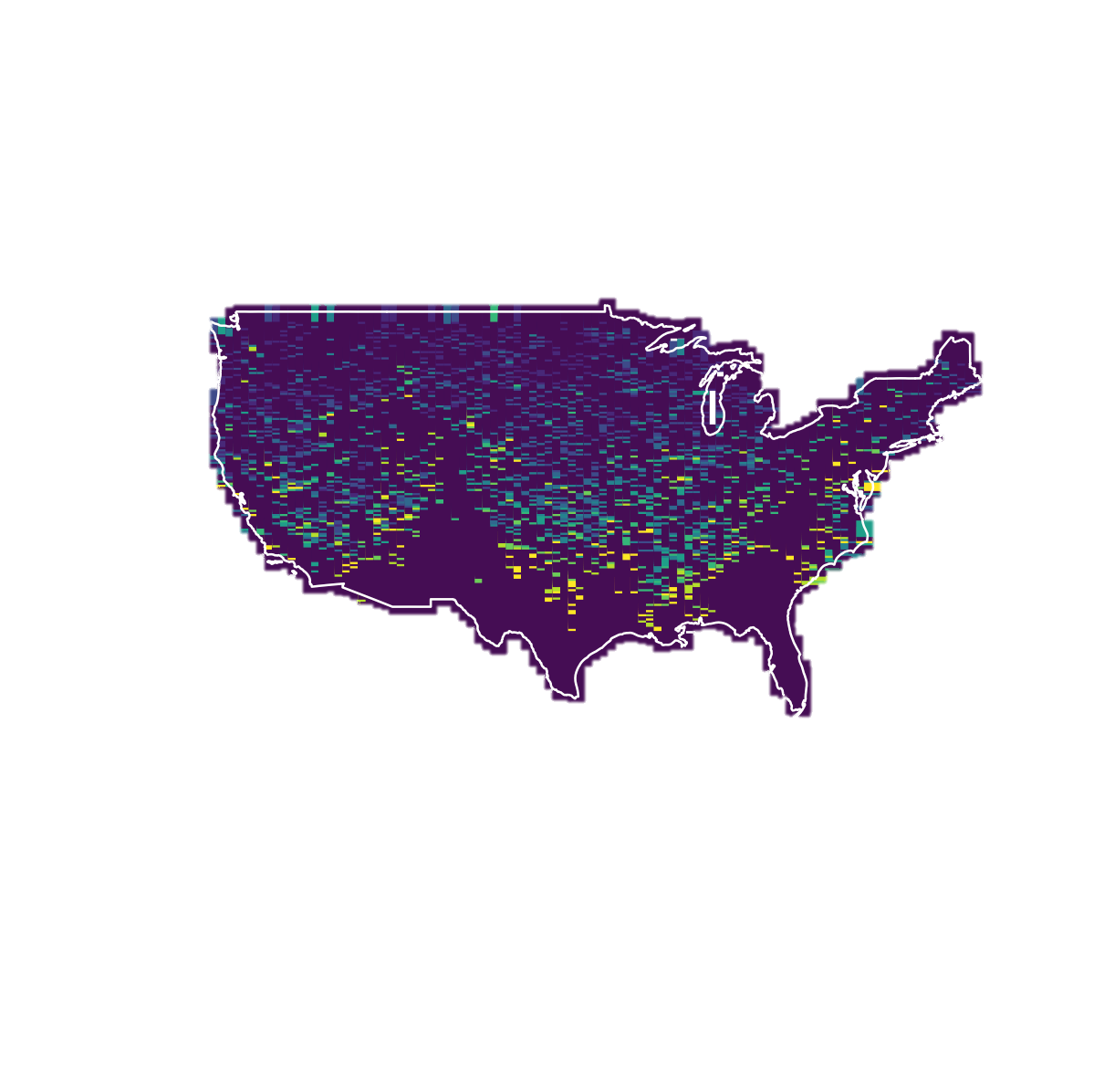
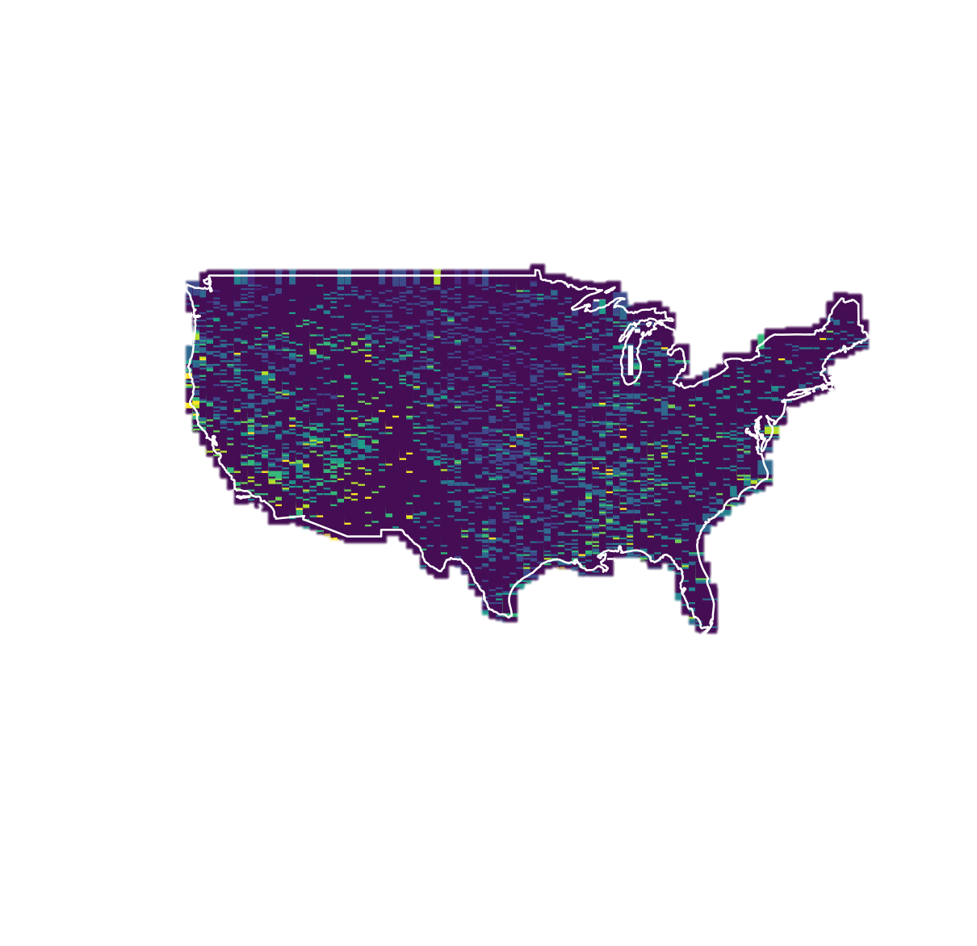
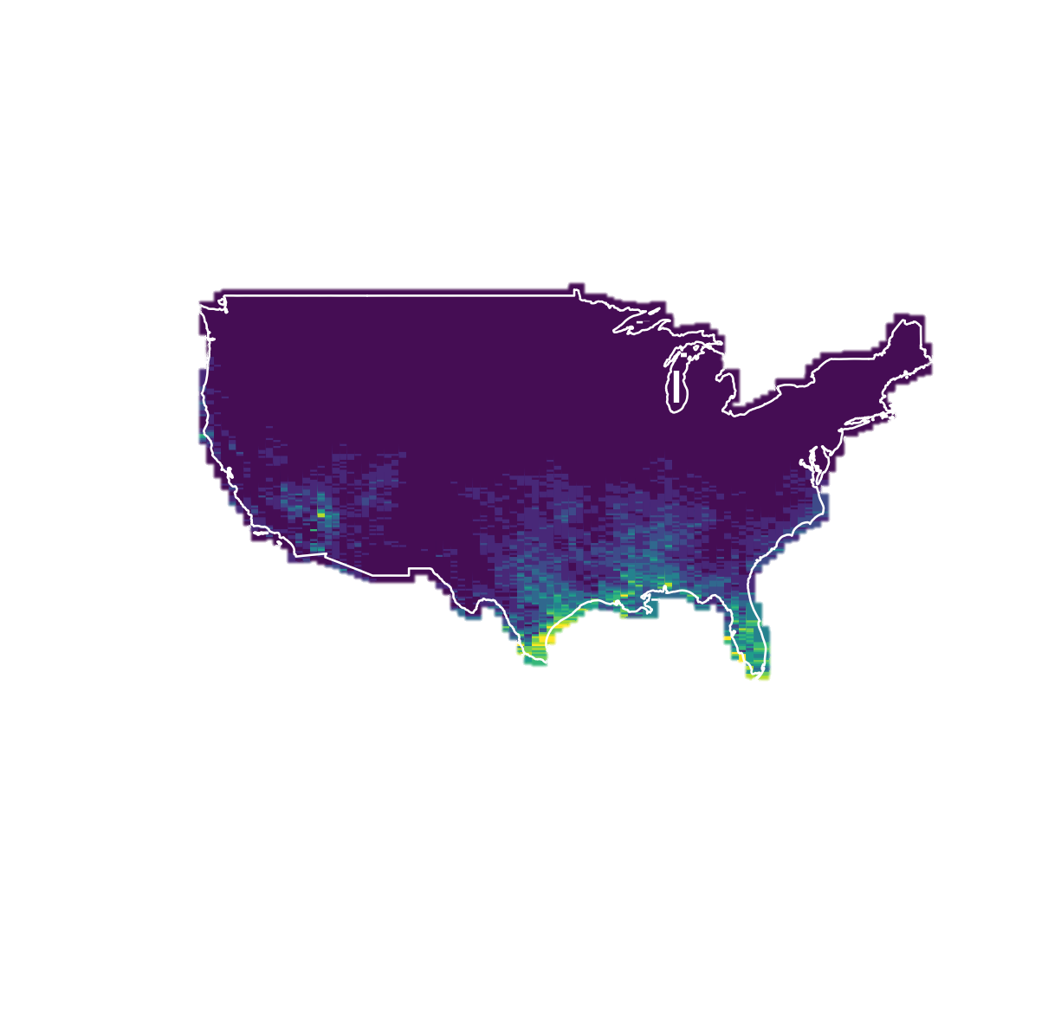
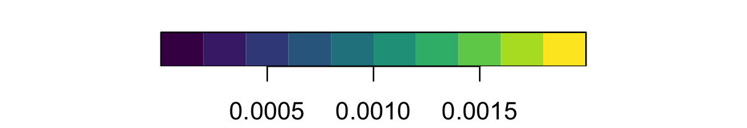
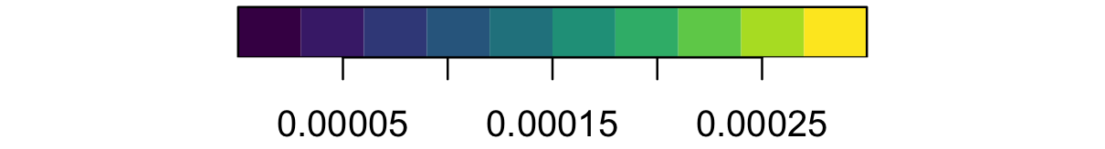
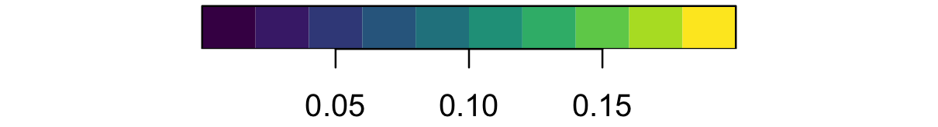
Mean Benzene 2021
Mean Chloroform 2021
Mean Hexane 2021
Concentration (μg/m³)
Concentration (μg/m³)
Concentration (μg/m³)

Slide 5
