Slide 1
HAPS poster slides

Slide 2
Motivation
The United States Environmental Protection Agency (EPA) has designated 188 compounds as Hazardous Air Pollutants (HAPs) for their known or suspected adverse health effects such as cancer, reproductive effects, and birth defects, among others.
While emitting facilities are required by the EPA to report and regulate HAPs emissions, the sparsity of available atmospheric concentration data for these chemicals precludes further studies on population exposure and resulting health risks.
We have TOX data for these
We need exposure data to determine impacts and exposure disparities

Slide 3
How the EPA regulates HAPs

Slide 4
Pollutant | Sites | %NonDetects | %BelowMDL | Mean Dates/Site
Benzene | 282 | 0.9 | 3.6 | 97
Carbon tetrachloride | 226 | 0.5 | 3.9 | 46
Chloroform | 225 | 3.2 | 5.0 | 46
Hexane | 165 | 1.0 | 0.6 | 119

Slide 5
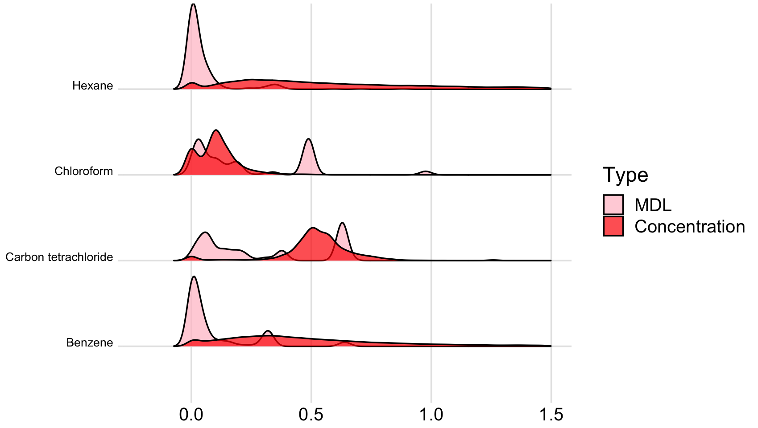
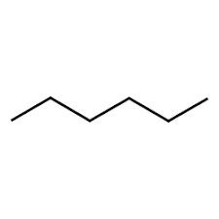
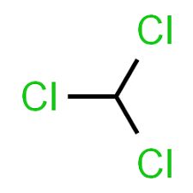
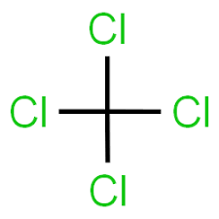

HAPS ridgeline plot
Density
Concentration (μg/m³)

Slide 6
Objectives
Mapping HAPs concentrations in the coterminous United States for recent years
Using novel statistical and computational methods for dealing with large datasets in multivariate scenarios
Developing analysis pipelines for easy reproducibility and expansion

Slide 7
Data
Hazardous Air Pollutants:
Benzene
Hexane
Carbon Tetrachloride
Chloroform
(We have 38 HAPs with 50+ sites across the US that have matching Tox information)
Covariate Data:
Gridmet (~4km reanalysis product)
Wind Speed 10m
Wind direction 10m
Specific humidity
Maximum temperature
Minimum temperature
Precipitation
Surface Downwelling Solar Radiation

Slide 9
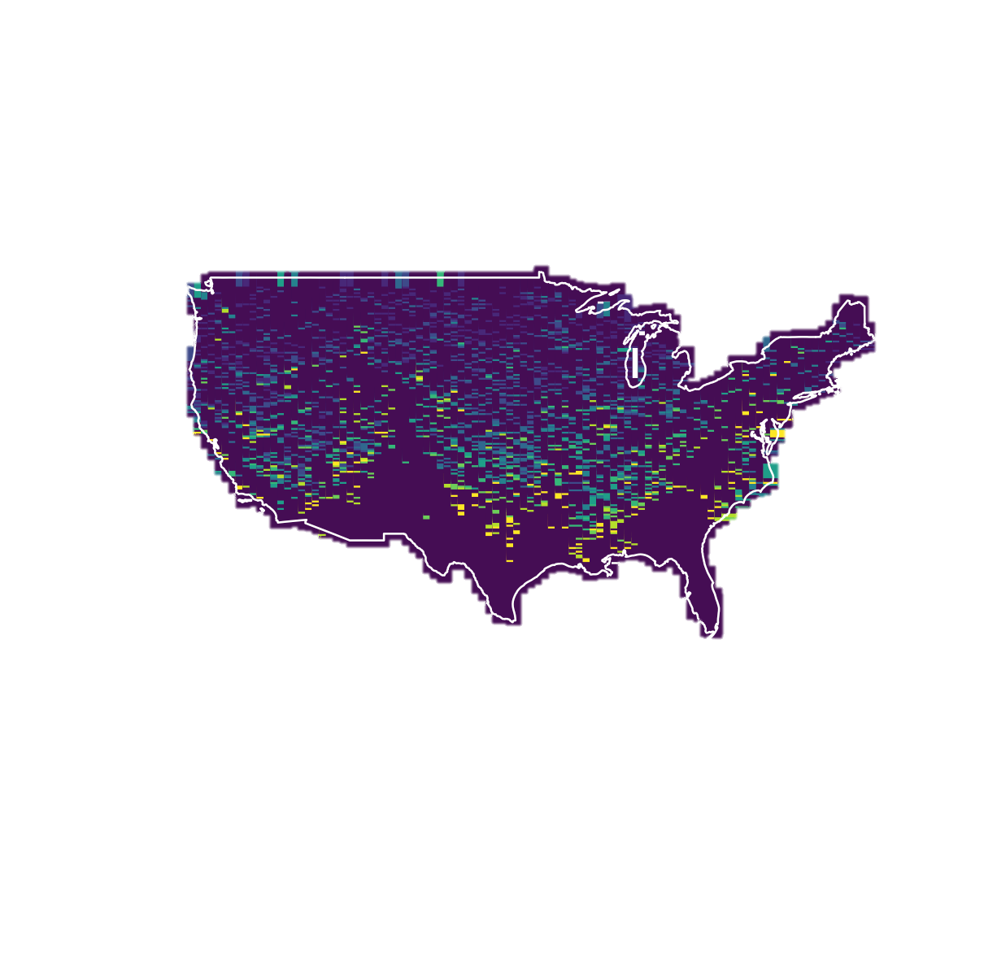
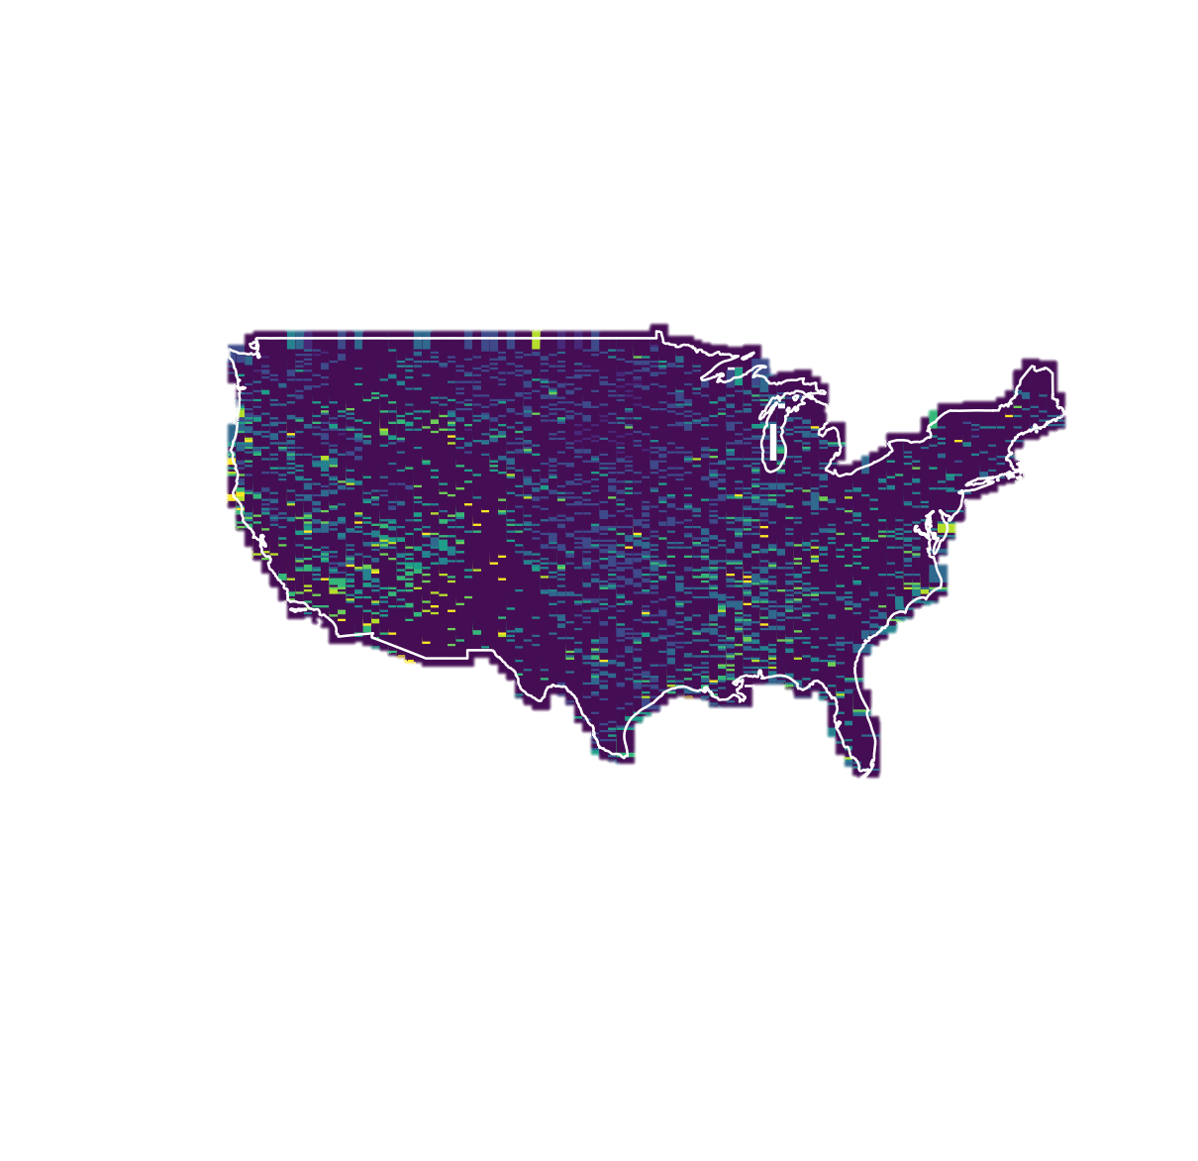
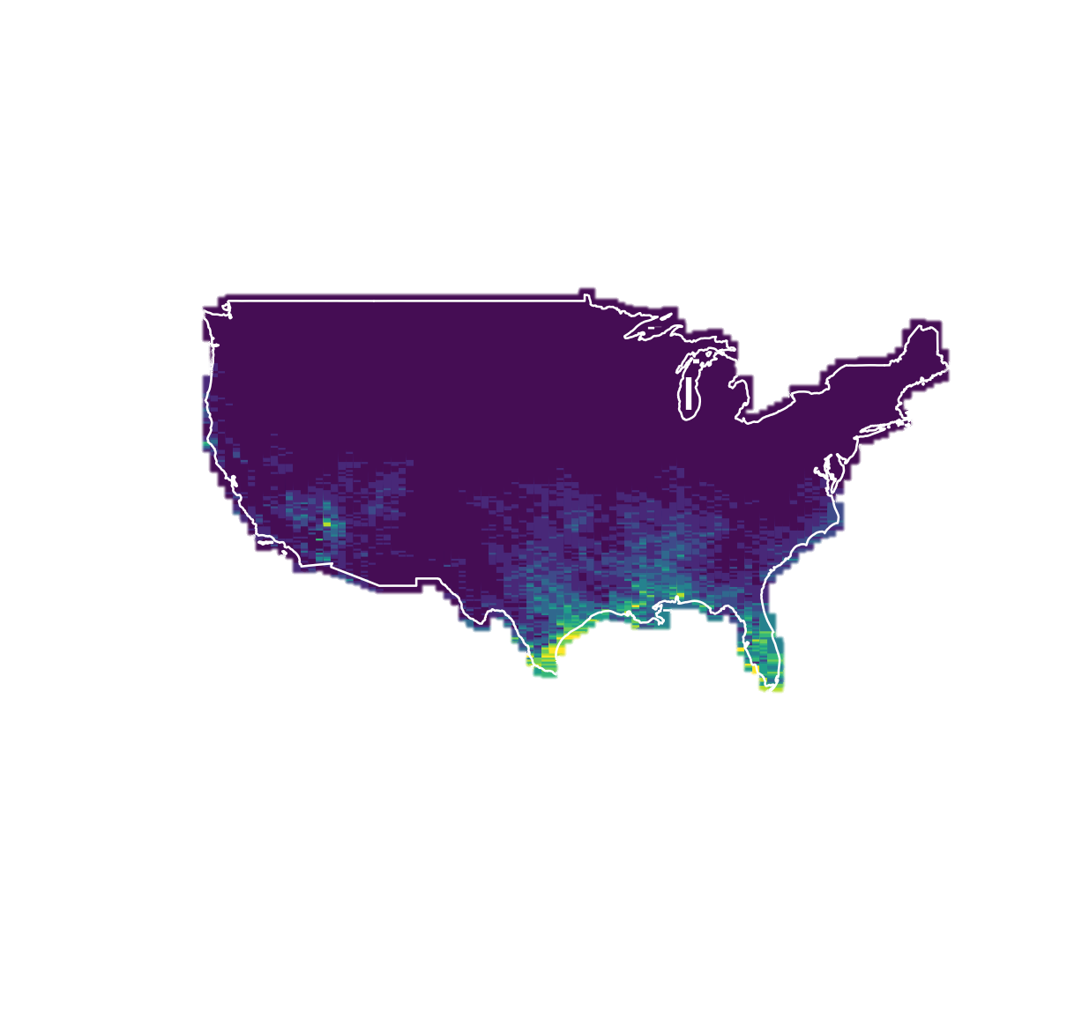
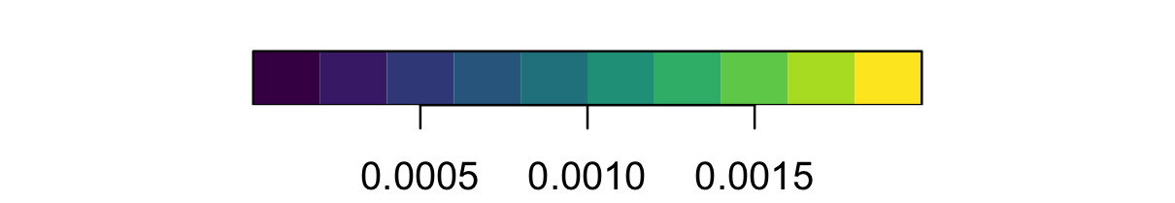
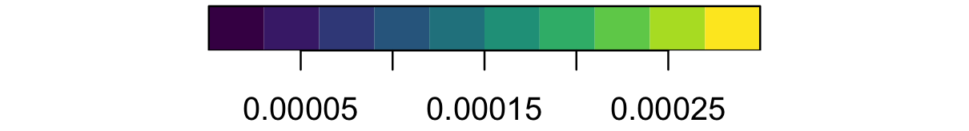
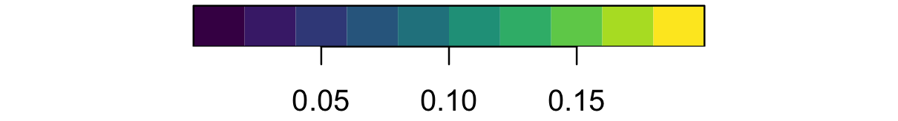
Mean Benzene 2021
Mean Chloroform 2021
Mean Hexane 2021

Slide 11
Mean Hexane 2021

Slide 13
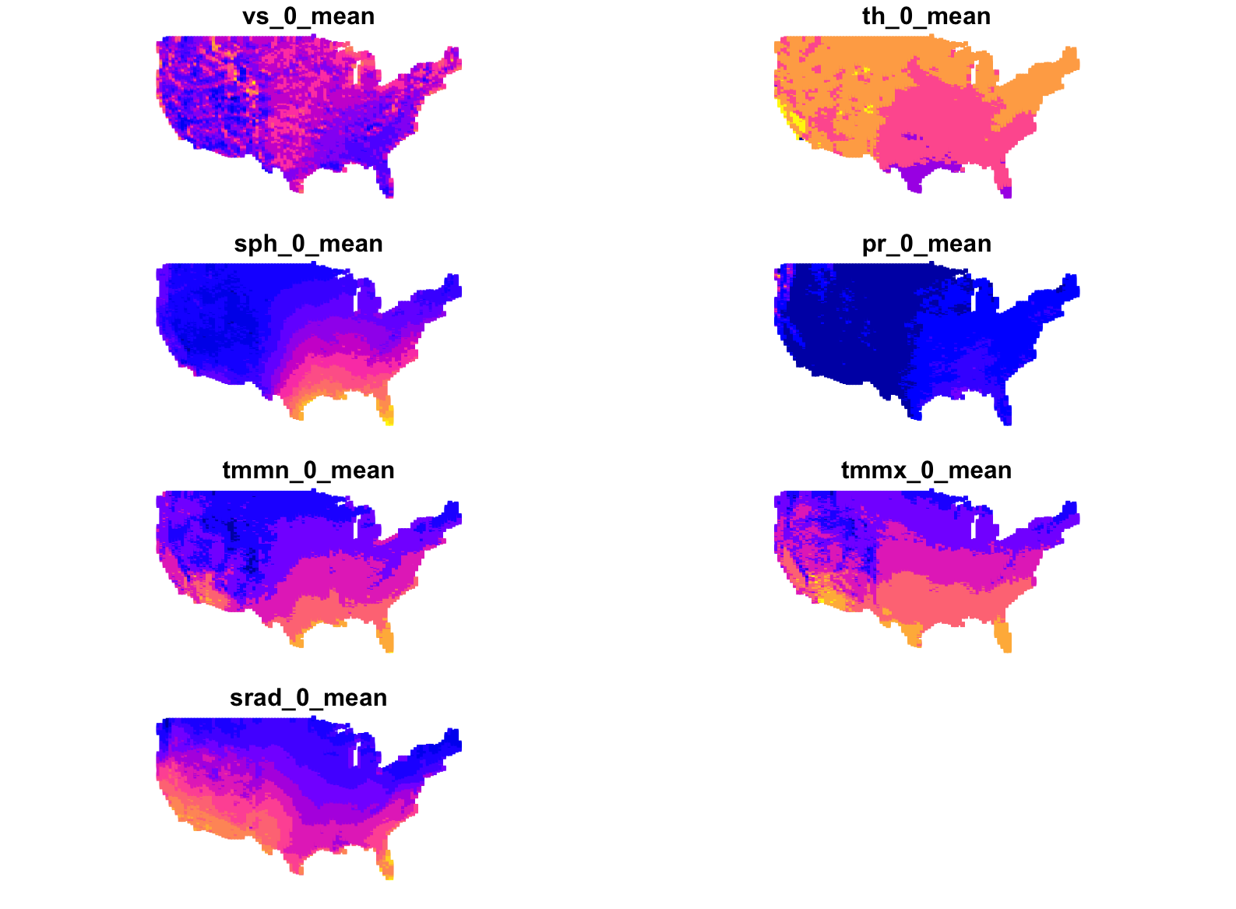
covariates

Slide 14
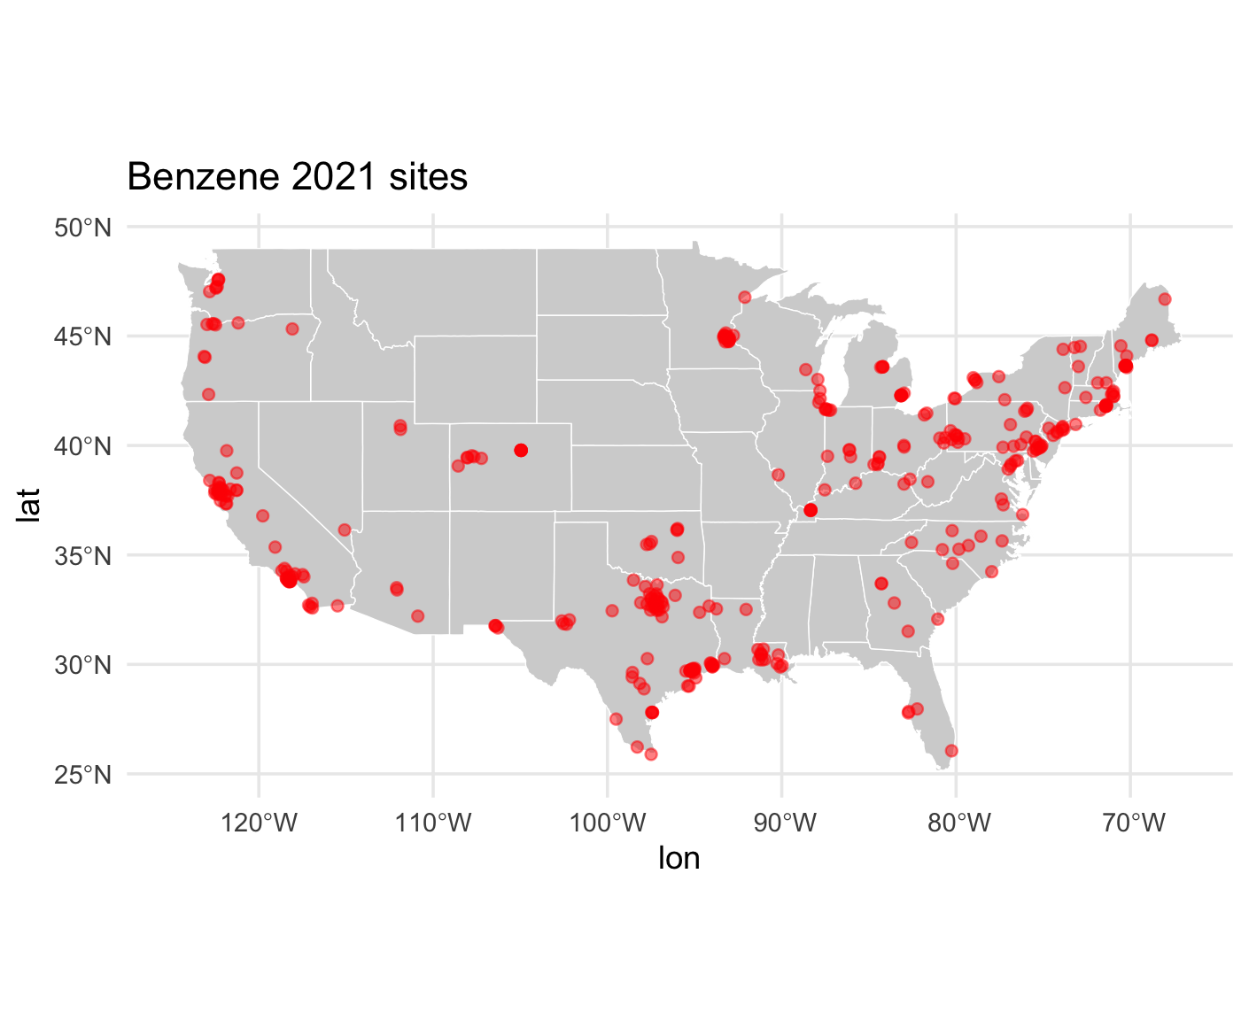
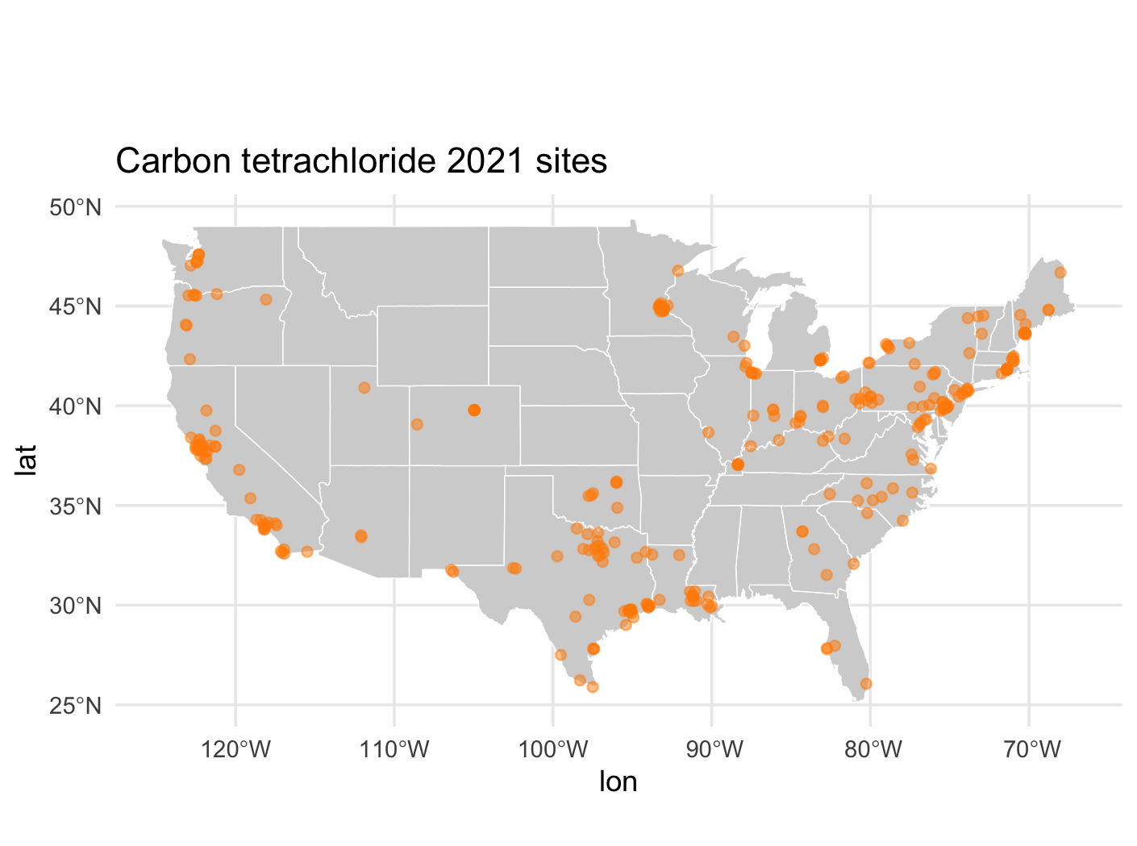
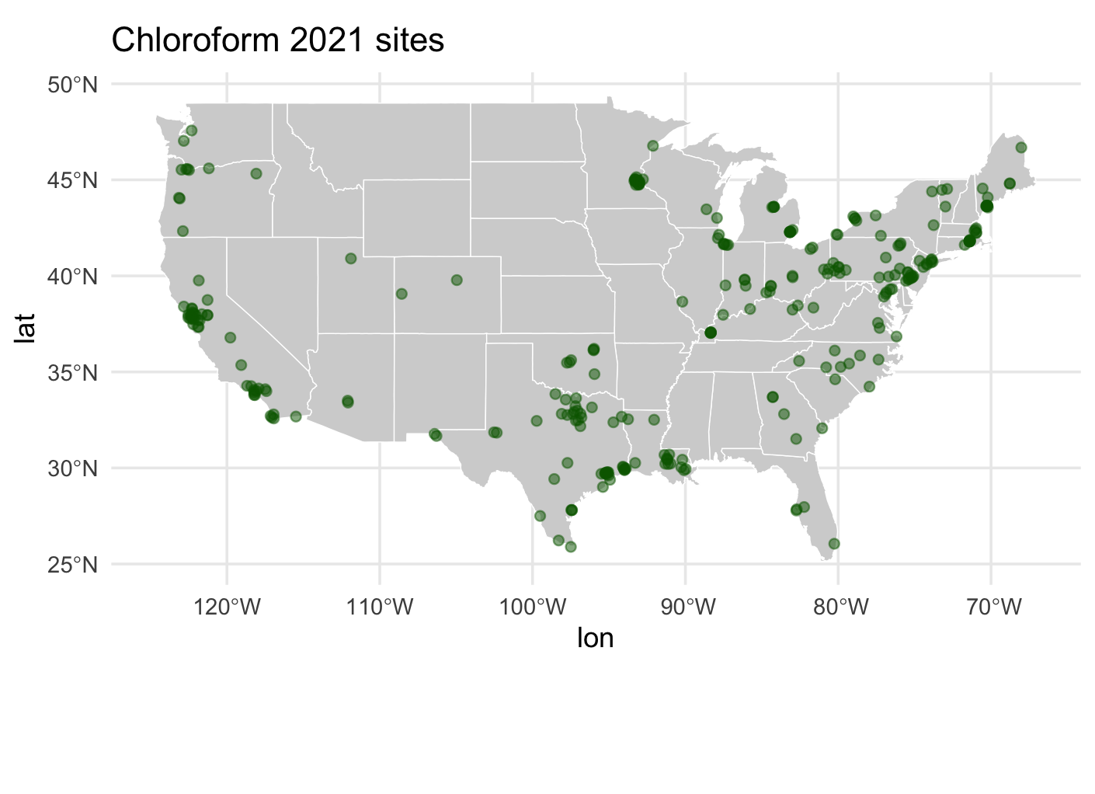
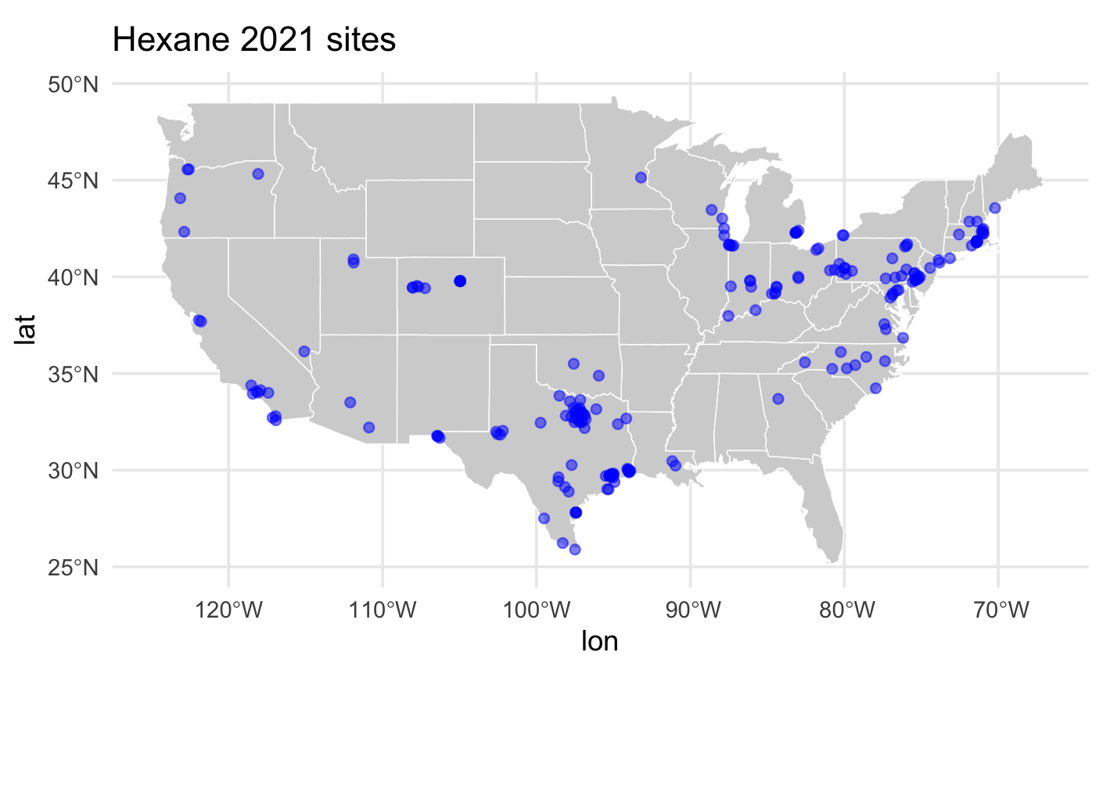

Slide 15
Model (equations?)
Land use regression equation

Slide 16
Computational innovations
PrestoGP: Penalized regression on Spatiotemporal Outcomes using Gaussian Processes

Slide 17
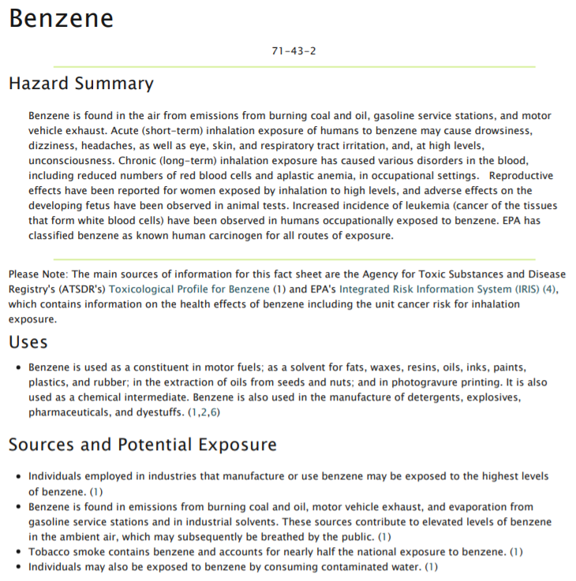

Slide 18
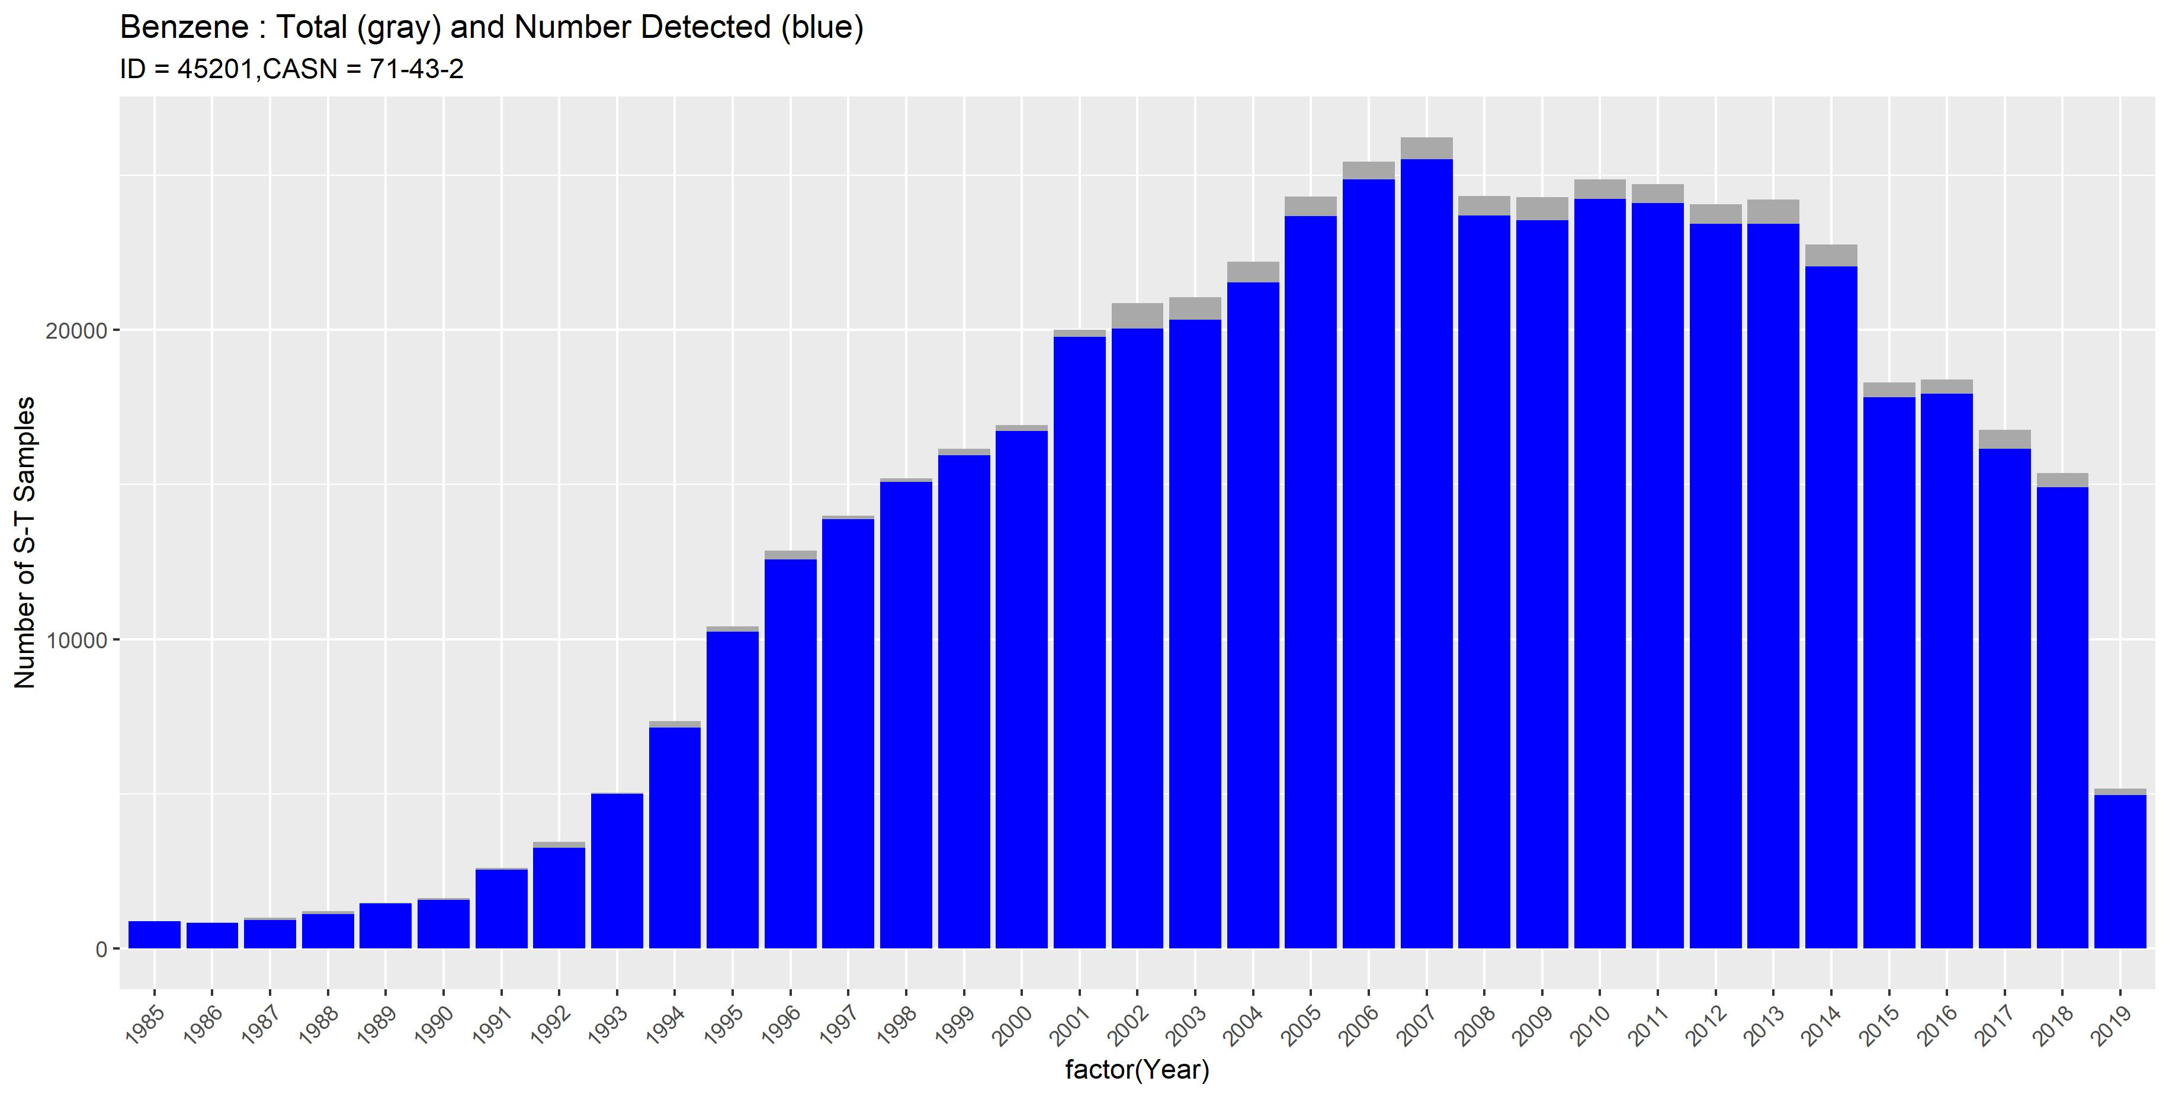

Slide 19
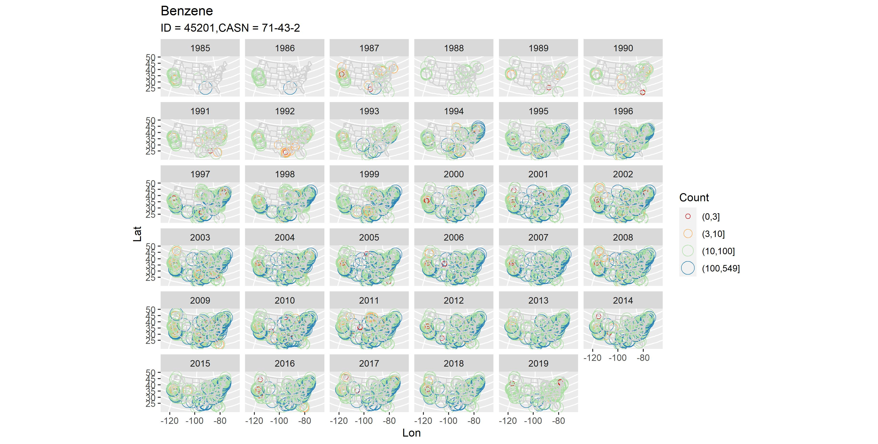

Slide 20
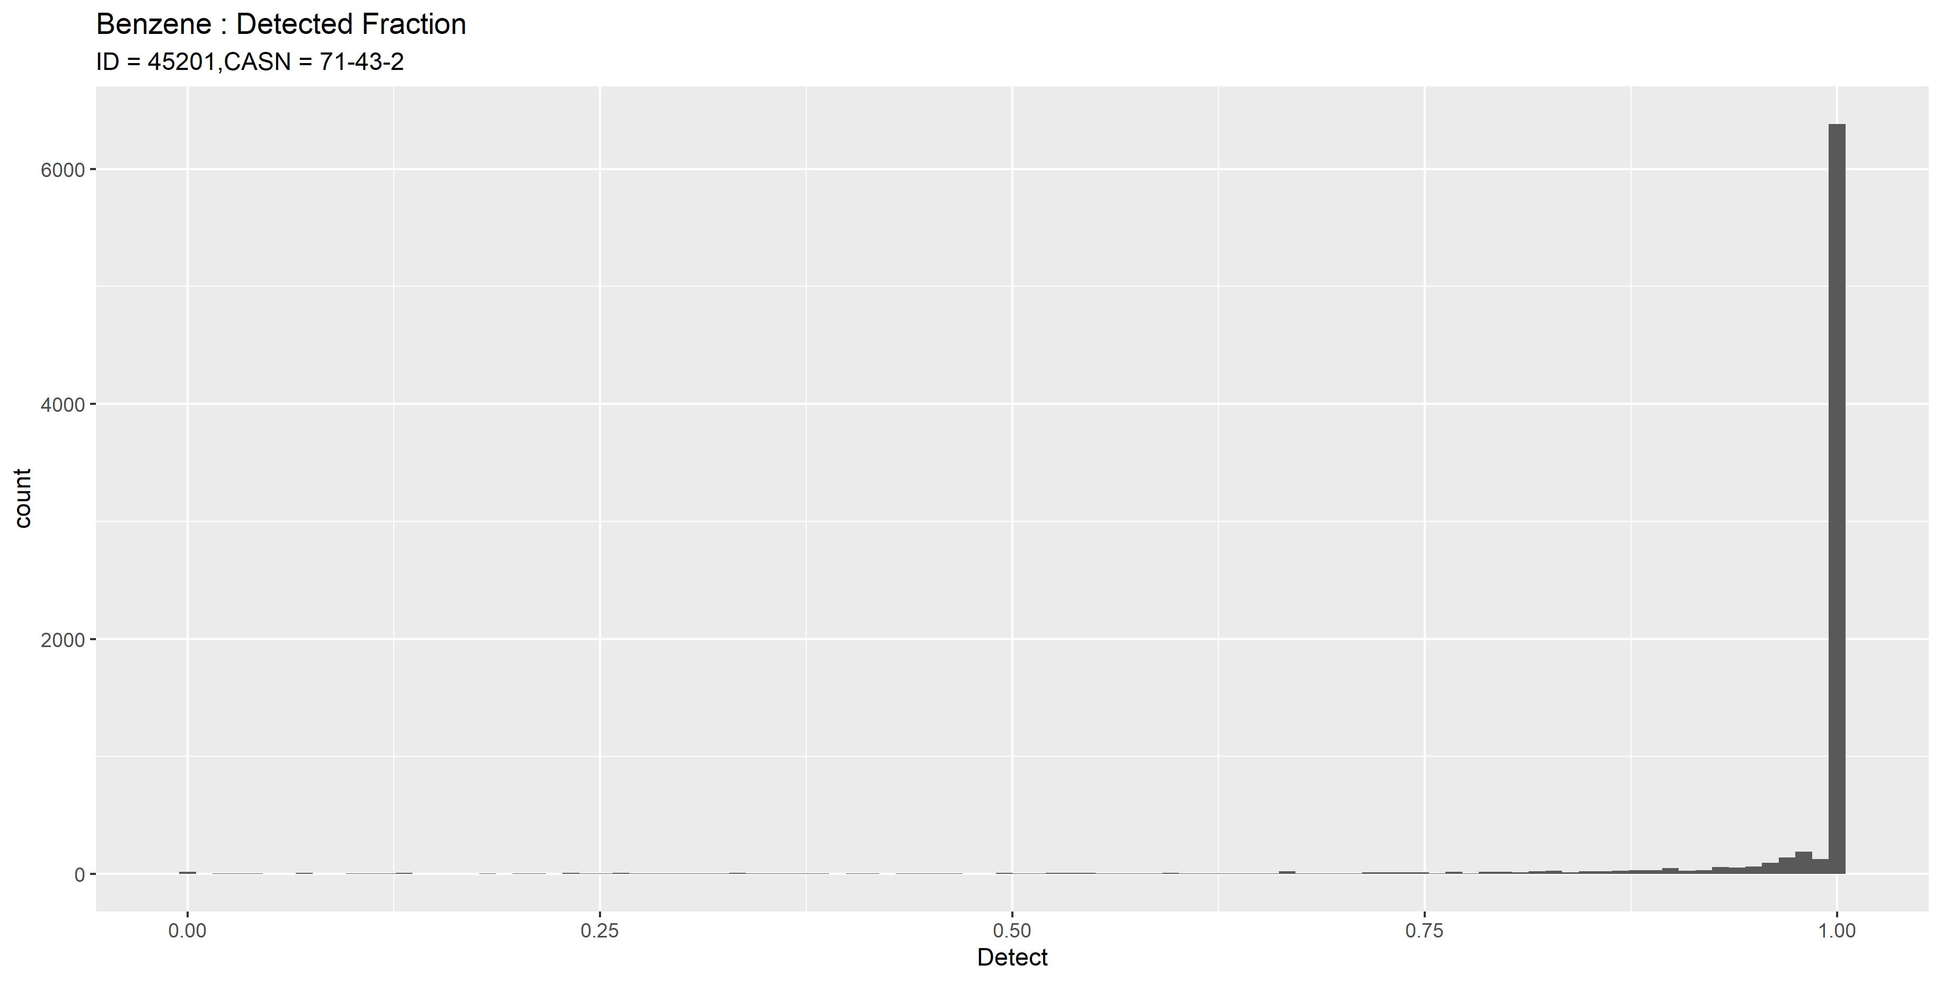

Slide 21
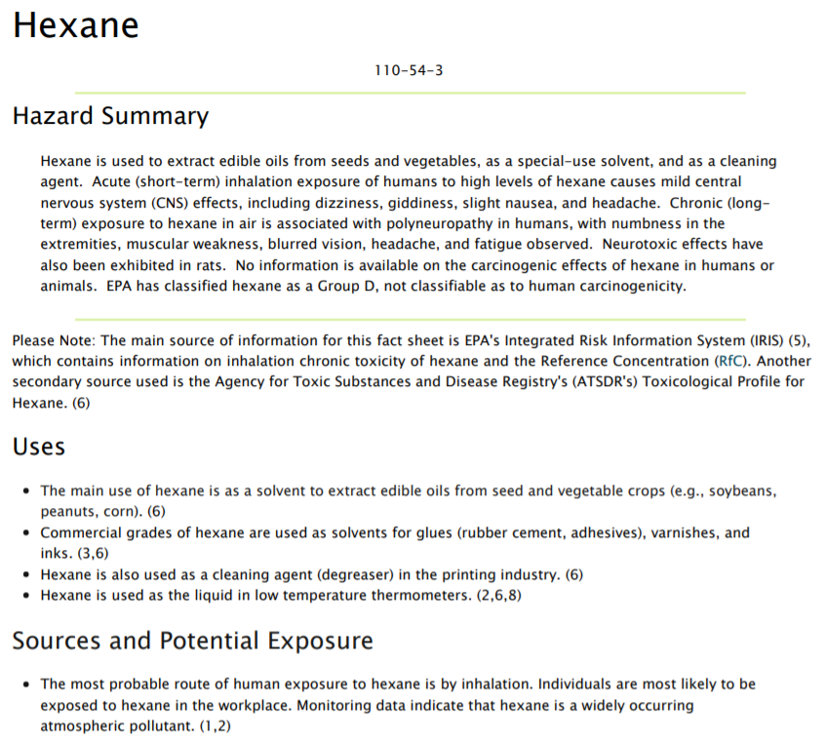

Slide 22
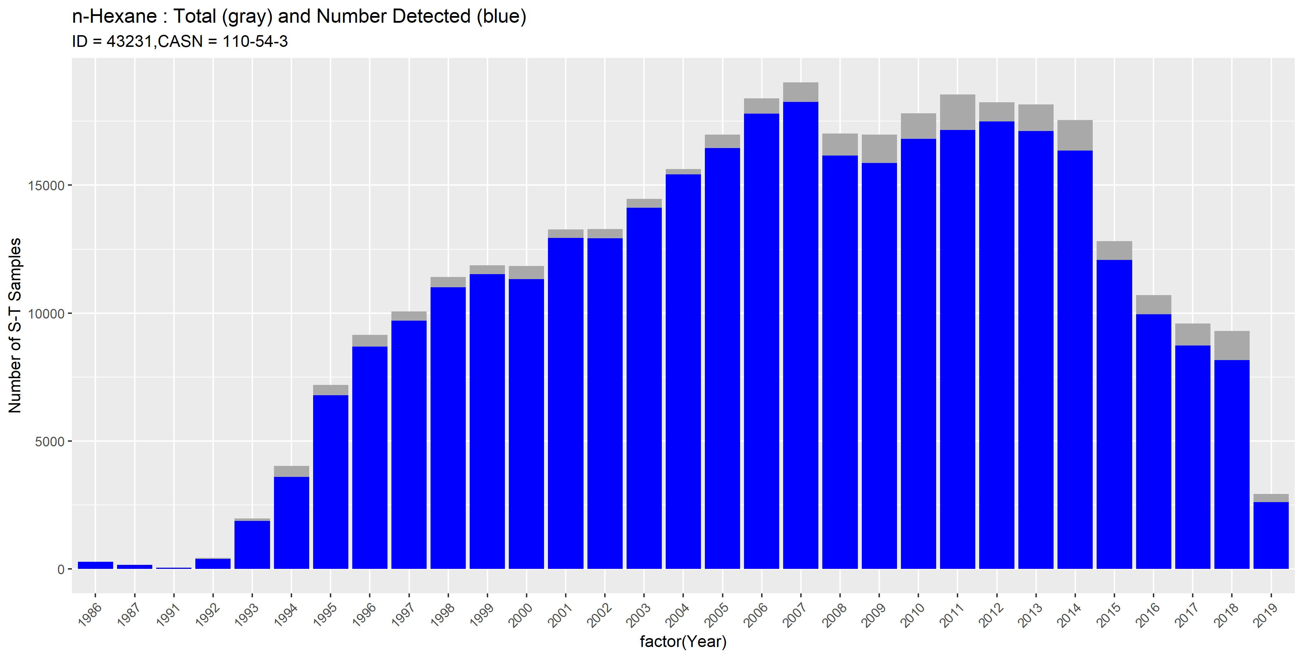

Slide 23
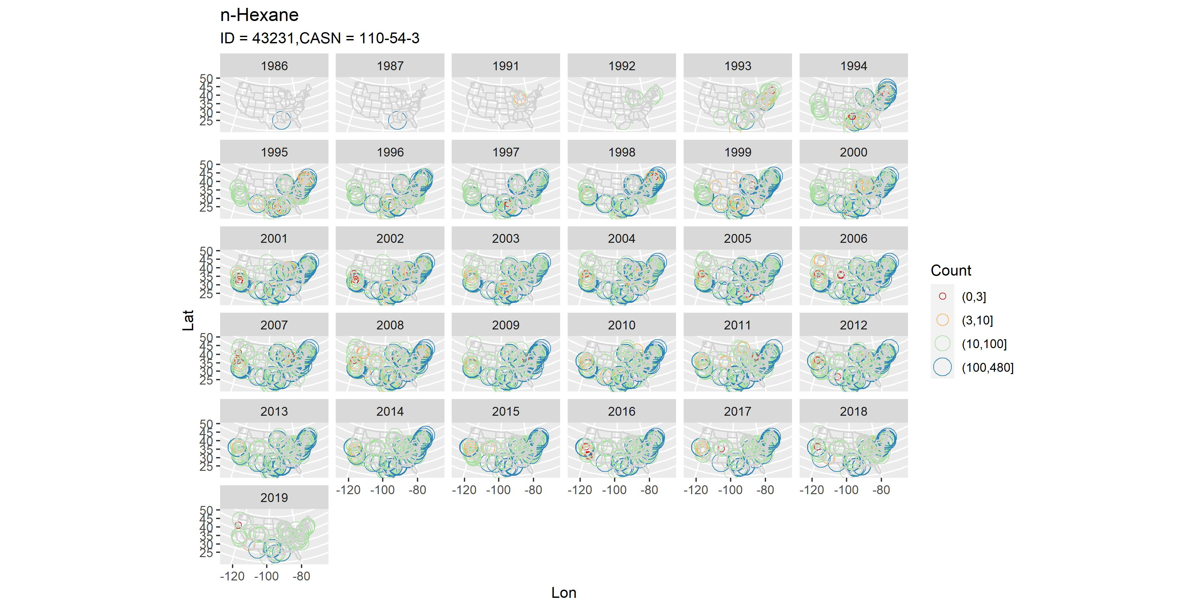

Slide 24
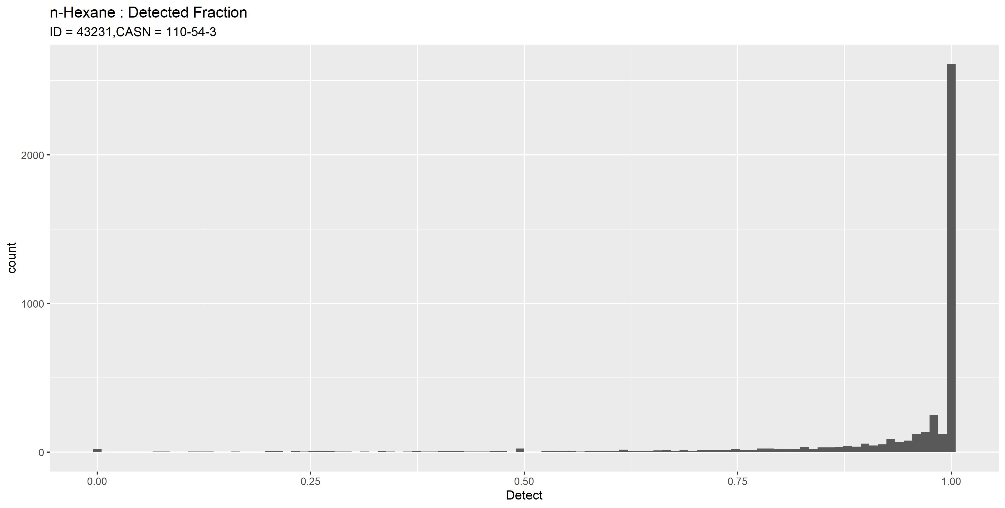

Slide 25
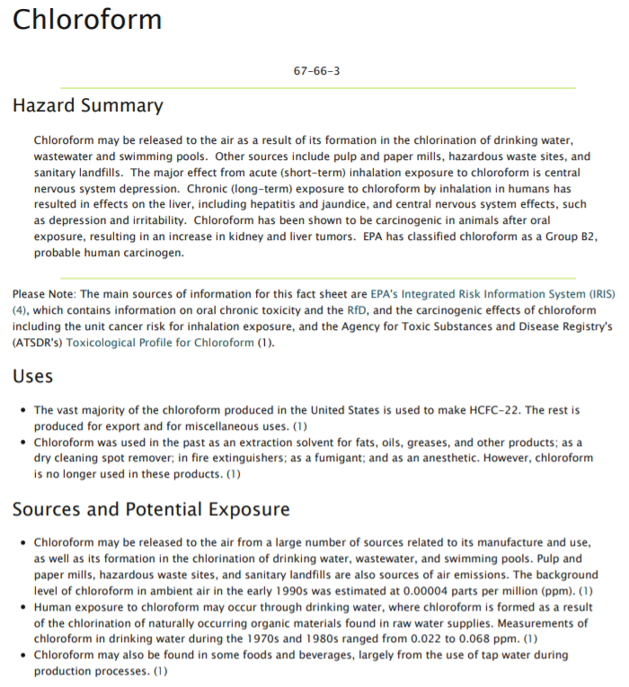

Slide 26
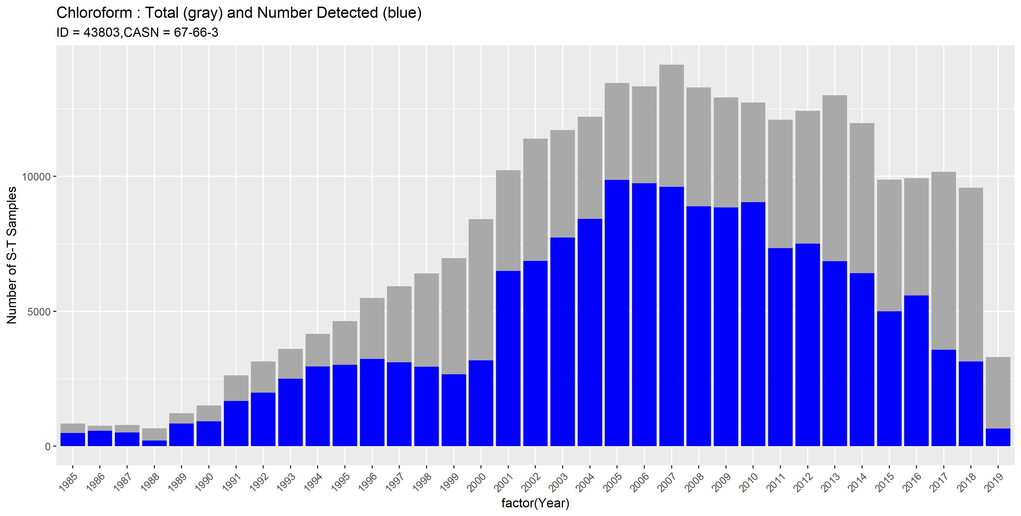

Slide 27
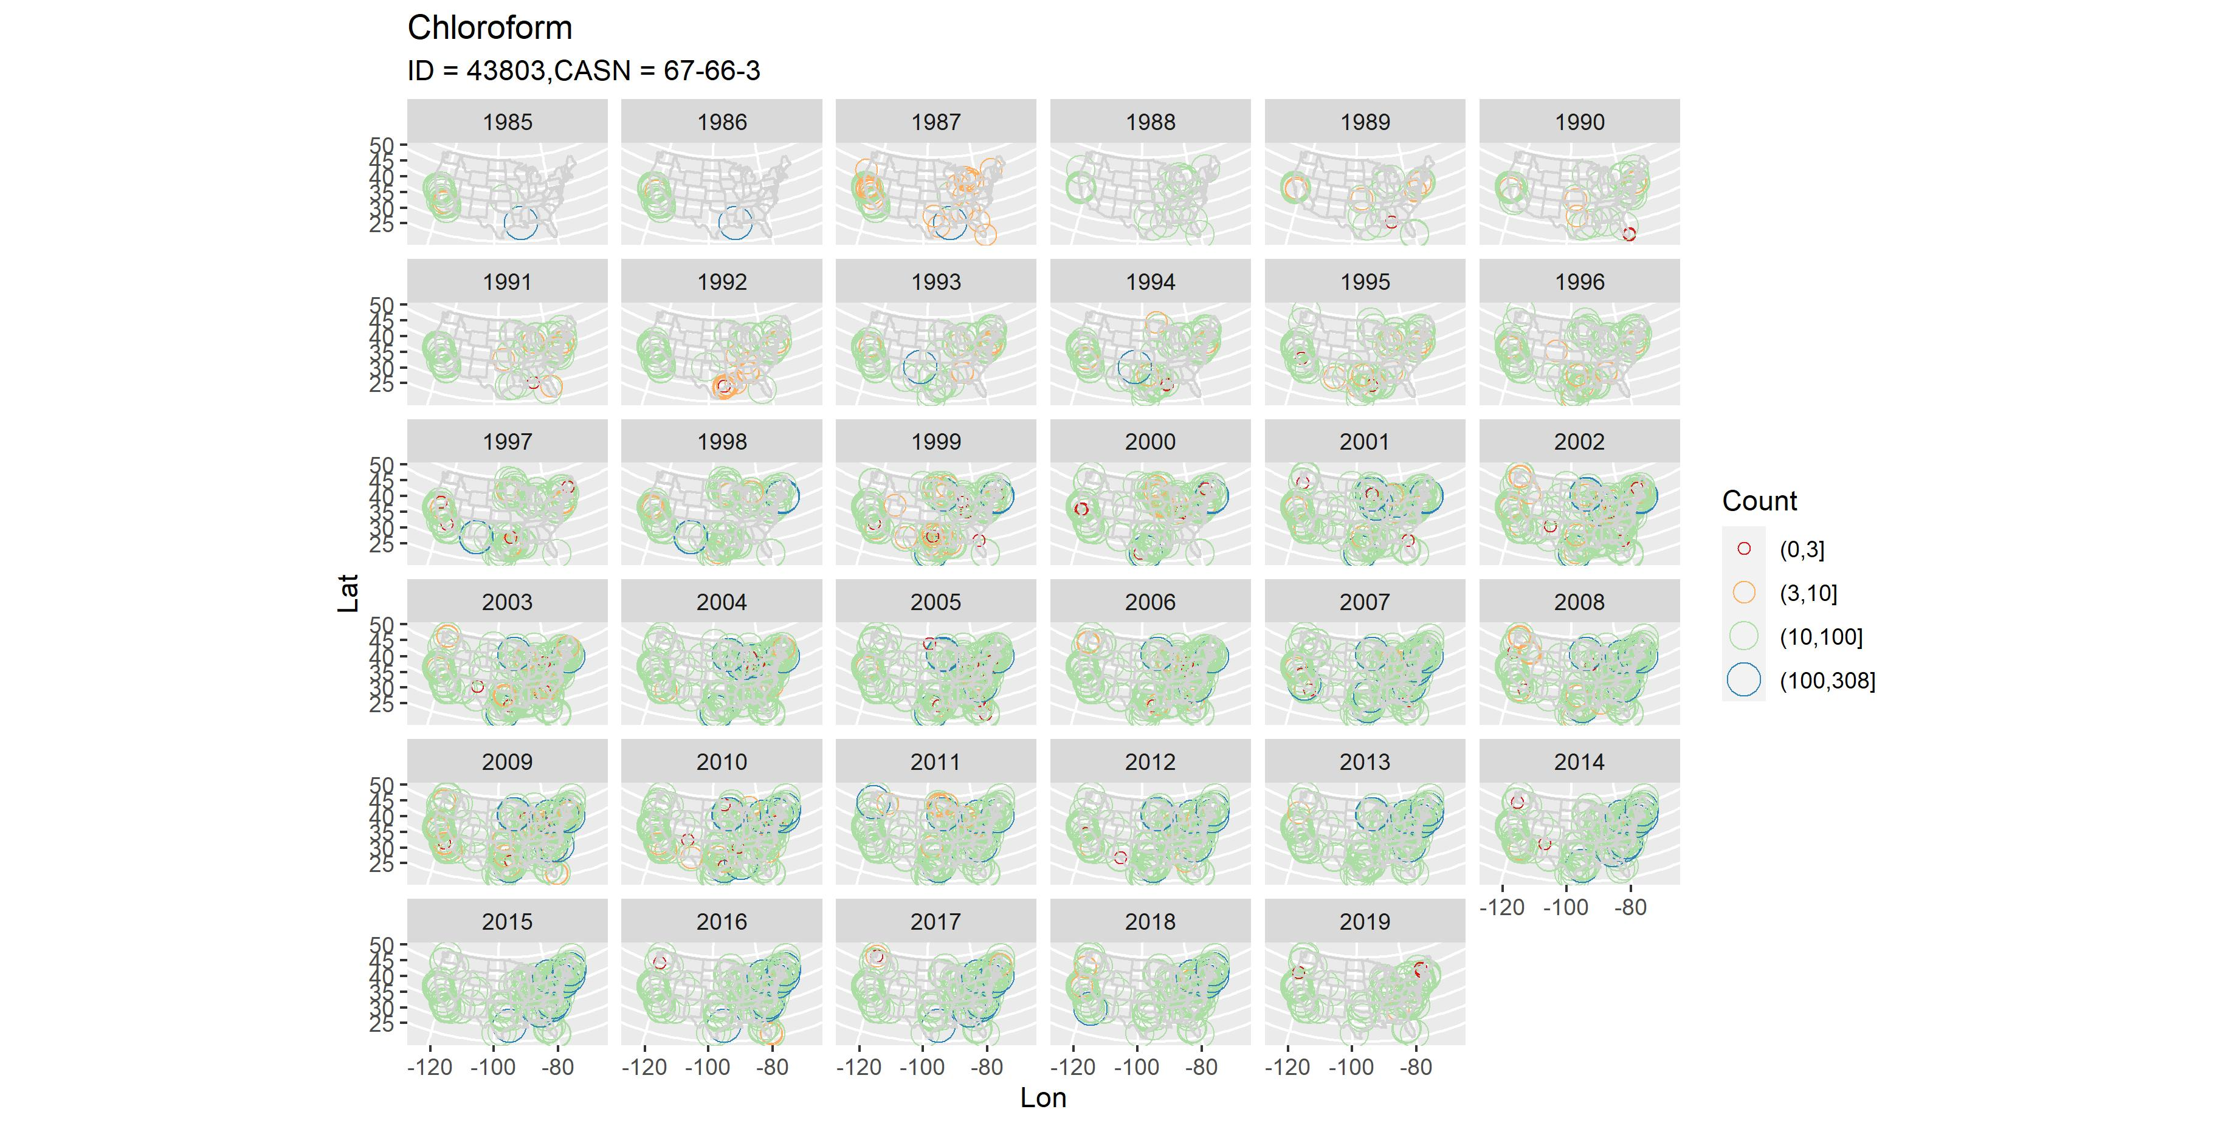

Slide 28
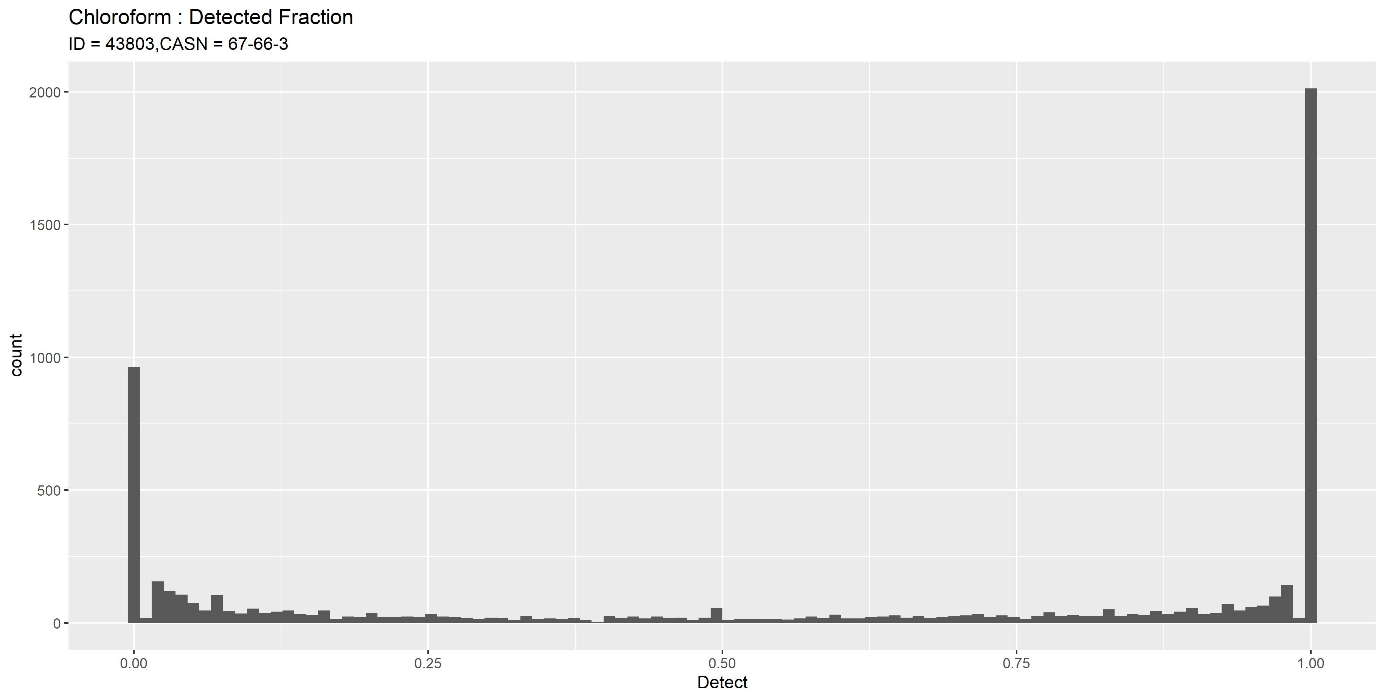

Slide 29
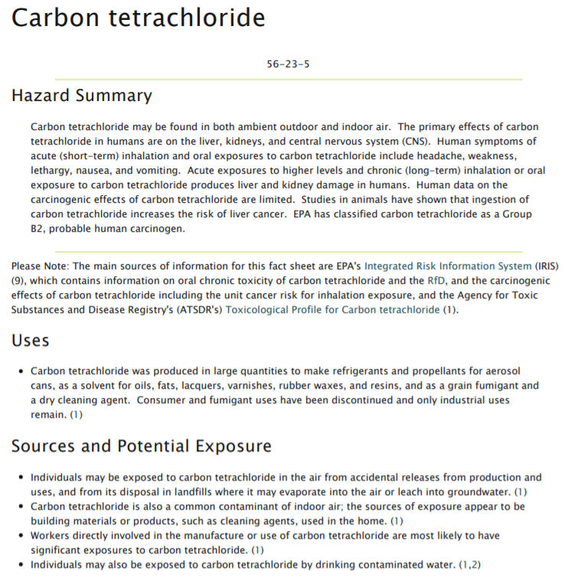


Slide 30
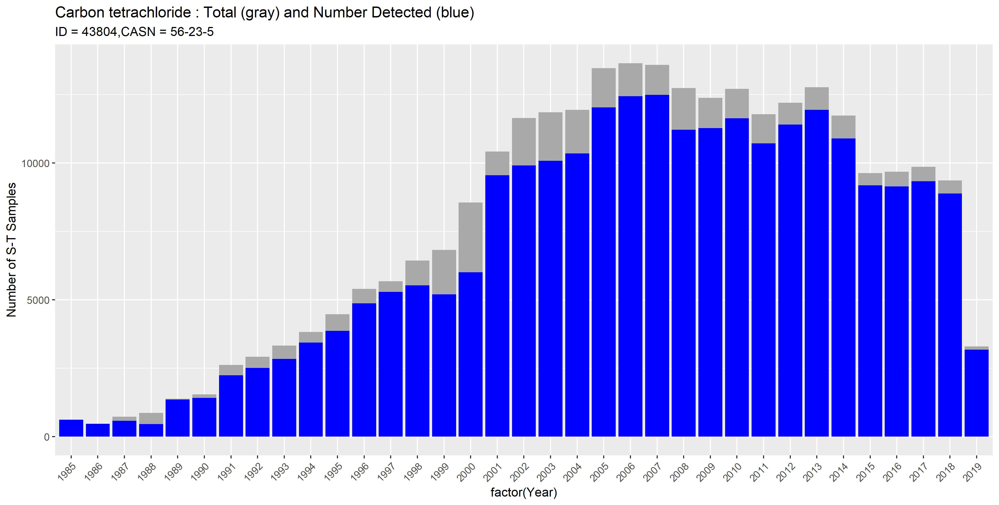

Slide 31
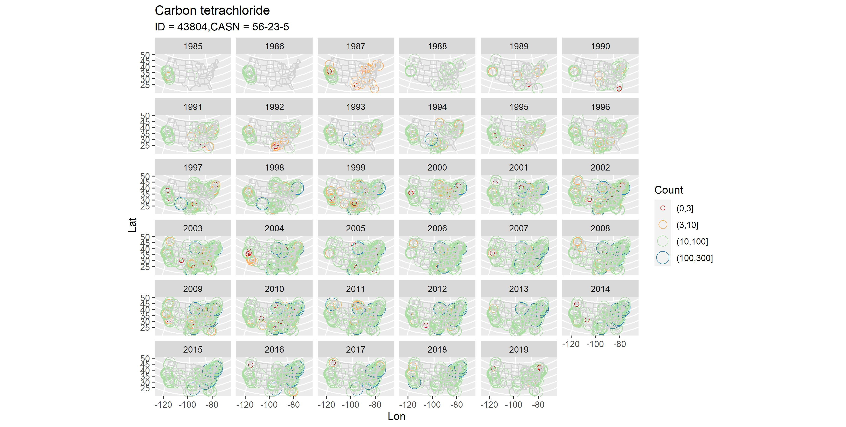

Slide 32
