Slide 1
HAPS project summary
Mariana Kassien
{SET} group meeting Jan 14 2025

Slide 2
Motivation
188 compounds designated by EPA since 1990
EPA regulates HAPs emissions, but unlike criteria pollutants there are no ambient concentration standards regarding HAPs exposure
The HAPs database combines monitoring data collected by multitude entities: the EPA, other federal, sate, local, and tribal agencies, and other academic, community, and short-term studies
Extensive toxicology data on HAPs adverse effects: cancer, reproductive effects, and birth defects, among others
Need for more exposure and epidemiology studies to understand public health impacts of HAPs

Slide 3
Objectives
Map HAPs concentrations in the United States for recent years
Use novel statistical and computational methods for large datasets in multivariate scenarios and missing/censored data
Develop an analysis pipeline for easy reproducibility and expansion

Slide 4
Data
Hazardous Air Pollutants:
We have 38 HAPs with 50+ sites across the US that have matching Tox information
First analysis with 4 chemicals that have good data availability

Slide 5
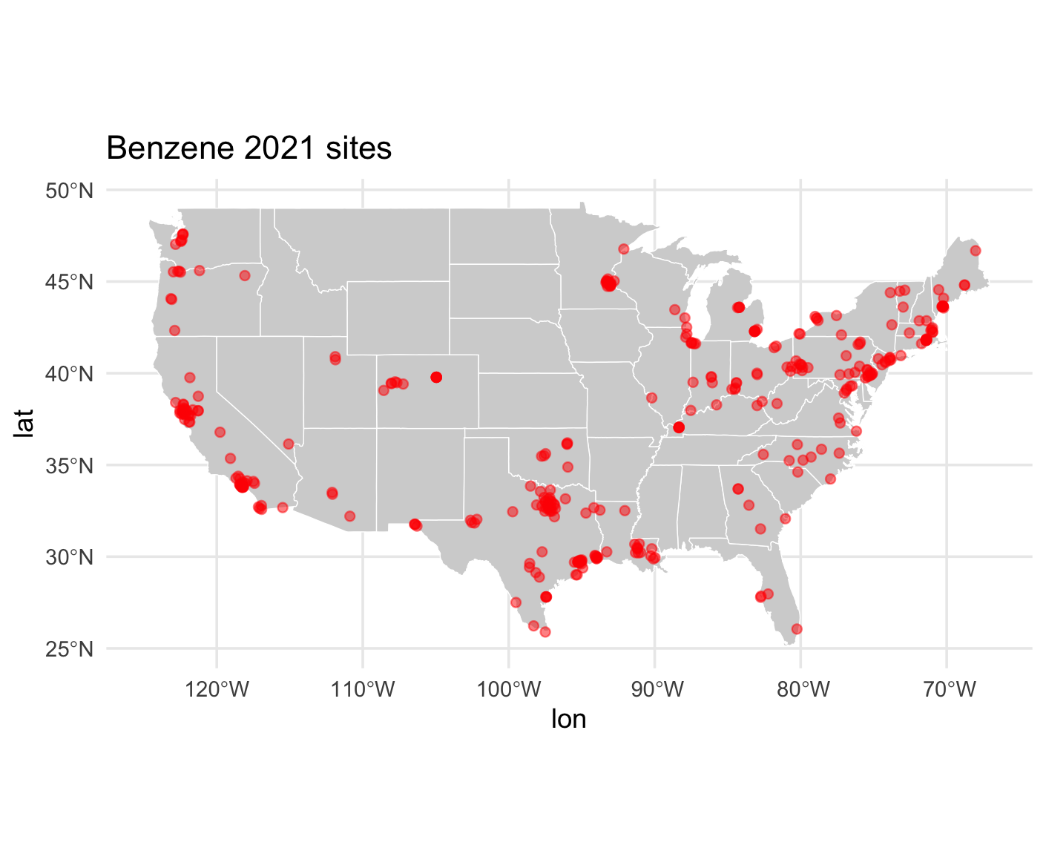
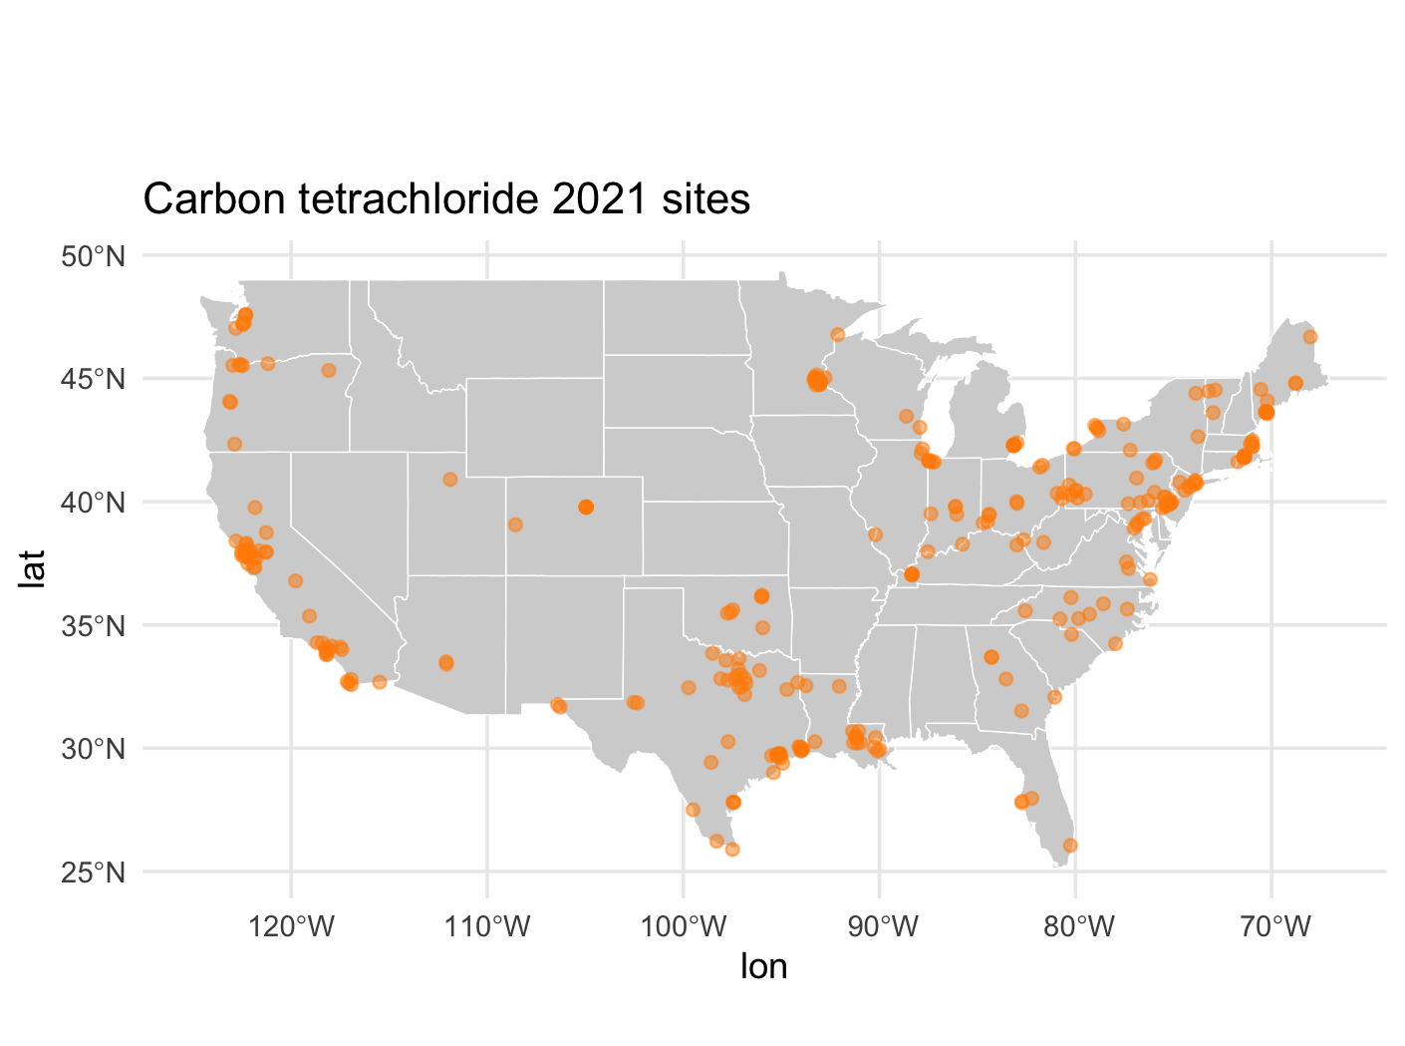
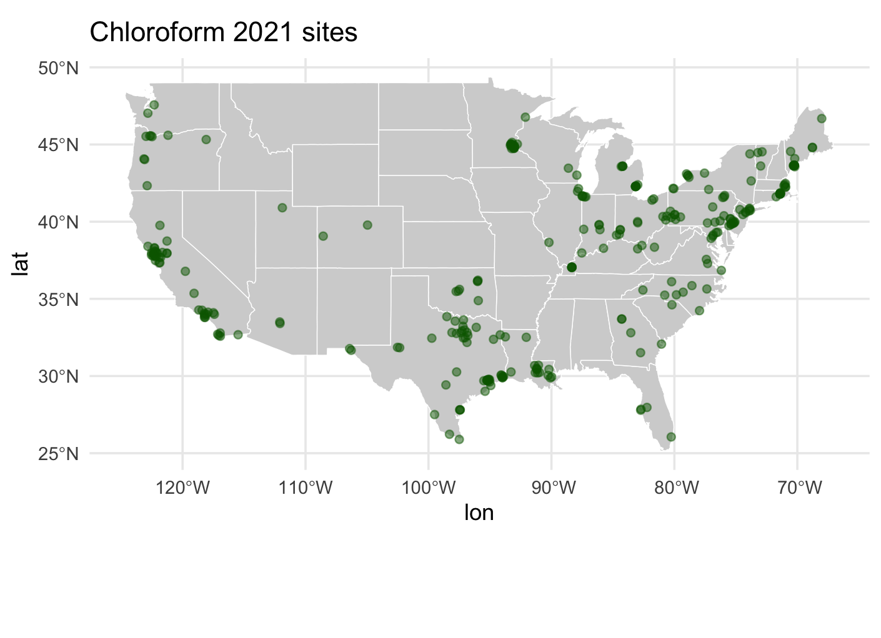
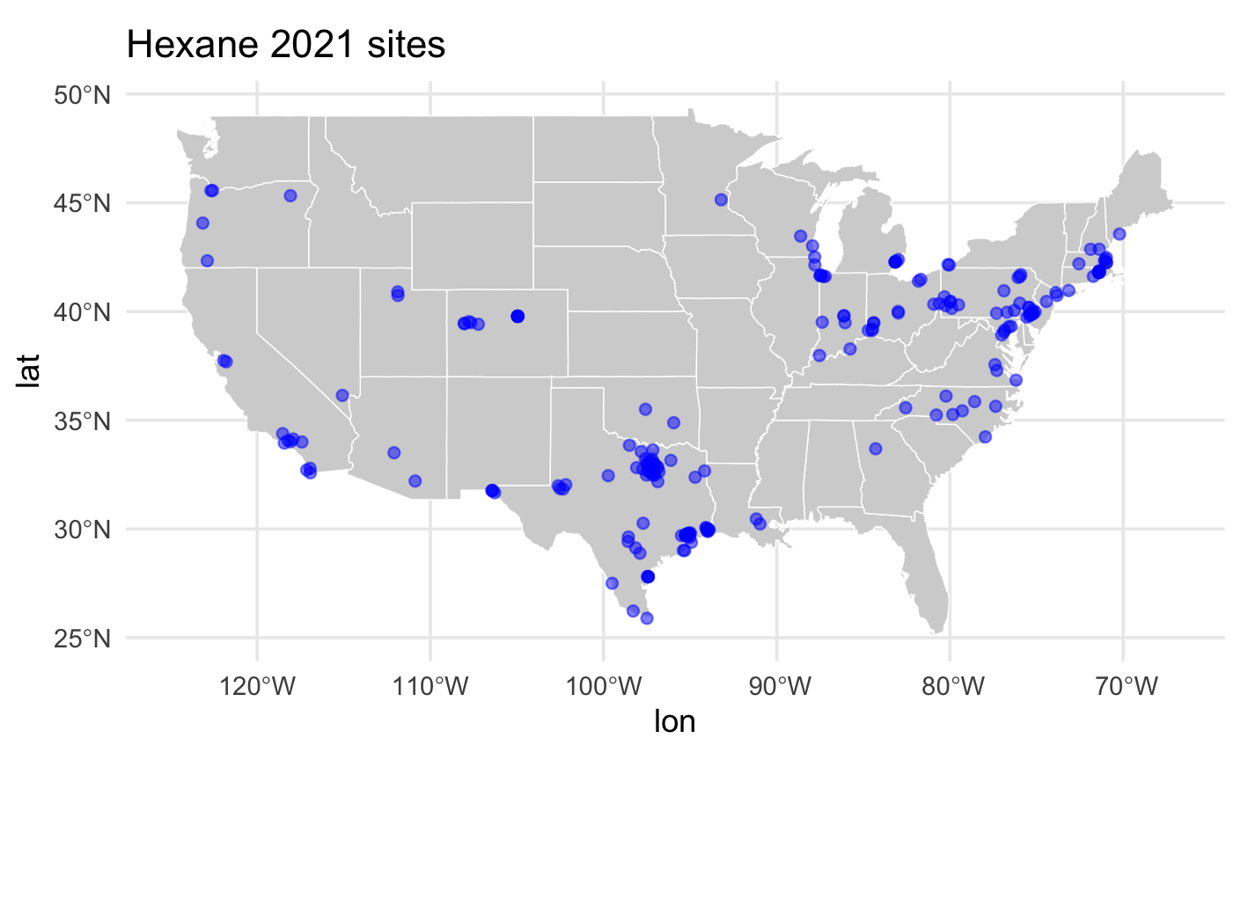
Site locations

Slide 6
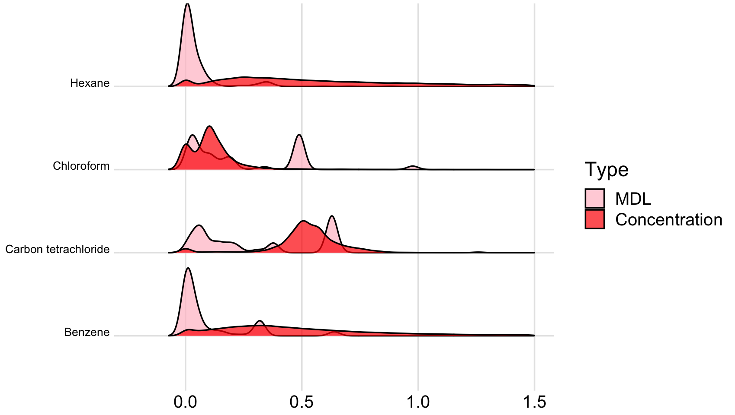
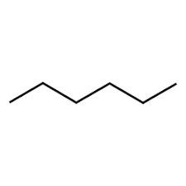
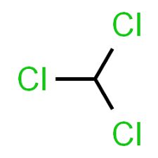
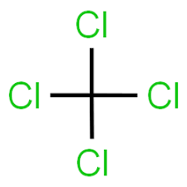

Measurements and MDL variability
Density
Concentration (μg/m³)

Slide 7
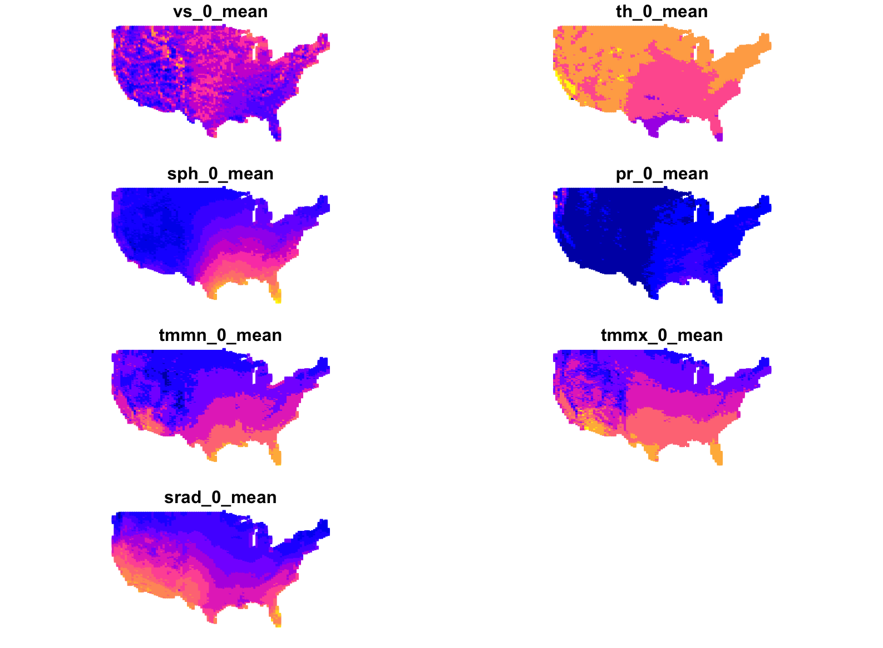
GridMET Covariates
Wind Speed 10m
Wind Direction 10m
Specific humidity
Precipitation
Wind Speed 10m
Wind direction 10m
Specific humidity
Maximum temperature
Minimum temperature
Precipitation
Surface Downwelling Solar Radiation
Min Temperature
Max temperature
Radiation

Slide 9
Cross-validation
Spatial block cross-validation (5 –fold)
MSE results across all outcomes (μg/m³): 5, 26, 0.8, 75, 2
Mean MSE across CV-folds: 22 μg/m³
Potential issues:
Outlier data
Missing covariates
Data sparsity
Pollutants sharing measuring sites
Other CV types to consider: k-means clustering, LOO, LLO with buffer

Slide 10
First results

Slide 11
Current work: targets pipeline
Current challenges:
Reformatting “imperative” scripts
Integration of covariates from Beethoven
Dynamic branching setup

Slide 12
Current work: targets pipeline

Slide 13
Coming up next
Containerization
Beethoven covariate integration
Wind-dependent buffer

Slide 14
Thanks!

Slide 15
Extras

Slide 16
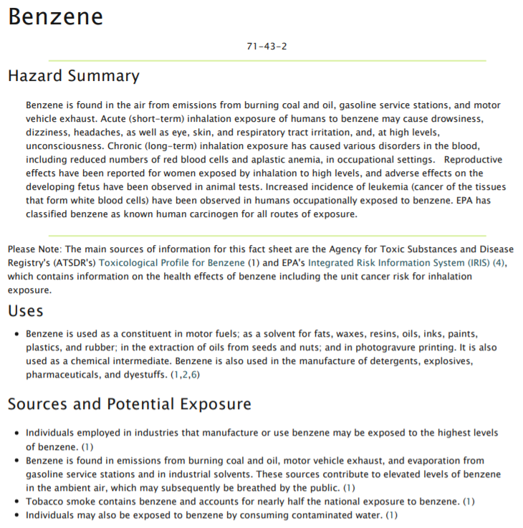

Slide 17
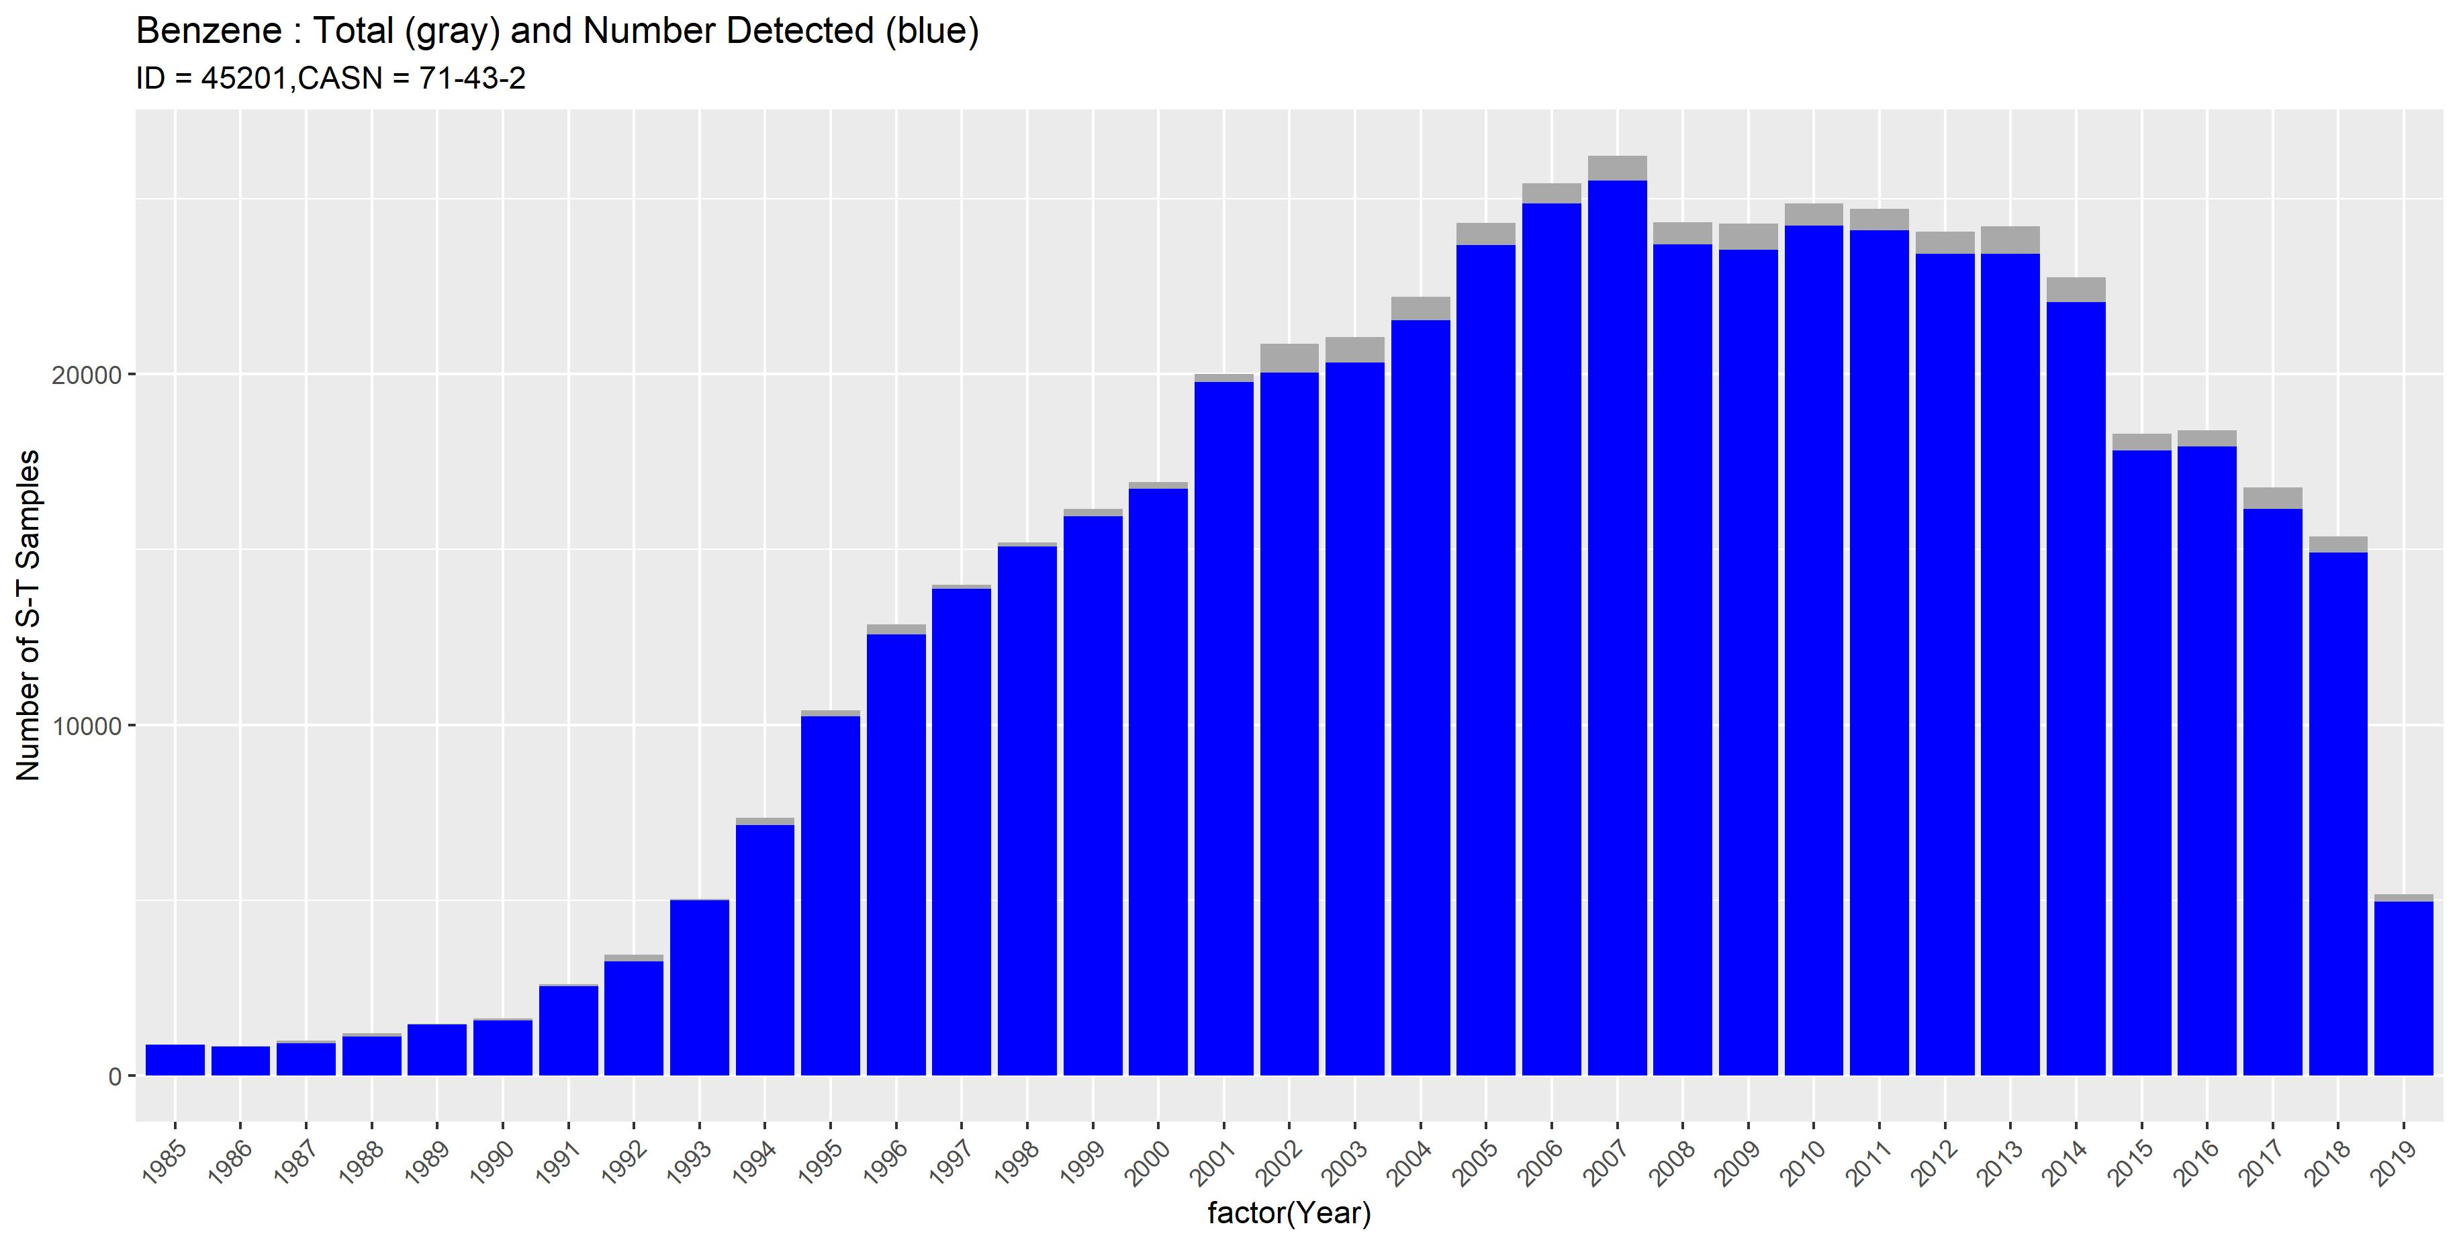

Slide 18
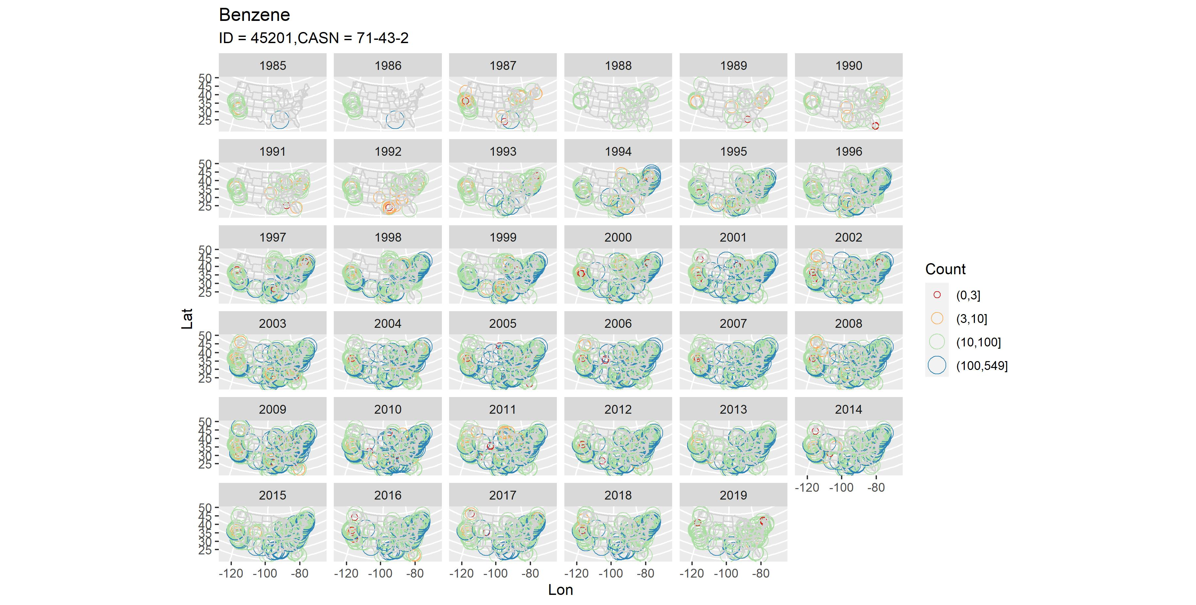

Slide 19
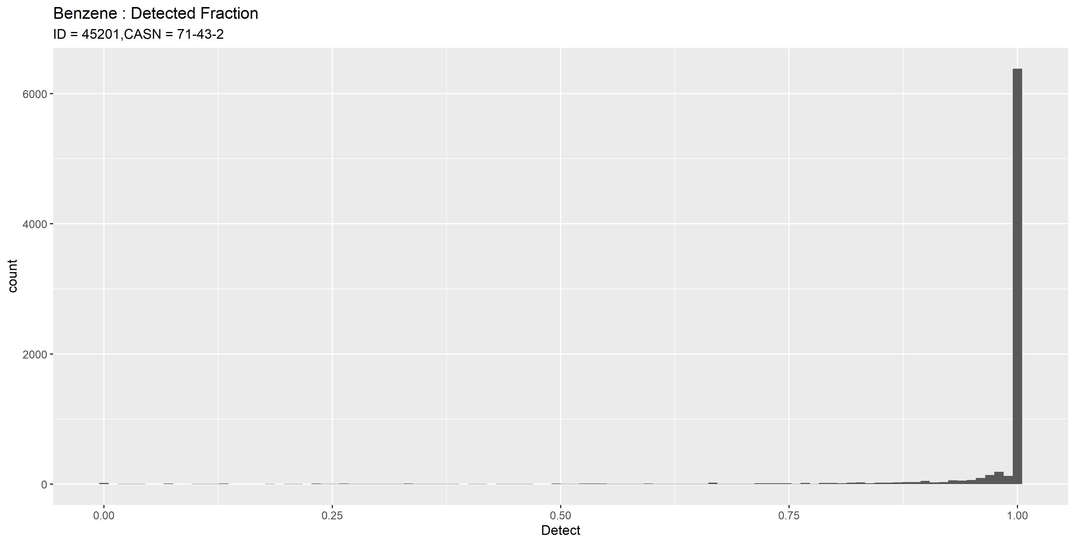

Slide 20
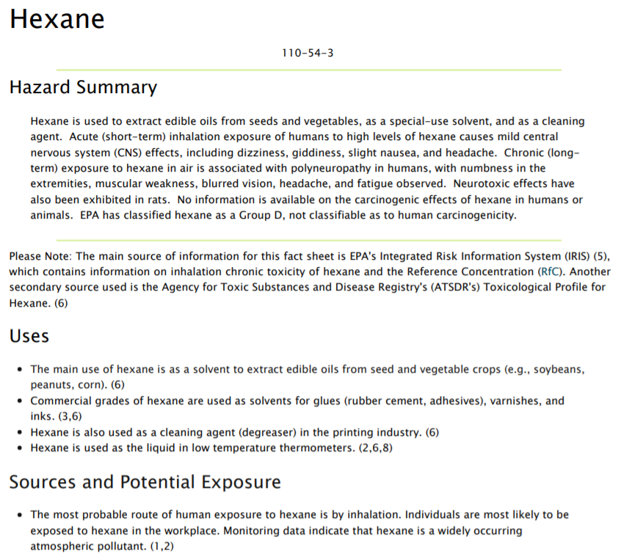

Slide 21
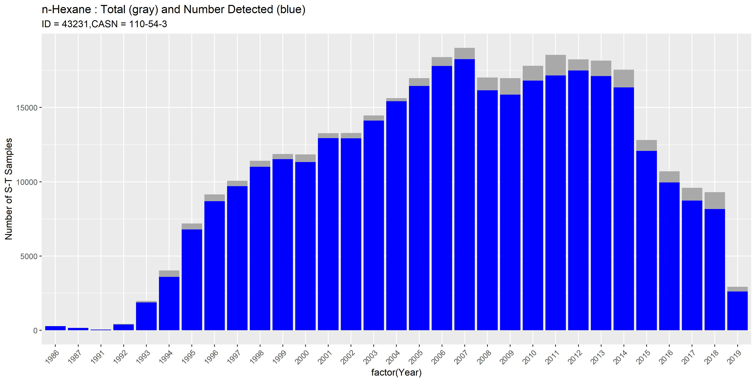

Slide 22
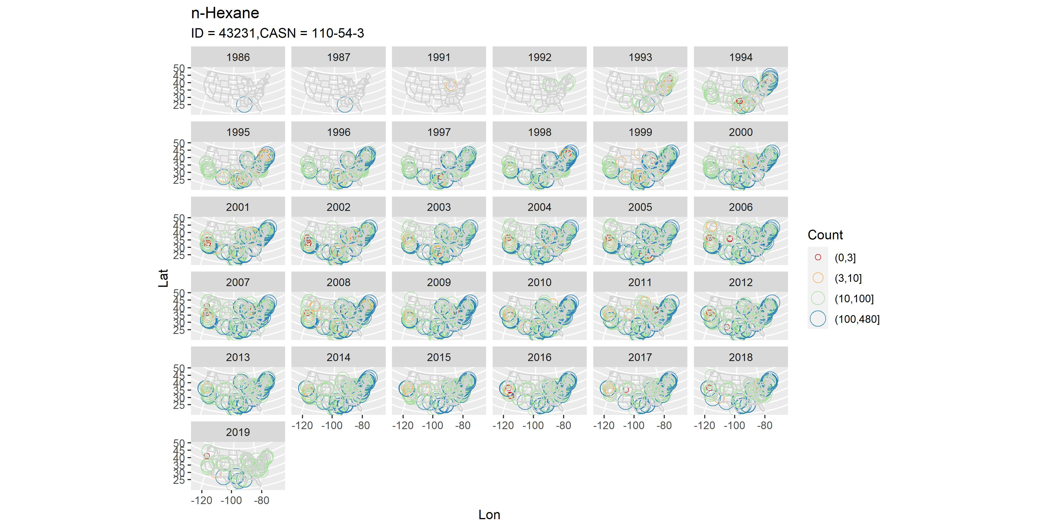

Slide 23
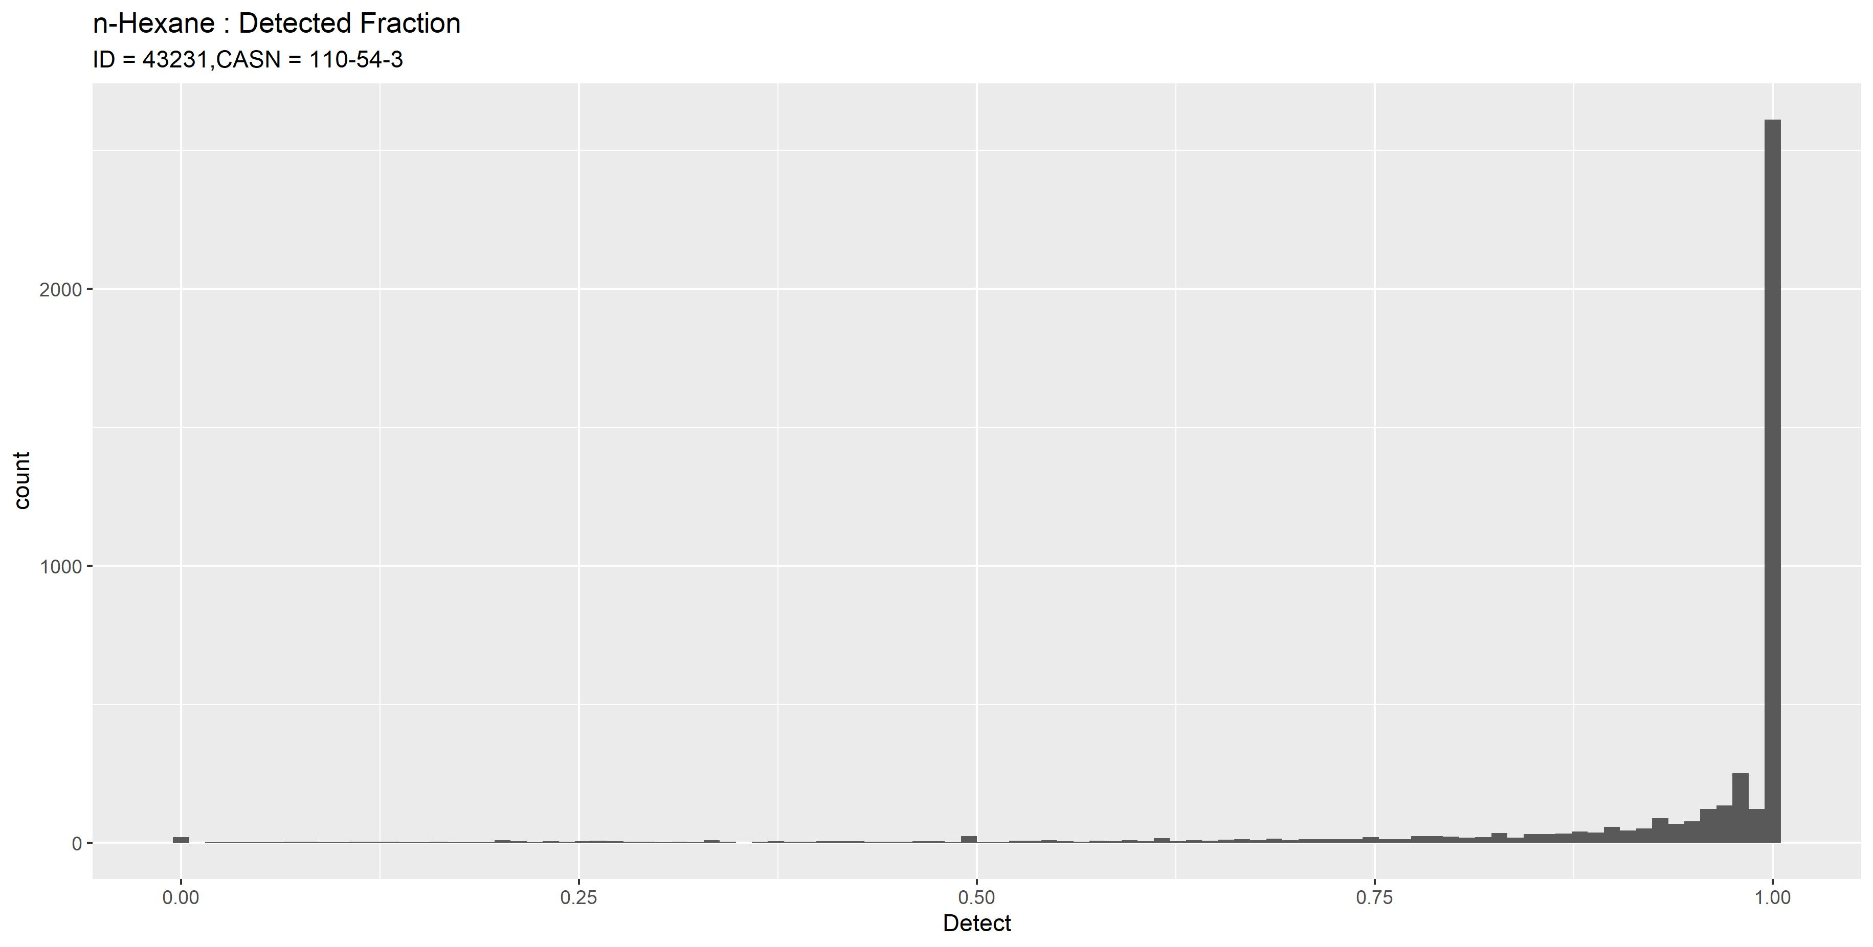

Slide 24
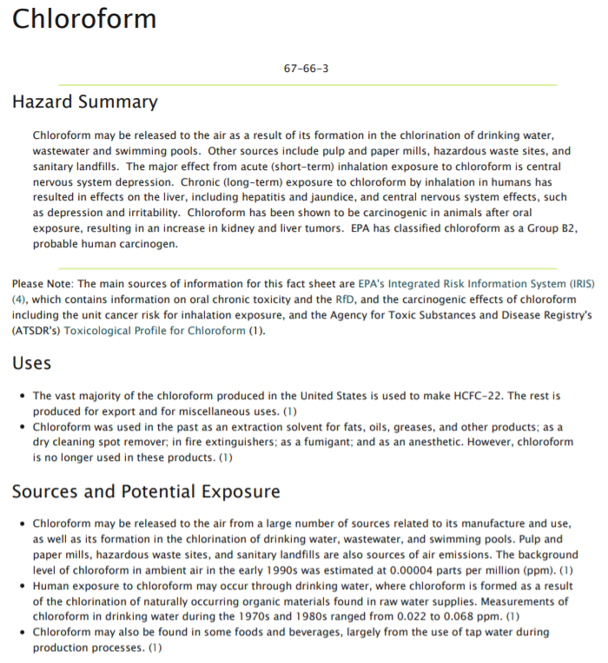

Slide 25
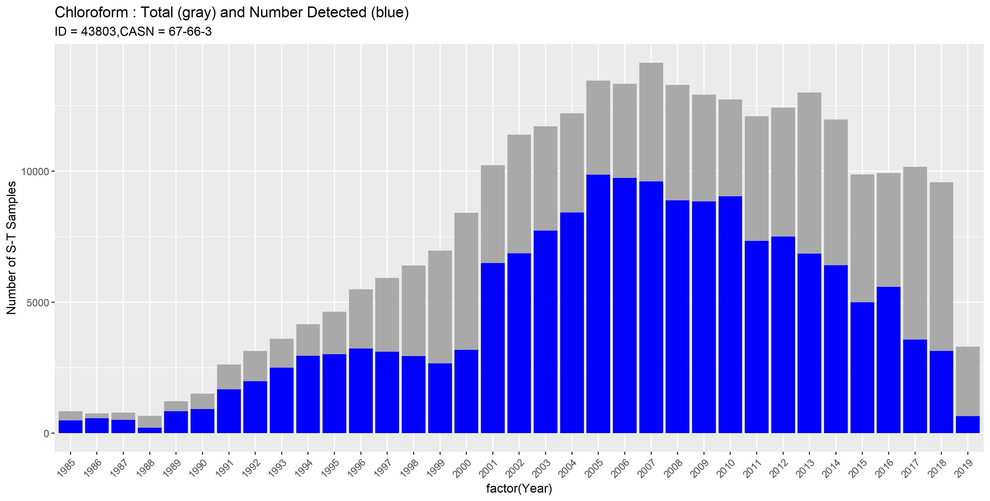

Slide 26
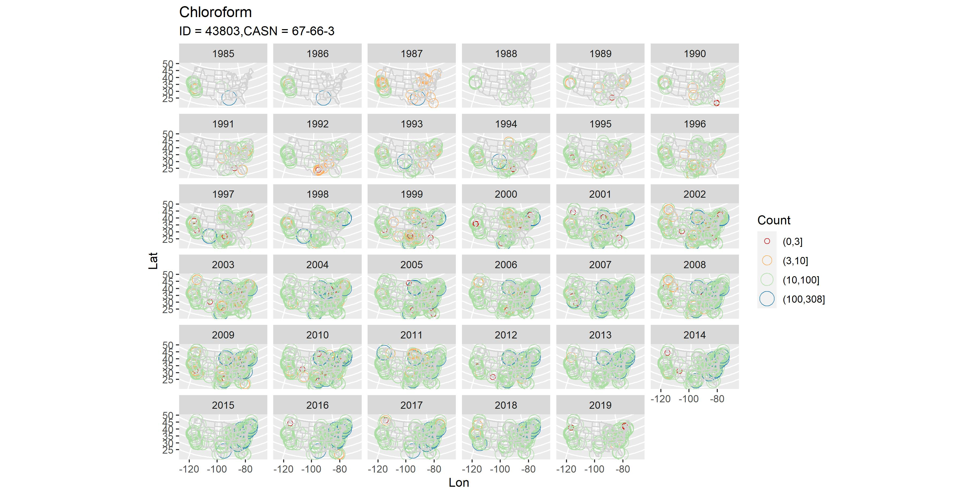

Slide 27
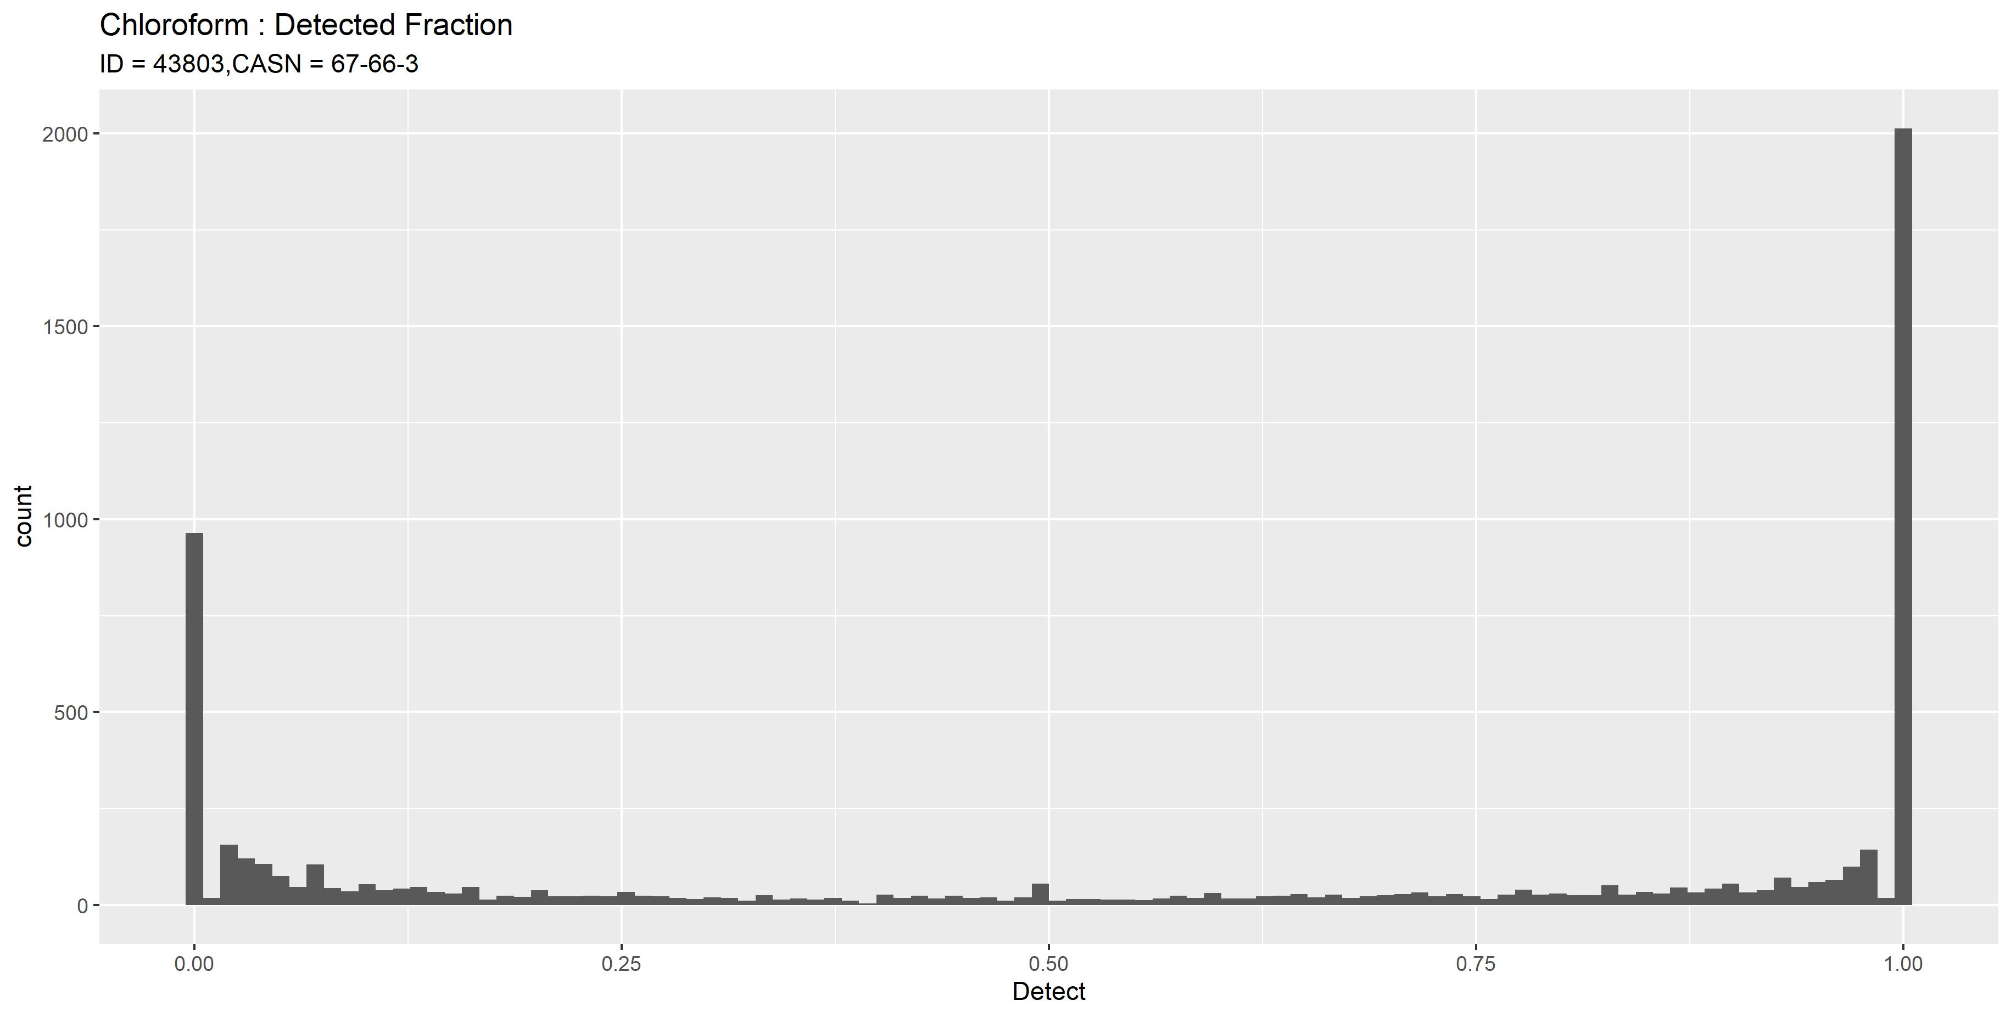

Slide 28
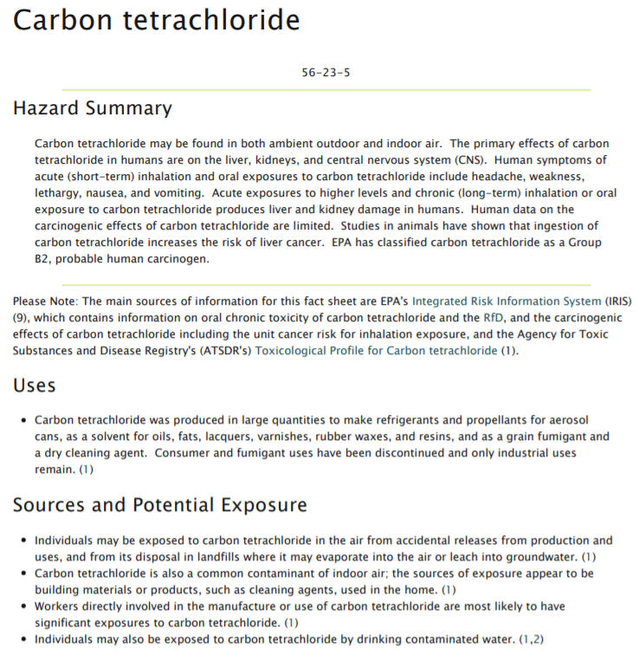


Slide 29
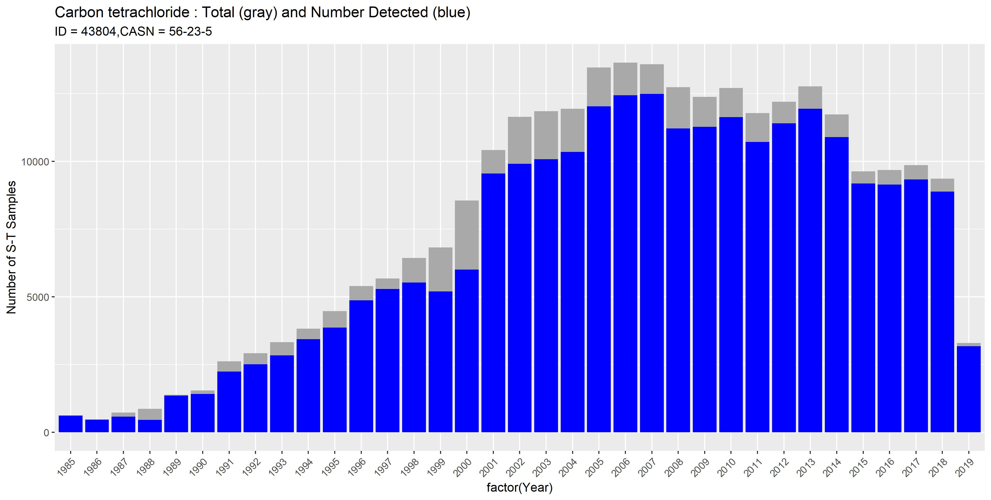

Slide 30
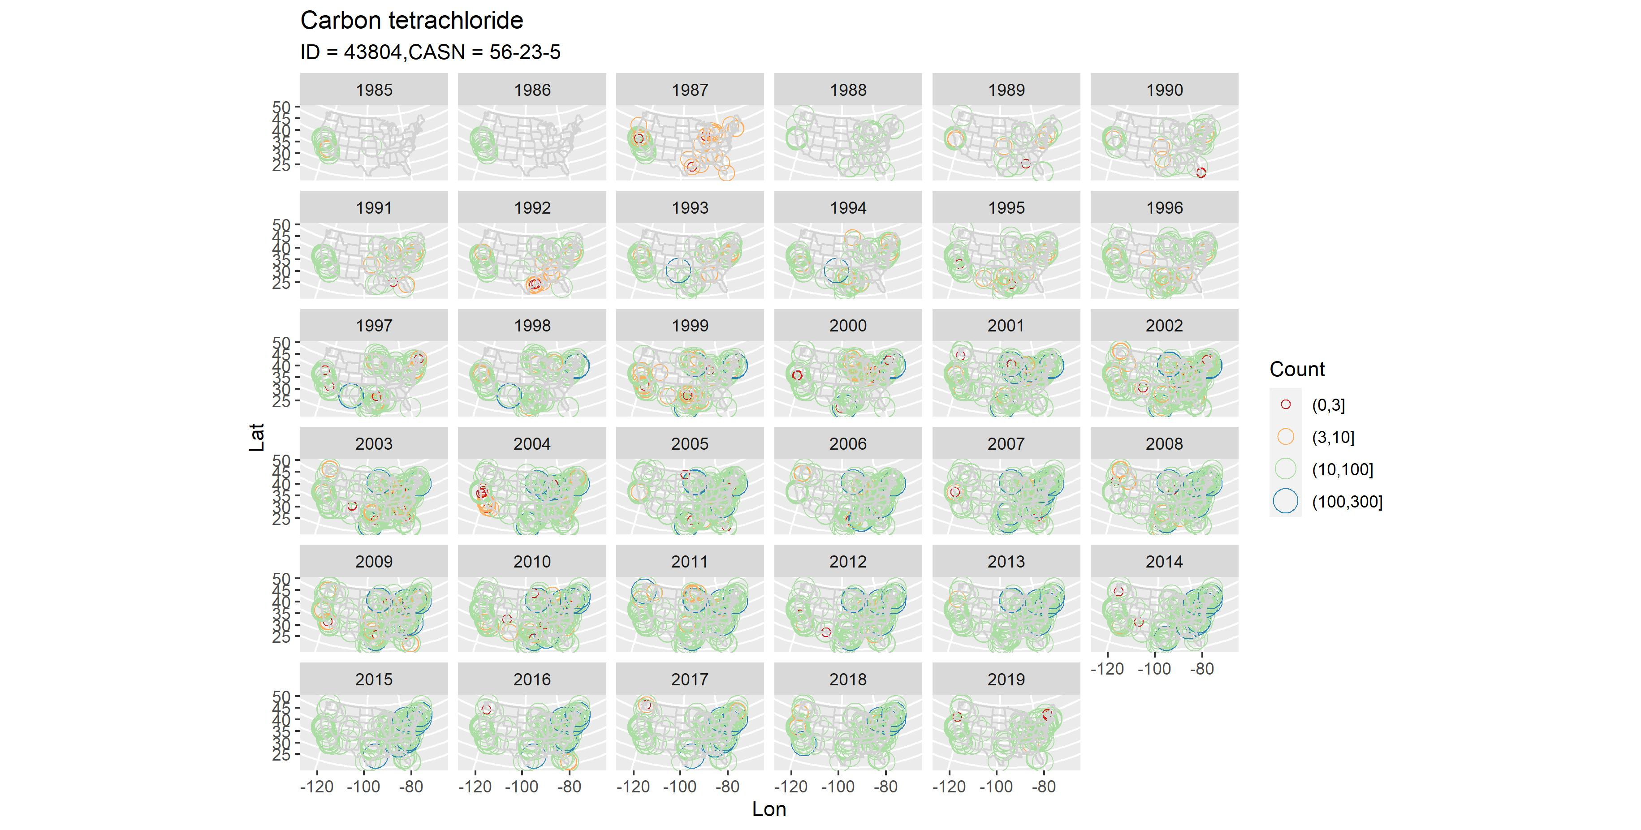

Slide 31
